Slide 1
What is True Storytelling?
True Storytelling a New Ethical Leadership and Strategic Approach
David M. Boje, Kenneth Mølbjerg Jørgensen,
Mogens Sparre, Ole Friis, Pernille Vibe, Mikkel Mølbjerg
\\
Workshop om ’true storytelling’: entreprenørskab og jobskabelse i og imellem virksomheder

Slide 2
True Storytelling
True Storytelling is design of David Boje, Jens Larsen, and Lena Bruun
See davidboje.com for copy of this slide set
See https://truestorytelling.org for more on True Storytelling Resources
The Skagen workshop May 21-22 2019 facilitated by David M. Boje, Kenneth Mølbjerg Jørgensen, Mogens Sparre, Ole Friis, Pernille Vibe, & Mikkel Mølbjerg

Slide 3
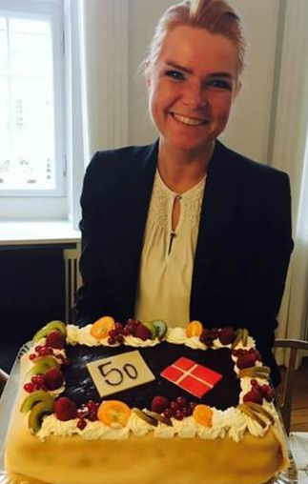
PROGRAM
10:30 – 12:30 Workshop om ”True Storytelling”: Entreprenørskab og jobskabelse i og imellem virksomheder.
V/ Ole Friis, Mogens Sparre, David M. Boje og Kenneth Mølbjerg Jørgensen.
Workshoppen er organiseret omkring 7 punkter, hvor de 6 punkter vil blive arbejdet med den 21. maj og punkt 7 den 22. maj – se vedhæftede om workshoppen.
12:30 – 13:30 Frokost på Skagen Hotel
13:30 – 15:00 Workshop fortsat
15:00 – 15:30 Kaffe pause
15:30 – 17.00 Workshop fortsat
19:00 – 21:00 Middag på Hotel Skagen

Slide 4
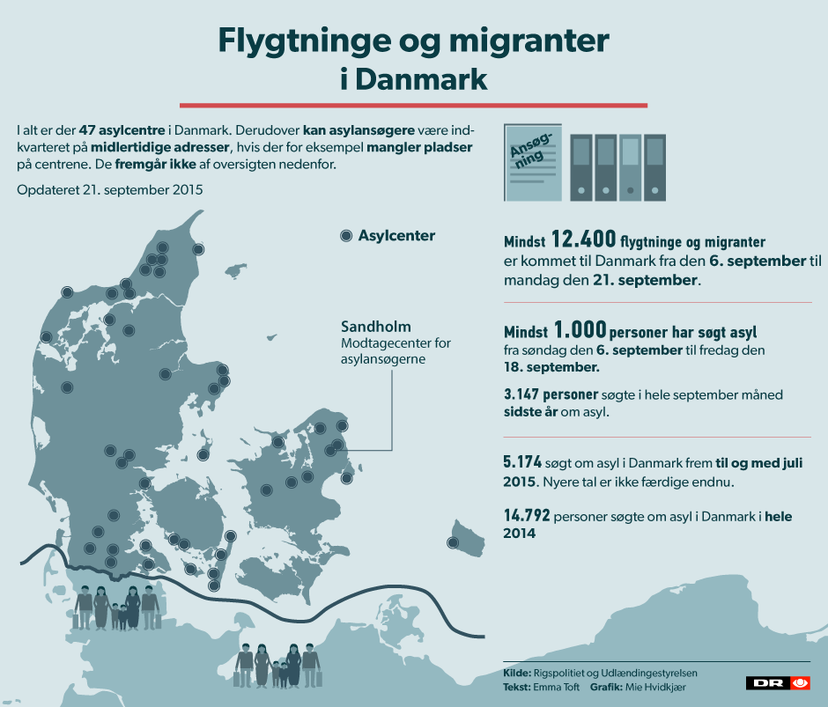

Slide 5
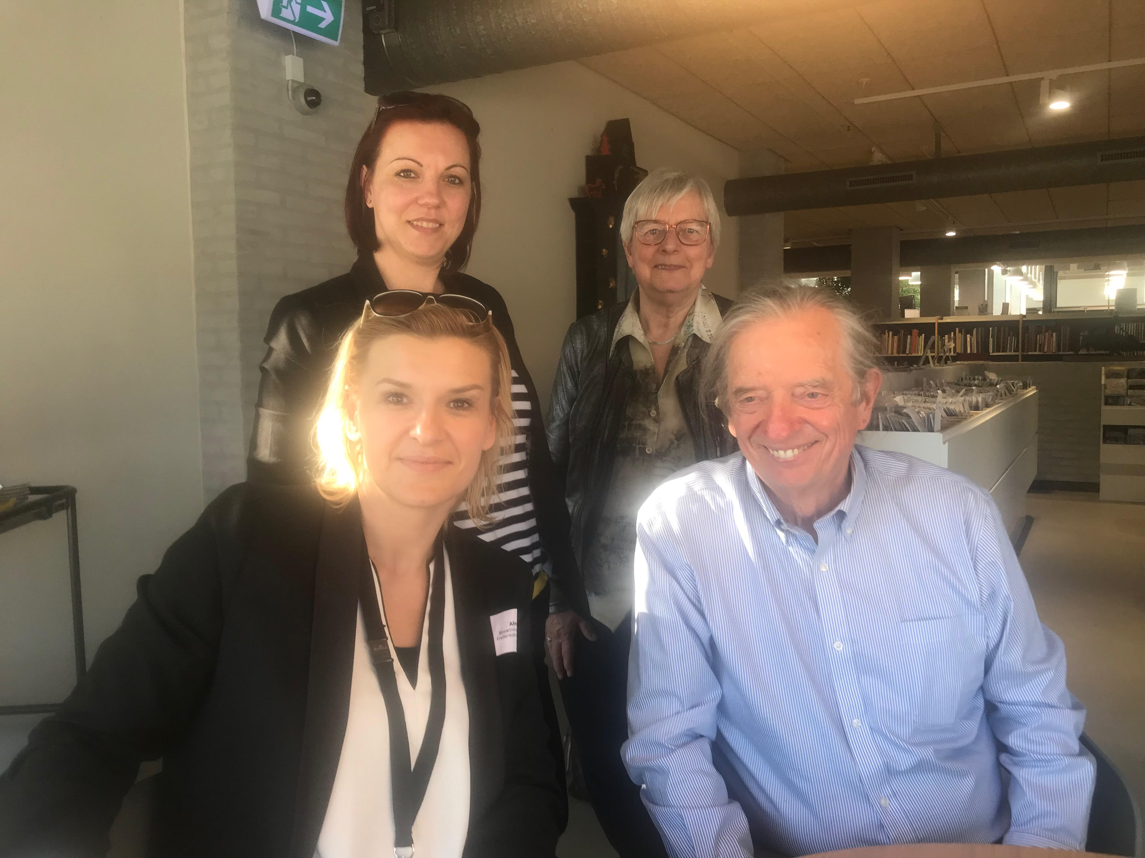
Modellen for ’true storytelling’ ser således ud:
Notes:
Example: Living Stories with a Place, A Time, and a Truth of lived experience
Happening Here and Now
In the middle, unfolding, emerging, happening
Goes from strategic level of power, to what is best for the world in Council of Elrond
Tell LESS is MORE
BE AUTHENTIC - Create an emotional component that resonates with the audience YouTube Peter Guber of Mandalay Group, so they retell it forward owning; See article 4 truths of the storyteller HBR

Slide 6
How to Implement True Storytelling?
What is TRUE STORYTELLING now?
How to plan FUTURE?
When & Where to do PROJECT?
Reflect on OUTCOMES?

Slide 7
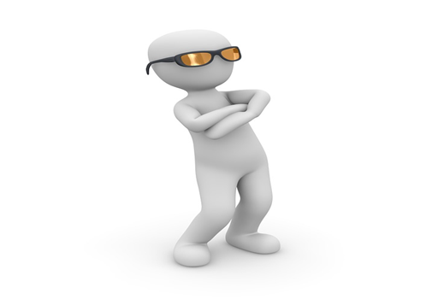
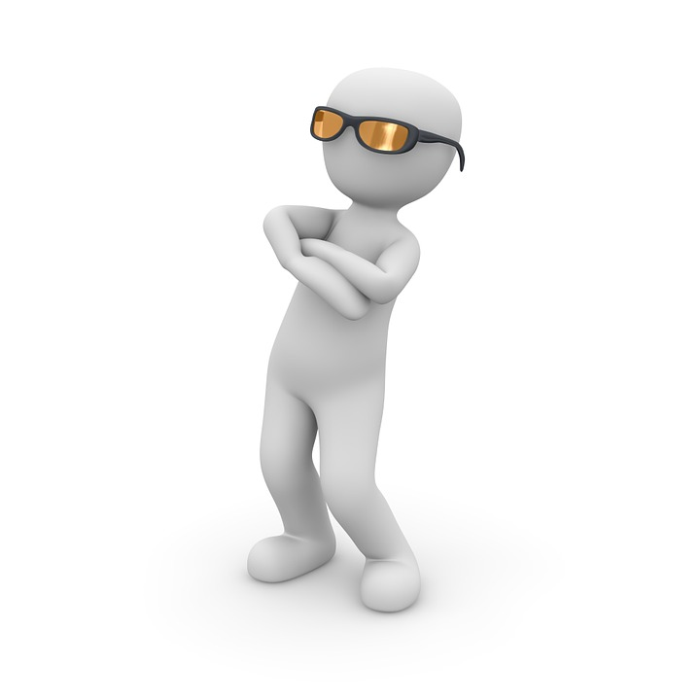
Functional Stupidity
The wall of Organizational Stupidity
Fra Organizational Stupidity til Human Stupidity
1. Stadie 2. Stadie 3. Stadie

Slide 8
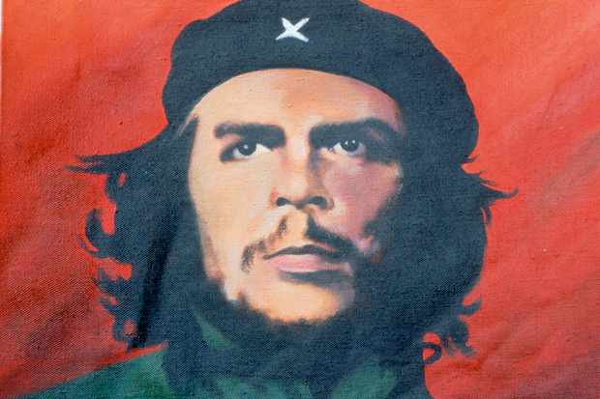
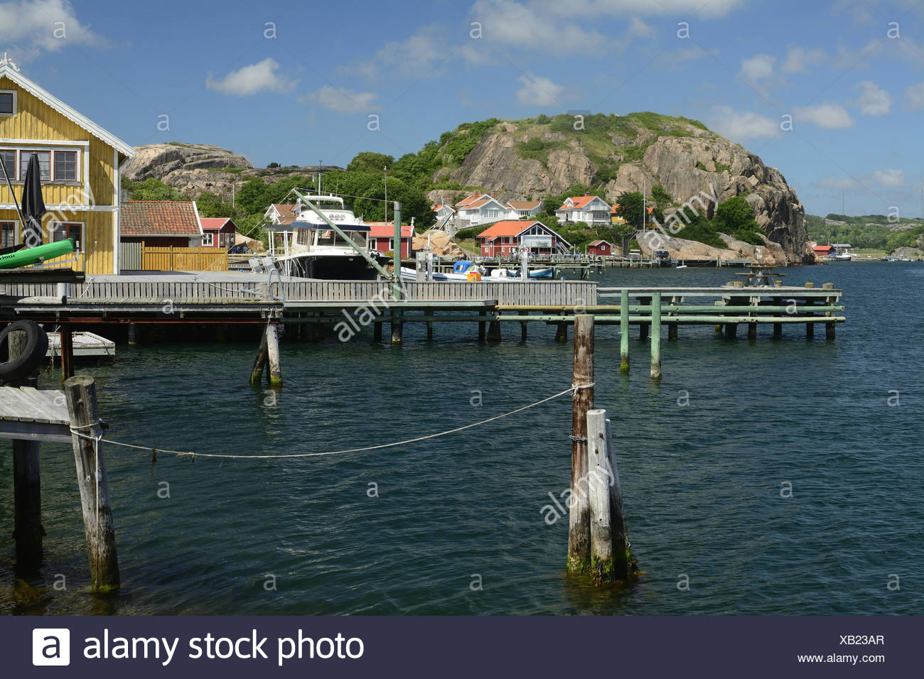
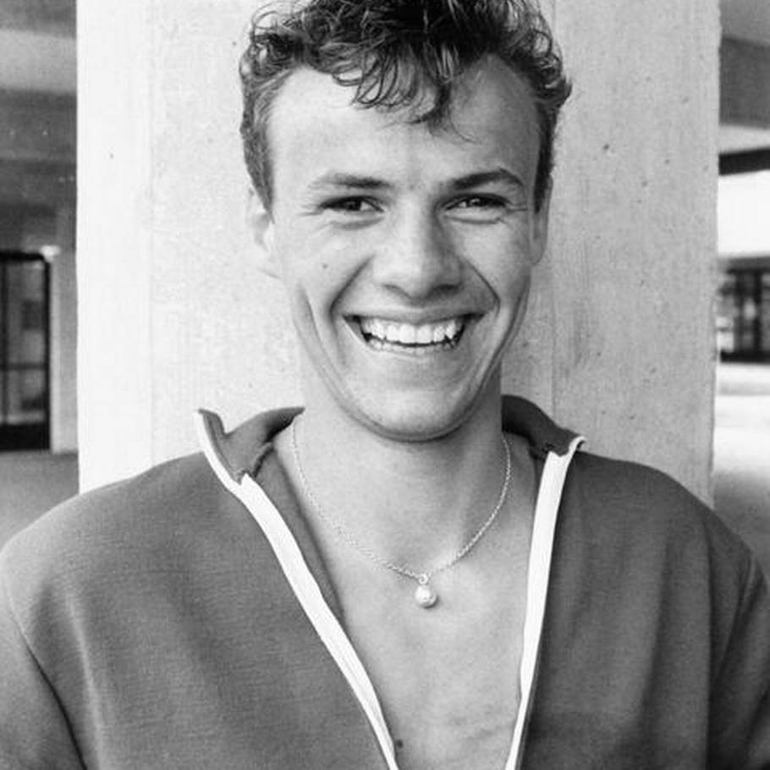
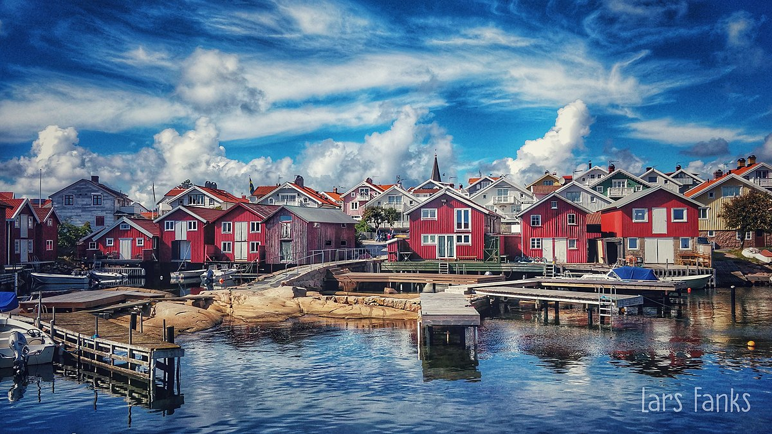
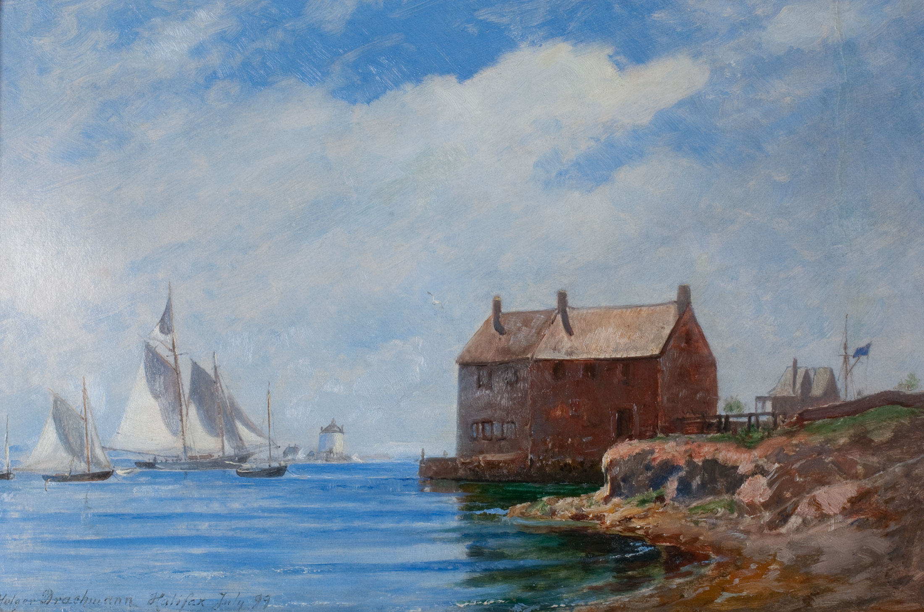
The true revolutionary is guided by great feelings of love
Mobilise and find the energy and passion
History
Culture
People
Places
Nature
Landscapes
First exercise:
Grand challenges

Slide 9
What is TRUE STORYTELLING now?
How to plan FUTURE?
When & Where to do PROJECT?
Reflect on OUTCOMES?
Notes:
What are the grand challenger

Slide 10
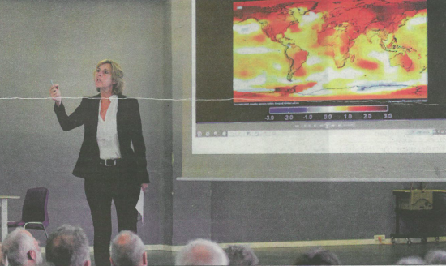
Sorø Municipality to implement UN GOALS
See Global Indicator Framework

Slide 11
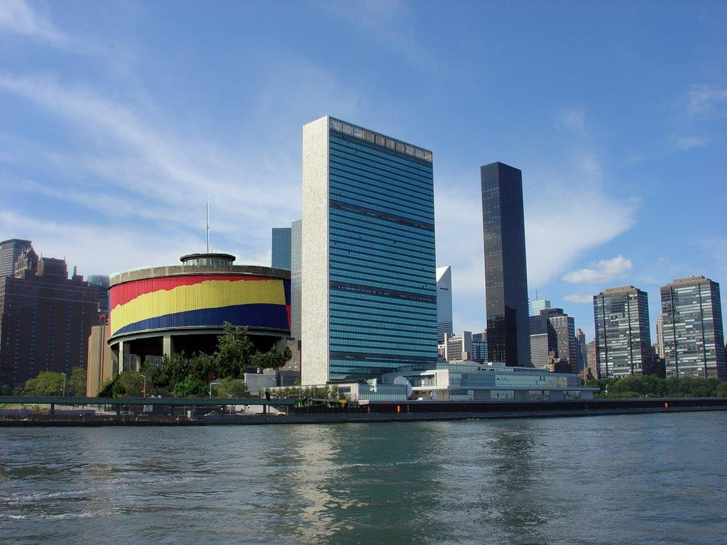
Implementation of UN Goals needs a Punctum
Take Sorø
Municipality to the UN

Slide 12
First exercise in true storytelling
Identify grand challenges. What are important grand challenges for you. Go up and look at the cubes. Pick one.
Why this grand challenge is important for you?
How does it relate to our project for immigrants?
Share it in a group. Frederikshavn, Skagen, Sötenæs and Munkedal.
Create a map of different stories about the future, which are particular to your place.
Use pictures and artefacts
Round of presentations

Slide 13
1st True Storytelling Principle: You yourself must be true and prepare the energy and effort for a sustainable future.
4 Questions:
Did you check it out?
Do you believe in it?
Do you have the knowledge to do it?
Can you sustain (get energized & not burn out) in long future?
Notes:
Example: Living Stories with a Place, A Time, and a Truth of lived experience
Happening Here and Now
In the middle, unfolding, emerging, happening
Goes from strategic level of power, to what is best for the world in Council of Elrond
Tell LESS is MORE
BE AUTHENTIC - Create an emotional component that resonates with the audience YouTube Peter Guber of Mandalay Group, so they retell it forward owning; See article 4 truths of the storyteller HBR

Slide 14
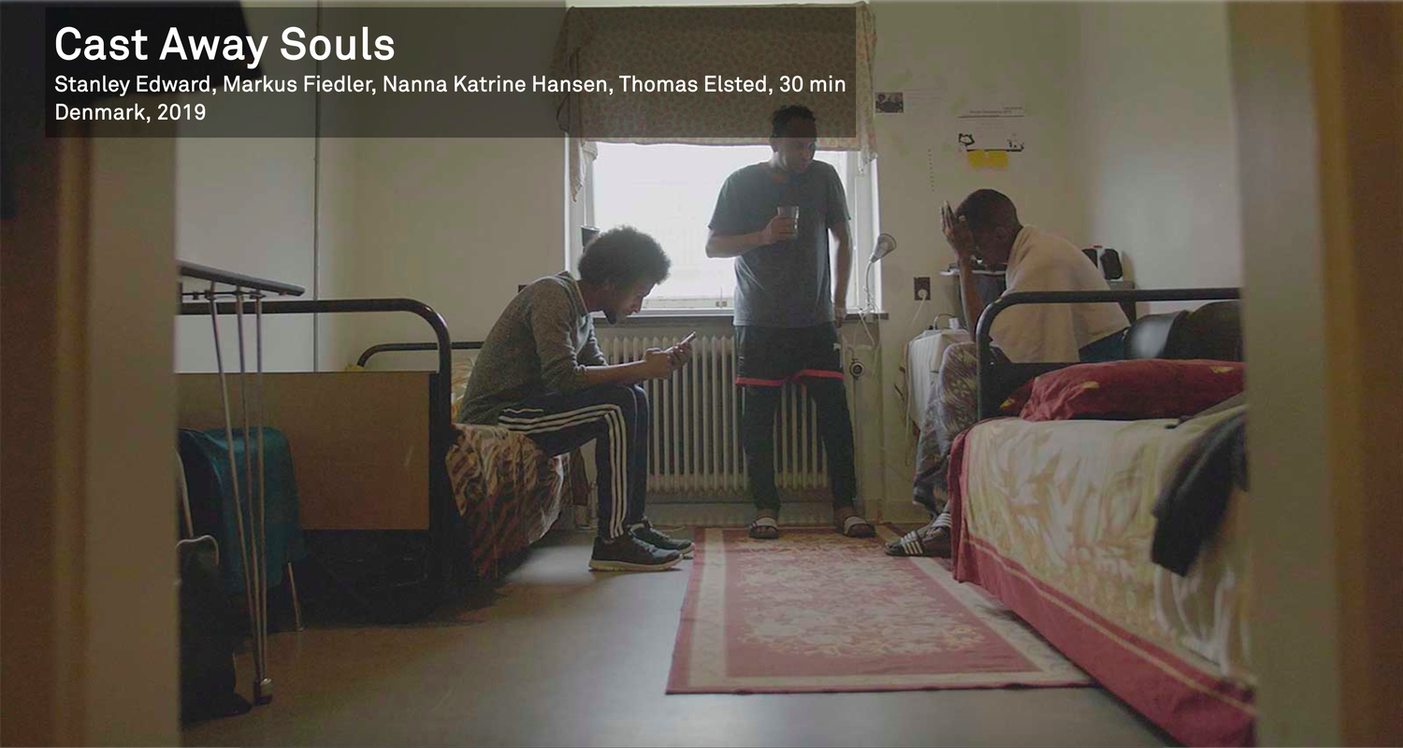
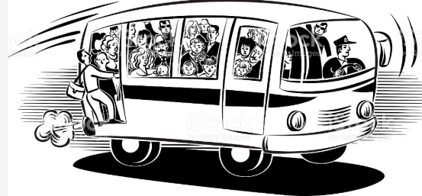
Principle 2: True storytelling makes spaces respecting the stories already there
Sleep in your own Hospital, eat the food to RESPECT what is there NOW
Take BUS TOUR with your stakeholders to SEE the TRUE STORYTELLING now.
Invite people there now, & include Mother Earth storyteller?
Notes:
Diane Dredge suggested Bus Tour with all the stakeholders on board on Tues May 8 2018 at Aalborg, at conference held there on storytelling
How to tell a motivating & inspiring story? MOST ENGAGING STORY WAITING TO BE TOLD IS YOURS! I was so shocked, surprised, stupid, suspicious (HOW DID YOU FEEL?)
What is ENGAGING & EMOTIVE-language? – when audience is ENERGIZED (look to body language) – START WITH CONTEXT (PAINT THE VIVID SCENE) e.g. in my driving through woods, icy roads, snowing, on mountain road ADD DIALOGUE
A PROBLEM, an OBSTACLE to OVERCOME: E.g. When I was first person in family ever to go to college? SET UP FOR THE TIMING POINT (THE ARC is SET) THEN SURPRISING TURNING POINT seeYouTube: Jim Carey
A proud moment when MORAL OF STORY →YOU inspired others? THE RESOLUTION E.g. When Bo Kimble died, the team used my motto to move forward

Slide 15
EXERCISE Principle 2: True storytelling makes spaces respecting the stories already there
Think of a story when you helped people respect how it is now, in the already there?
HOW COULD YOU TAKE A TOUR WITH THEM ALL, or HAVE YOUR STAKEHOLDERS EXPERIENCE THE SERVICE?
SHARE WITH ANOTHER PERSON & LISTEN TO THEIR EXAMPLE OF PRINCIPLE 2

Slide 16
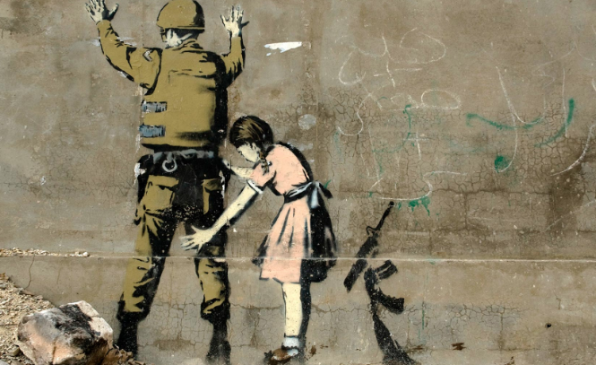
Principle 3: You must create stories with a clear plot creating direction and help people prioritize
We are ready to plan new future that is a PATTERN BREAKER from Past
We want a good plot that is TRUE STORYTELLING
It has Beginning, Middle & End to be Clear Direction
It tells WHY we are doing this
Best Plots have a TWIST, what Roland Barthes calls “PUNCTUM”
Banksy’ street-art YouTube
Notes:
In change people grasp for a narrative plot with clear why. A Punctum helps this.
Lars Bo H. presentation in Aalborg May 19 2018 spoke of the WHY in plot.

Slide 18
Space for a Pause

Slide 19
True Storytelling Principle 4 You must have timing.
KAIROS: place & time when conditions are right for the accomplishment of a crucial ’intelligent’ action
NOT the Beginning Middle End CHRONOS type of Narrative Plot we just did
Rather it is the fleeting RIGHTNESS of PLACE and TIME, and Material-Circumstance for an Opportune Moment
E.g. David’s Story of Meeting Grace Ann & an opportune moment of action

Slide 20
Practice Principle 5: You must be able to help stories on their way and be open to experiment
What is TRUE STORYTELLING now?
How to plan FUTURE?
When & Where to do PROJECT?
Reflect on OUTCOMES?

Slide 21
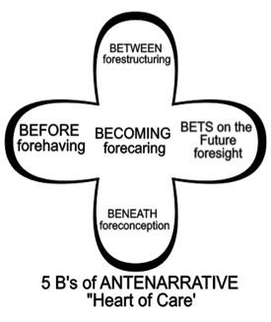
Practice Principle 5: You must be able to help stories on their way and be open to experiment
How is your organization preparing in advance BEFORE the future takes place?
What is in advance BENEATH in fore-conceptions?
Identify any BETWEEN the parties, in their fore-structuring?
What are the BETS on the future made with foresight?
What is the entire BECOMING, forecaring?
Notes:
Practice capturing attention, and getting it back when it moves away
Find pulse of audience, then hold it
Prepare the future in advance
Bring new future into being that changes everything before

Slide 22
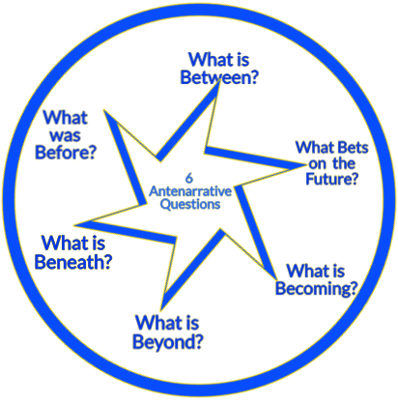
The 6th Question: WHAT IS BEYOND?
ANSWER:
Beyond is grasping by Embodiment, an encounter with the non-storyable, the non-narrativizable FUTURE
Notes:
The beyond comes for section 50 of Heidegger Being and Time. It is grasping the beyond by intuition, not by thinking It is an embodiment prospective sensemaking (not a retrospection). The question of the encounter is from Giorgio Agambe (2009 What is an Apparatus?). The apparatus in this situation of this seminar is the NORMS of CULTURES about IMMIGRANTS, that is in conflict with what Judith Butler (2005) calls ‘Giving and Account of Oneself.” In giving a moral account of oneself we face the addressee, the immigrant, but we are not present at the beginning of their migration to our CULTURE-NORMS (the apparatus). At same time there is embodiment of a non-narratiivizable encounter, our conflict with CULTURE-NORMS-APPARATUS and the immigrant-addressee facing us, as we give no account. I have “a point of bodily experience as well” an exposure “that cannot be narrated but constitute the bodily condition of one’s narrative account of oneself, then exposure constitutes one among several vexations in the effort to give a narrative account of oneself” (Butler, 2005: 39).

Slide 23
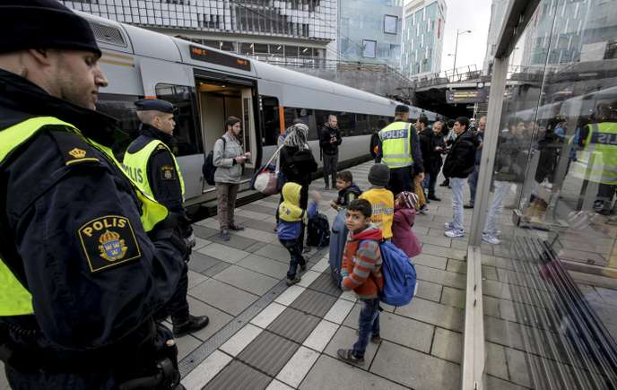
A lesson in WHAT IS BEYOND?
The body does not lie. But the mind does lie, and most every story and every narrative is a partial account of the Whole Situation.
To Grasp-Beyond, the non-narrativizable & non-storyable, means to rely on embodiment, to discern the future arriving, while at the same time, giving an account of oneself.
In today’s situation, we are giving a moral accountability of oneself (yourself) to one immigrant as the COUNTRY-NORMS (apparatus) opposes them

Slide 24
Principle 6: You must consider staging including scenography and artifacts of the BEYOND
How are material & social NORM-agents part of the staging & artifact of GIVING a MORAL ACCOUNTABILITY of ONESELF (You) as you face the immigrant (addressee)?
Notes:
The task here is to grasp-by-embodiment in scenography and artifacts the staging of the encounter between COUNTRY-NORM and the immigrant (see photo), and to do gesturing, to display the situation of the conflict of what is unpredictable future, and yet to do divination anyway of the BEYOND of the PRESENT. We experience the future, in advance, by our flesh-and-blood, and the body tells the true story to us here-and-now. Walter Benjamin (1928) in One-Way Street did 60 divinations of the future arriving in a German city after WWI.
Benjamin, Walter. (1928/2016). One-way Street. Original 1928, th 2016 edition with Preface, 2016. Translated by Edmund Jephcott, edited with intro by Michael W. Jennings, and preface by Greil Marcus. Cambridge, MA, London: The Belknam Press of Harvard University Press. Vol. 966. Penguin UK.

Slide 25
Principle 6: You must consider staging including scenography and artifacts of BEYOND
TASK: stage a SKIT encounter between your Country-Norm and one immigrant, with you giving a flesh-and-blood ‘MORAL ANSWERABILITY’ without words, by embodied gesturing, the FUTURE
Notes:
The task here is to grasp-by-embodiment in scenography and artifacts the staging of the encounter between COUNTRY-NORM and the immigrant (see photo), and to do gesturing, to display the situation of the conflict of what is unpredictable future, and yet to do divination anyway of the BEYOND of the PRESENT. We experience the future, in advance, by our flesh-and-blood, and the body tells the true story to us here-and-now. Walter Benjamin (1928) in One-Way Street did 60 divinations of the future arriving in a German city after WWI.
Benjamin, Walter. (1928/2016). One-way Street. Original 1928, th 2016 edition with Preface, 2016. Translated by Edmund Jephcott, edited with intro by Michael W. Jennings, and preface by Greil Marcus. Cambridge, MA, London: The Belknam Press of Harvard University Press. Vol. 966. Penguin UK.

Slide 26
Our place in the world
“The world of our present consciousness is here and now. Each of us is centered upon ourselves, and from this state of centered presence comes the idea that the surface of the earth is centered at a particular place” (Pennick, 2015: 37).

Slide 27
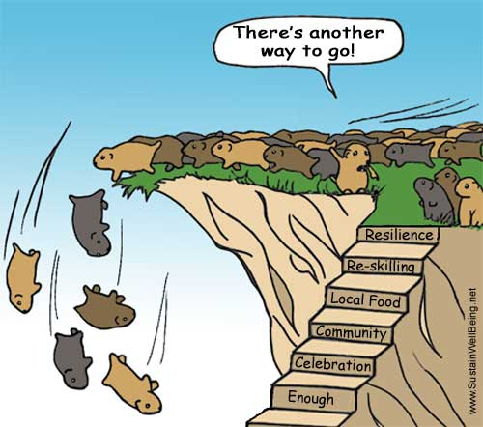
TRUE STORYTELLING Principle 7 You must reflect on the stories and how they create value.
Can you pull yourself up and look at the WHOLE SITUATION to give MORAL ANSWERABILITY?
Lemmings are not REFLECTING on long-term value of Immigrants?
How a FAKE Social responsibility story loses value in face of ACCOUNTABILITY?
TRUE STORYTELLING: How do we not fall over the edge?
Notes:
Here I (Boje) am applying Bakhtin (1993: 3) moral answerability and Butler (2005) moral acocuntability, to the non-narrativizable encounter with the conflict between COUNTRY-NORMS and the IMMIGRANT I FACE TO GIVE ACCOUNT. The immigrant is the addressee of my moral answerability, but the COUNTRY-NORM also is demanding a narrative account. I have an embodiment intelligibility of the vexation vectors that are crossed. What I seek to make recognizable in narrative is not fully mine. I was not there at the beginning of immigration journey. I am here now, giving an account of myself to the Other, who is also not here now. I have a fore-grasping, a graspying-by-embodiment and can express the scenography.

Slide 28
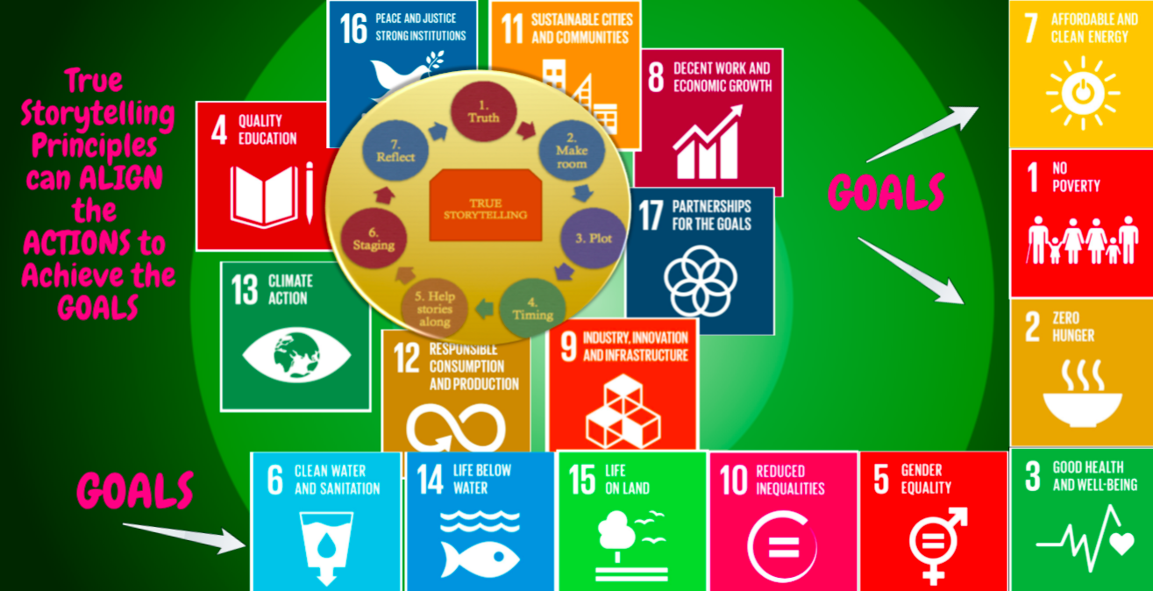

Slide 29
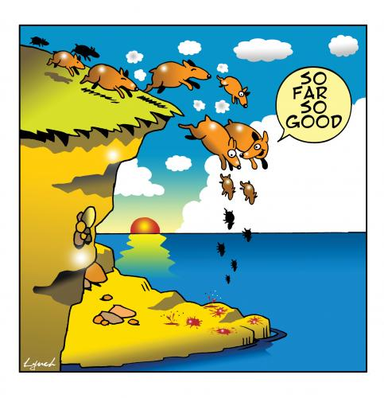
THANK YOU
Questions & Answers
Davidboje.com or davidboje@gmail.com

