Slide 1
Business Schools and 6th Extinction Scenario
PART II
David M. Boje See Part I of this series at
Professor, Aalborg University, Denmark https://davidboje.com

Slide 2
“Fake Storytelling” is more Prevalent than Science’s attempts at “True Storytelling.”
A fundamental tenet of the scientific method is that there is never certainty in science, only observation, experimentation, hypothesis refinement and the empirical accumulation of evidence. Our past and present leaders exploit that fact, warning of the dangers of scientific consensus as if it reeks of climate conspiracists.
100 companies are responsible for 71 percent of global emissions since 1970

Slide 3
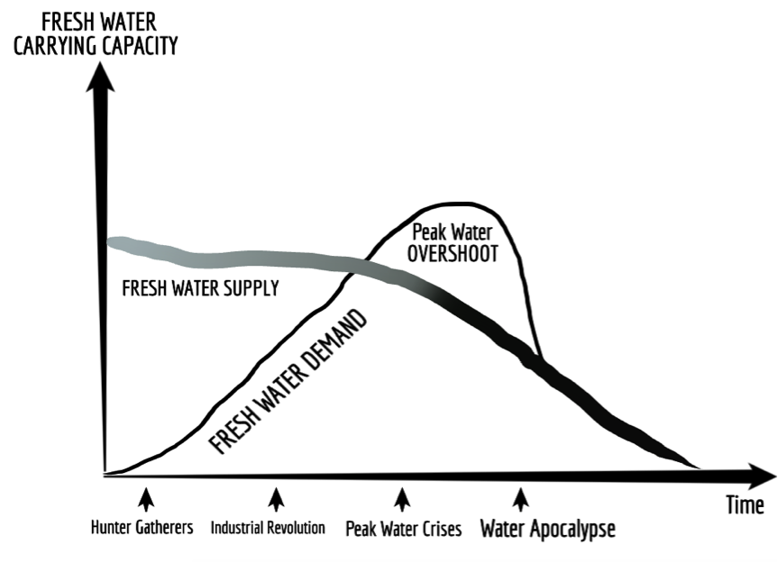

Slide 4
Water Facts
326 million trillion gallons total water on Earth
97% is Ocean (salt water), only 3% is Fresh Water source
Ocean ➔320 million cubic miles salt water
2.5% of fresh water is unavailable: locked up in glaciers, polar ice caps, atmosphere, and soil; highly polluted; or lies too far under the earth's surface to be extracted at an affordable cost.
1.63 million trillion gallons (Less than 0.5% of the earth's total water) is accessible Fresh Water
Coca-Cola Water Projects by end of 2017 replenished estimated 248 billion liters of Fresh Water that year
CONVERSION: 1 Liter = 0.26417205 Gallons
65.5 billion gallons of water that Coca-Cola Water Projects Replenish

Slide 5
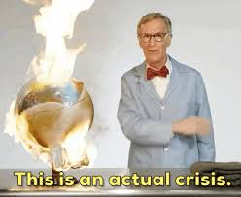
The Dark Side of Climate-Denier Storytelling Echo Chambers funded by Exxon & Koch Brothers
E.g. Watts Up With That (WUWT) & Global Warming Policy Forum (GWPF) belittles, derides, and condemns climate science, while misrepresenting the scientific findings
E.g. Bill Nye: “a science project that went wrong” a “fascist in a bow tie”, “Bill Nye The Crackpot Guy” and “The end is nye” (Bloomfield & Tillery, 2019).
Notes:
Jane Goodall’s storytelling solution, misses the DARK SIDE OF STORYTELLING, the echo chambers(Bloomfield & Tillery, 2019). And Bloomfield and Tillery, 2019 are not doing storytelling research, so they forget to trace the Exxon and the Koch Brothers Money
““The WUWT and the GWPF blogs … are highly involved in framing peer-reviewed scientific research to fit their narrative of the climate change hoax and in curating misrepresentations from other sources to heighten their legitimacy” (Bloomfield & TIllery, 2019: 32-33, boldness mine).’
Bloomfield, E. F., & Tillery, D. (2019). The Circulation of Climate Change Denial Online: Rhetorical and Networking Strategies on Facebook. Environmental Communication, 13(1), 23-34. Accessed Aug 7 2019 at https://www.researchgate.net/profile/Emma_Frances_Bloomfield/publication/329485682_The_Circulation_of_Climate_Change_Denial_Online_Rhetorical_and_Networking_Strategies_on_Facebook/links/5c7d6f5b92851c695054bbed/The-Circulation-of-Climate-Change-Denial-Online-Rhetorical-and-Networking-Strategies-on-Facebook.pdf

Slide 6
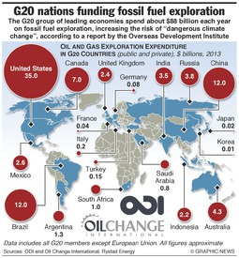
JPMorgan Chase, which has committed nearly $200 billion to fossil fuel exploration over the last three years
Notes:
https://www.nytimes.com/2019/11/10/climate/mary-robinson-maeve-higgins-thimali-kodikara-podcast.html

Slide 7
EXXON/MOBIL sued by New York for alleged fake storytelling
Misrepresented the risks of Global Warming to investors (More)
Exxon is one of just 20 fossil fuel companies responsible for a third of all greenhouse gas emissions in the modern era

Slide 8
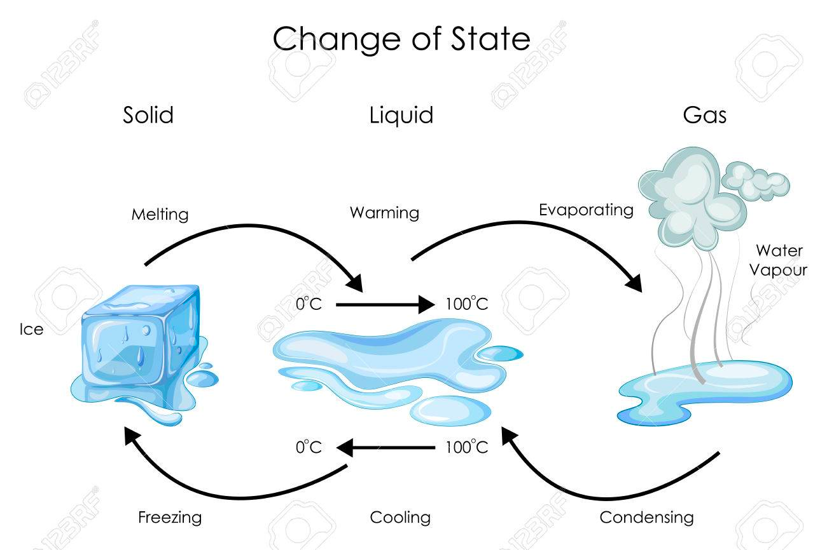

Slide 9
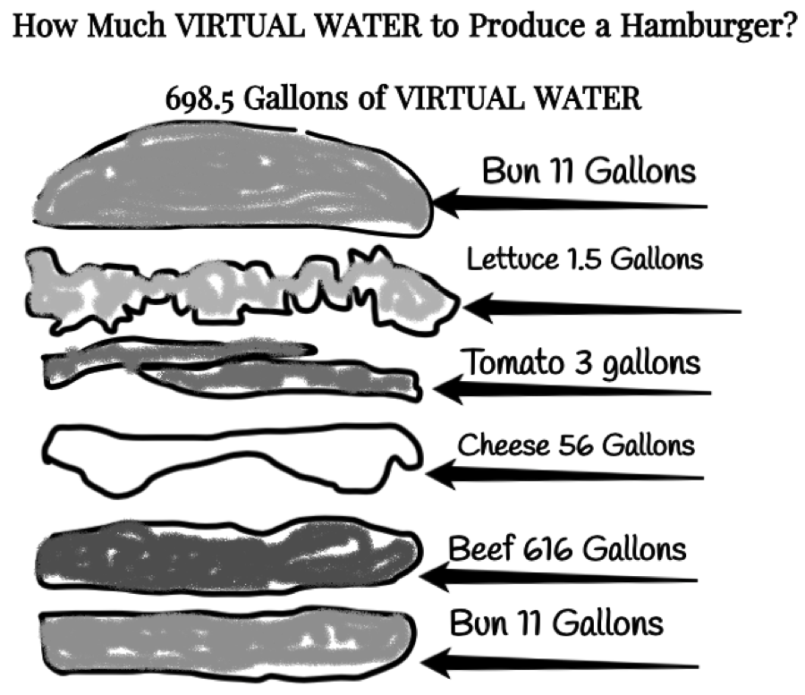
Notes:
usiness Product Virtual Water Footprint[1]
Car 13,737 – 21,926 gallons
Leather Shoes 3,626 gallons
Smart phone (mobile) 3,190 gallons
Bed Sheet (cotton) 2,839 gallons
Jeans (cotton) 2,108 gallons
T-shirt (cotton) 659 gallons

Slide 10
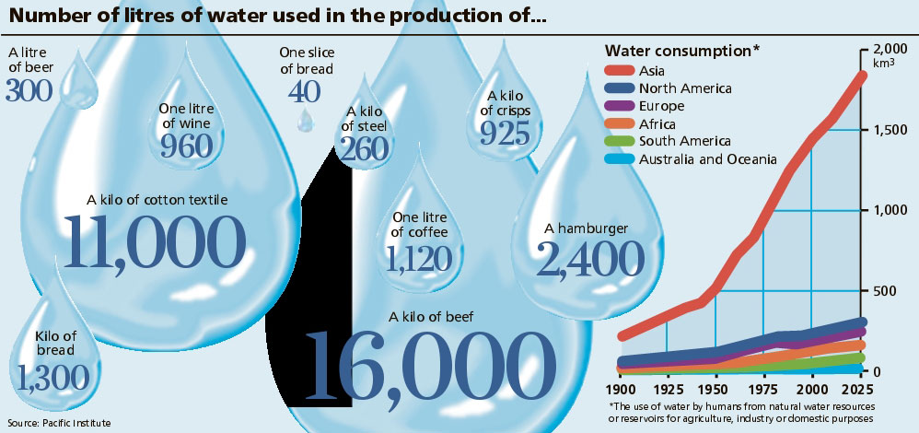
What is VIRTUAL WATER?
Notes:
http://www.linv.org/virtual-water/

Slide 11
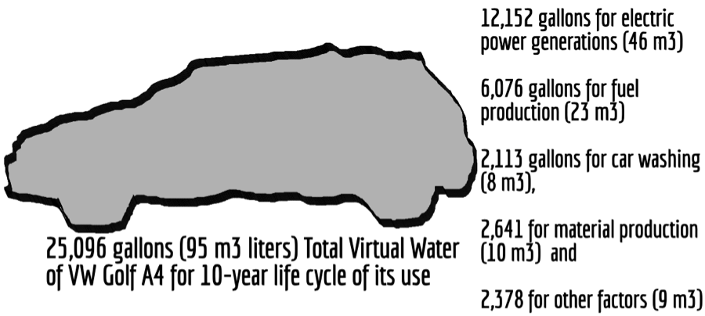
How Much Virtual Water to Produce a Car?
Notes:
Business Product Virtual Water Footprint[1]
Car 13,737 – 21,926 gallons
Leather Shoes 3,626 gallons
Smart phone (mobile) 3,190 gallons
Bed Sheet (cotton) 2,839 gallons
Jeans (cotton) 2,108 gallons
T-shirt (cotton) 659 gallons
One litre of bio-diesel fuel from soybeans uses 14,000 gallons of water
· One litre of bio-ethanol from maize uses 2,600 gallons of water
· One litre of bio-ethanol from sugar beet uses 1,400 gallons of water
· One litre of bio-ethanol from sugar cane uses 2,500 gallons of water
· One car uses 39,090 gallons of water in the entire business supply chain
· One ton of steel uses 62,000 gallons of water to produce it
· One ton of cement uses 1,360 gallons of water to produce it
· One cell phone uses 240 gallons of water to produce it
· One pound of plastic uses 24 gallons of water to produce it
· One single use plastic for water or soda uses 1.85 gallons for the plastic, and the water in has a virtual footprint that is
· One pound of synthetic rubber uses 55 gallons of water to produce it
· One cotton T-shirt uses 650 gallons of water to produce and transport it
· One pair of blue jeans uses 2000 gallons of water to produce and transport it

Slide 12
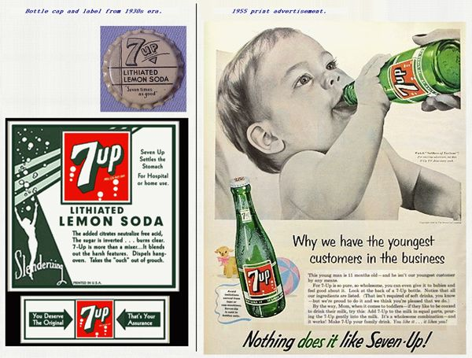

Slide 13
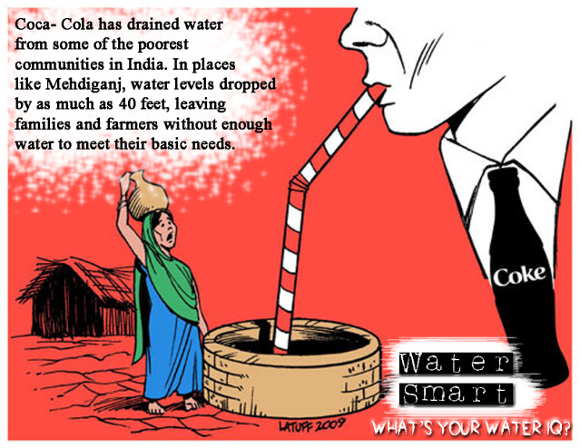

Slide 14
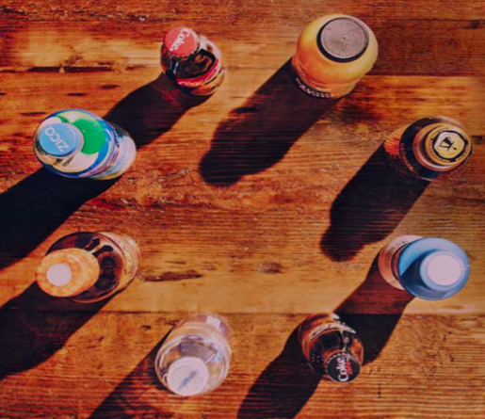
Coca-Cola’s Annual Sustainability Report

Slide 15
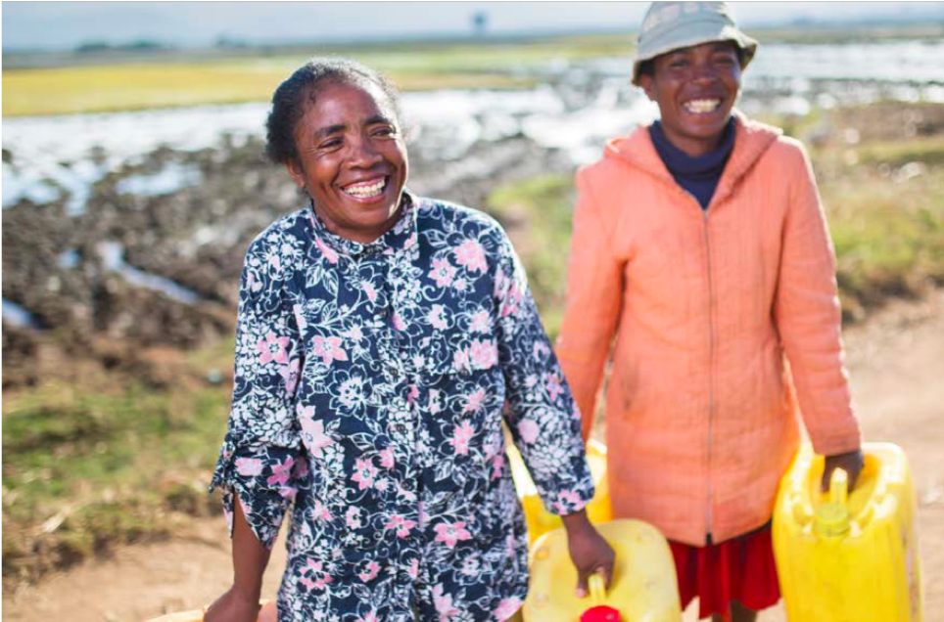
FOR EVERY DROP OF WATER WE USE, WE GIVE ONE BACK
… we take water leadership seriously because it’s the earth’s most valuable finite resource. With our size and local presence, we have the ability to help people and communities get access to the water they need (p. 11)

Slide 16
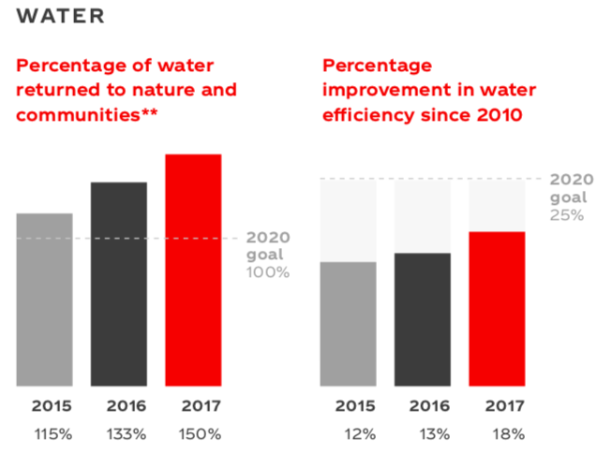
STUPIDITY EXAMPLE: Coca Cola says “Water We aim to give back the amount of water used in our finished beverages to replenish communities and nature” SOURCE
Question: How would you research this?
**As estimated working with our many external partners and using generally accepted, independently peer-reviewed scientific and technical methods. Finished beverages based on global sales volume. (Coke Sustainability Report, p. 9)
Notes:
https://www.coca-colacompany.com/2017-sustainability-report

Slide 17
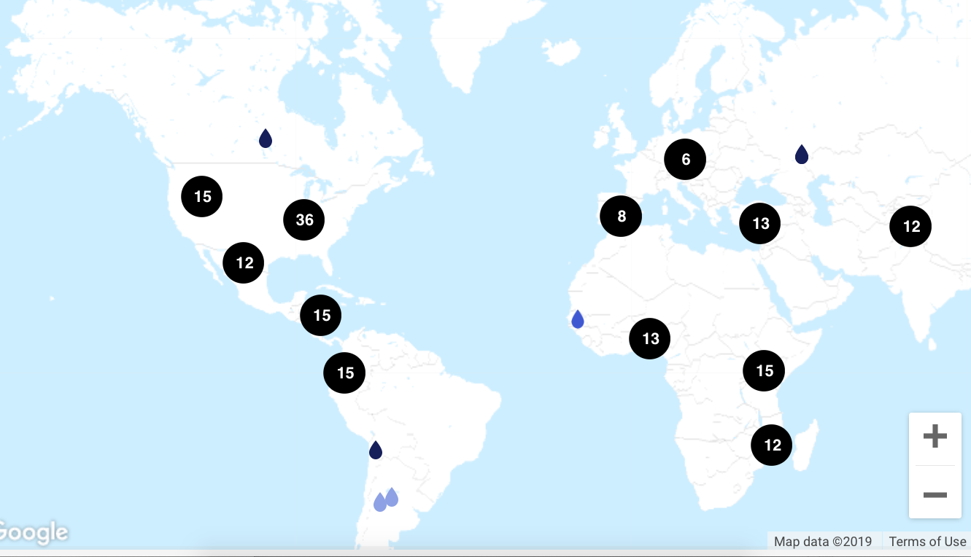
How does Coke Replenish 65.5 billion gallons of Fresh Water?
COCA-COLA’s STORY MAP
# = projects in that location to replenish water used

Slide 18
Economists Storytelling that Growth Prosperity is viable Bet on the Future
Political leaders worldwide need to recognise the causal connection between economic growth and global heating, manifest in fossil fuel consumption. To save the planet, fossil fuels need to stay underground
3BL and CE keep pushing growthmania onto the UN Sustainable Development Goals and their Pathways…

Slide 19
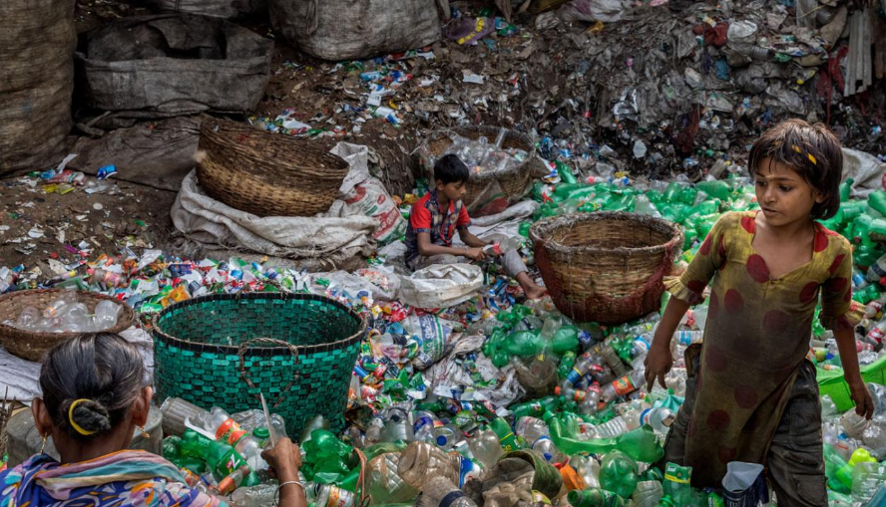
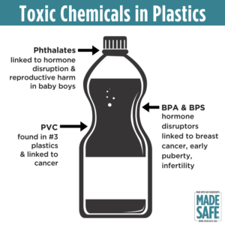
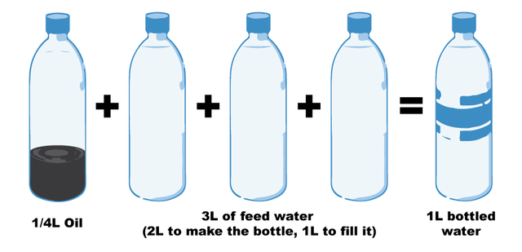
Notes:
Fill a plastic water bottle 25% with OIL to illustrate how much oil it take. https://www.portlandoregon.gov/sustainabilityatwork/article/535746
USA consumes 50 billion plastic water bottles a year, 23% head to recycling, but 38 billion don’t go to recycling, and then only about 9% actually gets recycled, because China is no long taking them, and because it costs $$$ to sort the bottles, shred them, wash them, heat them to sanitize, then melt into pellets and sell to beverage companies
Billions of gallons of water are used to make the Billions of gallons of water in water bottles ( feed waters 3 to 1 final bottle of water)
50 billion USA plastic water bottles is 17 million gallons of oil. It takes 6,000 megajoules of electricity for each barrel of oil, and with all the oil for 40 billion bottles that is 106 billion megajoules of electricity, which is how the 25% oil calculation is based on.
OUR PROBLEM TO BE SOLVED GETS WORSE: 50 billion USA plastic water bottles, is small part of the 250 billion BEVERAGE bottles with juices, sodas, etc. in them
WORLDWIDE: USA is 50 billion plastic water bottles, but world total is 500 Billion, and that means five times that in Total World Beverage plastic bottles
PROBLEM GETS WORSE AGAIN: Most are made of PET –Polyethylene Terephthalate and that has BPA in it.
https://www.madesafe.org/avoid-toxic-chemicals-plastics/
BPA stands for Bisphenol-A and it is a carcinogen, cause low sperm count in boys, and early puberty in girls. PBA is endocrine disruptor.
BPA has been a resin to make plastics clear and strong since the 1960s. https://www.mayoclinic.org/healthy-lifestyle/nutrition-and-healthy-eating/expert-answers/bpa/faq-20058331
It is not just making plastic bottles, but coats the insides of beverage cans, and used to make epoxy.
The FDA does not regulate it, saying low levels of BPA are SAFE to use in foods, and of no harm to human body. But Mayo Clinic says cut back on plastic bottles, and on metal cans (coated in BPA), for your good health life.
PROBLEM GETS WORSE: BPA has phthalates, and FDA refuses to regulate them either. Phthalates are industrial chemicals are binding agents, and to soften plastic, make it clearer and more durable.Also used in cosmetic consumer products. https://www.fda.gov/cosmetics/productsingredients/ingredients/ucm128250.htm Phthalates however do cause reproductive, liver, kidney, and lung problems in human beings. See Canada https://noharm-uscanada.org/issues/us-canada/phthalates-and-dehp Guardian https://www.theguardian.com/lifeandstyle/2015/feb/10/phthalates-plastics-chemicals-research-analysis
CDC recommends further study, FDA says its safe to consume, but others say health hazard https://www.theguardian.com/lifeandstyle/2015/feb/10/phthalates-plastics-chemicals-research-analysis. 2008 Henry Waxman bill did ban phthalates in some baby products
BUT the science says phthalates linked to asthmas, attention-deficit disorder, breast cancer, Type II diabetes, autism, and male fertility disorders. Watch the milk because a lot of plastic tubes are used in milking machines, and the phthalates make their way into even glass bottles of milk.
rPET is recycled PET https://earthhero.com/whats-the-deal-with-rpet/ Good news it uses 75% less energy to make rPET, less resource extraction, less CO2,
BUT ITS NOT A PERFECT SOLUTION TO NANOPLASTIC POLLUTION
The rPET, has microfibers, and with each washing, or swallow, it goes into the water, and these break down into microplastics, then into nanoplastic particles, which circulate in the water cycle with the PET nanoplastic particles, and it take 500 years to degrade, and that means all the plastic every made (except some incinerated) is still here, and worse problem, that are a lot of other plastics, and they break down to nanoparticles and head into food chain, so the water cycle gets more and more contaminated.
BOTTOM LINE
Our desire for plastic has change our Self. Other contaminants stick to the plastic and circulate in the water cycle, and the food chain, and that means plastic water and beverage bottles is a huge contributors to the human activities changing the global water cycle, and changing the Self of Water=Desire, Water=Life, Water=Memory, Water=Spirit, and Water=Matter but also means we are in Water-Denial, so Water=$$$
Plastic is a waste byproduct of petrochemical manufacturing. The oil industry had to get rid of the waste, so making it into plastic was how to do that, now we are past peak oil, and past three water peaks, and Water=Desire (our Ego manipulated by marketing hype) is causing an evolutionary change in the Self, so instead of an authentic Self, we have the Self as Desired by DuPont (inventor of plastic), and by Nestle, Coke, and PepsiCo (and their imitators). This is why Boje says in his books we are in a culture of denial, as marketing sells us a new self, and corporate lobbies corrupt agencies like FDA, or defang the EPA, and fund the campaigns of political leaders with PAC meney, as the corporation became a legal person, then its PAC money declared free speech act in political elections, while a human citizen ahs a limit in USA of $2,500.
All this boils down to Water=Desire is a corruption of Water=Spirit (Radah, mistranslated from the Hebrew in King James bible 1611, and used to by Francis Bacon soon after to make scientific method about subduing and domination of nature as an improper translation of ‘dominion’ and this became a political ideology in the 1970s e.g. James Watt, Secretary of the Interior to Reagan, said “After the last tree is felled, Christ will come back”
In sum bad bible translations of Radah are now being corrected so that it means ‘caring for creation’ and ‘stewardship, but the damage will take generations to undo, and by then the science says the water cycle will be destroyed. I.E. By 2030 global water demand will be 40% greater than it is today (McKinsey Report). By 2030 40% of world’s population will lack access to safe, sanitary water, in 2030 there will need 60% more fresh water to support demand than we have today in the water cycle. The developing nations are increasing water withdrawals by 50% and 18% in developing nations. In short, the fresh water system, if it were a bank, has more withdrawals than deposits, and is bankrupt!
https://www.waterlogic.com/en-us/resources-blog/world-oceans-day-plastic-pandemic/ for ocean impact
WATER sourced in a State, is NOT subject to FDA jurisdiction. And see Documentary Tapped – only one person works in FD WITH JOB OF OVERSEEING BOTTLED WATER INDUSTRY.
https://www.isitbadforyou.com/questions/is-ozarka-water-bad-for-you
Nestle says ‘Water is NOT a Human Right!’ https://www.nestle-watersna.com/en/bottled-water-brands/ozarka/ozarka-water-quality-report
Bottled Water Leaches dangerous chemicals into what you drink.
Most plastic bottles end up in the land fill
USA consumes 50 billion plastic single use bottles a year, and 77% are not recycled, much of the ones that are, are down-cycled to making polyester shirts, or rugs.
Since plastic invented, and took off in 1950s, then in bottled water in 1970s, we have 9.2 billion tons of it, and more each year than the prior year, and ALL OF IT STILL HERE. Of the 9.2 billion tons, 6.2 billion tons of plastic never reaches the recycling bin, and that which does, most of that is not actually being recycled.
Oil companies had waste gas, ethylene to get rid of, so plastic

Slide 20
If US, Australia Brazil etc. are not doing Climate Action, then Global Temperatures will rise and rise
President Trump is ripping away our right to address climate change.
The Trump administration just made a big move to revoke states' rights to adopt clean car standards that are tougher than those set at the national level.
2 of 77 Examples:
Withdrew a proposed rule requiring groundwater protections for certain uranium mines. E.P.A. | Read more
75. Weakened federal rules regulating the disposal and storage of coal ash waste from power plants

Slide 21
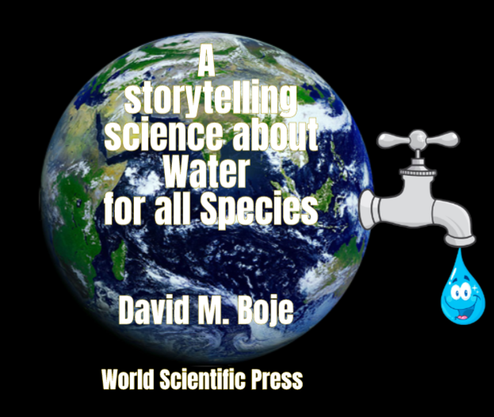
Thank You: Any Questions?
Download Conversational Storytelling book and slides for this presentation at
https://davidboje.com
Notes:
If you have and comments or questions contact me at davidboje@gmail.com
Thank you

