Slide 1
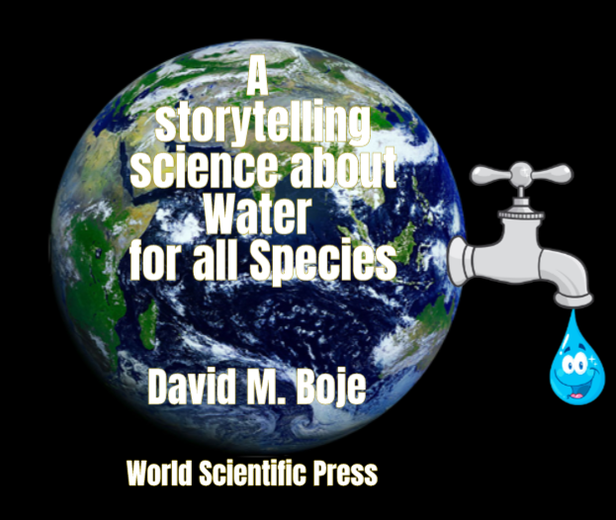
Why is SEAM’s self-correcting ‘storytelling science’ better than Appreciative Inquiry for Virtual Water Future of the World?
David M. Boje
Professor, Aalborg University (Denmark)
Emeritus & Regents Professor, New Mexico State University
Director, European School of Governance
https://davidboje.com/Lyon
Notes:
We are drowning our water in plastic https://www.nationalgeographic.com/magazine/2018/06/plastic-planet-waste-pollution-trash-crisis/
It is our storytelling of water and of plastic, that is changing our story of the Christian into a Marketed Self, and what Water=Desire becomes a marketed construction to make people smoke, drink bottled water or beer, etc., which is an evolutionary change in our our Self=Ego=Desire-concept as a Marketing Advertising.
NOTE: The word ego does not appear in the bible. https://www.gotquestions.org/Bible-ego.html

Slide 2
Topics Entangled
SEAM’s self-correcting storytelling science
How it can help solve the Plastic Pandemic and the Global Fresh Water Crisis
How SEAM can Conserve Virtual Water of every Organization on the Planet
Can SEAM expand from Socially Responsible Capitalism to Ecological Responsible Capitalism?

Slide 3
What is Virtual Water?
Virtual water trade refers to the hidden flow of water if food or other commodities are traded from one place to another. For instance, it takes 1,340 cubic meters of water to produce one metric tonne of wheat.

Slide 4
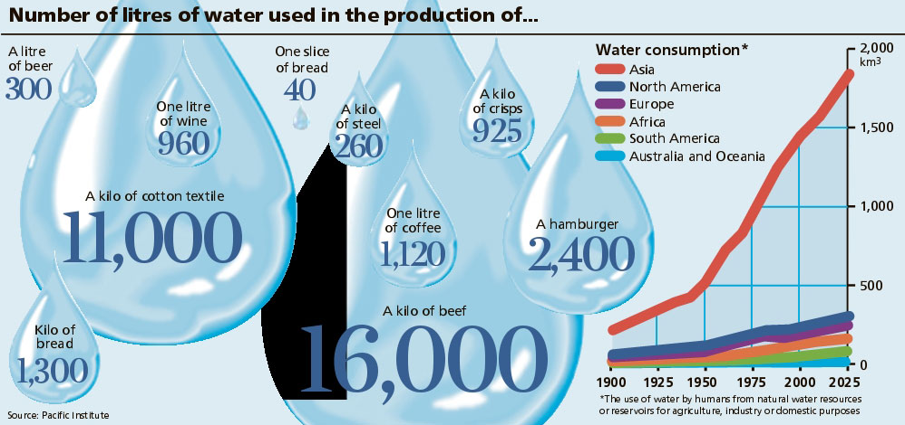
SEAM can help every organization measure Virtual Water of their Global Supply & Distribution Chain
Notes:
http://www.linv.org/virtual-water/

Slide 6
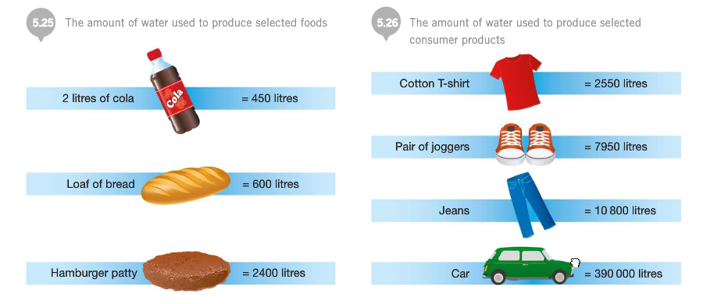
How can SEAM do Virtual Water Hidden Cost Diagnostics
Notes:
http://sncyear7geography.weebly.com/virtual-water.html
“When a country imports (bring in from another country) 1 tonne of wheat, that country saves about 1,300 cubic metres of its own water (as it would have used 1,300 cubic metres of its own water if it produced the wheat themselves instead of importing it). If the water is scare in a country, the water it saved can be used for other purposes. If however, the water is scarce in the country that produced the wheat, then they have exported 1,300 cubic metres of water that is no longer available for other purposes.”
“

Slide 7
SEAM could do this: Make workplaces Eco-Friendly
E.G. Goldman Sacks told 6000 employees: “Plastic isn’t as recyclable as you may think”
Removed plastics bottles from its shops & vending machines
Doing Rainwater harvesting in new HQ
Replacing executive parking with cyclist spaces
Goal: 85% reduction in plastic use by 2019 & divert 100% waste from landfill by 2020

Slide 8
Norway’s solution of deposits
Norway recycles 97% of its plastic bottles
EU rate if 57%
In United States, recycling rates for plastic bottles have plunged from 37.3 percent in 1995 to 28 percent today.
Notes:
https://www.huffpost.com/entry/norway-plastic-pollution_n_5b7c07e0e4b05906b41779ee

Slide 9
The problem: In 10 years it will be too late to solve it
By 2030 global water demand will be 40% greater than it is today (McKinsey Report).
By 2030 40% of world’s population will lack access to safe, sanitary water
In 2030 there will need 60% more fresh water to support demand than we have today in the water cycle.
Developing nations are increasing water withdrawals by 50% and 18% in developing nations.
In short, the fresh water system, if it were a bank, has more withdrawals than deposits, and is bankrupt!

Slide 10
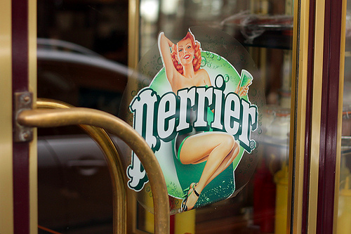
Nestlé Bought Perrier & Pellegrino
Nestlé says Water is NOT a Human Right
Notes:
Nestlé bought Perrier in 1992. As the story goes, Perrier was losing market share, so Nestlé hired Dita Von Teese, the ‘Queen of Burlesque’ and Playboy model to appeal to the desires of a younger male demographic. The ad aired July 2010 and went viral. Fans were invited by Dita to the Perrier Mansion (aka Playboy Mansion) who greets them at the front door in a clingy, blue satin dress and says, ‘Find me!’ The interactive website present two doors, one labeled ‘Dark Room’ and the other ‘Roll the Dice.’ If you ‘Roll the Dice’ Dita does a sultry fizzy, cold Perrier shower, dousing herself in the premium brand. If you enter ‘Dark Room’ you are invited to snap a photo of Dita in a green, silky negligée. Perrier accompanied the print, TV, and web ads with a special edition release of Dita’s image on Perrier cans and bottles.

Slide 11
Self-Correcting Induction Methods
For Karl Popper it is Zigzag between intuitive hypotheses and testing theories by disconfirmation, not by confirmation
For C. S. Pierce it is self-correcting induction by four tests to get closer to Truth
For Henri Savall it is self-correcting by ’Agile’ intervention using Peirce’s Abduction-Induction-Deduction in Scientific Method of unleashing human potential

Slide 12
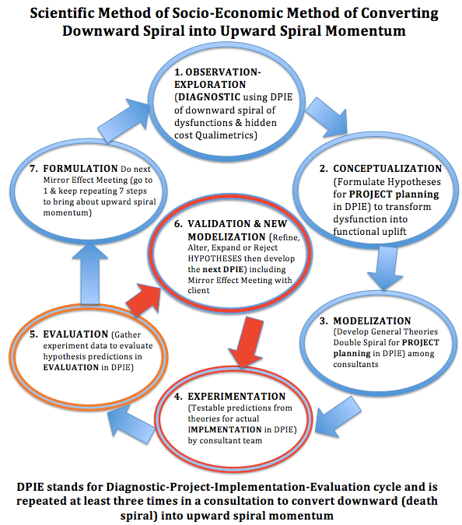
Why SEAM is not AR or GT inductive fallacies
Based upon (Savall & Zardet, 2008: 145, 148) Thank you, Rohny

Slide 13
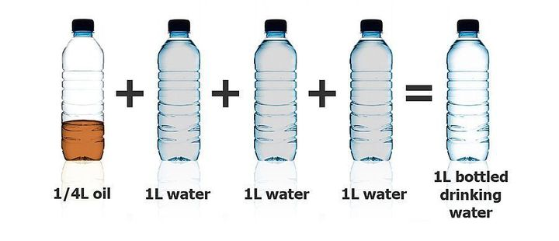
Bottling Water in Plastic is Wasteful of Socio-Economics & Ecology

Slide 14
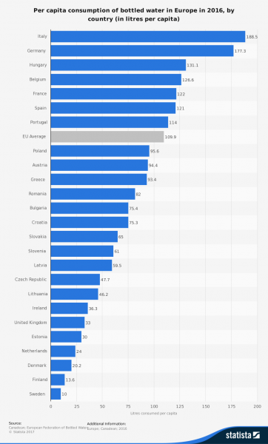
52 Billion litters of bottled water consumed in Europe per year
Plastic bottles are made of polyethylene terephthalate (PET or PETE), a 100% recycling material
59% are recycled in EU, about 35% in US
US uses 50 billion plastic water bottles a year
Notes:
https://www.surfrider.eu/en/le-blog/plastic-bottles-key-figures-environmental-disaster/

Slide 15
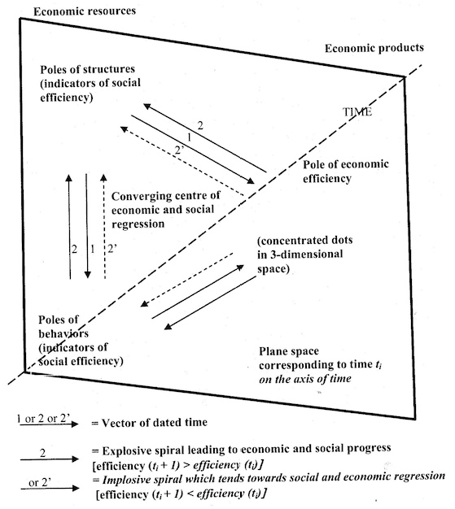
(Savall, 1975/2010: 205)
There is an important, and non-researched, double spiral that is theorized by Savall (1975/2010) which is dialectical relation between and explosive (upward) spiral and an implosive (downward) regressive {death} spiral
Notes:
Savall, Henri. (1975/2010). Work and People: An Economic Evaluation of Job-Enrichment. 1975 book "Enrichir le trail human dans les enterprises et les organizations". 2010 English version is Translated from French by M. A. Woodhall. Charlotte, NC: Information Age Publishing, Inc.

Slide 16
Plastic water bottles are dangerous to your health
Plastic has entered the water cycle
BPA and substitutes BPS and BPF are equally toxic
Fresh safe drinking water and sanitation getting so scarce
6,000 children die every day of water-borne diseases that are entirely preventable with modern science

Slide 17
SEAM’s Self-Correcting ‘storytelling science’ competitive advantages
SEAM uses Peirce’s Abduction-Induction-Deduction in Scientific Method of unleashing human potential
Appreciative Inquiry is POSITIVITY of Confirmation without any Refutation
Action Research and Grounded Theory are not doing self-correction refutation method

Slide 18
Roots of Storytelling Science
Karl Popper
Charles Sanders Peirce
Roger Penrose
Jean Paul Sartre
Henri Savall
Gilles Deleuze
Grace Ann Rosile
Karen Barad
Anete Strand
Marita Svane
Veronique Zardet
Jane Bennett
David Boje
Tyron Love
Linde & Graham Smith
Angus Macfarlane
Gregory Cajete
Don Peppion

Slide 19
Polychlorinated biphenyls (PCBs) are manmade chemicals that adhere to plastic
PCB, for example). If there was significant accumulation of environmental contaminants, there is the possibility that these concentrations could 'biomagnify' up the food chain to higher levels, to humans

Slide 20
Charles Sanders Peirce 4 Tests of Self- Correcting Induction
Test One: Try to dismiss the precepts. Given fallibility, “the first test consists in trying to dismiss the precepts” as as some kind of fancy or daydream. If the flow of precepts persists, proceed to Test Two.
Test Two: Ask other people if they see and hear the same thing. If you have reason to suspect hallucination persists, the second test consists in “asking some other person whether he [or she] sees or hears the same thing” If several people concur then treat the induction as conclusive, or proceed to Test Three.
Test Three: Use your knowledge of laws of nature. Some hallucinations and illusions can affect many people. The third test is surer than the first two. “I may make use of my knowledge of the laws of nature” (as fallible as that may be). Apply your knowledge of the Nature, making our observations.
Test Four: Do experiments to see if the precept is illusory. There is a fourth test, and it is the surest of them all. “ apply the test of experiment” .
Charles Sanders Peirce (Vol. 2.142)

Slide 21
Bisphenol-A (BPA) Its substitutes not that safe
"BPA but not BPS concentrations were positively correlated with both estrogenic and antiandrogenic activities. BPA still dominates the thermal paper market in Brazil and Spain, and BPS appears to be one of the main alternatives in France. There is an urgent need to evaluate the safety of alternatives proposed to replace BPA as developer in thermal printing. The large proportion of samples with hormonal activity calls for the adoption of preventive measures"
BPA, bisphenol S (BPS) and bisphenol F (BPF)

Slide 23
TRILECTIC
This is a positive dialectics, the interplay of practical findings from application with academic canons in a “conflict-cooperation dialectical system” to sort a zone of convergence (Savall & Zardet, 2008: 80).
Savall and Zardet (2008: 21) cite Peirce’s (1955) logics of induction, deduction, and abduction, but prefers to move from abductive hypothesis selections from many possible ones, to deduction, and finally inductive reasoning.

Slide 24
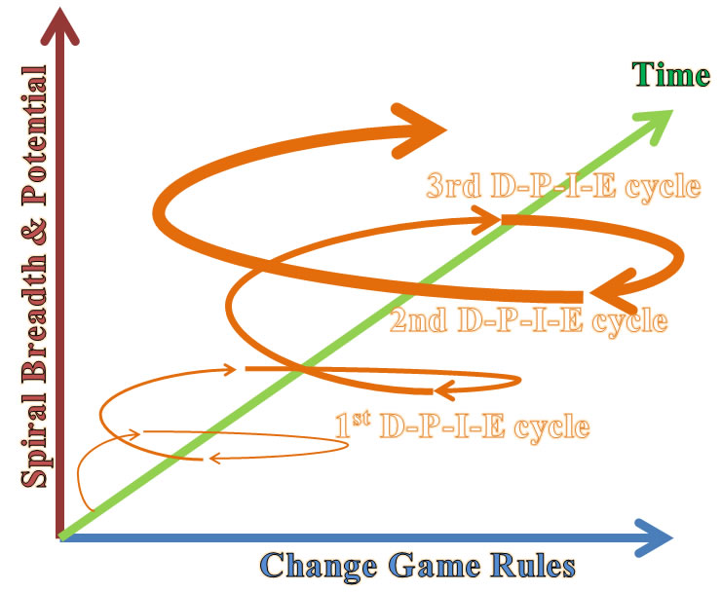

Slide 25
France and rPET
France plans to make bottles produced with recycled plastic cheaper than bottles made from virgin plastic and will further tighten regulation on plastics use, a government minister said
France recycles just 25.5 percent of its plastic packaging waste, the second-worst recycling rate in Europe, but has a plan to do better.
Notes:
https://www.reuters.com/article/us-france-plastics/france-to-make-unrecycled-plastic-bottles-more-expensive-idUSKBN1KY13T
The France plan for plastics recycleing http://www.desforgeslaw.com/uploads/4/6/9/3/46939111/2018_08_19_plastics_recycling_plan_france.pdf

Slide 27
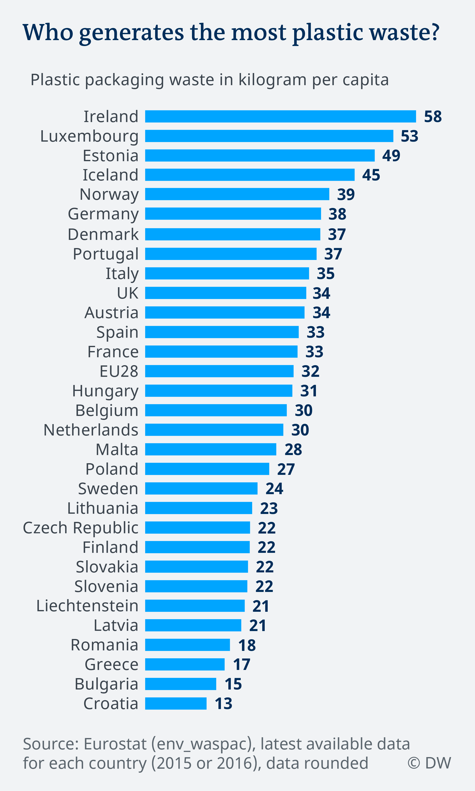
Notes:
https://www.dw.com/en/plastic-waste-and-the-recycling-myth/a-45746469

Slide 28
Popper (1972: 243) Self-Correction Formula
PS₁ ➔ TT₁ ➔ EE₁ ➔PS₂
PS₁ = Problem situation, initial response
TT₁ = Tentative theories (conjectures)
EE₁ = Error elimination by testing
PS₂ = Problem situation, theories surviving refutation process

Slide 29
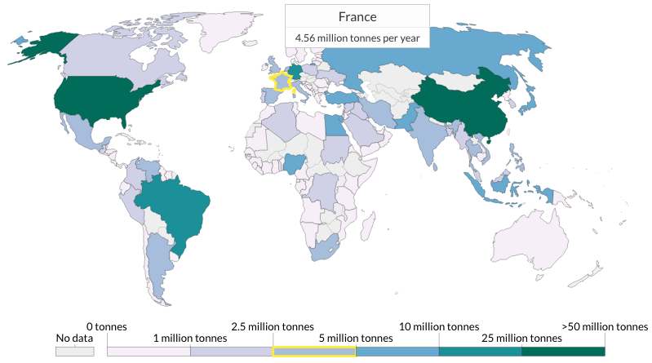
Plastic Waste By Country
United States
38 million tonnes per year
China
59 millon tonnes per year
For human health, it is the smallest particles — micro- and nano-particles which are of greatest concern. Particles must be small enough to be ingested.
Notes:
https://ourworldindata.org/plastic-pollution

Slide 30
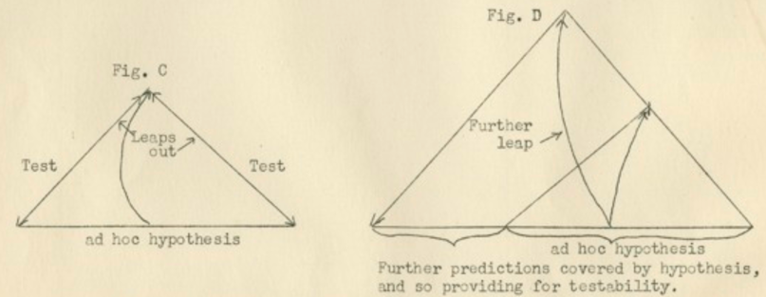
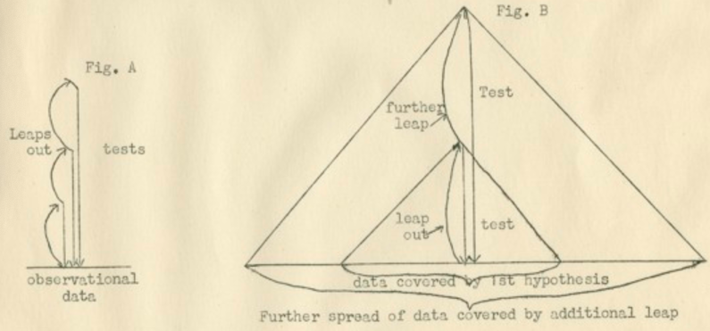

Slide 31
PET (Polyethylene Terephthalate)
The new rPET (recycled PET) not as good for you as the advertising suggests
rPET microfibers come loose in each washing, and in swooshing the beverage, some get into the water or soda-water, and are being swallowed
rPET gets into the water cycle, breaks down into microplastics, which breakdown into nanoplastic particles, and just like PET, the rPET takes about 500 years to degrade.

Slide 32
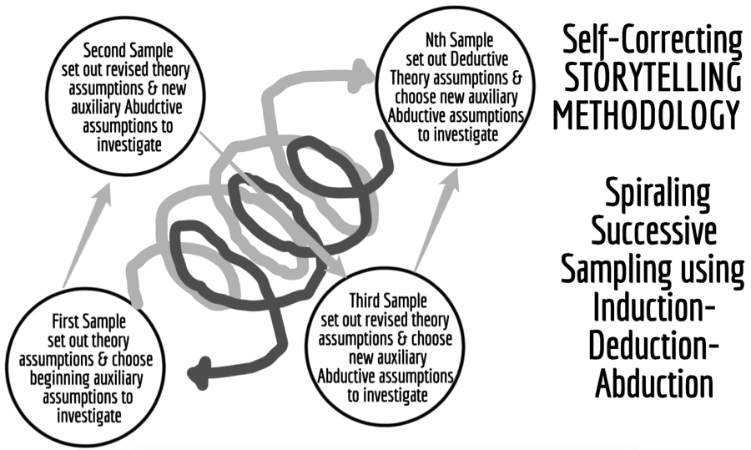

Slide 33
rPET bad for your Health and the Ecology
Hu et al. (2019: 1221) tested rPET and found "high temperature and oxygen in the recycling process may accelerate the degradation of PET and residual dyes, resulting in the volatile organic compounds (VOCs) emissions, which will do serious harm to the environment and human health."

Slide 34
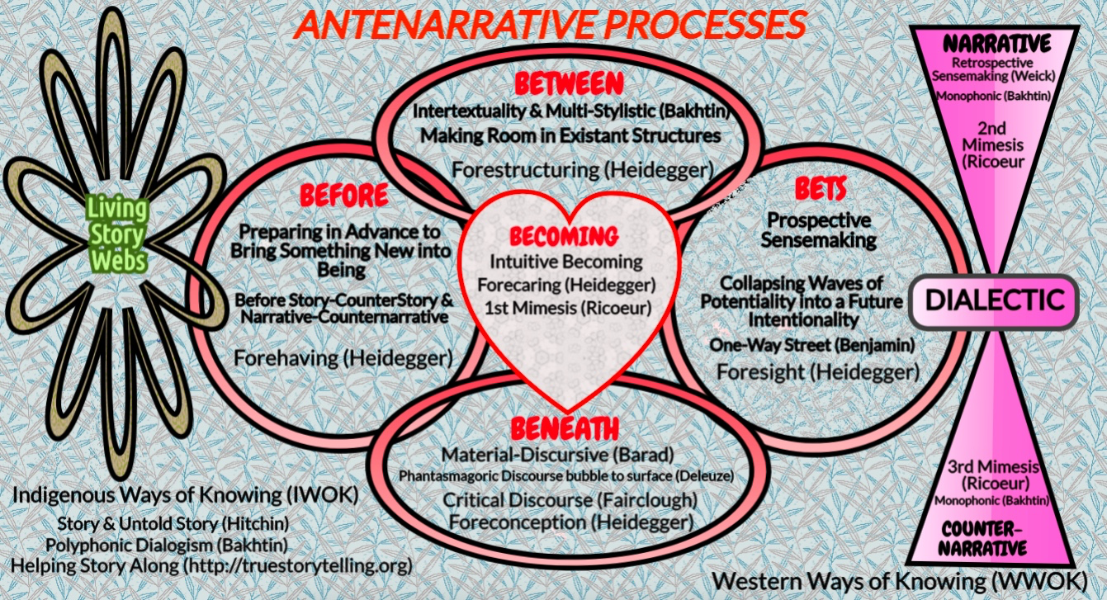

Slide 35
Most plastic water bottles never recycled
Plastic took off in 1950s, then in bottled water in 1970s
We have 9.2 billion tons of it, and more each year than the prior year
ALL OF IT STILL HERE
And 6.2 billion tons of plastic never reaches the recycling bin, and that which does, most of that is not actually being recycled.

Slide 36
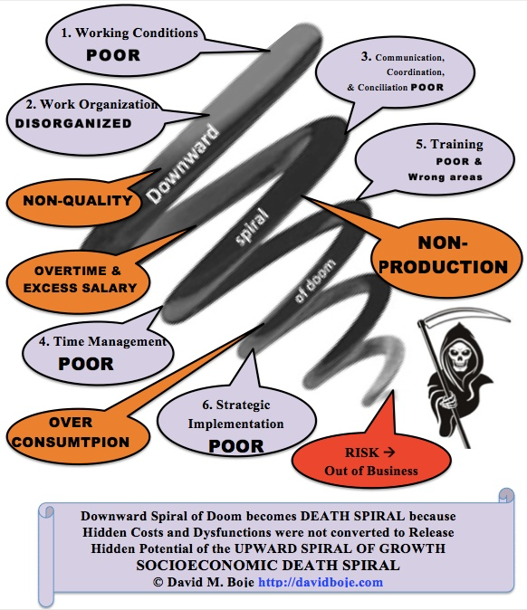

Slide 37
Plastic is dangerous to Health
BPA stands for Bisphenol-A and it is a carcinogen, causes low sperm count in boys, and early puberty in girls.
PBA is endocrine disruptor.
BPA has phthalates, industrial chemicals: binding agents and to soften plastic, make it clearer and more durable.
Phthalates are linked to asthmas, attention-deficit disorder, breast cancer, Type II diabetes, autism, and male fertility disorders

Slide 38
Can SEAM uses self-correcting ‘storytelling science’ to be Eco-Friendly?
Water quality standards are high in France as they must comply with strict EU standards.
62 percent of drinking water supply is from groundwater and 38 percent from surface water.
Veolia and Suez: Water privatization in France goes back to the mid-19th century when cities signed concessions with private water companies for the supply of drinking water.
75% of water and 50% of sanitation services in France are provided by the private sector, primarily by two firms, Veolia Water and Suez Environnement.
Wastewater is a problem; twice EU threatened France with fines if not brought up to EU standards
Agricultural is exempt from the Polluter-pays principle and that it continues to deteriorate the quality of groundwater with impunity.
Notes:
https://en.wikipedia.org/wiki/Water_supply_and_sanitation_in_France
https://en.wikipedia.org/wiki/Water_privatization_in_France

Slide 39
About Private Water System Providers in France
Tariffs of private water providers 22% higher than public providers
Private providers contribute to political campaigns
Private provides have hidden costs and hidden profit margins in their accounting systems
Veolia is largest private provider in the world & provides Lyon’s water services, and has its critics for putting profits ahead of people and planet
Notes:
https://en.wikipedia.org/wiki/Water_privatization_in_France
https://en.wikipedia.org/wiki/Veolia_Water

Slide 40
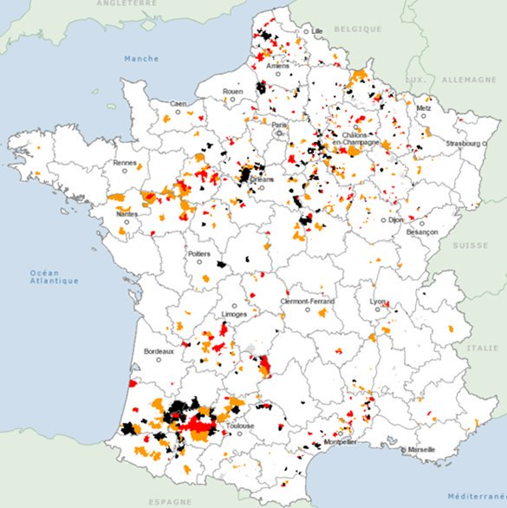
But, 3 Million live in rural areas of intense agriculture, where pesticides and nitrates have got into the water supplies.
Notes:
https://www.thelocal.fr/20170127/millions-in-rural-france-drink-polluted-tap-water

Slide 41
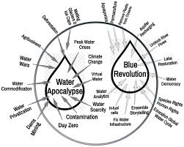
Can SEAM solve the Water Cycle Problems

Slide 42
France River Basin Management
River Basin Management Plans are a requirement of the Water Framework Directive[1] and a means of achieving the protection, improvement and sustainable use of the water environment across Europe. This includes surface freshwaters (including lakes, streams and rivers), groundwater, ecosystems such as some wetlands that depend on groundwater, estuaries and coastal waters out to one nautical mile.
Notes:
https://en.wikipedia.org/wiki/Water_Framework_Directive

Slide 43
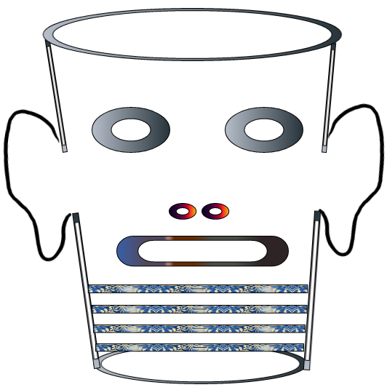
Storytelling Science and Your Dissertation
David M. Boje & Grace Ann Rosile
UK, US, Singapore: World Scientific
February 21, 2019; Revised March 19, 2019
Thank You: Any Questions?
Download Storytelling Science book and slides for this presentation at https://davidboje.com/Lyon434343
Notes:
If you have and comments or questions contact me at davidboje@gmail.com
Thank you

