Slide 1
Water and Plastic on Tilos Island
David M. Boje
Professor, Aalborg University & Storytelling Researcher
Special presentation to Andreas Andrapoulos, Tilos Island
Notes:
Business model storytelling See Christian Nielsen, Morten Lund, Marco Montemari, Francesco Paolone, Maurizio Massaro & John Dumay (2019). Routledge.
Digital transformation transfomrs a given business model, into an ensemble of dispositifs that affect selection of intellectual capital and (re)con-figure the value creation processes to the customer and what he/she requires
Not all businesses have data that works in a big-data context. They need different business models
See - “Sokkelund Café &amp; Brasserie” a 7 year intervention with conversational interviews and data, in digital enablers from analgue to data-driven small-data restaurant.
2009
40 seats and 850.000 euro
2017
74 seats and 4,7 million euro
We want business storytelling and its business model-dispositif to work for us, instead of confining the human potential
Move from too many documents, notes and paper, inefficent processes, slow comm, irrelevant into, and nothing was real time
The HR, productions, sales, and staff cost in one app.
Small-data – began with sales per seat per day (or per customer), customer retention, and find causation in data that is logical enough for humans to understand
Themes of natality and plurality becomes more visible.

Slide 2
Livadia Beach TILOS
The area behind the beach comprises the fertile plain where the majority of the Tilos grown produce comes from. There are lots of natural water wells providing the water to irrigate the fields. All Tilos grown vegetables and fruit is seasonal and maybe purchased direct from the farmers in Livadia off their trucks. Hidden in the fields are several old churches and abandoned buildings from various eras.

Slide 3
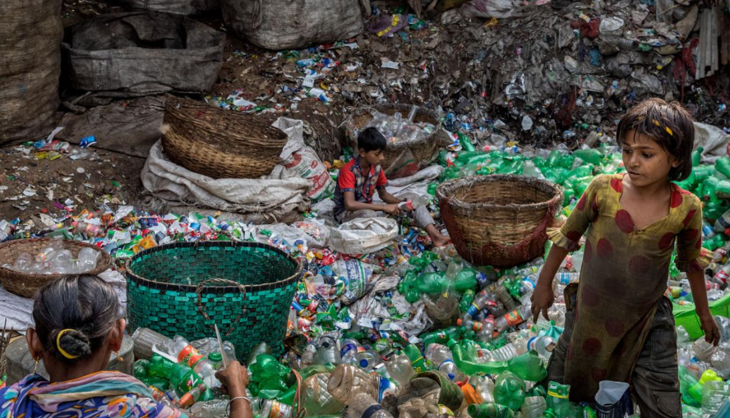
Notes:
Fill a plastic water bottle 25% with OIL to illustrate how much oil it take. https://www.portlandoregon.gov/sustainabilityatwork/article/535746
USA consumes 50 billion plastic water bottles a year, 23% head to recycling, but 38 billion don’t go to recycling, and then only about 9% actually gets recycled, because China is no long taking them, and because it costs $$$ to sort the bottles, shred them, wash them, heat them to sanitize, then melt into pellets and sell to beverage companies
Billions of gallons of water are used to make the Billions of gallons of water in water bottles ( feed waters 3 to 1 final bottle of water)
50 billion USA plastic water bottles is 17 million gallons of oil. It takes 6,000 megajoules of electricity for each barrel of oil, and with all the oil for 40 billion bottles that is 106 billion megajoules of electricity, which is how the 25% oil calculation is based on.
OUR PROBLEM TO BE SOLVED GETS WORSE: 50 billion USA plastic water bottles, is small part of the 250 billion BEVERAGE bottles with juices, sodas, etc. in them
WORLDWIDE: USA is 50 billion plastic water bottles, but world total is 500 Billion, and that means five times that in Total World Beverage plastic bottles
PROBLEM GETS WORSE AGAIN: Most are made of PET –Polyethylene Terephthalate and that has BPA in it.
https://www.madesafe.org/avoid-toxic-chemicals-plastics/
BPA stands for Bisphenol-A and it is a carcinogen, cause low sperm count in boys, and early puberty in girls. PBA is endocrine disruptor.
BPA has been a resin to make plastics clear and strong since the 1960s. https://www.mayoclinic.org/healthy-lifestyle/nutrition-and-healthy-eating/expert-answers/bpa/faq-20058331
It is not just making plastic bottles, but coats the insides of beverage cans, and used to make epoxy.
The FDA does not regulate it, saying low levels of BPA are SAFE to use in foods, and of no harm to human body. But Mayo Clinic says cut back on plastic bottles, and on metal cans (coated in BPA), for your good health life.
PROBLEM GETS WORSE: BPA has phthalates, and FDA refuses to regulate them either. Phthalates are industrial chemicals are binding agents, and to soften plastic, make it clearer and more durable.Also used in cosmetic consumer products. https://www.fda.gov/cosmetics/productsingredients/ingredients/ucm128250.htm Phthalates however do cause reproductive, liver, kidney, and lung problems in human beings. See Canada https://noharm-uscanada.org/issues/us-canada/phthalates-and-dehp Guardian https://www.theguardian.com/lifeandstyle/2015/feb/10/phthalates-plastics-chemicals-research-analysis
CDC recommends further study, FDA says its safe to consume, but others say health hazard https://www.theguardian.com/lifeandstyle/2015/feb/10/phthalates-plastics-chemicals-research-analysis. 2008 Henry Waxman bill did ban phthalates in some baby products
BUT the science says phthalates linked to asthmas, attention-deficit disorder, breast cancer, Type II diabetes, autism, and male fertility disorders. Watch the milk because a lot of plastic tubes are used in milking machines, and the phthalates make their way into even glass bottles of milk.
rPET is recycled PET https://earthhero.com/whats-the-deal-with-rpet/ Good news it uses 75% less energy to make rPET, less resource extraction, less CO2,
BUT ITS NOT A PERFECT SOLUTION TO NANOPLASTIC POLLUTION
The rPET, has microfibers, and with each washing, or swallow, it goes into the water, and these break down into microplastics, then into nanoplastic particles, which circulate in the water cycle with the PET nanoplastic particles, and it take 500 years to degrade, and that means all the plastic every made (except some incinerated) is still here, and worse problem, that are a lot of other plastics, and they break down to nanoparticles and head into food chain, so the water cycle gets more and more contaminated.
BOTTOM LINE
Our desire for plastic has change our Self. Other contaminants stick to the plastic and circulate in the water cycle, and the food chain, and that means plastic water and beverage bottles is a huge contributors to the human activities changing the global water cycle, and changing the Self of Water=Desire, Water=Life, Water=Memory, Water=Spirit, and Water=Matter but also means we are in Water-Denial, so Water=$$$
Plastic is a waste byproduct of petrochemical manufacturing. The oil industry had to get rid of the waste, so making it into plastic was how to do that, now we are past peak oil, and past three water peaks, and Water=Desire (our Ego manipulated by marketing hype) is causing an evolutionary change in the Self, so instead of an authentic Self, we have the Self as Desired by DuPont (inventor of plastic), and by Nestle, Coke, and PepsiCo (and their imitators). This is why Boje says in his books we are in a culture of denial, as marketing sells us a new self, and corporate lobbies corrupt agencies like FDA, or defang the EPA, and fund the campaigns of political leaders with PAC meney, as the corporation became a legal person, then its PAC money declared free speech act in political elections, while a human citizen ahs a limit in USA of $2,500.
All this boils down to Water=Desire is a corruption of Water=Spirit (Radah, mistranslated from the Hebrew in King James bible 1611, and used to by Francis Bacon soon after to make scientific method about subduing and domination of nature as an improper translation of ‘dominion’ and this became a political ideology in the 1970s e.g. James Watt, Secretary of the Interior to Reagan, said “After the last tree is felled, Christ will come back”
In sum bad bible translations of Radah are now being corrected so that it means ‘caring for creation’ and ‘stewardship, but the damage will take generations to undo, and by then the science says the water cycle will be destroyed. I.E. By 2030 global water demand will be 40% greater than it is today (McKinsey Report). By 2030 40% of world’s population will lack access to safe, sanitary water, in 2030 there will need 60% more fresh water to support demand than we have today in the water cycle. The developing nations are increasing water withdrawals by 50% and 18% in developing nations. In short, the fresh water system, if it were a bank, has more withdrawals than deposits, and is bankrupt!
https://www.waterlogic.com/en-us/resources-blog/world-oceans-day-plastic-pandemic/ for ocean impact

Slide 4
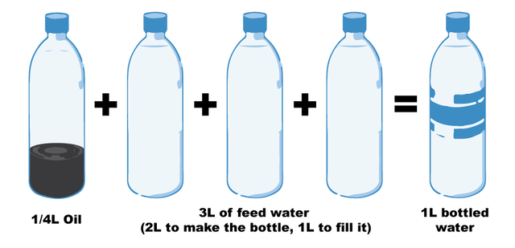
QUESTION: How to pursue a good life for oneself, as oneself, in the context of a broader world that is structured by inequality, exploitation and forms of effacement – Hannah Arendt
Notes:
Fill a plastic water bottle 25% with OIL to illustrate how much oil it take. https://www.portlandoregon.gov/sustainabilityatwork/article/535746
USA consumes 50 billion plastic water bottles a year, 23% head to recycling, but 38 billion don’t go to recycling, and then only about 9% actually gets recycled, because China is no long taking them, and because it costs $$$ to sort the bottles, shred them, wash them, heat them to sanitize, then melt into pellets and sell to beverage companies
Billions of gallons of water are used to make the Billions of gallons of water in water bottles ( feed waters 3 to 1 final bottle of water)
50 billion USA plastic water bottles is 17 million gallons of oil. It takes 6,000 megajoules of electricity for each barrel of oil, and with all the oil for 40 billion bottles that is 106 billion megajoules of electricity, which is how the 25% oil calculation is based on.
OUR PROBLEM TO BE SOLVED GETS WORSE: 50 billion USA plastic water bottles, is small part of the 250 billion BEVERAGE bottles with juices, sodas, etc. in them
WORLDWIDE: USA is 50 billion plastic water bottles, but world total is 500 Billion, and that means five times that in Total World Beverage plastic bottles
PROBLEM GETS WORSE AGAIN: Most are made of PET –Polyethylene Terephthalate and that has BPA in it.
https://www.madesafe.org/avoid-toxic-chemicals-plastics/
BPA stands for Bisphenol-A and it is a carcinogen, cause low sperm count in boys, and early puberty in girls. PBA is endocrine disruptor.
BPA has been a resin to make plastics clear and strong since the 1960s. https://www.mayoclinic.org/healthy-lifestyle/nutrition-and-healthy-eating/expert-answers/bpa/faq-20058331
It is not just making plastic bottles, but coats the insides of beverage cans, and used to make epoxy.
The FDA does not regulate it, saying low levels of BPA are SAFE to use in foods, and of no harm to human body. But Mayo Clinic says cut back on plastic bottles, and on metal cans (coated in BPA), for your good health life.
PROBLEM GETS WORSE: BPA has phthalates, and FDA refuses to regulate them either. Phthalates are industrial chemicals are binding agents, and to soften plastic, make it clearer and more durable.Also used in cosmetic consumer products. https://www.fda.gov/cosmetics/productsingredients/ingredients/ucm128250.htm Phthalates however do cause reproductive, liver, kidney, and lung problems in human beings. See Canada https://noharm-uscanada.org/issues/us-canada/phthalates-and-dehp Guardian https://www.theguardian.com/lifeandstyle/2015/feb/10/phthalates-plastics-chemicals-research-analysis
CDC recommends further study, FDA says its safe to consume, but others say health hazard https://www.theguardian.com/lifeandstyle/2015/feb/10/phthalates-plastics-chemicals-research-analysis. 2008 Henry Waxman bill did ban phthalates in some baby products
BUT the science says phthalates linked to asthmas, attention-deficit disorder, breast cancer, Type II diabetes, autism, and male fertility disorders. Watch the milk because a lot of plastic tubes are used in milking machines, and the phthalates make their way into even glass bottles of milk.
rPET is recycled PET https://earthhero.com/whats-the-deal-with-rpet/ Good news it uses 75% less energy to make rPET, less resource extraction, less CO2,
BUT ITS NOT A PERFECT SOLUTION TO NANOPLASTIC POLLUTION
The rPET, has microfibers, and with each washing, or swallow, it goes into the water, and these break down into microplastics, then into nanoplastic particles, which circulate in the water cycle with the PET nanoplastic particles, and it take 500 years to degrade, and that means all the plastic every made (except some incinerated) is still here, and worse problem, that are a lot of other plastics, and they break down to nanoparticles and head into food chain, so the water cycle gets more and more contaminated.
BOTTOM LINE
Our desire for plastic has change our Self. Other contaminants stick to the plastic and circulate in the water cycle, and the food chain, and that means plastic water and beverage bottles is a huge contributors to the human activities changing the global water cycle, and changing the Self of Water=Desire, Water=Life, Water=Memory, Water=Spirit, and Water=Matter but also means we are in Water-Denial, so Water=$$$
Plastic is a waste byproduct of petrochemical manufacturing. The oil industry had to get rid of the waste, so making it into plastic was how to do that, now we are past peak oil, and past three water peaks, and Water=Desire (our Ego manipulated by marketing hype) is causing an evolutionary change in the Self, so instead of an authentic Self, we have the Self as Desired by DuPont (inventor of plastic), and by Nestle, Coke, and PepsiCo (and their imitators). This is why Boje says in his books we are in a culture of denial, as marketing sells us a new self, and corporate lobbies corrupt agencies like FDA, or defang the EPA, and fund the campaigns of political leaders with PAC meney, as the corporation became a legal person, then its PAC money declared free speech act in political elections, while a human citizen ahs a limit in USA of $2,500.
All this boils down to Water=Desire is a corruption of Water=Spirit (Radah, mistranslated from the Hebrew in King James bible 1611, and used to by Francis Bacon soon after to make scientific method about subduing and domination of nature as an improper translation of ‘dominion’ and this became a political ideology in the 1970s e.g. James Watt, Secretary of the Interior to Reagan, said “After the last tree is felled, Christ will come back”
In sum bad bible translations of Radah are now being corrected so that it means ‘caring for creation’ and ‘stewardship, but the damage will take generations to undo, and by then the science says the water cycle will be destroyed. I.E. By 2030 global water demand will be 40% greater than it is today (McKinsey Report). By 2030 40% of world’s population will lack access to safe, sanitary water, in 2030 there will need 60% more fresh water to support demand than we have today in the water cycle. The developing nations are increasing water withdrawals by 50% and 18% in developing nations. In short, the fresh water system, if it were a bank, has more withdrawals than deposits, and is bankrupt!
https://www.waterlogic.com/en-us/resources-blog/world-oceans-day-plastic-pandemic/ for ocean impact

Slide 5
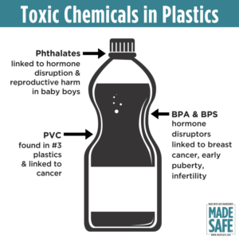
QUESTION: How to pursue a good life for oneself, as oneself, in the context of a broader world that is structured by inequality, exploitation and forms of effacement – Hannah Arendt
Notes:
Fill a plastic water bottle 25% with OIL to illustrate how much oil it take. https://www.portlandoregon.gov/sustainabilityatwork/article/535746
USA consumes 50 billion plastic water bottles a year, 23% head to recycling, but 38 billion don’t go to recycling, and then only about 9% actually gets recycled, because China is no long taking them, and because it costs $$$ to sort the bottles, shred them, wash them, heat them to sanitize, then melt into pellets and sell to beverage companies
Billions of gallons of water are used to make the Billions of gallons of water in water bottles ( feed waters 3 to 1 final bottle of water)
50 billion USA plastic water bottles is 17 million gallons of oil. It takes 6,000 megajoules of electricity for each barrel of oil, and with all the oil for 40 billion bottles that is 106 billion megajoules of electricity, which is how the 25% oil calculation is based on.
OUR PROBLEM TO BE SOLVED GETS WORSE: 50 billion USA plastic water bottles, is small part of the 250 billion BEVERAGE bottles with juices, sodas, etc. in them
WORLDWIDE: USA is 50 billion plastic water bottles, but world total is 500 Billion, and that means five times that in Total World Beverage plastic bottles
PROBLEM GETS WORSE AGAIN: Most are made of PET –Polyethylene Terephthalate and that has BPA in it.
https://www.madesafe.org/avoid-toxic-chemicals-plastics/
BPA stands for Bisphenol-A and it is a carcinogen, cause low sperm count in boys, and early puberty in girls. PBA is endocrine disruptor.
BPA has been a resin to make plastics clear and strong since the 1960s. https://www.mayoclinic.org/healthy-lifestyle/nutrition-and-healthy-eating/expert-answers/bpa/faq-20058331
It is not just making plastic bottles, but coats the insides of beverage cans, and used to make epoxy.
The FDA does not regulate it, saying low levels of BPA are SAFE to use in foods, and of no harm to human body. But Mayo Clinic says cut back on plastic bottles, and on metal cans (coated in BPA), for your good health life.
PROBLEM GETS WORSE: BPA has phthalates, and FDA refuses to regulate them either. Phthalates are industrial chemicals are binding agents, and to soften plastic, make it clearer and more durable.Also used in cosmetic consumer products. https://www.fda.gov/cosmetics/productsingredients/ingredients/ucm128250.htm Phthalates however do cause reproductive, liver, kidney, and lung problems in human beings. See Canada https://noharm-uscanada.org/issues/us-canada/phthalates-and-dehp Guardian https://www.theguardian.com/lifeandstyle/2015/feb/10/phthalates-plastics-chemicals-research-analysis
CDC recommends further study, FDA says its safe to consume, but others say health hazard https://www.theguardian.com/lifeandstyle/2015/feb/10/phthalates-plastics-chemicals-research-analysis. 2008 Henry Waxman bill did ban phthalates in some baby products
BUT the science says phthalates linked to asthmas, attention-deficit disorder, breast cancer, Type II diabetes, autism, and male fertility disorders. Watch the milk because a lot of plastic tubes are used in milking machines, and the phthalates make their way into even glass bottles of milk.
rPET is recycled PET https://earthhero.com/whats-the-deal-with-rpet/ Good news it uses 75% less energy to make rPET, less resource extraction, less CO2,
BUT ITS NOT A PERFECT SOLUTION TO NANOPLASTIC POLLUTION
The rPET, has microfibers, and with each washing, or swallow, it goes into the water, and these break down into microplastics, then into nanoplastic particles, which circulate in the water cycle with the PET nanoplastic particles, and it take 500 years to degrade, and that means all the plastic every made (except some incinerated) is still here, and worse problem, that are a lot of other plastics, and they break down to nanoparticles and head into food chain, so the water cycle gets more and more contaminated.
BOTTOM LINE
Our desire for plastic has change our Self. Other contaminants stick to the plastic and circulate in the water cycle, and the food chain, and that means plastic water and beverage bottles is a huge contributors to the human activities changing the global water cycle, and changing the Self of Water=Desire, Water=Life, Water=Memory, Water=Spirit, and Water=Matter but also means we are in Water-Denial, so Water=$$$
Plastic is a waste byproduct of petrochemical manufacturing. The oil industry had to get rid of the waste, so making it into plastic was how to do that, now we are past peak oil, and past three water peaks, and Water=Desire (our Ego manipulated by marketing hype) is causing an evolutionary change in the Self, so instead of an authentic Self, we have the Self as Desired by DuPont (inventor of plastic), and by Nestle, Coke, and PepsiCo (and their imitators). This is why Boje says in his books we are in a culture of denial, as marketing sells us a new self, and corporate lobbies corrupt agencies like FDA, or defang the EPA, and fund the campaigns of political leaders with PAC meney, as the corporation became a legal person, then its PAC money declared free speech act in political elections, while a human citizen ahs a limit in USA of $2,500.
All this boils down to Water=Desire is a corruption of Water=Spirit (Radah, mistranslated from the Hebrew in King James bible 1611, and used to by Francis Bacon soon after to make scientific method about subduing and domination of nature as an improper translation of ‘dominion’ and this became a political ideology in the 1970s e.g. James Watt, Secretary of the Interior to Reagan, said “After the last tree is felled, Christ will come back”
In sum bad bible translations of Radah are now being corrected so that it means ‘caring for creation’ and ‘stewardship, but the damage will take generations to undo, and by then the science says the water cycle will be destroyed. I.E. By 2030 global water demand will be 40% greater than it is today (McKinsey Report). By 2030 40% of world’s population will lack access to safe, sanitary water, in 2030 there will need 60% more fresh water to support demand than we have today in the water cycle. The developing nations are increasing water withdrawals by 50% and 18% in developing nations. In short, the fresh water system, if it were a bank, has more withdrawals than deposits, and is bankrupt!
https://www.waterlogic.com/en-us/resources-blog/world-oceans-day-plastic-pandemic/ for ocean impact

Slide 6
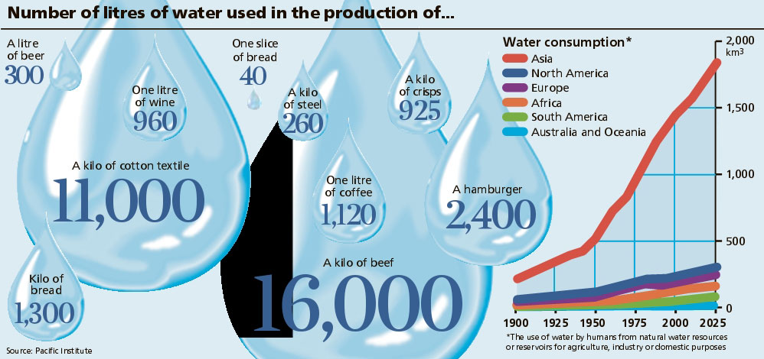
What is VIRTUAL WATER?
Notes:
http://www.linv.org/virtual-water/

Slide 7
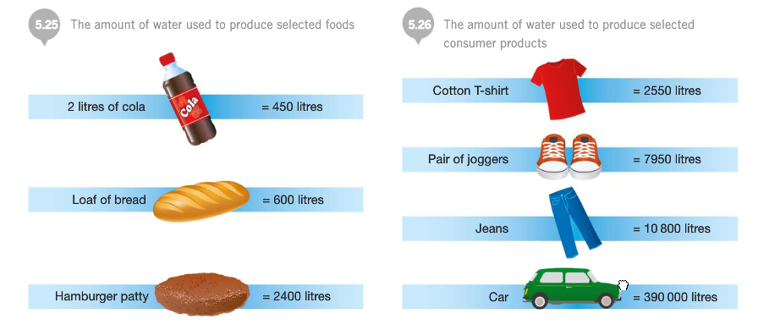
Virtual Water’s Hidden Cost Diagnostics
Notes:
http://sncyear7geography.weebly.com/virtual-water.html
“When a country imports (bring in from another country) 1 tonne of wheat, that country saves about 1,300 cubic metres of its own water (as it would have used 1,300 cubic metres of its own water if it produced the wheat themselves instead of importing it). If the water is scare in a country, the water it saved can be used for other purposes. If however, the water is scarce in the country that produced the wheat, then they have exported 1,300 cubic metres of water that is no longer available for other purposes.”
“

Slide 8
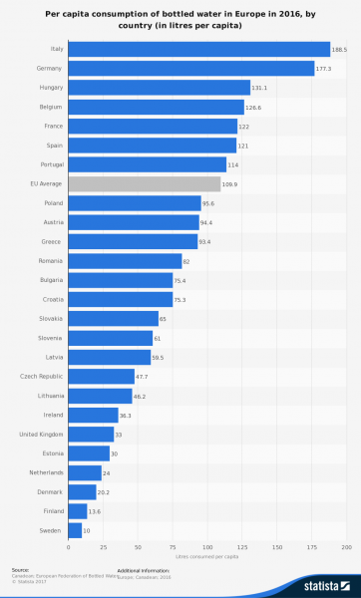
52 Billion litters of bottled water consumed in Europe per year
Plastic bottles are made of polyethylene terephthalate (PET or PETE), a 100% recycling material
59% are recycled in EU, about 35% in US
US uses 50 billion plastic water bottles a year
Notes:
https://www.surfrider.eu/en/le-blog/plastic-bottles-key-figures-environmental-disaster/

Slide 9
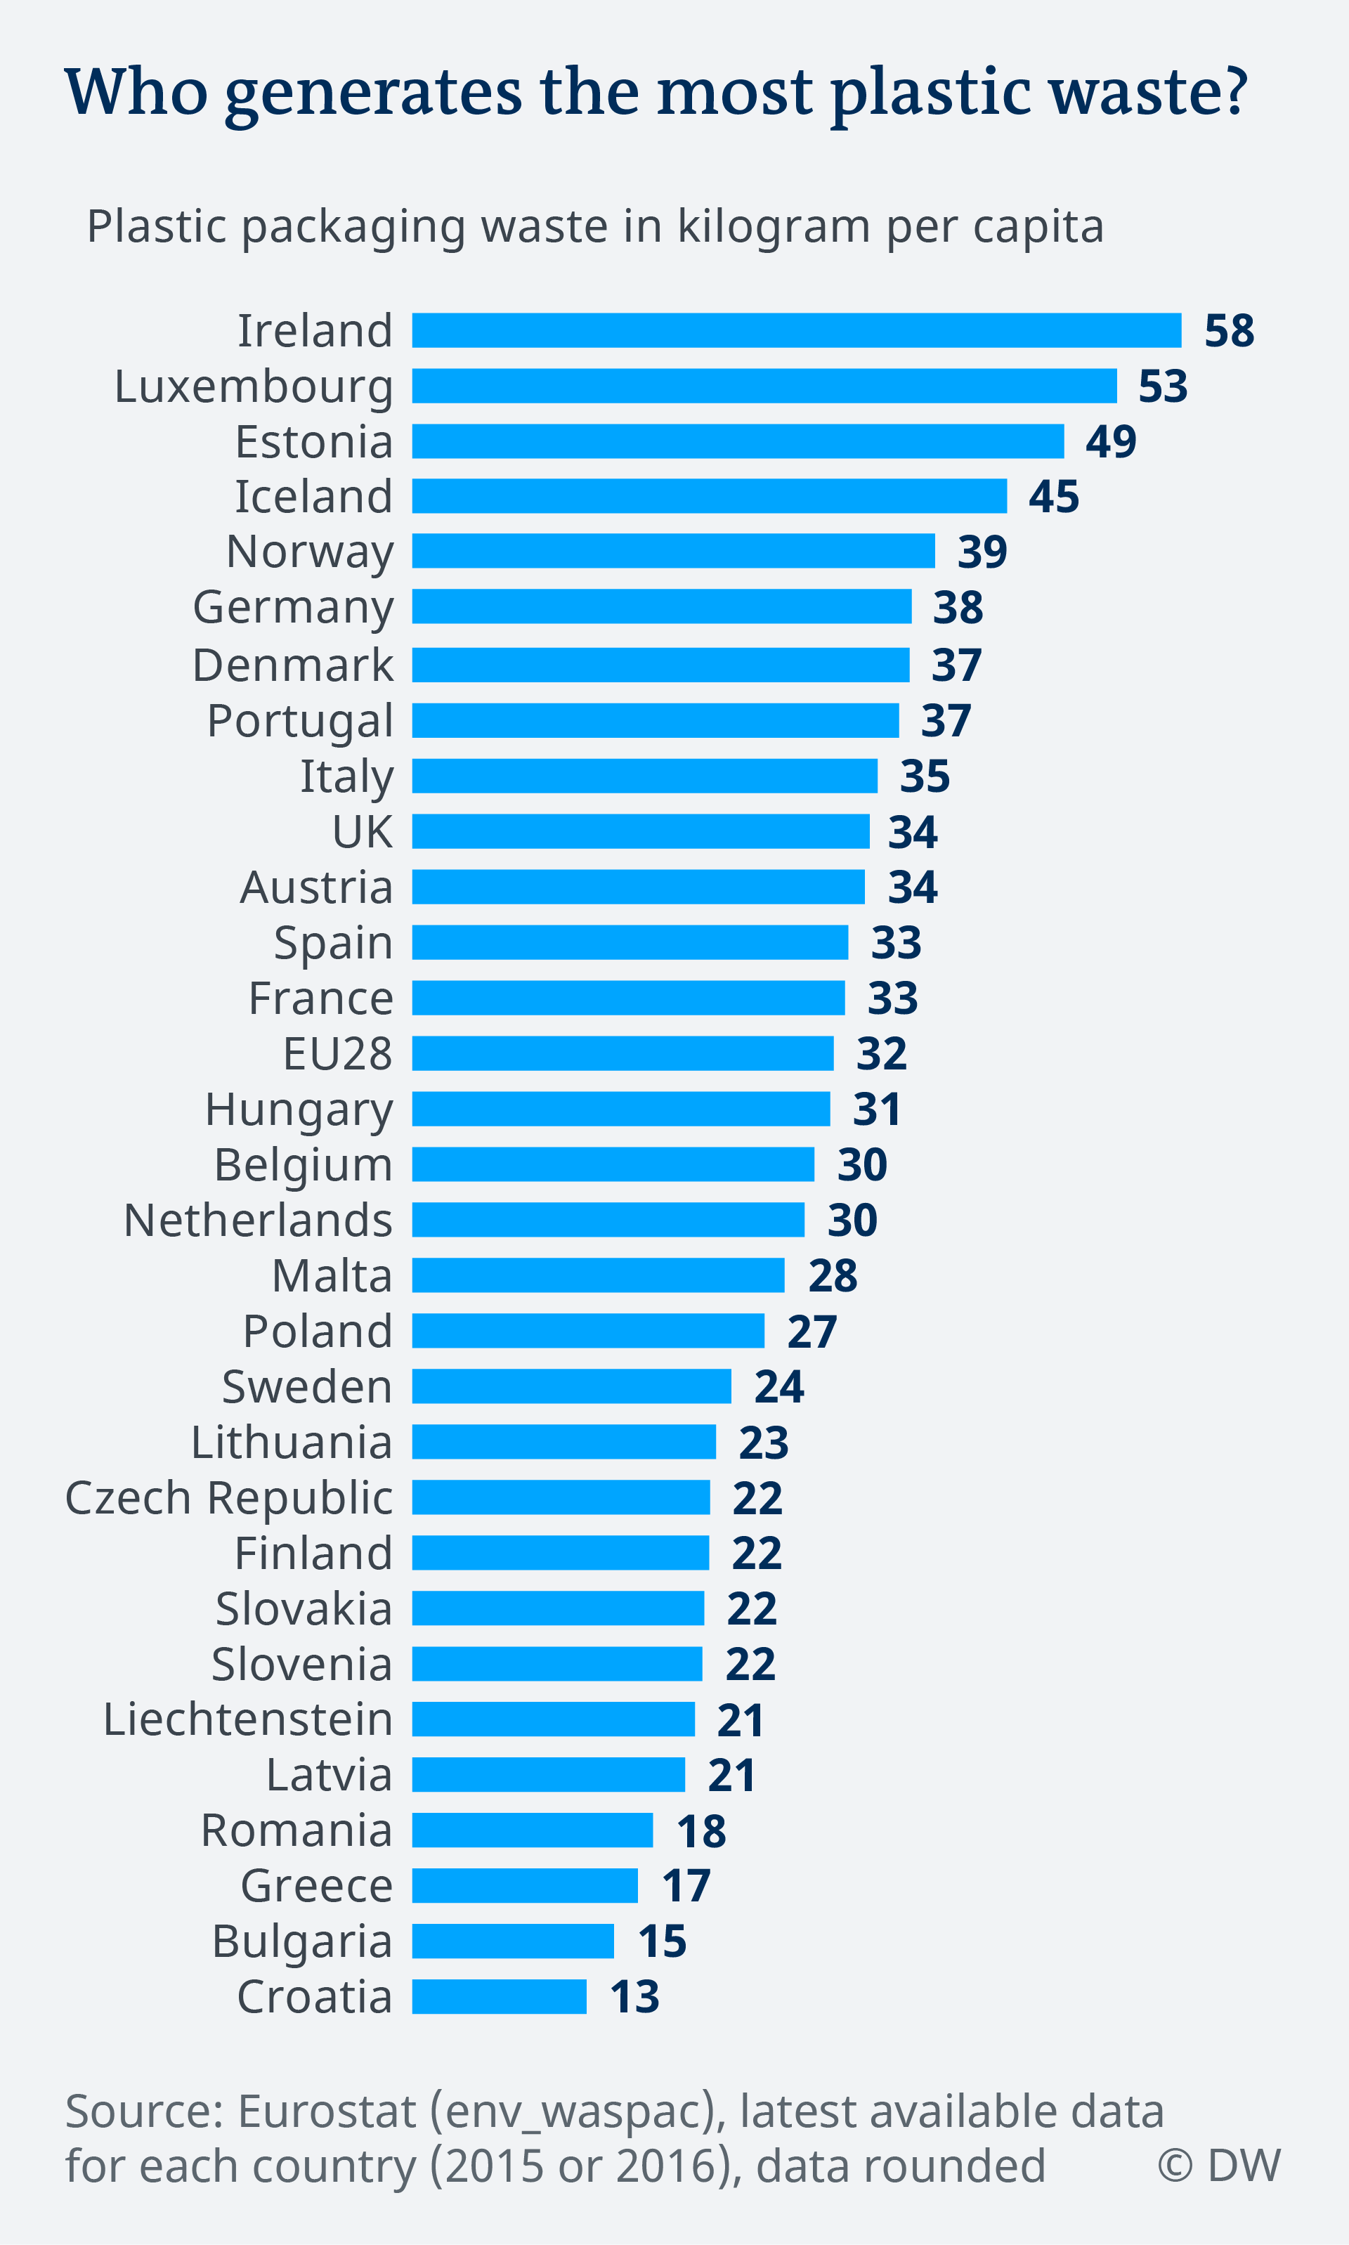
Notes:
https://www.dw.com/en/plastic-waste-and-the-recycling-myth/a-45746469

Slide 10
Bisphenol-A (BPA) Its substitutes not that safe
"BPA but not BPS concentrations were positively correlated with both estrogenic and antiandrogenic activities. BPA still dominates the thermal paper market in Brazil and Spain, and BPS appears to be one of the main alternatives in France. There is an urgent need to evaluate the safety of alternatives proposed to replace BPA as developer in thermal printing. The large proportion of samples with hormonal activity calls for the adoption of preventive measures"
BPA, bisphenol S (BPS) and bisphenol F (BPF)

Slide 11
Most plastic water bottles never recycled
Plastic took off in 1950s, then in bottled water in 1970s
We have 9.2 billion tons of it, and more each year than the prior year
ALL OF IT STILL HERE
And 6.2 billion tons of plastic never reaches the recycling bin, and that which does, most of that is not actually being recycled.
WHAT IS OUR MORAL ANSWERABILITY: “What form does this question take for us now?
Or, how does the historical time in which we live condition and permeate the form of the question itself?

Slide 12
Plastic is dangerous to Health
BPA stands for Bisphenol-A and it is a carcinogen, causes low sperm count in boys, and early puberty in girls.
PBA is endocrine disruptor.
BPA has phthalates, industrial chemicals: binding agents and to soften plastic, make it clearer and more durable.
Phthalates are linked to asthmas, attention-deficit disorder, breast cancer, Type II diabetes, autism, and male fertility disorders
WHAT IS OUR MORAL ANSWERABILITY: “What form does this question take for us now?
Or, how does the historical time in which we live condition and permeate the form of the question itself?

Slide 13
Plastic water bottles are dangerous to your health
Plastic has entered the water cycle
BPA and substitutes BPS and BPF are equally toxic
Fresh safe drinking water and sanitation getting so scarce
6,000 children die every day of water-borne diseases that are entirely preventable with modern science

Slide 14
Polychlorinated biphenyls (PCBs) are manmade chemicals that adhere to plastic
PCB, for example). If there was significant accumulation of environmental contaminants, there is the possibility that these concentrations could 'biomagnify' up the food chain to higher levels, to humans

Slide 15
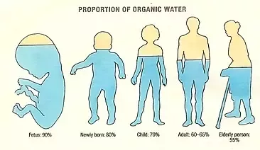
Water= $
3
Water= Thirst
2
Water= Denial
4
Water=Desire
1
Water= Matter
9
Water= Life
5
Water= Ethics
8
Water= Memory
6
Water= Spirit
7
Notes:
Water=Life. Water is an ecological necessity
The human body is 60 to 75% water depending on age and gender. Each human body has 37.2 trilliion living cells, allof them have water or they die.

Slide 16
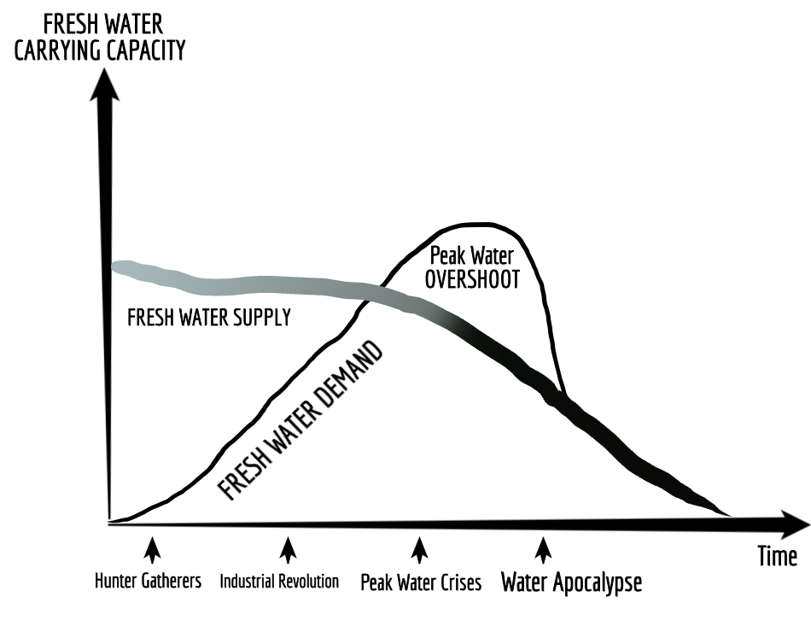
Water= Denial
4

Slide 17
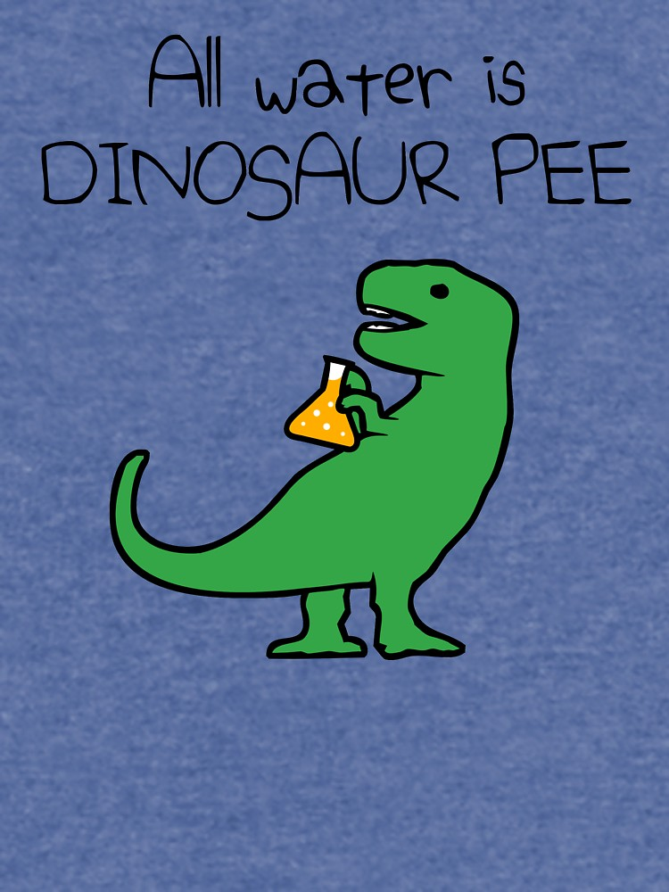
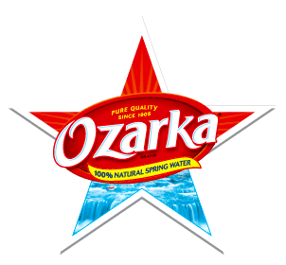
Notes:
Question: Why is all Water Dinosaur Pee?
E.g. OZARKA water is owned by Nestle, and in Texas it is said to be sourced from Natural Springs.
In Texas it is sourced at three different Springs, so each has different pH level
WATER sourced in a State, is NOT subject to FDA jurisdiction. And see Documentary Tapped – only one person works in FD WITH JOB OF OVERSEEING BOTTLED WATER INDUSTRY.
https://www.isitbadforyou.com/questions/is-ozarka-water-bad-for-you
Nestle says ‘Water is NOT a Human Right!’ https://www.nestle-watersna.com/en/bottled-water-brands/ozarka/ozarka-water-quality-report
Bottled Water Leaches dangerous chemicals into what you drink.
Most plastic bottles end up in the land fill
USA consumes 50 billion plastic single use bottles a year, and 77% are not recycled, much of the ones that are, are down-cycled to making polyester shirts, or rugs.
Since plastic invented, and took off in 1950s, then in bottled water in 1970s, we have 9.2 billion tons of it, and more each year than the prior year, and ALL OF IT STILL HERE. Of the 9.2 billion tons, 6.2 billion tons of plastic never reaches the recycling bin, and that which does, most of that is not actually being recycled.
Oil companies had waste gas, ethylene to get rid of, so plastic

Slide 18
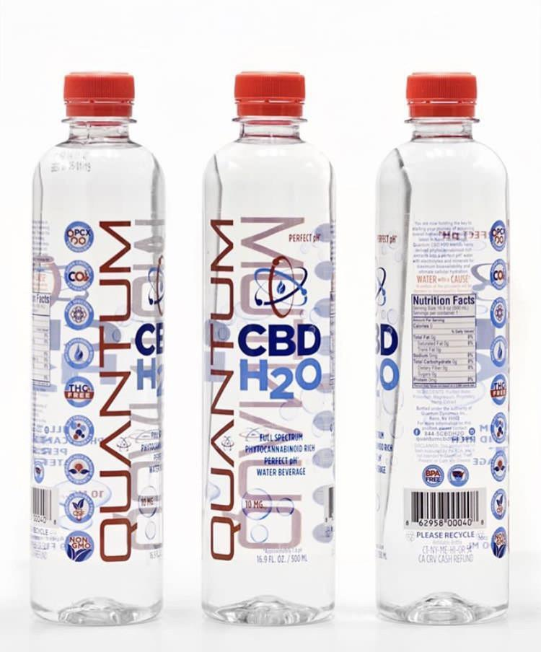
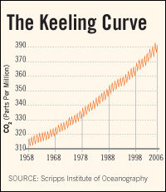
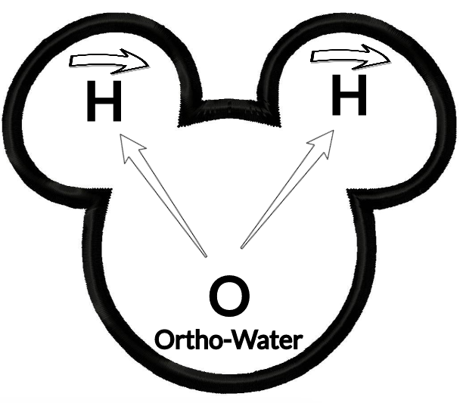
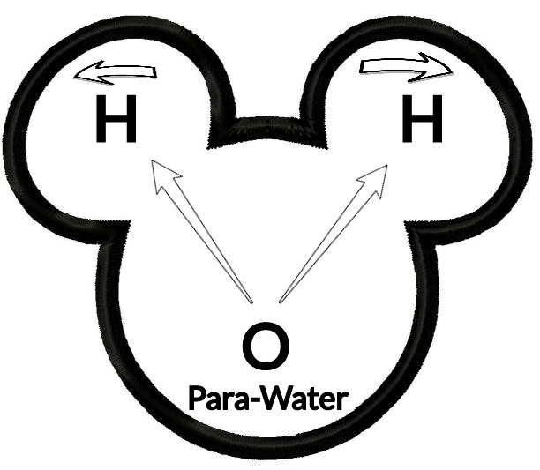
Water= $
3
Water= Thirst
2
Water= Denial
4
Empirical evidence:
Collapsing aquifers,
60% die-off of marine life in last few decades,
Deforestation,
Desertification,
Bioaccumulation of carcinogenic toxins, and
Keeling’s Curve of CO2 Climate Change summarily ignored by those in Water=Denial
Water=Desire
1
Water= Matter
9
Water= Life
5
Water= Ethics
8
Water= Memory
6
Water= Spirit
7
Notes:
The quantum tunneling of water occurs when water molecules in nanochannels exhibit quantum tunneling behavior that smears out the positions of the hydrogen atoms into a pair of corrugated rings. In that state, the water molecules become delocalized around a ring and assume an unusual double top-like shape.
The bottled water part is a joke sort of being played by https://www.quantumpcr.com/ https://www.terrawellnessok.com/12_pk_quantum_cbd_h20
It is water, it is for sale, but not really quantum in the scientific sense of the term
“QUANTUM PCR H2O uses a broad spectrum, hemp derived formula to provide CBD along with additional active cannabinoids and terpenoids providing maximum efficacy with a unique and familiar flavor profile”
See Roberto Car from Princeton University, “Quantum Physics in a Glass of Water” https://www.youtube.com/watch?v=SXqDhu4AEF8
https://www.livescience.com/62708-water-two-kinds.html
Second company -- http://www.quantumagua.com/quantum_en.html Quantum Water --- Quantum is derived from the springs deep within the mountains of the Juan Castro Blanco Water National Park of Costa Rica. The sedimentary rocks act as a natural filtration system, controlling the levels of acidity and minerals creating an ideal PH7.+. Quantum is not chemically processed in any way. We at Quantum know that what you drink is just as important as what you eat. This clean, crisp water will keep you hydrated and refreshed. Premium water created by nature and brought to you by Quantum.”
See Youtube “Water and Quantum Physics; The Perfect Couple” https://www.youtube.com/watch?v=sVIX3fnTCg0 by Marta from

Slide 19
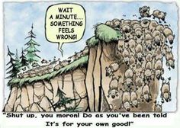
FINAL QUESTION about Water=DENIAL & Water=Spirit: JUST HOW BAD DOES WATER SHORTAGE HAVE TO BE BEFORE WE BELIEVE AND CHANGE OUR WATER AND PLASTIC BEHAVIORS
Water= Denial
4
Water= Spirit
7
Notes:
For some United Methodists, Creation Care is a biblical mandate https://www.umnews.org/en/news/assuming-role-of-creation-care-as-gods-mandate
God’s first word to Adam was ‘to till and keep the earth’
The spring conference in Atlanta, of Methodist Church had the them “Let Justice Roll Down Like Waters.
See Caretakers for God’s Creation United Methodist’s website https://www.umccreationcare.org/#!about_us/csgz
“Whether it’s clean water, chemical free food [& water], or healthy air [& water], millions of disadvantaged populations [& Abilene population] are affected by these environmental effects” says Beth Bond, member of Decatur First Methodists. She continues “as God’s people, part of us taking care of these sensitive populations, is taking care of the planet. Creation care is a key component of social justice” https://www.umnews.org/en/news/assuming-role-of-creation-care-as-gods-mandate
http://www.abxn.org/nv/shepherds.html Radah as Self-Giving love instead of Water=DESIRE, the Ego trip
Thanks to Marty Wortman, Dean at Dona Anna Community College for referring me to his dissertation, which is about the misinterpretation of Radah for over 400 years. See Wortman, Marty J. (2003). Dwellness: A radical notion of wilderness.Accessed Apr 14 2019 at https://scholarcommons.usf.edu/cgi/viewcontent.cgi?referer=https://scholar.google.com/&httpsredir=1&article=2508&context=etd
Wartman (2003: 10): “Referring to the original Hebrew, Steffen states that radah (dominion) means to govern, rule and to have dominion:
‘The verb was employed to refer in a general way to the rule of kings over territory, masters over servants, and the rule of God either over land or in the midst of God’s enemies. Outside of Genesis, the verb is used only five other times, and in each context, something other than oppressive power relations is connoted. (64-65).”

Slide 20
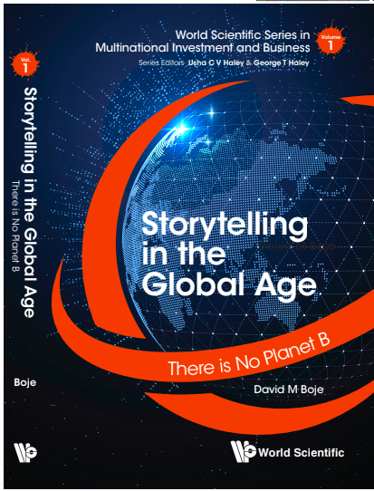
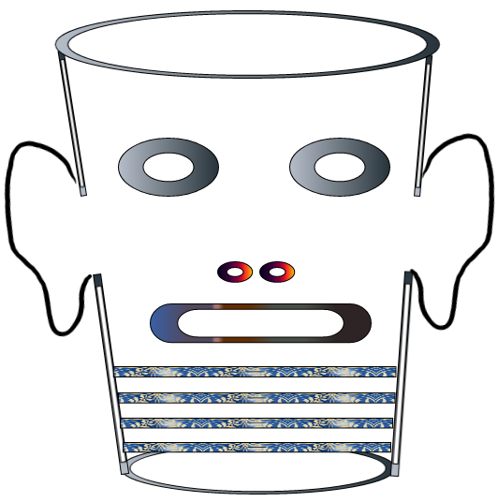
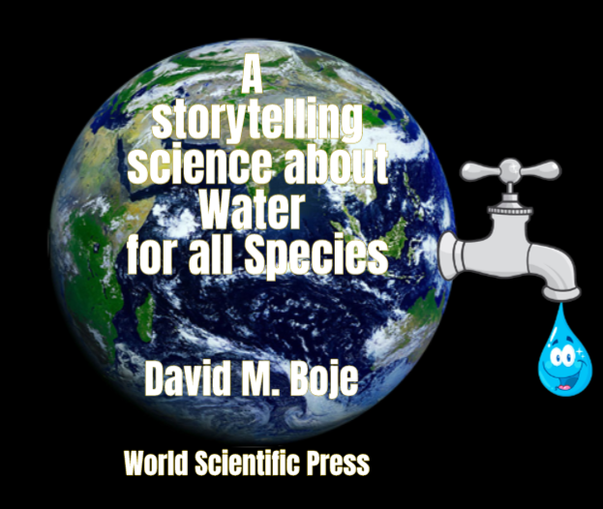
Storytelling Science and Your Dissertation
David M. Boje & Grace Ann Rosile
UK, US, Singapore: World Scientific
February 21, 2019; Revised March 19, 2019
Thank You: Any Questions?
Download Storytelling Science book and slides for this presentation at https://davidboje.com/Aalborg
Notes:
If you have and comments or questions contact me at davidboje@gmail.com
Thank you

