Slide 1
AGENDA
9-9:05 Welcome
9:05-9:15 Review Homework: Systemic and Structural Racism Examples
9:15-9:20 True Story Principle #3 Plots:
Linear, cyclical, upward spiral, downward death spiral, networked Tamara-land
9:20-9:25 Tamara-land: Networked Plots (advantages & disadvantages)
9:25-9:40 Breakout #1: I min prep for 1-sentence plot, 2 min share plot
9:40-9:50 Debrief Plot Lines—Systemic & Structural Root Causes
9:50-9:55 True Story Principle #4: Timing ‘Catch the wave’-Upward/Downward Death Spirals
9:55-10:05 Breakout #2 1 min prep waves up & down; 2 min share waves and timing.
10:05-10:10 Debrief, and Externalize the problem
10:10-10:15 Homework: DRAW a Storyboard of the Root Causes and Dynamics of Systemic and Structural Racism---place yourself in the storyboard.
10:15-10:25 Q&A--WRITE your questions in CHAT. ANSWERS as time allows, and via email follow-up.
10:25-10:30 True Storytelling Certification process, books for your library.

Slide 2
True Storytelling: Session #2 of 4 on Intercultural Racism Conversations
9am Pacific/10am Mountain Time on
24, 31 Aug, and 14 & 21 Sept
Join Zoom Meeting
https://us02web.zoom.us/j/89397616259
Meeting ID: 893 9761 6259
Passcode: endracism

Slide 3
Intercultural Conversations to Impact Racism
True
Storytelling
Facilitated by
David M. Boje and Oscar Edwards
Notes:
Image is from free downloads https://www.pexels.com/photo/hands-heart-love-305530/

Slide 4
Last Week’s HOMEWORK: Notice and Listen to Others’ stories to find examples of Systemic and Structural Racism
10 min
Report Out of a few examples.
Categories of examples? Promotion criteria, training, education, Equity, Access …
Systemic and Structural factors get us OUT OF blaming PEOPLE (self or others).
“Those turkeys” (or yourself, or others) are NEVER the PROBLEM if you want to be successful in re-story-ing.
”The Problem” will be its own CHARACTER in your new story (’Mr. Military’ example).
THIS WEEK’S TOPICS:
True Storytelling Principle #3 Plot, and
True Storytelling Principle #4 Timing
NEXT SESSION: HOW TO CHANGE the STORY (Re-Story-ing)
Notes:
The Oppression Tree Tool - https://coco-net.org/the-oppression-tree-tool/
The leaves and the branches are the outcomes and impacts of oppression. For example, racist and homophobic slurs or the way a city is organized.
The trunk of the tree are the ideologies and institutions of oppression. For example, the idea that people of colour need to be saved, or the institution of policing.
The roots are the systems of oppression. For example, colonialism or white supremacy.

Slide 5
the dynamic balance of nature is becoming increasingly disturbed; species are disappearing at a rapid rate. Humanity is recklessly exploiting natural resources, producing so much waste and pollution that nature is “striking back”, creating a great disturbance to the healthy self-regulation of the biosphere. The main responsibility for this is carried by the First World countries, “the West”, with its lifestyles that are imitated and coveted worldwide. “The West” has the potential to change this way of life quickly - within the next 20 years.
Principle 1: Unconcious/Implicit Bias
Principle 2:
Systemic/Structural Factors
- A given perspective on regulations
- Though craving for We’ness, still caught in the egocentric - …
Karin’s Homework

Slide 6
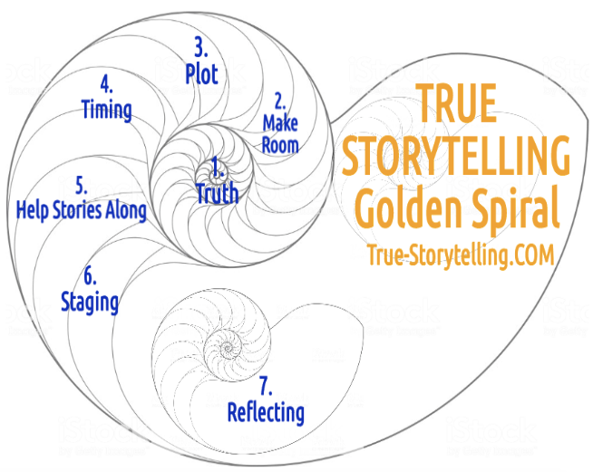
True Storytelling – 7 Principles for Impacting Racism
Session#2
P3: Plot &
P4: Timing
Notes:
What is ‘Truth’? – It is the ancient Greek dialogues that bring True Storytelling out of hiding.
A ancient indigenous Guide before Aristotle and Plato would help people find a way of Being-in-the-world of Being-true
In today’s corporations, media, government, and our daily lives, The Being-true of ‘Truth’ has been diminished.
As Walter Benjamin (1968, in 1930s essay The Storyteller) put it, ‘True’ “Storytelling is coming to an end”.
See p. 4 and read his story of the ‘True Storyteller’ https://arl.human.cornell.edu/linked%20docs/Walter%20Benjamin%20Storyteller.pdf
“From this story it may be seen what the nature of true storytelling is” (p. 4).
TRUTH in True Storytelling is what Parmenides called “The Goddess of Truth”… “both in truth and in untruth: (Heidegger, Being and Time, 1962: section #223).
As True Storytelling Guides, you encounter the Truth and Untruth of your own inner and outer dialogues.
We live in societies that cover up what is Truth and Untruth, and what a True Storytelling guide does is uncover the Truth (#226).

Slide 7
Root Causes of Systemic Racism on 7 Continents
Notes:
One way to visualize and understand this is through a root cause tree. A root cause tree is a graphic organizer that connects the foundation and the impact of an issue. https://www.ywca-ens.org/blog/2019/06/07/understanding-the-root-causes-of-violence/

Slide 8
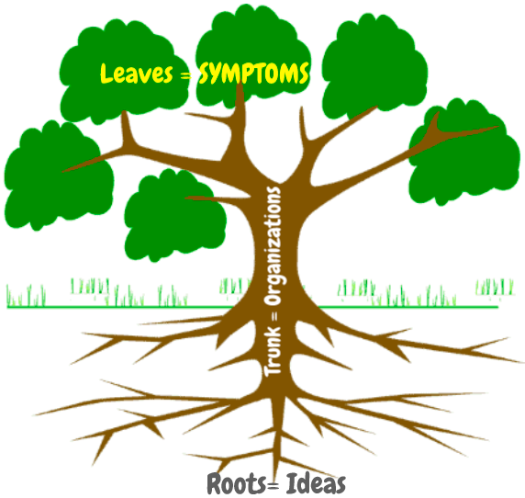
True Storytelling Principle #3: PLOTs
Linear: This caused that. (A caused B)
Cyclical: We’ve been here before. (A-B-C, A-B-C).
Spiral upward: We’ve been here before, but now we know better.
(A-B-C, A-B-C-D, A-B-C-D-E) improving upward spiral
Downward Death Spiral: We’ve been here before, and now it is even worse.
(Z-Y-X, Z-Y-X-W, Z-Y-X-W-V) worsening downward spiral
Network: A web of stories that contains linear, cyclical, and spiral patterns within it. How can Network do this? Answer: Tamara-land.

Slide 9
(”Plot,” continued) TAMARA-LAND
”TAMARA” is a play that was performed in LA and around the world.
The play takes place in multiple rooms of a mansion, with action occurring in many rooms at once.
Each audience member chooses which character to follow, or which room to go to next, so that the story may look different to each audience member.
Surprises may include discovering that the chauffer is really a spy who is having an affair with the maid. The plot is very complex and engaging!

Slide 10
SYMPTOMS
ORGANIZATIONS/
INSTITUIONS/
SYSTEMS
IDEAS
Notes:
Lundholt, M. W., & Boje, D. (2018). Understanding Organizational Narrative-Counter-narratives Dynamics: An overview of Communication Constitutes Organization (CCO) and Storytelling Organization Theory (SOT) approaches. Communication and Language at Work, 5(1), 18-29.
Explain:
Multiple simultaneous fragmented stories
That have permutations & combinations (factorial)
Different sides of Personalitie show up with different characters in different rooms
Meaning of story you get depends on sequence of rooms you were in BEFORE
We keep Diffracting the multiple histories coming unraveled and reweaving in Tamara-Land

Slide 11
Breakout #1: Draw a Tree, What are the PLOTs?
Take 2 minutes SILENCE, DRAW a ROOT CAUSE PLOT TREE in your notebook Label Leaves=Symptoms; Trunk=Organizations/Institutions/Systems; Roots =Ideas. Can make left side bad leaves, orgs, & ideas, and right side good ones
Click to enter your break-out room.
Choose who will be timekeeper and who will go first.
2 min for each person share STORY TREE and explain why they think it is true for them.
10 min total in break-out rooms. You will get a 1-min warning.
Click “Leave” to return to large group.

Slide 12
Debrief Plot Lines: Systemic and Structural Racism Examples of PLOTS you are in

Slide 13
Summarize Principle 3: PLOT, Move to Principle 4: TIMING
Next Session (in 2 weeks) we get to Success and Change Stories
Next Session (Little Wow Moments to collect into NEW STORY for a NEW PLOT)

Slide 14
True Storytelling Principle #4: TIMING “Catch the wave”
What Triggers change? (Listening to each other’s life stories, voices at the table…)
How do we KNOW this is the TIME to act, to change ideas, to create new plots? LIST:
What is there in the NETWORK of Tamara-Land Stories that can help Change the PLOT (not symptoms, but transform the organizations/institutions & root ideas)? LIST:
TYPE YOUR ANSWERS, as brief words or phrases, into CHAT
Notes:
WHY is it now?
WHAT systemic and structural factors contribute to
upward and spirals? LIST:
Consider what triggers change to create upward or downward spirals.
WHAT systemic and structural factors contribute to
downward spirals? LIST:

Slide 15
Breakout #2: Waves and TIMING
1 min prep: Write in your notebook what you think are the
most important waves of IDEAS for upward and/or downward spirals of Storytelling
EXTERNALIZE ideas you want to change
In tree as a Character, e.g. MR GREED;
MR MULTICULTURAL-BARRIER
Click on the link for the Breakout.
Choose a timekeeper and choose who will go first.
Each person takes 2 min to present their waves and timing ideas.
You will receive a 1-min. warning when time is almost up.
Click on the link to return to the large group.
Notes:
(systemic and structural factors).

Slide 16
Debrief and EXTERNALIZE the problem as its own FANTASY CHARACTER in your story
Factors that get us away from Symptoms, Blaming people (self or others), and get at Root Cause Truck of Institution Change, and Roots of Idea Changes
In Successful Re-Storying, the IDEAS are the PROBLEM, and People Practices are the Symptoms; and Intervention is in the SYSTEMS
EXTERNALIZE: “The ROOT-Problem” will be its own CHARACTER in your ‘new story’ with ‘new plot’
(’Mr. Media,’ ‘The SYSTEM,’ ‘The MATRIX,’ or ‘The Man’ ‘Mrs. Banker’ etc.).
WRITE 1 or more of your FANTASY CHARACTER names in CHAT.
Notes:
The ‘System’ is the problem, not the Person, yet we are the system

Slide 17
HOMEWORK: DRAW your Storyboard
Storyboard: Visual IMAGES of the PLOT of your story.
Externalize the problem, make it a character in your story
Systemic and Structural factors get us OUT OF blaming PEOPLE (self or others).
Address PRESENT time, BEFORE we begin to re-story -
Re-story-ing will be NEXT WEEK!
REMEMBER:
Place YOURSELF somewhere on the storyboard.
DUE before Sept 7; (Labor Day Holiday Sept 7 so next session is Sept 14).
PLEASE SEND your Homework STORYBOARD to davidboje@gmail.com by SUNDAY Sep 13th

Slide 18
STORYBOARD example by Oscar Edwards

Slide 19
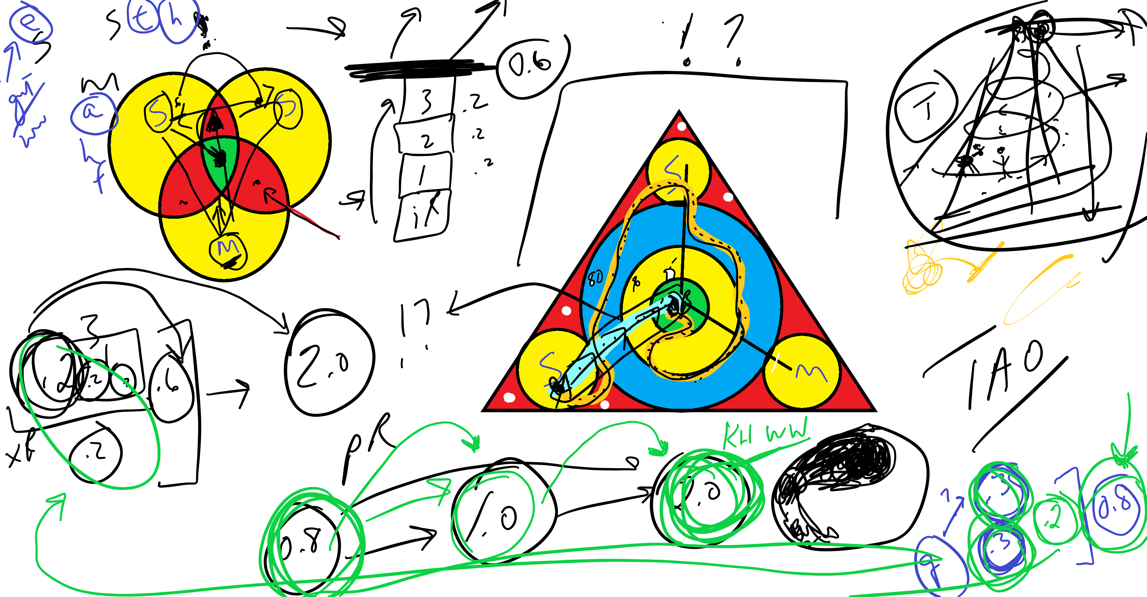
Ken Long Storyboard example

Slide 20
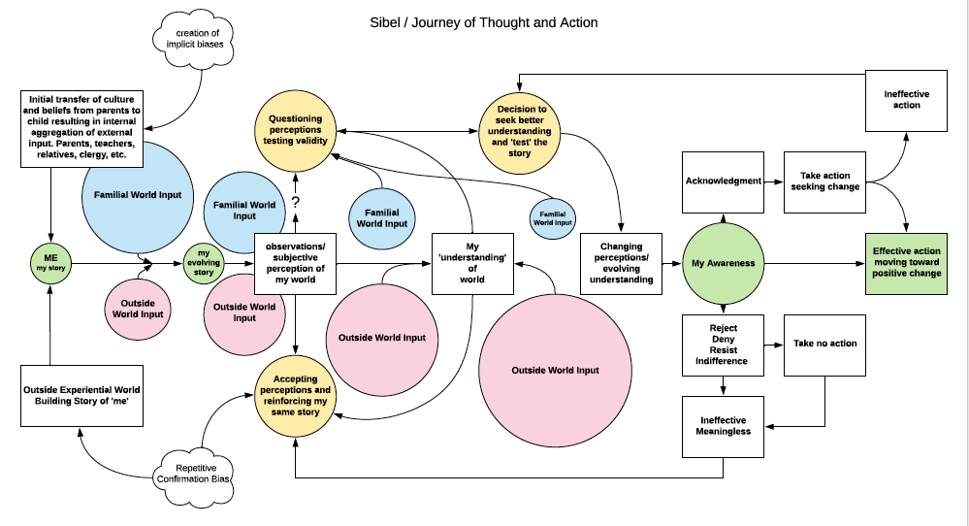

Slide 21
Q&A: WRITE your questions in CHAT NOW.
As time permits, some questions will be answered immediately.
Answers will be addressed in emails to all, and as appropriate, during upcoming sessions.
Feel free to email us with further questions/comments as you think of them: David Boje (davidboje@gmail.com) and/or
Oscar Edwards (oscar@hgs-solutions.com )

Slide 22
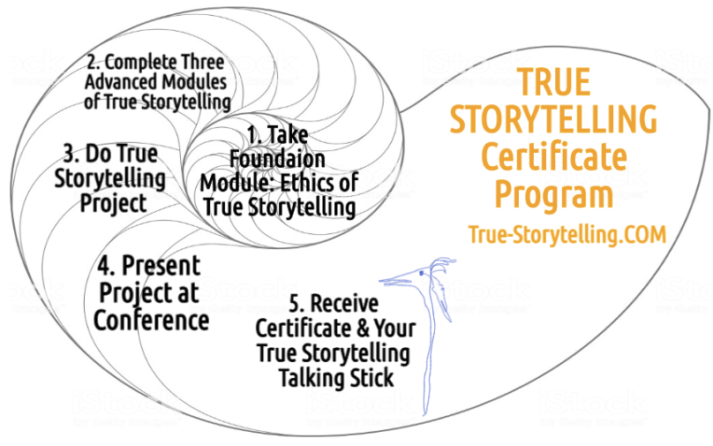
Become a True Storyteller
“It’s not about living a good life, but a true life
[an ethical life]” – Kierkegaard
Jens Larsen oldfriendsindustries@gmail.com ,
David M. Boje davidboje@gmail.com ,
Grace Ann Rosile garosile@nmsu.edu ,
Lena Bruun lenabruunjensen@gmail.com
True-storytelling.com Truestorytelling.blog

Slide 23
Homework Resources
Short, Karen G. (2012). Story as world making. Language Arts, 90(1), 9-17. https://www.coe.arizona.edu/sites/default/files/story_as_world_making.pdf
Slides from Session One https://davidboje.com/truestorytelling/final%20Session%20ONE%20intercultural%20racism%20P1%20and%20P2%20vesion%204.pptx

Slide 24
THANK YOU
For your
PATIENCE,
COURAGE,
COMMITMENT,
and
HEART-of-CARE
in this process!
https://us02web.zoom.us/j/89397616259
Meeting ID: 893 9761 6259
Passcode: endracism

