Slide 1
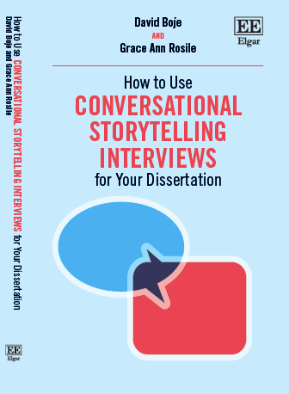
Malmö Cohort Mar 7, 2022
Collaborative Storytelling Conversations by David M. Boje and Grace Ann Rosile
Slides at https://davidboje.com/Denmark

Slide 2
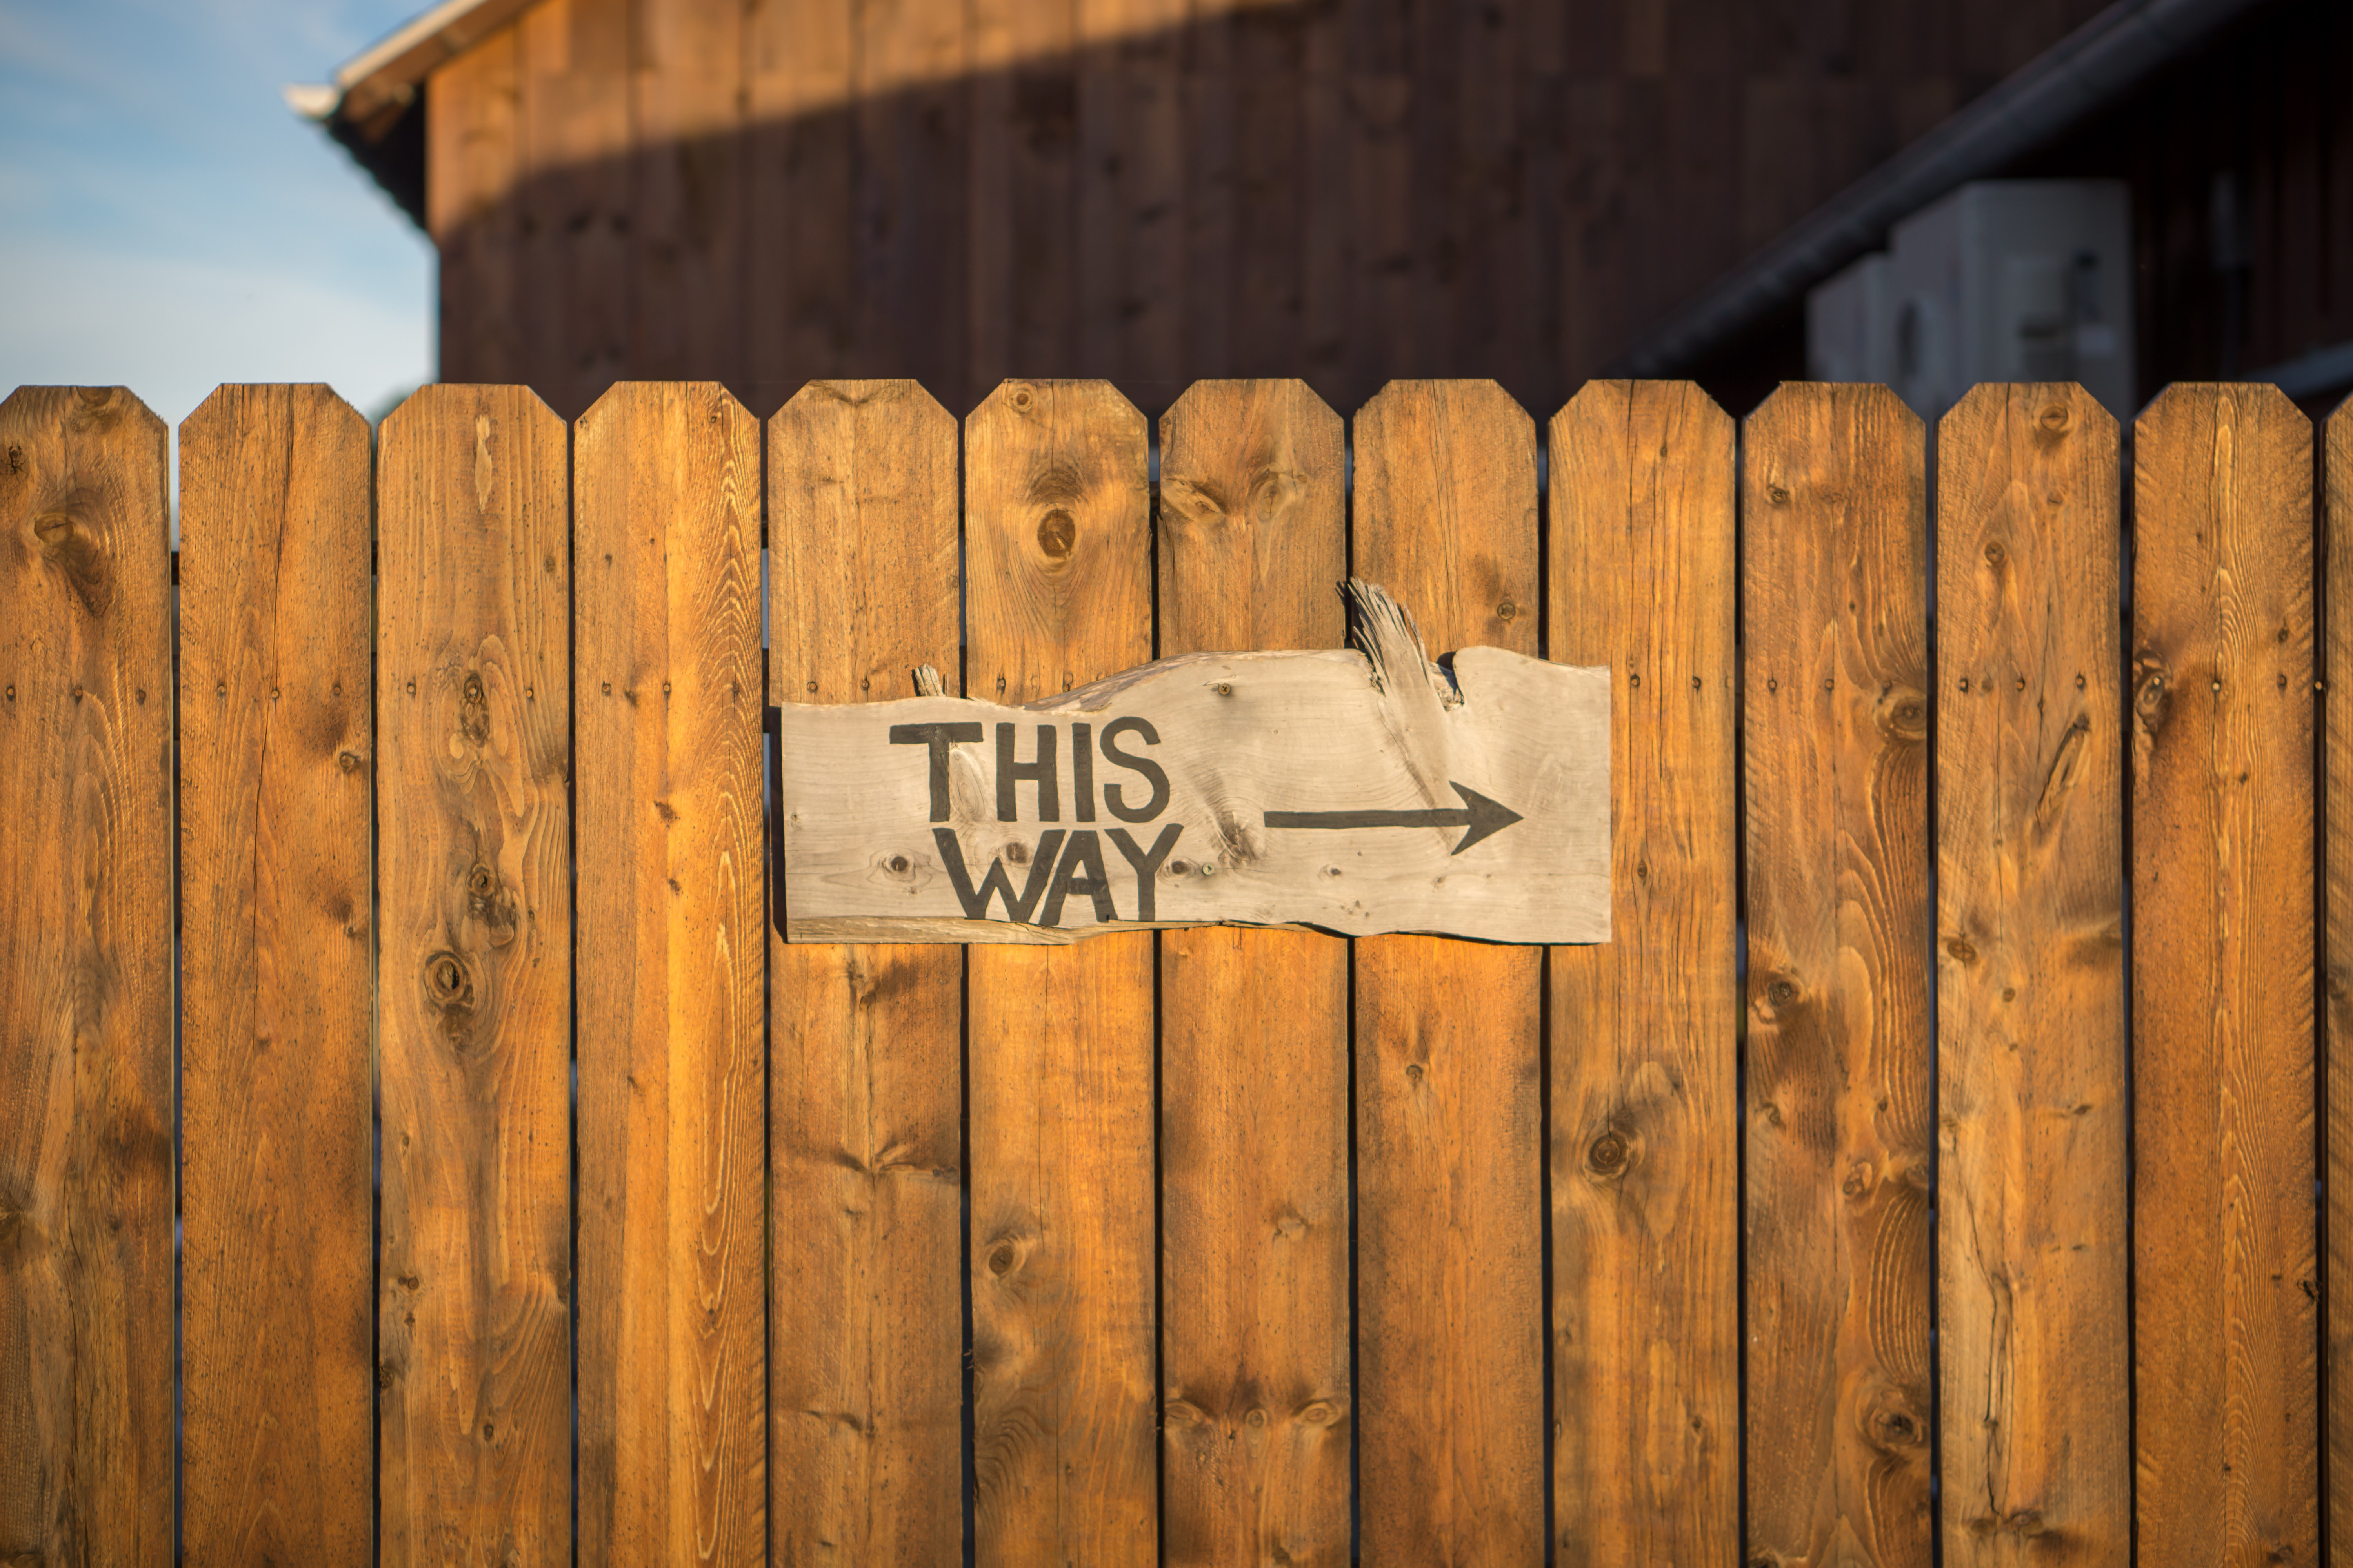
Agenda for Today
PART I Q: How are you living a True Story Life? How does your Heart Discern What’s True & What’s Not?
PART II Q: What are Antenarrative Processes?
PART III Q: What is Collaborative Storytelling in Tamara-Land?
PART IV What Abduction are you exploring? How do you Sample in A-I-D?
PART V How to use A-I-D in conversational storytelling interviewing?
PART VI What are the 4 Who’s of Collaborative Storytelling?

Slide 3
Groundrules
Please bring a notebook and pen/pencil to each session.
Use the “Gallery View” so you can see each other while viewing PowerPoint.
Please do not give advice to others or use ‘should’ statements for self or others.
Speak more from the heart than from the head.
Laser in, be concise, and share only one story
instead of several.
CONFIDENTIALITY:
Do not tell someone else’s story. Please DO NOT record any session of the presenters or the participants.
Please use Chat
ONLY when asked to do so. Avoid “side talk.”
Please attend all sessions. If you must miss one, contact us so we can help you to catch up before you return.

Slide 4
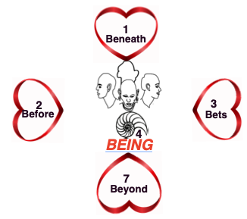
Part I: How does your Heart discern what’s true and what’s not?
Please Draw Your 4 Heart’s
Click Here for one page handout;
Notes:
What direction are you look in-time (past, present, future, or from future present past?), and in-depth (dwell in surface or in grounding)

Slide 5
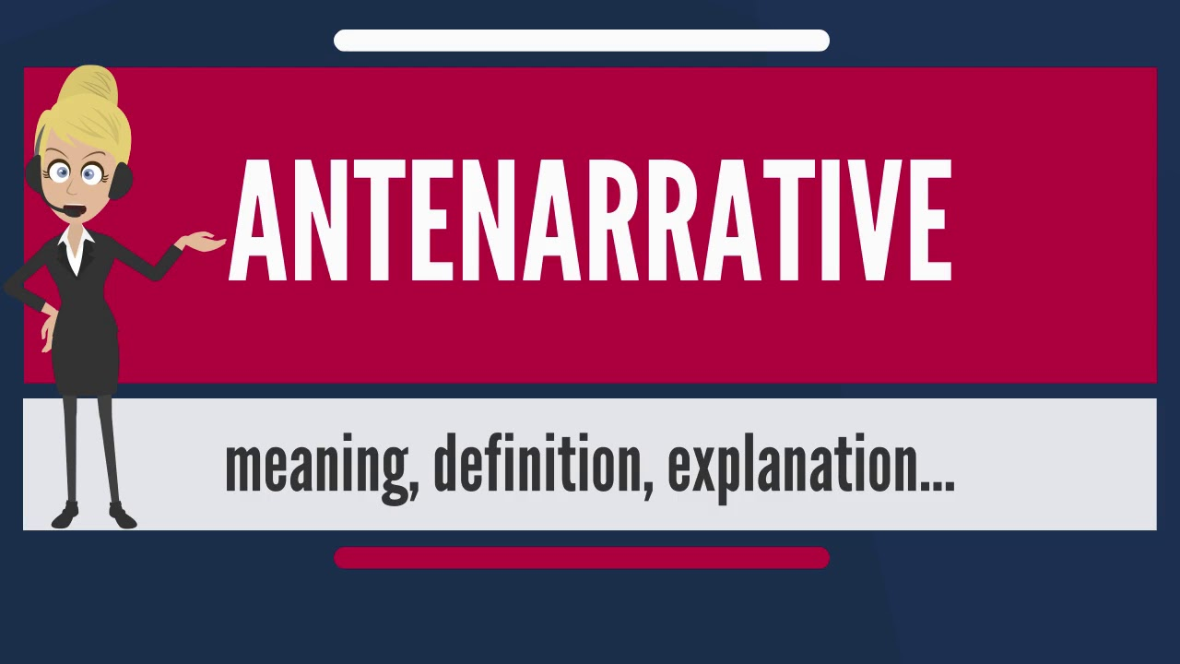
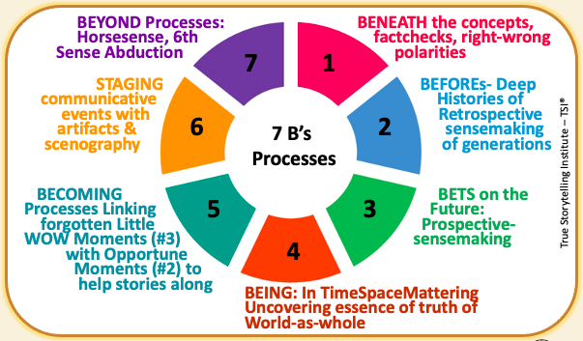
Part II: What are Antenarrative Processes?
Notes:
Stories & Narratives are composed of pre-conceived SURFACE values, concepts, & motives, so GUIDES go BENEATH to core values…
On the surface is the ‘Domination of the Obvious’
Going BENEATH the words, labels, judgements, and polarities, gets to CORE values & CORE concepts & CORE motives
BENEATH the surface is the changes, movements, the flow, and its what is changeless about the world and universe
Going BENEATH the Narrative-Counternarrative arguing, the polarities, we get to the changes and the changeless
What is the BENEATH?
Stories & Narratives are composed of pre-conceived
SURFACE values, concepts, & motives
→ Guides go BENEATH to core values
On the surface is the ‘Domination of the Obvious’
BENEATH the words, labels, judgements, and polarities is the CORE
→ Guides gets to CORE values & CORE concepts & CORE motives
BENEATH the surface is the changes, movements, the flow, and it’s what is changeless about the world and universe
BENEATH the Narrative-Counternarrative arguing, the polarities
→ Guides get to the changes and the changeless

Slide 6
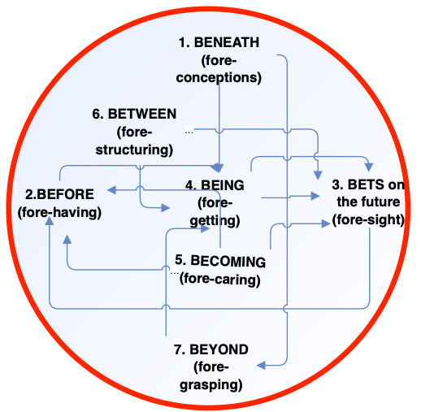
Part II: What are Antenarrative Processes?
Notes:
Stories & Narratives are composed of pre-conceived SURFACE values, concepts, & motives, so GUIDES go BENEATH to core values…
On the surface is the ‘Domination of the Obvious’
Going BENEATH the words, labels, judgements, and polarities, gets to CORE values & CORE concepts & CORE motives
BENEATH the surface is the changes, movements, the flow, and its what is changeless about the world and universe
Going BENEATH the Narrative-Counternarrative arguing, the polarities, we get to the changes and the changeless
What is the BENEATH?
Stories & Narratives are composed of pre-conceived
SURFACE values, concepts, & motives
→ Guides go BENEATH to core values
On the surface is the ‘Domination of the Obvious’
BENEATH the words, labels, judgements, and polarities is the CORE
→ Guides gets to CORE values & CORE concepts & CORE motives
BENEATH the surface is the changes, movements, the flow, and it’s what is changeless about the world and universe
BENEATH the Narrative-Counternarrative arguing, the polarities
→ Guides get to the changes and the changeless

Slide 7
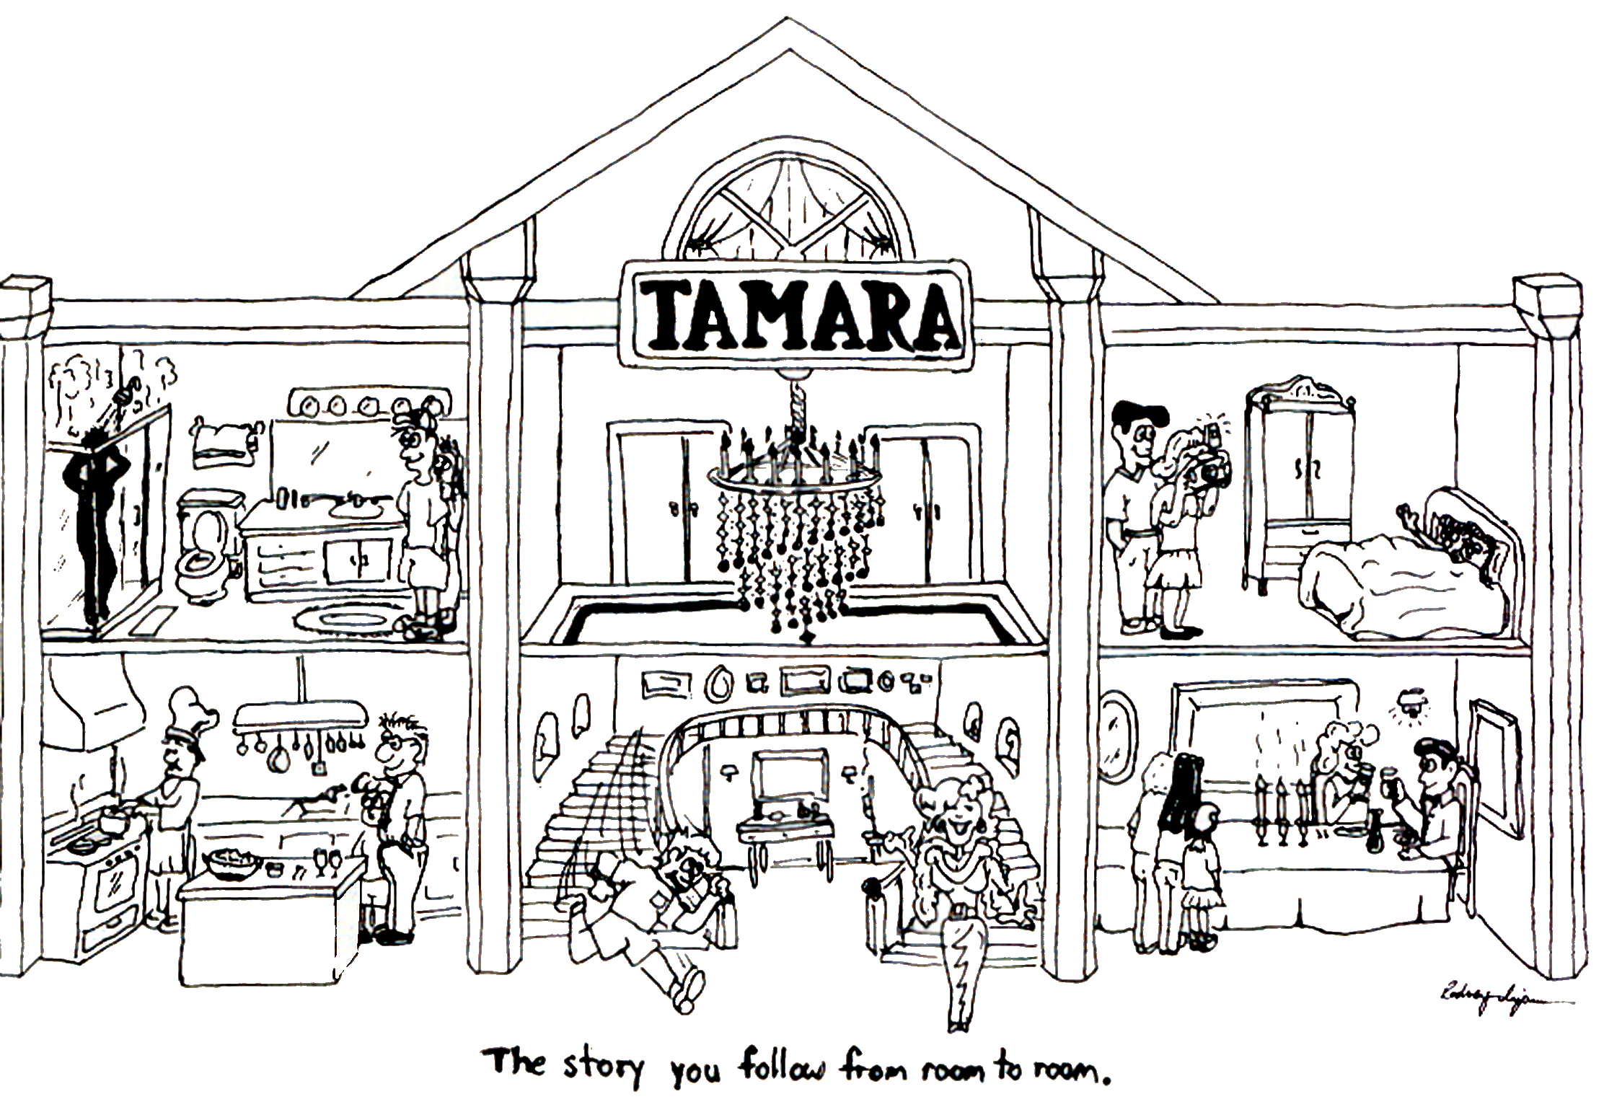
Part III: What is Collaborative Storytelling in Tamara-Land?
TAMARA-Land
True Storytelling Institute – TSI®
“You cannot be in every room at once. So the Meaning of the storytelling conversation in the room you are in depends on the history or rooms you have been in.”
The factorial of 6 rooms in TAMARA-LAND Is exactly 720

Slide 8
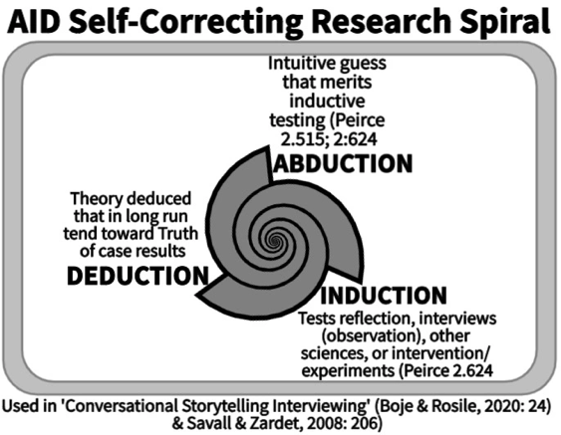
Part IV: What ABDUCTION are you exploring?

Slide 9


PART IV : BREAKOUT
Write notes on your ABDUCTIONS so far for your dissertation topic (3 min.)
-No theory yet, no tests yet.
Share your story with Breakout Partner, and hear and note their story of Abductions
  TOTAL = 5 min
  2 per group
  2 min per person
REMEMBER:
NO THEORY YET!
That will happen next.
Talking Stick
My intuitive hunch is …
My wild guess …
My own idea..
Notes:
When did you foresee a negative outcome
and turn around the plot as it was happening?
INTRO TO BREAKOUT ROOM
15 minutes total in groups of 3 or 4
2 min explains/demonstrates questions to Faith Groups and Consumer Groups aligning to Agricultural Workers to affect growers & corporations
Workers that pressure Corporate Social Responsibility which pressures growers (BUILD VISUAL OF CONNECT THESE DOTS)...
Any extra time:
What we had in common; where we diverged.
2 min silent written prep
BREAKOUT
2 min. per person; Total 8 or 10 minutes
QUESTION:
What stories are already there that you can connect to in your situation?
After you took action (broke up with someone, fired someone, quit your job) and said to yourself:

Slide 10
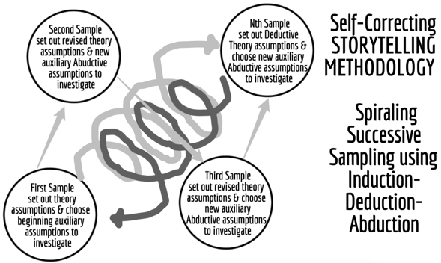
Part IV: How do you sample in A-I-D?
Charles Peirce Sanders
self-correcting method

Slide 11
PART IV : BREAKOUT
Make a few notes: What was your best and your worst ever conversation (3 min.)
Share your BEST conversation experience, please hear your partners, then tell your WORST experience, and then please hear theirs.
  TOTAL BREAKOUT = 3 min per person for Best & 3 min for Worst (total 12 minutes)
REMEMBER:
You are having a Storytelling Conversation, back and forth, wandering together.
Talking Stick
My Best conversation experience …
My Worst ever ..
Notes:
When did you foresee a negative outcome
and turn around the plot as it was happening?
INTRO TO BREAKOUT ROOM
15 minutes total in groups of 3 or 4
2 min explains/demonstrates questions to Faith Groups and Consumer Groups aligning to Agricultural Workers to affect growers & corporations
Workers that pressure Corporate Social Responsibility which pressures growers (BUILD VISUAL OF CONNECT THESE DOTS)...
Any extra time:
What we had in common; where we diverged.
2 min silent written prep
BREAKOUT
2 min. per person; Total 8 or 10 minutes
QUESTION:
What stories are already there that you can connect to in your situation?
After you took action (broke up with someone, fired someone, quit your job) and said to yourself:

Slide 12
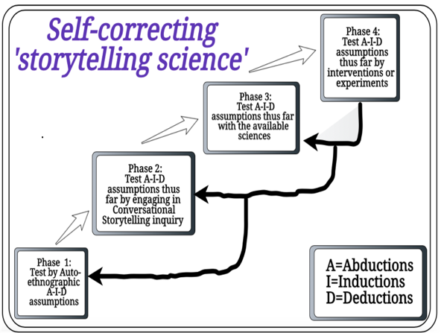
Part V: How to use A-I-D in conversational storytelling interviewing?
Rosile, Grace Ann; Boje, David M; Herder Richard A.; Sanchez, Mabel. (2021). The Coalition of Immokalee Workers Uses Ensemble Storytelling Processes to Overcome Enslavement in Corporate Supply Chains. Business and Society.
Business & Society, Vol. 60(2) 376–414. Click here fore pre-press pdf.

Slide 13
PART V : BREAKOUT
Imagine Using Iterative Cycles of Spiraling Sampling in your dissertation (3 min.)
Share your spiraling sample plan with Breakout Partner, and hear and note theirs
  TOTAL = 5 min
  3 person groups
  1 min per person
REMEMBER:
You are having a Storytelling Conversation, back and forth, wandering together.
Talking Stick
My first sample is …
My 2nd sample …
My 3rd sample..
Notes:
When did you foresee a negative outcome
and turn around the plot as it was happening?
INTRO TO BREAKOUT ROOM
15 minutes total in groups of 3 or 4
2 min explains/demonstrates questions to Faith Groups and Consumer Groups aligning to Agricultural Workers to affect growers & corporations
Workers that pressure Corporate Social Responsibility which pressures growers (BUILD VISUAL OF CONNECT THESE DOTS)...
Any extra time:
What we had in common; where we diverged.
2 min silent written prep
BREAKOUT
2 min. per person; Total 8 or 10 minutes
QUESTION:
What stories are already there that you can connect to in your situation?
After you took action (broke up with someone, fired someone, quit your job) and said to yourself:

Slide 14
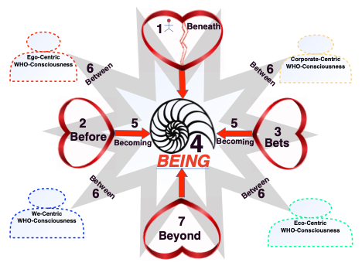
Part VI: What are the 4 Who’s of Collaborative Storytelling?
GAIA’s Who

Slide 15
Part VI: What are the 4 Who’s of Collaborative Storytelling?
GAIA’s Who
Boje, David M.; Jorgensen, Kenneth Mølbjerg. (2020). A ‘storytelling science’ approach making the eco-business modeling turn. Journal of Business Modeling, Vol. 8, No. 4, pp. 8-25. Click here for pre-press pdf. Please Click here for final print version PDF
Boje, David M.; Rana, Mohammad B. (2020). Defining a Sustainably-Driven Business Modeling Strategy with a ‘Storytelling Science’ Approach. Chapter to appear in Markovic, S., Sancha, C. and Lindgreen, A. (Eds.), Handbook of Sustainability-driven Business Strategies in Practice, Northampton, MA: Edward Elgar. Click here for pre-press pdf.
Mogens Sparre and Boje, David M. (2020). Utilizing Participative Action Research With Storytelling Interventions to Create Sustainability in Danish Farming. To appear in Organizational Development Journal. Click here for pre-press pdf.
Jørgensen, Kenneth Mølbjerg; Boje, David M. Storytelling Sustainability in Problem-Based
Learning. Chapter to appear. Click here for pre-press pdf.

Slide 16
PART VI : Your Four Who’s
Make a few notes: Your 4 Who’s are telling you what?
Share you’re your ego-who, corporate-who, we-who (family, colleagues), ecological who (nature). Have a conversation on each and heart your partners…
  TOTAL BREAKOUT = 2 min per person each who & 2 min to hear theirs (total 16 minutes)
REMEMBER:
You are having a Storytelling Conversation, back and forth, wandering together.
Talking Stick
My EGO self…
My CORPORATE…
My We (they-self), looking glass self…
My Ecological self..
Notes:
When did you foresee a negative outcome
and turn around the plot as it was happening?
INTRO TO BREAKOUT ROOM
15 minutes total in groups of 3 or 4
2 min explains/demonstrates questions to Faith Groups and Consumer Groups aligning to Agricultural Workers to affect growers & corporations
Workers that pressure Corporate Social Responsibility which pressures growers (BUILD VISUAL OF CONNECT THESE DOTS)...
Any extra time:
What we had in common; where we diverged.
2 min silent written prep
BREAKOUT
2 min. per person; Total 8 or 10 minutes
QUESTION:
What stories are already there that you can connect to in your situation?
After you took action (broke up with someone, fired someone, quit your job) and said to yourself:

Slide 17
SUMMARY:
7 Processes, 4 Hearts, & 4 Who’s

Slide 18
SUMMARY:
7 Processes, 4 Hearts, & 4 Who’s

Slide 19
SUMMARY:
7 Processes, 4 Hearts, & 4 Who’s

Slide 20
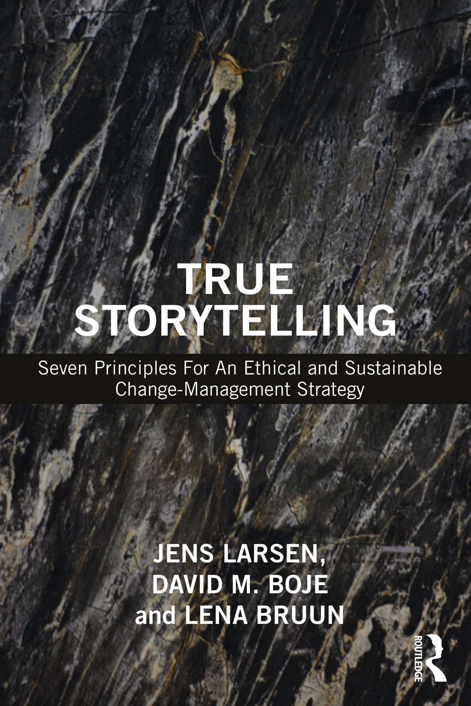
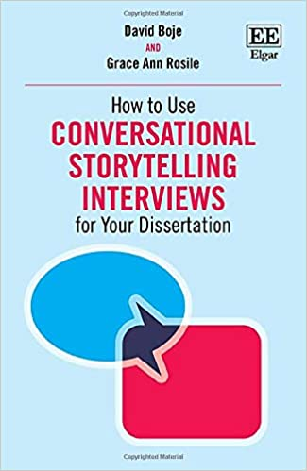
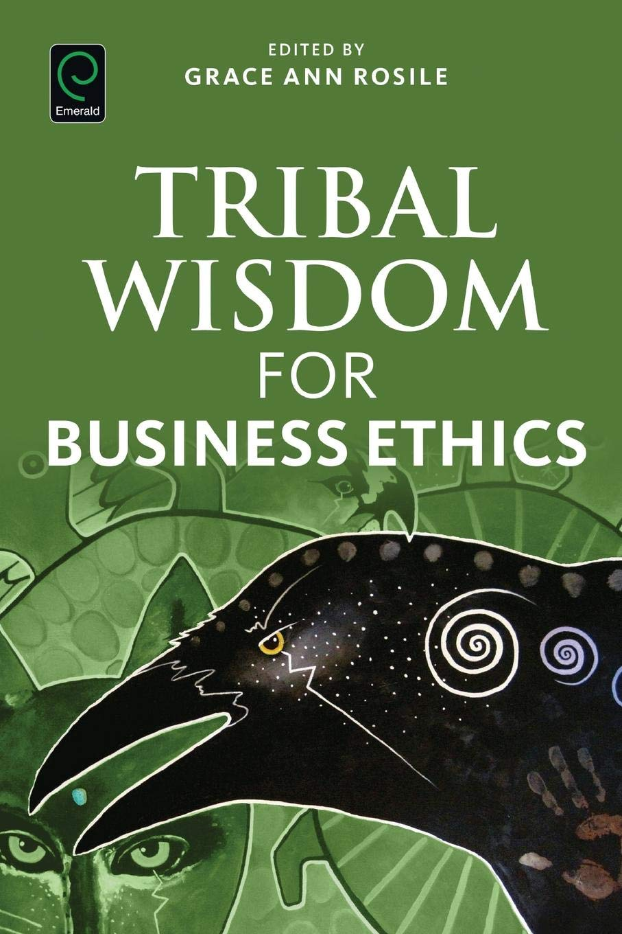
BUILD YOUR LIBRARY
True Storytelling (Larsen, Boje & Bruun 2021)
Conversational Storytelling (Boje & Rosile 2020)
Tribal Wisdom (Rosile 2016)
True Storytelling (Larsen, Boje & Bruun 2021)
Conversational Storytelling (Boje & Rosile 2020)
Tribal Wisdom (Rosile 2016)
Glossary of Terms (emailed to you, and in Conversational Storytelling)

Slide 21
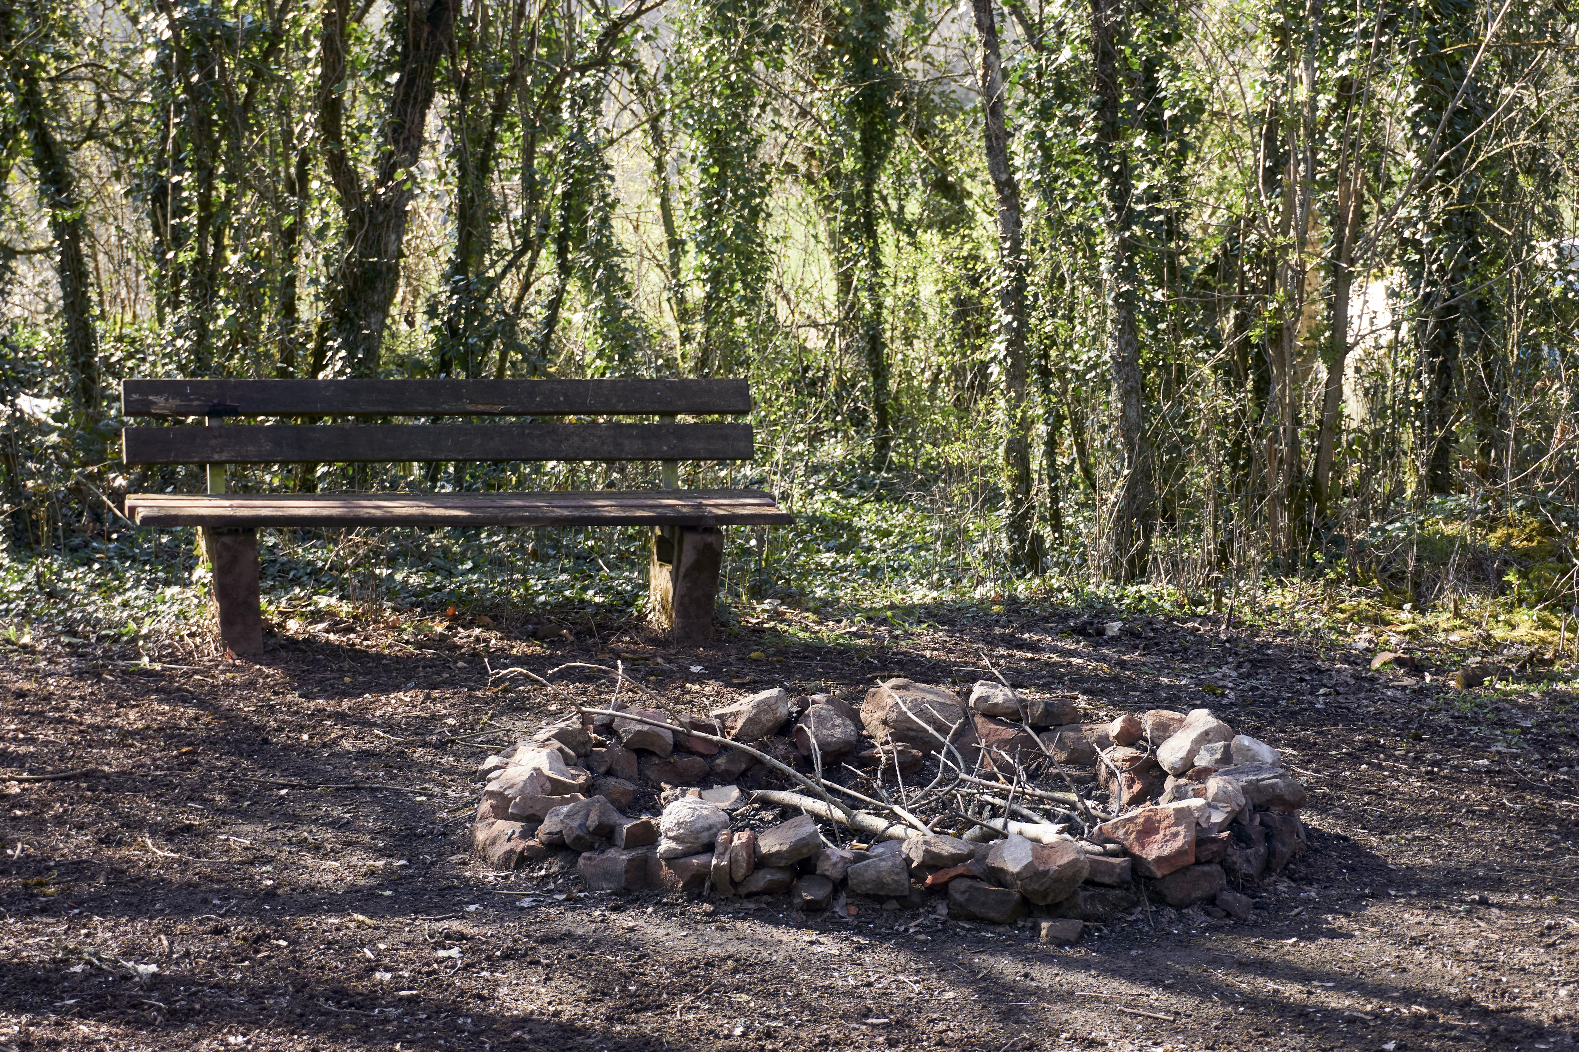
POST-
SESSION
“COFFEE
in the LOBBY”
Go-Around:
Wow Moments?
Slides at WebSite https://enthinkment.com &
Slides at https://davidboje.com/Denmark
Notes:
ROADMAP: Lena
Last Week:
Principle 1 True
This week:
Principle 2 Making Room
and
Nuts and Bolts

