Slide 2
CSI Conversational Storytelling Institute
Conversational Storytelling Institute (CSI) is an innovative methodology for exploring and analyzing Conversations through co-Institute dialogue and collaborative storytelling.
It emphasizes the co-creation of meaning through conversational storytelling. More

Slide 3
What We Do?
We offer Basic Certification module in Basics of doing CSI for personal relationships at home and at work.
There are four sessions, covering Horsesense, Assertiveness, and Blended Rivers. We do not include hands on work with horses, that is extra.
For this certificate you complete basic course modules training you for CSI one-and-one and CSI group and CSI team training.
You can use this certificate for having better relationships at home and at work.
It does not certify you to teach or train our CSI relationship program.
Online course at https://truestorytelling.org

Slide 4
Four Certificates in ODC
Level One ODC: Certifies you to do internal or external organizational development and change (ODC) consulting in 1st Loop ODC - command and control hierarchies. Online course and pricing at https://truestorytelling.org
Level Two ODC: Certifies you to do internal or external organizational development and change (ODC) consulting in 1st and 2nd Loop ODC for organizations with mix of command and control, and some open systems. Online course and pricing at https://truestorytelling.org
Level Three ODC: Certifies you to do internal or external organizational development and change (ODC) consulting in 1st, 2nd, and 3rd Loop ODC for organizations with mix of command and control, open systems, and advanced socioeconomic transformations. We recommend you also take classes in SEAM (Socioeconomic Approach to Management) consulting, at Lyon France, or in the USA.
Level Four ODC: Certifies you to do internal or external organizational development and change (ODC) consulting in 1st, 2nd, and 3rd Loop ODC , plus Ensemble Leadership development for organizations that intend to harmonize and balance command and control, open systems, socioeconomic transformation teams with Ensemble Leadership and team networking. Online course and pricing at https://truestorytelling.org
All ODC Certificates must be earned and paid for in sequence. No jumping levels.

Slide 5
Seven Principles of Conversational Storytelling Institute (CSI)
1. Be Assertive, not aggressive or meek
2. Be clear why you want to tell the story
3. Primacy of personal experience stories
4. Use silence to give space for self-reflectivity
5. Give ’gift of story’ and reciprocate counter-story
6. Use invitational rhetoric listening to counter-stories
7. Goal to get to co-Institute of ‘Braided River’

Slide 6
CSI Principles | Conversational | Storytelling | Institute
1. Assertiveness, not aggression or weakness | Challenging | Self-Assertive | Participatory | Who?
2. Clear intent of why you want to tell this story | Concisely | Simplifying | Personalize | What?
3. Personal experience stories have primacy | Certifying | Sincerely | Place | Where & When?
4. Silence to give space for self-reflectivity | Catching-up | Silence | Pause | Wait?
5. Give ’gift of story’ and exchange counter-story | Concernfully | Sharing | Personable | Why?
6. Use invitational rhetoric openness to listening to counter-stories | Convivially | Soliciting | Process | Way?
7. Goal to get to co-Institute of ‘Braided River’ | Collaborative | Selecting | Purpose | Wish?
® https://csistory.com

Slide 7
CSI Principles | Conversational | Storytelling | Institute |  | ANTE Narrative
1. Assertiveness, not aggression or weakness | Challenging | Self-Assertive | Participatory | Who? | Beneath
2. Clear intent of why you want to tell this story | Concisely | Simplifying | Personalize | What? | Becoming
3. Personal experience stories have primacy | Certifying | Sincerely | Place | Where & When? | Before
4. Silence to give space for self-reflectivity | Catching-up | Silence | Pause | Wait? | Beyond
5. Give ’gift of story’ and exchange counter-story | Concernfully | Sharing | Personable | Why? | Being
6. Use invitational rhetoric openness to listening to counter-stories | Convivially | Soliciting | Process | Way? | Between
7. Goal to get to co-Institute of ‘Braided River’ | Collaborative | Selecting | Purpose | Wish? | Bets
® https://csistory.com
® https://csistory.com

Slide 8
1. You yourself must be true & prepare the energy & effort for a sustainable future
2. Make room, respecting stories already there
3. You must create stories with a clear plot creating direction & help people prioritize
4. You must have timing
5. Help stories along their way & be open to experiment
6. You must consider staging including scenography & artefacts
7. You must reflect on the stories & how they create value

Slide 9
CSI Principles | Conversational | Storytelling | Institute |  | ANTE Narrative | True Storytelling Principles
1. Assertiveness, not aggression or weakness | Challenging | Self-Assertive | Participatory | Who? | Beneath | 1. You yourself must be true & prepare the energy & effort for a sustainable future
2. Clear intent of why you want to tell this story | Concisely | Simplifying | Personalize | What? | Becoming | 5. Help stories along their way & be open to experiment
3. Personal experience stories have primacy | Certifying | Sincerely | Place | Where & When? | Before | 2. Make room, respecting stories already there
4. Silence to give space for self-reflectivity | Catching-up | Silence | Pause | Wait? | Beyond | 7. You must reflect on the stories & how they create value
5. Give ’gift of story’ and exchange counter-story | Concernfully | Sharing | Personable | Why? | Being | 4. You must have timing
6. Use invitational rhetoric openness to listening to counter-stories | Convivially | Soliciting | Process | Way? | Between | 6. You must consider staging including scenography & artefacts
7. Goal to get to co-Institute of ‘Braided River’ | Collaborative | Selecting | Purpose | Wish? | Bets | 3. You must create stories with a clear plot creating direction & help people prioritize
® https://CSIstory.com
® https://csistory.com

Slide 10
The Quest for Triple Loop
Spoiler alert: An Open System Level is analogous to Double-loop.
The Single-loop is analogous to what Kenneth Boulding and then Louis Pondy call, ‘Cybernetic system.’
But that still does not answer the question, what is the Triple Loop?
So many management and organization theorists tried and failed to find the Triple-loop.
OK, here’s the answer: Going Beyond Open System, is precisely what Triple Loop is all about.

Slide 11
BOULDING
PONDY
Transcendent
NINE
?
Social-Organ
EIGHT
Roles
Human
SEVEN
Symbol
Animal
SIX
Image
Cell Society
FIVE
Organic
OPEN
FOUR
OPEN SYSTEMS
Cybernetic
THREE
CONTROL
Clockwork
TWO
Mechanistic
Framework
one
Framework
Sources: Boulding (1956), Pondy (1976); Pondy & Mitroff (1979),
Boje (2008); Boje & Saylors, (2024)

Slide 12
BOULDING
PONDY
Transcendent
NINE
?
Social-Organizing
EIGHT
Roles
Human
SEVEN
Symbol
Triple-
loop?
Animal
SIX
Image
Cell Society
FIVE
Organic
Double-loop?
OPEN
FOUR
OPEN SYSTEM
Single-loop?
Cybernetic
THREE
CONTROL SYSTEM
Clockwork
TWO
Mechanistic
Framework
one
Framework
Boje’s Proposed (2025) Solution to Triple Loop Mystery
Sources: Boulding (1956), Pondy (1976); Pondy & Mitroff (1979), Boje (2008); Boje & Saylors, (2024)

Slide 13
SINGLE LOOP
CSI
TRIPLE LOOP
DOUBLE LOOP
ENSEMPLE LEADERSHIP
HEART of CARE
CSIstory.com

Slide 15
ODC
Organizational
Development &
Change
There are three kinds of ODC
Single, Double & Triple Loop
CSI creates Heart of Care that connects the 3 loops for a balanced approach, called ENSEMBLE LEADERSHIP

Slide 16
SINGLE LOOP ODC
Single Loop is command and control structure.
It is part of every hierarchical organization
It is also known as cybernetic system, which controls any and all deviations.
Those on top determine problems and solutions

Slide 17
DOUBLE LOOP ODC
Single Loop is command and control structure.
It is part of every hierarchical organization
It is also known as cybernetic system, which controls any and all deviations.
Those on top determine problems and solutions

Slide 18
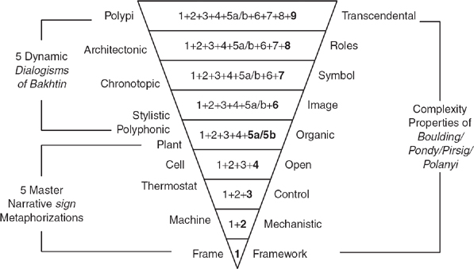
Pondy and Mitroff apply Kenneth Boulding’s 9 levels of systems theory
Framework, 2. Mechanistic, 3. Control (cybernetic deviation-counteraction, e.g. command and control), 4. Open systems (both deviation-counteracting & deviation-amplifying), 5. Organic, 6. Image systems, 7. Symbol systems, 8. Roles systems, 9 Transcendental systems.
The Organic, Image, Symbol, Roles, and Transcendental are beyond Level 4 Open Systems, and Level 3 Control Systems.

Slide 19
TRIPLE LOOP ODC
Triple Loop develops a cascade of socioeconomic teams doing D-PIE projects that transform downward spiral economic performance into upward spiral of success.
This is done by converting hidden costs of dysfunctional performance into innovations and problem solving.
How is it done? We develop the human potential with competency training in skills that result in economic performance.
David Boje & Grace Ann Rosile traveled to France every year for 20 years to learn SEAM and give gift of CSI. David taught SEAM for 20 years at NMSU.

Slide 20
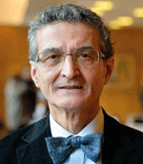
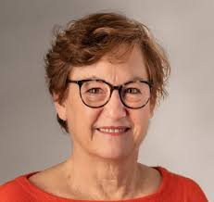
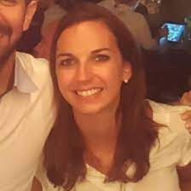
SEAM: SOCIOECONOMIC APPROACH TO Management
HENRI SAVALL
VENOIQUE ZARDET
AMANDINE SAVALL
MARC BONNET

Slide 21
David Boje is Editor in Chief of Business Storytelling Encyclopedia
Amandine Savall edited Volume 5 to which Boje is a contributor
This is the book we use as foundation for our socioeconomic training in Third Loop ODC.

Slide 22
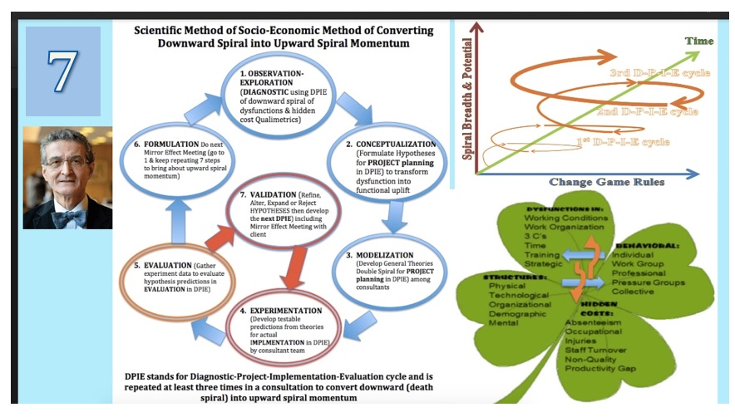
HENRI
SAVALL

Slide 23
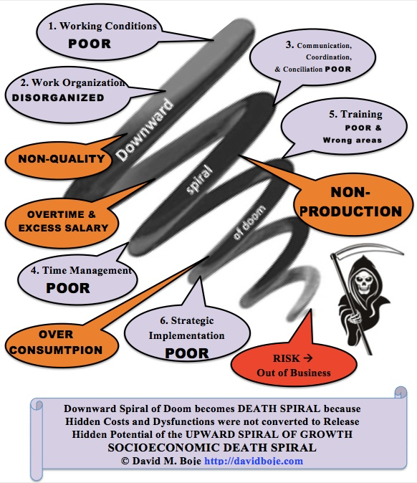
CSI Socioeconomic Approach CAN TURN AROUND
A DOWNWARD SPIRAL
CSI

Slide 24
CSI TRIPLE LOOP Socioeconomic Approach CAN TURN A DOWNWARD SPIRAL INTO AN UPWARD SPIRAL
CSI

Slide 25
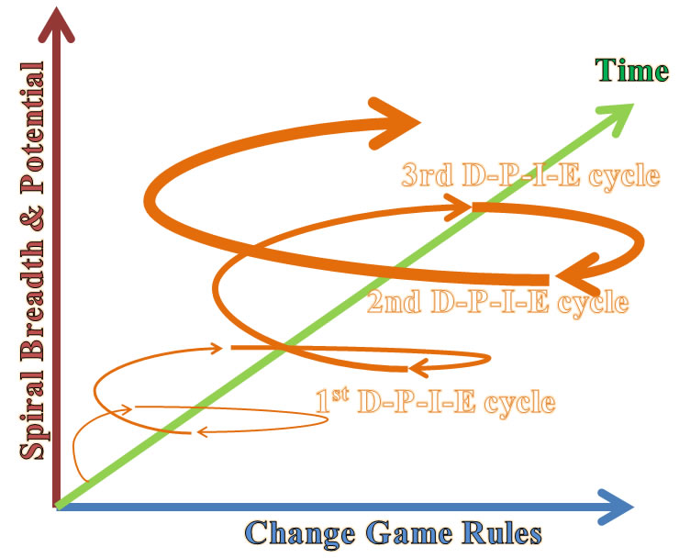
CSI Socioeconomic Approach DEVELOPS
UPWARD SOCIOECONOMIC SPIRAL
UPWARD SPIRAL
D-DIAGNOSIS
P-PROJECT
I-IMPLEMENTATION
E-EVALUATION
CSI
ORGANIZATIONAL DEVELOPMENT & CHANGE (ODC)
With CSI Socioeconomic Approach

Slide 26
What a Triple Loop Cascading?
Step 1 Several Teams receive CSI training in D-PIE (Diagnosis, Project Planning, Implementation, and Evaluation
Step 2 D-PIE Team forms in several departments
Step 3 As more D-PIE teams start up, Ensemble Leadership training is done to network them together
Step 4 When project is complete, D-PIE team disbands. More teams form, and cascading effect has socioeconomic results increasing economic performance outcomes

Slide 27
The Basic Level of Conversational Storytelling Institute combines HorseSense with Assertiveness
This is a prerequisite for developing cascading teams in Triple Loop and in the Heart of Care that Braids Together the 3 loops with ENSEMBLE LEADERSHIP
CSI offers 5 certification courses:
1 Basic CSI in team relationships
2 Single Loop
3 Double Loop
4 Triple Loop, &
5 Heart of Care for Ensemble Leadership

