Slide 1
Theorizing and Theory Building Using Conversational Storytelling Interviewing (CSI) in Liquid Modernity
David M. Boje
Professor, Aalborg University, and
Professor Emeritus of Management,
New Mexico State University
Slides at https://davidboje.com

Slide 2
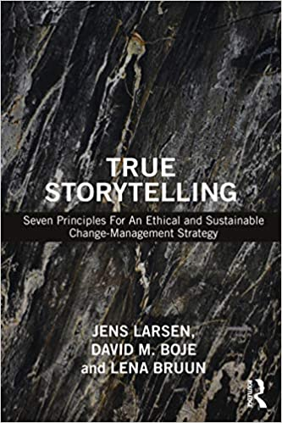
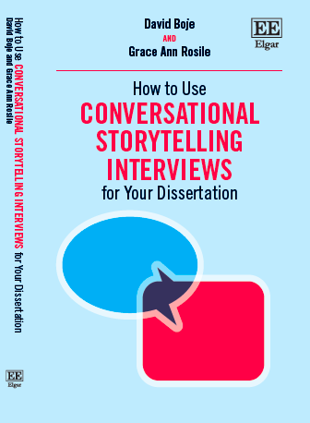
For your Library
Published 2020
Published 2020 E-book $40, handback $100 version CLICK HERE
Paperback $42.95
or Kindle $40.80
Notes:
<number>

Slide 3
History of Conversational Storytelling Interviewing as Alternative to Semi-Structured Interviewing (SSI)
CSI history begins Oct 1929 when Hawthorne Studies toss 1,600 SSI transcript-results (Roethlisberger et al, 1939)

Slide 4
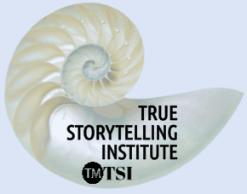
“Talking Stick” Break Out
Experiential Exercise in Conversational Storytelling Interviewing
SPEAKERS: In this exercise, No questions are asks, no chit-chat, only listening to Other’s stories, and sharing your own ‘I’-person story
LISTENERS: Use deep listening; do not ask questions of the storyteller, do not give advice, and please hold a space for silence BEFORE giving Talking Stick to next Storyteller (who signals they will go next)
PASS OPTION: It is OK to ‘pass’ and wait for another opportunity
TIME: Continue with Story Conversation (one story at a time) until all have shared once, and if time remains you may do another round holding space of silence in-between each story shared
Notes:
<number>

Slide 5
“Talking Stick” Conversational Storytelling Process Guidelines
Pick someone to share their story first. The person who speaks holds the Talking Stick, and only they have the authority to speak. They will share one (and only one) story. When done, the speaker says ‘I’m done’ or ‘Ho’ or ’I’m complete’ so people know when they are done.
Hold Silence for at least 20 seconds between stories
Then, current storyteller passes the Talking Stick to that person.
©TSI
Notes:
<number>

Slide 6
BREAKOUT TOPIC The Worst Conversation You ever had (3 person groups)
1. Only share one story (laser in and keep it to under 2 minutes each)
2. No questions are allowed
3. Each story shared must by your own, use ‘I’ language
4. After Space of Silence, then use eye contact (or in Zoom raise hand); Do not go in a circle, use Space of Silence, so you each are LINKING your own story-in-silence to what was just shared, then if and only if yours makes a self-correcting LINK, raise your hand

Slide 7
What is Self-Correcting Induction Method?
For Karl Popper it is Zigzag between intuitive hypotheses and testing theories by disconfirmation, not by confirmation
For C. S. Pierce it is self-correcting induction by four tests to get closer to Truth
For Henri Savall it is self-correcting by ’Agile’ intervention using Peirce’s Abduction-Induction-Deduction in Scientific Method of unleashing human potential
<number>

Slide 8
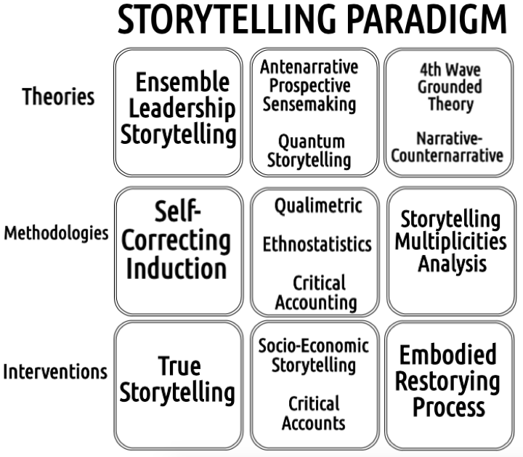

Slide 9
How to Theorize with Storytelling?

Slide 10
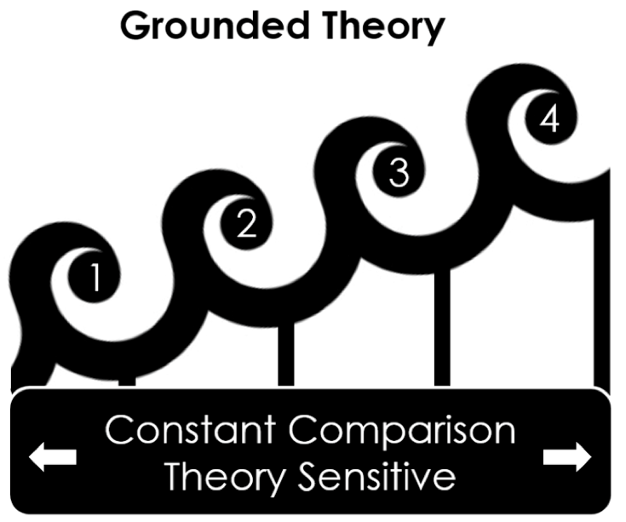
WAVES

Slide 11
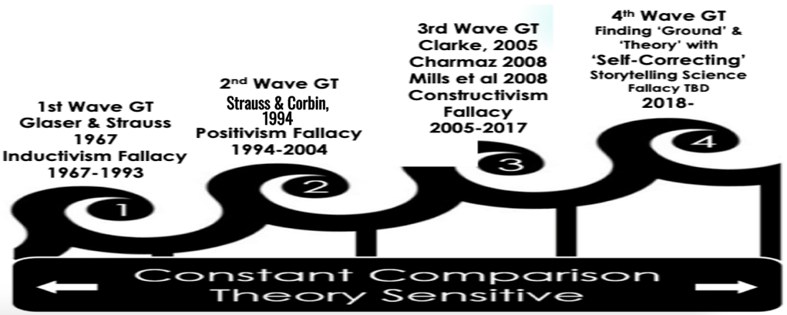

Slide 12
SSI is Anti-Dialogical---CSI is Dialogical
Factionism of Opposition
Conquest
Divide & Rule
Manipulation
Cultural Invasion
Conscientização of Co-Inquiry
Cooperation
Unity
Organization
Cultural Synthesis
Paulo Freire’s (1970) Pedagogy of the Oppressed
( Conversational Storytelling Interviewing CSI) is an alternative to Semi-Structured Interviewing (SSI)

Slide 13
2nd Breakout, this time Using Gentle Self-Correcting
TOPIC: BEST CONVERSATION YOU EVER HAD
First person shares 1 story (laser in and keep it to under 2 minutes each)
2. No questions are allowed
3. Each story shared must by your own, use ‘I’ language
4. After Space of Silence, then use eye contact (or in Zoom raise hand); Do not go in a circle
5. Next person LINKS their ‘I’ story that Gently deviates from the last story

Slide 14
SUMMARY: What is Conversational Storytelling Interviewing (CSI)?
CSI is an alternative to Semi-Structured Interviewing (SSI)
CSI history begins Oct 1929 when Hawthorne Studies toss 1,600 SSI results (Roethlisberger et al, 1939)
CSI is Method of Self-Correcting Induction (Peirce)
CSI is based in C.S. Peirce’s AID Triad
CSI is Living Story (Indigenous Ways of Knowing [IWOK]) & gently invite Untold Stories (Hitchin, 2015) Liberation, missing in SSI’s Western Ways of Knowing (WWOK)
CSI is back-and-forth exploratory process of self-correcting in dialogical (polyphonic in Bakhtin, 1981)
CSI is 4th Wave of Grounded Theory (Boje, 2019)
CSI invites “sacred space of listening” (Boje & Rosile, 2020: 10)
CSI is dialogical instead of SSI’s anti-dialogical, serial-monological (Freire, 1970)
SSI is a priori question list followed by post- hot theme analysis to deduce typology (taxonomy), whereas CSI is Freire’s conscientização & Peirce’s Abduction BEFORE each conversation of co-inquiry

Slide 15
What is the A-I-D Model of STORYTELLING SCIENCE?
Use Abduction, and let the story emerge.
Use Induction by observing something and then draw a conclusion which can be explored.
Use Deduction by forming a general theory

Slide 16
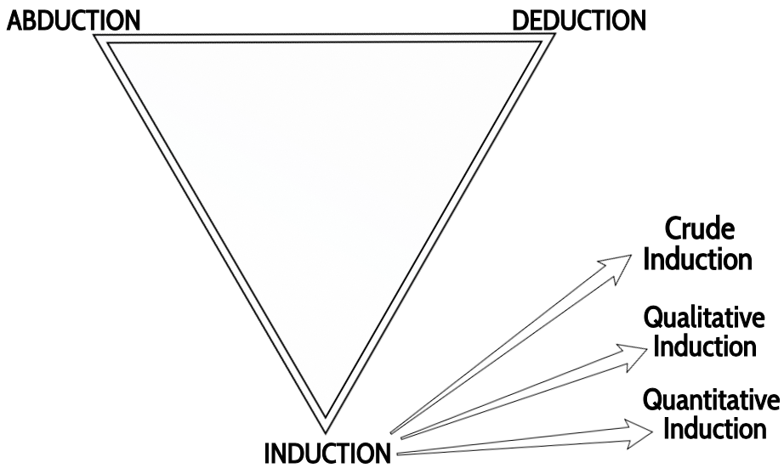
Basic Model of AID Inquiry
<number>
Notes:
Dissertations using this method
Feminist Decolonizing Pláticas: Trabajo con dignidad in the Agricultural Fields on Southwest Borders of the US by Mabel Sanchez, 2020 PhD Diss. New Mexico State University
The Reflexive Dignity Theory of the Firm: Grassroots Local Development-Oriented Corporate Social Responsibility in Action by Andani Thakhathi, 2020 PhD Diss, 2019 South Africa
Dissertation by Mark van der Klei, University of Canterbury, New Zealand. https://www.linkedin.com/in/mark-van-der-klei-8601542a/?originalSubdomain=nz
Dynamics in the Lived Experience of Long-Term Undocumented Mexican Residents of the United States by James Sibel PhD Diss., Cabrini University, 2019 (13864204) https://search.proquest.com/openview/cd2315732e5c7c2b6aba450f1fecff0b/1?pq-origsite=gscholar&cbl=18750&diss=y
<number>

Slide 17
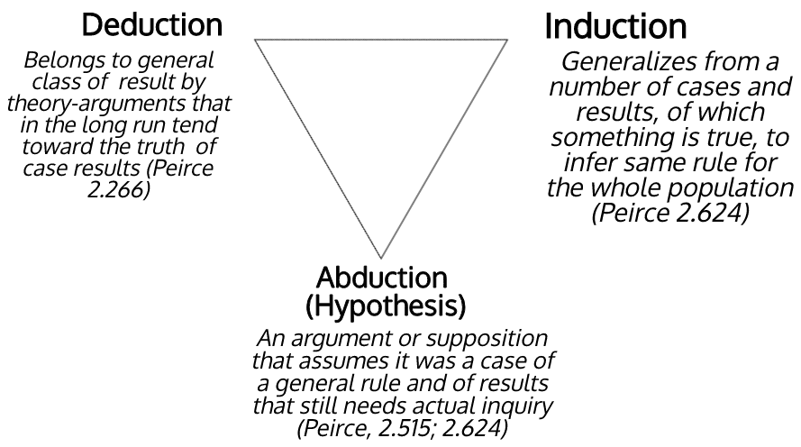

Slide 18
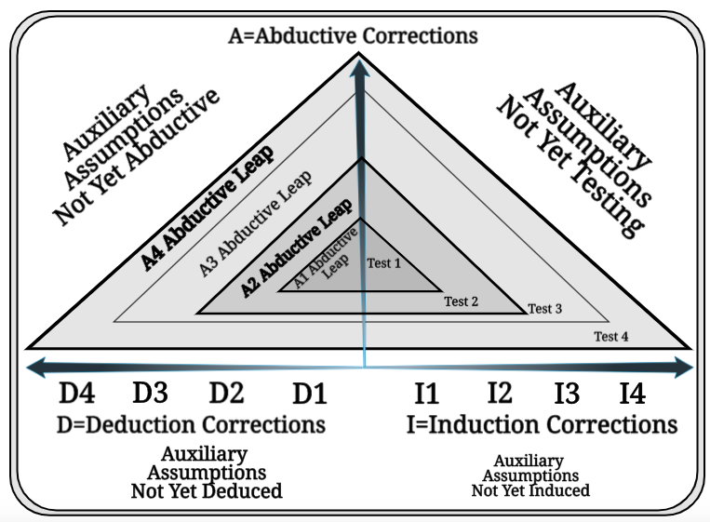
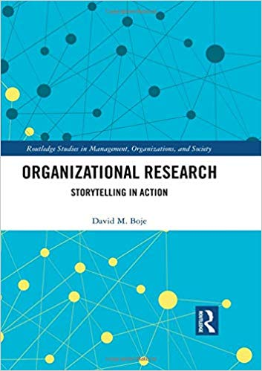
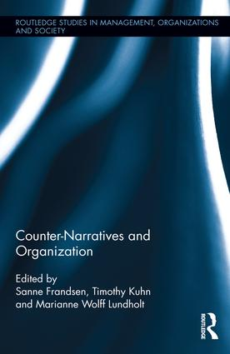
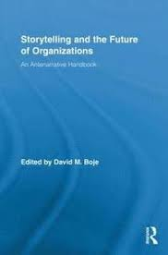
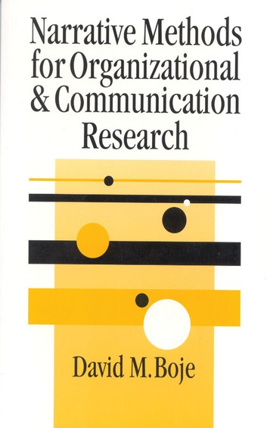
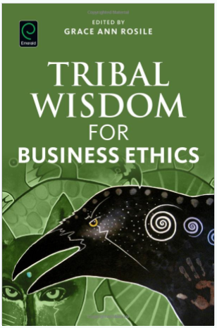
Antenarrative Books:
2019
2016
2011
2001
Notes:
<number>

Slide 19
Charles Sanders Peirce 4 Tests of Self- Correcting Induction
Test One: Try to dismiss the precepts by Your Own Reflection
Test Two: Ask other people if they see and hear the same thing
Test Three: Use your knowledge of laws of nature
Test Four: Do experiments to see if the precept is illusory. Charles Sanders Peirce (Vol. 2.142)
<number>
Notes:
Test One: Try to dismiss the precepts. Given fallibility, “the first test consists in trying to dismiss the precepts” as as some kind of fancy or daydream. If the flow of precepts persists, proceed to Test Two.
Test Two: Ask other people if they see and hear the same thing. If you have reason to suspect hallucination persists, the second test consists in “asking some other person whether he [or she] sees or hears the same thing” If several people concur then treat the induction as conclusive, or proceed to Test Three.
Test Three: Use your knowledge of laws of nature. Some hallucinations and illusions can affect many people. The third test is surer than the first two. “I may make use of my knowledge of the laws of nature” (as fallible as that may be). Apply your knowledge of the Nature, making our observations.
Test Four: Do experiments to see if the precept is illusory. There is a fourth test, and it is the surest of them all. “ apply the test of experiment” .
Charles Sanders Peirce (Vol. 2.142)
<number>

Slide 20
Living Stories are Agential!
Living Story is Indigenous Ways of Knowing (IWOK)
Living Story has 3 ways of Being
A PLACE
A TIME
An ALIVENESS of Spirit, all its Own
Kaylynn TwoTrees ‘living stories’ from Lakota IWOK

Slide 21
There are differences between Western Ways of Narrative and Indigenous Ways of Living Story
WWOK – Western Ways of Knowing privileges Narrative-Counternarrative polemics, compare-contrast linear dualisms
IWOK – Indigenous Ways of Knowing privileges ‘Living Story Webs’ of community, in which Nature (all species & all elements) are energetic spirits, circular and simultaneous logics

Slide 22
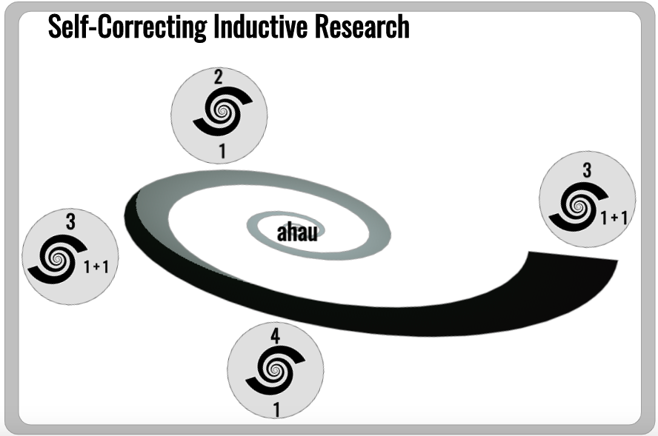
New Zealand example (Mark van der Klei dissertation) using Maori method
<number>

Slide 23
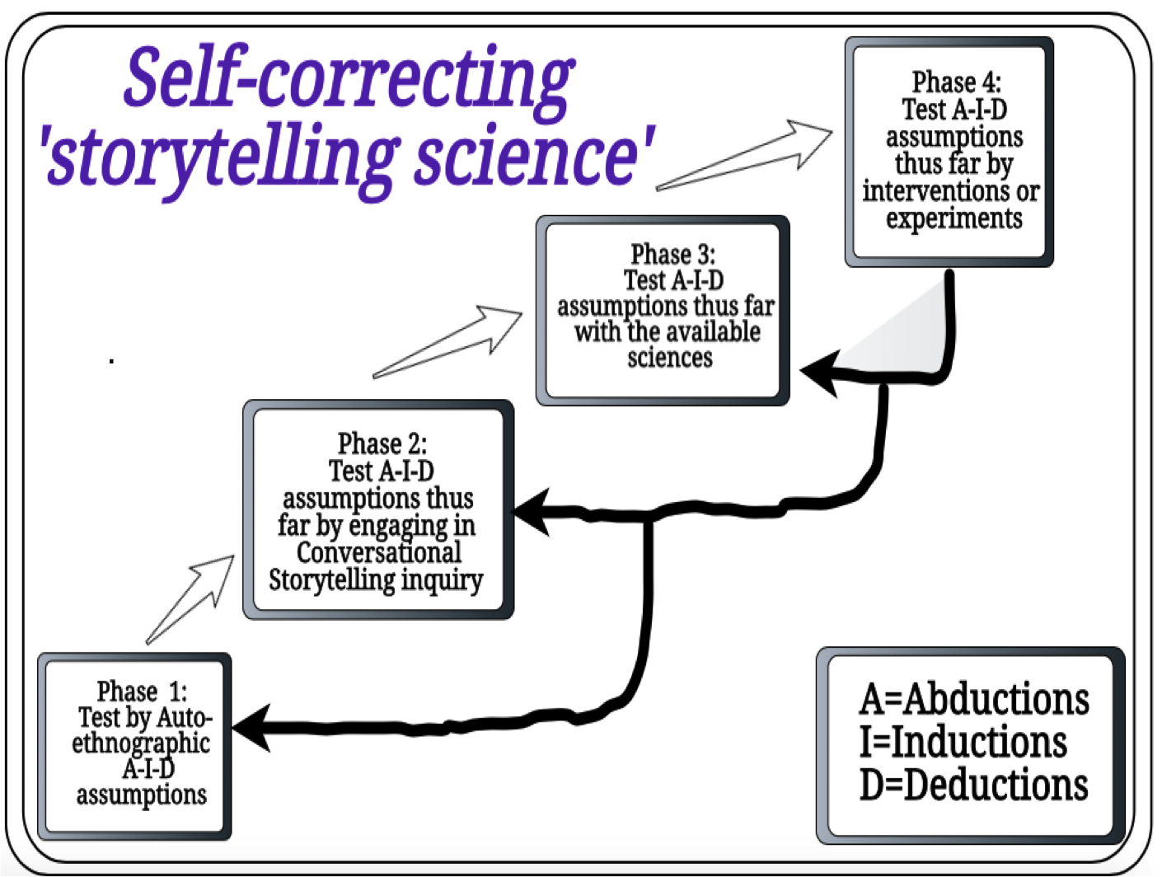

Slide 24
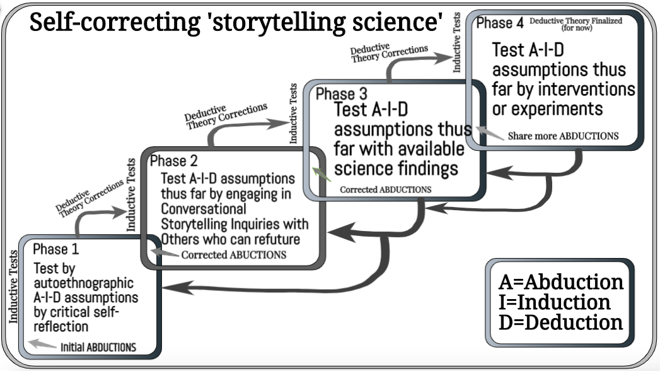
<number>

Slide 25
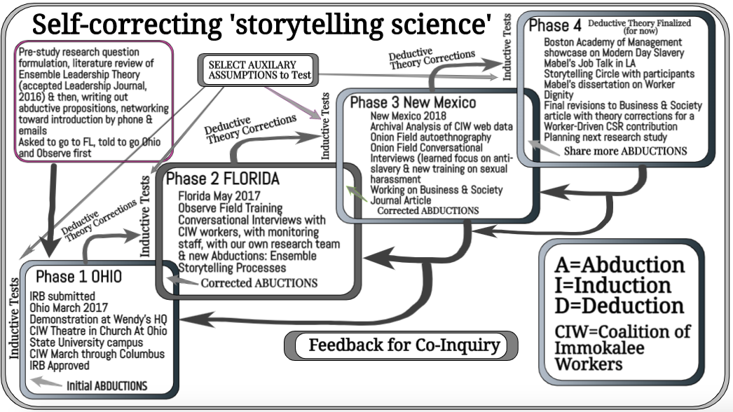
Example of Self-Correcting Study
<number>

Slide 26
Recent Articles
Rosile, G. A., Boje, D. M., Herder, R. A., & Sanchez, M. (2020). The Coalition of Immokalee Workers uses ensemble storytelling processes to overcome enslavement in corporate supply chains. Business & Society Journal.
Boje, D. M. (2020). Water Avengers and their Endgame. Markets, Globalization & Development Review, 4(4).
Jørgensen, K. M., Boje, D. M., (2020). Storytelling approach to Terrestrial Business Modeling Journal of Business Modeling (just accepted, with final revisions)

Slide 28
Antenarrative Books:
2019
2016
2011
2001
Notes:
<number>

Slide 29
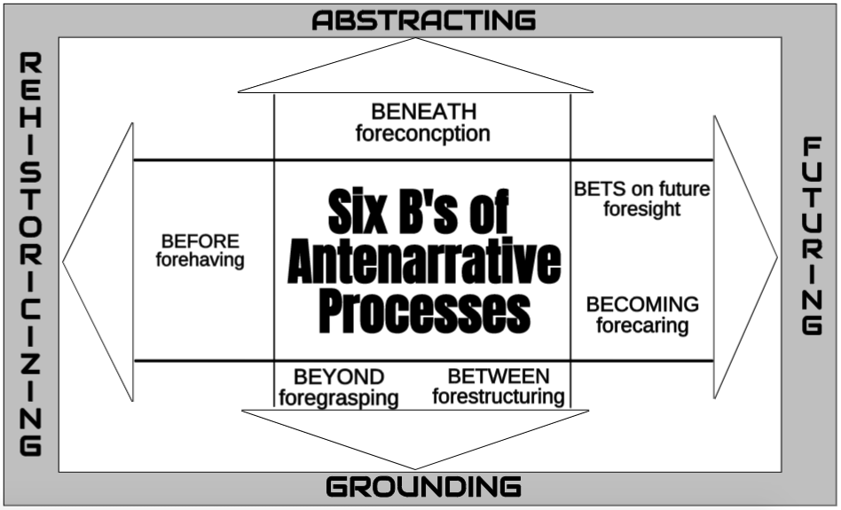
<number>

Slide 30
Notes:
WWOK and IWOK are two different kinds of storytelling patterns that are intertwining
<number>

Slide 31
Thank you
Any questions – please come to DECEMBER QUANTUM STORYTELLING CONFERENCE on Zoom https://davidboje.com/quantum
davidboje@gmail.com
More info
https://davidboje.com
https://truestorytelling.blog
https://true-storytelling.com
Extras slides follow – that you may find of interest

Slide 32
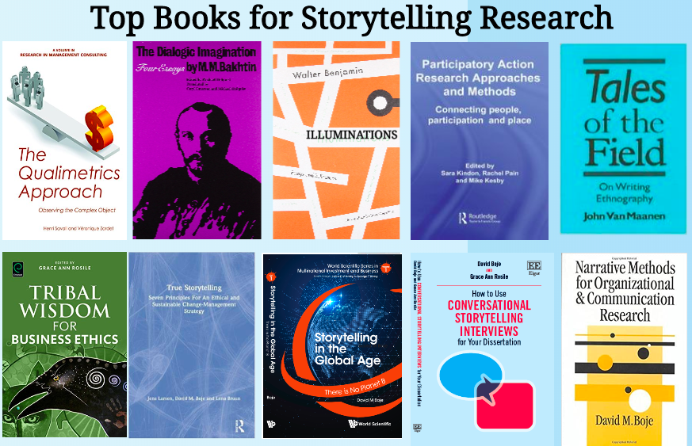

Slide 33
I am a storytelling researcher
Each day I choose the next chapter of my living story
In this way my storytelling is AGENTIAL, not TEXTUAL
So What? We theorize and tell stories in LIQUID TIMES of LIQUID POST-MODERN WORLD that has lost all stability, as the Cathedral of Consumption NARRATIVE no long gives us norms or direction for our lives

Slide 34
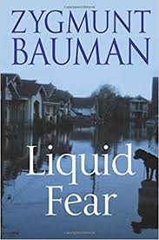
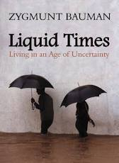
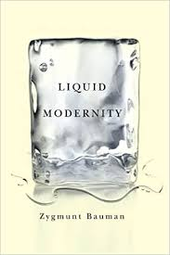
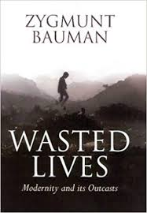
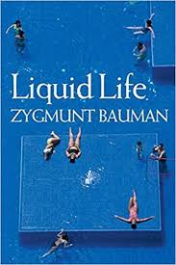

Slide 35
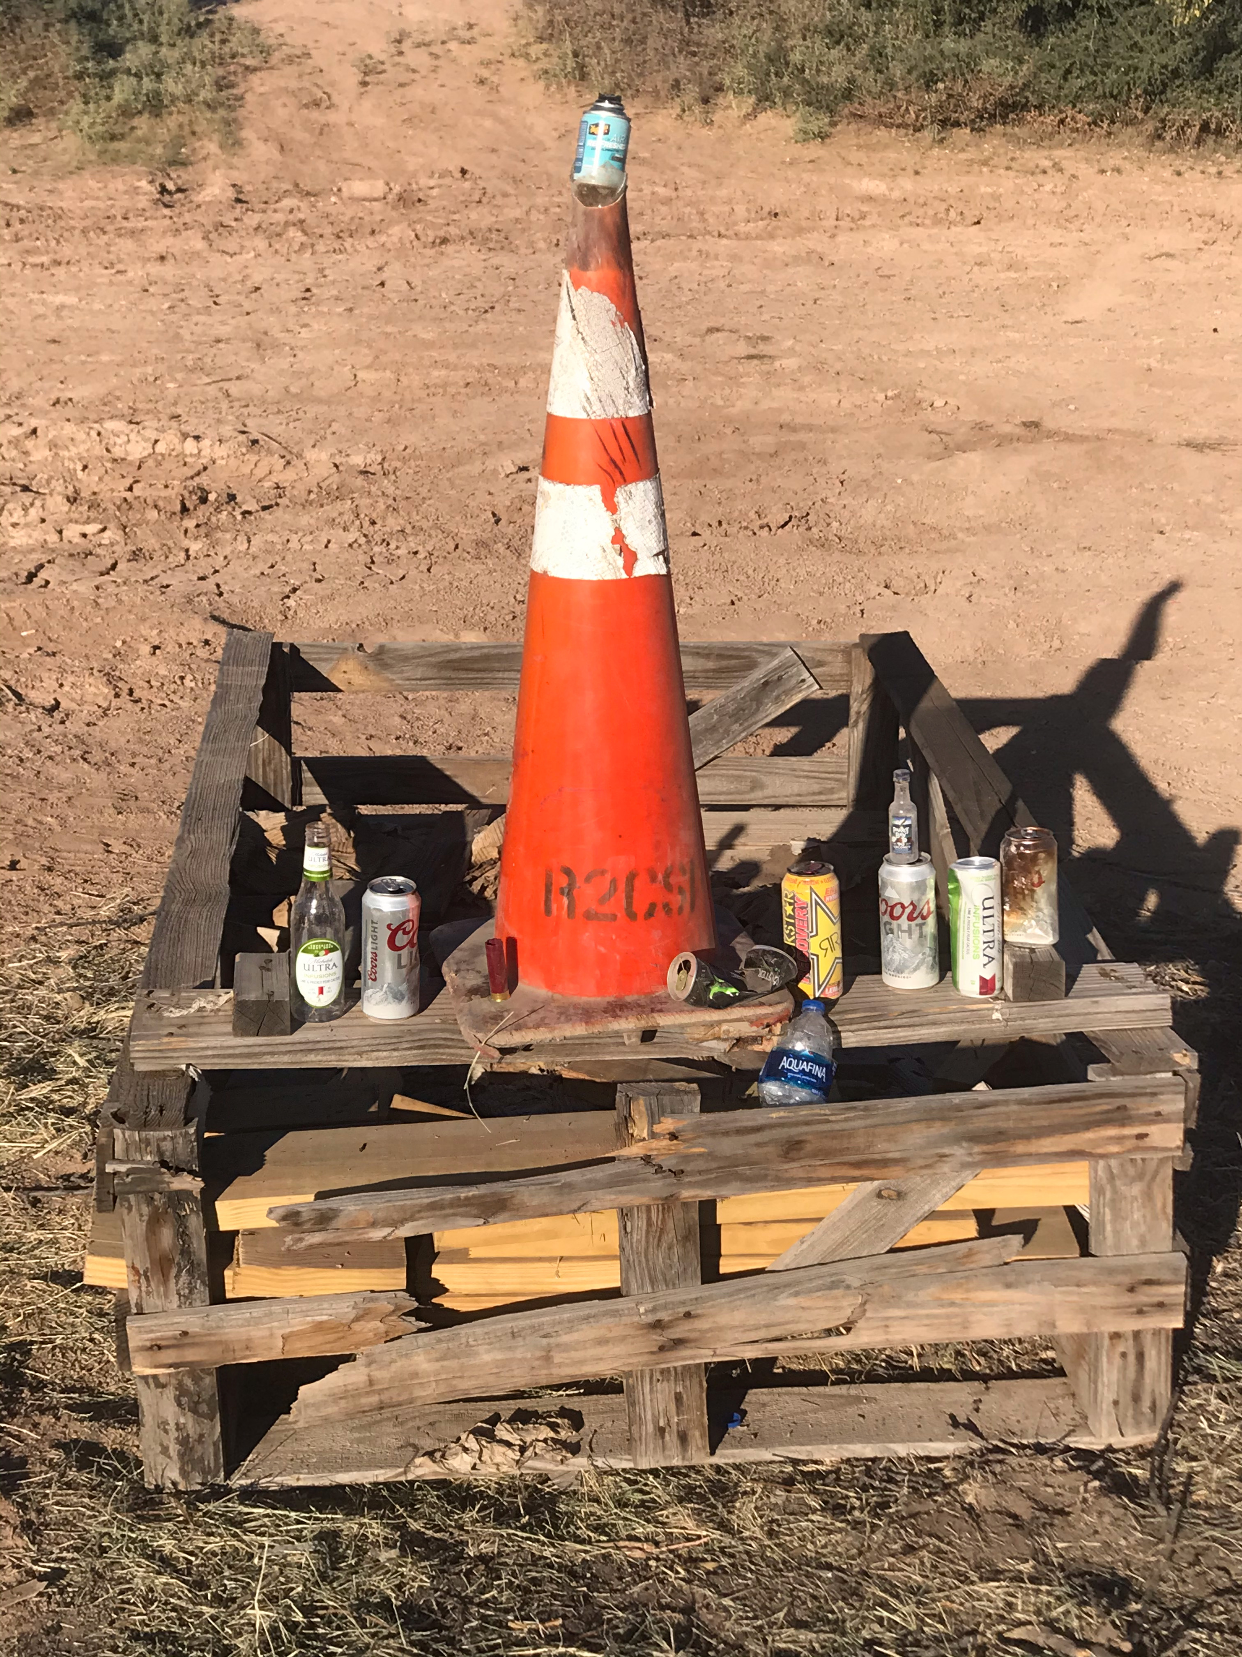
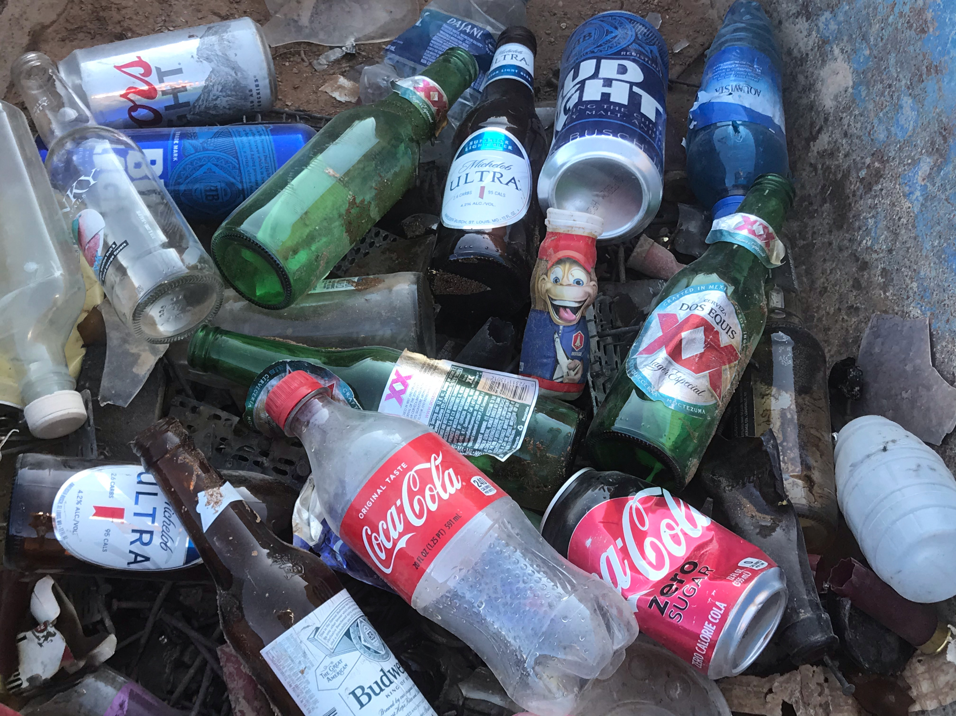
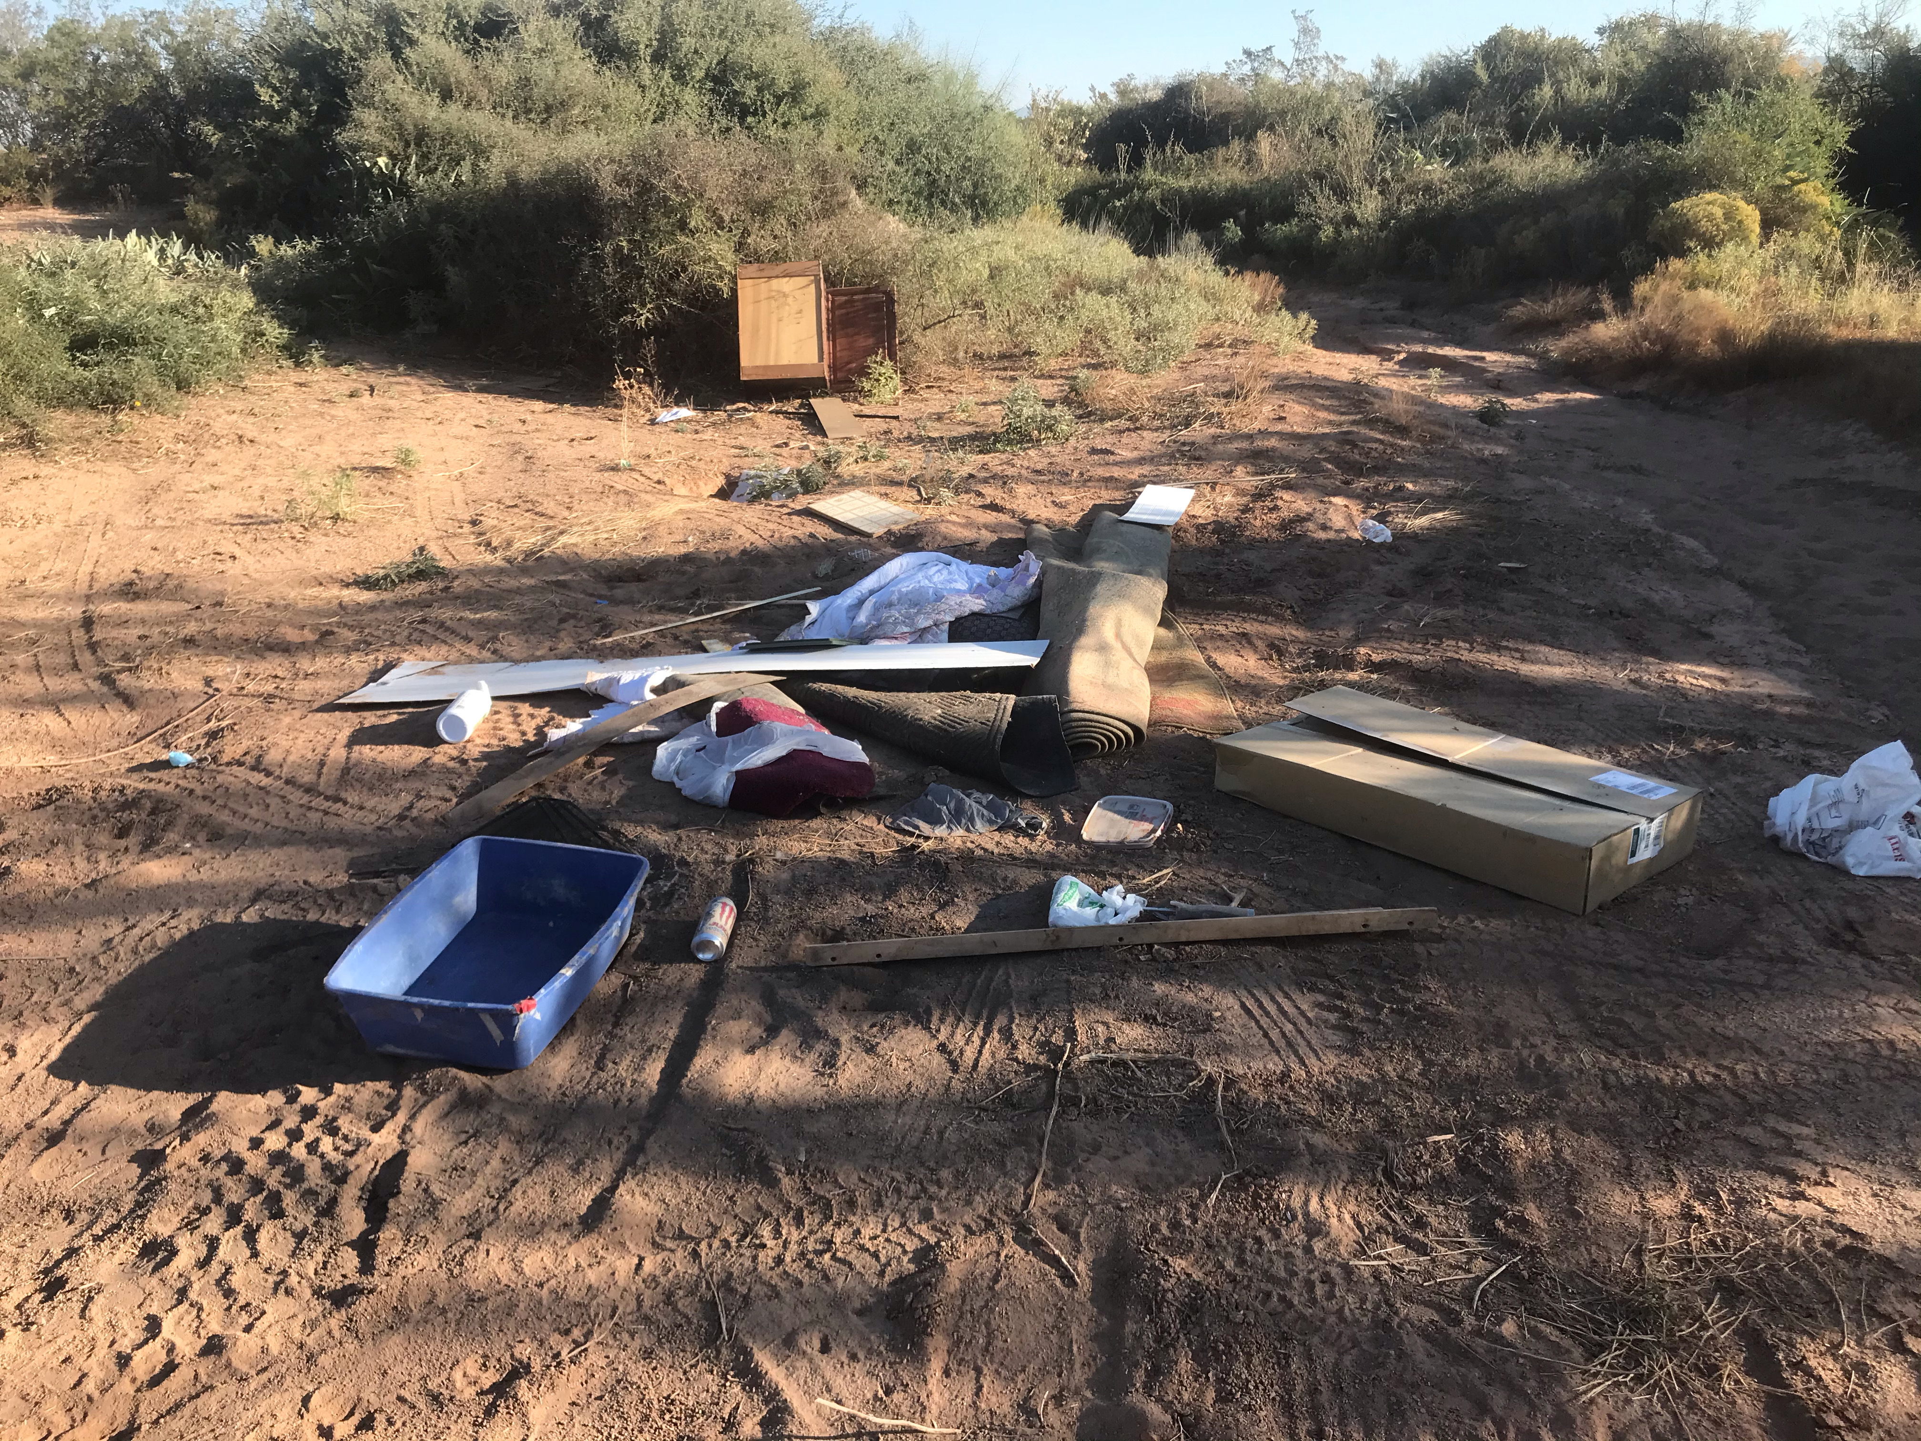
This Living Story is Repeated Daily as REFUGE HEAPS fill an Ephemeral Wetlands Pond.
The Post-Modern Cathedral of Consumption of Wasted Lives

