Slide 1
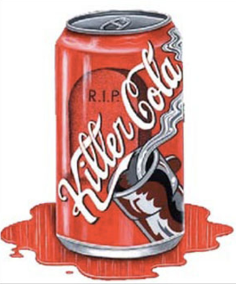
COCA COLA KILLS
David M. Boje
Updated Apr 17 2019
McMurry University

Slide 2
Women drinking more Diet Soda
23% more likely to have a fatal or nonfatal stroke;
31% more likely to have the type of stroke from a clot in the brain or ischemic stroke;
29% more likely to develop fatal or nonfatal heart disease;
16% more likely to die from any cause.
Abbasi, J. (2019). Unpacking a Recent Study Linking Diet Soda With Stroke Risks. JAMA. https://jamanetwork.com/journals/jama/fullarticle/2730251

Slide 3
Sugar and your Diet
Sugar-sweetened beverages the single largest source of added sugar in the US diet.
associated with weight gain
and higher risk of type
2 diabetes mellitus,
coronary heart disease,& stroke
FOUND women who consumed ≥2 servings of SSBs per day had a 63% higher risk of death
Malik, V. S., Li, Y., Pan, A., De Koning, L., Schernhammer, E., Willett, W. C., & Hu, F. B. (2019). Long-Term Consumption of Sugar-Sweetened and Artificially Sweetened Beverages and Risk of Mortality in US Adults. Circulation.

Slide 4
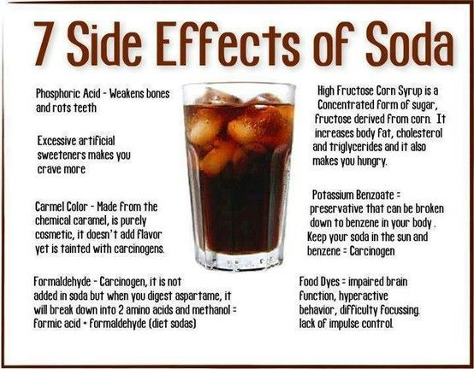

Slide 5
19 Reasons Diet Coke is Unhealthy for you

Slide 6
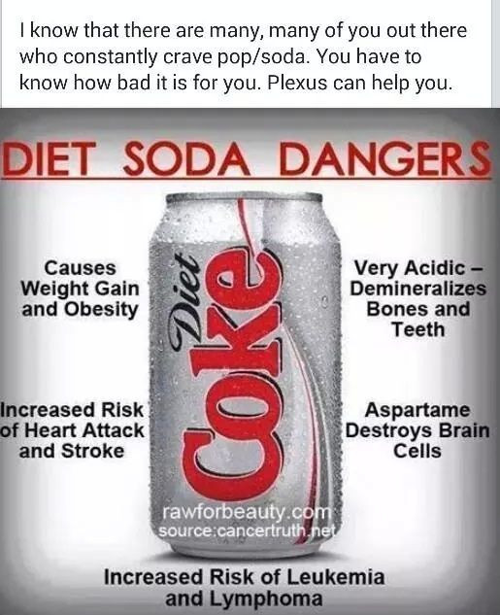

Slide 7
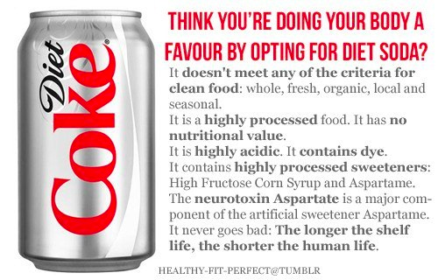

Slide 9
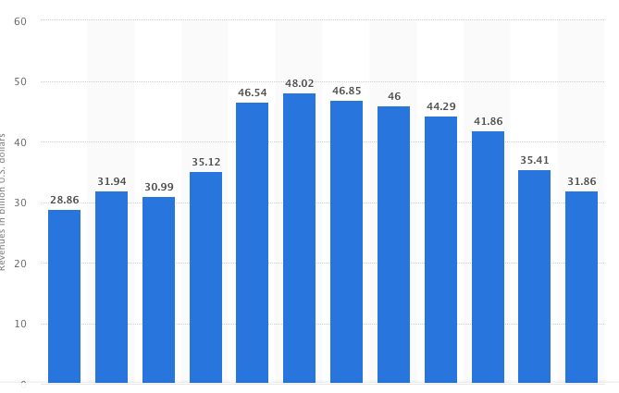
Coca-Cola Net Operating Revenue in BILLIONS

Slide 10
Schmacher 1.5 Scale
Coke founded 1886, sells 50 billion drinks a day
Made of Syrup concentrate (sugar) + caffeine additive (classic) sold to bottling (franchise plants) around the world.
Health Impact: teeth & bone deterioration, obesity, kidney & liver failure, type 2 diabetes, insomnia, neurochemical imbalance, addiction
Coke is the GIANTISM Economic model, not SMALL IS BEAUTIFUL, NOT HEALTHY ECONOMICS

Slide 12
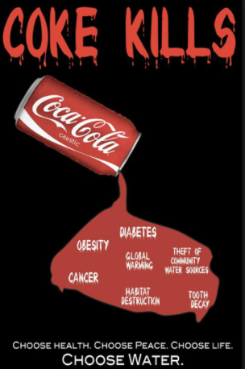

Slide 13
Black and Hispanic production workers at Coca-Cola are typically assigned to the most undesirable and physically dangerous positions, and to tests that are outside of their job descriptions.
Meanwhile, the managers contravene the established seniority system by giving better jobs and more overtime hours to white workers with less seniority than minority workers.
http://stopcokediscrimination.org/

Slide 14
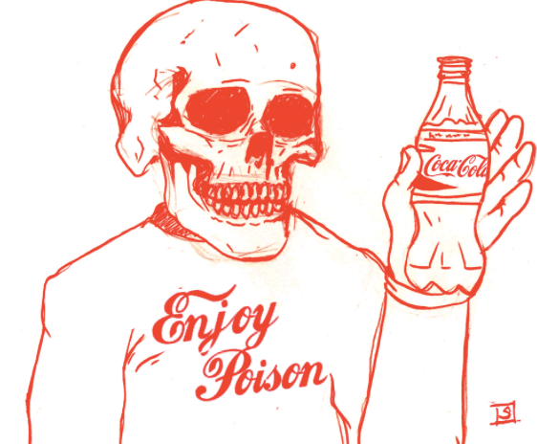
KOTKE textbook chapter 8 Population and poison
7.5 Billion people in world & 1.8 billion will drink coke today!
Notes:
7.5 Billion people in world

Slide 15
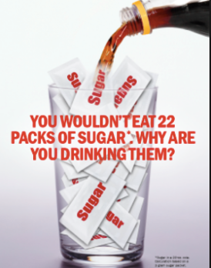
39 grams of sugar in a coke can, and it takes 132 gallons water to make 2 litter bottle coke
Notes:
39 grams of sugar in a coke, and it takes 132 gallons water to make 2 litter bottle coke

Slide 16
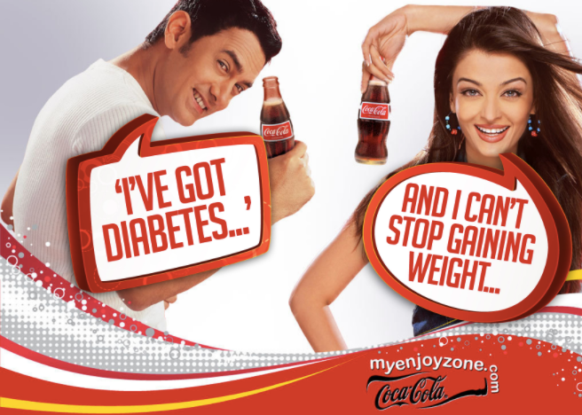
Coke is the Drink of EMPIRE, a toxic posion

Slide 17
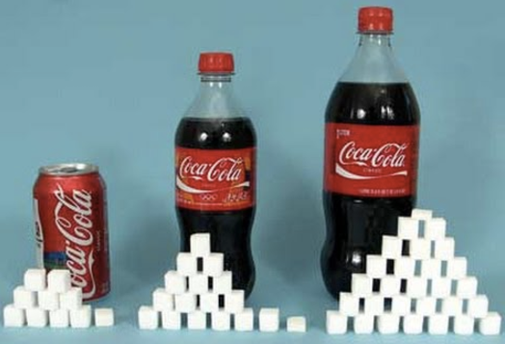

Slide 18
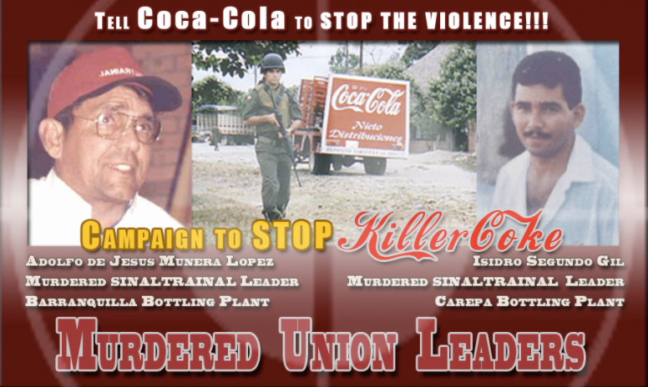

Slide 19
On February 25, 2010, another human rights abuse lawsuit against Coca-Cola was filed in the Supreme Court of the State of New York and later moved to federal district court. "This case involves a campaign of violence - including rape, murder, and attempted murder - against trade unionists and their families at the behest of the management of Coca-Cola bottling and processing plants in Guatemala."

Slide 20
In Turkey, in 2005, 105 workers at a Coca-Cola bottling plant in Istanbul joined a union and were terminated. They organized a lengthy sit-down strike in front of the main offices of Coca-Cola in Turkey. After several weeks of protesting, Coca-Cola workers entered the building to demand their reinstatement. While leaders of the workers were meeting with senior management for the company, the company ordered Turkish riot police to attack the workers who were by all accounts peacefully assembled, many with their spouses and children. Nearly two hundred of them were beaten badly and many required hospitalization.

Slide 21
Mexico, the country with the highest per capita consumption of Coca-Cola, is a huge profit center for Coke to the detriment of the health of millions of children and adults who suffer an inordinate rate of obesity, diabetes and other serious maladies. Dr. Ann Lopez, author and environmental science Professor, Ph.D. at San Jose City College in California, and Director of the Center for Farmworker Families states:
"The people of west central Mexico are easy corporate prey for predator Coke. You can't stand anywhere in some of the rural towns and not see a Coke ad. I've seen what Coke is doing in the west central Mexico countryside where I do research: pushing their addictive products on peasant populations who can ill afford them and in which one in 10 may have undiagnosed diabetes."

Slide 22
To control the soft drinks market in Mexico, Coca-Cola has shown repeatedly it will break the law. The Angel Alvarado Agüero case, currently in the Mexican courts, describes how this former marketing executive of Coca-Cola was unjustifiably dismissed when he refused to carry out illegal monopolistic marketing practices as directed by the Company. This case also highlights how The Coca-Cola Co. is cheating Mexican workers out of hundreds of millions of dollars in profit sharing and other benefits and shortchanging the Mexican government out of millions of dollars in tax revenues.
Investigative reporter Beverly Bell pointed out that "...more than 12 million people do not have access to potable water in Mexico." She explains how then-Mexican President Vicente Fox, who prior to his election in 2000 was president of Coca-Cola in Mexico and Latin America, "...with help from the World Bank-has successfully pursued water privatization, as well as a massive land privatization program, that allowed companies free access to all the resources on the land, including water."
Bell wrote in 2006, "Since 2000 [while Fox was president], Coca-Cola has negotiated 27 water concessions from the Mexican government. Nineteen of the concessions are for the extraction of water from aquifers and from 15 different rivers, some of which belong to indigenous peoples. Eight concessions are for the right of Coke to dump its industrial waste into public waters."

Slide 23
IN INDIA -- The International Environmental Law Research Centre issued a report in 2007 that stated, in part, "The deterioration of groundwater in quality and quantity and the consequential public health problems and the destruction of the agricultural economy are the main problems identified in Plachimada.

Slide 24
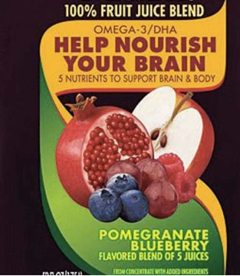
Coca-Cola misled consumers about how much pomegranate juice is in its Minute Maid brand Pomegranate Blueberry drink.
The drink is just 0.3% pomegranate juice and 0.2% blueberry juice. But Coca-Cola had argued that since Food and Drug Administration rules said calling the product "a flavored blend of five juices" was not misleading,

Slide 25
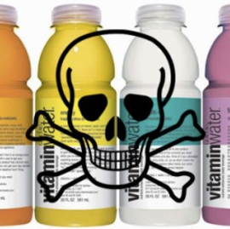
The Coca Cola ad campaign claims that the bottled water can replace flu shots and prevent illness. Coca Cola claims the water is nutritious based upon the fact it contains 100% of the recommended daily allowance of vitamin C. What the advertisement doesn’t tell us is that the water also contains up to 5 teaspoons of sugar!
http://www.waterfyi.com/bottled-water/coca-cola-dangerously-misleading-advertising-for-vitaminwater-ads/

Slide 26
Law suits include
1909 and 1916 US government sued to get caffine additive out claiming mental and motor deficits
2003 India lawsuit for coke plants overusing aquifer water
2009 lawsuit calimed Coke’s vitamin drinks have 33 grams of sugar, Coke Classic has 39 grams
2016 court cases said Coke vita-water had to change labeled health claims

Slide 27
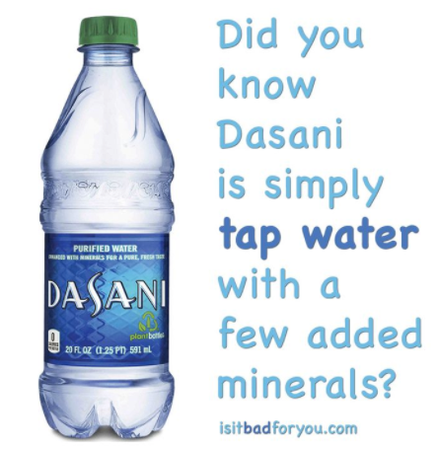

Slide 28
DASANI
Coca-Cola's biggest environmental issue has been its use of water, both in the bottling of its traditional beverages and in the sale of bottled water itself, mainly its Dasani brand.
When Coca-Cola introduced Dasani in 1999 environmental groups such as the Natural Resources Defense Council were already raising questions about the growing bottled water industry.
Meanwhile, Coca-Cola suffered a significant setback during its European introduction of Dasani in 2004. The company was forced to recall some 500,000 bottles from the British market after authorities there found excessive levels of bromate, a by-product of the process it was using to purify the tap water. The uproar prompted the company to postpone Dasani’s launch in the rest of Europe.

Slide 29
DASNI
Dasani Bottled Water Has 4 Ingredients: Tap Water, Known Teratogen, Lethal Drug, and Salt
https://wellnessandequality.com/2014/02/19/dasani-bottled-water-has-4-ingredients-tap-water-known-teratogen-lethal-drug-and-salt/

Slide 32
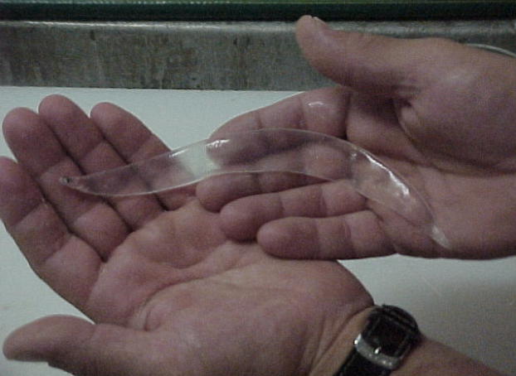

Slide 33
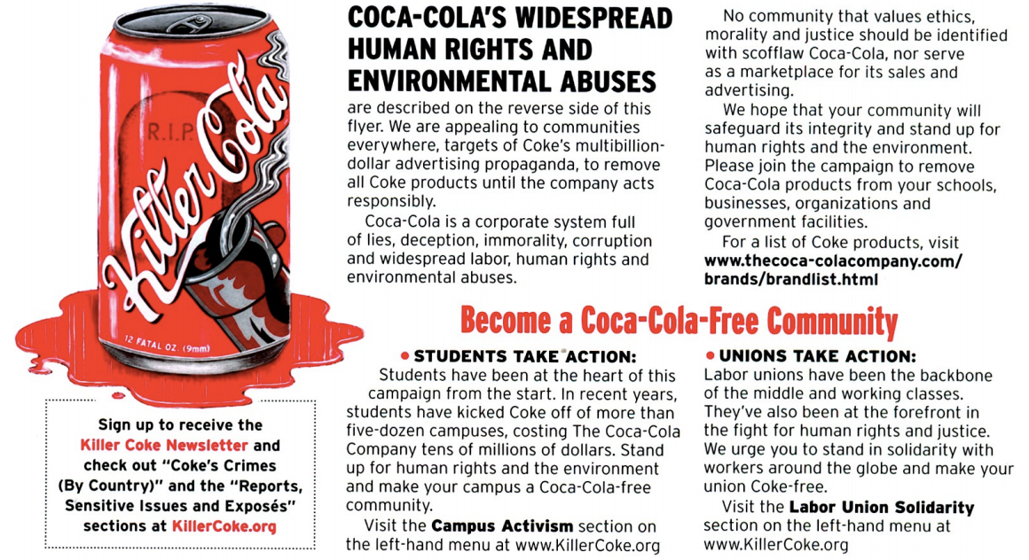

Slide 34
Q & A
What can students at NMSU do about Coca Cola impact on ENVIRONMENT (WATER), HEALTH, FALSE ADVERTISING, LABOR ABUSE, and so on?

Slide 35
What Students are doing in Universities?
100-some University of Montana students, faculty and community members marched into UM President George Dennison's office in Main Hall Wednesday afternoon, chanting "Kill the Coke Contract."
UConn students ask college to nix contract with Coke, stop using primates for research
U of Michigan & U of Florida drop Coca Cola Contract due to environmental and human rights abuses

Slide 36
Starting in 1990s
Cash-strapped K-12 and Universities began agreeing to Coke contracts
By 2002 80% public schools had coke or pepsi contracts
E.g. Ohio State U – paid $32 million for Coke contract

Slide 37
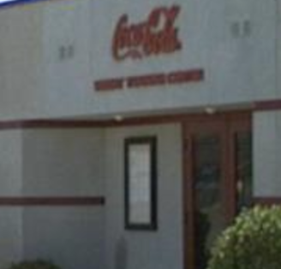
Built in 1992, NM State's weight-training center is located in the Aggie Memorial Stadium complex. The 13, 500-square-foot facility benefits NMSU student athletes in 17 athletic programs. It became a reality thanks to the Coca-Cola Bottling Company of Las Cruces, which funded construction as well as the facility's original weightlifting equipment and exercise machines. Additional weight and aerobic equipment was added to the facility in 1998.

Slide 38
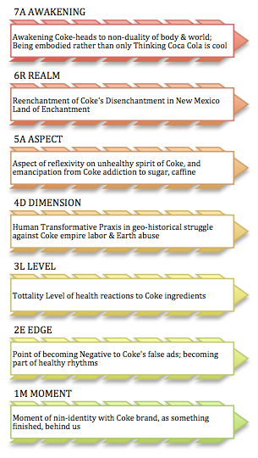

Slide 39
The 7 Dialectics of Coke [and] Sustainability (Boje applies Bhaskar)
1M (Moment) of dialectic of Coke-Identity and Non-Identity, Coke is factually unsustainability, since its founding in 1886
2E (Edge) the edge of becoming Coke addict is dialectically opposed by Negativity of become un-Healthy, un-Happy, & un-Terrific
3L (Level) the Level of totality, in Coke materials (ingredients, labor abuse, false ads, etc.) is the emergent Whole reality vs. Fantasy-ads
4D (Dimension) There is a human transformative praxis in a go-history struggle to counter coke domination

Slide 40
7 Dialectics of Coke (Boje summary of Roy Bhaskar)
5A (Aspect) dialectic of reflexivity about the spiritual deficiency of Coke, and the emancipatory health projects
6R (Realm) In realm of New Mexico, the Land of Enchantment, a Re-enchantment of health & life alternatives to Coke by showing all the ways Coke disenchants
7A (Awakening) An awakening to non-duality (inseparability) of the body [&] world, rather than thinking Coke is cool.

