Slide 1
What is the ‘storytelling science’ of Abilene’s Water?
April 2019 Abilene, McMurry University
David M. Boje
Professor, Aalborg University (Denmark)
Emeritus & Regents Professor, New Mexico State University
Director, European School of Governance
https://davidboje.com/Abilene
Notes:
We are drowning our water in plastic https://www.nationalgeographic.com/magazine/2018/06/plastic-planet-waste-pollution-trash-crisis/
It is our storytelling of water and of plastic, that is changing our story of the Christian into a Marketed Self, and what Water=Desire becomes a marketed construction to make people smoke, drink bottled water or beer, etc., which is an evolutionary change in our our Self=Ego=Desire-concept as a Marketing Advertising.
NOTE: The word ego does not appear in the bible. https://www.gotquestions.org/Bible-ego.html

Slide 2
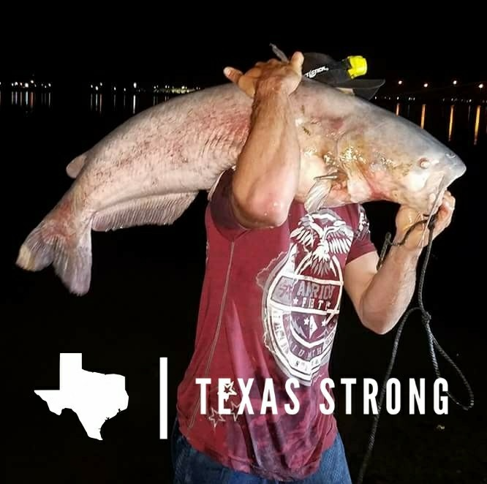
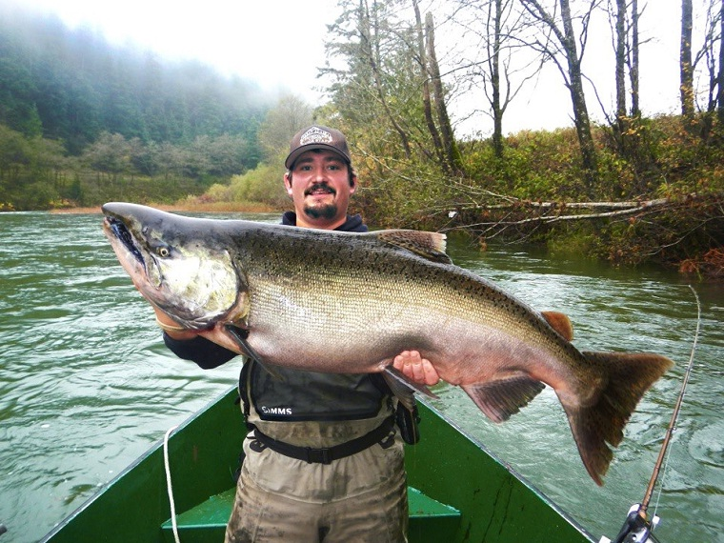
Notes:
Once Upon a time Boje’s story of King Salmon at Spokane River, on Boje’s grandfather’s farm
Catfish photo left provided by Dean of Business Division, Paul Mason, McMurry University, right is Chinook Salmon, once upon a time where I was born, Little Spokane River
This is when Boje, got the call to care for the WHOLE of CREATION
“Most of us talk ‘green,’ and act ‘brown’ – Sallie Mc Fague, , Life Abundant
See Gen 9:8-17; Proverbs 8: 22-31.
Hymn #122 (United Methodist Hymnal)
Care for the whole is a God-thing
Connectedness of all creation is a God-thing
Seeing this connection is a STEWARDSHIP THING
Celebrating this CONNECTEDNESS is a call for earthlings such as we are
John Wesly’s sermon “THE NEW CREEATION” lmessage is God makes all things new….
Romans 8:19-20 – uilding the Ark for Climate Healing
https://www.unitedmethodistwomen.org/bible-studies/care-of-the-earth
Once Upon at Time, Abilene experienced it's greatest day of water consumption in July 1980 when 49 million gallons of water was used.
By 1985, the Texas Legislature recognized that conservation was much more economical then developing new water resources and made it a key factor in granting water permits. https://saveabilenewater.com/history/
In 2011, we had the single worst climate year in our history with high temperatures and drought. However, the changes worked. In 2011, only 37 million gallons of water were used on our peak day. For the entire year of 2011, the city used 1 billion fewer gallons than we did in 1998 and we even had 14,000 more residents.
United Methodist Women - Bible Study on Sustainability https://www.unitedmethodistwomen.org/bible-studies/choose-life
“Choose life so that you and your descendants may life” (Moses, Deuteronomy 30: 19).
He retells the story of sustenance God provides in the poverty of the Isrealites, such as the water from the rock. https://www.unitedmethodistwomen.org/bible-studies/choose-life

Slide 3
Water= $
3
Water= Thirst
2
Water= Denial
4
Water=Desire
1
Water= Matter
9
Water= Life
5
Water= Ethics
8
Water= Memory
6
Water= Spirit
7
Notes:
In Texas ‘Rule of Capture’ is in force. First one to CAPTURE and put to USE the water, oil, gas, etc. on their property, OWNS.
Is Soda a good use of water? If its malicious intent, then ‘Rule of Capture’ actually may mean to stop that kind of use.
“Texas court cases addressing groundwater ownership date back to at least 1904. W. A. East sued the Houston & Texas Central Railway Co., alleging the Railway’s aggressive pumping of water from a well on their property had dried up a natural spring on East’s adjacent property. The Texas Supreme Court sided with the Railway saying that a landowner has the right to divert, consume, or cut off groundwater, without regard to neighboring properties. Their view was that groundwater was part of the soil and was thus a part of the landowner’s property like the soil.” https://www.sprouselaw.com/ownership-of-texas-groundwater/
“

Slide 4
Question: What Does ‘Care of Creation’ mean for Moral Answerability for Water & Soda?
Water= $
3
Water= Thirst
2
Water= Denial
4
Water=Desire
1
Water= Matter
9
Water= Life
5
Water= Ethics
8
Water= Memory
6
Water= Spirit
7
Notes:
According to United Methodists, “Care for Creation” means “caring for and healing the earth are integral to what it means to be a United Methodist”. See “Social Principles: The Natural World”
It says that water, and resources for plants, for animal life, etc. are useful to human bings, but “God has granted us stewardship of creation. We should meet these stewardship duties through acts of loving care and respect” https://www.unitedmethodistwomen.org/bible-studies/choose-life
“Be an Earthkeeper” https://www.umccreationcare.org/

Slide 5
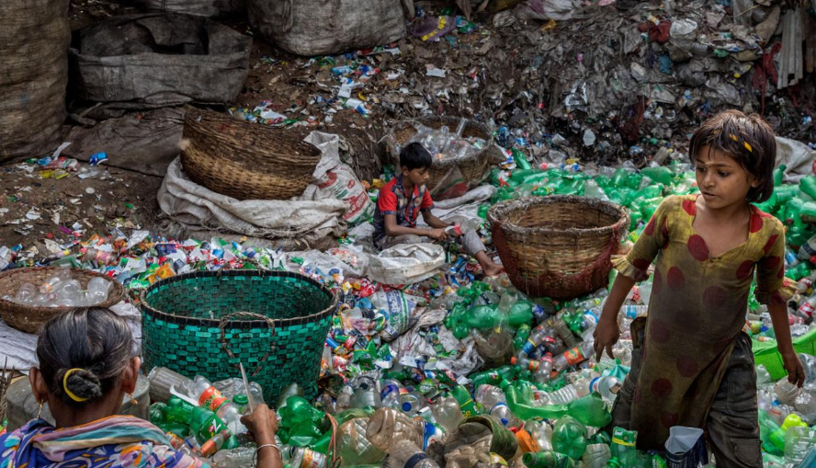
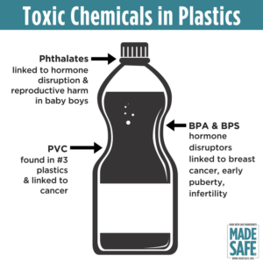
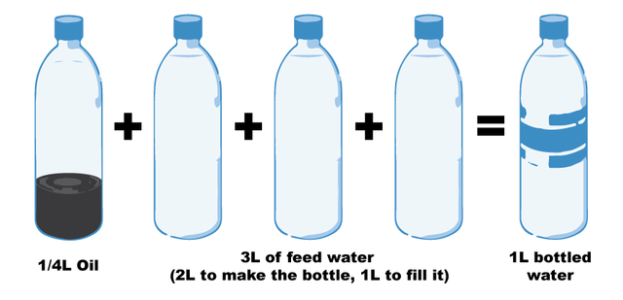
Notes:
Fill a plastic water bottle 25% with OIL to illustrate how much oil it take. https://www.portlandoregon.gov/sustainabilityatwork/article/535746
USA consumes 50 billion plastic water bottles a year, 23% head to recycling, but 38 billion don’t go to recycling, and then only about 9% actually gets recycled, because China is no long taking them, and because it costs $$$ to sort the bottles, shred them, wash them, heat them to sanitize, then melt into pellets and sell to beverage companies
Billions of gallons of water are used to make the Billions of gallons of water in water bottles ( feed waters 3 to 1 final bottle of water)
50 billion USA plastic water bottles is 17 million gallons of oil. It takes 6,000 megajoules of electricity for each barrel of oil, and with all the oil for 40 billion bottles that is 106 billion megajoules of electricity, which is how the 25% oil calculation is based on.
OUR PROBLEM TO BE SOLVED GETS WORSE: 50 billion USA plastic water bottles, is small part of the 250 billion BEVERAGE bottles with juices, sodas, etc. in them
WORLDWIDE: USA is 50 billion plastic water bottles, but world total is 500 Billion, and that means five times that in Total World Beverage plastic bottles
PROBLEM GETS WORSE AGAIN: Most are made of PET –Polyethylene Terephthalate and that has BPA in it.
https://www.madesafe.org/avoid-toxic-chemicals-plastics/
BPA stands for Bisphenol-A and it is a carcinogen, cause low sperm count in boys, and early puberty in girls. PBA is endocrine disruptor.
BPA has been a resin to make plastics clear and strong since the 1960s. https://www.mayoclinic.org/healthy-lifestyle/nutrition-and-healthy-eating/expert-answers/bpa/faq-20058331
It is not just making plastic bottles, but coats the insides of beverage cans, and used to make epoxy.
The FDA does not regulate it, saying low levels of BPA are SAFE to use in foods, and of no harm to human body. But Mayo Clinic says cut back on plastic bottles, and on metal cans (coated in BPA), for your good health life.
PROBLEM GETS WORSE: BPA has phthalates, and FDA refuses to regulate them either. Phthalates are industrial chemicals are binding agents, and to soften plastic, make it clearer and more durable.Also used in cosmetic consumer products. https://www.fda.gov/cosmetics/productsingredients/ingredients/ucm128250.htm Phthalates however do cause reproductive, liver, kidney, and lung problems in human beings. See Canada https://noharm-uscanada.org/issues/us-canada/phthalates-and-dehp Guardian https://www.theguardian.com/lifeandstyle/2015/feb/10/phthalates-plastics-chemicals-research-analysis
CDC recommends further study, FDA says its safe to consume, but others say health hazard https://www.theguardian.com/lifeandstyle/2015/feb/10/phthalates-plastics-chemicals-research-analysis. 2008 Henry Waxman bill did ban phthalates in some baby products
BUT the science says phthalates linked to asthmas, attention-deficit disorder, breast cancer, Type II diabetes, autism, and male fertility disorders. Watch the milk because a lot of plastic tubes are used in milking machines, and the phthalates make their way into even glass bottles of milk.
rPET is recycled PET https://earthhero.com/whats-the-deal-with-rpet/ Good news it uses 75% less energy to make rPET, less resource extraction, less CO2,
BUT ITS NOT A PERFECT SOLUTION TO NANOPLASTIC POLLUTION
The rPET, has microfibers, and with each washing, or swallow, it goes into the water, and these break down into microplastics, then into nanoplastic particles, which circulate in the water cycle with the PET nanoplastic particles, and it take 500 years to degrade, and that means all the plastic every made (except some incinerated) is still here, and worse problem, that are a lot of other plastics, and they break down to nanoparticles and head into food chain, so the water cycle gets more and more contaminated.
BOTTOM LINE
Our desire for plastic has change our Self. Other contaminants stick to the plastic and circulate in the water cycle, and the food chain, and that means plastic water and beverage bottles is a huge contributors to the human activities changing the global water cycle, and changing the Self of Water=Desire, Water=Life, Water=Memory, Water=Spirit, and Water=Matter but also means we are in Water-Denial, so Water=$$$
Plastic is a waste byproduct of petrochemical manufacturing. The oil industry had to get rid of the waste, so making it into plastic was how to do that, now we are past peak oil, and past three water peaks, and Water=Desire (our Ego manipulated by marketing hype) is causing an evolutionary change in the Self, so instead of an authentic Self, we have the Self as Desired by DuPont (inventor of plastic), and by Nestle, Coke, and PepsiCo (and their imitators). This is why Boje says in his books we are in a culture of denial, as marketing sells us a new self, and corporate lobbies corrupt agencies like FDA, or defang the EPA, and fund the campaigns of political leaders with PAC meney, as the corporation became a legal person, then its PAC money declared free speech act in political elections, while a human citizen ahs a limit in USA of $2,500.
All this boils down to Water=Desire is a corruption of Water=Spirit (Radah, mistranslated dfrom the Hebrow in King James bible 1611, and used to by Francis Bacon soon after to make scientific method about subduing and domination of nature as an improper translation of ‘dominion’ and this became a political ideology in the 1970s e.g. James Watt, Secretary of the Interior to Reagan, said “After the last tree is felled, Christ will come back”
In sum bad bible translations of Radah are now being corrected so that it means ‘caring for creation’ and ‘stewardship, but the damage will take generations to undo, and by then the science says the water cycle will be destroyed. I.E. By 2030 global water demand will be 40% greater than it is today (McKinsey Report). By 2030 40% of world’s population will lack access to safe, sanitary water, in 2030 there will need 60% more fresh water to support demand than we have today in the water cycle. The developing nations are increasing water withdrawals by 50% and 18% in developing nations. In short, the fresh water system, if it were a bank, has more withdrawals than deposits, and is bankrupt!
https://www.waterlogic.com/en-us/resources-blog/world-oceans-day-plastic-pandemic/ for ocean impact

Slide 6
Water= $
3
Water= Thirst
2
Water= Denial
4
Water=Desire
1
Water= Matter
9
Water= Life
5
Water= Ethics
8
Water= Memory
6
Water= Spirit
7

Slide 7
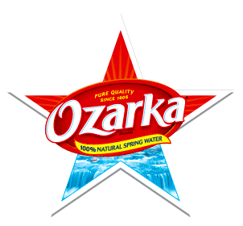
Notes:
Question: Why is all Water Dinosaur Pee?
E.g. OZARKA water is owned by Nestle, and in Texas it is said to be sourced from Natural Springs.
In Texas it is sourced at three different Springs, so each has different pH level
WATER sourced in a State, is NOT subject to FDA jurisdiction. And see Documentary Tapped – only one person works in FD WITH JOB OF OVERSEEING BOTTLED WATER INDUSTRY.
https://www.isitbadforyou.com/questions/is-ozarka-water-bad-for-you
Nestle says ‘Water is NOT a Human Right!’ https://www.nestle-watersna.com/en/bottled-water-brands/ozarka/ozarka-water-quality-report
Bottled Water Leaches dangerous chemicals into what you drink.
Most plastic bottles end up in the land fill
USA consumes 50 billion plastic single use bottles a year, and 77% are not recycled, much of the ones that are, are down-cycled to making polyester shirts, or rugs.
Since plastic invented, and took off in 1950s, then in bottled water in 1970s, we have 9.2 billion tons of it, and more each year than the prior year, and ALL OF IT STILL HERE. Of the 9.2 billion tons, 6.2 billion tons of plastic never reaches the recycling bin, and that which does, most of that is not actually being recycled.
Oil companies had waste gas, ethylene to get rid of, so plastic

Slide 8
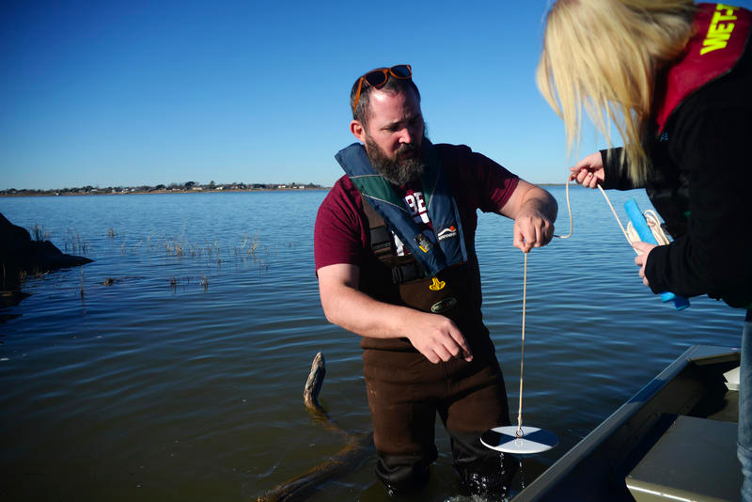
Notes:
HOW DOES SMALL LIFE IN TEXAS LAKES RESPOND TO DROUGHTS? Terrence J. Boyle, McMurry University Assistant Professor of Biology, and future Marine Biologist, Brianna Littlefield use a secchi disk to measure water clarity at Hubbard Creek Lake. TJ is n Invertebrate Ecologist! He is doing a 4 year study of lose of habitats, of macro bentos and what it means for next level up the food chain.
The only natural lake in Texas is Caddo Lake on the Louisiana border, but its artifically sustained by dams. https://m.chron.com/sports/outdoors/article/Natural-lakes-in-Texas-hold-many-hidden-treasures-11291431.php
Dr. TJ Boyle’s research project titled, “Macrobenthic Surveys of 12 Big Country Reservoirs.” His goal is to establish a baseline data set for plankton, periphyton and macrobenthic organisms found in local reservoirs. Or as Boyle puts it- he studies the ecology of “all the little critters without a backbone.” His research also records changes in the ecology of each lake over time, and in West Texas, that means through periods of drought. WHY is the white-fingered mud crab is found in this lake but not in a lake 12 miles away? (it is size of a quarter).
TJ Boyle teashes a class in fresh water ecology at McMurry.

Slide 9
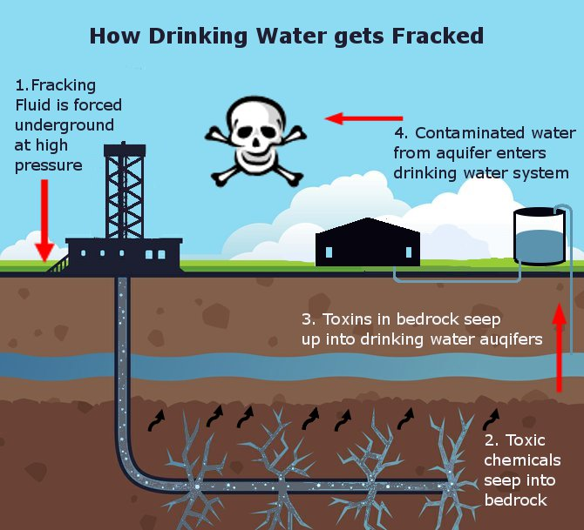
Notes:
https://s3-us-west-1.amazonaws.com/lifeionizers.com/media/blog-images/Fracked.jpg
http://frackingfact.com/fracking_refs.html#contaminated
The fracking industry storytelling is it does not affect aquifers, but the counternarrative is to drill to frack means drilling through aquifers, the well can crack, the deep storage wells can crack and split, crumble and leak.
The problem in the water cycle is major because, the evaporation enters the water cycle, the leaked ground water enter the water cycle, the recycled wastewater sprayed on roads enters the water cycle, the leaking fracking-water into neighboring ground wells, enters the water cycle. Once the water cycle is contaminated, the water enters tap and bottled water. Some fracking wastewater is sued in agriculture, and that also enters the water cycle through drainage, evaporation, and transpiration processes
The industry sponsored sciences, says not a concern
The non-industry sponsored sciences, say yes a big concern
From a creation care standpoint, what do you think?

Slide 10
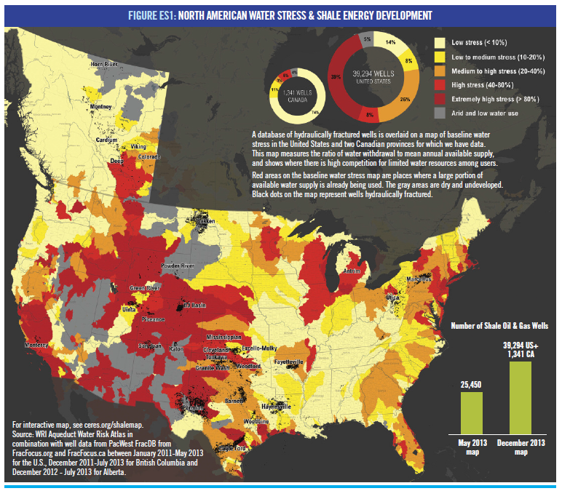
Notes:
http://www.texasvox.org/tag/fracking/
Fracking is wasting and contaminating Texas Water
CERES Report 97 Billion gallons water used (1/2 in Texas) by 39,294 oil and shale gas wells fractured between 2011 and 2013, and Texas is more vulnerable than any other state to WATER DEPLETION
Reservoirs, already low, are being diminished
DOUBLE EDGE SWORD – If fracked water is put in deep wells, then its no longer available to the WATER CYCLE, If fracked water seeps into aquifers, or evaporates from wastewater pond, it enters and contaminates the water cycle. In Texas 5% of fracking waste water reused, 95% put in underground injection wells
Two scientific studies offer evidence of toxicity, with contaminants detected more frequently in counties with the fracking. Benzene, toluene, ethylbenzene, and xylene, etc. Benzene, e.g. is known carcinogen, and all 4 affect kidney, liver, and blood
In retreat from Texas local control, now illegal to do so due to financial contributions to 31 Texas senators of $1.7 million Water=$$$ and to 144 Texas representative of $3.8 million

Slide 11
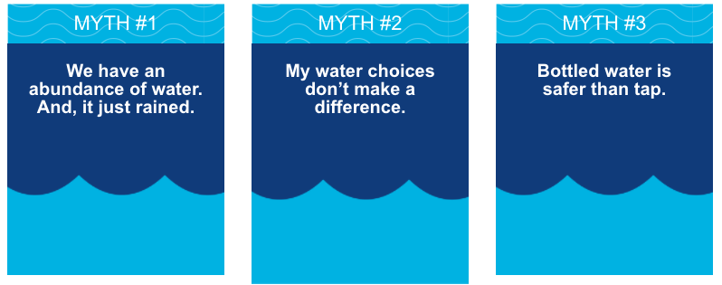
Fact
We depend on our nearby lakes and reservoirs to supply our City’s water.
…., Abilene can face water shortages.
…typical day of rain will make little impact.
Fact
You alone can make a significant difference. Small changes in your routine can cut your water usage by more than half.
Each person in Abilene uses 88 gallons.
If you cut those by half and saved 44 gallons a day, that would be 16,016 gallons of water a year.
Fact
Tap water and bottled water are comparable in terms of safety
What are Abilene’s 3 Myths about Water?
Notes:
FDA oversees the bottled water industry with ONE EMPLOYEE ONLY The EPA, by contrast, requires about 14 tests a day, and a detailed comprehensive analysis of water contaminants be given to the public each year or on demand. Each city or county has municipal water systems that must adhere to the Clean Water Act. Bottled Water manufactures are NOT REQUIRED TO DISCLOSE much at all. Even their labels do not have to be accurate. Most have no wayt to find out.
Only 23% of plastic water bottles are recycled (a high estimate) and of these some are not, and of those that are about 5 or 6 times recycled, and its to land fill or most of them eventually into the oceans. More plastic particles in ocean by weight than fish and other biotic life.
An NRDC.orog study 25-40% of bottled water is tap water in a bottle
Study of 1,000 plastic bottles of 183 brands tested in 3 independent labs found that one third of them had concentrations levels of chemical and or bacterial contaminants exceeding those allowed under state or industry standards.
The BPA to make plastic bottles costs twice what the water does.
If you add up the oil it takes to make the 50 billion plastic water bottles in US each year, it 17 million barrels of oil each year.
PETER GLICK transcript https://www.circleofblue.org/2010/world/the-war-on-tap-water-an-exclusive-excerpt-from-peter-gleicks-bottled-and-sold/
“In the fall of 2007 I attended the IBWA annual convention in Las Vegas. Las Vegas is a pretty incongruous place to hold a bottled water convention. Planted in the heart of one of the driest regions in the United States, it has very limited access to water. Yet the IBWA’s major social event is a golf tournament played on waterintensive grass that consumes precious, limited water. The bottled water convention itself is a cross between a pep rally, a political campaign meeting, and a how-to seminar for individuals hoping to cash in on the bottled water craze. I wandered from session to session, from discussions of marketing strategies to closed-door meetings on how to deal with new regulatory efforts by federal agencies. I listened to talks on how to counter the efforts of anti–bottled water activists and watched demonstrations of the latest machines for bottling water. The culmination of the convention was the keynote presentation of Fred Smith, president of the Competitive Enterprise Institute, which promotes a libertarian, free-market agenda.14 Smith extolled the virtues of a world where business entrepreneurs could make money selling water in bottles. The problem, Smith told me afterward, without a hint of irony, was that water “suffers most from being treated as a common property resource.” Smith believes that “water policy could benefit greatly from exploring the strategies that have been used to produce oil.”
It is this belief that water is fundamentally no different than oil or any other private commodity that lies at the heart of the controversy over selling water. A few months after the IBWA convention, Smith’s Competitive Enterprise Institute launched a special project called “Enjoy Bottled Water” in which they criticize the safety of tap water, ridicule opponents of bottled water, and promote the industry’s merits. “Bottled water is substantially different from tap water,” the CEI website declares. “When compared to bottled water, risks appear to be somewhat higher for tap water. . . . Available data indicates that bottled water has a better safety record.” The CEI is so ideologically anti-regulation that the site says, “The fact that anyone would want to ban or regulate a healthy and safe option like bottled water is really absurd.”

Slide 12
Abilene & Water Early History
Abilene Settlement
Cameron Lake (Cal Young Park)
Lake Abilene (Brazos River Basin)
1881
1883
Lake Fort Phantom Hill
1937
1911
Possum Kingdom
1938
1923 - McMurry University held its formal opening as McMurry College.
Notes:
1876 Once upon a time, Native Americans roamed the land
1881 Abilene Settlement
1883 Cameron Lake (now Cal Young Park)
1911 Lake Abilene (Brazos River Basin)
1937 Lake Fort Phantom Hill
1938 Possum Kingdom,
1961 Hubbard Creek Reservoir
1985 O. H. Ivie Reservoir
See 1883 Map of Abilene Settlement https://upload.wikimedia.org/wikipedia/commons/1/10/Old_map-Abilene-1883.jpg

Slide 13
Abilene & Water Middle History
Hubbard Creek Reservoir
O. H. Ivie Reservoir
DROUGHT 49 Million Gallons Consumed
1961
1985
new reservoir (Cedar Ridge) PROPOSED
2005
1985
DROUGHT 37 Million Gallons Consumed 2011
Notes:
1961 Hubbard Creek Reservoir
1985 O. H. Ivie Reservoir
1985 - Abilene Drought, greatest day of water consumption, 49 million gallons of water
2005 - Abilene’s Mayor Norm Archibold proposes new reservoir (Cedar Ridge)
2011 - Abilene worst drought & highest temperature, but only 37 million gallons of water were used. Amazing that Abilene used 1 billion fewer gallons than we did in 1998 and we even had 14,000 more residents.
City of Abilene Water Conservation Plan Year-Round Water
Stage 1 Water Alert
Stage 2 Water Warning
Stage 3 Water Emergency
Stage 4 Water Crisis
ABILENE WATER MANAGEMENT of WATER SHORTAGES AND WATER STRESS
First offense: Minimum $50
Second offense: Minimum $75
Subsequent offenses: Minimum $250
Termination of water service for repeat violations.
Reconnect fee: $250
Failure to pay penalty: $250 which can be applied to water bill.
Fraudulent misrepresentation of well water use: $500
Drought conditions in the late 1980s and again in 1999-2000 spurred city leaders to plan for Abilene's future water needs. HOW?
Purchase of water from a third reservoir, Lake O.H. Ivie, 86 miles south of Abilene.
New reclaimed water use program that provided treated wastewater effluent to large irrigation customers, such as golf courses, parks, and universities, which previously used drinking water to nourish their green spaces.
Creation of Abilene's water conservation plan

Slide 14
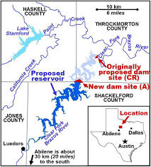
Abilene & Water Its Future
Stage 2 IN EFFECT
Cedar Creek Reservoir Plan
2014- 2015
2018
Environment Impact Report Due
2020
2019
Population Expected Increase 120K to 145K 2070
Today New Reservoir or New Pipeline or ???
Notes:
2014 - October 2014 through June 2015, the City of Abilene was in Stage 2 conservation, still two stages from a water crisis
2015 - Hubbard Creek fell to a dangerous 12 percent capacity, carrying about 14 billion gallons of water; O H Ivie Reservoir was also at 12 percent capacity, holding 23 billion gallons; Fort Phantom Hill was down to 30 percent capacity with just 6 billion gallons of water
2018 - O H Ivie is just about 17 percent full today. Hubbard, fluctuating, but standing strong.
2018 - Cedar Ridge Reservoir Plan, with potential to bring millions of gallons of water into the West Texas water supply; flood more than 65 hundred acres of land north of Abilene
2019 - Decisions Today affect FUTURE Water for Abilene for next 50 years. City of Abilene treats on average--20 million gallons of water a day. $290 million price tag for Cedar Ridge Reservoir —a price that would fall on the people of Abilene? Or, would a pipeline from the Clear Fork of the Brazos to Hubbard Creek Reservoir would be the better project.
2020 - Environmental Impact Statement will be available for public review
2022 -Decision made to proceed with Cedar Ridge reservoir, or pipe line, or other option
2070 - City of Abilene is expected to grow from 120,000 people to 145,000 people, Texas Water Development Board estimates
City narrative: “It's not just the number of people that will be in the region, but it will also be manufacturing it will also be agriculture the feeding of cattle,” said Archibald. “This has never been about the next five years or the next 10 years, it’s been about the next 50 years,” said Archibald.
Counternarrative: Janice Bezanson has been with the Texas Conservation Alliance for more than 30 years--and she stands against the Cedar Ridge Reservoir. “Abilene has done an absolutely wonderful job developing water they've done it just right and the result is that now, Abilene has way more water than they will actually need or are projected to need into the future,” said Bezanson. According to Bezanson, a pipeline from the Clear Fork of the Brazos to Hubbard Creek Reservoir would be the better project.“ We had an engineer look at it, he came up with $51 million to get about two thirds as much water as Cedar Ridge would build,” said Bezanson.
Other Voices: “The state law will decide how much water actually might be available or how much water the city is allowed to take,” said Chandler Peter, a technical specialist with the U.S. Army Corps of Engineers.
Other Voices: “There’s a requirement that there's a certain amount of water flow in the river all the way down the river, so we'd be concerned about making sure that still happens,” said Sandra Skrei, with Friends of the Brazos. Skrei said she's been fighting upstream construction along the Brazos for years.
Other Voices: Ecosystem: “For Cedar Ridge — inundating more than 6 ,000 acres along the Clear Fork of the Brazos -- would not only divert water but change the ecosystem in the area.’ “Before, we've had trouble with fish kills because of algae in the water because of decreased flow,” said Skrei.
Sources:
http://abilenetx.gov/living/history-information
http://www.twdb.texas.gov/surfacewater/rivers/reservoirs/abilene/index.asp
https://ktxs.com/news/big-country/cedar-ridge-reservoir-a-need-or-a-want
https://www.bigcountryhomepage.com/news/main-news/cedar-ridge-reservoir-could-be-created-as-abilenes-5th-water-source/1001355791
https://www.reporternews.com/story/news/2018/03/30/progress-cedar-ridge-still-hope-50-year-water-supply-abilene/365588002/

Slide 15
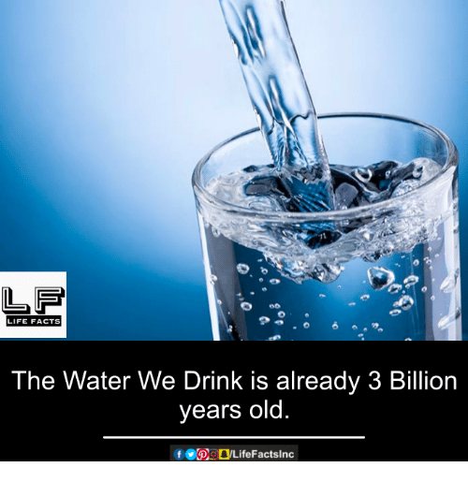
Water= $
3
Water= Thirst
2
Water= Denial
4
Water=Desire
1
Water= Matter
9
Water= Life
5
Water= Ethics
8
Water= Memory
6
Water= Spirit
7
Notes:
Water=Desire is a marketing and advertising game to build desire for water.
Dita Von Teese douses herself in Perrier in this popular ad designed to equate WATER with DESIRE https://www.youtube.com/watch?v=aRTYDUS8fp0
Twilight Actress, Ashley Greene, endorses SoBe Lifewater in an ad that features her wearing nothing but body paint.
Mark Wahlberg endorses this high performance sports water in a commercial that features him in the middle of an intense workout. Recently, Wahlberg teamed up with IZOD and AquaHydrate in a strategic marketing partnership to promote the brands through the IZOD IndyCar Series.
When Coca-Cola tried to Sell Dasani Bottled Water with SPUNK ads (it flopped) https://www.youtube.com/watch?v=TK4IhaLwXVc
Jennifer Aniston Video selling SMART WATER (Glaceau Coca-Cola) with humor and with Sexual posing and with dancing babies to appeal to another demographic http://www.filtersfast.com/blog/index.php/2010/06/celebrities-for-bottled-water/
Nestle’s PURE LIFE bottled water ad sells theDESIRED FUTURE = BOTTLED WATER https://www.youtube.com/watch?v=Aa6a6qOu-aM
QUESTION: Why do we Drink Cleopatra’s Bathwater?
ANSWER: Water is a closed loop planetary system.
We have the same water that we had at GENESIS or for Atheists BIG BANG, 3-4.5 billion years ago
Water recirculates in the closed loop water cycle between surface water, ground water, evaporation to atmosphere, precipitation, etc.
Our bodies are 55% to 75% water
Our bodies are 37.2 trillion living cells, that are mostly composed of water

Slide 16
Water= $
3
Water= Thirst
2
Water= Denial
4
Water=Desire
1
Water= Matter
9
Every Day 6,000 children die of water-borne diseases that are preventable
Water= Life
5
Water= Ethics
8
Water= Memory
6
Water= Spirit
7
Notes:
Water=Desire is a marketing and advertising game to build desire for water.
Americans consume 50 billion single use plastic water bottles a year
It takes 3x the water to make the bottled water as it does tap water, which is not counting the VIRTUAL WATER going into the production and distribution process. https://pacinst.org/publication/bottled-water-and-energy-a-fact-sheet/
2009 study shows it takes 2000 times more energy to make and distributed bottled water than your tap water https://pacinst.org/news/352/
Bottling water produced more than 2.5 million tons of carbon dioxide
LIFE WTR
The launch of LIFEWTR is especially intriguing because PepsiCo has a big, bottled water brand already. It owns Aquafina, which is one of the company's 22 “billion-dollar brands” and already dominates the $185 billion global bottled water market http://fortune.com/2016/12/09/pepsico-new-premium-water/abcklash- some calling it Satanic Anti-Life WTR https://me.me/i/pepsis-newsatanicline-pepsi-life-beb-life-wtr-wtr-666-united-8373877 http://www.evilyoshida.com/thread-13354.html
There is a b

Slide 17
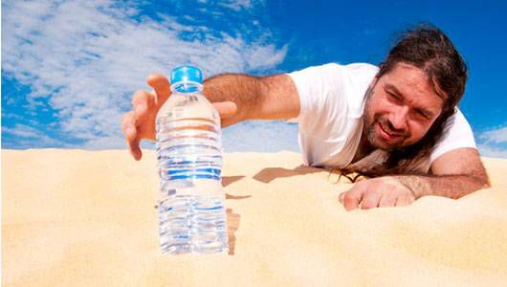
Water= $
3
Water= Thirst
2
Water= Denial
4
Water=Desire
1
“When drinking water meets federal standards, there may not be any health-base benefits to purchasing bottled water or point of use devices” Source p. 13 ABILENE ‘WATER QUALITY REPORT.’
Water= Matter
9
Water= Life
5
Water= Ethics
8
Water= Memory
6
Water= Spirit
7
Notes:
https://saveabilenewater.com//wp-content/uploads/2015/03/Water_Stage_Chart.pdf

Slide 18
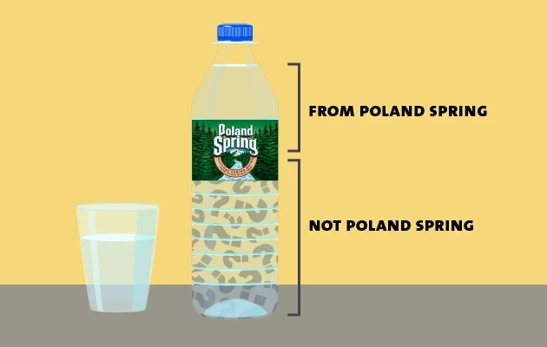
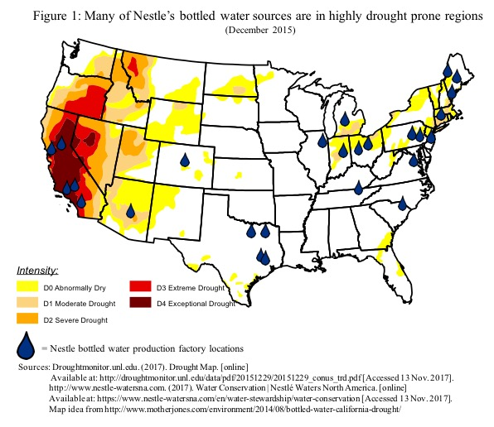
Water= $
3
Water= Thirst
2
Water= Denial
4
Water=Desire
1
Nestlé mines water in areas with weak water laws:
Maine and Texas operate under a remarkably lax rule from the 1800s called “absolute capture,” which lets landowners take all the groundwater they want.
Water= Matter
9
US is largest consumer of bottled water in the entire world
50 Billion water bottles/year US
Water= Life
5
Water= Ethics
8
Water= Memory
6
Water= Spirit
7
Notes:
FACT: US is largest consumer of bottled water in the entire world: 50 billion single-use plastic water bottles,
GETS WORSE: 250 Billion beverage bottles made of plastic sold in USA, 69% go to landfill
USA=> 8.6 billion gallons a year in 2017; Average US consumer 21 gallons a year
Bottled water costs consumers 3 to 7 times more water in production than tap water & costs 1,000 times more
50 billion bottles of water in plastic sold in US each year.
They say 23% recycled, most of other 38 billion single use bottles make their way to the ocean
In 1999 Charles Moore found 6 times more plastic than plankton, by 2008 it was 46 times more, a huge increase
rPET is the new storytelling of how to make plastic beverage drinks healthy for people & planet
But the the plastic fiber in rPET breaks down, putting microplastics, and then nanoplastic particles into the water
PepsiCo says its consumers are INDIFFERENT to plastic effect on health and ecology, so it refuses to put post-consumer content on its labels
This goes back to Water=Desire is being manipulated by advertising
Poland Springs water does not come from Poland Springs, Maine, not much of it, less than 30%, and its mostly well water that is being mislabeled as spring water.
Looking at the places Nestle (owner of Poland Springs, Arrowhead Mountain, etc) sinks their wells, much of it is in draught areas
In Texas, so far, its in areas not hit by drought.

Slide 19
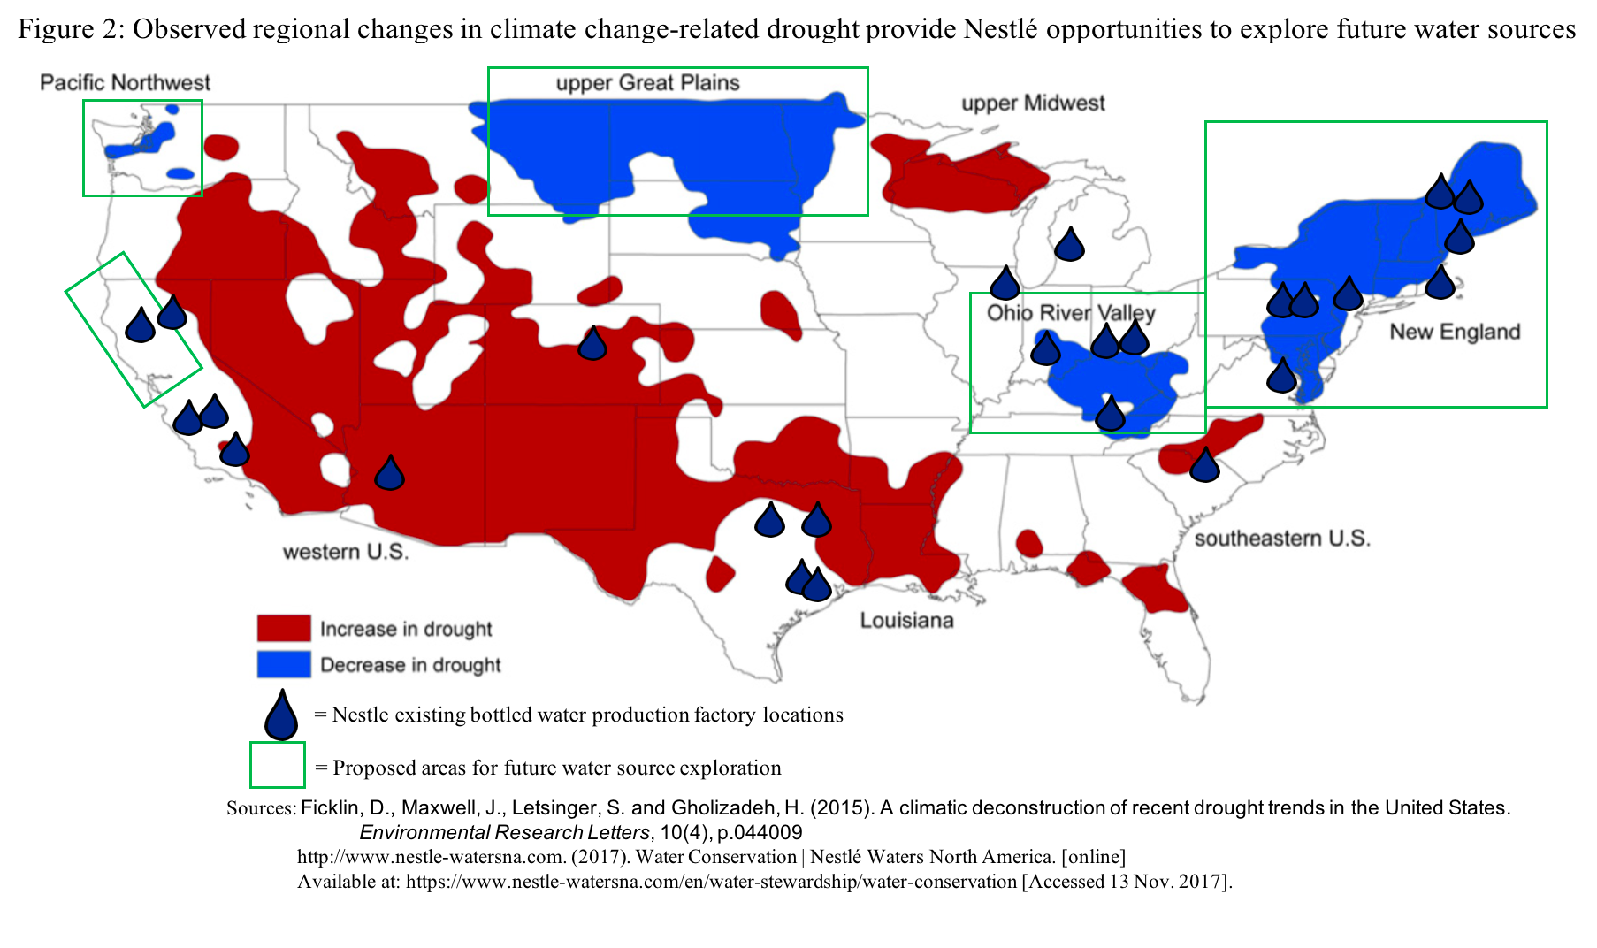
Notes:
Not just Nestl
In North Carolina PepsiCo pumped 400,000 gallons a day mostly shipping it out of the state

Slide 20
Water= $
3
Water= Thirst
2
Water= Denial
4
Water=Desire
1
By 2025 UN predicts 66% of world’s people will live in countries with high water stress = 5.3 billion
Water= Matter
9
Water= Life
5
Water= Ethics
8
Water= Memory
6
Water= Spirit
7
Notes:
https://saveabilenewater.com/our-lakes/
https://saveabilenewater.com//wp-content/uploads/2015/03/Water_Stage_Chart.pdf

Slide 21
Where does Abilene’s Water go?
THIS IS ABILENE’s WATER TREATMENT
2017- It has 936 miles of pipe and repaired 424 leaks
Lake Fort Phantom Hill 1.934 billion gallons
Hubbard Creek Reservoir 3.800 billion gallons
Lake O.H. Ivie 1.860 billion gallons
TOTAL 7.594 billion gallons
Abilene treated 7.477 billion gallons of water
Maximum capacity of Abilene plant is 22 million Gallons per day
Notes:
https://saveabilenewater.com/wp-content/uploads/2018/08/Water-Quality-Annual-Report-2017-Abilene.pdf
2017- Abilene treated 7.477 billion gallons of water
It has 936 miles of pipe and repaired 424 leaks
Lake Fort Phantom Hill 1.934 billion gallons
Hubbard Creek Reservoir 3.800 billion gallons
Lake O.H. Ivie 1.860 billion gallons
TOTAL 7.604 billion gallons

Slide 22
Water= $
3
Water= Thirst
2
Water= Denial
4
Water=Desire
1
Faced with Doomsday Water Scenarios, human inclination is denial
By selectively filtering-in what AFFIRMS & CONFIRMS self-interest
Be selectivity filtering-out what Disaffirms & Refutes self-interest
Therefore ‘storytelling science’ needed to do refutations of denial
Water= Matter
9
Water= Life
5
Water= Ethics
8
Water= Memory
6
Water= Spirit
7
Notes:
Former Gov. Rick Snyder is again a defendant in Flint water class action lawsuit
By STEVE CARMODY • APR 1, 2019
One story (unconfirmed) is Flint Michigan was a greedy plot to make $ from having to sell more bottled water. Beneath the surface, bottled water companies do engage in ads disparaging the quality and safety of tap water.
The Flint water crisis began in 2014, after the drinking water source for the city of Flint, Michigan .... October 15 – Michigan Governor Rick Snyder signs a bill for $9.35 million to re-connect to Detroit water and provide relief. The switch is made https://www.michiganradio.org/post/former-gov-rick-snyder-again-defendant-flint-water-class-action-lawsuit

Slide 23
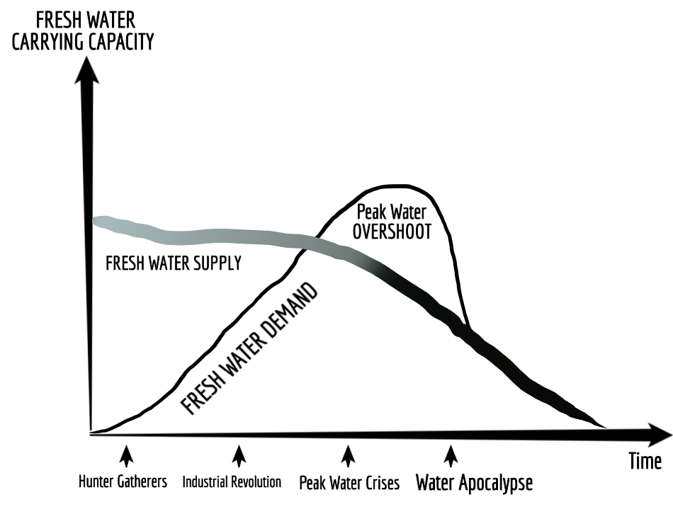
Water= Denial
4

Slide 24
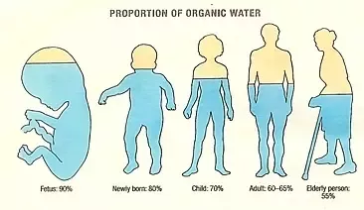
Water= $
3
Water= Thirst
2
Water= Denial
4
Water=Desire
1
Water= Matter
9
Water= Life
5
Water= Ethics
8
Water= Memory
6
Water= Spirit
7
Notes:
Water=Life. Water is an ecological necessity
The human body is 60 to 75% water depending on age and gender. Each human body has 37.2 trilliion living cells, allof them have water or they die.

Slide 25
Water= $
3
Water= Thirst
2
Water= Denial
4
Water=Desire
1
Water= Matter
9
Water= Life
5
Water= Ethics
8
Water= Memory
6
Water= Spirit
7

Slide 26
Water= $
3
Water= Thirst
2
Water= Denial
4
Water=Desire
1
And the earth was without form, and void; and darkness was upon the face of the deep. And the Spirit of God moved upon the face of the waters
Water= Matter
9
Water= Life
5
Water= Ethics
8
Water= Memory
6
Water= Spirit
7

Slide 27
Water= $
3
Water= Thirst
2
Water= Denial
4
Water=Desire
1
And God said, Let there be a firmament in the midst of the waters, and let it divide the waters from the waters
Water= Matter
9
Water= Life
5
Water= Ethics
8
Water= Memory
6
Water= Spirit
7

Slide 28
Water= $
3
Water= Thirst
2
Water= Denial
4
Water=Desire
1
And God made the firmament, and divided the waters which were under the firmament from the waters which were above the firmament: and it was so
Water= Matter
9
Water= Life
5
Water= Ethics
8
Water= Memory
6
Water= Spirit
7

Slide 29
Water= $
3
Water= Thirst
2
Water= Denial
4
Water=Desire
1
But there went up a mist from the earth, and watered the whole face of the ground
Water= Matter
9
Water= Life
5
Water= Ethics
8
Water= Memory
6
Water= Spirit
7

Slide 30
Water= $
3
Water= Thirst
2
Water= Denial
4
Water=Desire
1
Question: What does ‘Radah’ mean in Genesis 1:28
Water= Matter
9
Water= Life
5
Water= Ethics
8
Water= Memory
6
Water= Spirit
7
Notes:
King James Bible: “And God blessed them, and God said unto them, Be fruitful, and multiply, and replenish the earth, and subdue it: and have dominion over the fish of the sea, and over the fowl of the air, and over every living thing that moveth upon the earth” https://www.kingjamesbibleonline.org/Genesis-Chapter-1/#28

Slide 31
Water= $
3
Water= Thirst
2
Water= Denial
4
Water=Desire
1
“And God blessed them, and God said unto them, Be fruitful, and multiply, and replenish the earth, and subdue it: and have dominion [Radah] over the fish of the sea, and over the fowl of the air, and over every living thing that moveth upon the earth” King James G 1.28
Water= Matter
9
Water= Life
5
Water= Ethics
8
Water= Memory
6
Water= Spirit
7
Notes:
Point: 1611 King James reflect the Renaissance period of English monachy where kings wanted a ‘Radah’’=$, interpretation
Wartman (2003: 16 )Steffen argues “that by translating the Hebrew word radah into the English word dominion, the authors of the King James Bible played on meaning appropriate to that English word in its particular historical and cultural context” (66, footnote 3). https://scholarcommons.usf.edu/cgi/viewcontent.cgi?referer=https://scholar.google.com/&httpsredir=1&article=2508&context=etd
1620 Francis Bacon invents ‘Scientific Method’ and say ‘Nature is enemy to be crushed and conquered’, as Radah.
King James Bible: “And God blessed them, and God said unto them, Be fruitful, and multiply, and replenish the earth, and subdue it: and have dominion over the fish of the sea, and over the fowl of the air, and over every living thing that moveth upon the earth” https://www.kingjamesbibleonline.org/Genesis-Chapter-1/#28

Slide 32
Water= $
3
Water= Thirst
2
Water= Denial
4
Water=Desire
1
Francis Bacon 1620, who invented Scientific Method, said: -- ‘Nature as the enemy to be crushed and conquered’ - THE NEW ORGANON
“Like the Hebrew notion of radah, [John] Locke’s view of dominion is one of responsible stewardship” (Wortman, 2003: 28)
Water= Life
5
Water= Matter
9
Water= Ethics
8
Water= Memory
6
Water= Spirit
7
Notes:
See Marty Wortman (2003) dissertation
Wortman, Marty J. (2003). Dwellness: A radical notion of wilderness.Accessed Apr 14 2019 at https://scholarcommons.usf.edu/cgi/viewcontent.cgi?referer=https://scholar.google.com/&httpsredir=1&article=2508&context=etd
BUT 1969 when Cuyahoga River caught fire in Ohio
Be an Earth Keeper – Environmental Justice see https://www.umccreationcare.org/
Caring for Creation: A call for Stewardship and Justice, see 2016 Book of Resolutions, #1033
The covenant to protect and defend God’s creation. https://www.umcjustice.org/who-we-are/social-principles-and-resolutions/caring-for-creation-a-call-to-stewardship-and-justice-1033
See
Poole, Kelsey. (2010). “Ecotheology and the United Methodist Church. Accessed Apr 16 2019 at https://dra.american.edu/islandora/object/0910capstones%3A67/datastream/PDF/view
Poole asks, ‘What does God mean by dominion, the radah Hebrew word. Many now believe that Radah has a different meaning than the modern world has given to it. Instead of an Anthropocentric religion, are people called to stewardship? Greek word for ‘steward’ is oikonomos. Stewardship implies humans are part of nature, and the well-being of life depends on stewardship of nature, including Boje’s focus on water care.
The story of Genesis 2 reveals complete and harmonious interrelatedness of creation with humankind and all creation (Colossians 1:15-20)
Uncheced consumption and development patterns are unsustainable to creation, and bringing increased inequality around the world https://www.umcjustice.org/who-we-are/social-principles-and-resolutions/caring-for-creation-a-call-to-stewardship-and-justice-1033

Slide 33
Water= $
3
Water= Thirst
2
Water= Denial
4
Water=Desire
1
Psalm 72:8, 12-14 “May he rule (Radah) from sea to sea and from the River to the ends of the earth…”
Water= Matter
9
Water= Life
5
Water= Ethics
8
Water= Memory
6
Water= Spirit
7
Notes:
Psalm 72:8, 12-14 “May he rule (Radah) from sea to sea and from the River to the ends of the earth. For he will deliver the needy who cry out, the afflicted who have no one to help. He will take pity on the weak and the needy and save the needy from death. He will rescue them from oppression and violence, for precious is their blood in his sight.”
1620 Francis Bacon invents ‘Scientific Method’ and say ‘Nature as enemy to be crushed and conquered’, as Radah.
Exact phrase “For man by the fall fell at the same time from his state of innocency and from his dominion over creation” OR TRUE DIRECTIONS CONCERNING THE INTERPRETATION OF NATURE
L2 https://www.constitution.org/bacon/nov_org.htm
1969 when Cuyahoga River caught fire in Ohio
In 2019 United Methodist Creation Care Conference will be held in Nashville, TN, July 11-13 https://www.umccreationcare.org/
There is a Global Ministries Earthkeepers Program with trianing application announced for 2019.
For Psalm 72:8, 12-14 study of Radah see https://veritas.community/veritas-community/2015/04/20/the-generous-life-week-2-stewardship-of-the-environment
See Gen @:% study of Radah at http://www.abxn.org/radah.html
A Majority of Christians believe God has called them to care for the world -- https://www.deseretnews.com/article/865621588/A-majority-of-Christians-believe-God-has-called-them-to-save-the-world.html This is also source of Francis Bacon quote

Slide 34
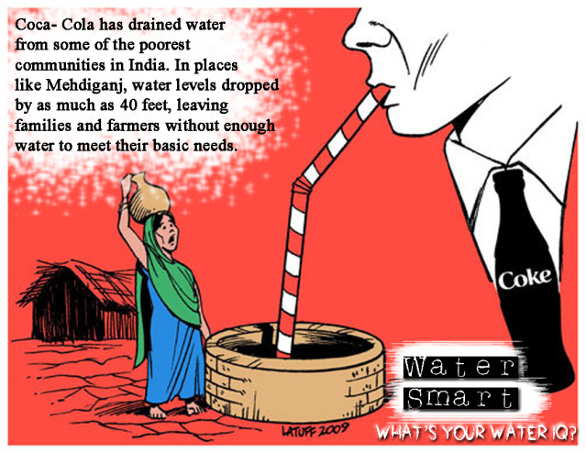
Water= $
3
Water= Thirst
2
Water= Denial
4
Water=Desire
1
Water=Ethics means what United Methodists call ‘Creation Care’ and Justice.
QUESTION: How to be an earth Keeper? A Water Protector?
Water= Matter
9
Water= Life
5
Water= Ethics
8
Water= Memory
6
Water= Spirit
7
Notes:
The implication of Creation Care is for United Methodists to hold conferences and studies on ‘Water=Ethics”
https://www.umccreationcare.org/#!about_us/csgz

Slide 35
Water= $
3
Water= Thirst
2
Water= Denial
4
Water=Desire
1
WATER=MATTER: Are we all drinking the same water the Apostle’s bathed in?
Water= Matter
9
Water= Life
5
Water= Ethics
8
Water= Memory
6
Water= Spirit
7
Notes:
For some United Methodists, Creation Care is a biblical mandate https://www.umnews.org/en/news/assuming-role-of-creation-care-as-gods-mandate
God’s first word to Adam was ‘to till and keep the earth’
The spring conference in Atlanta, of Methodist Church had the them “Let Justice Roll Down Like Waters.
See Caretakers for God’s Creation United Methodist’s website https://www.umccreationcare.org/#!about_us/csgz

Slide 36
Water= $
3
Water= Thirst
2
Water= Denial
4
Water=Desire
1
YES, USA 4.25 billion prescriptions/year
Studies find more Meds in Rivers, Lakes, Reservoirs, and, in drinking water
QUESTION: Does the water we drink contain Prescription Meds, Animal Growth hormones, nicotine, caffeine, fertilizers, pesticides?
Water= Matter
9
Water= Life
5
Water= Ethics
8
Water= Memory
6
Water= Spirit
7
Notes:
Unsafe water kills 200 children every hour of diarrheal, malaria, parasites
3.4 million people, mostly children die each year of water-borne diseases.
11 million children die each year of mostly quite preventable diseases before reaching their 5th birthday! And ½ of world’s population suffering from 1 or more water-related diseases.4 billion annual cases of diarrheal water-borne disease cause 2.2 million deaths a year, mostly of children under five https://www.unicef.org/media/media_21423.html
QUESTION: Does the water we drink contain Prescription Meds, Animal Growth hormones, nicotine, caffeine, fertilizers, pesticides?
YES, Mayo Clinic study says Pain Killers top list of Meds taken in USA, and USA consumes more than other nations
Leading cause of death now among people under 50 is opioid Med overdose, 59,000 deaths a year (19% up from year before) https://www.cbsnews.com/news/overdoses-are-leading-cause-of-death-americans-under-50/
Study in 2008 found Mood altering Meds in tap water in 24 municipalities, and 34 other that don’t test at all Americanlives.org
THEREFORE: Need more research into water treatment methods that can remove Meds from not just drinking water but entire Closed Loop Water Cycle
Another study found 47 different Meds in samples of drinking water before water treatment plants, and 37 still there after treatment tonicvice.com
QUESTION: WHY are people in US, UK, Western Europe using so many Meds? Why the upward trend?
ANSWER: People seeking quick fix to health instead of exercise, changing drink and food habits, or changing their life/work styles
Age 50 to 65, average # of Meds is 19.2. Number of Meds drops after age 65
Drug companies charge Americans 2 and 3 times price of same drugs sold in UK or Switzerland healthsystemtracker.org
HOW TO FILTER MEDS FROM WATER? Reverse Osmosis is best, but tastes Yuk; Activated Charcoal filters some
Most bottled water contains Meds, Caffeine, and Nicotine
Study in Spain found 58 active Meds in 10 bottled water brands
Study in UK found Meds in ground water, drinking water, and says bottled water often uses no filtration or filtration designed for Macro-Pollutants, NOT the Micro-Pollutants
See book by Cases Adams, Pure Water
Study by Scientific America.com finds Meds in 80% of samples of USA groundwater, rivers, lakes, estuaries, and affects the drinking water of 40 million Americans.
THEREFORE: We can conclude from the Statistical Storytelling that 11 million children die each year of preventable diseases, most of them involving water quality and sanitation practices
We can also conclude that Closed Loop Water Cycle of the World is being Over-Medicated, and the kinds of Filtration Systems being used and regulated are not getting at the root causes of the problem of decreasing worldwide fresh water quality control, and we are slipping into a downward spiral, hovering over the abyss, which makes Water=Denial and escapism popular option, rather than actually getting at Water= 5, 6, 7, 8, 9, we expect Water-3 to solve Water=2, but fail to understand Water+1, 4,7 8, & 9.
56 meds found in drinking water
CA has meds such as sex hormones
3 kinds of meds in AZ
There are no federal regulations for meds in the drinking water of America. So anyone can dump any med in the water, and there are no testing going on. NY state refused to test their water for meds. Then USDA stepped in and found lots of different meds. But NYC drinking water continues to meet all federal EPA regulations (because there aren’t any).
90% of bottled water, come from tap supplies, and it still has the pharmaceutical in it. No telling the long term side effects of ingesting meds in bottled water.
US citizens take 4.25 billion pills a year, https://www.youtube.com/watch?v=qGWWarqyp8I Drugs in Drinking Water Mind Control and Others Must Watch
7 EXAMPLES:
J&J 2006 $11 billion profit
Pfizer $19.3 billion profit(viagra)
GSK $10.1 billion profit
Merck $4.4 billion profit
Abbott 1.7 billion profit
P&G 1$0.3 billion profit
Genetech $2.1 billion profit

Slide 37
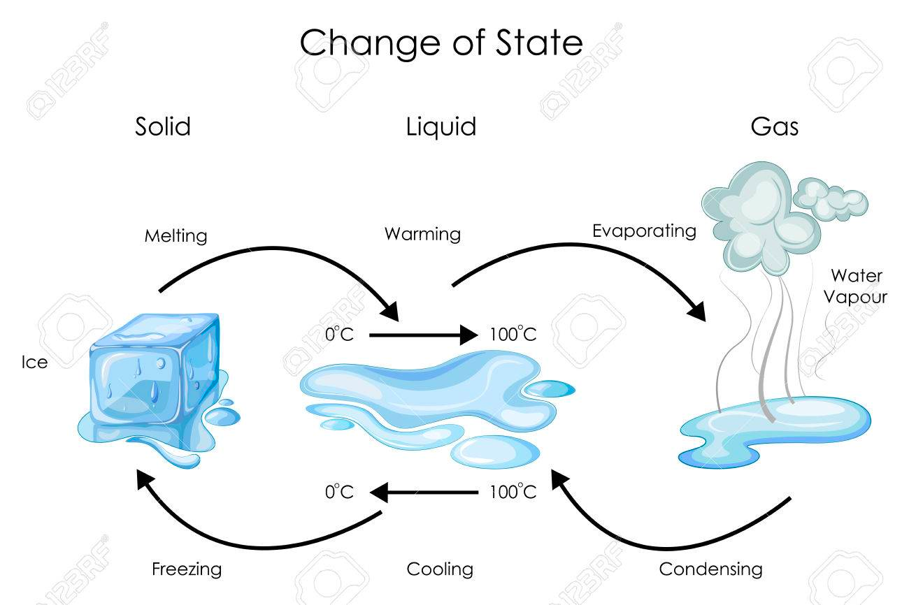
Water= $
3
Water= Thirst
2
Water= Denial
4
Water=Desire
1
Water= Matter
9
Water= Life
5
Water= Ethics
8
Water= Memory
6
Water= Spirit
7
Notes:
Quantum Water is the 4th State of water, so this is a complete anomaly changing what we know of Hydrology,
It has implications for the study of water, for ‘creation care’ for water justice.
The new Quantum Water (4th State of Water) can mean new ways of Provision of Water for the People, Animals, Plants, and so on of the world. It can mean new solutions to “creation care.” https://www.umccreationcare.org/#!about_us/csgz
Ronald Gurney first predicted quantum tunneling of water in 1931. It is being confirmed by numerous experiments that violate the laws of classic physics. So the quantum theory of wave-particle duality is one theory. The spin theory of the oxygen ears is an alternative, as is the Einstein theory that particles are smeared waves.

Slide 38
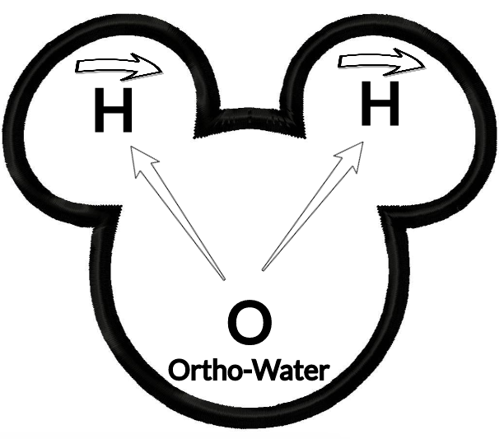
Water= $
3
Water= Thirst
2
Water= Denial
4
Water=Desire
1
Water= Matter
9
Water= Life
5
Water= Ethics
8
Water= Memory
6
Water= Spirit
7
Notes:
25.4 billion hydrogen atoms would make 1 inch

Slide 39
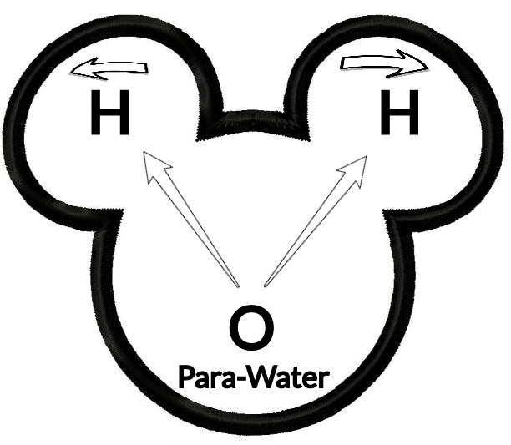
Water= $
3
Water= Thirst
2
Water= Denial
4
Water=Desire
1
Water= Matter
9
Water= Life
5
Water= Ethics
8
Water= Memory
6
Water= Spirit
7
Notes:
The Ortho-water and Para-Water are what is theorized to be constitutive of the universe, and forms clouds in particular areas of space.

Slide 40
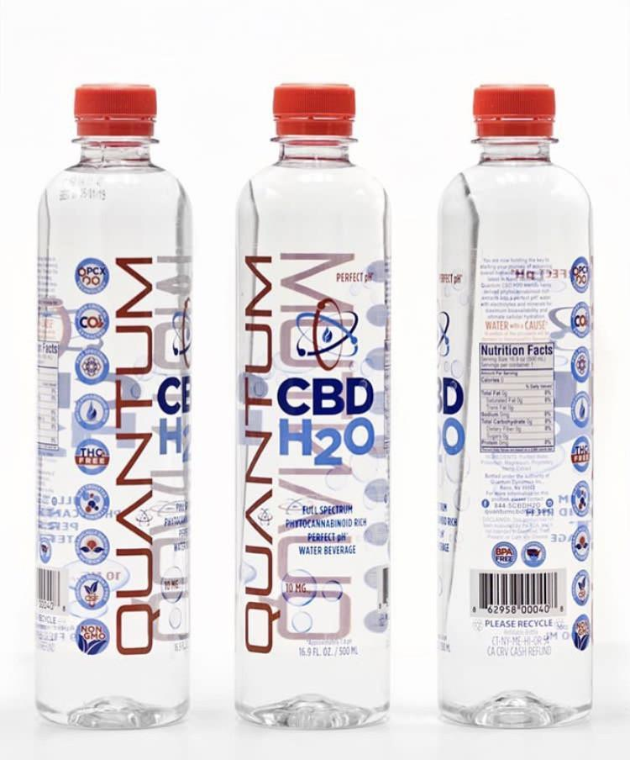
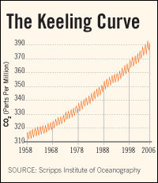
Water= $
3
Water= Thirst
2
Water= Denial
4
Empirical evidence:
Collapsing aquifers,
60% die-off of marine life in last few decades,
Deforestation,
Desertification,
Bioaccumulation of carcinogenic toxins, and
Keeling’s Curve of CO2 Climate Change summarily ignored by those in Water=Denial
Water=Desire
1
Water= Matter
9
Water= Life
5
Water= Ethics
8
Water= Memory
6
Water= Spirit
7
Notes:
The quantum tunneling of water occurs when water molecules in nanochannels exhibit quantum tunneling behavior that smears out the positions of the hydrogen atoms into a pair of corrugated rings. In that state, the water molecules become delocalized around a ring and assume an unusual double top-like shape.
The bottled water part is a joke sort of being played by https://www.quantumpcr.com/ https://www.terrawellnessok.com/12_pk_quantum_cbd_h20
It is water, it is for sale, but not really quantum in the scientific sense of the term
“QUANTUM PCR H2O uses a broad spectrum, hemp derived formula to provide CBD along with additional active cannabinoids and terpenoids providing maximum efficacy with a unique and familiar flavor profile”
See Roberto Car from Princeton University, “Quantum Physics in a Glass of Water” https://www.youtube.com/watch?v=SXqDhu4AEF8
https://www.livescience.com/62708-water-two-kinds.html
Second company -- http://www.quantumagua.com/quantum_en.html Quantum Water --- Quantum is derived from the springs deep within the mountains of the Juan Castro Blanco Water National Park of Costa Rica. The sedimentary rocks act as a natural filtration system, controlling the levels of acidity and minerals creating an ideal PH7.+. Quantum is not chemically processed in any way. We at Quantum know that what you drink is just as important as what you eat. This clean, crisp water will keep you hydrated and refreshed. Premium water created by nature and brought to you by Quantum.”
See Youtube “Water and Quantum Physics; The Perfect Couple” https://www.youtube.com/watch?v=sVIX3fnTCg0 by Marta from

Slide 41
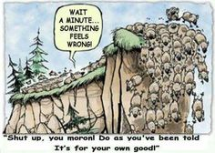
FINAL QUESTION about Water=DENIAL & Water=Spirit: JUST HOW BAD DOES WATER SHORTAGE HAVE TO BE BEFORE WE BELIEVE AND CHANGE OUR BEHAVIORS FROM DOMINATION Radah TO STEWARDSHIP Radah?
Water= Denial
4
Water= Spirit
7
Notes:
For some United Methodists, Creation Care is a biblical mandate https://www.umnews.org/en/news/assuming-role-of-creation-care-as-gods-mandate
God’s first word to Adam was ‘to till and keep the earth’
The spring conference in Atlanta, of Methodist Church had the them “Let Justice Roll Down Like Waters.
See Caretakers for God’s Creation United Methodist’s website https://www.umccreationcare.org/#!about_us/csgz
“Whether it’s clean water, chemical free food [& water], or healthy air [& water], millions of disadvantaged populations [& Abilene population] are affected by these environmental effects” says Beth Bond, member of Decatur First Methodists. She continues “as God’s people, part of us taking care of these sensitive populations, is taking care of the planet. Creation care is a key component of social justice” https://www.umnews.org/en/news/assuming-role-of-creation-care-as-gods-mandate
http://www.abxn.org/nv/shepherds.html Radah as Self-Giving love instead of Water=DESIRE, the Ego trip
Thanks to Marty Wortman, Dean at Dona Anna Community College for referring me to his dissertation, which is about the misinterpretation of Radah for over 400 years. See Wortman, Marty J. (2003). Dwellness: A radical notion of wilderness.Accessed Apr 14 2019 at https://scholarcommons.usf.edu/cgi/viewcontent.cgi?referer=https://scholar.google.com/&httpsredir=1&article=2508&context=etd
Wartman (2003: 10): “Referring to the original Hebrew, Steffen states that radah (dominion) means to govern, rule and to have dominion:
‘The verb was employed to refer in a general way to the rule of kings over territory, masters over servants, and the rule of God either over land or in the midst of God’s enemies. Outside of Genesis, the verb is used only five other times, and in each context, something other than oppressive power relations is connoted. (64-65).”

Slide 42
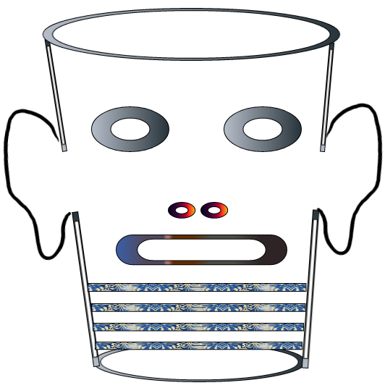
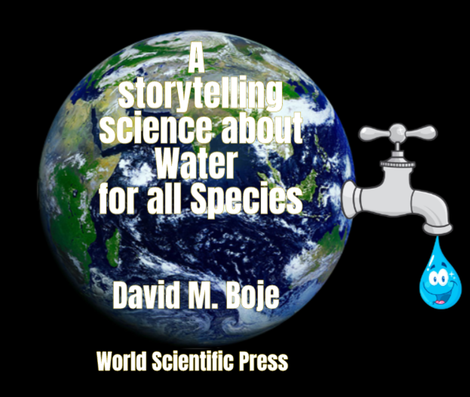
Storytelling Science and Your Dissertation
David M. Boje & Grace Ann Rosile
UK, US, Singapore: World Scientific
February 21, 2019; Revised March 19, 2019
Thank You: Any Questions?
Download Storytelling Science book and slides for this presentation at https://davidboje.com/Abeline
Notes:
If you have and comments or questions contact me at davidboje@gmail.com
Thank you

