Slide 1
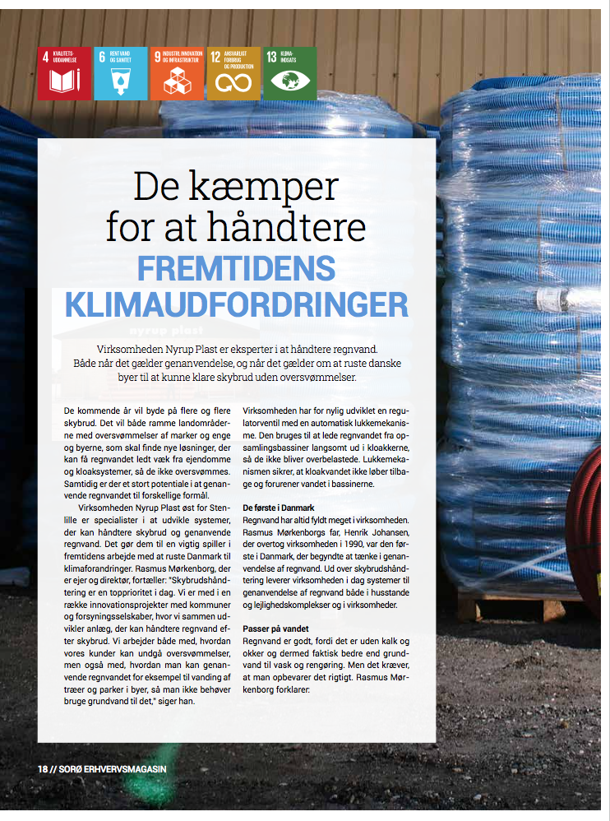
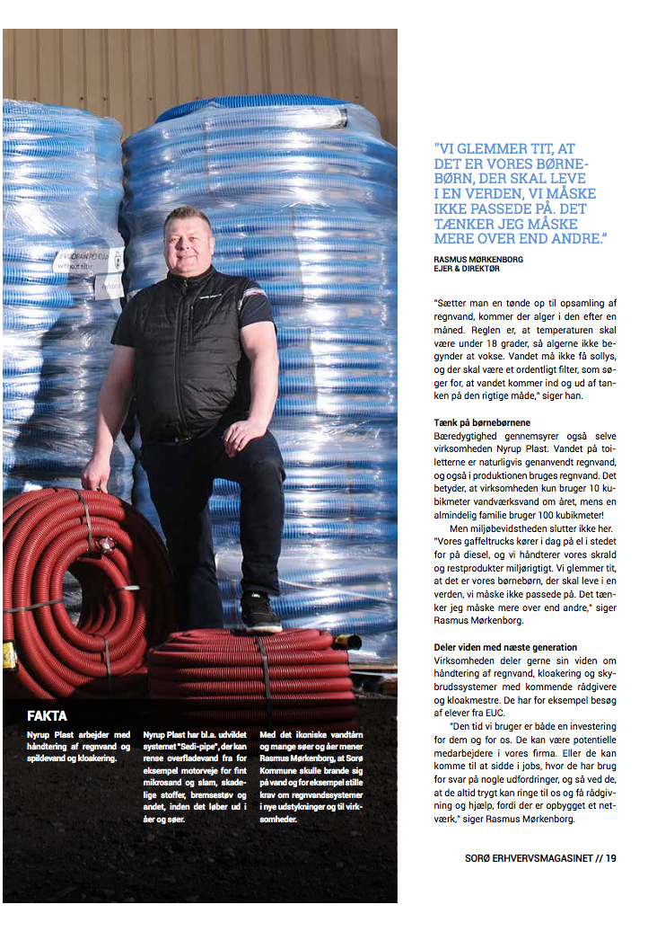
Danish company Nyrup Plast expert in
dealing with rainwater for recycling and flood in cities

Slide 2
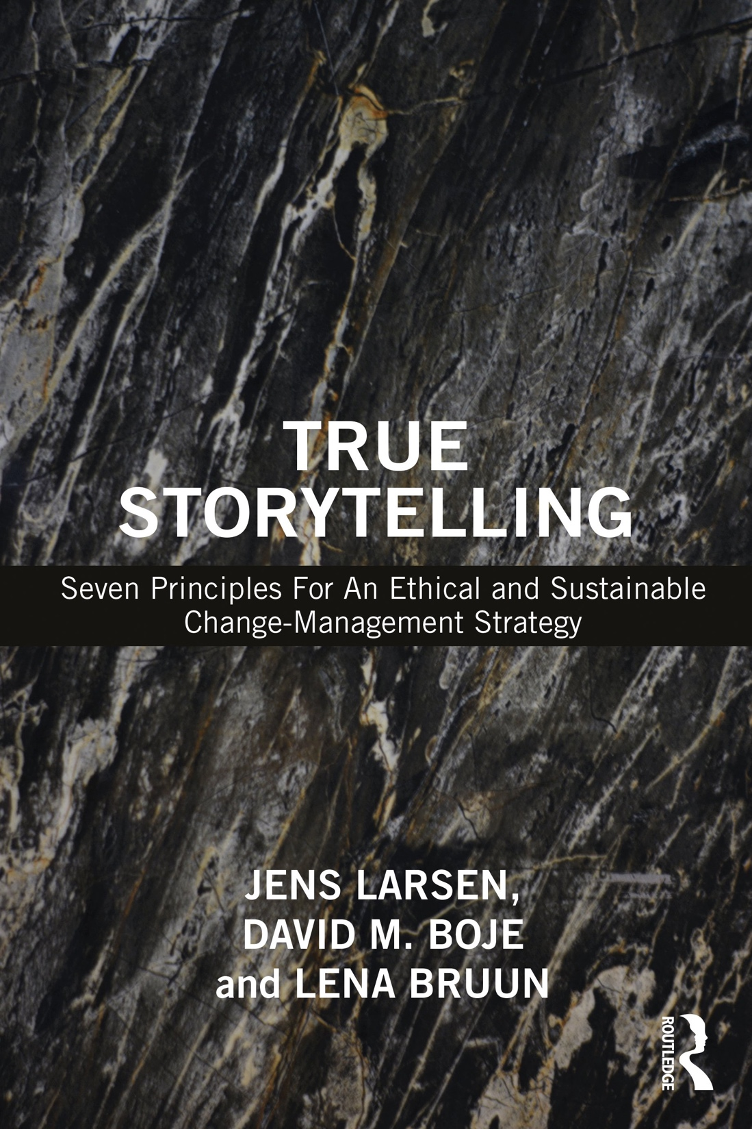
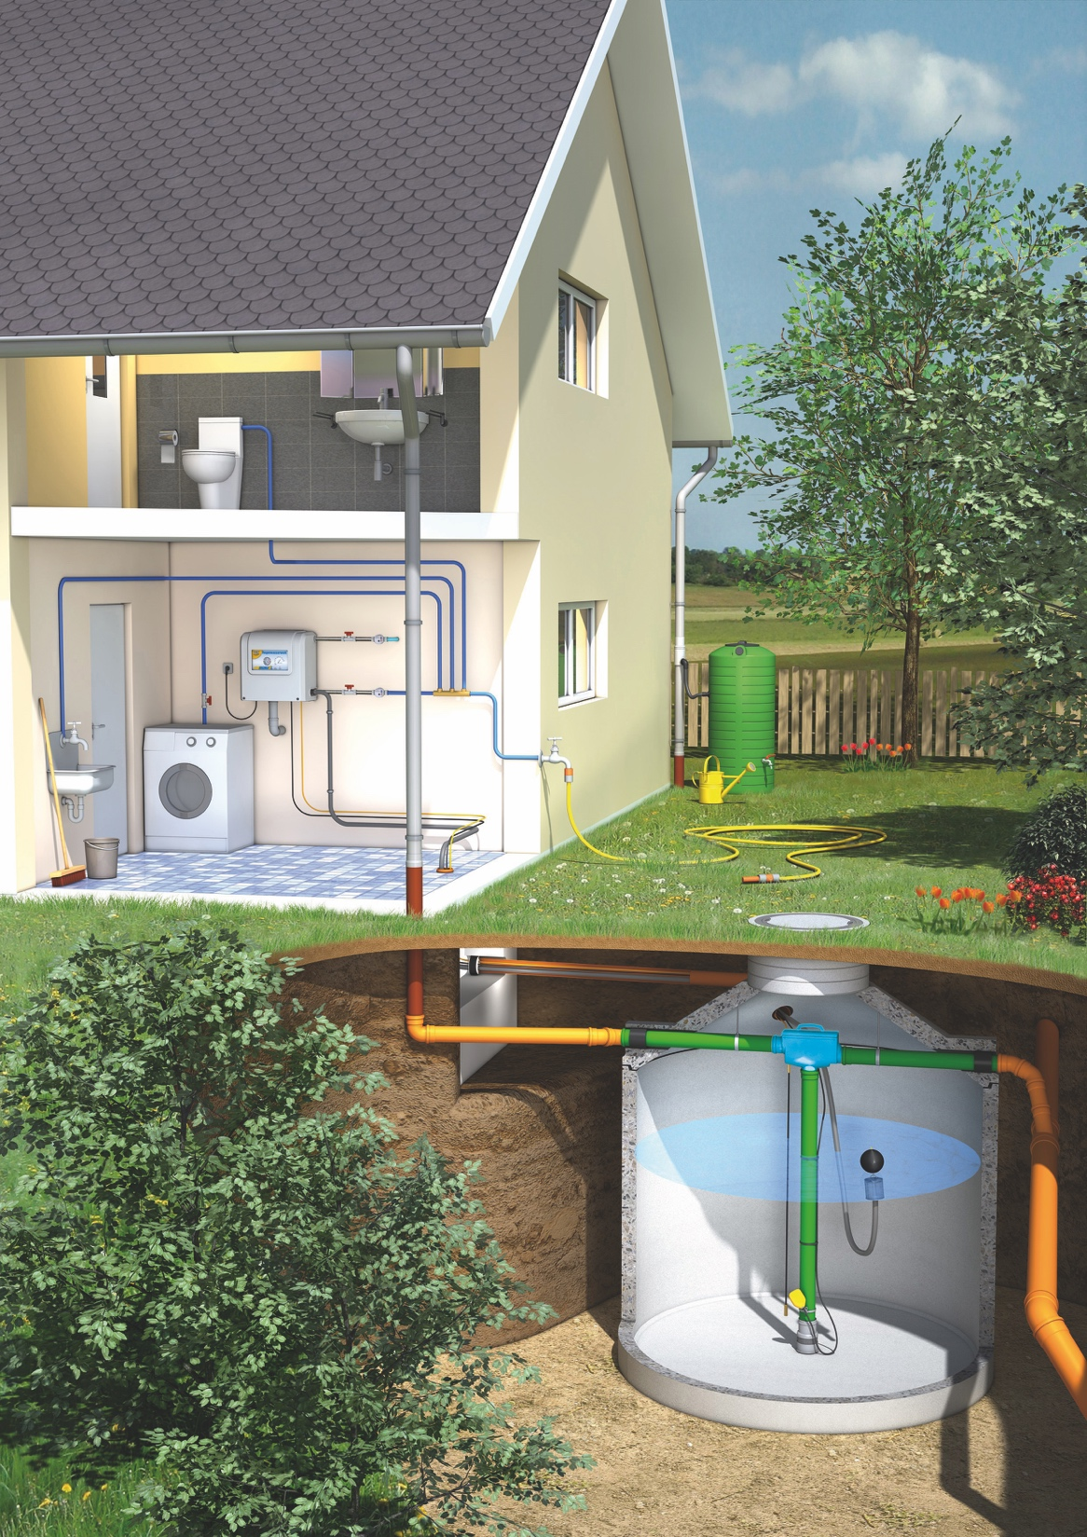
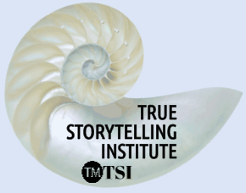
"How True Storytelling in Denmark
Created Ethical Water Business"
Jens Larsen, storytelling researcher,
Co-funder Old Friends Industries and True Storytelling Institute
True-storytelling.com & oldfriendsindustries.com

Slide 3
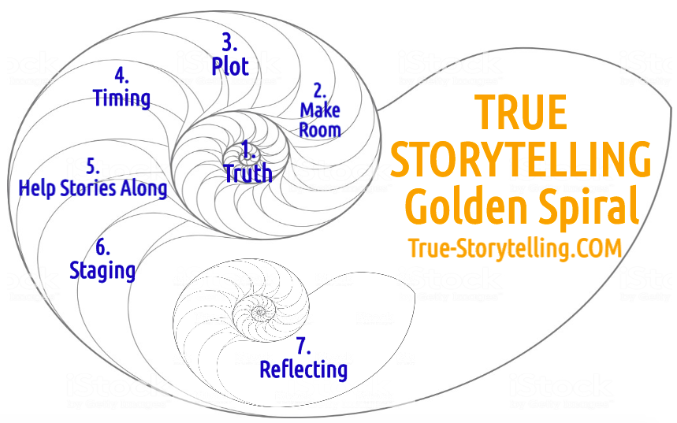

Slide 4
The Seven Principles of True Storytelling
Method for researcher´s and consultant´s
Plan, facilitate and reflect

Slide 5
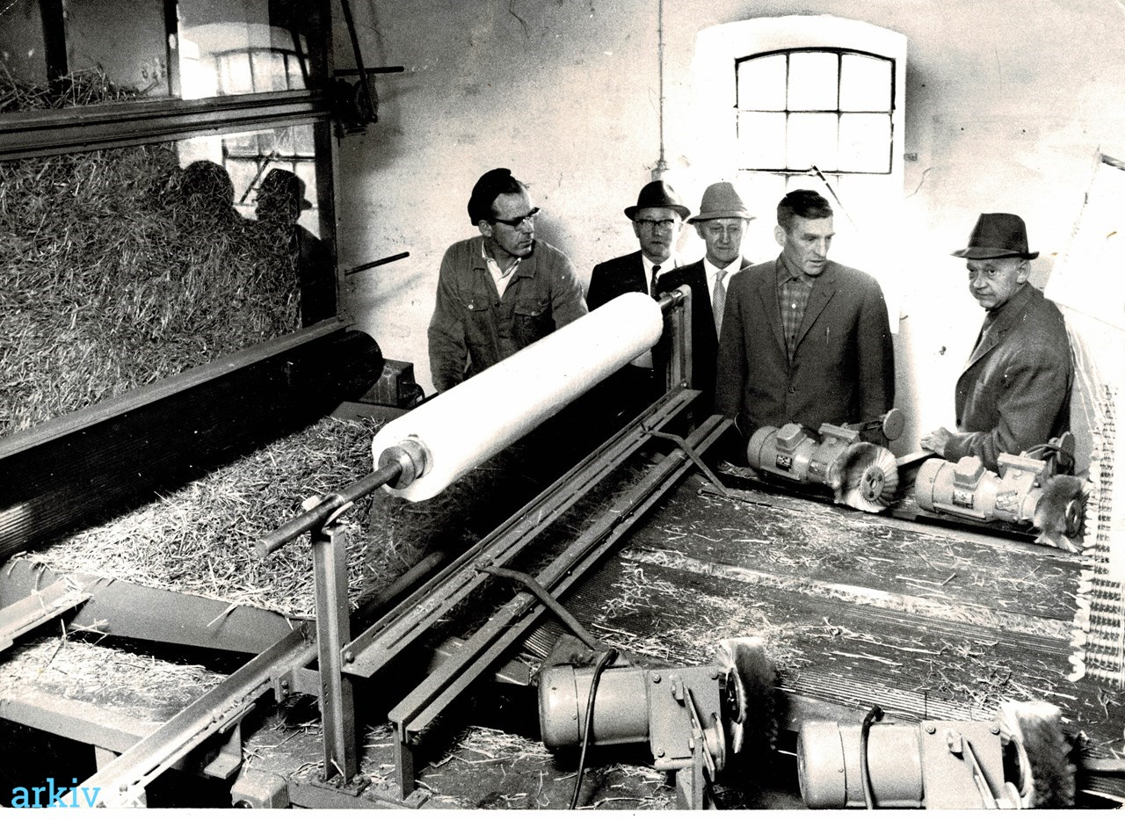
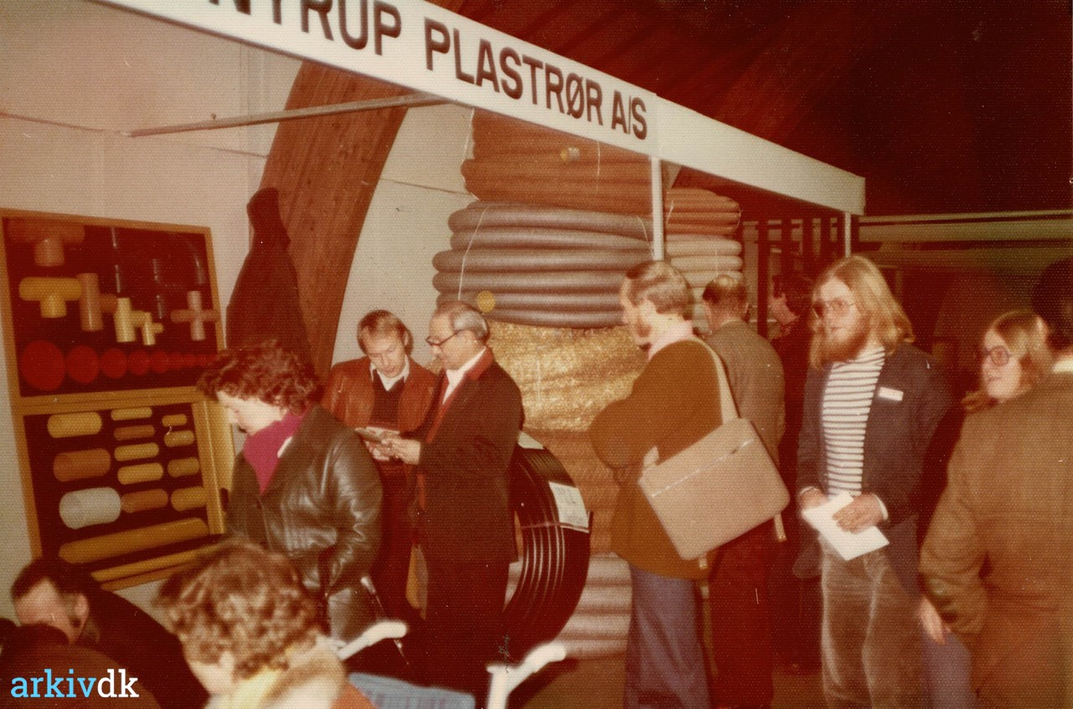
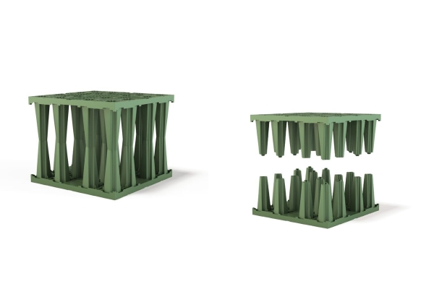
1st True Storytelling Principle: You yourself must be true and prepare the energy and effort for a sustainable future
4 Questions:
What´s the story now?
Which story is sustainable (human, economic and resources)?
Do we have the knowledge?
Do we believe in it?
Notes:
Example: Living Stories with a Place, A Time, and a Truth of lived experience
Happening Here and Now
In the middle, unfolding, emerging, happening
Goes from strategic level of power, to what is best for the world in Council of Elrond
Tell LESS is MORE
BE AUTHENTIC - Create an emotional component that resonates with the audience YouTube Peter Guber of Mandalay Group, so they retell it forward owning; See article 4 truths of the storyteller HBR

Slide 6
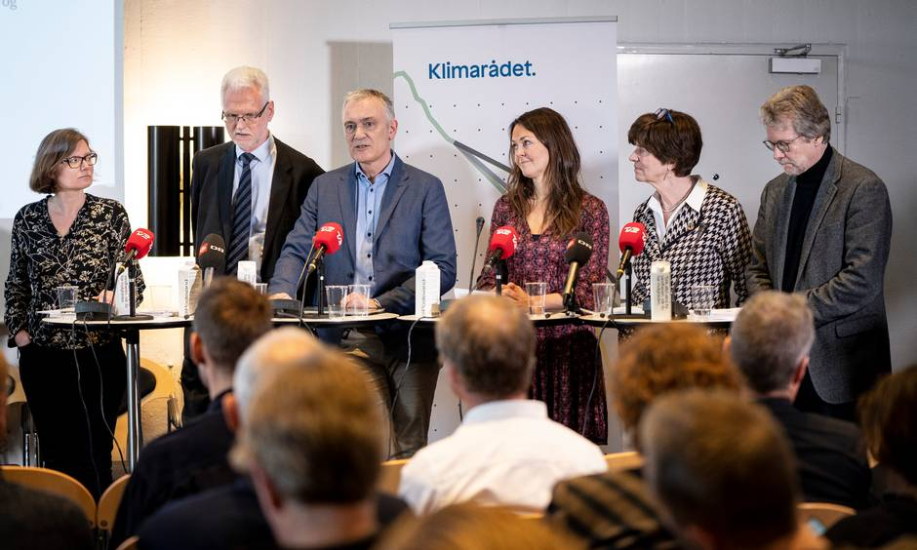
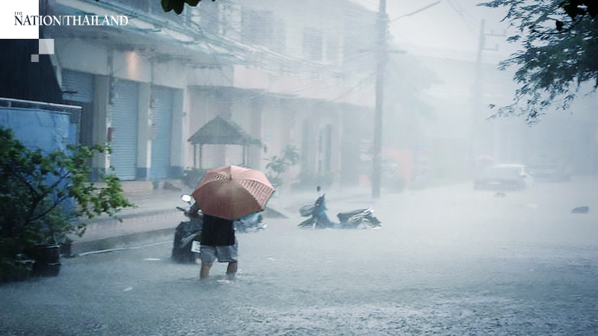
Princip 2 Make room True storytelling makes spaces
respecting the stories already there

Slide 7
Principle 3: You must create stories with a clear plot creating direction and help people prioritize
True-storytelling.com & oldfriendsindustries.com
Notes:
In change people grasp for a narrative plot with clear why. A Punctum helps this.
Lars Bo H. presentation in Aalborg May 19 2018 spoke of the WHY in plot.

Slide 8
True Storytelling Principle 4 You must have timing
KAIROS: place & time when conditions are right for the accomplishment of a crucial ’intelligent’ action

Slide 9
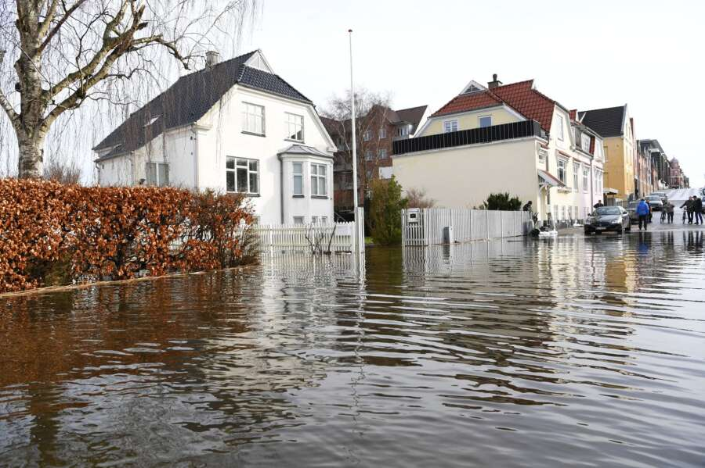
Principle 5 Help stories along
You must be able to help stories on their way and be open to experiment
True-storytelling.com & oldfriendsindustries.com

Slide 10
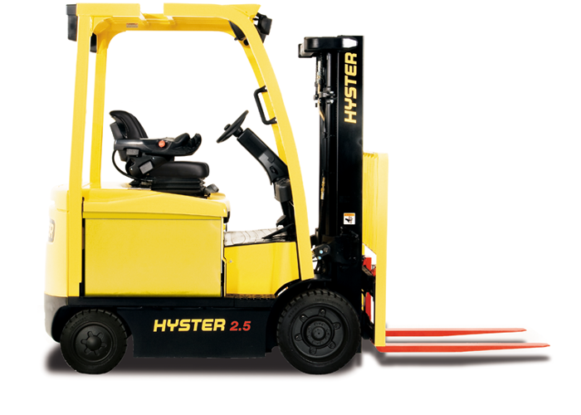
Principle 6: You must consider staging including scenography and artifacts
How are material & social agents part of the staging & artifact of RESTORYING?
True-storytelling.com & oldfriendsindustries.com

Slide 11
TRUE STORYTELLING Principle 7 You must reflect on the stories and how they create value
Can you pull yourself up and look at the WHOLE SITUATION?
What is the story now?
What have we achieved?
Are their side effects?
Where do we have to adjust?
True-storytelling.com & oldfriendsindustries.com

Slide 13
Question to explore
Where and how can you get the energy
to sustain for your research project?

