Slide 1
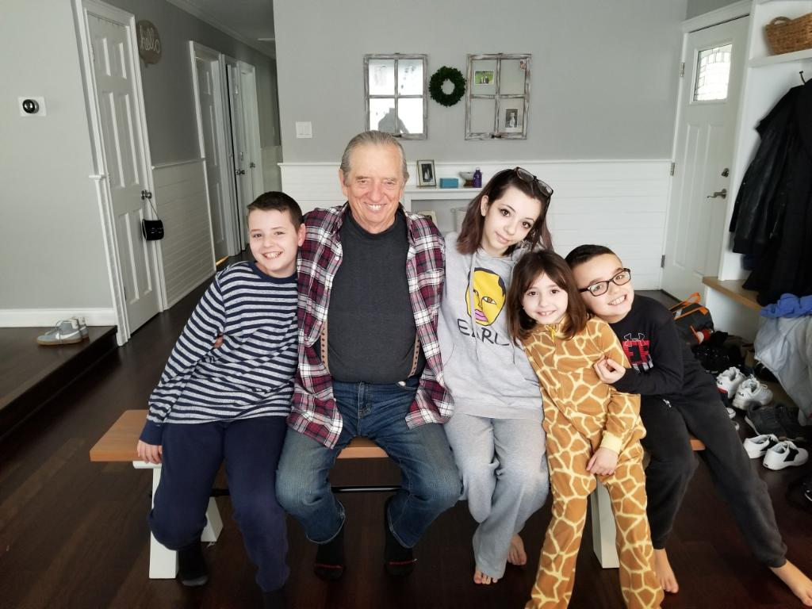
Water Storytelling and The Dark Side of Sixth Extinction Denial
David M. Boje, Professor Aalborg University
Slides for talk at https://davidboje.com/Aalborg
Keynote to Dark Side of Communication Conference (2ND INTERNATIONAL AND INTERDISCIPLINARY CONFERENCE ON DISCOURSE AND COMMUNICATION IN PROFESSIONAL CONTEXTS)
14 – 16 August 2019
AALBORG UNIVERSITY, DENMARK (website)
Why I joined Extinction Rebellion aginst the Dark Side of Corporatized Storytelling
Notes:
MY STORY is doing (auto) ethnography (& disruptive reflexivity) in investigating how corporatized environmentalism is creating denier storytelling circulating through social media echo chambers and continuing to turn climate change into climate denial. I worked my whole career in the belly of the beast, the Business School, and its ‘business storytelling’ is the DARK SIDE OF STORYTELLING, colonizing the climate action movement with watered down corporatized ’sustainable development’ emplotments, such as Triple Bottom Line and Circular Economy. The result is that the UN and EU according to climate scientist accounts are likely to miss the Agenda 2030 goal of limiting climate global warming to 1.5 degrees Centigrade by 2030, and overshoot to a disastrous 4.0 to 6.0 result, in which only the poles will grow food by 2100 and most species including human kind will be extinct.
You are an audience who believes in dark side of communication, or in dark side of discourse, or in dark side of narrative. But I believe in the dark side of storytelling of the fossil fuel industry, the Koch brothers, who fund Climate Deniers’ echo chambers in public media in order to keep on making their money by BUSINESS-AS-USUAL. There is a huge gap between the story told in climate science and the way the story is being told in Business Schools. It is this dark side of storytelling that matters in keeping the United Nations 17 SDGs from actually averting the 1.5 degree increase in average global temperature since the industrial revolution. It is not ONLY communication constitutes organization, and it is not ONLY critical discourse that will change climate denial of business storytelling. It is different storytelling research methodology, I am calling ‘self-correcting storytelling science, a methodology of refuting the claims, instead of just verification.
Business Storytelling and the 'Storytelling Science' of Self-Correcting Research'. Accepted Aug 12 2019 LJRMB London Journal of Management and Business | Vol:19 | Issue:2 | Compilation:1. AND See Boje & Rosile Self-correcting storytelling science book you can download book til its published
And its combining CRITICAL STORYTELLING with CCO with Critical Discourse, instead of SILOING them in separate disciplines. More than this it takes all 3 to trace the flaw in WATER CAPITALISM that is displacing OIL CAPITALISM!
WHY? Edward Abbey’s famous quote “growth for the sake of growth is a cancerous madness’ actually has a context that is THE DARK SIDE OF WATER STORYTELLING
As Edward Abbey (1968/1971: 145, boldness, mine) put it, “growth for the sake of growth is a cancerous madness”. What people don’t do is read the rest of the quote, which is about water:
“There is no lack of water here unless you try to establish a city where no city should be … The Developers, of course-the politicians, businessmen, bankers, administrators, engineers-they see ... a desperate water shortage ... They propose schemes of conspiring proportions for diverting water by the damful ... What for? In anticipation of future needs, in order to provide for the continued industrial and population growth of the Southwest…
STOP HERE
….And in such an answer we see that it's only the old numbers game again, the monomania of the small and very simple minds in the grip of an obsession. They cannot see that growth for the sake of growth is a cancerous madness, that Phoenix and Albuquerque will not be better cities to live in when their populations are doubled again and again. They would never understand that an economic system which can only expand or expire must be false to all that is human” (Abbey, 1968/1971: 145, boldness mine).

Slide 2
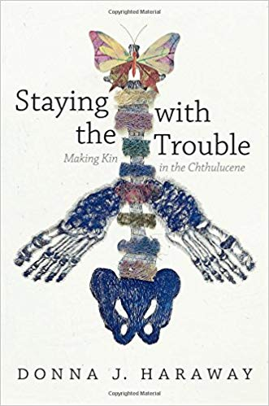
Notes:
My Draft of a CLAW article on dark side of water storytelling
Haraway, Donna J. (2016) Staying with the Trouble. Is a MULTI-SPECIES STORYTELLING answer to the Dark Side of Communication. By Making Odd-Kin with all species, we discover our connectedness in the midst of spiraling ecological devastation. Instead of Anthropocene, she calls t the Chthulucene, how humans and non-humans are inextricably linked in sym-poiesis instead of auto-poiesis. How to build more livable futures. Chthulucene is not just a word, it replaces Human Relations with Kin-Ship of all kinds of species in a multi-species storytelling. It is a pathway out of troubled waters of neoliberal Spencerism Economic growth damage to our ecosystems. It is an answer to gloom and doom world telling of Anthropocene scholarship by ‘Staying with the Trouble’ of our damage to the planet systems. It is the Power of Storytelling of our entanglement with all species. It is not the self-making narratives of neoliberal individualism. It is not to clear away present and past to make way for some future pathways for coming generations. It is not Apocalyptic Water Capitalism, it is not the future prophesized by the Capitalocene. Instead of bitter cynicism of game over, it isa pathway to multi-species flourishing.
The post WWII marked Earth’s Water Capitalism emergence, the privatization and commercialization of world’s water sources and systems. For Haraway ‘Staying with the Trouble’ means a method of ‘Material semiotics’ a multi-species storytelling of collaboration, combinations, and COM-POST in the “midst of rapidly metlting ice” rising sea levels, it is “be care that animates action” of ‘multispecies environmental justice’. It is Terapolis a “fabulated’, ‘multispecies storytelling.’ No longer a posthuman, but a COM-POST, a constellation of emerging sites of Terapolis.
I learn from Navajo Indigenous Ways of Knowing (IWOK) abut the string games, the continuous weaving of string figures Na’atl’o’.
I lear to become part of the weave, the becoming-with of both living things and living beings co-producing spacetimemattering.
We are 37.2 trillion living cells in a body sack, that loves water, survives in water bodies on a planet of 70% sea water, and only half of one percent of accessible fresh drinkable water. I live in New Mexico and it has the most droughts of any of the states, and the flash flooding. We only get 10 inches of rain, and that is a lot less than the rain in Denmark.
As a storytelling researcher, I observer, participate in, am complicit in, and analyze the multi-species storytelling phenomena. I am observiing the hermeneutic spiral as pre-stories and pre-narratives I call ‘antenarratives’ constitute dialogic story webs and dominant monological narratives and dialectical counternarratives. This all swims in discourses, is semiotic materialism language, and the cyber semiotics of Søren Brier of Copenhagen Business School, who combines Charles Sanders Peirce semiotic triadics with Luhman’s auto-poiesis. I am a Walter Benjamin and Mikhail Bakhtin, a Jean Paul Sartre, and Ivan Illiich, and Zygmunt Bauman philosopher. I made my turn away from social constructivism to social materialism.
The earth’s atmospheric water vapor, its surface ice glaciers and permafrost, and its underground purifying aquifers are part of the water cycle, whose scientific name is hydrological cycle. Warming the planet, shifts the water cycle to something no longer nurturing, caring, and loving to most watery species, including human kind.
Gaiagraphy O’Doherty & Statler (2019) paper “The Coming Crisis of Organization Studies: Gaiagraphy and New Political Imaginaries
Authors Damian O'Doherty, Critical Management Studies, damian.odoherty@mbs.ac.uk Matt Statler, New York U., mstatler@stern.nyu.edu Academy of Management, Boston presentation).
I am initiating a Peircean self-correcting approach to advocate a storytelling science, with abduction-induction-deduction triadics.
I use it to study the multi-species storytelling of water, of lakes called limnology, of rivers called potamology, and of aquifers called hydrogeology. What is the study of atmospheric changes called/ Climatology, and its doe both to natural and anthropogenic climate variability. Then there is the word, ‘meteorology’ that includes both atmospheric chemistry and atmospheric physics. My point is science does its storytelling of water bodies, with limnology, potamology, climatology, and meteorology. The stody of oceans is oceanobraphy, and its important to be ‘Staying with the Truble’ of the oceans, the acidification from the temperature changes that makes of acidic Ph and that kills off the coral life. We can extend the future of life of biota in the biosphere. This is our terrestrial answerability, our existential relational ontology of water storytelling.
Water is life for millions of species, all living together in a narrow temperature range of this living watery world. It is also populated by neoliberal economists, and politicians without will power to turn away from teachings of Herbert Spencer’s’Social Darwinism’ the ideology that justifies the rich are meant to be rich and the poor are meat to be poor, and that’s the ordained order of things. That Spencerism is what Michel Foucault calls a regime of truth. If we allow neoliberal Spencerism to become the dominant regime of truth of political economies then we are complicit accomplices of a downward spiral into the abyss. We can measure our decent with a themometer in quantitative metrics.
Qualitatively we not ask the ontological existential question: What is life? It is the title of a book by Erwin Rudolf Josef Aldexander Schrodinger, a quantum theory of the wave function and an attempt at unified field theory. You know Schrodinger’s Cat, thought experiment and his equation is inscribed on the gravestone of Annemarie and Erwin. The wave function describes the state of subatomic systems, at each spatial postion, and time.
The wave function of the water system of planet earth is changing dynamically in spacetimemattering (Barad, 2007). The wave function collapse as any possible futures become a probability of what I call a ‘bet on the future’ and antenarrative bet of great importance.
My question: How can the water and temperature events in spacetimemattering within this living planet be accounted for in both quantum storytelling and multi-species storytelling?
It cannot be acocunted for only be Neoliberal Specerism growth economics. That monologic initiated by Hebert Spencer (1820-1903_ and not as many believe by Charles Darwin. It was Spencer who cointed the term ‘survival of the fittest.’ People become powerful in society because they are innately better, and thefore racism, genderism, eugenics, imperialism and social inequality are all justified in Spencerism.
Haraway’s (2016) Staying with the Trouble, its multi-species storytelling of Terapolis, the making Odd-Kin to all species, in connectedness, in the midst of spiraling ecological collapse. We can build a multi-species storytelling of entanglement, and shake off our technofixes fixation. Trouble in French is a verb, ‘to stir up’. It is not to clear away present and past to make come Capitalocene obscene future.

Slide 3
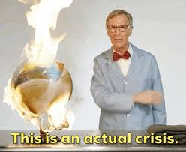
The Dark Side of Climate-Denier Storytelling Echo Chambers
E.g. Watts Up With That (WUWT) & Global Warming Policy Forum (GWPF) belittles, derides, and condemns climate science, while misrepresenting the scientific findings
E.g. Bill Nye: “a science project that went wrong” a “fascist in a bow tie”, “Bill Nye The Crackpot Guy” and “The end is nye” (Bloomfield & Tillery, 2019).
Notes:
Jane Goodall’s storytelling solution, misses the DARK SIDE OF STORYTELLING, the echo chambers(Bloomfield & Tillery, 2019). And Bloomfield and Tillery, 2019 are not doing storytelling research, so they forget to trace the Exxon and the Koch Brothers Money
““The WUWT and the GWPF blogs … are highly involved in framing peer-reviewed scientific research to fit their narrative of the climate change hoax and in curating misrepresentations from other sources to heighten their legitimacy” (Bloomfield & TIllery, 2019: 32-33, boldness mine).’
Bloomfield, E. F., & Tillery, D. (2019). The Circulation of Climate Change Denial Online: Rhetorical and Networking Strategies on Facebook. Environmental Communication, 13(1), 23-34. Accessed Aug 7 2019 at https://www.researchgate.net/profile/Emma_Frances_Bloomfield/publication/329485682_The_Circulation_of_Climate_Change_Denial_Online_Rhetorical_and_Networking_Strategies_on_Facebook/links/5c7d6f5b92851c695054bbed/The-Circulation-of-Climate-Change-Denial-Online-Rhetorical-and-Networking-Strategies-on-Facebook.pdf

Slide 4
What is Dark Side of Water Storytelling? (book link)
Corporate environmentalism (Linstead & Banerjee, 2009) has colonized deep ecology with storylines of ‘sustainable economic development’ & Greenwash
‘Triple Bottom Line’ & ‘Circular Economy’ emplotments of ‘Business-As-Usual (BAU) ‘Business Storytelling’ have already co-opted the United Nations’ and European Union’s ‘Agenda 2030’
The 17 UN Sustainable Development Goals (SDGs) attempts to keep global warming within 1.5˚C, returning climate to pre-industrial levels, antenarrative ’bet on the future’ has already been co-opted
Haraway’s Staying With Trouble
Notes:
Planet has only until 2030 to stem catastrophic climate change (UN experts) - CNN headline
WHAT IS THE UN NARRATIVE: “Climate solutions already exist. Together we can limit global warming to 1.5˚C, says UN.
Can we mesh the stories of success with the broader narrative of THE 6THE EXTINCTION, THE existential threat TO HUMANKIND AND MOST OTHER SPECIES IF WE OVERSHOOT LIMIT OF 1.5˚C ?
Agenda 2030 forms the basis for a "global partnership" to encourages cooperation among nations as they support a transition to sustaining life on earth. The central belief is that all countries can protect the environment while simultaneously experiencing economy growth and same consumerist lifestyles (source)
What is the Agenda 2030 Narrative of Denial?
The Circular Economy is ‘corporatized environmentalism’ that is COLONIZING the UN and EU Agenda 2030
It is another version of Triple Bottom Line that expanding Profit can happen while expanding People and Planet
If Agenda 2030 continues to be CO-OPTED by these Economic Myths, then greater than 1.5 C increase, by 2030, and by 2050 go high to 4.5 C, and by 2100, even higher to 6.0 C average Earth temperature
See Weetman, C. (2016). A circular economy handbook for business and supply chains: Repair, remake, redesign, rethink. Kogan Page Publishers.
See Boje 2019c book on water storytelling, in press at http://davidboje.com/water or https://www.dropbox.com/sh/rpypeuo62esu5bl/AAD2SgXnAbB8JXFaWfWtVYMma?dl=0 to download entire manuscript until its published
See Linstead, S.; Banerjee, B. (2009). Pp. 239-276 (Chapter 5) in Stephen Linstead, Li Fulop & S. Simon Lilley (Eds.) Management and Organization: A Critical Text. 6th Edition. NY, NY: Palgrave Macmillan.

Slide 5
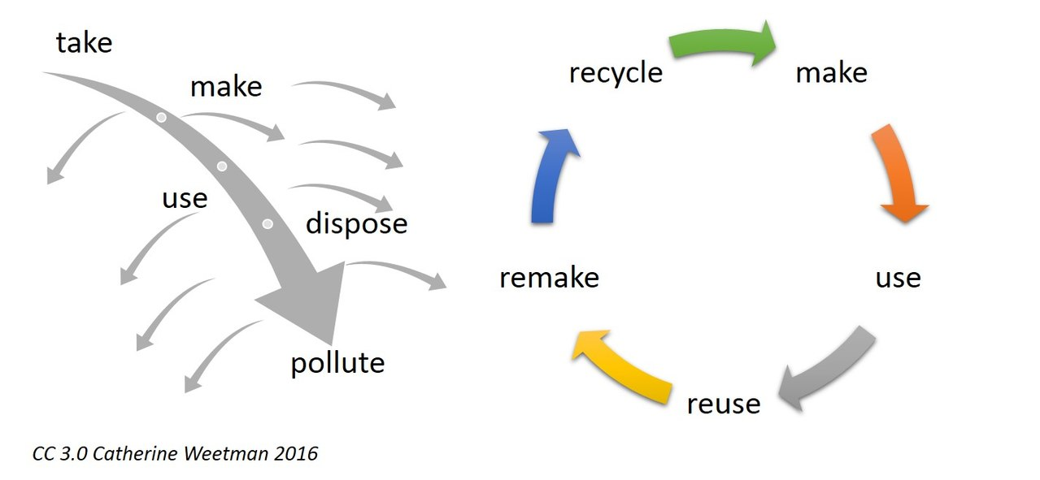
Linear Economy Narrative vs. Circular Economy Counternarrative
Notes:
Weetman, Catherine. (2016). A circular economy handbook for business and supply chains: Repair, remake, redesign, rethink. Kogan Page Publishers. Image accessed from creative commons Aug 13 2019 at https://commons.wikimedia.org/wiki/File:Linear_versus_circular.jpg
The linear model of economy is contrasted by Weetman (2016) with her own rendition of the Circular Economy (CE) model. I suggest it is a counternarrative, that needs deconstruction because it reduces ecosystem stewardship to just economic bottom line. In short, CE is constituted as a solution to the business of ‘sustainable development, which is itself a watered-down version of deep ecology, and is an example of ‘corporate environmentalism storytelling-discourse, and definitely qualifies as Dark Side of Communication since it is a weak appropriation with substitutions of economic prosperity and continued growth of the linear economy CE purports to move away form. There are few published critiques of CE, so I started an edit to the Wikipedia Circular Economy page, which you can access, and please add your critique to it before the consulting firms (e.g. McKinsey & Company) find out its there. https://en.wikipedia.org/wiki/Circular_economy
CE is a version of Triple Bottom Line (3BL, a term coined by Elkington 1994) counternarrative, which tries to make Profit Bottom Line in balance with People Bottom Line and Planet Bottom Line. However Profit is always hegemonic, with power over the other two bottom lines.
Elkinton’s (2013: 12) own writing says even if 3BL follows Ben & Jerry’s, Body Shop, or Patagonia “Paul Hawken has argued, even if every company in the world were to model itself on such companies, our economies would still not be sustainable”
Elkington, J. (2013). Enter the triple bottom line. In The triple bottom line (pp. 23-38). Routledge. Accessed Aug 13 2019 at
http://kmhassociates.ca/resources/1/Triple%20Bottom%20Line%20a%20history%201961-2001.pdf).
See my critique of 3BL: Boje, D. M. (2016d). Critique of the Triple Bottom Line. Pp. 181-198 in Grace Ann Rosile (ed.) Tribal Wisdom for Business Ethics. Bingley, UK: Emerald Group Publishing Limited.
And critique of Circular Economy:
For more see work we are submitting to review: A ‘storytelling science’ Approach Making the E-Business Modeling Turn May, 2019; Revised Aug 13, 2019 by David M. Boje, Kenneth Mølbjerg Jørgensen, and Marita Svane
Critique of 3BL
Lazarevic, D., & Valve, H. (2017). Narrating expectations for the circular economy: Towards a common and contested European transition. Energy research & social science, 31, 60-69.
Milne, Markus J.(2005). "From soothing palliatives and towards ecological literacy: A critique of the Triple Bottom Line." Accessed Aug 1 2019 at https://ourarchive.otago.ac.nz/bitstream/handle/10523/1551/From_soothing_palliatives_and_towards_ecological_literacy.pdf
Norman, W., & MacDonald, C. (2004). Getting to the bottom of “triple bottom line”. Business ethics quarterly, 14(2), 243-262.
One of the only published articles critical of CE:
Valenzuela, F., & Böhm, S. (2017). Against wasted politics: A critique of the circular economy. ephemera: theory & politics in organization, 17(1), 23-60.Accessed Aug 1 2019 at http://irep.ntu.ac.uk/id/eprint/30441/1/PubSub8234_Valenzuela.pdf
MORE CRITIQUE
Fry and Slocum (2008: 88) promote 3BL as a business model for spiritual leadership “A business model is a description of the value a company offers to one or several sets of customers … This means developing and adopting business models with strategies that have a positive economic, social, and environmental impact, often referred to as the triple bottom line” (boldness, mine).
Fry, L. W., & Slocum Jr, J. W. (2008). Maximizing the triple bottom line through spiritual leadership. Organizational dynamics, 37(1), 86-96.

Slide 6
How I tackled the ‘Dark Side of Water Storytelling’ in 5 PHASES
Self-reflexivity on teaching in the Belly of the Beast
Conversational Storytelling Method
Business Myths colonizing UN & EU Agenda 2030
Experiments in the Gap between Capitalist World and Natural World
Interventions (Whistle Blowing)
Notes:
Self-correcting storytelling is the testing of ABDUCTIVE guesses, testing theINDUCTIVE inference from cases to generality, and testing the DEDUCTIVE theories by trying to falsify and refute them, It the longitudinal iterating around by scientific method towards CS Peirce and Walter Benjamin’s unattainable True Storytelling, while knowing its fallibility. My talk today is about the craftiness of storytelling research as my ‘disruptive reflexivity’ challenges the epistemic reflexivity of Triple Bottom Line (3BL) and Circular Economy (CE), and critiques the constitutive reflexivity of the United Nations’ and European Union’s Agenda 2030.
See Bell, Emma; Willmott, Hugh. (2019). Ethics, politics and embodied imagination in crafting scientific knowledge, to appear in Human Relations.
My critique is that it has been already colonized by business storytelling TINA narratives (3BL & CE). I challenge the Business School for its bystander ethics, and call upon in to engage with Bakhtinian ethics of moral answerability.It is the business myths that are colonizing the UN and EU Agenda 2030.
Charles Sanders Peirce’s 1st test is self-reflexive, and if that is not enough do conversations with others, and if that is not enough study the science, and if that does not work do the interventions
This problem is super wicked complexity so all four tests in all phases. On the Dark Side, Storytelling is a battle of three forms of reflexivity: Epistemic, Constitutive, & Disruptive (Bell & Willmott, 2019 in HR) Titled: Ethics, politics and embodied imagination in crafting scientific knowledge
As Spitzberg and Cupach (2011b) describe, the dark side signifies a host of remarkably common uses of interpersonal communication for purposes other than generously connecting or sharing with others: bullying, threatening, deceiving, harassing, rejecting, expressing anger, eliciting guilt, hurting feelings, and so on”
“ (as cited in Monahan, 20156 p. 231).
The EU, Agenda 2030 is the commitment to eradicate poverty and achieve sustainable development by 2030 world-wide, ensuring that no one is left behind.
The UN 2030 Agenda envisages “a world of universal respect for human rights and human dignity, the rule of law, justice, equality and non-discrimination”.
My disruptive reflexivity happens in five phases. My own research-as-craft is quite messy, tacit response to the politics and ethics of the UN and EU plans to keep average global temperature under the 1.5 degree Centigrade threshold. Self-correcting storytelling science is a craft (Boje & Rosile, 2019). I bring my own self-correcting deliberation, imagination, and innovation out of the margins of untold story (Hitchin, 2014). I confront my own fallibilism in producing and disseminating the dark side of water storytelling. I make ‘craft gestures’ and deploy tacit knowledge of ‘craftiness’ in ‘critical’ qualitative inquiry (Prasad, 2005). I am an embodied researcher. And my storytelling is “largely left in the dark” (Van Maanen, Sørensen, & Mitchel (2007: 1149).
Bell, Emma; Willmott, Hugh. (2019). Ethics, politics and embodied imagination in crafting scientific knowledge, to appear in Human Relations.
Prasad P (2005) Crafting Qualitative Research: Working in the Post-Positivist Traditions. Armonk, New York: M.E. Sharpe.
Van Maanen J, Sørensen JP and Mitchell TR (2007) The interplay between theory and method. Academy of Management Review 32(4): 1145-54.

Slide 7
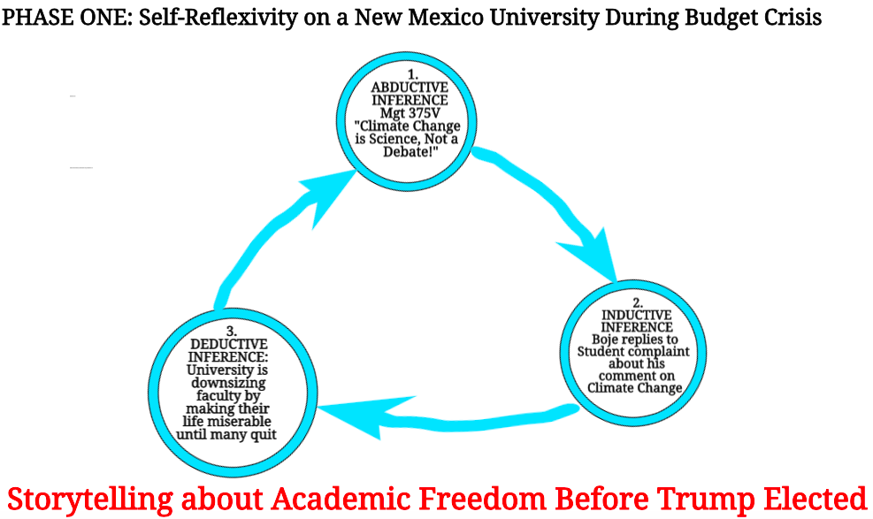
Notes:
I write out Abductive inference before doing inductive inference and deductive inference
I do this in all five phases
It is part of the self-correcting storytelling method I want to share with you
This is not the usual collect interviews or observations, then do content or theme analysis and off to publication
It is a method I derive from C.S. Peirce triadic semiotics of self-correcting and form Karl Popper trial-and-error longitudinal approach to scientific method

Slide 8
Has this happened to you?
First Day of sustainability Course Jan 23, 2017
Student: “Climate change is a debate.”
Boje: “it’s a science about temperature variations, and so on.”
Student: “Faculty are supposed to be neutral.”
Boje: “I am not neutral. Climate change is a science.”
Student: “Without GMO, that won’t feed the world.”
See course syllabus etc. athttps://business.nmsu.edu/~dboje/375/
Notes:
What Follows are my own autoethnographic self-reflexivities, and they are disruptive reflexivities.

Slide 9
On Mar 8 2017 Boje interrogated by University ‘Office of Institutional Equity’ Lawyer
Question: Did you tell a student that ‘climate change is a science’?
Question: Did you talk against the university golf course expansion?
Question: Did you talk against the Chancellor and Provost and their reorganization plans?
Question: Did you say your workload is expanded and salary frozen?
Notes:
New Mexico State University is committed to creating and maintaining a respectful, inclusive, and responsible learning and working environment
Email from University Equity/EEO Attorney on Mar 8 2017
Dr. Boje,
Earlier this semester, information was provided to me regarding your interaction with a student in your Global Environmental Assessment Management course. After further inquiry into the allegation, I would like to speak with you to obtain your perspective.
Executive Director
Title IX Coordinator/Section504 Coordinator
Office of Institutional Equity/EEO
New Mexico State University
OTHER SIDE OF THIS STORY:
Question: Did you tell student climate change is a science?
Answer: “I did tell the [entire] class climate change is science, not a debate [on January 23rd, 2017 at 2:45 PM]. It was the opening introduction of the sustainability course I teach at NMSU (Mgt 375v). I noticed student was shaking the head and rolling eyes, and only student moving about, so I asked, “did you have something you wanted to say?” The student said, “Climate change is a debate.” I held my ground, “it’s a science about temperature variations, and so on.” Student continued, “Faculty are supposed to be neutral.” I replied, “I am not neutral. Climate change is a science.”
Question: Did you talk against the university golf course expansion?
Answer: Yes, I did. It uses one million gallons of water a day now, and expanding it, will mean more water. There is a plan [at Board of Regents] to expand the 18 hole course to 27, and extend it up to A-Mountain, near the Rodeo Grounds.
Question: Did you talk against the Chancellor and Provost and their reorganization plans?
Answer: I spoke against the plans, but not against them. I disagree with the plans, and the process. It lacks participation. I have been speaking out against it. It is my academic freedom.
Question: Did you say your workload is expanded and salary frozen?
Answer: Not at that time, but at other times, yes. I have an extra course to teach.
Question: Wasn’t everyone’s workload expanded?
Answer: No, just the senior tenured professors in two of five College of Business departments had their workload increased.
And so on the questions continued.
===================
BEHIND THE SCENES Between 2017 and 2019, University downsized its staff & faculty to meet the Budget Veto Crisis
e.g. My Department went from 17 faculty to 6

Slide 10
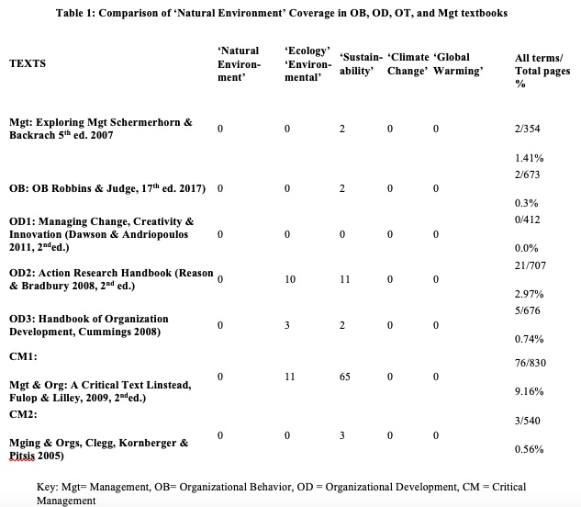
Notes:
*Transformational Change of Business Colleges/ AoM
*More critical Org. Beh., Org. Dev., Org. Theory, and *Textbooks highlighting Natural Ecology

Slide 11
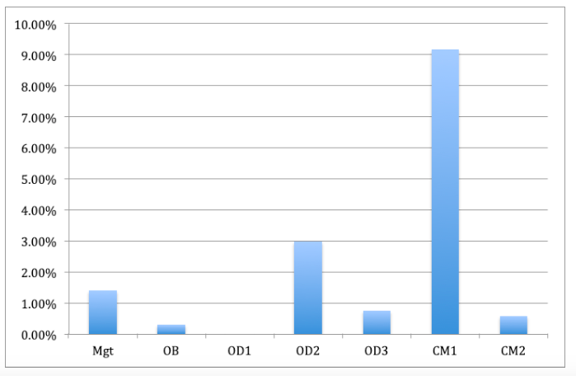
Non-Random Sample Comparisons of Ecological Page Content Percentage
Notes:
“Critics of sustainable development also argue that it can colonize areas of Third World social life that are not yet ruled by the logic of the market or the consumer, areas such as forests, water rights and sacred sites (Escobar, 1995; Visvanathan, 1991)” from Banerjee 1999
CM1 has critique of Sustainable Development lacking in other texts

Slide 12
Notes:
Again in Phase Two use Abductive-Inductive-Deductive triad
This is phase two of self-correcting in which doing storytelling conversations with others sharing my reflexivities with them and they sharing theirs with me.

Slide 13
Kevin Bixby, Executive Director of Southwest Environmental Center about the Rio Grande/Rio Bravo del Norte River
My abductive propositions
Over-grazing cattle changed semi-arid desert to a more arid desert
Rio Grande river dammed in summer to fill Elephant Butte and Caballo reservoirs, in which the water mostly evaporated,
This is killing the fish and other aquatic life
Businesses dumped toxic (but not always illegal) petrochemicals into the river, which mostly dry
Aquifers were being overpumped
Politicians, Corporations, & most Business professors look other way
I did not know where to start, so I said, “Kevin, tell me about the Rio Grande.”
Notes:
I wrote this out before the sessions

Slide 14
Kevin Bixby storytelling conversation
Bixby: “What we’ve done to the Rio Grande in Southern New Mexico and West Texas is a tragedy. And it's a tragedy that very few people know about and fewer care about. We would never treat a river, today, the way we treated the Rio Grande, a hundred years ... So it was very difficult to live with. …
“People think ‘well it’s weird the river dries up in the wintertime.’ But it didn’t used to dry up in the wintertime... It’s because all the water is allocated for agriculture
Notes:
I have seen the river in wintertime and no water flows in it
Fish and Wild Life collect some silvery minnows since they are on Endangered Species List
You might have heard, this week Trump proposed to put economic calculations on the choice of what species gets to be on the endangered list.
87% of Americans support endangered species list, but this is the Dark Side of Storytelling

Slide 15
Kevin suggested a conversation with Professor Emeritus Kurt Anderson, Hydrologist & Director of a local water company
My advance abductive hypothesis:
Kurt will confirm Kevin’s three part theory about dams, channelizing, and dewatering
1. Rio Grande is really not a river anymore
2. Total decline in the quality of water
Notes:
not a living energy supporting the web of life,
not riparian shore life and not aquatic life,

Slide 16
Kurt S. J. Anderson Storytelling Conversation
Boje: “I am studying how business storytelling is kind of messing up whole world hydrology system. I call it the ‘Global Water Cycle.”… How did you get into all this?
Anderson: “One of our charges was to get the data, gather it
[BUT THE State Agent] said ‘No, you are not going to do that! Here’s the data you use.’”
Anderson: “Well the data that was to be used was for the single year 2010”
Boje: “Wow!”
Anderson: “If you sit and actually look at the numbers, how much surface water is available, it jumps all over the place from year to year. And 2010 was the last year before the drought hit big time.”
Notes:
Anderson (still laughing): “Actually if you look at the numbers, just look at the ground water withdrawals from Doña Ana County, and surface water withdrawals. Up to 2010 it looks like this [telling the story by making an X with his arms]. Starting in 2011 through 2017 it stops.”
Boje: “Let me get this straight. Surface water would have been high, then ground water low, but then it reversed?”

Slide 17
Anderson gives me this data-- Purple bars are Drought Severity
2010
Notes:
Point out the yellow arrow, the only data point the State of NM wants to admit into its reporting

Slide 18
Feb 9 2019 a self-correcting conversation with Professor Don Pepion
Boje: “I am doing a book on water…. I have been studying all the water science, and studying about the Little Spokane River where I grew up…. And the Rio Grande Rio Bravo River, looking at that.”
Pepion: “What do you need to know?”
Boje: “Everything!”
Notes:
Don has been a leading participant in the Quantum Storytelling Conference since the beginning
“In our tribe, there’s a story of a person named… ‘Scabby Round Robe.’ He’s probably a person with a worn buffalo robe. He’d stayed with the beavers and learned many things. That is another whole long story. But this story I want to tell now, it was decided that there needed to be a treaty between humans and all the animals. And this goes back to native philosophy, native belief that ‘we’re related to everything’ …”
So in this meeting with the animals, Scabby Round Robe, kind of, you might say, facilitated that. And after discussions, the animals agreed, ‘well we need to make this agreement, this understanding between us, to be able to keep things in harmony and balance’, and to insure continuation, as you work with sustainability, if you will. So they agreed to it.
And there was a lizard there, a salamander.... What the animals agreed is they would share their power with humans. And share some of their power. And so because we all have power, and as you know in Quantum Physics, power is related to energy. That’s because everything has energy. And that’s how everything is related. And everyone was agreeing to share their power with humans.
And so the Salamander said, ‘OK Yeah, I’ll share some of my power.’
And the other animals started laughing at him. ‘Oh, you’re just a little tiny thing.’ ‘You don’t have any power.’ And that, and so the little salamander says ‘OK, we’ll see then.’
And so what happened is he made it rain.
And it rained.
And it rained.
And it rained.
And it rained!
And the Earth started to flood. Pretty soon the animals got scared and realized what was going on. So they went to the salamander and said: “OK, OK, you got power. You got power!”
[Boje and Pepion both belly laughing]
Pepion: Between them, they said: ‘please stop it. Please stop it!’ And so that’s when they realized that even something that minute and something that small has power.

Slide 19
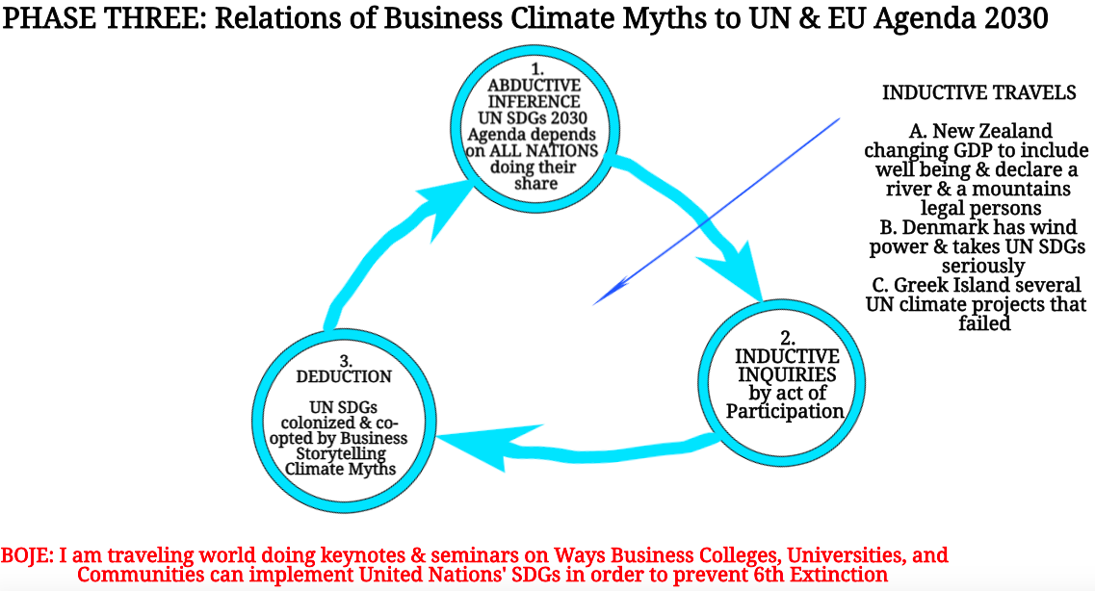
Notes:
I keep journals recording my abductive inferences before doing the inquiries that are inductive and I record the deductive theories available, and change the assumptions after the travels

Slide 20
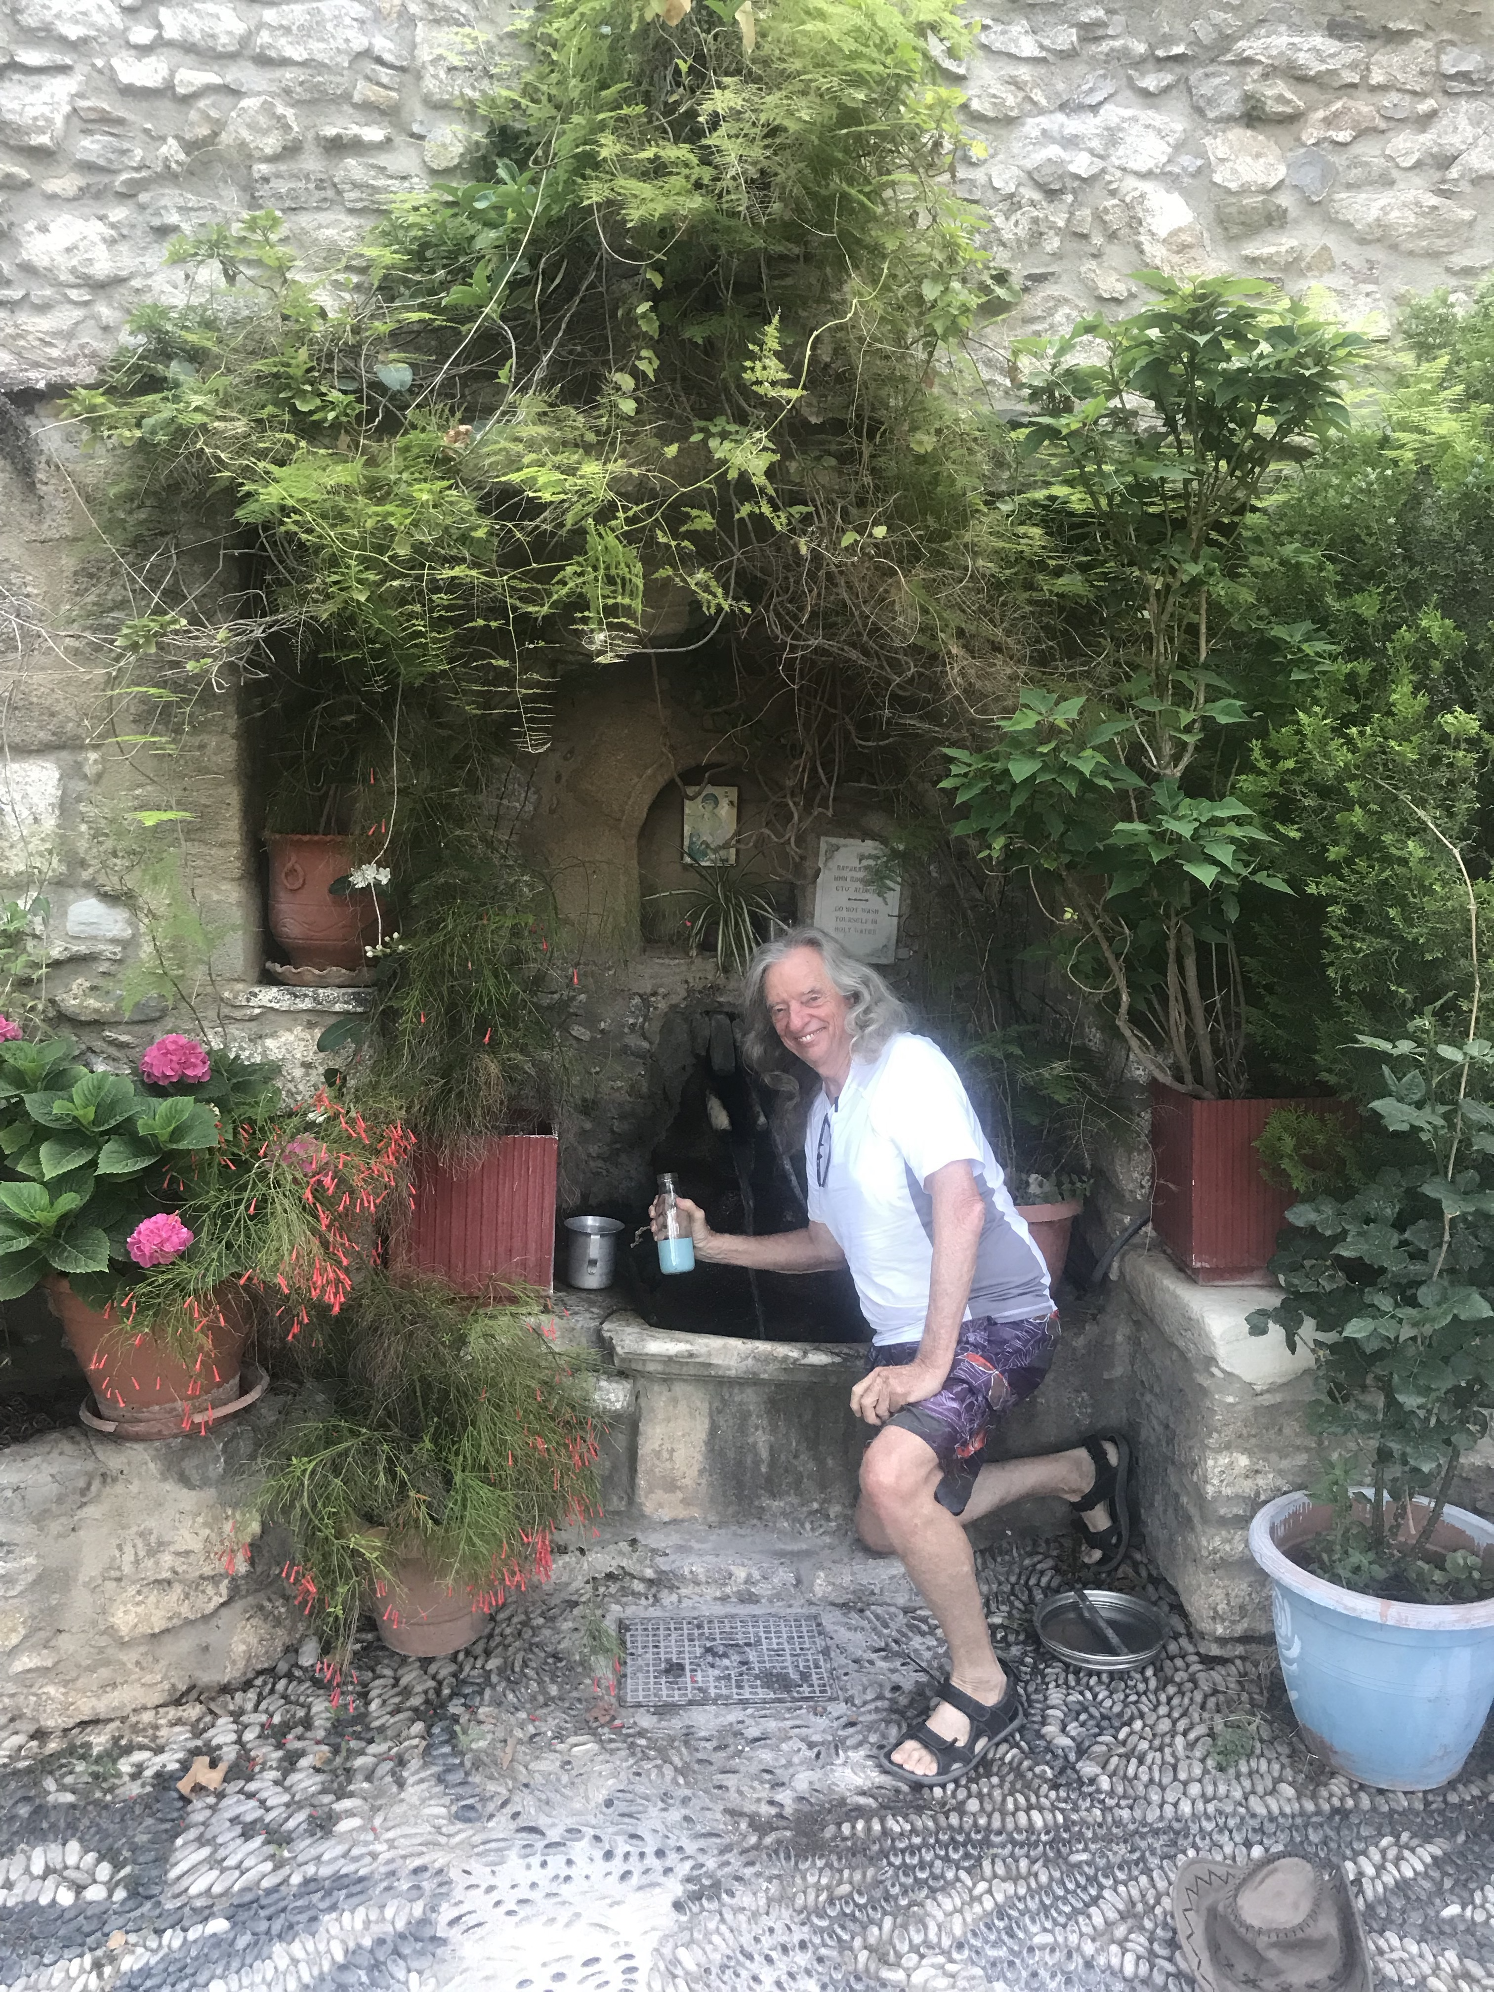
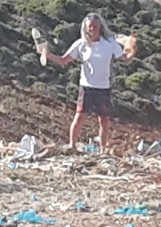
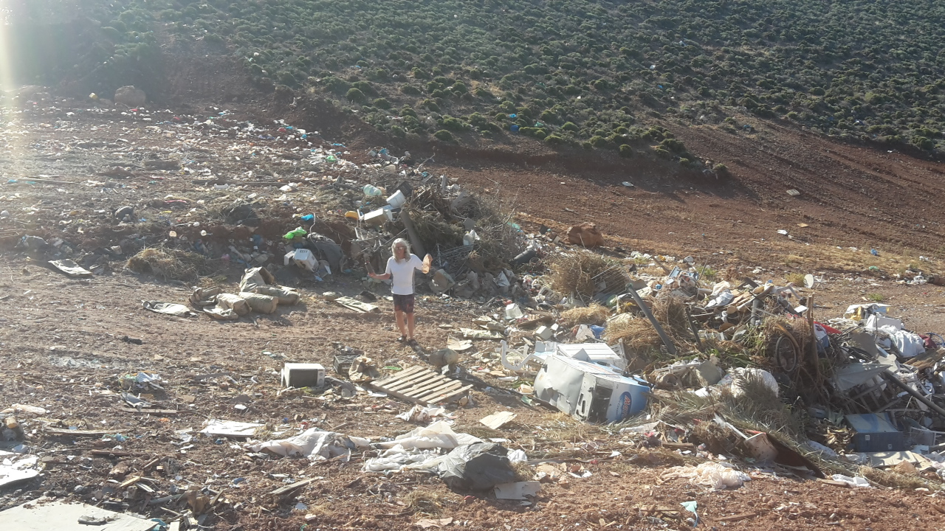
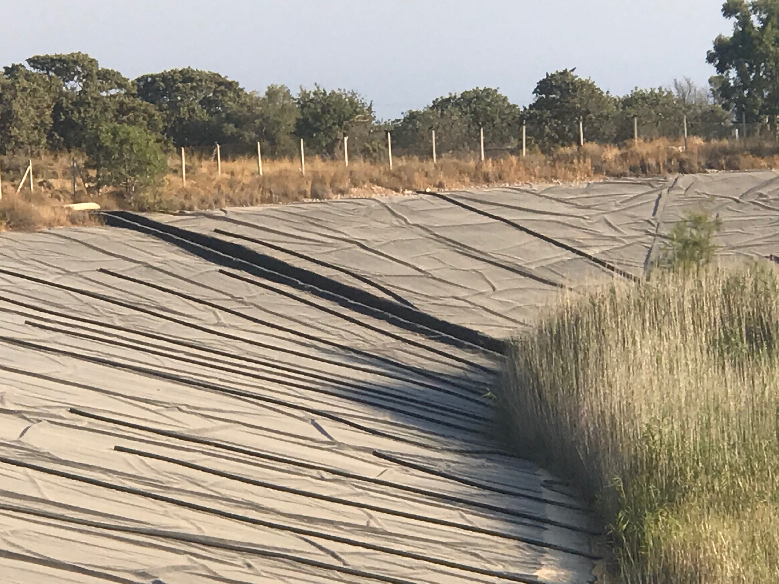
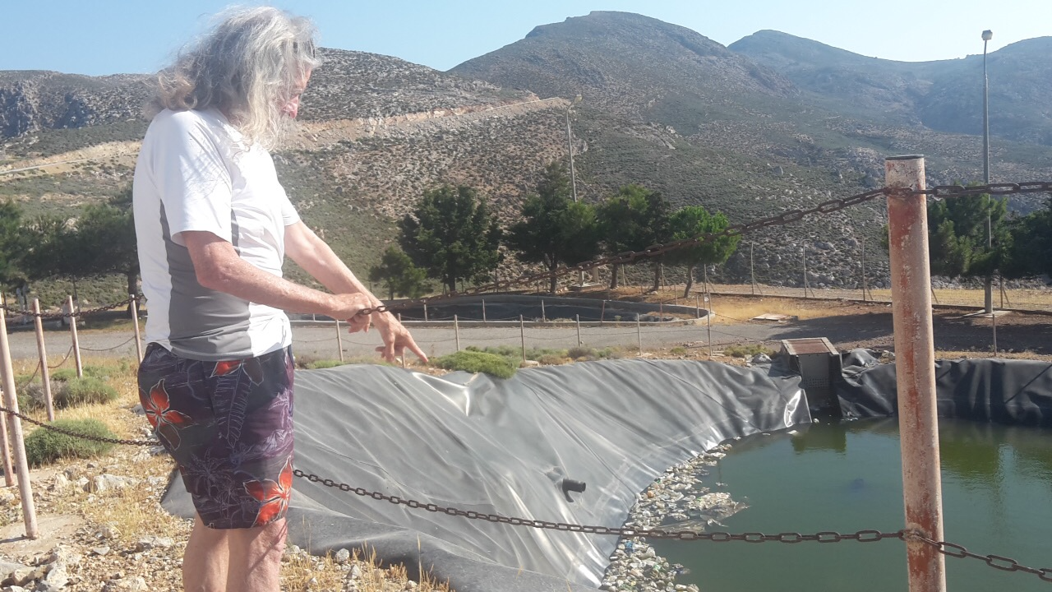
Why Global Storytelling of UN Sustainable Development Goals to the Rescue is Failing
Eliminate all single use plastic
Notes:
Grace Ann and I go each year to a Greek Island. You know, where you dare not drink the tap water, and water is plastic bottles. You know those islands where you are not allowed to flush toilet paper, and put it into a little basket. OK, where do the plastic bottles and the toilet paper go? For that matter, where does the business you flush go? In the top photos, is where it goes. Garbage trucks go to the other side of the mountain from the village beach. And during tourist season, several times a week a leaky tanker truck pumps the sewage tank and drives to the other side of the mountain. There in a gorge, sloping to the ocean, where I am standing (upper left), the plastic and other trash and the toilet waste is dumped.
The United Nations has given grants to create a sewage treatment facility (lower left), but unfortunately the islanders cannot make it work. It is two ponds (foreground and in distance) with liners, but there are already punctures in the liners, and where I am pointing the plastic bottles and plastic bags are accumulating. They flow about. In the far pond (not shown) someone tossed a big dumpster into the pond and ripped the liner. The facility is now not in use.
The UN has another project (lower right), a pond the size of a large soccer field to collect spring water pumped from half a dozen wells. But the wells had some silt that damaged the pumps, and now the project lines in ruins.
The island government does not have enough money in its budget to repair the sewage treatment plant or the reservoir to collect spring water to use for agriculture during the hotter summer months. Currently the islanders are not using several natural springs for their drinking water. An exception is the owner of the apartments where we stay. He goes to the Monastery on top an old volcano mountain, and reuses 36 2-liter plastic bottles. He uses the water for his personal consumption. I go with him, and fill my glass or stainless steel water bottle. The spring water here and in a few other locations, is not pumped. It flows naturally, and continues to flow all year round. It tastes great, has no fluoride or chlorine. My friend, the apartment owner, had the water tested at labs on a larger island.
There are successful projects, such as the photovoltaic arrays (installed 2018), and a new windmill generator (installed in 2019). This makes the island less dependent on an undersea cable from a larger island.
My point is that the UN SDGs on this island are failing. On the surface, there are UN projects, but beneath we find the dark side, how the project engineering designs are faulty, the islanders do not have the budget to keep them going, to repair them, when a dumpster tears the liner, or the pumps clog. Meanwhile, the spring water that is better quality than the bottled water keeps flowing and is mostly unused for anything. The small villages where islanders live, and tourists ome to stay a while, only have bottled water (except those of us who trek to the Monastery spring.

Slide 21
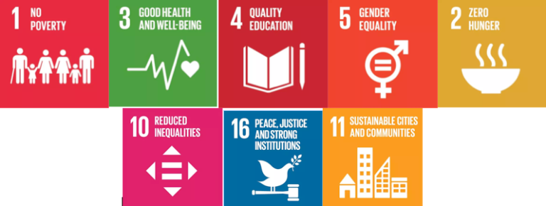
What is Dark Side of Water Storytelling?
The Economic SDGs Dominate the Others
The Social SDGs subordinated to Economic Ones
The Biosphere SDGs are not the priority of Business Storytelling
Notes:
The UN SDGs global initiatives are monitoring some biosphere aspects of the hydrological cycle (6, 13, 14, & 15), but a coherent framework remains the untold dark side of water storytelling

Slide 22
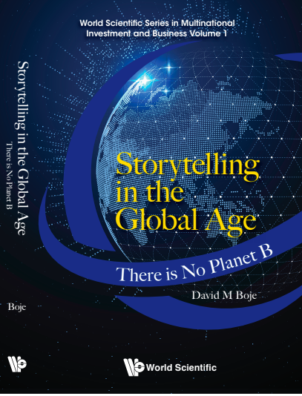
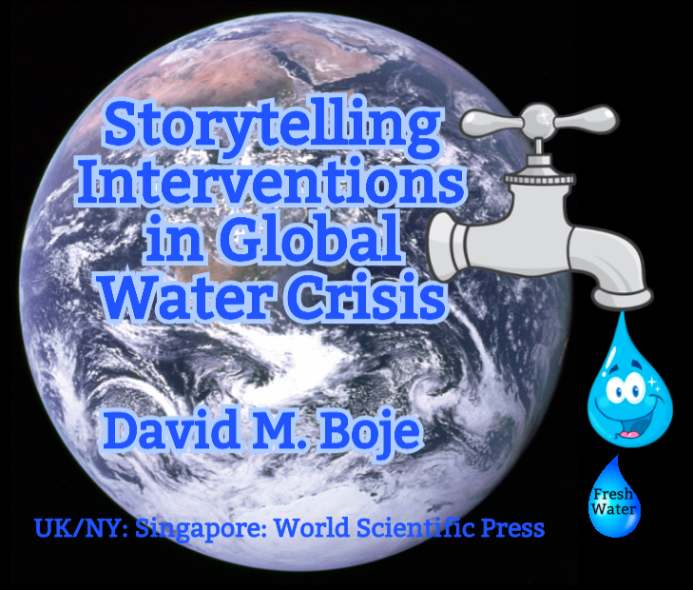
Why are corporations so worried about Climate Action??
Notes:
Big business takes narratives of climate change & freshwater crisis and spins them into a ‘climate debate’

Slide 23
My answer
“A mere 100 companies are responsible for
71 percent of global emissions since 1970”
Source
FOLLOW THE $$$: Exxon knew about climate change since 1982 and spent $30 million on climate debate [denial] advertising (Scientific America)
Koch Family Foundations spent $127,006,756 directly financing 92 groups that have attacked climate change science and policy solutions, from 1997-2017 (Greenpeace).
Notes:
It’s about Multinational Corporate Denial Storytelling
Guardian.com “Just 100 companies responsible for 71% of global emissions, study says” by Tess Riley 10 July 2017 accessed at https://www.theguardian.com/sustainable-business/2017/jul/10/100-fossil-fuel-companies-investors-responsible-71-global-emissions-cdp-study-climate-change
ScientificAmerica.com “Exxon Knew about Climate Change almost 40 years ago” by Shannon Hall Oct 26 2015. Accessed Aug 6 2019 at https://www.scientificamerican.com/article/exxon-knew-about-climate-change-almost-40-years-ago
GreenPeace.com “Koch Industries: Secretly Funding the Climate Denial Machine” by Gus Ruelas 2017. Accessed Aug 6 2019 at (https://www.greenpeace.org/usa/global-warming/climate-deniers/koch-industries/

Slide 24
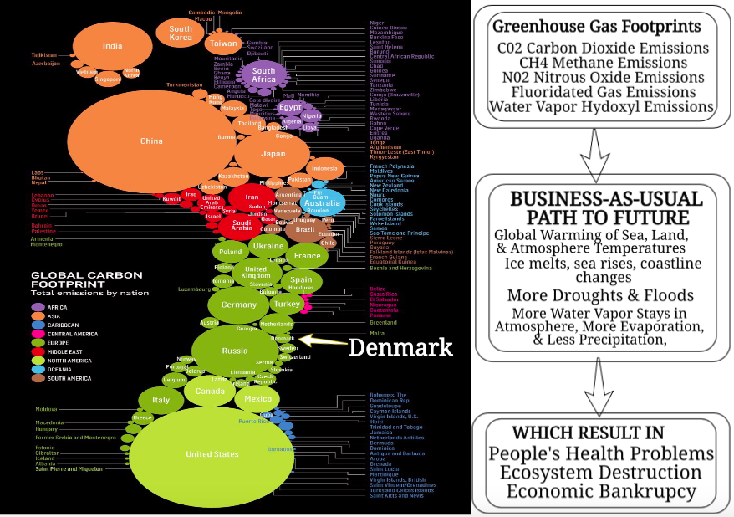
Notes:
Late Modern Capitalism cannot work in a world whose natural” resources are depleted, corroded, burned through, violated (unless by ‘work’ we mean plunge us back into the Stone Age)” –Umair Haque
POINT: 2018 emissions reached record high
China up 4.7% and US up 2.5%
And USA withdrew from Paris agreement and Trump rolling back auto manufacturer emissions limits, appointing anti-climate science administrators, etc.

Slide 25
THERE ARE 4 PATHWAYS OF THE UN WE CAN DECONSTRUCT
UN PATHWAY 1:
Big Techno Fix of Energy Systems
No change western lifestyles, while southern living standards increase
Plant trees
Notes:
Stated in the original UN IPCC report
P1: A scenario in which social, business and technological innovations result in lower energy demand up to 2050 while living standards rise, especially in the global South. A downsized energy system enables rapid decarbonization of energy supply. Afforestation is the only CDR option considered; neither fossil fuels with CCS nor BECCS are used.
Analysis: Circular economy and 3BL sell the plot that you can keep expanding economy GROWTH, while keep using up natural resources.
Pathways “temporal evolutions of natural and human systems”
Afforestation ‘planting lots of trees’
CDR “Carbon Dioxide Removal” options
CCS “Carbon Dioxide Capture”
BECCS “Bio Energy with Carbon Dioxide Capture”
Citing UN IPCC Report Glossary

Slide 26
UN PATHWAY 2:
Sustainable development of energy, economic convergence
Shift to healthy consumption patterns
More big technology innovation for low-carbon
Manage land systems for limited societal acceptability of Bioenergy with Carbon Dioxide Capture
Notes:
“Broad focus on sustainability including energy intensity, human development, economic convergence and international cooperation, as well as shifts towards sustainable and healthy consumption patterns, low-carbon technology innovation, and well-managed land systems with limited societal acceptability for BECCS”

Slide 27
UN PATHWAY 3:
“A middle-of-the-road scenario” is Business-as-Usual
Techno development follows historical patterns
Emission reductions mainly by energy & how products are produced
Not much reduction in demand
Notes:
‘Middle of the road scenario’ in which societal as well as technological development follows historical patterns. Emissions reductions are mainly achieved by changing the way in which energy and products are produced, and to a lesser degree by reductions in demand.”
In other words Business-As-Usual, a term the UN Report Glossary depicts as too hard to fathom, and therefore should be dropped form use. Talk about spinning the narrative:
“In much of the literature the term is also synonymous with the term business-as-usual (BAU) scenario, although the term BAU has fallen out of favor because the idea of business as usual in century-long socio-economic projections is hard to fathom.” See Baseline Scenario, new UN speak for BAU https://www.ipcc.ch/sr15/chapter/glossary/

Slide 28
UN PATHWAY 4:
“Resource & Energy Intensive Scenario”
Economic growth and globalization lead to widespread adoption of less greenhouse-gas-intensive lifestyles
High demand for transportation & fuels, & livestock products
Emissions reductions mainly by technological means for strong Carbon Dioxide Capture and deployment of Bioenergy Carbon Capture
Notes:
“A resource- and energy-intensive scenario in which economic growth and globalization lead to widespread adoption of greenhouse-gas-intensive lifestyles, including high demand for transportation fuels and livestock products. Emissions reductions are mainly achieved through technological means, making strong use of CDR through the deployment of BECC.”

Slide 29
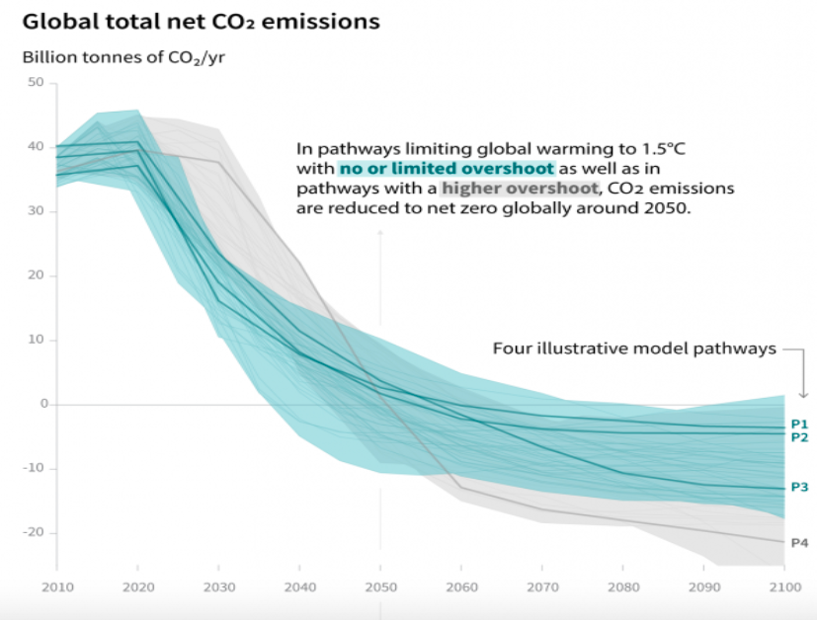
Notes:
WE HAVE TO CHOOSE THE FUTURE CLIMATE WE WANT IN NEXT DECADE!
Impacts of a 4°C global warming scientists are nearly unanimously predicting will happen by the end of the century if no significant policy changes are undertaken.
foreseen consequences are:
the inundation of coastal cities;
increasing risks for food production potentially leading to higher malnutrition rates; many dry regions becoming dryer and wet regions wetter;
unprecedented heat waves in many regions, especially in the tropics;
substantially exacerbated water scarcity in many regions;
increased frequency of high-intensity tropical cyclones;
irreversible loss of biodiversity, including coral reef systems.

Slide 30
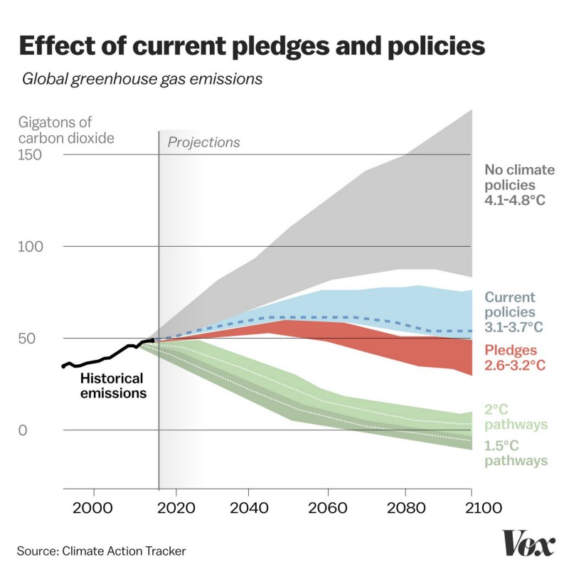
A world in which warming reaches 4°C above preindustrial levels, would be one of unprecedented heat waves, severe drought, and major floods in many regions, with serious impacts on human systems, ecosystems, and associated services
Notes:
A counternarrative is the temperatures under the proposed Business-As-Usual Pathway Scenario, is will be 3.5° or more: "According to current trends, with all our mitigation efforts, the temperature of our Earth is expected to rise by 3.5° Celsius at the end of this century… we would see an increase of 4.1-4.8° Celsius at the end of this century” (Goodmenproject.com).
The image is from VOX.comThe world’s bleak climate situation, in 3 charts
We’ve got a long way to go and a short time to get there.
By David Roberts Accessed Aug 6 2019 at
https://www.vox.com/energy-and-environment/2018/4/30/17300946/global-warming-degrees-replace-fossil-fuels
According to Mark Lynas (2008) if we raise global average surface temperatures by just 6 degrees above pre-industrial levels, we'll create a scenario, which is so extreme it's almost unimaginable (CN.com 2015.)
Most of the planetary surface would be functionally uninhabitable
Agriculture would cease to exist everywhere, apart for the polar and sub-polar regions
Humans biologically can't survive outside
Oceans would become oxygen-deficient
6 degrees is global average; probably twice that over land and somewhat less than that over the oceans.
CNN.com “On 6 degrees of climate change” by John D. Sutter interview with Mark Lynas, author of 2008 book, "Six Degrees: Our Future on a Hotter Planet”, May 22, 2015. Accessed Aug 6 2019 at https://www.cnn.com/2015/05/21/opinions/sutter-6-degrees-climate/index.html
Goodmenproject.com, “Why Is an Increase of 2 Degrees Celsius Such a Big Deal?
The range of this value is huge. So why doesn't everyone see it?” by Saurab Babu.
July 30, 2019, accessed at https://goodmenproject.com/featured-content/why-is-an-increase-of-2-degrees-celsius-such-a-big-deal/

Slide 31
In Sum
“It’s a tragic missed opportunity” The new IPCC report:
Shies away from the big issues:
Farming subsidies for BUSINESS-AS-USUAL
Diet change would allow reforesting & increase health
Oil & Coal BIG SHILLS coopting IPCC
Fails to properly represent scientific ALARM
Gives us few clues about how we might survive the century
POINT: CLIMATE GOALS ARE OFF COURSE (instead of IPCC GHG emissions cut by 40% by 2030 it needs to be 80% to keep Global Warming below the 1.5 degree C goal
Notes:
Aug 8 2019 by George Monboit in Guardian accessed Aug 8 2019 at https://www.theguardian.com/commentisfree/2019/aug/08/ipcc-land-climate-report-carbon-cost-meat-dairy
Another article: 53.5 gigatonnes of CO2 emissions shows no signs of peeking by 2030
Passing 1.5 degree limit means sea levels rise, droughts, and floods plus extreme weather events

Slide 32
Notes:
I stated some experiments
Make an Earchship Greenhous
Then learned
MUST PLANT THE WATER FIRST THEN PLANT THE GARDEN
WATER RUN OFF A SOUCE
DEMI LUNES and Navajo/Zuni Wafalo Garden method better than green house
Go Outdoors and Observe Nature.
Nature is the best teacher I’ve ever had.

Slide 33
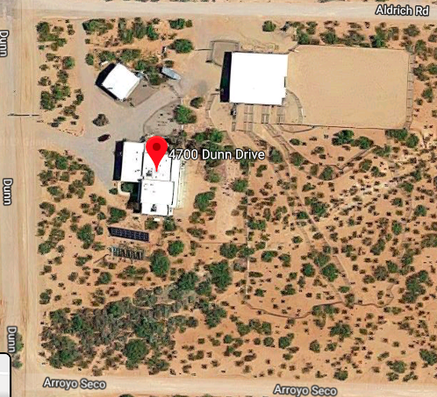
Our desert ranch in New Mexico
Notes:
An arroyo runs diagonally through our ranch and three more arroyos, one on each street to north, south, and west.

Slide 34
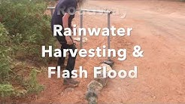
12 Minutes on What to Do? About Dark Side of Water Storytelling
WATER IS LIFE. Harvesting Road and Arroyo rainwater to control Flash Flooding and smooth out the Drought periods of New Mexico by David Bojehttps://www.youtube.com/watch?v=54DbYx7-XIc
Notes:
May not show this if not enough time

Slide 35
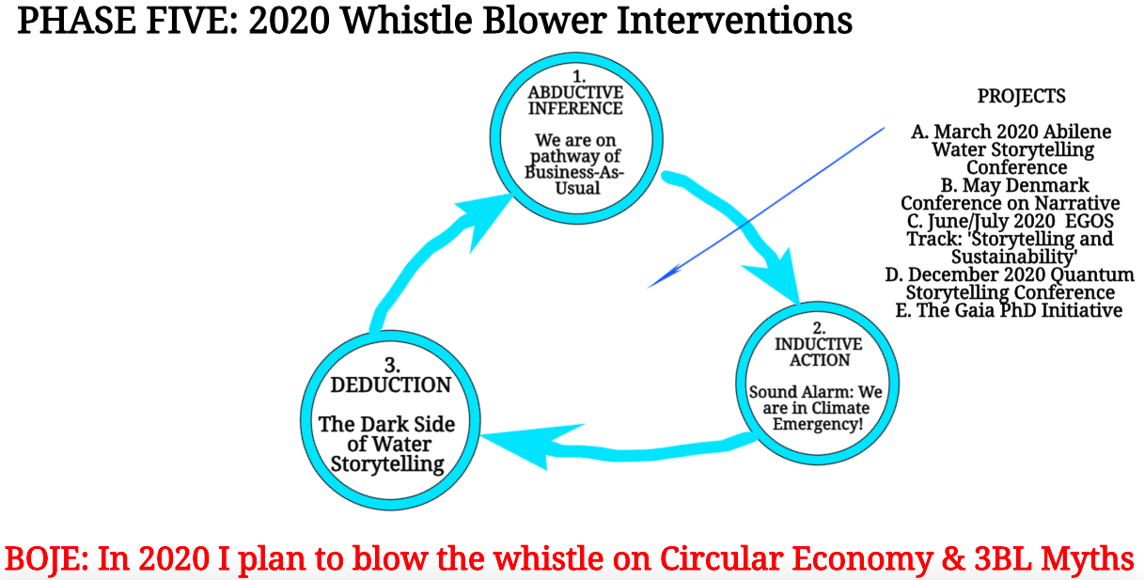
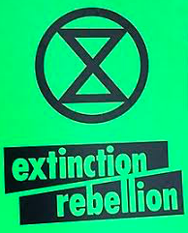
Notes:
In 2020 I want to go public with the DARK SIDE OF CLIMAte & WATER STORYTELLING, HOW UN and EU are being Colonized by BUSINESS STORYTELLING and its corporatized environmentalism

Slide 36
Take Aways about Dark Side Storytelling
We are in the Age of Denial of Existential Crises (Climate Change, Global Warming, Water Day Zeroes, 6th Extinction, Creeping Fascism)
Our Political Elites are solving Fake Problems of TRIPLE BOTTOM LINE with Fake Solutions of CIRCULAR ECONOMY (Trumpism is a form of violent denial; TrumpLand agencies exist to craft denial narratives in service of fossil fuel, plastic, and big pharmaceutical industries) COLONIZING UN & EU 2030 Agenda
Neoliberal economists, academic capitalism, and fake news are all about denial of existential crises spiraling out of control
United Nations doing Doomsday Climate Storytelling that most people tune out, since evolutionary brain socialized to only see immediate threats to survival
Notes:
THEORY POINT: Antenarrative Bets on the Future by UN and EU Agenda 2030 are not according with Climate Science Forecasts
Another article by Lisa about IPCC report
The report finds even the current levels of global heating are increasing the risks of water scarcity, soil erosion, vegetation loss, fire damage, coastal degradation, permafrost thawing and declines in crop yields.
A paper in Geophysical Research Lettersreveals that the thawing of permafrost in the Canadian High Arctic now exceeds the depths of melting projected by scientists for 2090.
While record temperatures in Europe last month caused discomfort and disruption, in south-west Asia they are starting to reach the point at which the human body hits its thermal limits.
A recent paper in Nature shows that we have little hope of preventing more than 1.5C of global heating unless we retire existing fossil fuel infrastructure. Even if no new gas or coal power plants, roads and airports are built, the carbon emissions from current installations are likely to push us past this threshold.
Only by retiring some of this infrastructure before the end of its natural life could we secure a 50% chance of remaining within the temperature limit agreed in Paris in 2015. To pursue efforts to limit the temperature increase even further to 1.5 degrees Celsius. The Paris Agreement entered into force on 4 November 2016,
Union of concerned scientists Aug 8 2019 email Boje received
The Trump administration is about to finalize a rollback of our clean car standards, the single most effective federal policy to reduce global warming emissions. Unfortunately, in addition to getting rid of all of the benefits to public health, climate, and fuel savings of the clean car standards, the Trump administration is also trying to take away states' ability to adopt their own emission standards.

Slide 37
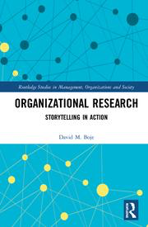
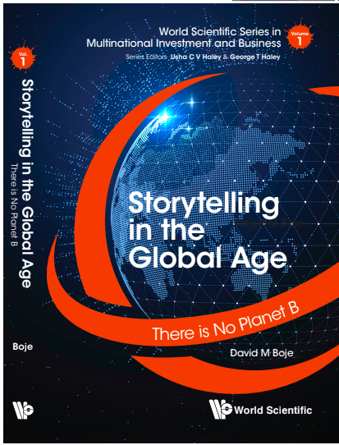
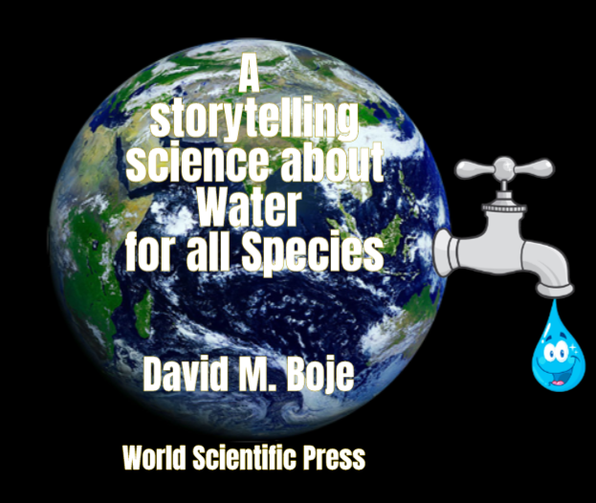
Storytelling Science and Your Dissertation
David M. Boje & Grace Ann Rosile
UK, US, Singapore: World Scientific
February 21, 2019; Revised March 19, 2019
Thank You: Any Questions?
Download Storytelling Science book and slides for this presentation at https://davidboje.com/Aalborg
Notes:
If you have and comments or questions contact me at davidboje@gmail.com
Thank you

Slide 38
McMurry University's "Water is Life” Storytelling Conference: Water as More Valuable than Oil
March 18, 19, and 20, 2020
Professors David M. Boje, Ph.D. and Duncan Pelly, Ph.D. will facilitate the conference, plan the presentations, and host interactive sessions.
Please contact either Professor David Boje davidboje@gmail.com or Professor Duncan Pelly duncan.pelly@gmail.com with a two page proposal and your contact information.
Eliminate all single use plastic

Slide 39
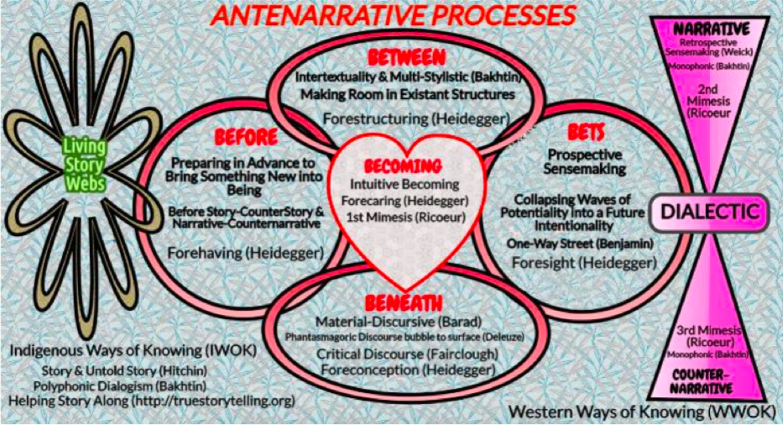
Lundholt, Marianne Wolff, & Boje, David M. (2018). Understanding Organizational Narrative-Counter-narratives Dynamics: An overview of Communication Constitutes Organization (CCO) and Storytelling Organization Theory (SOT) approaches. Communication and Language at Work, 5(1), 18-29. (see Article)
Notes:
In the can be CLAW Journal article, we relate CCO to Storytelling by showing the DIALECTIC and DIALOGICAL processes
At my last keynote, here in Aalborg in May, focused on how such an approach can be used to change BUSINESS MODELLING in the BUSINESS SCHOOL’S BUSINESS STORYTELLING to ECO-BUSINESS MODELING, and with Kenneth and Marita we introduced a 6th B, THE BEYOND, which is about Embodied ways of intuitive knowing.
It is what an article released by Human Relations by Emma Bell and Hugh Willmott call, three dynamic kinds of reflexivity: (1) epistemic reflexivity, (2) constitutive reflexivity, and (3) disruptive reflexivity. GUESS WHICH ONE I AM TODAY? ANSWER DISRUPTIVE REFLEXIVITY TO THE KINDS OF EPISTEMIC RELFEXIVITY OF GRAND NARRATORS and THE CONSTITUTIVE REFLEXIVIY OF BUSINESS SCHOOL METHODOLOGISTS STUCK IN MAINSTREAM OB OT OD and MGMT METHODS. THAT IS A TALE FOR ANOTHER TIME!
Lundholt, Marianne Wolff, & Boje, David M. (2018). Understanding Organizational Narrative-Counter-narratives Dynamics: An overview of Communication Constitutes Organization (CCO) and Storytelling Organization Theory (SOT) approaches. Communication and Language at Work, 5(1), 18-29. https://findresearcher.sdu.dk:8443/ws/files/143389162/document.pdf
ABSTRACT: I believe United Nations’ (& EU) Agenda 2030 is being colonized and co-opted by corporatized environmentalism approaches such as Circular Economy and Triple Bottom Line that put economic growth ahead of ecology and equity As a result the 17 UN SDGs will not contain average climate temperatures overshooting the 1.5 degree C by 2030. I will assert that this has everything to do with the look the other way ‘bystander’ ‘Business Storytelling’ and the Echo Chambers of social media, partially funded by Exxon and by the Koch Brothers. With the withdrawal of Trump from Paris Climate agreement, and installing anti climate science administrators to head US agencies, it is unlike the 1.5 degree climate change targets of UN and EU will be met by 2030. My approach is to develop storytelling science, in relation to critical discourse analysis and critical organization communication studies, a sort of critical storytelling discourse organizational communication paradigm shift. We (Boje & Rosile) calling ‘self-correcting storytelling science', a methodology of refuting the business storytelling claims, instead of just verification. As Edward Abbey (1968/1971: 145, boldness, mine) put it, “growth for the sake of growth is a cancerous madness”. What people don’t do is read the rest of the quote, which is about water, because as climate warms, the water warms, glaciers melt, sea levels rise, oceans acidify, temperatures rise some more, and the earth is not habitable by most species. I will argue that we need a research-as-craft storytelling approach that is about reflexives. It is what a new article released by Human Relations by Emma Bell and Hugh Willmott call, three dynamic kinds of reflexivity: (1) epistemic reflexivity, (2) constitutive reflexivity, and (3) disruptive reflexivity. GUESS WHICH ONE I AM TODAY?

Slide 40
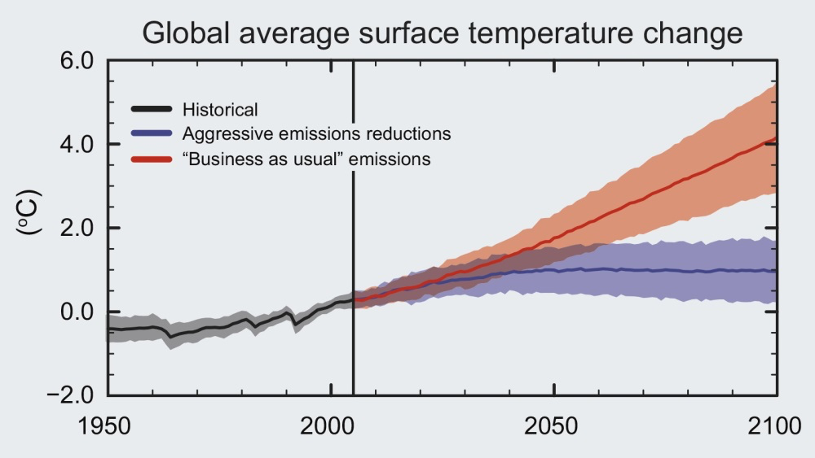
Notes:
We will choose the future our grandchildren will have in the next decade!
https://royalsociety.org/topics-policy/projects/climate-change-evidence-causes/basics-of-climate-change/

Slide 41
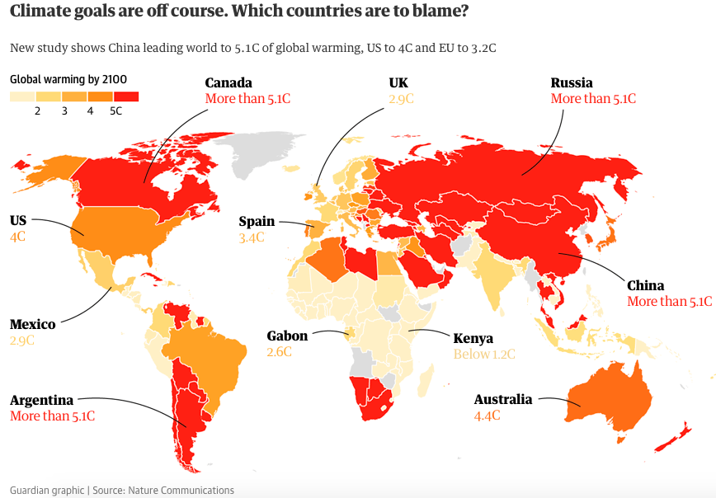
Notes:
JUST IN “In the absence of major action to reduce emissions, global temperature is on track to rise by an average of 6 °C (10.8 °F), according to the latest estimates. Some scientists argue a “global disaster” is already unfolding at the poles of the planet” NASA.com accessed Aug 10 2019 at https://climate.nasa.gov/faq/16/is-it-too-late-to-prevent-climate-change/
Policies of China, Russia and Canada threaten 5C climate change, study finds, by Jonathan Watts 16 Nov 2018, accessed Aug 9 2019 at https://www.theguardian.com/environment/2018/nov/16/climate-change-champions-still-pursuing-devastating-policies-new-study-reveals
Ranking of countries’ goals shows even EU on course for more than double safe level of warming
https://www.theguardian.com/environment/2018/nov/16/climate-change-champions-still-pursuing-devastating-policies-new-study-reveals
Emissions are on the upswing image from https://www.vox.com/energy-and-environment/2018/4/30/17300946/global-warming-degrees-replace-fossil-fuels
G20 subsided for fossil fuels have tripled
USA Trumpland refuses Paris Agreement
2018 emissions reached record high
China up 4.7% and US up 2.5%
A recent paper in Nature shows that we have little hope of preventing more than 1.5C of global heating unless we retire existing fossil fuel infrastructure. Even if no new gas or coal power plants, roads and airports are built, the carbon emissions from current installations are likely to push us past this threshold. Only by retiring some of this infrastructure before the end of its natural life could we secure a 50% chance of remaining within the temperature limit agreed in Paris in 2015. Yet, far from decommissioning this Earth-killing machine, almost everywhere governments and industry stoke its fires.

Slide 42
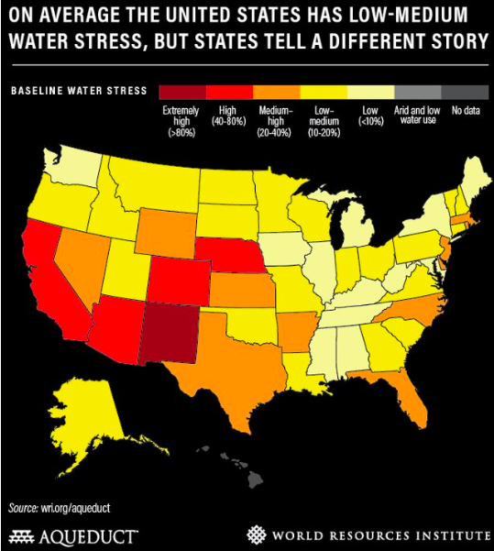
The state of New Mexico tells a different story of water
Notes:
NEW MEXICO IS A STORY OF EXTREMELY HIGH WATER STRESS, highest of all sates: “industries and municipalities in the state use about 95% of New Mexico's available annual water supply, leaving little in the reserves for droughts and dry spells” “the federal government had to lease $2 million of groundwater from Albuquerque in order to keep the Rio Grande flowing.” “The state's largest reservoir ran as low as 2.9% capacity” USDA declare New Mexico a disaster area.” In regions that face "extremely high" water stress — like New Mexico — industry, agriculture, and municipalities are withdrawing at least 80% of available surface and groundwater each year. That puts them in a precarious position, with little leftover water to serve as a buffer in dry spells.”
“New Mexico faces extreme water scarcity on par with the United Arab Emirates. Experts warn more 'day zeros' are looming” By Morgan McFall-Johnsen Aug. 7, 2019,
Accessed Aug 10 2019 at https://www.businessinsider.com/new-mexico-faces-extreme-water-stress-2019-

Slide 43
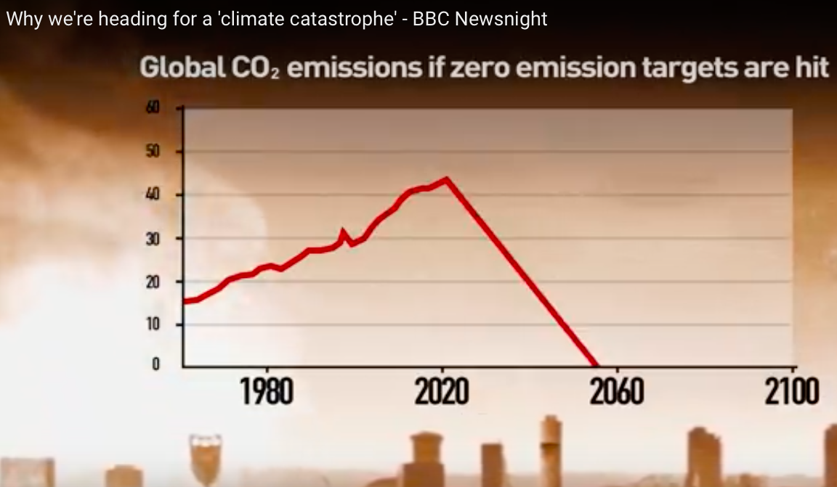
The radical change need to hit Agenda 2030 target
Notes:
Why we are headed for a ‘climate catastrophe’ BBC Newsnight Youtube accessed Aug 12 2019 at https://www.youtube.com/watch?v=pJ1HRGA8g10

Slide 44
Kevin Bixby
“People think ‘well it’s weird the river dries up in the wintertime.’ But it didn’t used to dry up in the wintertime... It’s because all the water is allocated for agriculture, and farmers don’t want that water released in the wintertime, so they store it up behind the dams…
So these three things.
Taking of all the water from the river for irrigation
Building the dam that stop the floods, and
Channelizing the river
have destroyed the river ecosystem.
You know, it’s obvious that fish cannot live without water. ”

Slide 45
EXTRAS SLIDES
For those interested in the climate science

Slide 46
https://davidboje.com/Gaia/
Notes:
See also OM 2019 paper
The Coming Crisis of Organization Studies: Gaiagraphy and New Political Imaginaries
Authors
Damian O'Doherty, Critical Management Studies, damian.odoherty@mbs.ac.uk Matt Statler, New York U., mstatler@stern.nyu.edu

Slide 47
More Take Aways about Dark Side Storytelling
Western nations are unprepared for life in a 1.5˚C increase in average global temperature, indigenous survival skills will become essential
We are living in artificial digital and mall worlds disconnected from natural ecology, so we clueless how to survive the 1.5˚C increase.
In our life time, with a 1.5˚C increase in temperature, Water will cost more than Oil because it’s scarce
Notes:
7. …been commodified by bottled water industry, and commodified by international water companies taking over city & municipal water systems

Slide 48
Please add your critique of Circular Economy to the Wikipedia page, to the section on CRITICISM I initiated (and may still be there) https://en.wikipedia.org/wiki/Circular_economy
Notes:
I put in this critique to the Wikipedia page on Circular Economy, and I wonder how long it will survive the forces of climate denial, when the consulting industry, in my experience, often edits out such criticisms of TINA narratives, so as not interfere with sales. Here is my addition to it:
Critiques of circular economy
“The logic of the 'circular economy' narrative and discourse: business can be as profitable as it has been in the linearity model of grow now, clean up later (focus on short-term gains at expense of long-term externalities). While it is possible to somewhat reduce, reuse, and recycle, in its circularity the circular economy is all about sustainable economy, and sustainable development without limits to growth, that can keep placing more demands for additional natural resources, evermore growth, and does not account for exceeding nine planetary limits on the carrying capacity for all life on planet Earth. Circular economy uses the same logic as 'triple bottom line' and therefore merits the same critique. Triple Bottom Line (3BL) of people, planet and profit (aka economic prosperity or by the economic, equity and environment (aka, Triple Bottom Line or 3BL), puts profit/economic ahead of people/equity and planet/environment. As with 3BL, circular economy has robust measures of profit/economic variables but not much on the people/equity or planet/environment. The premise of the Circular Economy is a set of boundary conditions that ensure all activity translates to contributing toward positive impact for the Triple Bottom Line (3BL) people, planet and profit (aka economic, equity, & environment).
"Given the all too obvious social and environmental crises associated with out-of-bounds growth capitalism, the circular economy has been one of the main references for rebuilding and reforming a political economy of sustainable growth" (Valenzuela & Böhm, 2017: 23).
For more see
Lazarevic, D., & Valve, H. (2017). Narrating expectations for the circular economy: Towards a common and contested European transition. Energy research & social science, 31, 60-69.
Milne, Markus J.(2005). "From soothing palliatives and towards ecological literacy: A critique of the Triple Bottom Line." Accessed Aug 1 2019 at https://ourarchive.otago.ac.nz/bitstream/handle/10523/1551/From_soothing_palliatives_and_towards_ecological_literacy.pdf
Norman, W., & MacDonald, C. (2004). Getting to the bottom of “triple bottom line”. Business ethics quarterly, 14(2), 243-262.
Valenzuela, F., & Böhm, S. (2017). Against wasted politics: A critique of the circular economy. ephemera: theory & politics in organization, 17(1), 23-60.Accessed Aug 1 2019 at http://irep.ntu.ac.uk/id/eprint/30441/1/PubSub8234_Valenzuela.pdf
Wikipedia Circular Economy – Critique (posted by D. M. Boje on July 28 2019) accessed Aug 6 2019 at https://en.wikipedia.org/wiki/Circular_economy

Slide 49
What is Dark Side of Climate Storytelling?
FAKE STORYTELLING BELIEFS”
US can buy its way out
Technology will fix it
Government will save us
(MIT Study; and MIT Survey 2012)
Notes:
USA Trails Latin American and Asian Cities in Climate Change Preparation
95 percent of major cities in Latin America are planning for climate change, compared to only 59 percent of such cities in the United States
(Global Survey 2014)
DUE TO DARK SIDE OF STORYTELLING “Climate change discussion is off the table, quite frankly, more in the U.S. than anywhere else,”
(MIT Study; and MIT Survey 2012).

Slide 50
Notes:
Reference: Water Use by Categories, OSE Technical Reports Nos.41, 44, 46, 47, 49, 51, 52, and 54.
Data is for Doña Ana County only. Groundwater diversion includes Jornada del Muerto
Sigma is the Standard Deviation
*Surface water diversion, and the average, are as given in EBID minutes for the six (6) years 2005-2010.
Note that 2005-2010 surface withdrawals average about 90,000 Af/yr (23%) lower than those for1990-2000
While groundwater withdrawals for irrigated agriculture increase by almost 45.000 Af/yr (49%).
Note: EBID diversion in a (hypothetical) Full Supply Year is 454,980 Af of a 790,000 Project Release.
1990-2010 Average was 70.6% of this.
2005-2010 Average was 58.9% of this.

Slide 51
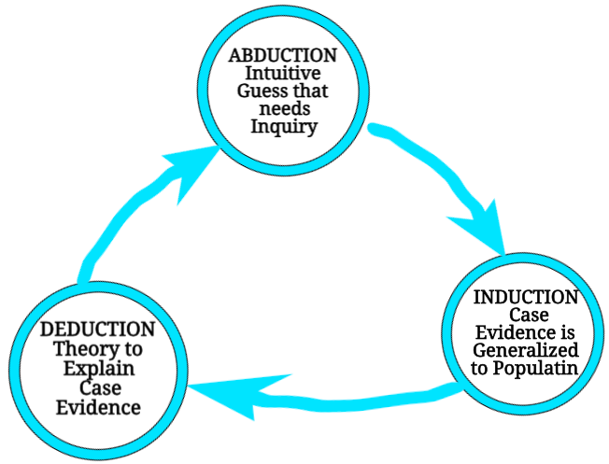
Each Phase does Peircean Triadic

Slide 52
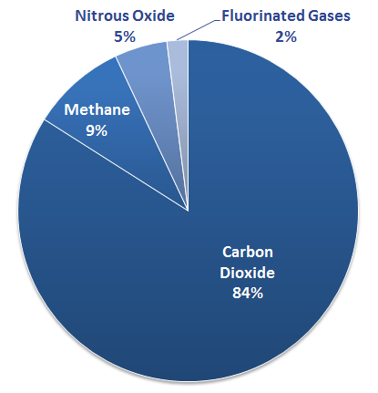
GHG Material Storytelling Leaves out Water Vapor Emissions

Slide 53
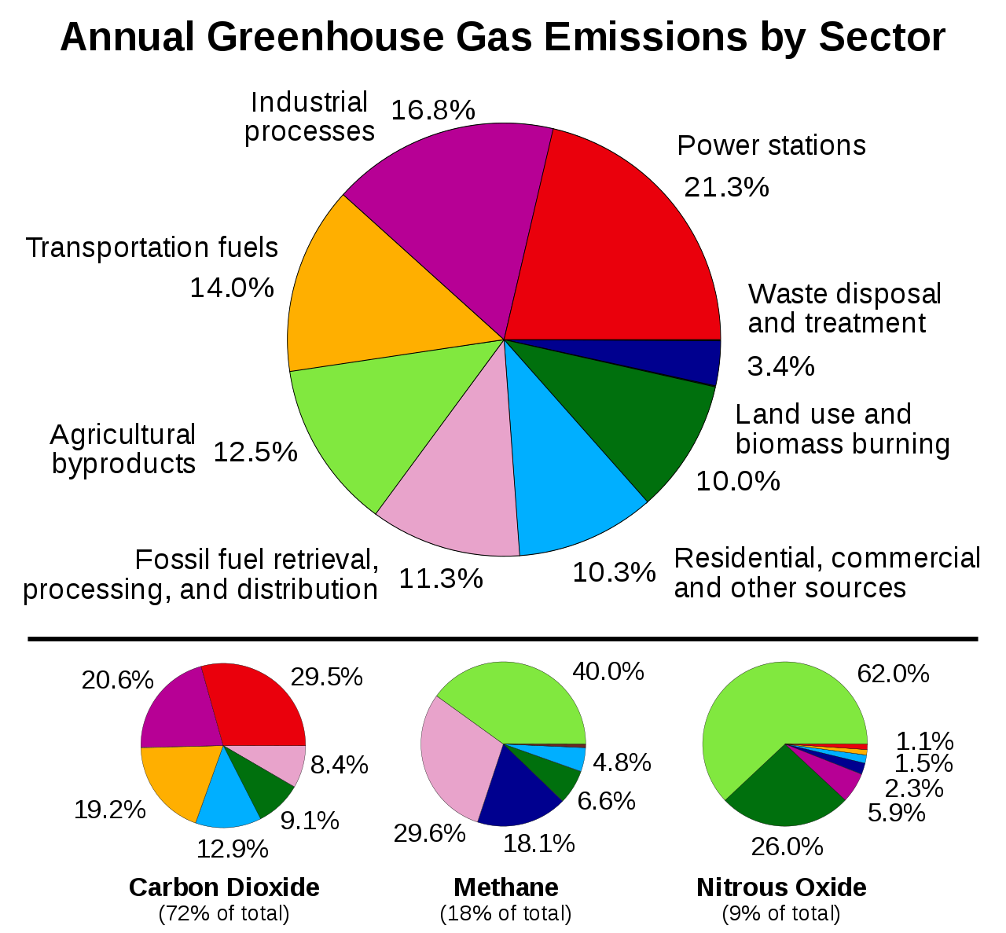
Storytelling Leaves out Water Vapor Emissions

Slide 54
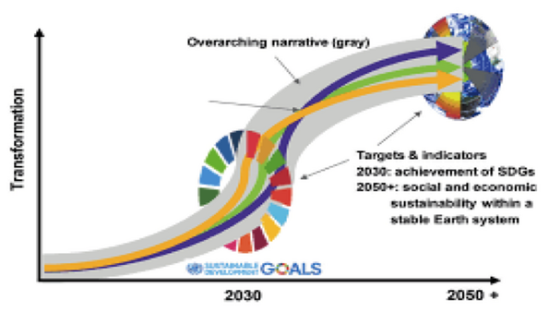
Will 4 Pathways of UN be ‘Narrative’ Overshoot?
See Antenarrative Blog https://davidboje.wordpress.com/2019/07/30/dark-side-of-business-storytelling-discourses-implications-for-united-nations-actually-meeting-sustainable-development-goals/

Slide 55
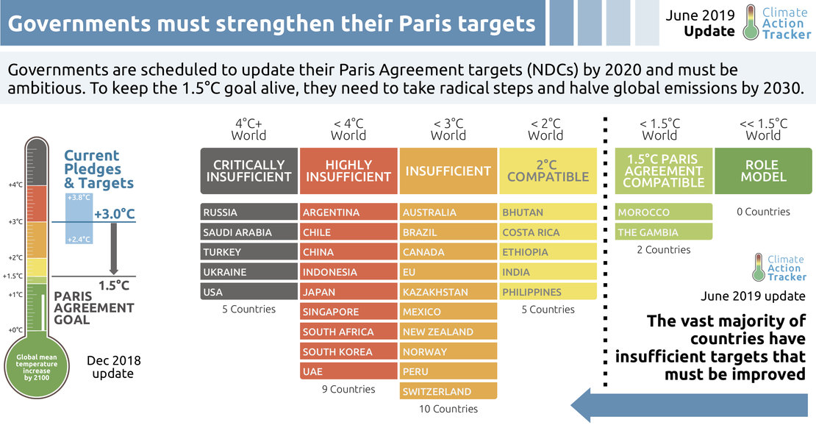
Which nations keeping targets?

Slide 56
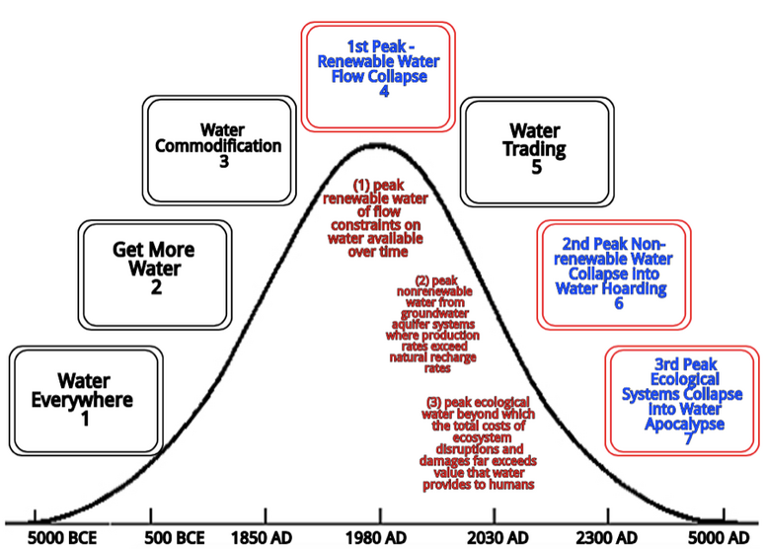
Source article in review by David Boje and Kenneth Mølbjerg Jørgensen

Slide 57
Hydroxyl Radicals (OH)
THE GOOD SIDE: Very important for cleaning earths atmosphere, which oxidize volatile organic compounds such as methane and isoprene
isoprene, naturally released by plants, contributes to the reduction as well as to the formation of OH radicals and recycling efficiency of OH radicals depends on isoprene quantity.
THE BAD SIDE: Very harmful due to its toxic effects →cause cell damage in inhabitants exposed to it, leading to cancer, accelerated ageing, disrupted enzyme function, affect membrane permeability etc.

Slide 58
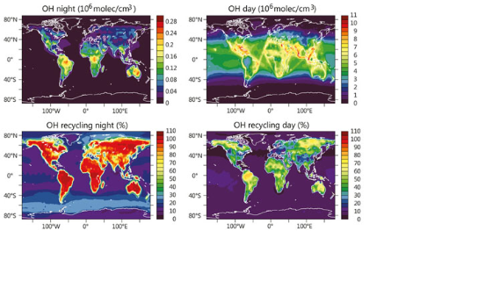
Water Vapor (HYDOXYL) Emissions Split H2O into H & OH
World maps model hydroxyl recycling efficiency during daytime.
Orange & yellow show high recycling efficiency, i.e. over Amazon rainforest.

Slide 59
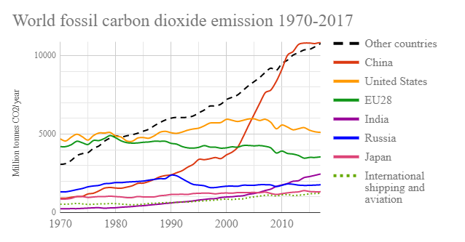

Slide 60
Quito, Ecuador TRUE STORYTELLING
For 17 years, Ecuador’s mountainous capital has been studying the effects of global warming on nearby melting glaciers, developing ways of dealing with potential water shortages and organizing conferences on climate change for leaders of other Latin American cities.

Slide 61
First, Some Definitions
Black carbon is the sooty black material emitted from gas and diesel engines, coal-fired power plants, and other sources that burn fossil fuel. It pollutes air and water, causing 8 million human deaths a year plus animal morbidity by embedding black carbon in lungs. Black carbon darkens the snow and ice, reducing reflectivity and increasing the glacial melt, raising the sea levels, and warms the atmosphere water vapor (source)
Notes:
3.7 million premature deaths in 2012 to outdoor air pollution, and 4.3 million to household air pollution. The breathing in of particulate matter (composed of black carbon, sulfate, nitrates, ammonia, sodium chloride, mineral dust and water) that measures 10 microns or less in diameter (PM10), poses the greatest health risks because the particles can find their way deep into lungs and the bloodstream, and cause cardiovascular and respiratory disease, and premature death. https://blogs.ei.columbia.edu/2016/03/22/the-damaging-effects-of-black-carbon/

Slide 62
Time to do True Storytelling (Boje, Larsen & Bruun)
What is TRUE STORYTELLING now?
How to plan FUTURE?
When & Where to do PROJECT?
Reflect on OUTCOMES?

Slide 63
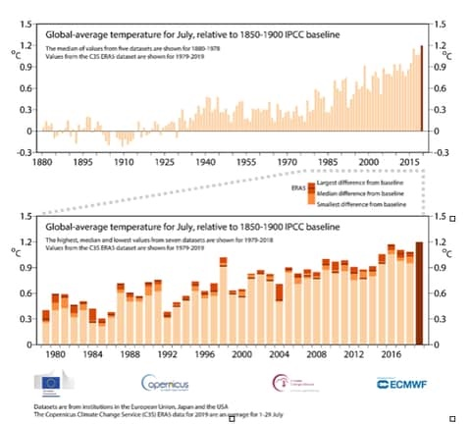
July Hottest Month on record
Notes:
It has been hot in Europe in 2019

Slide 64
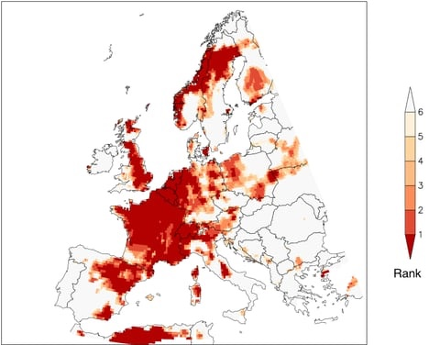
Europe Summer 2019

Slide 65
What is Jane Goodall’s Answer to CLIMATE DENIAL?
She does it through storytelling (See YouTube)
Jane Goodall’s Tips on Convincing People to Care for the Planet: “I always do it through stories, never through direct confrontation?”
Take them to the Artic in the summer and see how quickly they vanish under the water!
How do you get somebody to realize we actually are destroying the planet?
BUT WHAT IS GOODALL NOT SEEING – DARK SIDE OF STORYTELLING!
Notes:
How do you get someone to understand we humans really are destroying the planet’s climate? IS IT BY COMM STUDIES, BY CRITICAL DISCOURSE, or IS IT BY STORYTELLING.
Jane Goodall’s Answer “I always do it through stories” https://www.youtube.com/watch?v=wTmNE4br8TY&feature=youtu.be
WHY? Because if you confront someone who is polar opposite to you, they don’t really listen, they are thinking of ways to refute you.
They come up with what Marianne Wolf Lundholt and I call counternarratives to your antenarrative (2018).
BUT I AM GOING TO REFUTE JANE GOODALL’s APPROACH TO STORYTELLING. WHY? SHE IS MISSING THE DARK SIDE OF THE STORYTELLING. SHE IS MISSING HOW ITS NOT JUST ABOUT showing people Earth is reaching point of no return because of Exxon Oil, Koch Brothers and Echo Chamber
Goodall says, “When it comes to Earth, we are reaching the point of no return!” The youth are coming up to Goodall and saying “WE HAVE LOST HOPE IN THE FUTURE!” “We have been borrowing our children’s future, and we are still stealing it today?” This sounds like Extinction Rebellion, like 15 year old, Greta Thunberg, her age when she addressed the UN plenary 2018. Or civilization is being sacrificed for rich people to live in luxury, and Greta’s children will ask why are you stealing our future. Change the system is her message, and you are running out of excuses. https://www.youtube.com/watch?v=HzeekxtyFOY
BUT I am a STORYTELLING RESEARCHER, and something else is going on, I call it DARK SIDE OF WATER STORYTELLING!
Goodall says “if you think globally, you get depressed with the harm we are inflicting” So do something locally: cleaning a beach, campaign against the use of plastic, and so on. There are 3 types of involvement for young people
(1) project to help people, (2) project to help animals, (3) project to help the environment.
Global warming is long-term rise in the average temperature of the Earth's climate system, an aspect of current climate change shown by temperature measurements and by multiple effects of the warming.
Wikipedia
AND WE HUMANS DO NOT KNOW HOW TO LIVE ON EARTH AT A HIGHER TEMPERATURE, NOT IN THIS CAPITALIST ECONOMIC GROWTH SYSTEM, as Edward Abbey said it ““growth for the sake of growth is a cancerous madness!”

