Slide 1
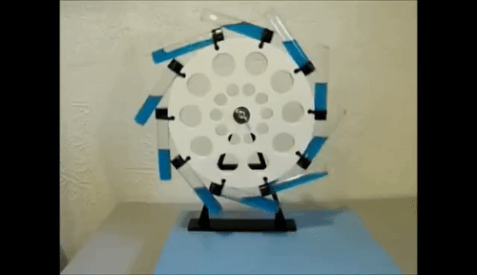
Storytelling Strategies for Sustainability:
How Conversational Storytelling Interviews and True Storytelling
use both qualitative and quantitative methods
to improve the Triple Bottom Line approach to Sustainability

Slide 2
Presenters
David M. Boje, Professor, Aalborg University, and
Professor Emeritus of Management, New Mexico State University
davidboje@gmail.com
Grace Ann Rosile, Professor Emeritus of Management, New Mexico State University
garosile@nmsu.edu
Jens Larson, Co-Founder, Old Friends Industries
info@oldfriendsindustries.com
Slides at https://davidboje.com/Aalborg

Slide 3
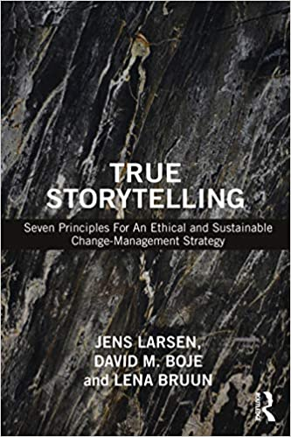
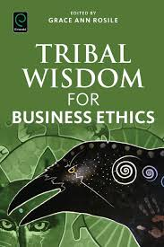
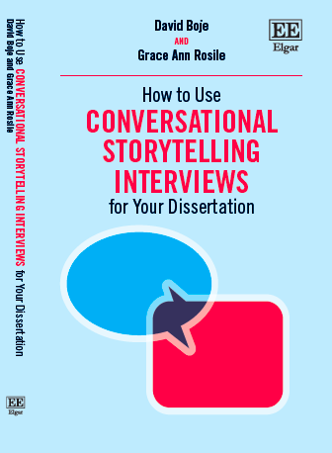
For your Library
Published 2016 $48 Paperback & also Kindle
Published 2020
2020 E-book $40, hardback ~$104, version CLICK HERE;
paperback next year for ~$50
Paperback $42.95
or Kindle $40.80
Notes:
<number>

Slide 4
AGENDA:
Hour 1 = THEORY
Hour 2 = METHOD
Hour 3 = INTERVENTION /PRACTICE

Slide 5
TOPIC OUTLINE
What is a THEORY?
How is Storytelling Research like Tamara-Land?
Chart: How can storytelling be both qualitative & quantitative? What is intersubjectivity?
Russell Means, and his Grandfather’s story
BREAKOUT for 5 min. When did you not know something everyone else knew?
Debrief: 5 I’s of Indigenous Storytelling; Intersubjectivity; Self-Correcting Method
3 CASES demonstrating use of storytelling THEORY
What are storytelling research METHODS?
A-I-D Abduction, Induction, Deduction definitions and explanations
BREAKOUT for 5 min. When have you used ABDUCTION in your research?
Self-Correcting: Pierce’s 4 tests of Induction
Conversational Storytelling Interviews
Critique of the Triple Bottom Line
3 CASES demonstrating methods: CIW, Danish Agriculture, Apple
True Storytelling Rainwater Recycling Case
Q&A: What can you USE? What do you want to hear more about?
Popcorn: Chat and oral answers regarding motivation for True Storytelling
Notes:
<number>

Slide 6
What is a Theory?
Sutton and Staw (ASQ 1995, “What theory is not”)
References in your Literature Review, not a theory
Data in Tables, not a theory
List of Variables, not a theory
Diagrams with boxes and arrows, not a theory
Abductive-Propositions (or hypotheses), not a theory
An Experiment or an Interview, or a P-Test, not a Theory
Notes:
<number>

Slide 7
Notes:
Lundholt, M. W., & Boje, D. (2018). Understanding Organizational Narrative-Counter-narratives Dynamics: An overview of Communication Constitutes Organization (CCO) and Storytelling Organization Theory (SOT) approaches. Communication and Language at Work, 5(1), 18-29.
Explain:
Multiple simultaneous fragmented stories
That have permutations & combinations (factorial)
Different sides of Personalitie show up with different characters in different rooms
Meaning of story you get depends on sequence of rooms you were in BEFORE
We keep Diffracting the multiple histories coming unraveled and reweaving in Tamara-Land
<number>

Slide 8
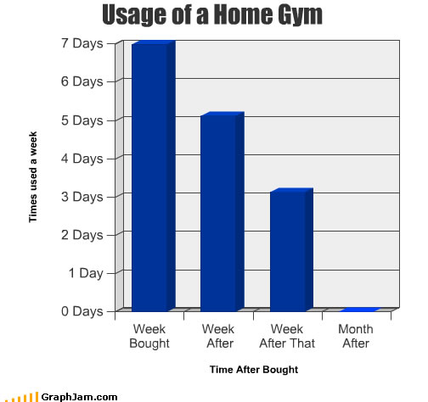

Slide 9
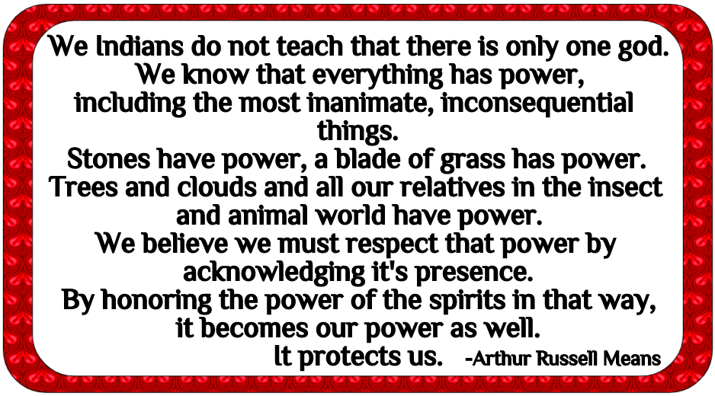

Slide 10
INTERSUBJECTIVITY and Russell Means’ Grandfather’s Story The young brave kills a deer with no bow or lance, only his knife. When Russell asks how, Grandfather says when he figures that out, he will be a man.
INTERSUBJECTIVITY EXERCISE:
David & Grace Ann arrived at 13:50 for their 14:00 class. At 14:00, no one was in the room. Why?
How do you know what you don’t know? (extra example: The Choral Company)
And how do you find out what you need to know in the early stages of research?
(Hint: The answer involves intersubjectivity and self-correcting research methods.)
Notes:
<number>

Slide 11
BREAKOUT #1 on Intersubjectivity for 5 minutes IN TOTAL. In groups of 3 or 4, each person takes 1 minute to answer. Tell only your own story. Please do not respond to others’ stories.
Tell about a time when everyone else knew something that you did not. Perhaps you were in a new town, new school, different job, etc.
NOW go to your break-out rooms and take 1 min each to tell your story.

Slide 12
1. INDIRECT: STORY STEM, YOU TELL WHAT HAPPENS NEXT
2. INCLUSIVE: INCLUDES NON-HUMANS AND ENVIRONMENT
3. INCOMPLETE: TERSE, AMBIGUOUS, INTERSUBJECTIVITY
4. IN CONTEXT: PRINCIPLES INSTEAD OF RULES TO SUIT DIFFERENT CONTEXTS AND SITUATIONS
5. INQUIRING: ASKS FOR THE MORAL OF THE STORY INSTEAD OF TELLING IT.
THE 5 I’S OF INDIGENOUS STORYELLING

Slide 13
CASES that demonstrate THEORY
Kenneth and David’s article on business modeling including supply chain and value propositions
Mogens and David’s example of Danish agriculture efforts to make TBL workable
David and Rana’s Ecological Business Modeling

Slide 14
NEXT Part 2: We look at STORYTELLING METHODS
Charles Sanders Peirce 4 Tests of Self- Correcting Induction

Slide 15
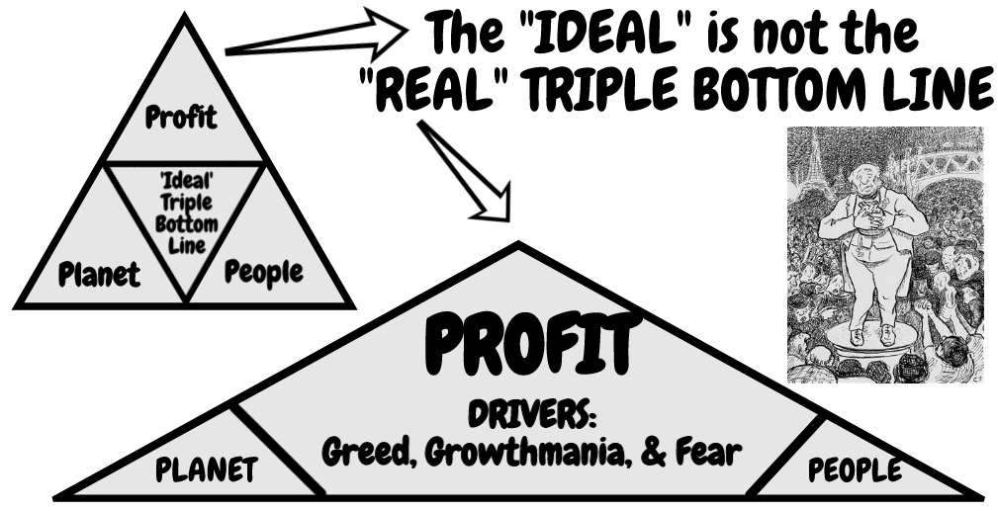
DENY THE DOMINANT PLOT?

Slide 16
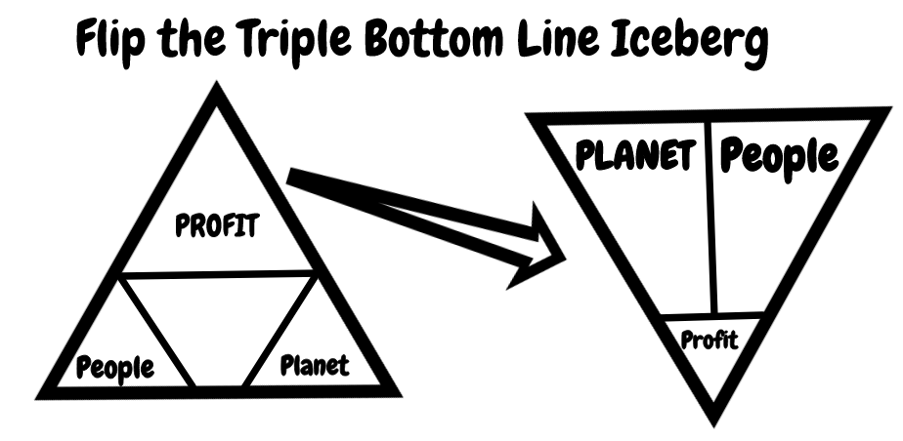
Help Stories Along –> RESITUATE

Slide 17
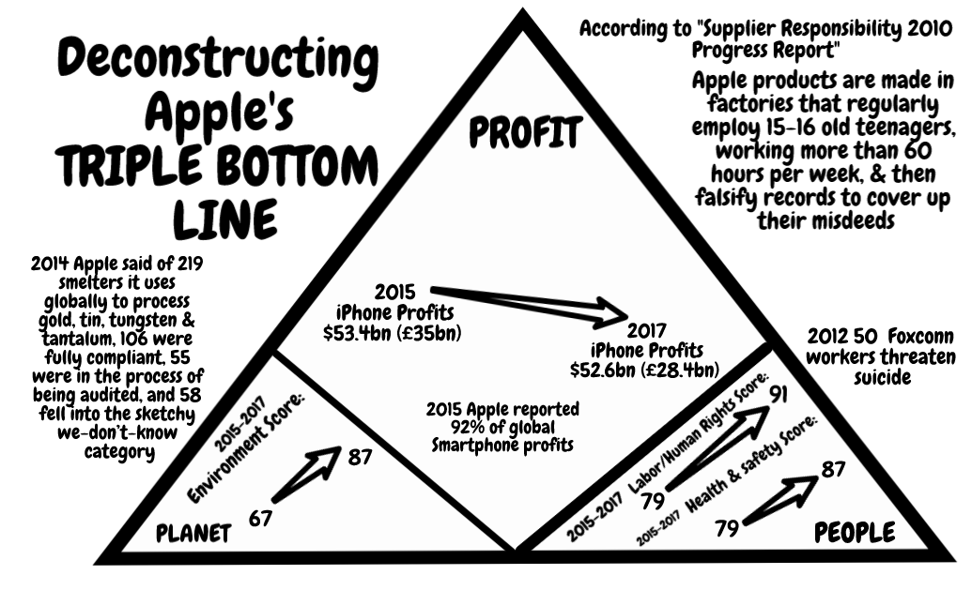

Slide 18
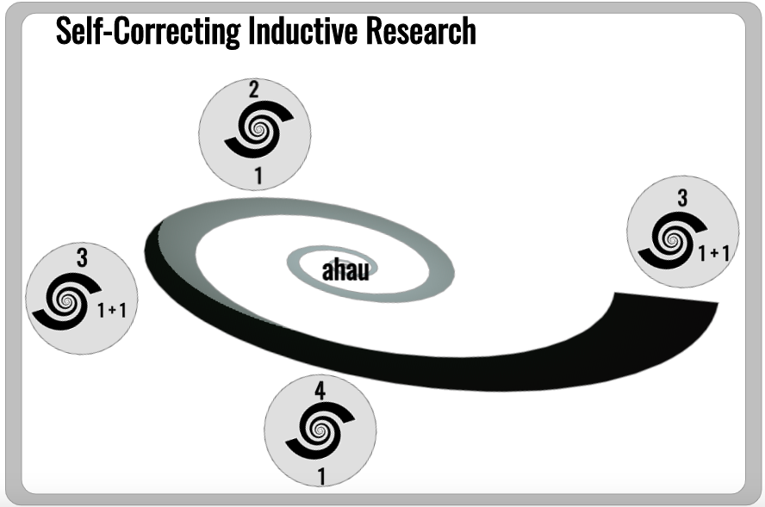
Figure 18: Self-Correcting Induction Methodology (diagram by Mark Van der Klei, used by permission)

Slide 19
What is the
A-I-D Model
of STORYTELLING SCIENCE?
Use Abduction, and let the story emerge.
Use Induction by observing something and then draw a conclusion which can be explored.
Use Deduction by forming a general theory

Slide 20
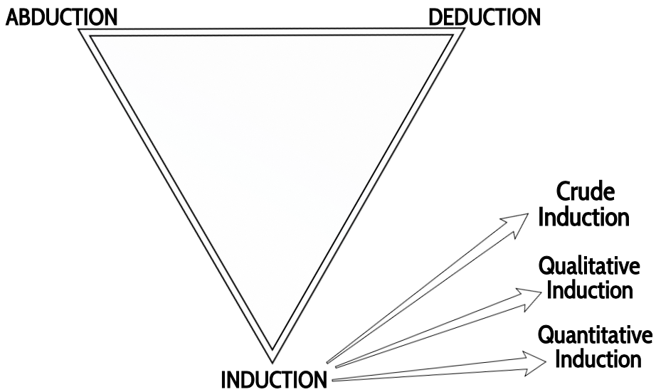
DEFINITIONS from Boje & Rosile 2020
Abduction: an intuitive guess, a tentative hypothesis, or speculative insight about what is being tested.
Induction: From gathered qualitative or quantitative empirical data, develop generalizations and theories (thus going from observation to theory).
Deduction: Starting with an existing theory, use the theory to develop a hypothesis about what is being studied. Then test the hypothesis to support or refute the theory (thus going from theory/hypothesis to testing/observation).

Slide 21
BREAKOUT:
5 min
3-4 per group
1 min per person/story
QUESTION:
When have you used ABDUCTION in your research?

Slide 22
Test One: Try to dismiss the precepts by your own Reflection
Test Two: Ask other people if they see and hear the same thing
Test Three: Use your knowledge of laws of nature
Test Four: Do experiments to see if the precept is illusory.
Charles Sanders Peirce (Vol. 2.142)
Charles Sanders Peirce 4 Tests of
Self- Correcting Induction
22
Notes:
Test One: Try to dismiss the precepts. Given fallibility, “the first test consists in trying to dismiss the precepts” as as some kind of fancy or daydream. If the flow of precepts persists, proceed to Test Two.
Test Two: Ask other people if they see and hear the same thing. If you have reason to suspect hallucination persists, the second test consists in “asking some other person whether he [or she] sees or hears the same thing” If several people concur then treat the induction as conclusive, or proceed to Test Three.
Test Three: Use your knowledge of laws of nature. Some hallucinations and illusions can affect many people. The third test is surer than the first two. “I may make use of my knowledge of the laws of nature” (as fallible as that may be). Apply your knowledge of the Nature, making our observations.
Test Four: Do experiments to see if the precept is illusory. There is a fourth test, and it is the surest of them all. “ apply the test of experiment” .
Charles Sanders Peirce (Vol. 2.142)
<number>

Slide 23
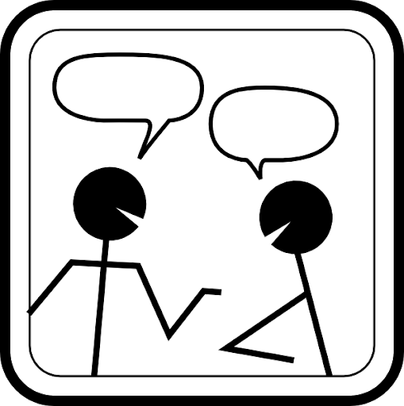
Conversational Storytelling Interviews (CSI)
*Began with the Hawthorne Studies
*Are dialogical rather than dialectical
*Seek cooperation, unity, synthesis instead of conquest, manipulation, invasion
*Are self-correcting
*Use A-I-D
*Make room for living story, untold stories, and IWOK
*Are polyphonic (multi-voiced)
*Emphasize listening
*Foster egalitarianism and ensemble processes
*Are more FUN!
NEXT: Critique of Triple Bottom Line for Sustainability

Slide 25
CASE EXAMPLES
Coalition of Immokalee Workers (CIW) (article in Business & Society 2020)
Gaining trust to be admitted by sharing our stories of activism
Using Self-Correcting to move from Ensemble Leadership to Ensemble Storytelling
Using worker-driven approaches for Corporate Social Responsibility & accountability
Danish Agriculture Case - - making Triple Bottom Line workable
Apple Triple Bottom Line Case
CONCLUDING SUMMARY:
Conversational Storytelling research uses qualitative as well as quantitative methods to overcome shortcomings of the Triple Bottom Line to promote sustainability.
NEXT: INTERVENTION/PRACTICE with an extensive case example

Slide 26
PART III: INTERVENTIONS
True Storytelling by Jens Larsen
Rainwater Recycling Case Example

Slide 27
QUESTIONS?
What can you USE?
What would you like to know more about?
FINAL QUESTION:
Please raise your hand to answer:
Where/How can you get the energy to sustain True Storytelling
in your own research?
(For example, the plight of enslaved/abused workers; the importance of water as essential to life, the joy of connecting and understanding another’s lived experiences, etc. What makes your research fun/exciting?)

Slide 28
CURRENT PUBLICATIONS FOR YOU TO ENJOY
“ A ‘storytelling science’ approach making the eco-business modeling turn” by Kenneth MÃ¸lbjerg Jorgensen and David M Boje,Â Accepted Journal of Business Modeling Sept 21 2020
Sparre and Boje (2020) Utilizing participative action research with storytelling interventions to create sustainability in Danish Farming, Journal of Organizational Development
Defining Sustainably-Driven Business Modeling Strategy with a ‘storytelling science’ Approach byÂ David M. Boje, Aalborg University and Mohammad B. Rana, Aalborg University. Chapter in theÂ Defining a sustainability-driven business strategy,Â “Handbook of Sustainability-driven Business Strategies in Practice”, edited by Dr. Stefan Markovic (Copenhagen Business School), Dr. Cristina Sancha (OBS Business School), and Prof. Adam Lindgreen (Copenhagen Business School), and published by Edward Elgar.

