Slide 1
What’s Next for Narrative in Gunfighter Nation?
Professor David M. Boje, Ph.D.
4700 Dunn Drive
Las Cruces, New Mexico
https://davidboje.com

Slide 2
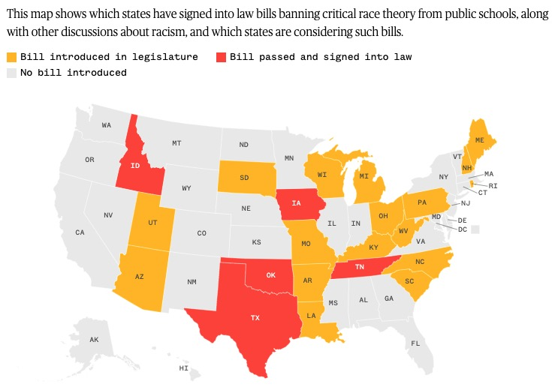
Why AOM should not be Bringing Manager Back In? Why AOM needs to take a stand supporting Critical Race Theory

Slide 3
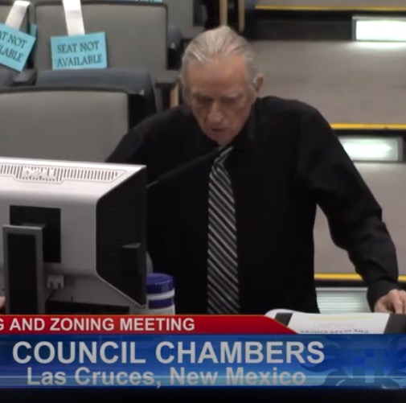
https://www.youtube.com/watch?v=
July 27 2021
Notes:
Original at https://lascruces.civicweb.net/document/15646?splitscreen=true&media=true

Slide 4
Each story & narrative casts a searchlight onto existence, & leaves much in the shadows
“Stories aid the seekers of comprehension by separating the relevant from the irrelevant, actions from their settings, the plot from its background, and the heroes or the villains at the centre of the plot from the hosts of supernumeraries and dummies” (Zygmunt Baumann, 2004: p. 17).
Baumann is citing Mary Douglas (1970: 12) Purity and Danger: An Analysis of Concepts of Pollution and Taboo. Penguin.

Slide 5
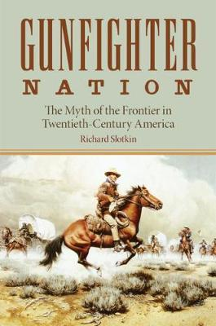
What about a different ‘what’s next for narrative?
“Myth expresses the ideology in narrative, rather than discursive or argumentative structure (Slotkin, 1998: p. 6)
Myth-making in the narrative (or story-telling) is one way to deflect logical and analytic discourse
Myth-making of ideology of the Gunfighter Nation, alleges cause-and-effect (emplotment) and therefore a ‘theory of history’.
So What?

Slide 6
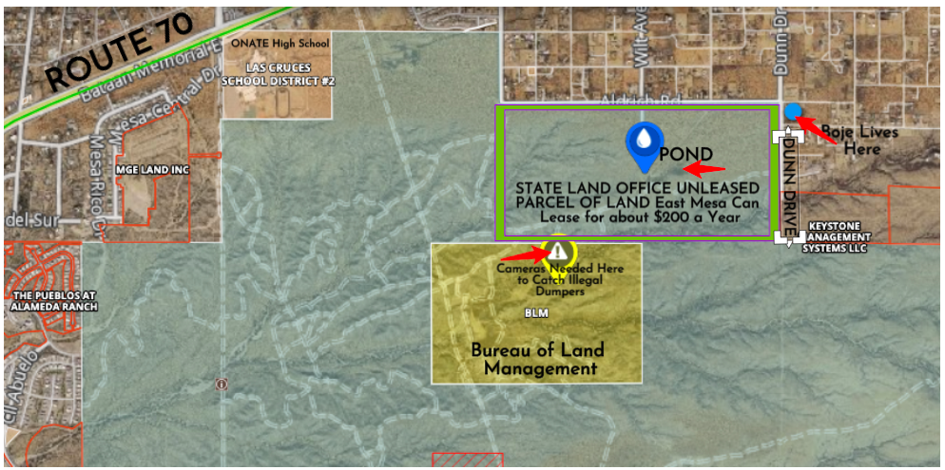
$750 to $1,500 a year
WHAT’s NEXT is em-PLACE-ment
More maps, films, & photos at my blog
CLICK HERE; slides at https://davidboje.com
6

Slide 7
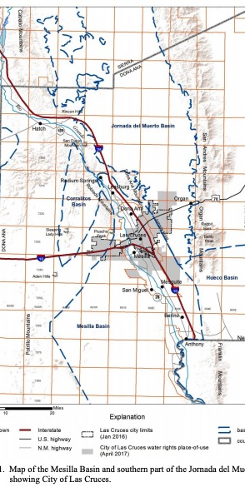
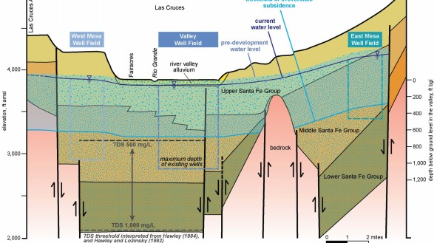
East Mesa is Future of Las Cruces Water (Click here City’s 40-year plan)

Slide 8
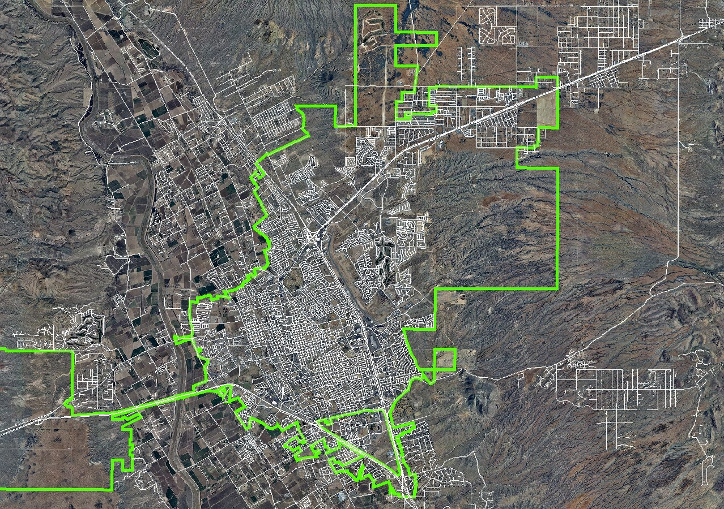
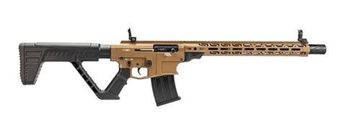
PROBLEM: People act confused about discharging firearms, including AR-15s. City’s map of areas where discharging firearms in corporate city limits is prohibited click here
Dunn &
Aldrich location of Rancho Las Fincas
Click for sound
PROBLEM: Police, Sherriff, City & County codes, & residents confused about which jurisdiction of which land areas apply (e.g is target practice legal,
Is off-roading legal. Bump-stocks on AR-15s?
SOLUTION: Inter-agency marketing campaign
Notes:
New Mexico fish and game says:
Established road means:
“A road, built or maintained by equipment, which shows no evidence of ever being closed to vehicular traffic by such means as berms, ripping, scarification, reseeding, fencing, gates, barricades or posted closures;
A two-track road which shows use prior to hunting seasons for other purposes such as recreation, mining, logging, and ranching and which shows no evidence of ever being closed to vehicular traffic by such means as berms, ripping, scarification, reseeding, fencing, gates, barricades or posted closures.”
https://www.wildlife.state.nm.us/hunting/general-rules/

Slide 9
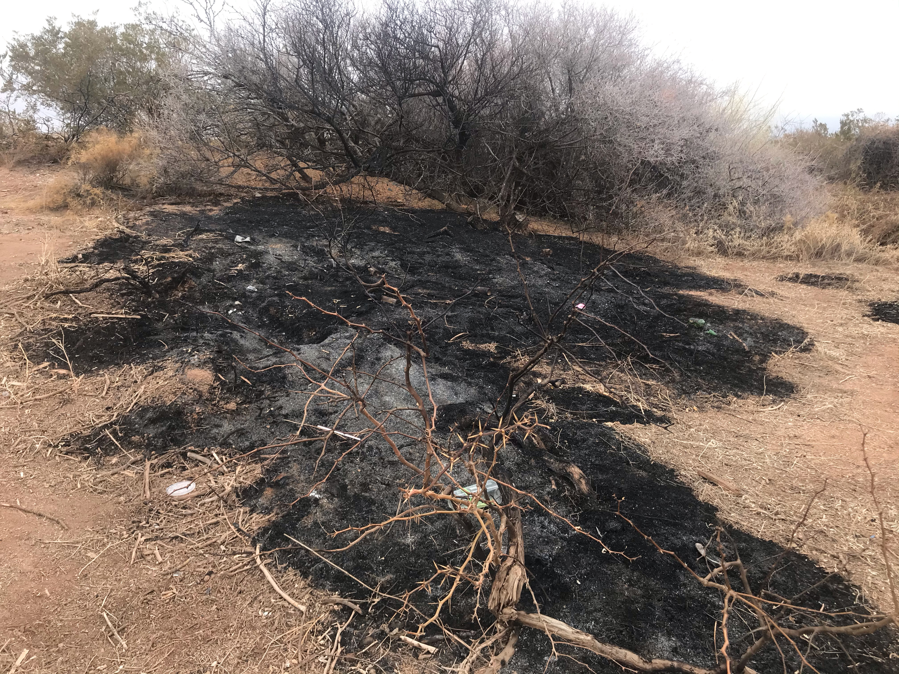
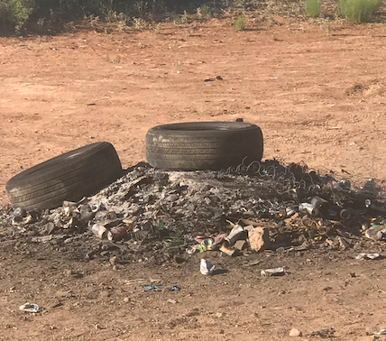
Sec. 37-81 #4: Preliminary plat submittal requirements
“Detailed area/vicinity map clearly showing surrounding area and the proposal’s relationship to existing road networks, and existing natural and/or man-made features that may impact the development…”
Solution: Communicate true boundaries of corporate city limits (green on map) Click here for map
Notes:
Sound of bump-stock on AR-15 YouTube at https://www.youtube.com/watch?v=UwSIxKZAs40

Slide 10
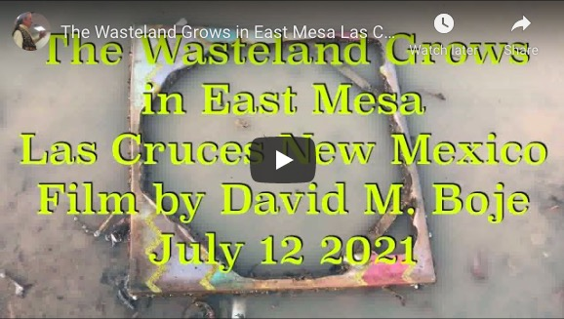
https://youtu.be/aNIbVcJY00s

