Slide 2
INTRODUCTION
What is a hidden cost?
It refers to those unseen costs which don’t merely show up on the company’s information system or financial budget.
It can also be defined as the cost that is hidden behind the basic price of a commodity or equipment.

Slide 3
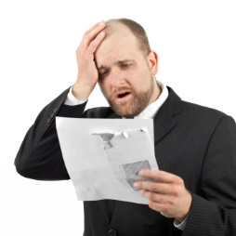
Why we should avoid hidden costs?
There are many reasons why to avoid hidden costs some are the following:
Many businesses end up with failure due to incurring too much of hidden costs. ( assigned consulting project )
Avoiding hidden costs can stop companies lowering employees’ salaries and bonuses.
It can also help business maintain consistent level of employment; in other words, it would decrease the lay off of employees at time of economic crisis.

Slide 4
Things you should know about hidden costs
Hidden costs are collectively produced; no single individual, in particular, is responsible of a particular cost. Inversely, each individual actor is jointly liable with other individuals for the production of these hidden costs.
Hidden costs can be avoided through the team work, liberating time and developing decision-making energy, then applying those decisions and ensuring they are respected by all company actors.

Slide 5
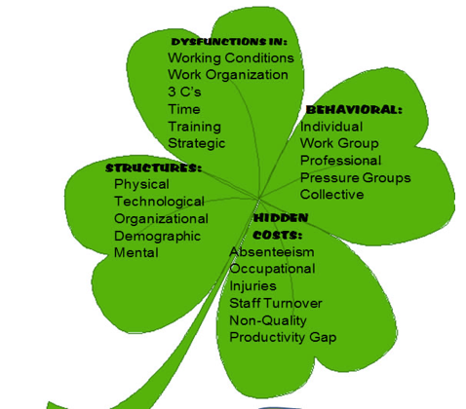
Hidden Costs Diagnostic Analysis
The analysis can include five socio-economic indicators

Slide 6
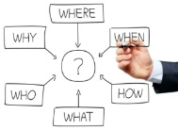
CHAPTER ONE : causes of hidden costs & general characteristics of the socio-economic method of enterprise analysis.(DYSFUNCTION, HIDDEN COST ANALYSIS, JOB-TRAINING)
CAUSES OF HIDDEN COSTS
Structures and behaviors of company actors.

Slide 7
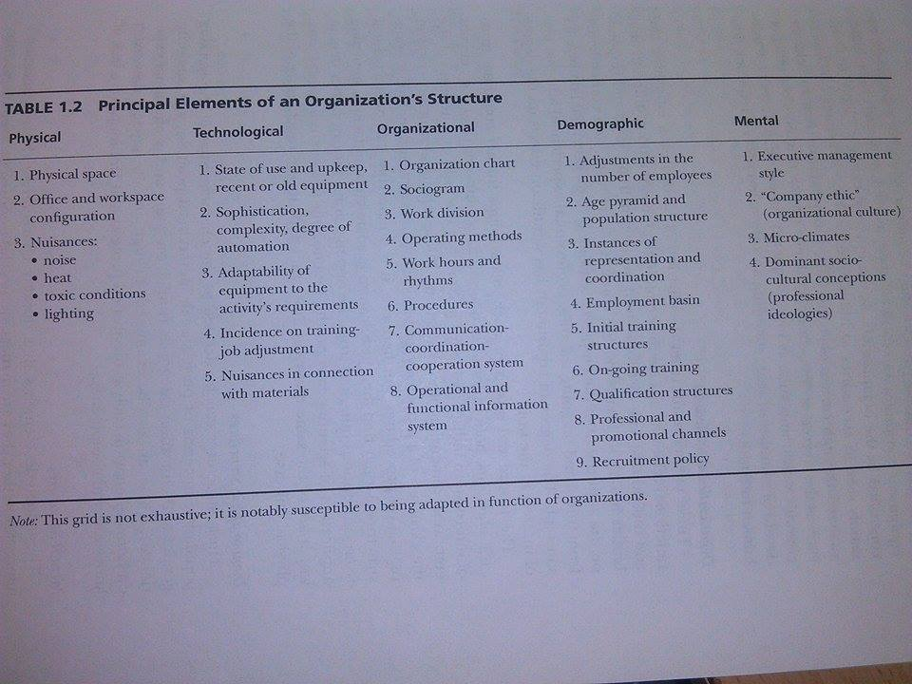
Structure of the business

Slide 8
Behaviors of business actors
Behavior is the observed human action that has an incidence on the physical and social environment.
Employees often can follow five behavior rationales or logics depending on the situation in which he or she is placed and on the nature of the problems that is faced with.
Individual logic ( personality, and family)
Group activity logic ( belongs to dept. – agency - … etc ).
Categorical logic ( job categories, job positions )
Affinity group logic (groups membership as political, religious… etc)
Collective logic ( behaving as expected …. (rare).

Slide 9
Socio-economic four-leaf clover. (dysfunction)

Slide 10
Examples of hidden costs
https://www.youtube.com/watch?v=yboLgZPCAR8

