Slide 1
Ernest Ramey
DaSein of Homeless

Slide 2
Define homeless
home·less
(of a person) without a home, and therefore typically living on the streets.

Slide 3
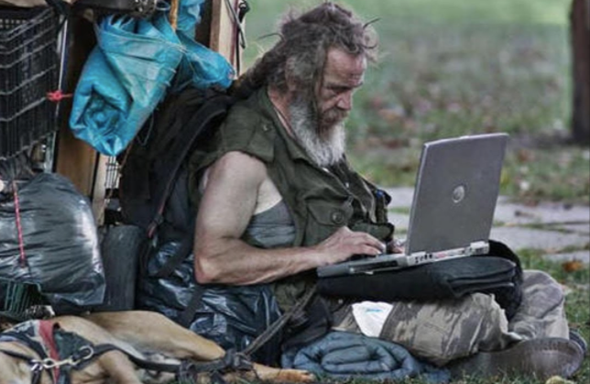

Slide 4
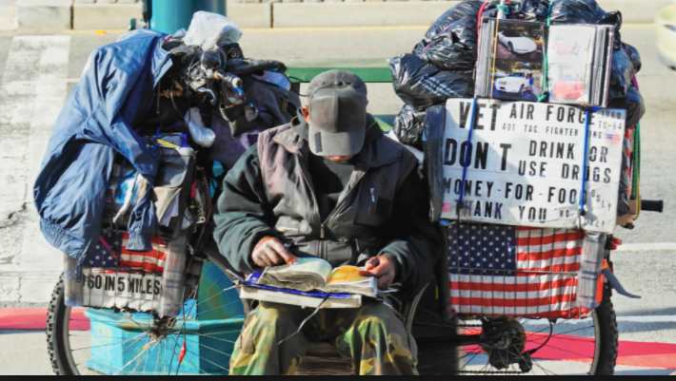

Slide 5
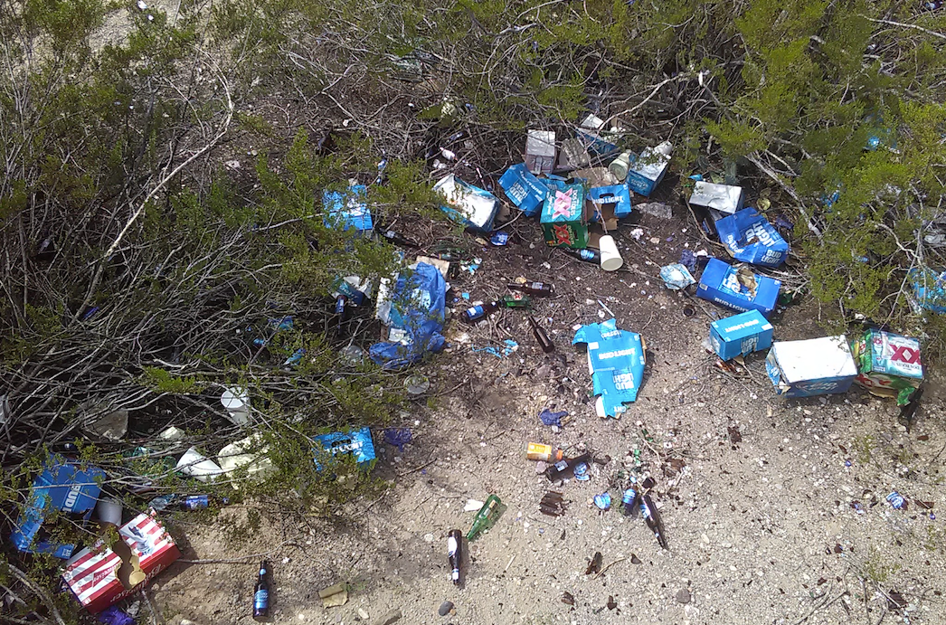

Slide 6
