Slide 1
Narratives and Counternarratives of Climate Change in Storytelling Organization Research
by
David M. Boje,
Professor, Aalborg University, and
Professor Emeritus of Management,
New Mexico State University
and
Grace Ann Rosile,
Professor Emeritus of Management,
New Mexico State University
SLIDES are available at https://daivdboje.com/Kolding

Slide 2
David And Grace Ann
David started teaching a class in storytelling and a class in complex adaptive systems at UCLA in 1979. In 25 books & 140 journal articles he began to combine these two topics.
Grace Ann met David in 1993, and since then, they have led conferences together, and write and teach together. They married in 1995. Her book is Tribal Wisdom for Business Ethics (2016),
Their co-authored book is Doing Conversational Storytelling Interviewing (out in Oct 2020).

Slide 3
Purpose today
Use a combination of Storytelling tools and complex adaptive systems tools to examine Global Heating in relation to the Global Water Cycle.
Define and identify tipping points.
Apply several storytelling systems tools to assess tipping points
Compare the tipping point scenario to counternarratives that say it is alarmist.
Explore these two scenarios in detail in breakout sessions to foster ante-story analysis and restorying

Slide 4
Story Research as Tamara-land
Text, Context, & Subtext
Intertextuality & Intersubjectivity
Antenarrative and Ante-story
6 B’s of Antenarrative
Story Deconstruction
IWOK & WWOK ontologies/epistemologies
Restorying

Slide 5
Notes:
Lundholt, M. W., & Boje, D. (2018). Understanding Organizational Narrative-Counter-narratives Dynamics: An overview of Communication Constitutes Organization (CCO) and Storytelling Organization Theory (SOT) approaches. Communication and Language at Work, 5(1), 18-29.
Explain:
Multiple simultaneous fragmented stories
That have permutations & combinations (factorial)
Different sides of Personalitie show up with different characters in different rooms
Meaning of story you get depends on sequence of rooms you were in BEFORE
We keep Diffracting the multiple histories coming unraveled and reweaving in Tamara-Land

Slide 6
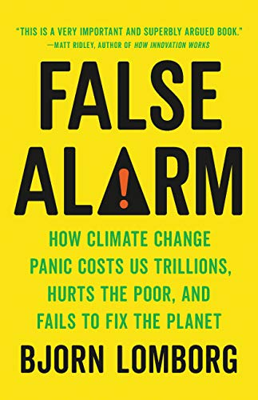
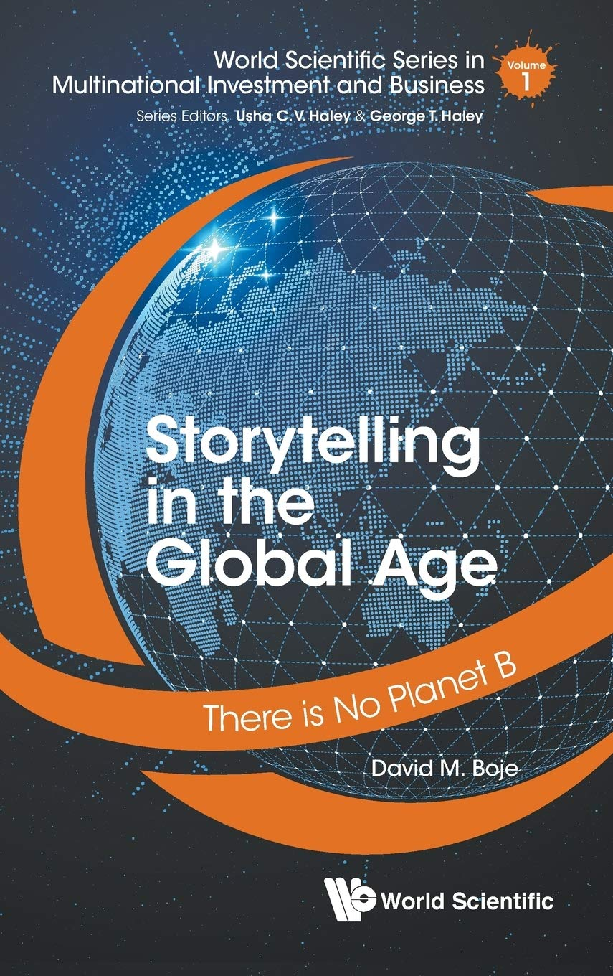
Narrative - Counternarrative

Slide 7
BREAK OUT PROCESS
SPEAKERS: Pick someone to share their story first. The person who speaks holds the Talking Stick, and only they have the authority to speak. They will share one (and only one) story. When done, the speaker says ‘I’m done’ or ‘Ho’ or ’I’m complete’ so people know when they are done. The current speaker chooses who will speak next and passes the Talking Stick to that person.
LISTENERS: Use deep listening; do not ask questions of the storyteller, do not give advice, and please hold a space for silence because silence speaks.
PASS OPTION: It is OK to ‘pass’ and wait for another opportunity;
TIME: Continue to Story Circle until all have shared once, and if time remains you may do another round.

Slide 8
Break Out #1: Tell a brief story about some way in which you think Global Warming is overestimated or underestimated as a problem.
Choose a timekeeper for the group.
Tell your story in 1 minute or less.
This is information-seeking (we want a range of stories)
NOT argumentative, NOT problem-solving, just story-sharing
When you return to the large group, we will ask if you have noticed a) Intertextuality (reliance on another text)
and/or b) Intersubjectivity (reliance on shared understanding)

Slide 9
Break Out #1 Debrief
Intertextuality:
Between corporate charters and environmental regulations
Between capitalist business practices and environmental science
Intersubjectivity
Taken-for-granted, unspoken parts of the story that ‘everyone knows’
Different for Indigenous-Ways-of-Knowing and Western-W-of-K
“You’ll be walking the stairs!” or “Man is in the Forest!”
Genesis 1:26-1:31 And God said, 'Let us make man in our image, according to our likeness; and let them have dominion over the fish of the sea, and over the birds of the air, and overall the wild animals of the earth, and over every creeping thing that creeps upon the earth. ‘
What does ”dominion” mean? In IWOK or WWOK?

Slide 10
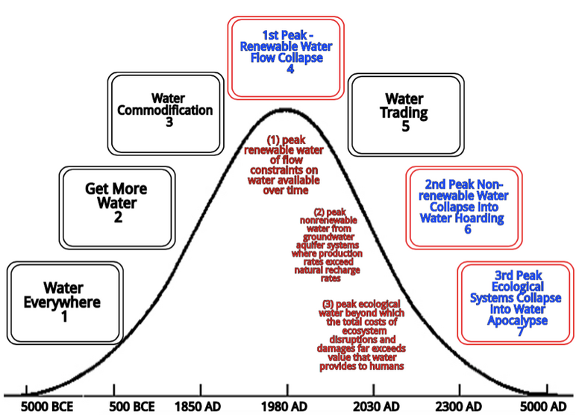
Source article in review by David Boje and Kenneth Mølbjerg Jørgensen

Slide 11
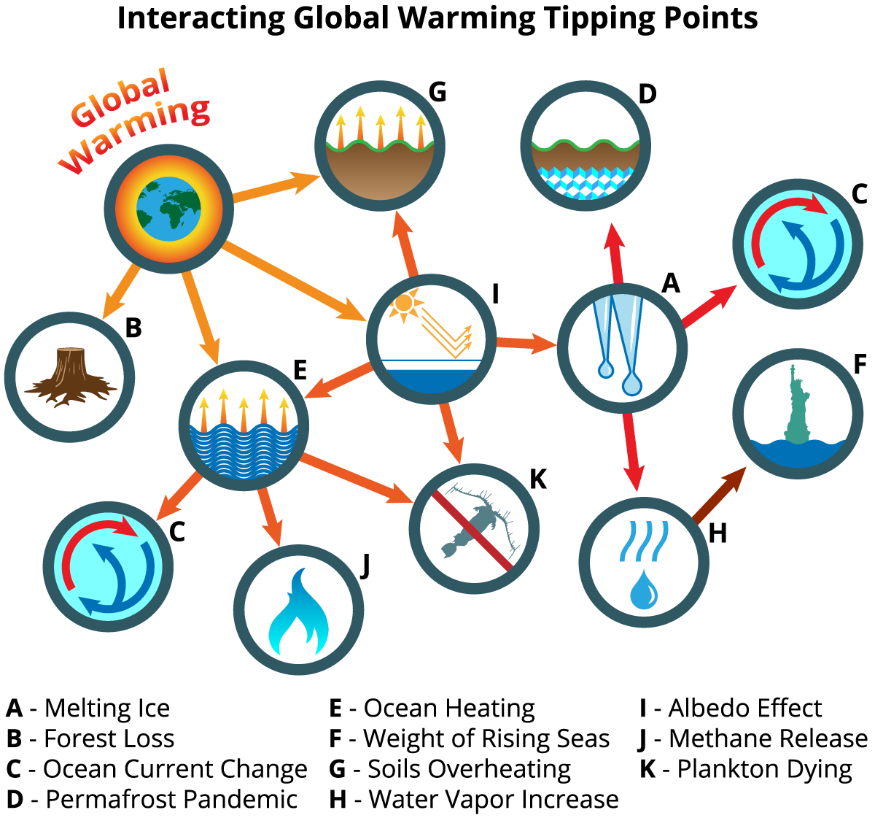

Slide 12
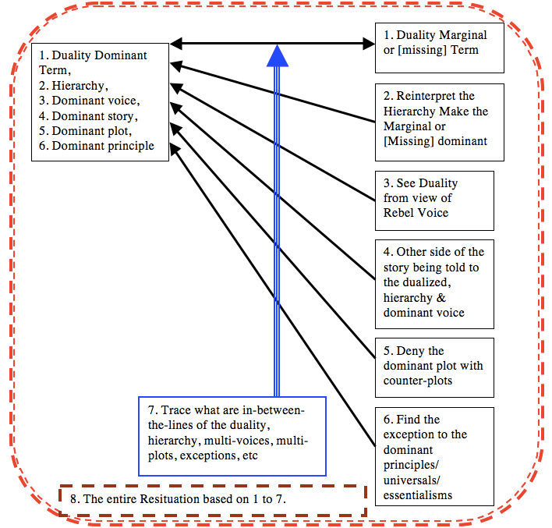
How to Deconstruct a Narrative

Slide 13
Deconstruct this Book’s COUNTERNARRATIVE https://youtu.be/PEoZVbYMxPY
Dualities
Reinterpret Hierarchy
Rebel Voice
Other Side of the Story
Deny Plot
Find Exceptions
Between the Lines
ALL THE ABOVE →
For A Resituation

Slide 14
BREAKOUT 2 Using Deconstruction Method
PRE-Work: 3 minutes in silence to prepare your deconstruction
TOTAL time: 6 minutes in pairs (3 minutes each) Pick who goes 1st who is 2^{nd.} First person asks these questions, 2nd answers, then switch.
Dualities
Reinterpret Hierarchy
Rebel Voice
Other Side of the Story
Deny Plot
Find Exceptions
Between the Lines
ALL THE ABOVE →
For A Resituation

Slide 16
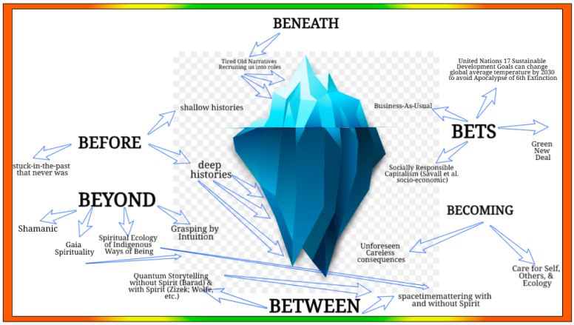
What is Antenarrative?

Slide 17
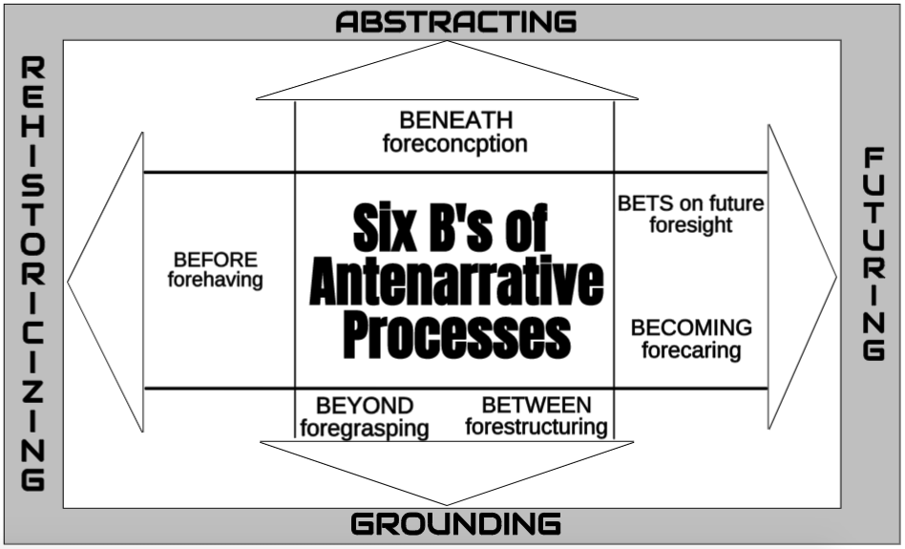

Slide 18
There are differences between Western Ways of Narrative and Indigenous Ways of Living Story
WWOK – Western Ways of Knowing privileges Narrative-Counternarrative polemics, compare-contrast linear dualisms
IWOK – Indigenous Ways of Knowing privileges ‘Living Story Webs’ of community, in which Nature (all species & all elements) are energetic spirits, circular and simultaneous logics

Slide 19
What is LIVING STORY Web?
Has a place
Has a time (non-linear)
Has a mind (an aliveness of spirit)

Slide 20
Notes:
WWOK and IWOK are two different kinds of storytelling patterns that are intertwining

Slide 21
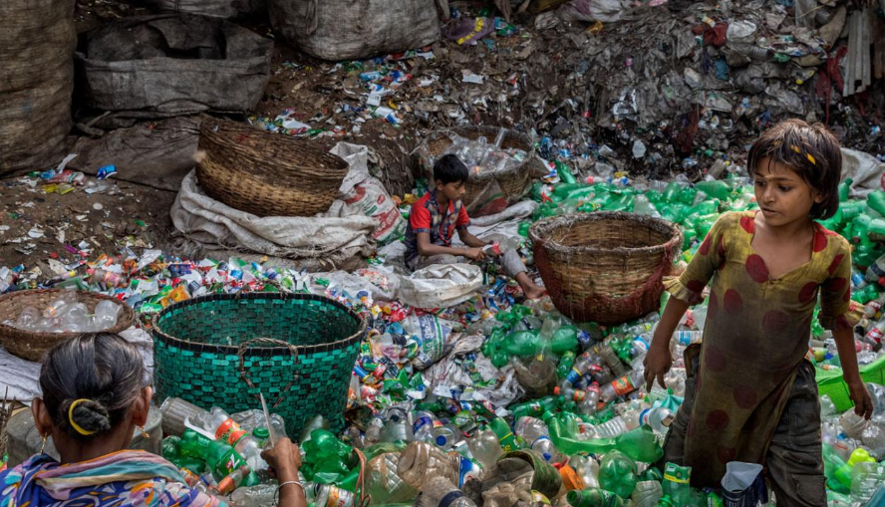
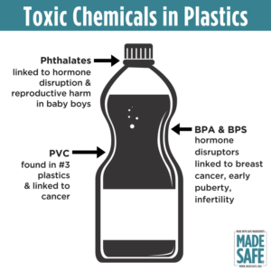
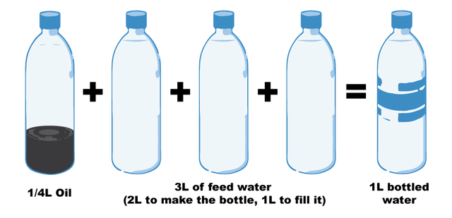
QUESTION: How to pursue a good life for oneself, as oneself, in the context of a broader world that is structured by inequality, exploitation and forms of effacement – Hannah Arendt
Notes:
Fill a plastic water bottle 25% with OIL to illustrate how much oil it take. https://www.portlandoregon.gov/sustainabilityatwork/article/535746
USA consumes 50 billion plastic water bottles a year, 23% head to recycling, but 38 billion don’t go to recycling, and then only about 9% actually gets recycled, because China is no long taking them, and because it costs $$$ to sort the bottles, shred them, wash them, heat them to sanitize, then melt into pellets and sell to beverage companies
Billions of gallons of water are used to make the Billions of gallons of water in water bottles ( feed waters 3 to 1 final bottle of water)
50 billion USA plastic water bottles is 17 million gallons of oil. It takes 6,000 megajoules of electricity for each barrel of oil, and with all the oil for 40 billion bottles that is 106 billion megajoules of electricity, which is how the 25% oil calculation is based on.
OUR PROBLEM TO BE SOLVED GETS WORSE: 50 billion USA plastic water bottles, is small part of the 250 billion BEVERAGE bottles with juices, sodas, etc. in them
WORLDWIDE: USA is 50 billion plastic water bottles, but world total is 500 Billion, and that means five times that in Total World Beverage plastic bottles
PROBLEM GETS WORSE AGAIN: Most are made of PET –Polyethylene Terephthalate and that has BPA in it.
https://www.madesafe.org/avoid-toxic-chemicals-plastics/
BPA stands for Bisphenol-A and it is a carcinogen, cause low sperm count in boys, and early puberty in girls. PBA is endocrine disruptor.
BPA has been a resin to make plastics clear and strong since the 1960s. https://www.mayoclinic.org/healthy-lifestyle/nutrition-and-healthy-eating/expert-answers/bpa/faq-20058331
It is not just making plastic bottles, but coats the insides of beverage cans, and used to make epoxy.
The FDA does not regulate it, saying low levels of BPA are SAFE to use in foods, and of no harm to human body. But Mayo Clinic says cut back on plastic bottles, and on metal cans (coated in BPA), for your good health life.
PROBLEM GETS WORSE: BPA has phthalates, and FDA refuses to regulate them either. Phthalates are industrial chemicals are binding agents, and to soften plastic, make it clearer and more durable.Also used in cosmetic consumer products. https://www.fda.gov/cosmetics/productsingredients/ingredients/ucm128250.htm Phthalates however do cause reproductive, liver, kidney, and lung problems in human beings. See Canada https://noharm-uscanada.org/issues/us-canada/phthalates-and-dehp Guardian https://www.theguardian.com/lifeandstyle/2015/feb/10/phthalates-plastics-chemicals-research-analysis
CDC recommends further study, FDA says its safe to consume, but others say health hazard https://www.theguardian.com/lifeandstyle/2015/feb/10/phthalates-plastics-chemicals-research-analysis. 2008 Henry Waxman bill did ban phthalates in some baby products
BUT the science says phthalates linked to asthmas, attention-deficit disorder, breast cancer, Type II diabetes, autism, and male fertility disorders. Watch the milk because a lot of plastic tubes are used in milking machines, and the phthalates make their way into even glass bottles of milk.
rPET is recycled PET https://earthhero.com/whats-the-deal-with-rpet/ Good news it uses 75% less energy to make rPET, less resource extraction, less CO2,
BUT ITS NOT A PERFECT SOLUTION TO NANOPLASTIC POLLUTION
The rPET, has microfibers, and with each washing, or swallow, it goes into the water, and these break down into microplastics, then into nanoplastic particles, which circulate in the water cycle with the PET nanoplastic particles, and it take 500 years to degrade, and that means all the plastic every made (except some incinerated) is still here, and worse problem, that are a lot of other plastics, and they break down to nanoparticles and head into food chain, so the water cycle gets more and more contaminated.
BOTTOM LINE
Our desire for plastic has change our Self. Other contaminants stick to the plastic and circulate in the water cycle, and the food chain, and that means plastic water and beverage bottles is a huge contributors to the human activities changing the global water cycle, and changing the Self of Water=Desire, Water=Life, Water=Memory, Water=Spirit, and Water=Matter but also means we are in Water-Denial, so Water=$$$
Plastic is a waste byproduct of petrochemical manufacturing. The oil industry had to get rid of the waste, so making it into plastic was how to do that, now we are past peak oil, and past three water peaks, and Water=Desire (our Ego manipulated by marketing hype) is causing an evolutionary change in the Self, so instead of an authentic Self, we have the Self as Desired by DuPont (inventor of plastic), and by Nestle, Coke, and PepsiCo (and their imitators). This is why Boje says in his books we are in a culture of denial, as marketing sells us a new self, and corporate lobbies corrupt agencies like FDA, or defang the EPA, and fund the campaigns of political leaders with PAC meney, as the corporation became a legal person, then its PAC money declared free speech act in political elections, while a human citizen ahs a limit in USA of $2,500.
All this boils down to Water=Desire is a corruption of Water=Spirit (Radah, mistranslated from the Hebrew in King James bible 1611, and used to by Francis Bacon soon after to make scientific method about subduing and domination of nature as an improper translation of ‘dominion’ and this became a political ideology in the 1970s e.g. James Watt, Secretary of the Interior to Reagan, said “After the last tree is felled, Christ will come back”
In sum bad bible translations of Radah are now being corrected so that it means ‘caring for creation’ and ‘stewardship, but the damage will take generations to undo, and by then the science says the water cycle will be destroyed. I.E. By 2030 global water demand will be 40% greater than it is today (McKinsey Report). By 2030 40% of world’s population will lack access to safe, sanitary water, in 2030 there will need 60% more fresh water to support demand than we have today in the water cycle. The developing nations are increasing water withdrawals by 50% and 18% in developing nations. In short, the fresh water system, if it were a bank, has more withdrawals than deposits, and is bankrupt!
https://www.waterlogic.com/en-us/resources-blog/world-oceans-day-plastic-pandemic/ for ocean impact

Slide 22
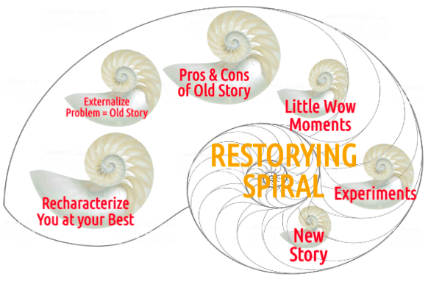
BREAKOUT 3 – Using Restorying Method (successful at both the individual and the corporate levels)
PRE-Work: 3 minutes in silence to prepare answers to 6 questions.
TOTAL time: 6 minutes in pairs (3 minutes each) Pick who goes 1st who is 2^{nd.} First person asks these questions, 2nd answers, then switch.
RECHARACTERIZE: Tell the story of your ‘best self’. Tell of a problem you have, when you are NOT at your best (‘I use too many plastic water bottles’).
EXTERNALIZE A PROBLEM/CHALLENGE: Make the problem a character, so problem is ‘Pat Plastic’ not you the person.
PROS & CONS of this problem: convenient & clean vs weight & maintenance/cleaning, etc.
Little Wow Moments of exception when you bested the problem (borrowed a friend’s stainless bottle).
EXPERIMENTS that can make Little Wow Moments into your ‘New Story’ for the future (shopped for bottles with better features than old warped plastic bottle).
What is your ‘New Story’ for the future in one sentence? (Grace Ann sent Pat Plastic away and replaced her with turquoise stainless steel bottle with built-in anti-bacterial plastic straw.) Who in your network can you enlist to support your new story? (Grace Ann got David a blue stainless bottle like hers.)
SWITCH ROLES

Slide 23
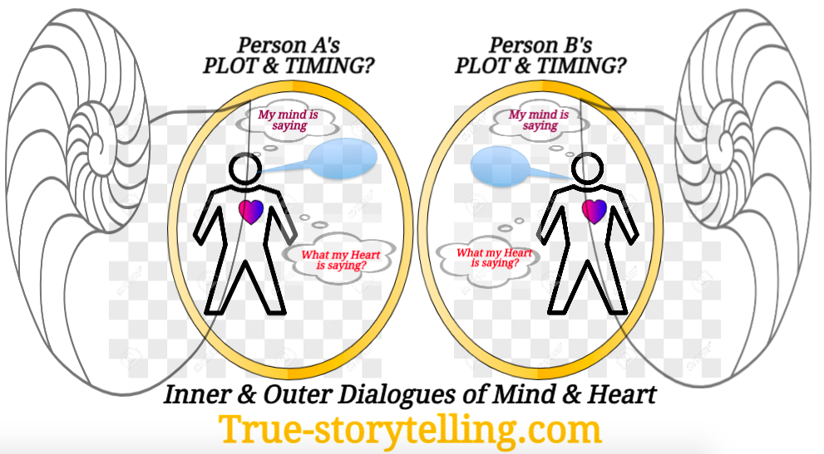
Aligning Inner and Outer, and Self and Other

Slide 24
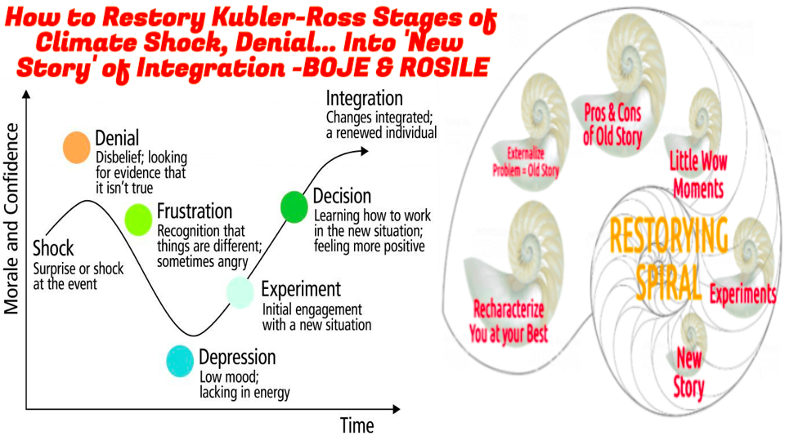
Notes:
Denial, Anger, Bargaining, Depression, & Acceptance (Kublar-Ross, 1969)
We are using the revised stages of the grief curve
Cleverism.com “Understanding the Kubler-Ross Change Curve” by Anastasia Belyn, Anastas. Last updated July 28, 2020. Accessed Aug 16 2020 at https://www.cleverism.com/understanding-kubler-ross-change-curve;
Ekrroundation.org “Kübler-Ross Change Curve”. Last updated 2020. Accessed Aug 16 2020 at https://www.ekrfoundation.org/5-stages-of-grief/change-curve/; Manchester.ac.uk “The Kübler-Ross Change Curve”. Accessed Aug 16, 2020 at http://documents.manchester.ac.uk/display.aspx?DocID=31848

Slide 25
Break-out #4: Regarding Kubler-Ross’ STAGES, where are you now? Where do you want to be next? How will you get there?
Stages: Shock, Denial, Frustration, Depression, Experiment, Decision, Integration
INSTRUCTIONS
Pre-work: Take 1 Minute to consider your answers to the questions below.
Take 2 minutes for Partner 1 to ask the 3 questions to Partner 2, then switch.
Which stage are you at NOW?
Where do you want to be NEXT?
How will you use your support network (of both objects and support people) to help you get there?
SWITCH ROLES
After both have done the activity, have a conversation about:
What did you learn?
What questions do you have?

Slide 26
Notes:
Adapted from Bill Sharpe’s (2013) Three Horizons book

Slide 27
Thank you
Any questions
davidboje@gmail.com
garosile@nmsu.edu
More info
https://davidboje.com
https://truestorytelling.blog
https://true-storytelling.com

Slide 28
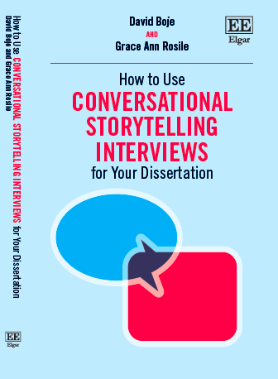
For advanced method of Storytelling Research, our new book available in Oct 2020
David M. Boje and Grace Ann Rosile
https://davidboje.com
davidboje@gmail.com
garosile@nmsu.edu
We live in Las Cruces New Mexico

Slide 30
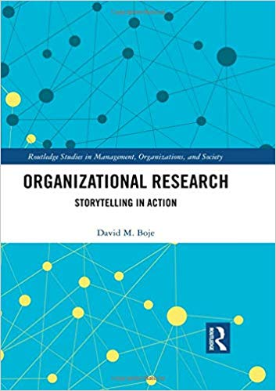
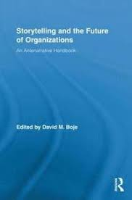
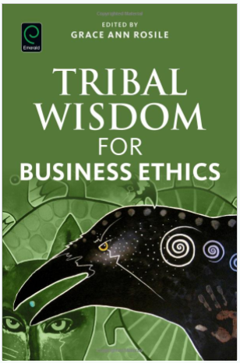
Antenarrative Books:
2019
2016
2011
2001

