Slide 1
What is ‘Braided Leadership’?
David M. Boje
Erskine Visiting Scholar
University of Canterbury
March 18 2019
Notes:
Braided River in Ice Land

Slide 2
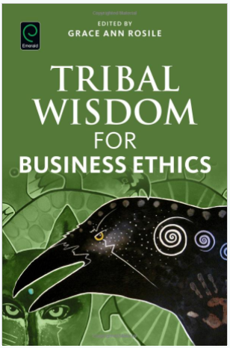
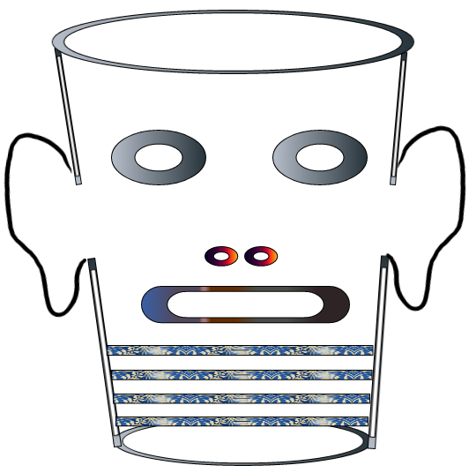
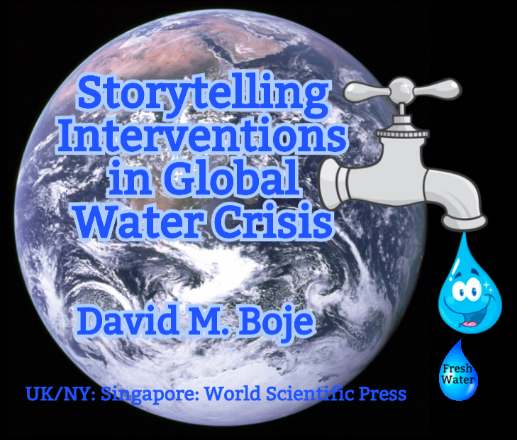
Storytelling Science and Your Dissertation
David M. Boje & Grace Ann Rosile
UK, US, Singapore: World Scientific
February 21, 2019; Revised March 19, 2019
Download Storytelling Science book and slides for this presentation at https://davidboje.com/Canterbury

Slide 3
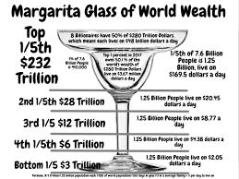

Slide 4
University Changes
Human Relations (HR) has become Human Resource Management (HRM)
1945 Karl Popper, and Sir Eccles wrote the ‘Canterbury Declaration with colleagues in New Zealand
Why TEACHING was DUALITY with RESEARCH
They proposed FUSION of Teaching & Research

Slide 5
What is a Practical Ensemble of Leadership?
Practico-inert (Sartre) was problem for Popper & Eccles, a contradiction of Teaching & Research
“We do not accpet the point of view that teaching is the main function of the University… Teaching which is not linked with research is on a lower lane and does not stimulate the best intellects of successive generations of students” (1945: 1).

Slide 6
Practico-Inert
Is a sociomaterial field that can by Bureaucracy, Hierarchy, Central Administration become PASSIVE, and in the Exteriority of the 8 billionaires we become Other, powerless groups in ALIENATION
This is relation of Popper & Eccles Canterbury Declartaion to Jean Paul Sartre’s Practical Ensemble writing

Slide 7
Practico-Inert
“The commonly held view that the University is prmarily a teaching institution should be abondoned and the University should be looked upon as an institution in shich the spirit of free inquiry is preserved and cultivated” (Canterbury Declaration, 1945: 2).

Slide 8
Practico-Inert
We work in practico-inert ensembles in which we “hand to the student a definite body of examinable knowledge” is a praxis that must be discarded (Canterbury Declaration, p. 3).
In the sociomateriality of Teaching, Research, and Student learning there there is lack of material resources, and technologies are displacing teachers and researchers, resulting in more alienation

Slide 9
Practico-Inert Field
Capitalism is bringing more :air pollution, destruction of the environment, occupational diseases, etc.” (Sartre, 207).
We become abstract beings, in what Savall calls the TFW virus of bureaucracy and central hierarchic control systems of organization as our praxis field in Sartre ‘negation of workers’ hows humanity is at risk

Slide 10
Practico-Inert Field
Alterity = the state of Being Other in field of serial impotence that is anti-social
Alterity is flight of the Other in systems of exploitation, oppression and strctural inequality

Slide 11
Practico-Inert Field
Coalition of Immokalee Workers (CIW)
CIW forms aliances to change their practico-inert field, to change alienation by theater, by demonstration, by storytelling, and by enselmble leadership as their apparatuses of mediation.
They do extensive multiplicity in fair Food Program
CIW reverses modern day slavery by self-empowerment acts in movement of praxis

Slide 12
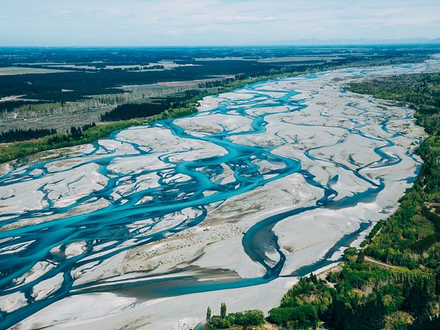
Braided River

Slide 13
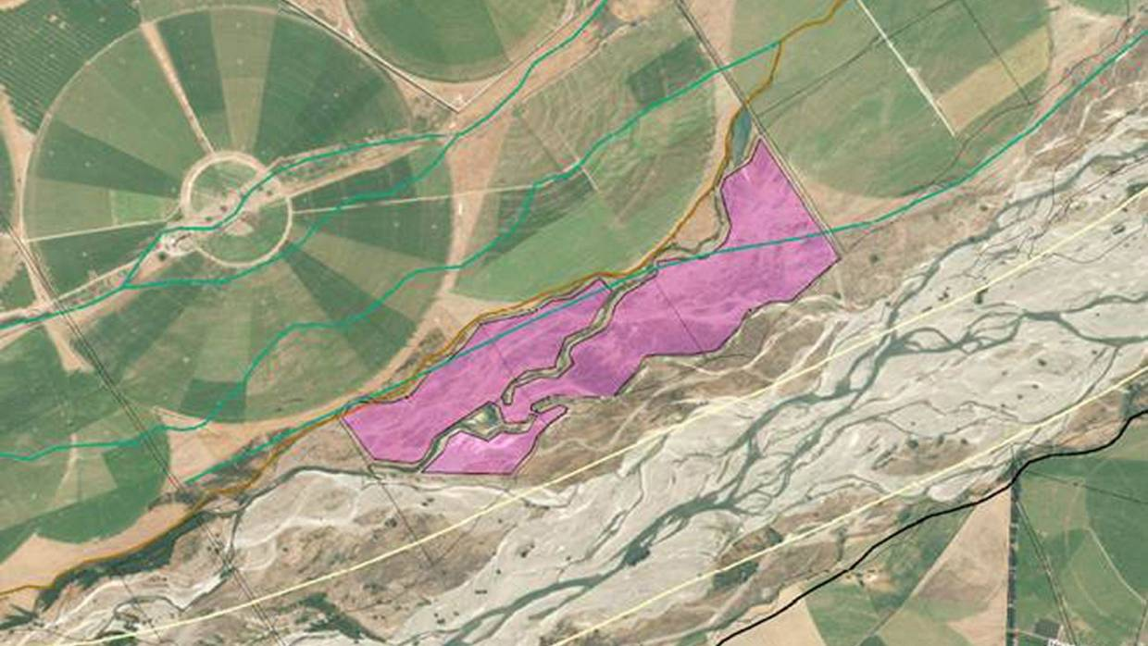
What went wrong in this Braided River?

Slide 14
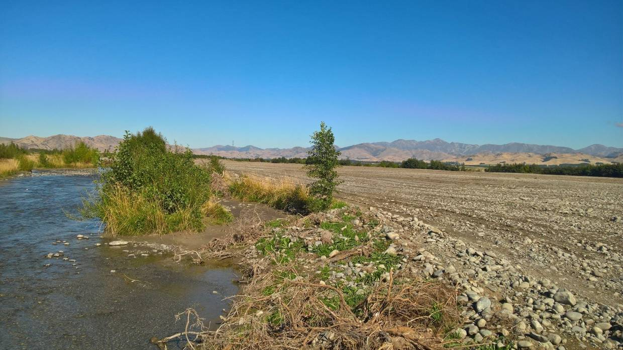
Fine for North Canterbury farmer who cleared 70ha of braided riverbed for commercial gain Aug 27 2018 Click here to read

Slide 15
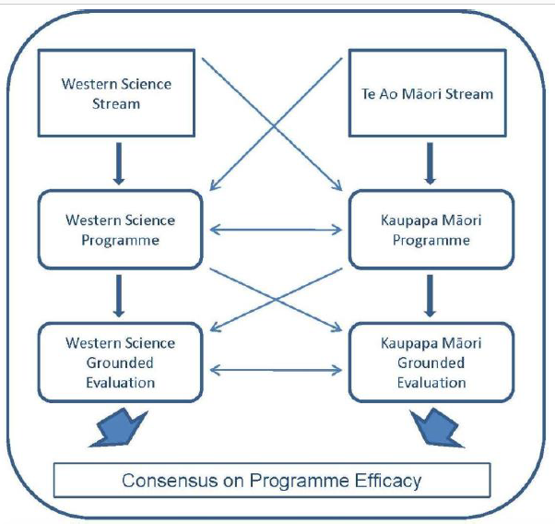
Angus Macfarlane, UC, He Awa Whiri, p. 217

Slide 17
Some readings by Colleen Mills
Lips-Wiersma, M., & Mills, C. (2002). Coming out of the closet: Negotiating spiritual expression in the workplace. Journal of managerial Psychology, 17(3), 183-202.
Mills, C. (2011). Grappling with the dark side of organisations [Paper in special issue: Exploring the Dark Side of Organisations: A Communication Perspective. Mills, Colleen (ed.).]. Australian Journal of Communication, 38(1), 1.
Mills, C. E. (2018). Creating Meaningful Dialogic Spaces: A Case of Liberation Management. The Palgrave Handbook of workplace spirituality and fulfillment, 1-21.
Rogers, P., Burnside-Lawry, J., Dragisic, J., & Mills, C. (2016). Collaboration and communication: Building a research agenda and way of working towards community disaster resilience. Disaster Prevention and Management, 25(1), 75-90.

Slide 18
What would Karl Popper say?
In 1940, lecturing at Canterbury College ➔There must be a “spirit of cooperation, not only of Christians and non-Christians, but of [all races & ethnicities], of Māoris and Pākehās, of scholars and layman, of old and young …” (Popper, 2008: 62, bracketed changes ours).

Slide 19
The Spirit of Cooperation
“… a prerequisite towards building a world which is a little better than ours at present” and in “a common effort to get nearer to the truth of what is the spirit of rationalism” (Popper, 2008: 62). Lecture in Canterbury College, New Zealand, 1940

Slide 20
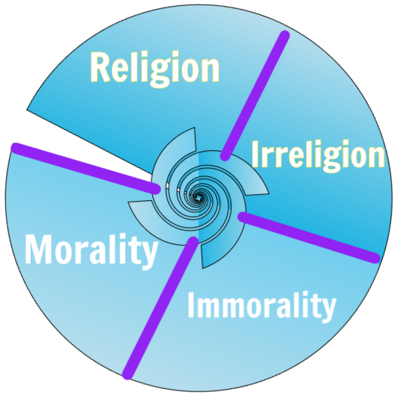

Slide 21
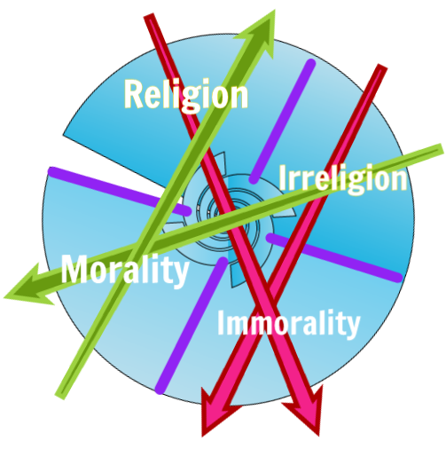

Slide 22
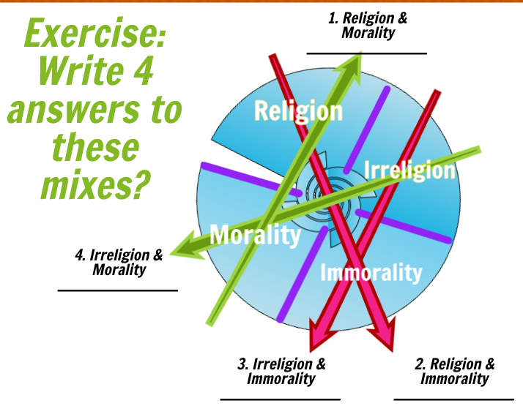

Slide 23
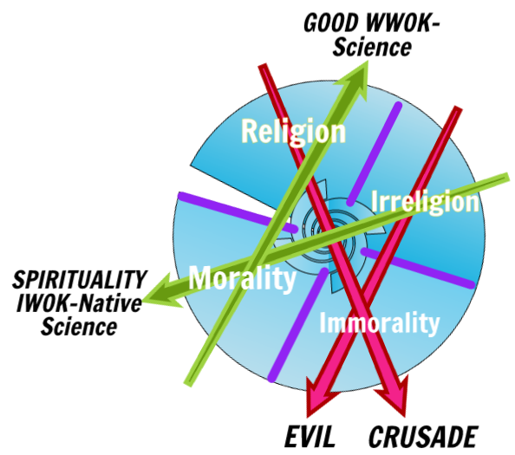

Slide 24
Some Definitions
Pākehā ➔ New Zealander of European descent; new settler to Aotearoa New Zealand
Māori ➔ Indigenous people of Aotearoa New Zealand
Kaupapa Māori ➔ Māori approach to Native Science (see work by Rosile, 2016; Boje & Rosile in press)

Slide 25
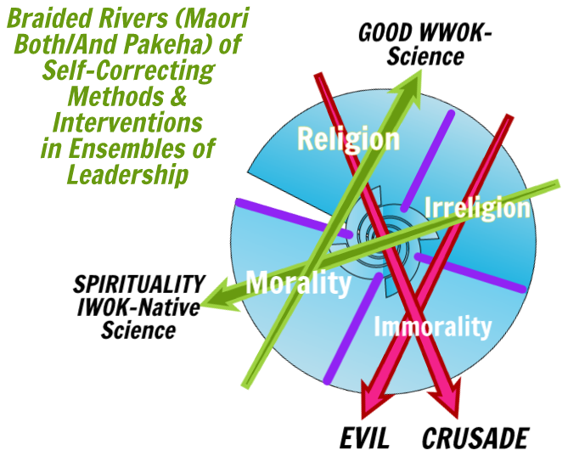

Slide 26
Blended River
Kaupapa Māori Streams
Indigenous Ways of Knowing (IWOK)
Ways of Being
Ways of Doing
Ways of Testing
Ways of Leading
Pākehā Streams
Western Ways of Knowing (WWOK)
Ways of Being
Ways of Doing
Ways of Testing
Ways of Leading
How to blend in together-telling Ensembles of Leadership?

Slide 27
Popper’s (2008) Spirit of Cooperation fits Macfarlane’s University of Canterbury work
Macfarlane →“promotes the blending of clinical and cultural streams of knowledge (affectionately named ‘Tō Tātou Waka’ – Our Canoe)…. A blended scientific-indigenous framework (appropriately names ‘He Awa Whiria’ – The Braided Rivers)”
Macfarlane (2012: 205)

Slide 28
Popper asks this Leadership Question
Should there be ‘Sweeping Social Engineering’ or ‘Piecemeal’ Zigzag changes by ‘social experiment’ in the context he lectured about in New Zealand, in 1940?
WHAT IS YOUR ANSWER AS STUDENTS OF LEADERSHIP?

