Slide 1
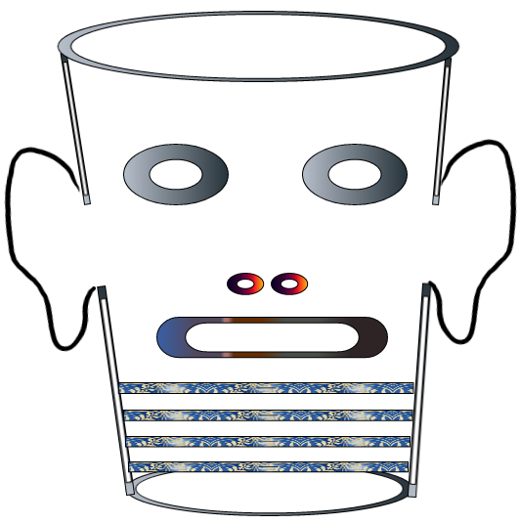
What is Storytelling Science?
David M. Boje
Seminar for University of Canterbury
March 19, 2019
Download book and slides for this presentation at https://davidboje.com/Canterbury

Slide 2
Knowing
Being
Testing
Doing

Slide 3
Some Definitions
Pākehā ➔ New Zealander of European descent; new settler to Aotearoa New Zealand
Māori ➔ Indigenous people of Aotearoa New Zealand
Kaupapa Māori ➔ Māori approach to Native Science (see work by Love, 2019; Cajete, 2000; Rosile, 2016; Boje & Rosile in press)

Slide 4
EXERCISE: Stand up, find partner, in one word or phrase, where is your work?
WAYS OF
Knowing
Being
Doing
Testing
Intervening
Kaupapa Māori
Pākehā

Slide 5
Roots of Storytelling Science
Karl Popper
Charles Sanders Peirce
Roger Penrose
Jean Paul Sartre
Henri Savall
Gilles Deleuze
Grace Ann Rosile
Karen Barad
Anete Strand
Marita Svane
Veronique Zardet
Jane Bennett
David Boje
Tyron Love
Linde & Graham Smith
Angus Macfarlane
Gregory Cajete
Don Peppion

Slide 6
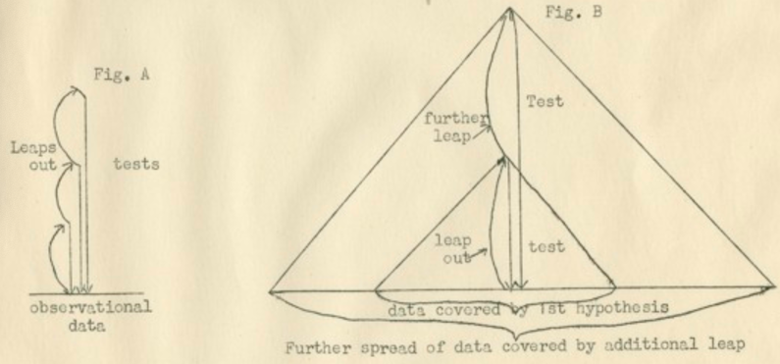
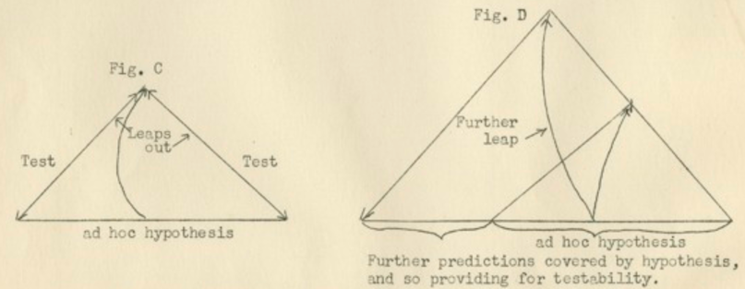
Karl Popper Lecture, New Zealand 1940

Slide 8
Braided River ‘He Awa Whiria’ Storytelling Science

Slide 9
Popper’s (2008) Spirit of Cooperation fits it
Macfarlane (2012: 205) →“promotes the blending of clinical and cultural streams of knowledge (affectionately named ‘Tō Tātou Waka’ – Our Canoe)…appropriately” named:
“‘He Awa Whiria’ –
The Braided Rivers”

Slide 10
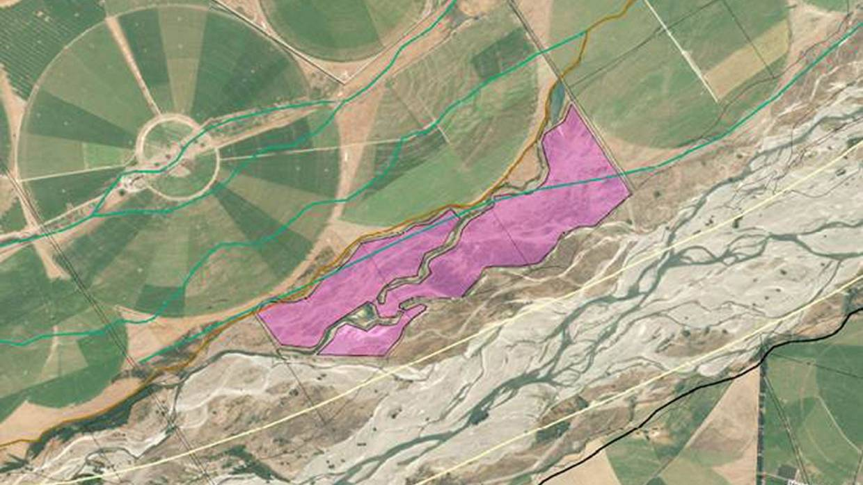
What went wrong in this Braided River?

Slide 11
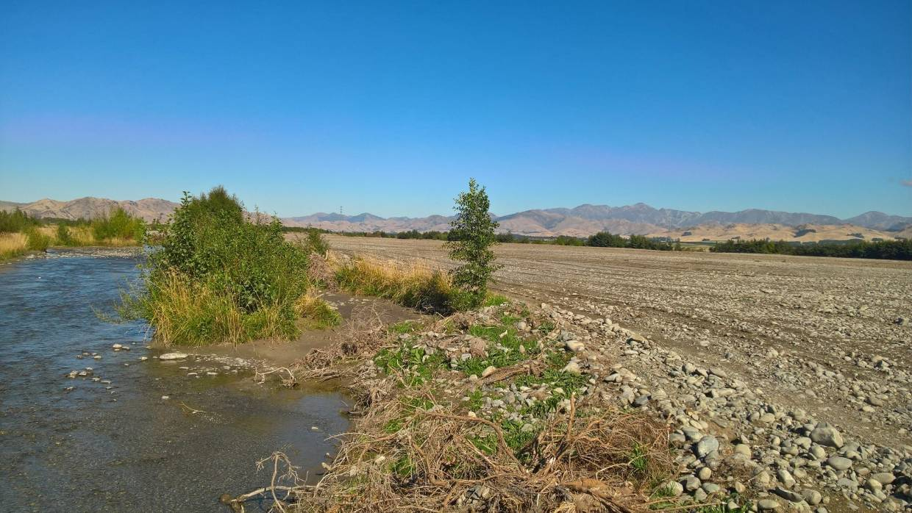
North Canterbury farmer fined for bull dozing 70ha of Braided Riverbed for commercial gain Aug 27 2018 Click here to read

Slide 12
What is Your Deep Theory?
"We are not simply looking for truth, we are after interesting and enlightening truth after theories which offer solutions to interesting problems…
we are after deep theories”
(Karl Popper, 1972: 55)

Slide 15
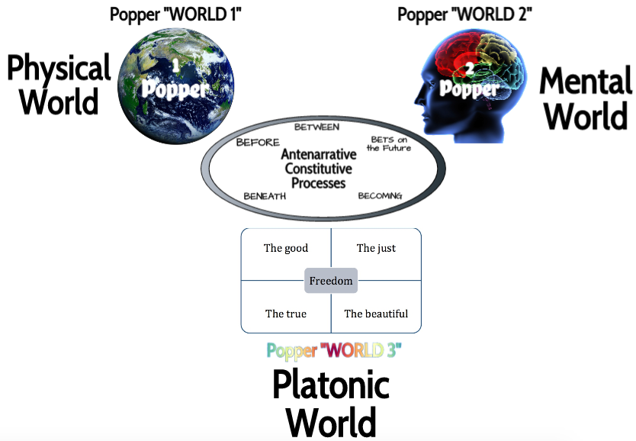

Slide 16
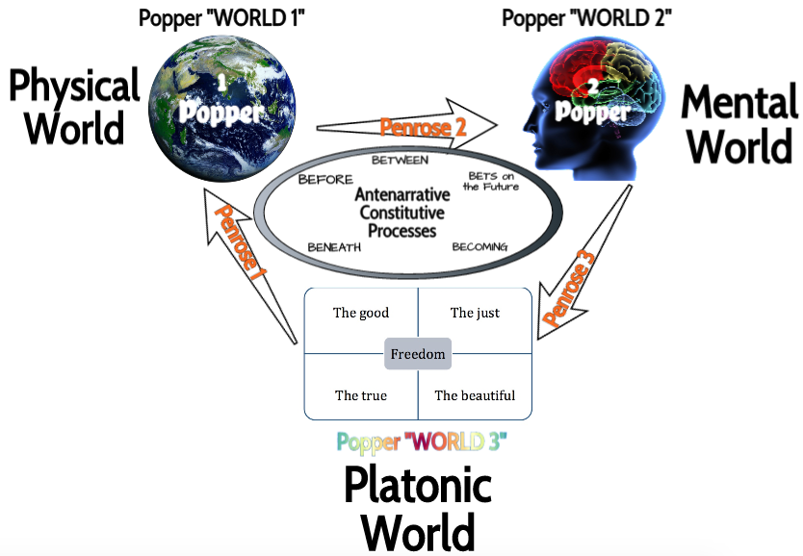

Slide 17
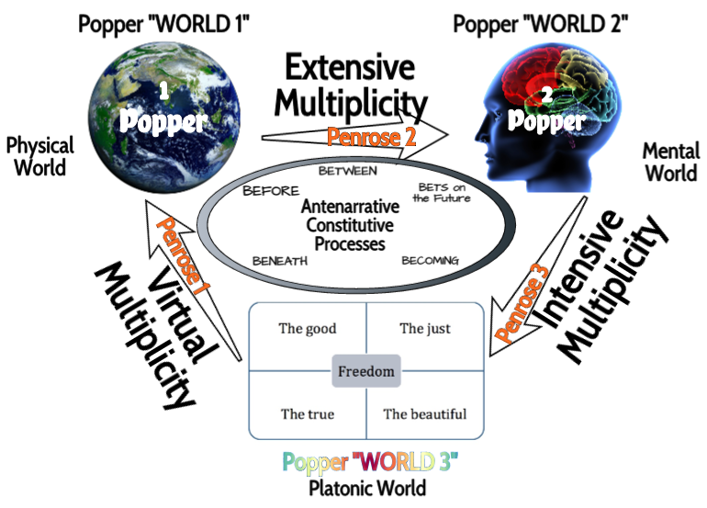

Slide 18
What is TRUE STORYTELLING now?
How to plan FUTURE?
When & Where to do PROJECT?
Reflect on OUTCOMES?

Slide 19
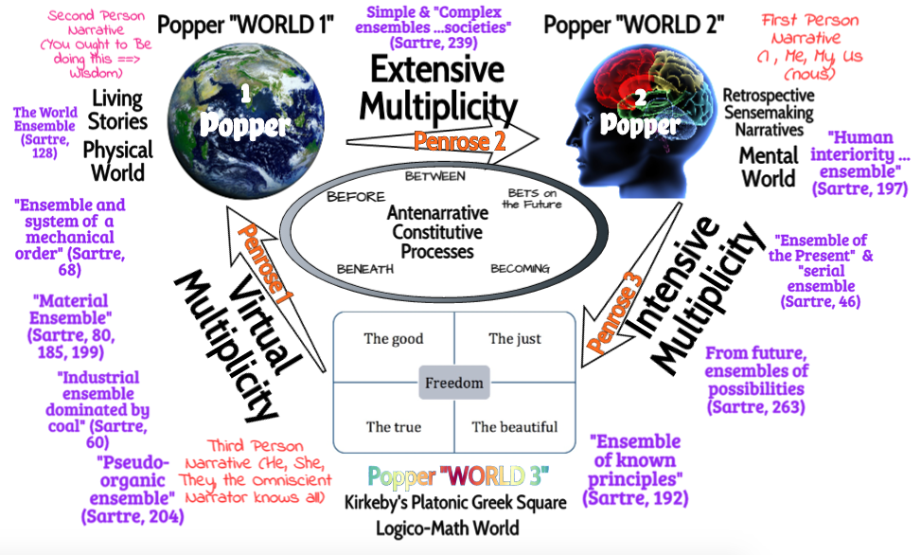

Slide 20
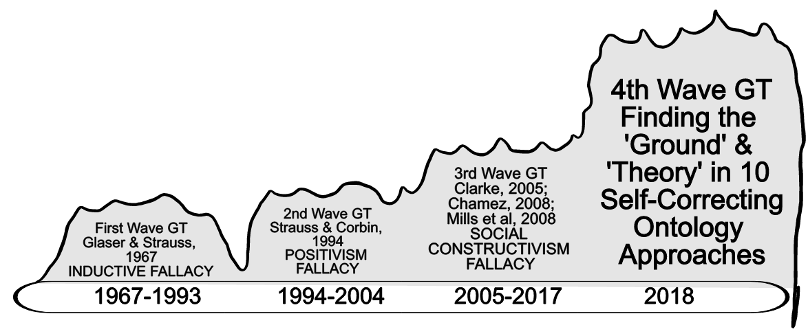
4 Waves of Grounded Theory

Slide 21
3rd Wave Grounded Theory is Only CONFIRMING never DISCONFIRMING
P. 132 is about confirming emergent ideas but as Charmaz says ‘Grounded Theory’
“does not equal verification” by
“systematic quantitative procedures”
Charmaz, K. (2006). Constructing grounded theory: A practical guide through qualitative analysis. London: Sage.

Slide 22
What is Your Method?

Slide 23
Self-Correcting Induction Methods
For Karl Popper it is Zigzag between intuitive hypotheses and testing theories by disconfirmation, not by confirmation
For C. S. Pierce it is self-correcting induction by four tests to get closer to Truth
For Henri Savall it is self-correcting by ’Agile’ intervention using Peirce’s Abduction-Induction-Deduction in Scientific Method of unleashing human potential

Slide 24
Charles Sanders Peirce 4 Tests of Self- Correcting Induction
Test One: Try to dismiss the precepts. Given fallibility, “the first test consists in trying to dismiss the precepts” as as some kind of fancy or daydream. If the flow of precepts persists, proceed to Test Two.
Test Two: Ask other people if they see and hear the same thing. If you have reason to suspect hallucination persists, the second test consists in “asking some other person whether he [or she] sees or hears the same thing” If several people concur then treat the induction as conclusive, or proceed to Test Three.
Test Three: Use your knowledge of laws of nature. Some hallucinations and illusions can affect many people. The third test is surer than the first two. “I may make use of my knowledge of the laws of nature” (as fallible as that may be). Apply your knowledge of the Nature, making our observations.
Test Four: Do experiments to see if the precept is illusory. There is a fourth test, and it is the surest of them all. “ apply the test of experiment” .
Charles Sanders Peirce (Vol. 2.142)

Slide 25
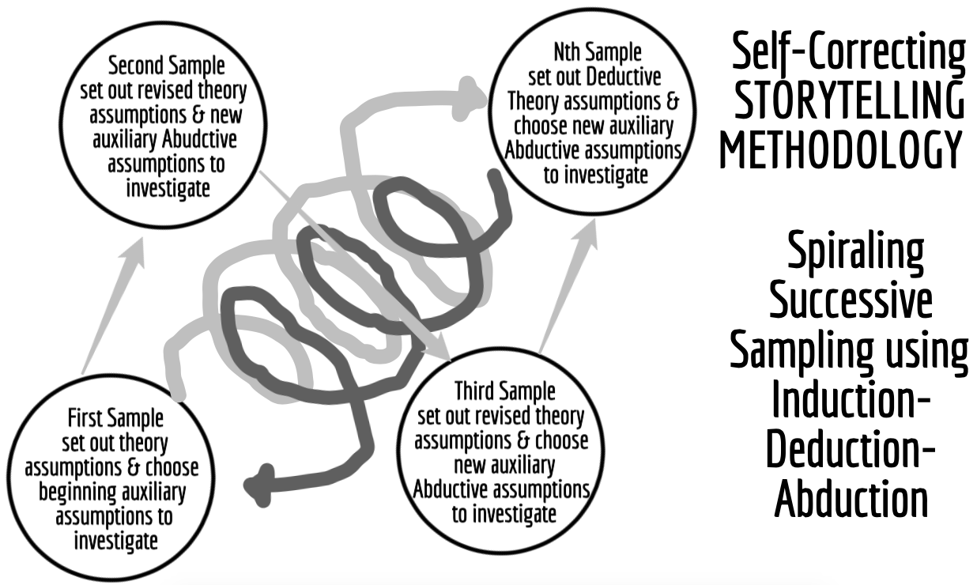
What is Self-Correcting Method?

Slide 27
Popper (1972: 243) Self-Correction Formula
PS₁ ➔ TT₁ ➔ EE₁ ➔PS₂
PS₁ = Problem situation, initial response
TT₁ = Tentative theories (conjectures)
EE₁ = Error elimination by testing
PS₂ = Problem situation, theories surviving refutation process

Slide 28
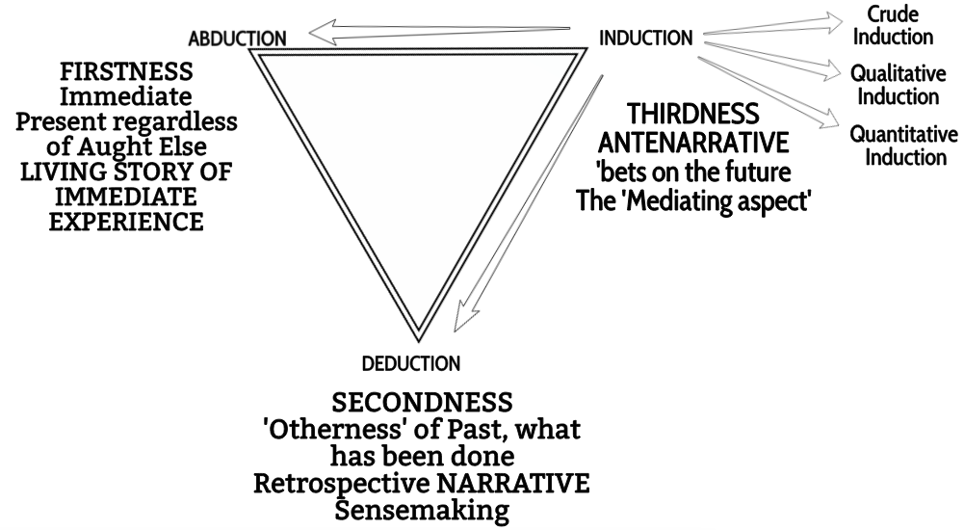
Peircean Triad and Antenarrative

Slide 29
Karl Popper (1970) “Evolutionary Epistemology” says Cup of Knowing lacks “force of refutation” from “critical discussion”
Filling cup with
Positive-only Stories
is POSITIVISM of POSITIVE SCIENCE
Movement
➔
Notes:
See page 61 in Popper’s Objective Knowledge book

Slide 30
What is your Intervention?

Slide 31
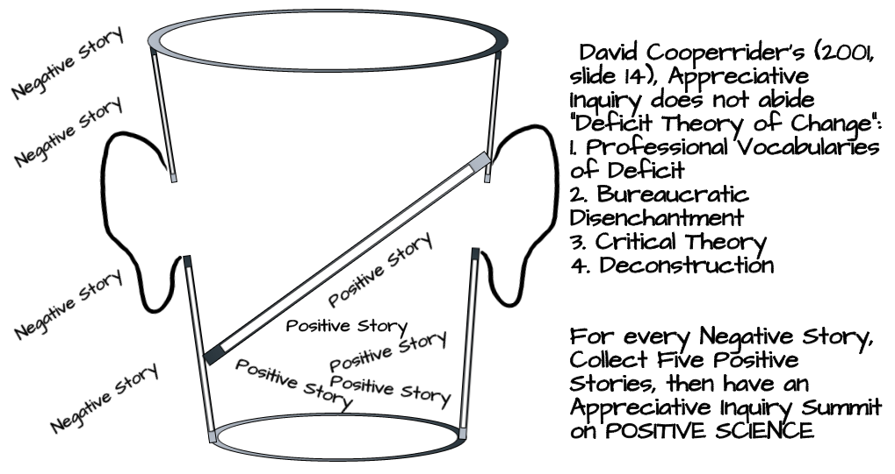

Slide 32
Knowing
Being
Testing
Doing

Slide 34
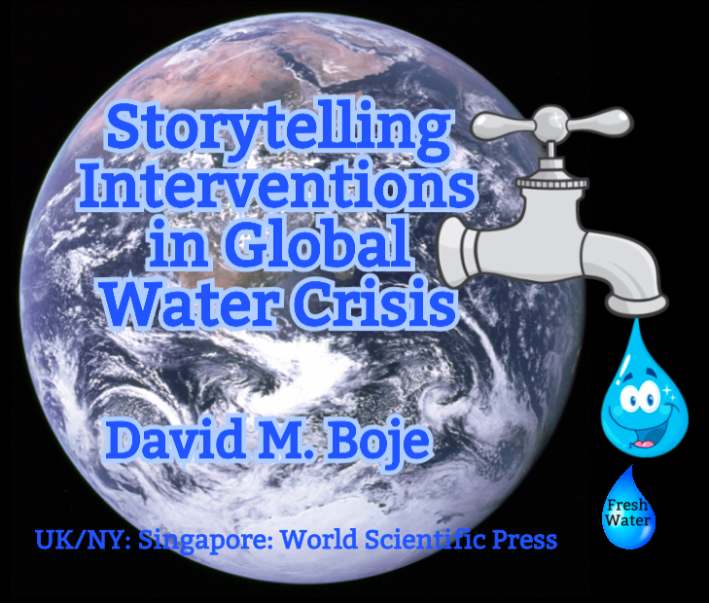
Storytelling Science and Your Dissertation
David M. Boje & Grace Ann Rosile
UK, US, Singapore: World Scientific
February 21, 2019; Revised March 19, 2019
Download Storytelling Science book and slides for this presentation at https://davidboje.com/Canterbury

