Slide 1
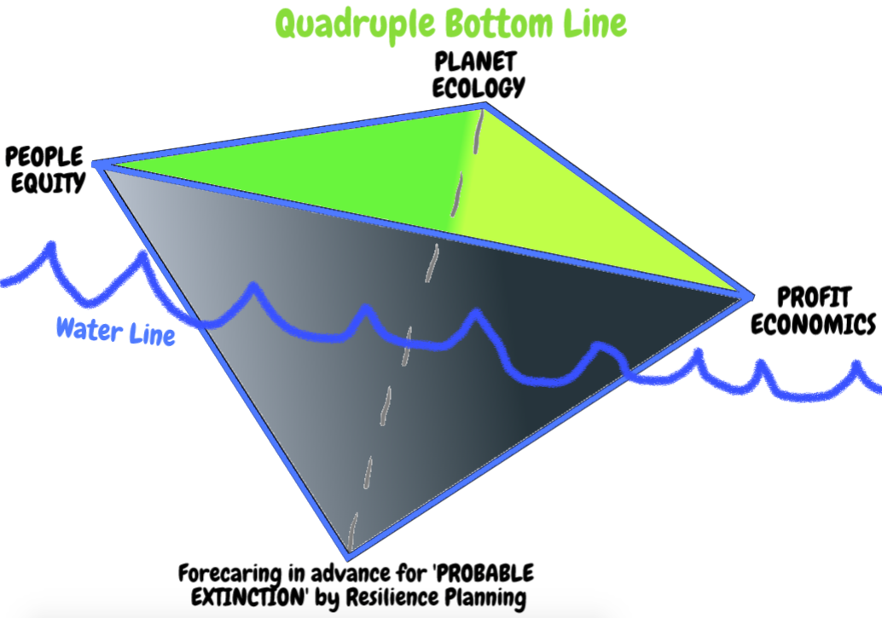
New Quadruple Bottom Line for New Zealand
David M. Boje, Ph.D.
New Mexico State University
Facutly & PhD Seminar March 14 2018
See http://davidboje.com/Canterbury slides, books & videos

Slide 2
Opener
Individually, brainstorm list of Human Extinction events
Get into groups of 5 and make one list on a poster
For each Human Extinction event, assign a probability from 0 to 99.9% that this will occur in your grandchildren’s lifetime
How do we reduce the risk of Human Extinction for top 3 events? Add this to your poster
Notes:
If time remains, answer: Why does New Zealand have highest youth suicide rate in the developed world? On poster, Top 3 reasons

Slide 3
CONTINUE groups of 5, answer 4 Starter Questions for Sustainability Reporting, add to Poster
What does sustainability mean?
What is to be sustained?
For how long?
In whose interests?
“Most so-called ‘sustainability’ reports simply ignore such questions …” (Milne, 2013: 136)
Notes:
Milne, Markus J. (2013). Phantasmagoria, sustain-a-babbling in social and environmental reporting. Pp. 135-153 in Lisa Jack, Jane Davison, Russell Craig (Eds.) The Routledge companion to accounting communication. NY: Routledge.

Slide 4
YouTube on Triple Bottom Line
https://www.youtube.com/watch?v=2f5m-jBf81Q
As you watch, write a list of the fallacies, questionable assumptions being made.

Slide 5
PROBLEM for today: Can New Zealand become first place in the world where budget is not the umbrella of quantitative economic measures?
Prime Minister Jacinda Ardern is making a policy change for Budget 2019
Change the country’s economic measures of economic success, from just Gross Domestic Product (GDP), the value of all goods and services produced for final sale in an economy, to include people’s wellbeing as a “more holistic measure of country’s success.”
She proposes a new ‘Living Standard Framework’ as a counternarrative to the usual globalization-narrative that privileges GDP over all other measures"

Slide 6
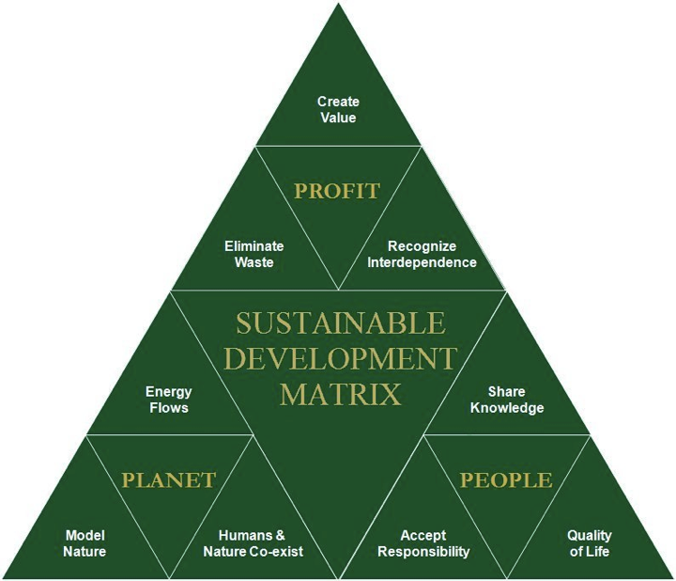
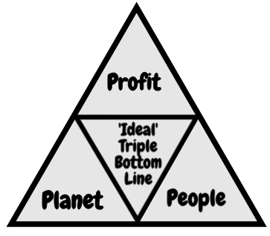
Prime Minister Jacinda Ardern’s Triple Bottom Line
Notes:
'Wealth: Having it all and wanting more'
Published 19 January 2015
Author: Deborah Hardoon, Senior Researcher, Oxfam GB
There were two main external data sources used:
1 - Credit Suisse Global Wealth Databook 2014
https://www.credit-suisse.com/uk/en/news-and-expertise/research/credit-suisse-research-institute/publications.html
Data was extrcated from the 2014 report and a STATA file which included revised calculations for global wealth and wealth shares dating back to 2000.
All data from Credit Suisse is highlighted in blue in this file

Slide 7
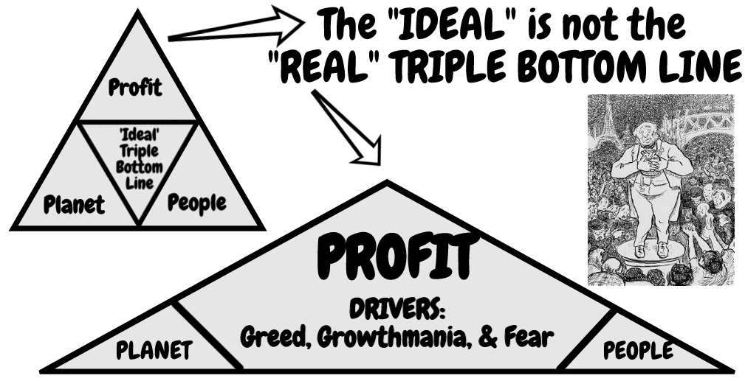
Is this Principle of Equal-Opportunity?
CORE DRIVERS (Greed, Growthmania, & Gross-Scale)
MANIFEST: Vicious Spirals of waste, pollution, degradation, depletion, exploitation, poverty, corruption, deprivation, and increasing inequalities of GLOBALIZATION

Slide 8
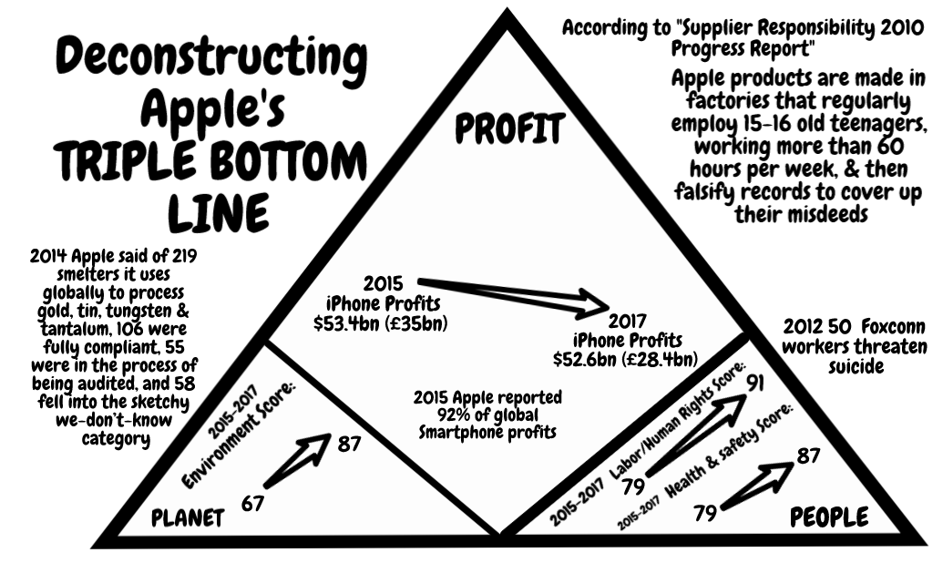
Deconstruct Apple Example

Slide 9
Apple does surface level measures of supply chain
“There is widespread smuggling across borders of conflict minerals used to make laptops and cell phones in order to finance warlords. Therefore it’s in every businessman’s interest to keep conflict going, and have nobody watching child labor, smuggling, etc.” – Boje, Storytelling Globalization book
Each firm in Apple’s supply chain ranked on 100-point scale based on its performance relative to our Code of Conduct on 500 data points
Administrative non-compliance violations (inadequate record keeping, inadequate documentation of policy or procedures, or insufficient training on policy)
Core violations (underage workers, document falsification, intimidation of workers, or environmental & safety threats) – only 22 violations discovered, & supplier put on probation
Alvesson and Spicer (2012: 1194) call this methodology: “functional stupidity!”
Notes:
“… creating safer working conditions, treating workers fairly, and using environmentally responsible practices in our supply chain”(2017: 3)

Slide 10
McDonald’s Sustainability Report is McFantasy
McDonald’s reports on water use at its fast food outlets, but not of the 600 gallons of water to make each quarter-pounder
Not reported →large-scale pork produced water pollution (pfisteria-laden waters) in the southeast US causing lesions in fish & fish die-off
Reports on energy use, NOT on 10 calories of energy for every calorie of good produced in unsustainable fast food system
Para. Hawken 2002 as cited in Milne, Markus J. (2013). Phantasmagoria, sustain-a-babbling in social and environmental reporting. Pp. 135-153 in Lisa Jack, Jane Davison, Russell Craig (Eds.) The Routledge companion to accounting communication. NY: Routledge.
Notes:
The report carefully avoids the corporation’s real environmental impacts. It talked
about water use at the outlets, but failed to note that every quarter-pounder requires
600 gallons of water. It talked about recycled paper, but not the pfisteria-laden waters
caused by large-scale pork producers in the southeast. It talked about energy use in the
restaurants, but not in the unsustainable food system McDonald’s relies upon that uses
10 calories of energy for every calorie of good produced. “Sustaining” McDonald’s requires
a simple unsustainable formula: cheap food plus cheap non-unionized labor plus deceptive
advertising = report would tell stakeholders how much it truly costs
society to support a corporation like McDonald’s high profits. An honest. It would detail the externalities borne by
other people, places, and generations.
Hawken (2002)

Slide 11
From Milne, 2013
“‘Sustaining’ McDonald’s requires a simple unsustainable formula”:
cheap food + cheap non-unionized labor + deceptive advertising = high profits
(Hawken, 2002, as cited in Milne, 2013: 143, boldness, mine).

Slide 12
Monsanto example
Farmers in India committing suicide, able to keep their farms due to fees payable to Monsanto when terminator seeds blow onto their land or are introduced by shady vendors

Slide 13
take action alongside migrant farmworker women: demand freedom from sexual violence in Wendy’s supply chain!

Slide 14
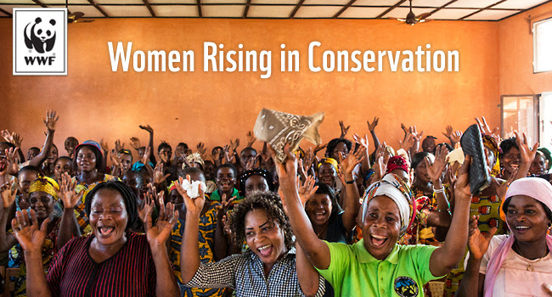
Democratic Republic Congo, women at center of household and heart of local livelihoods: preparing meals for their families, tending crops & fishing, making soap, o weaving mats

Slide 15
“New Zealanders were once proud of our farming heritage. But at some point, as agriculture intensified and started spilling into our other source of pride, our clean green image, trust was lost” -- Glen Herud.

Slide 16
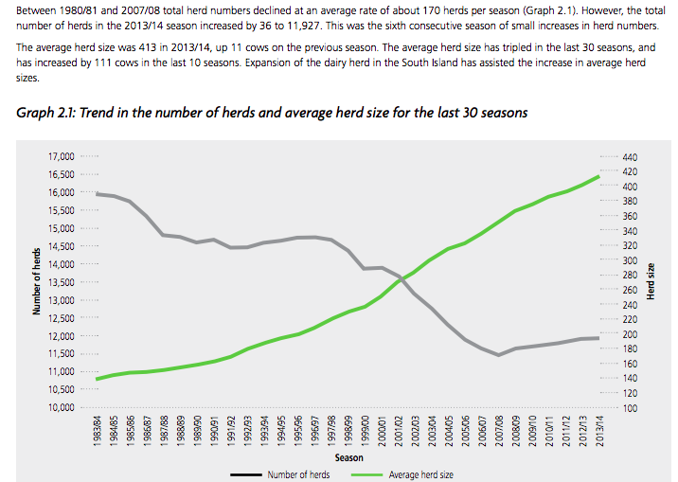
New Zealand

Slide 17
Critique of Triple Bottom Line
3BL assumes 3 bottom lines are EQUAL
Measures exist for PROFIT; disagreement on or missing ‘real’ measures of PLANET and PEOPLE
3BL = Greenwashing narrative used to make it seem like Corporate Sustainability exists
3BL = narrative exceptionalism→ humanity creates itself as outside the natural limits of ecosystems AND technology can solve any problem
3BL = humancentric narrative opposed by the counternarrative of posthumanism (all species matter)

Slide 18
What can you do?
New Prime Minister Jacinda Ardern is making a policy change for Budget 2019, to change the country’s economic measures of economic success, from just Gross Domestic Product (GDP), the value of all goods and services produced for final sale in an economy, to include people’s wellbeing as a “more holistic measure of country’s success.”

Slide 19
Prime Minister Jacinda Ardern
"We want New Zealand to be the first place in the world where our budget is not presented simply under the umbrella of pure economic measures, and often inadequate ones at that, but one that demonstrates the overall wellbeing of our country and its people. It will no longer be good enough to say a policy is successful because it increases GDP"

Slide 20
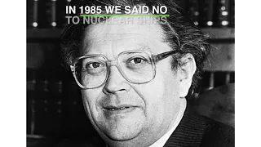
Schlumberger’s operation will see it firing seismic blasts into the seabed to search for oil every 10 seconds, 24 hours a day, for up to three months
Our nuclear free moment Greenpeace NZ Video (homework)
•
Right now the monstrous seismic blasting oil ship known as The Beast is on its way to New Zealand: http://greenpeace.nz/turn-back-

Slide 21
Difference Between Espoused TRIPLE BOTTOM LINE and ‘Actual’ Ethics Behavior
Q: What are the differences?

Slide 22
Core Drivers and Manifestations of Triple Bottom Line
CORE DRIVERS: Experience of a lowering quality of life
MANIFESTATIONS: Global fragility: fresh water reduction, climate change, ocean pollution and acidity, societal disruptions, job-losses
Source: Newsletter 117: Shift Happens: so how do we respond? Feb 7 2018

Slide 23
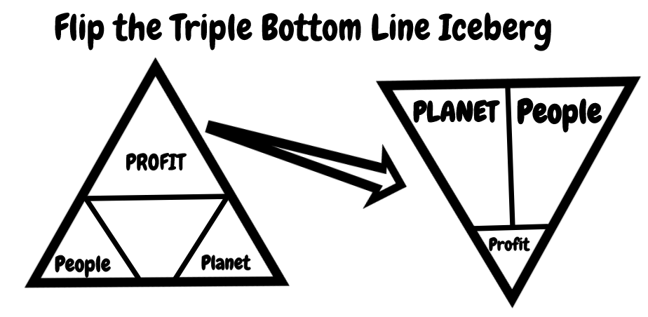

Slide 24
Why Flip the Triple Bottom Line & add a line?
3BL missing → ADD line Mātauranga Māori IWOK Whānaungatanga (relationships) of family, community, ecology
3BL = Peoples’ Multicultural equality becomes what is left over after the Profit bottom line measures→Rangatiratanga (self-determination/ resilience)
3BL = Driver for calculating worth of the planet without regard to spiritual ecology → Wairuatanga (spirituality)
3BL = Greenwashing because the TIME VALUE of Profit is the short-term→Kaitiakitanga (stewardship) long-term
3BL = Economists persuade politicians NGOs can pick up the pieces after Globalization does its GREED thing →Manaakitanga (generosity)

Slide 25
For Prime Minister Jacinda Ardern

Slide 26
Tyron Love’s narrative research is a step forward
“Further, many firms that would apparently benefit from reporting – large, listed, high impact and visible companies – do not report (Higgins et al., forthcoming; Martin and Hadley, 2008) and many have never considered it (Stubbs et al., 2013)” (Higgins, Stubbs, & Love, 2014: 1093)

Slide 27
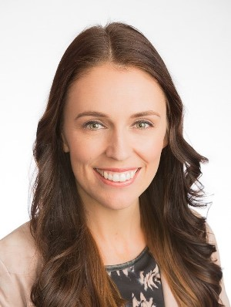
NZ: Take Action for quadruple bottom line!
Write Letter to Prime Minister Jacinda Ardern jacinda.ardern@parliament.govt.nz
Notes:
Milne, Markus J. (2013). Phantasmagoria, sustain-a-babbling in social and environmental reporting. Pp. 135-153 in Lisa Jack, Jane Davison, Russell Craig (Eds.) The Routledge companion to accounting communication. NY: Routledge.
Milne, M. J., Kearins, K., & Walton, S. (2006). Creating adventures in wonderland: The journey metaphor and environmental sustainability. Organization, 13(6), 801-839.
Milne, M. J., & Gray, R. (2013). W(h)ither ecology? The triple bottom line, the global reporting initiative, and corporate sustainability reporting. Journal of business ethics, 118(1), 13-29.
Milne and Gray (2013: 14) critique the triple bottom line and sustainability reporting history such as the Global Reporting Initiative (GRI), SustainAbility, and other integrated reporting schemes for their ‘change-but-no-change rhetoric of sustainability” is a dangerous discourse.
Byrch, C., Milne, M. J., Morgan, R., & Kearins, K. (2015). Seeds of hope? Exploring business actors’ diverse understandings of sustainable development. Accounting, Auditing & Accountability Journal, 28(5), 671-705.
Gray, R., & Milne, M. J. (2018). Perhaps the Dodo should have accounted for human beings? Accounts of humanity and (its) extinction. Accounting, Auditing & Accountability Journal, (just-accepted), 00-00.
Tregidga, H., Milne, M. J., & Kearins, K. (2015). Ramping up resistance: Corporate sustainable development and academic research. Business & Society, 0007650315611459.
Recent publications
Gray, R. & Milne, M.J., Perhaps the Dodo Should Have Accounted for Humanity? Accounts of Humanity and (Its) Extinction,Accounting, Auditing & Accountability Journal. https://doi.org/10.1108/AAAJ-03-2016-2483
Russell, SL, Milne, M.J. & Dey, C Accounts of nature and the nature of accounts: Accounting, Auditing & Accountability Journal.https://doi.org/10.1108/AAAJ-07-2017-3010
Higgins, C., Stubbs, W., & Milne, M.J., Is sustainability reporting becoming institutionalized? The role of an issues-based field, Journal of Business Ethics. http://dx.doi.org/10.1007/s10551-015-2931-7.
Tregidga, H.M., Milne, M.J. & Kearins, K.N., Ramping up Resistance: Corporate Sustainable Development and Academic Research,Business & Society. http://dx.doi.org/10.1177/0007650315611459

Slide 28
Thank you - questions
Slides and books to download at http://davidboje.com/Canterbury
Notes:
Milne, Markus J. (2013). Phantasmagoria, sustain-a-babbling in social and environmental reporting. Pp. 135-153 in Lisa Jack, Jane Davison, Russell Craig (Eds.) The Routledge companion to accounting communication. NY: Routledge.
Milne, M. J., Kearins, K., & Walton, S. (2006). Creating adventures in wonderland: The journey metaphor and environmental sustainability. Organization, 13(6), 801-839.
Milne, M. J., & Gray, R. (2013). W(h)ither ecology? The triple bottom line, the global reporting initiative, and corporate sustainability reporting. Journal of business ethics, 118(1), 13-29.
Milne and Gray (2013: 14) critique the triple bottom line and sustainability reporting history such as the Global Reporting Initiative (GRI), SustainAbility, and other integrated reporting schemes for their ‘change-but-no-change rhetoric of sustainability” is a dangerous discourse.
Byrch, C., Milne, M. J., Morgan, R., & Kearins, K. (2015). Seeds of hope? Exploring business actors’ diverse understandings of sustainable development. Accounting, Auditing & Accountability Journal, 28(5), 671-705.
Gray, R., & Milne, M. J. (2018). Perhaps the Dodo should have accounted for human beings? Accounts of humanity and (its) extinction. Accounting, Auditing & Accountability Journal, (just-accepted), 00-00.
Tregidga, H., Milne, M. J., & Kearins, K. (2015). Ramping up resistance: Corporate sustainable development and academic research. Business & Society, 0007650315611459.
Recent publications
Gray, R. & Milne, M.J., Perhaps the Dodo Should Have Accounted for Humanity? Accounts of Humanity and (Its) Extinction,Accounting, Auditing & Accountability Journal. https://doi.org/10.1108/AAAJ-03-2016-2483
Russell, SL, Milne, M.J. & Dey, C Accounts of nature and the nature of accounts: Accounting, Auditing & Accountability Journal.https://doi.org/10.1108/AAAJ-07-2017-3010
Higgins, C., Stubbs, W., & Milne, M.J., Is sustainability reporting becoming institutionalized? The role of an issues-based field, Journal of Business Ethics. http://dx.doi.org/10.1007/s10551-015-2931-7.
Tregidga, H.M., Milne, M.J. & Kearins, K.N., Ramping up Resistance: Corporate Sustainable Development and Academic Research,Business & Society. http://dx.doi.org/10.1177/0007650315611459

