Slide 1
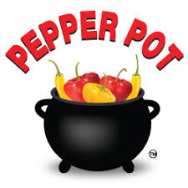
Formation of ‘School of Sustainability’ SOS and Wonder Woman 2.0 Story
David M. Boje
Ph.D. & Faculty Seminar 27 March 2018
Slides and books at http://davidboje.com/Canterbury

Slide 2
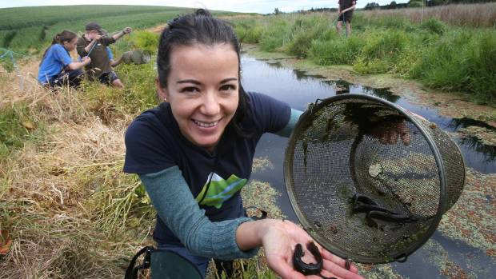
Part I: Wonder Woman 2.0, Lan Pham
Lan Pham released the Taylor Swift-inspired music video
Wonder Woman 2.0 Pepper Pot Environmental Projects won’t help BOTTOM LINE Extinction of Water Quality

Slide 3
QUESTION: What are the “Pepper Pot Environmental Projects” in New Zealand and at University of Canterbury?
ANSWER: They are projects that ignore measuring: (1) Economic Externalities, (2) Hidden Costs, (3) actually doing counter-Accounting of the BOTTOM LINE OF WATER QUALITY, & (4) Kaupapa Māori methodology (Hoskins & Jones, 2017)!

Slide 4
Wonder Woman 2.0 says:
“Narrow-minded economic thinking and pepper pot environmental projects aren’t going to save us, but if we start thinking strategically, and all pull our weight in reducing our impact on the environment, future generations might be able to have the same opportunities that we had – ideally, much, much better.”
Who is Wonder Woman 2.0 in her day job?

Slide 5
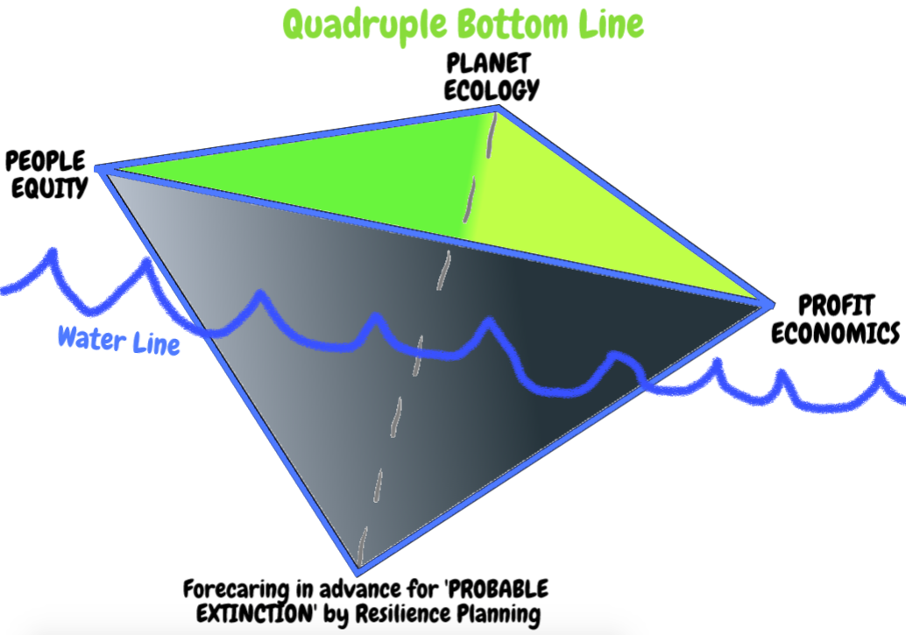
Bottom Line Extinction of Water Quality!

Slide 6
When Living Water is treated as Object, Resource
The bottom line of extinction of Water Quality is the result.
When a Pepper Pot of Environmental Projects is called ‘SUSTAINABILITY’ then the HIDDEN COSTS of Polluted Water go Unmeasured, Economic Externalities are pushed to the side, there is no Critical Counter-Accounts of Accountability enacted, & we need a critical conversation about Kaupapa Māori at University of Canterbury

Slide 7
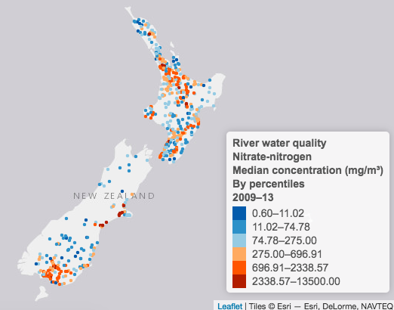
NZ Stats 2017
“Of the native species we report on, around three-quarters of fish, one-third of invertebrates, and one-third of plants are threatened with, or at risk of, extinction” (NZ Stat 2017, p. 13).
Animal or human faeces in fresh water increases risk of E.coli bacteria, to swimmers. “Māori tribal identity is linked to fresh water, for whom each water body has its own mauri (life force)” (2017 NZ Stats, p. 1).
Notes:
Animal or human faeces in fresh water increases risk of E.coli bacteria, to swimmers. “Māori tribal identity is linked to fresh water, for whom each water body has its own mauri (life force)” (2017 NZ Stats).

Slide 8
10 Hidden Costs of NZ Polluted Waterways
Dysentery – high fever from traces of fetal matter in water supply
Arsenicosis – skin lesions form small amounts of arsenic from industrial units along river banks & aquifers
Polio (Infantile Paralysis) – feces passed into drinking water by infected person
Trachoma (Eye Infection) – bacterium forming in unsanitary water coarses the eye and lesions form resulting in blindness
Typhoid fever – consuming water contaminated with Salmonella Typhi bacteria infects 12 million people a year
Schistosomiasis – contaminated water breeding snails whose worms penetrate the skin resulting in liver, lung, bladder, intestine infections
Cholera – about 100,000 deaths occur annually from bacterium Vibrio Cholerae in contaminated water
Diarrhea – from water born water-borne viruses parasites particularly deadly to small children
Malaria – female mosquitoes carrying parasite called Anopheles spreads the disease which can spread to other people
Lead Poisoning – from old pipes and surface water pollutants causing organ damage, nervous system disorders, anemia, high blood pressure, kidney disease and problems with the reproductive system
Notes:
See https://www.stats.govt.nz/reports/our-fresh-water and health effects above I gathered in my search
List is from https://www.livpure.in/blog/10-diseases-that-are-caused-by-water-pollution-and-what-you-can-do

Slide 9
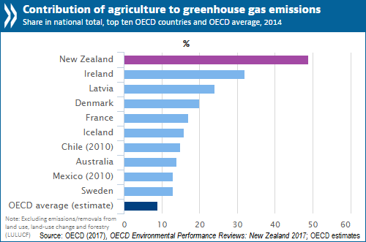
RESEARCH the 2017 OECD Report: New Zealand has the second-highest level of emissions per GDP unit in the OECD and the fifth-highest emissions per capita.

Slide 10
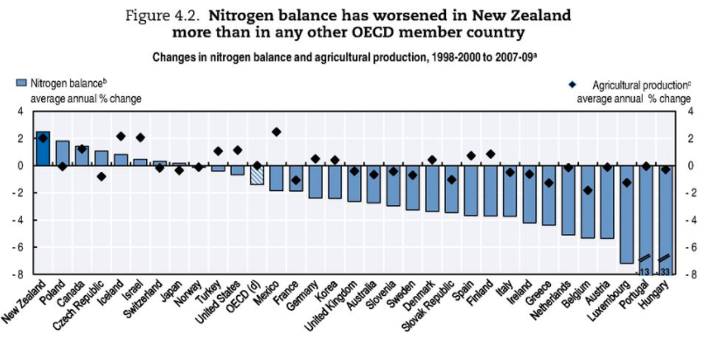
Click for OECD 2017 Report
The OECD Report for 2017 says “The nitrogen balance between 1998 and 2009 has worsened more than in any other OECD member country, primarily due to expansion and intensification of farming” (p. 159)
Decline of New Zealand water quality was rated the number one environmental problem in public opinion surveys (Hughey et al., 2013).

Slide 11
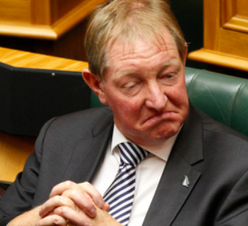
Wonder Woman 2.0 & Nemesis Dr. Nick Smith
“To describe Lan Pham as Wonder Woman 2.0 is not even a stretch. Her resume reads something like this: Freshwater ecologist, youngest Environment Canterbury councilor, director of not-for-profit Working Waters Trust, formidable campaigner for the protection and preservation of the environment; and she’s only just getting started’ “ (Linda Truesdale, 2017 article BRUTAL TRUTH: The Business of Water).
Who is Nick Smith? He is NZ Environment Minister and National Party member of parliament (MP). 1996 became Minister of Conservation; National Party's Climate Change spokesman when in opposition, and has held the post of Minister for Climate Change Issues; champions moderating NZ role in emissions trading permit system; 21 March 2012 Smith resigned his cabinet post due to conflicts of interest Read More 2014 to 2017 Minister of Environment Read More. In 2017 Horse Manure sculpture by artist Sam Mahon Read More & short Video

Slide 12
Wonder Woman 2.0
In 2010, Lan Pham, freshwater ecologist, one of four Christchurch candidates elected to Environment Canterbury Regional Council & survived the National Government 19 Apr 2010 coup led by Minister Dr. Nick Smith. The 4 Sep 2010 Earthquake used to justify appointed replacements remaining in place unil Oct 2016. Please make this required reading: article BRUTAL TRUTH: The Business of Water 2017; 2nd video on her view of water plan in Christchurch

Slide 13
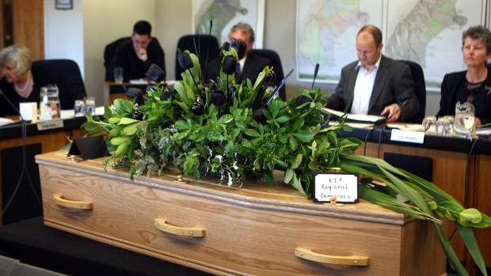
Casket at the last meeting of fully-elected ENVIRONMENT CANTERBURY in 2010
E-CAN elections unlikely before 2019; One of councillors, Eugenie Sage (far left), sacked by Nick Smith, when he was Minister of Conservation in 2010, and she became the new 2018 Minister of Conservation, replacing Smith. READ MORE

Slide 14
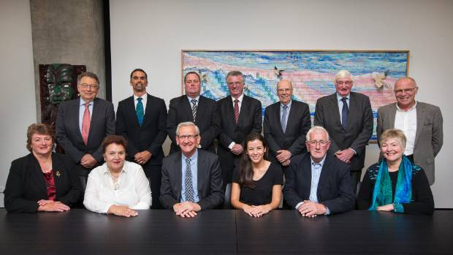
Why did the protests happen?
Three thousand people protested against the 2010 coup / Environment Minister Nick Smith would have power of water decisions. New commissioners were appointed that reported directly to ministers in Wellington, unlike other councils that were democratically elected, and whose decisions could not be appealed in the Environmental Court. With the 4 Sep 2010 earthquake, minister Nate Smith argues that it was not advisable to have an elected Canterbury council.
Feb 9 2018 → Eight years on and Canterbury's environment still has no democracy Read More

Slide 15
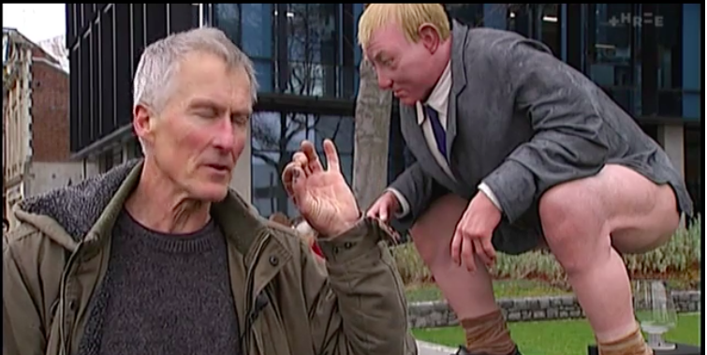
Artist protests Environment Minister of New Zealand - YouTube
Sam Mahon's statue of NZ Minister for the Environment Nick Smith; The piece, which is two and a half times life size, is made of horse manure and epoxy resin.

Slide 16
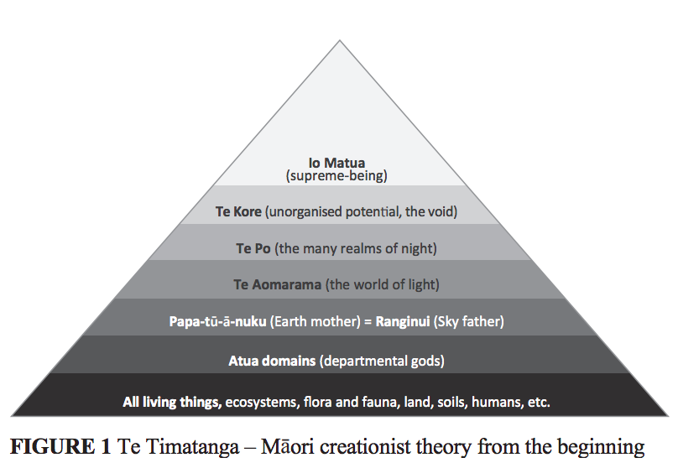
Part II: A look at Kaupapa Māori water Theory & Methodologies
Māori have an intricate, holistic and interconnected relationship with the natural world and its resources, ..... ancestors established their philosophy of preservation and conservation as a foundation on which future can be built. But Mātauranga Māori is not same as Kaupapa Māori Read more → Garth R. Harmsworth (Te Arawa, Ngāti Tūwharetoa, Ngāti Raukawa) , Shaun Awatere (Ngāti Porou) & see Hoskins & Jones, 2017 Critical Conversations in Kaupapa Māori. Wellington, NZ: Huia Publishers.
Notes:
Read more at https://www.landcareresearch.co.nz/__data/assets/pdf_file/0007/77047/2_1_Harmsworth.pdf

Slide 17
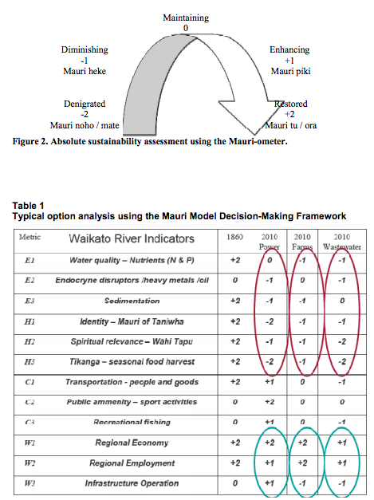
results depicted show mauri raw score averages for the impact of activities (such as farming and treatment of waste water) are modified by the prioritizations of different worldviews
Source: Pikiao, N., Te Arawa, N. K., & Tahu, N. (2010, June). The Mauri Model Decision-Making Framework: Robust Decision-Making for Community Cultural Mosaics. In 4th International Traditional Knowledge Conference (Vol. 2010, p. 245-250) figure from p. 248

Slide 18
Whanganui River is a Person
2017 local Māori tribe of Whanganui in the North Island, after 140 years, has fought recognition of their Whanganui River – the third-largest in New Zealand – as an ancestor and granted the world’s first legal status as a person.
Gerrard Albert,tribal leaders, says that after a century of treating the river as a resource (object), it now its degradation can be stopped, and the river cared for. Youtube-source

Slide 19
Next: FORM 6 GROUPS, Compare 5 University of Canterbury definitions with deeper actual Māori definitions & #6 missing Kaupapa Māori Method:
Kaitiakitanga – guardianship and protection of people, environment, knowledge, culture, language and resources for future generations.
Mahinga Kai – traditional customary food gathering, encompasses the places where natural resources were obtained; the resources themselves; and the practises and principles that guided how those resources were managed
Manaakitanga –The extension of charity, hospitality, reciprocity and respect to others.
Mana Whenua – Mana or ‘authority’ held by the local hapū or iwi over the land or particular area.
Mauri Tū – environmental health is protected, maintained and/or enhanced
Kaupapa Māori – theory & methodology in plan of actions, ways of doing things, expressing “deeper worldview” (Ahukaramū & Royal, 2017: 112).

Slide 20
Group 1 - Kaitiakitanga is already acknowledge in legislation and is defined as follows:
… the exercise of guardianship by the tangata whenua of an area in accordance with tikanga Māori in relation to natural and physical resources, and include the ethic of stewardship (section 2 RMA)
… the exercise of guardianships; and, in relation to any fisheries resources, includes the ethic of stewardship based on the nature of the resources, as exercised by the appropriate tangata whenua in accordance with tikanga Māori (section 2, Fisheries Act 1992)
Concern has often been expressed however that present legal definitions do not fully express what kaitiakitanga is about, and that any attempt to define it in anything other than te reo Māori will always be insufficient.

Slide 21
GROUP 2: The term ‘Mahinga Kai’ was used in the Crown’s Settlement Offer
‘Mahinga Kai’ refers to many cultural aspects of the redress package. Mahinga kai properly refers to Ngāi Tahu interests in traditional food and other natural resources and the places where those resources are obtained. source
HOWEVER, “So what will happen to the land cleared by the earthquakes? And who gets to decide? …the possibilities for the future of the red zone.?” source

Slide 22
GROUP 3: Manaakitanga
Manaakitanga is a time-honoured practice and many early European settlers experienced Māori hospitality on their arrival in New Zealand. It’s the basis of tourism industry.
However, Manaakitanga: Is generosity killing Māori enterprises (Mika, 2014, Proceedings paper); As alternative to Schermerhorn or Robbins [globalization] management texts is what Mika and O’Sullivan (2014: 8) “define Māori management as the systematic action-oriented deployment of resources by managers of Māori descent and within a Māori world view (āronga Māori), to achieve purposes which are meaningful and of benefit to whānau (family), hapū (sub-tribe), iwi (tribe) and Māori communities, in terms of both the means and ends, and which may be conducted within both Māori and non-Māori organisational contexts.” But they stay within Planing Leading Organization & Control (PLOC) managerial functionalism of Globalization ideology?
Mātauranga Māori can be defined as 'the knowledge, comprehension, or understanding of everything visible and invisible existing in the universe’
Notes:
Mika, J. P., & O'Sullivan, J. G. (2014). A Māori approach to management: Contrasting traditional and modern Māori management practices in Aotearoa New Zealand. Journal of Management & Organization, 20(5), 648-670.

Slide 23
GROUP 4: Mana Whenua
Mana Whenua in Wiki Walker’s dissertation proposal presentation, I saw upon arrival in NZ. Wiki has many more meanings of Mana than the UC sustainability definition.
Among them is how there is a loss of understanding of Mana from one generation to the next.
Mana is deep ecology of spirit of birds, water, all nature is getting lots in today’s economics and business ways of knowing
Kaupapa Māori conscientization, resistance, and transformational praxis See Paulo Freire —> Understanding people as subjects rather than objects, this process involves the consideration of self, reality, and the way in which both have been shaped, in order to take transformative action.
Another is the importance of self-determination
Notes:
Magallanes, C. I. (2011). The use of tangata whenua and mana whenua in New Zealand legislation: Attempts at cultural recognition. Victoria U. Wellington L. Rev., 42, 259.

Slide 24
GROUP 5: Mauri Tū
WWOK and IWOK have divergent thinking on monetary wealth (profit) in triple bottom line.
“The relationship between Māori and the environment is specifically provided for in parts of the Resource Management Act 1991. Section 6 sets out matters of national importance and refers to the relationship of Māori and their culture and traditions with their ancestral lands, water, sites, wāhi tapu (sacred sites) and other taonga (treasures)” (Pikiao, Te Arawa, & Tahu, 2010: 246).
Notes:
Pikiao, N., Te Arawa, N. K., & Tahu, N. (2010, June). The Mauri Model Decision-Making Framework: Robust Decision-Making for Community Cultural Mosaics. In 4th International Traditional Knowledge Conference (Vol. 2010, p. 245).

Slide 25
Group 6” Kaupapa Māori Theory & Methodologies
“… particular plan of action created by Māori expressing Maori aspirations and certain Maori values and principles” (Ahukaramū & Royal, 2017: 109).
“… ways of doing things and cultural behaviors through which Kapapa Māori are expressed and made tangible” (IBID, 109).
“… a political tool by Māori to make space, for activities and enterprises initiated and controlled by Māori” (IBID, 110).
Kaupapa Māori methodologies are ‘antenarrative’ (Boje, in press) because it prepares in advance by prospective sensemaking “sequences of knowledge-creation actions:& “making space” for “principles of knowledge inquiry” that give expression to transformative ideals” enabling “liberations to take place” from colonization and negative statistics in education and health, & is “very much in the mode envisaged by the Brazilian education theorist Paulo Freire” (IBID, 110).
Antenarrative is BEFORE Western narrative, foreconception BENEATH WWOK, forestructuring actions BETWEEN WWOK and IWOK, and BETS ON MANY FUTURES with foresight (Boje, in press). See G. H. Smith (2003).
Notes:
Ahukaramū, Te; Royal, Charles. (2017). Politics and knowledge: Kaupapa Māori and Mātauranga Māori. Pp. 109-113 in Hoskins, Kawehau; Jones, Alison (Eds.). Critical Conversations in Kaupapa Maori. Wellington, NZ” Huia Publishers.
You can download Paulo Freire’s(1970.2000). Pedagogy of the Oppressed at http://www.msu.ac.zw/elearning/material/temp/1335344125freire_pedagogy_of_the_oppresed.pdf
Smith, Graham Hingangaroa. (2003). ‘Indigenous struggle for the transformation of education and schooling.’ Keynote address presented to the Alaskan Federation of Natives (AFN) Convention, Anchorage, Alaska. Accessed Mar 27 2018 at http://www.ankn.uaf.edu/curriculum/Articles/GrahamSmith/index.html

Slide 26
Part III: What are the Pepper Pot Environmental Projects at University of Canterbury?
My Hypothesis: Externalities of Hidden Costs and Counter-Accounting of Extinction from Declining Water Quality and its Root Causes are not yet being addressed.
By taking inventory of what is being done in name of ‘sustainability’ UC can develop a FORECARING for the Future by using Kaupapa Māori methodologies
We will start with deconstruction of the university’s definition of sustainability development to making space for Kaupap Māori
Then we will look at the historical SITUATION to see what and who has been blocking the way to FORECARING I call antenarrative (preparing in advance).

Slide 27
GO TO University of Canterbury’s Sustainability Reporting framework
“Sustainable development – according to the foundational definition in the Our Common Future (‘Brundtland Commission’) Report to the United Nations on March 20, 1987, is ‘meeting the needs of the present without compromising the ability of future generations’” (source).

Slide 28
Deconstruct the Brundtland Report used by University of Canterbury
University of Canterbury sustainability framework does not address the “hegemonic threat of sustainable development” (Tregidga et al., 2014: 487). Critique is that in this sustainability discourse, “it was the business voice which prevailed” (IBID, 481) → as we discussed in Triple Bottom Line critique.
Business voice gives advice and guidance to a corporate-friendly, neoliberal agenda by painting a ‘rosy’ narrative of the future in which “corporate environmentalism, based on open markets, free trade and self-regulation, will give birth to global green capitalism” (citing Bruno & Karliner, 2002: 26-7, as cited in Tregidga et al 2014: 480).
Evidence accumulates that the public university, in particular, is no longer sustainable in the neoliberal economic era of liquid modernity, and the Trump destruction of Environmental Protection Agency, withdrawal Climate Accord
Tregidga, H., Milne, M., & Kearins, K. (2014). (Re) presenting ‘sustainable organizations’. Accounting, Organizations and Society, 39(6), 477-494.

Slide 29
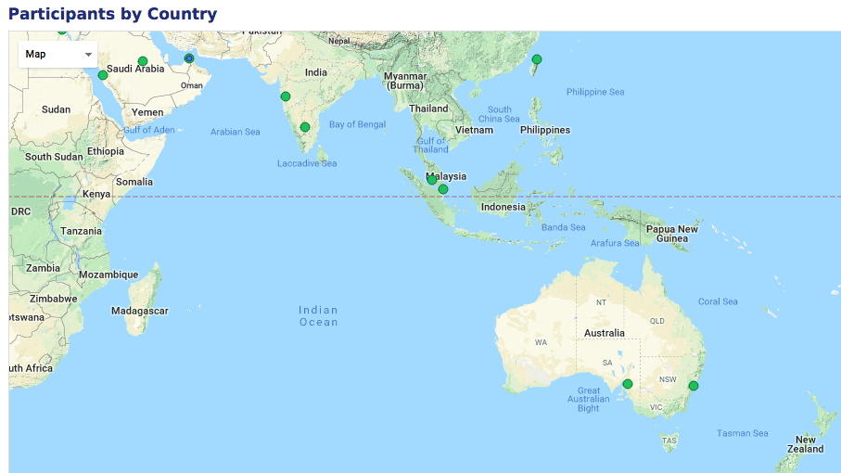
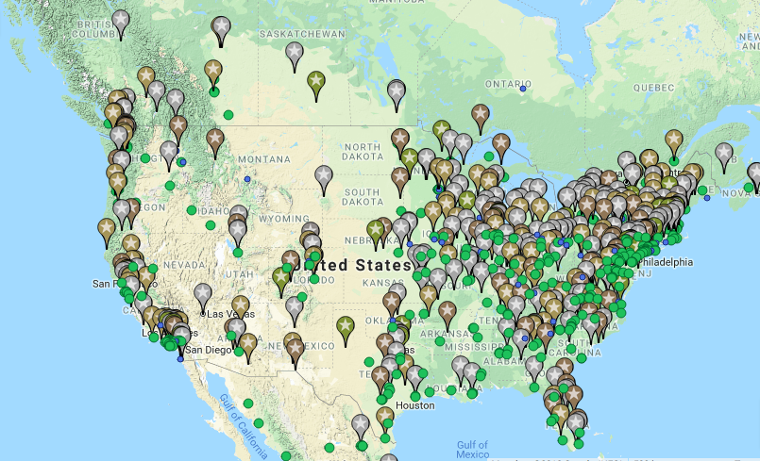
Why is New Zealand not doing Sustainability Tracking, Assessment & Rating System™(STARS) measurement framework for universities?
THERE IS NO STARS SYSTEM AT ANY UNIVERSITY IN NEW ZEALAND

Slide 30
What is the history of UC Pepper Pot-sustainability?
A History of Sustainability Initiatives at the University of Canterbury, 1970-2011 Agnete Gundersen
1989 UC Environmental Club
1993 Kakariki Environmental Group, and more clubs …
1995 founded, 1996 March is first meeting of Environment and Resource Use Committee(ERUC)
1970s, 'Ecology and Behavior' was taught at 100 level as part of a Biology course; Biol102; plus more in 80s & 90s
March 2001 istated suitable opportunity had not yet presented itself for the VC to sign the Talloires Declaration
March 2003, ERUC tabled the draft Environment Sustainability Strategy with the VC’s office where it was given a sympathetic but cautious hearing.
2007, 149 courses were identified as being potentially related to sustainability.
2008, the numbers of courses related to sustainability had decreased to 111
2010, UC signed CEMARS; Certified Emissions Measurement And Reduction Scheme
UC was the first university in the Southern Hemisphere to achieve CEMARS (Certified Emissions Measurement And Reduction Scheme) certification. CEMARS certification involves taking accountability and action against the greenhouse gas emissions (GHG) generated as a result of the university's business activities source
Notes:
http://www.canterbury.ac.nz/life/sustainability/other-uc-initiatives/energy/

Slide 31
How to change the Pepper Pot Projects of Sustainability at UC?
Sustainability Research Profile of UC
Sustainability Map of UC
Sustainability Awards program of UC
Sustainability Newsletters of UC 2014-2016
Sustainability Office Reports 2012- 2016
Edible foods growing at UC map
Waterways research of faculty & students
Green Building history of UC

Slide 32
Which University of Canterbury Chancellors supported Sustainability Measurement?
Ian Leggat 1992-1997 At this point in history students and faculty not organized for sustainability
Phyllis Guthardt ^{1998-2002 (does} March 2001 signing Talliores agreement is tabled
Robin Mann ^{2003–2008 -} March 2003, ERUC tabled their draft Environment Sustainability Strategy Initiative
Rex Williams ^{2009–2012 –} CEMARS signed; With earthquake, UC expects $17.4 million loss (ERUC stops meeting); 2010 Environment Minister Nick Smith appoints Williams one of commissioners to Environment Canterbury (E-CAN Council) to replace elected ones
John Wood ^{2012 – 2018 –} Focus → getting UC back to economic sustainability
^{Next} Chancellor 2019 – Will they have Sustainability Measurement Committment?
RESEARCH: A History of Sustainability Initiatives at the University of Canterbury, 1970-2011 – then do more research on history of UC leadership
Notes:
March 2010, after the release of the "Creech Report" the government chose to appoint a panel of commissioners to replace the elected Councillors

Slide 33
HOMEWORK→How to get beyond Pepper Pot Projects by using Kaupapa Māori ?
RESEARCH ON Web: What is University of Canterbury’s Sustainability Reporting Measurement System for its own Quadruple Bottom Line?
What is measured about PLANET-ECOLOGY of UC (last measure found 2009)?
What is measured about PEOPLE-EQUITY of UC?
What is measured about PROFIT-ECONOMICS of UC (annual reports 2016 net assets $218,770)?
What is measured about Hidden Costs of Probable Extinction Events, such as Climate Change, Natural Resource Exhaustion, Water Contamination, and so on
Notes:
p. 10 A key consideration is long-term sustainability, that is, providing flexible learning spaces that can continuously evolve to support a greater range of teaching methods, underpinned by a robust IT infrastructure.
p. 11 The University’s cash resources are significant and are mostly committed to the major construction projects on campus, with a budgeted $206 million allocated to capital projects in 2017. The net operating cash inflow of nearly $65 million — over twice that budgeted — indicates we are managing within our means and remain on track to return to a sustainable surplus in 2019
p. 29 The University Council has sponsored teaching awards that recognise sustained excellence in the area of teaching. The criteria for excellence are strict and as a result an award is not made every year. No award was made in 2016
2016 Annual-Report
p. 35 in need. In 2016, the 21 Day Challenge asked teams of students to help Niue to conserve, protect and sustainably manage its food supply with a view to becoming self-sufficient using a $10,000 budget.

Slide 34
CRITICAL about Quadruple Bottom Line
Without an agreed Kaupapa Māori methodology, university profit statement trumps the probable-extinction, people and planet measurement in New Zealand.
You end up with Pepper Pot Environmental Projects
Notes:
CRITICS: “We submit that the only way to make sense of such a claim is by formulating it (roughly) in the way we have with the Aggregation Claim, above. That is, we cannot see how it could make sense to talk about a bottom line analogous to the bottom line of the income statement unless there is an agreed-upon methodology that allows us, at least in principle, to add and subtract various data until we arrive at a net sum.

Slide 35
Thank you
Don’t be a Pepper Pot! Apply the theory and methodologies of Kaupapa Māori to develop the world’s first holistic School of Sustainability at University of Canterbury.
I have enjoyed my time in New Zealand.
Slides and books at http://davidboje.com/Canterbury

Slide 36
David Boje, past-Sustainability Council ChaiR, twice 2010-2011, 2016-2017
Welcome
Introductions
School of Sustainability is 3rd year initiative of the GREENING THE CURRICULUM program funded by President’s Excellence Initiative
SOS (School of Sustainability) is in partnership with Sustainability Council
For entire history → Click Here; PREZI

Slide 37
Sustainability Report Card - 2011
UNIVERSITY | YEAR | Overall | Administration | Climate Change/ Energy | Food/ Recycling | Green Building | Student Involvement | Transportation | Endowment Transparency | Investment | Shareholder Engagement
New Mexico State University | 2011 | C+ | A | C | C | B | D | C | B | B | D
University of New Mexico | 2011 | B | B | B | A | C | C | B | B | B | --
Colorado State University | 2011 | B+ | B | A | A | B | B | B | A | A | D
Iowa State University | 2011 | B | A | A | A | A | A | B | C | B | F
Kansas State University | 2011 | C | C | C | B | C | B | D | C | A | F
Oklahoma State University | 2011 | B- | C | A | B | B | C | A | D | A | F
Oregon State University–Corvallis | 2011 | B+ | A | A | B | A | A | A | B | A | D
Texas Tech University | 2011 | C- | F | F | C | D | D | C | B | A | --
University of Arizona | 2011 | B | B | B | B | A | B | A | A | B | F
University of Idaho | 2011 | D | C | D | D | D | D | C | F | C | F
University of Nevada–Las Vegas | 2011 | B | B | B | C | B | C | A | C | A | F
Washington State University | 2011 | C | C | B | B | C | D | B | B | C | F
University of Wyoming | 2011 | B | B | B | B | C | A | C | B | A | --

Slide 38
How Measuring Sustainability began at New Mexico State University (NMSU)?
2007 NMSU signed The American Colleges and University President’s Climate Commitment ; Climate Commitment briefing report (p. 4) concludes, “In the decades ahead, climate change will threaten the peace and stability of the planet and rank at the top of the list of national security concerns.”
2009 NMSU earns C- on GREEN REPORT CARD, with F’s for student involvement & endowments
2010 NMSU signed Talloires Declaration agreement. Talloires Declarations includes a ten-point action plan for incorporating environmental sustainability in education and research. Action item 9 is to broaden service and outreach for sustainability, nationally and internationally.
2010 NMSU earns C+ on GREEN REPORT CARD, and participating no peer institutions has above a B+
2011 Boje January joins Faculty Senate & February gets memorial passed to create Sustainability Council and start measuring with STARS (AASHE) system, by Sept 11 2011 NMSU earns Bronze Star
2012 Nov 30th NMSU earns Gold Star rating in STARS AASHE measuerment
2017 NMSU earns renewal of it Gold Star sustainability rating from STARS AASHE

Slide 39
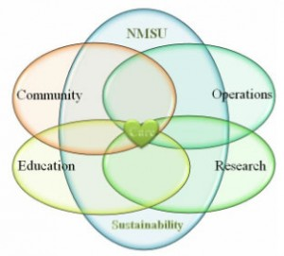
Research team met with Chancellor & Provost to get buy-in 2011

Slide 40
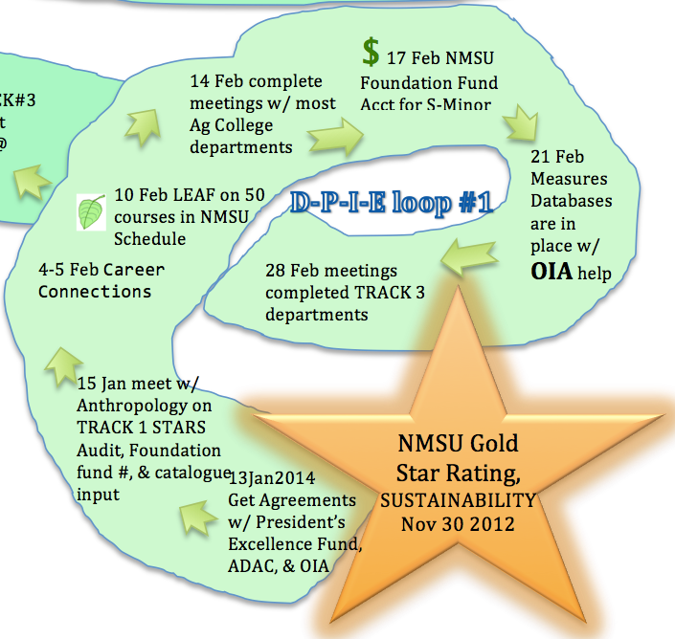
Boje’s Diagnosis-Projects-Implementation-Evaluation (DPIE) #1 to envision a SCHOOL OF SUSTAINABILITY

Slide 41
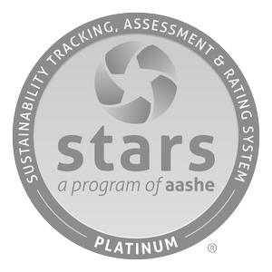
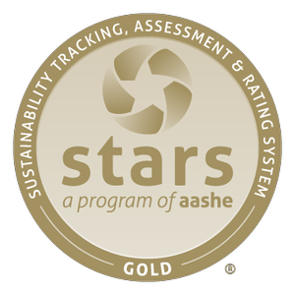
Click here for NMSU’s STARS report
We use STARS to measure People, Planet, and Profit
New Mexico State University’s Sustainability Council is organized around STARS
Sustainability Tracking, Assessment & Rating System™

Slide 42
ER-5: Sustainability Course Identification
ER-6: Sustainability-Focused Courses
ER-7: Sustainability-Related Courses
ER-8: Sustainability Courses by Department
ER-9: Sustainability Learning Outcomes
ER-10: Undergraduate Program in Sustainability
ER-11: Graduate Program in Sustainability
ER-12: Sustainability Immersive Experience
ER-13: Sustainability Literacy Assessment
ER-14: Incentives for Dev. Sustainability Courses
RESEARCH
ER-15: Sustainability Research Identification
ER-16: Faculty Involved in Sustainability Research
ER-17: Departments Involved in Sustainability Research
ER-18: Sustainability Research Incentives
ER-19: Interdisciplinary Research in Tenure and Promotion AC 9: Academic Research*
AC 10: Support for Research*
AC 11: Access to Research*
education & research of Sustainability Council
Education
AC 1: Academic Courses
AC 2: Learning Outcomes*
AC 3: Undergraduate Program*
AC 4: Graduate Program*
AC 5: Immersive Experience*
AC 6: Sustainability Literacy Assessment
AC 7: Incentives for Developing Courses
AC 8: Campus as a Living Laboratory*
ER-1: Student Sustainability Educators Program
ER-2: Student Sustainability Outreach Campaign
ER-3: Sustainability in New Student Orientation
ER-4: Sustainability Outreach and Publications
Tier2-1: Student Group
Tier2-2: Organic Garden
Tier2-3: Model Room in a Residence Hall
Tier2-4: Themed Housing
Tier2-5: Sustainable Enterprise
Tier2-6: Sustainability Events
Tier2-7: Outdoors Program
Tier2-8: Themed Semester or Year

Slide 43
Purchasing
OP 12: Electronics Purchasing
OP 13: Cleaning Product Purchasing
OP 14: Office Paper Purchasing
OP 15: Inclusive and Local Purchasing
OP 16: Life Cycle Cost Analysis
OP 17: Guidelines for Business Partners
Transportation
OP 18: Campus Fleet*
OP 19: Student Commute Modal Split*
OP 20: Employee Commute Modal Split
OP 21: Support for Sustainable Transportation
Waste
OP 22: Waste Minimization
OP 23: Waste Diversion
OP 24: Construction and Demolition Waste Diversion*
OP 25: Hazardous Waste Management
Water
OP 26: Water Use
OP 27: Rainwater Management
OP 28: Wastewater Management
OPERATIONS
Air & Climate
OP 1: Greenhouse Gas Emissions
OP 2: Outdoor Air Quality
Buildings
OP 3: Building Operations and Maintenance*
OP 4: Building Design and Construction*
OP 5: Indoor Air Quality
Dining Services
OP 6: Food and Beverage Purchasing*
OP 7: Low Impact Dining*
Energy
OP 8: Building Energy Consumption
OP 9: Clean and Renewable Energy
Grounds OP 10: Landscape Management*
OP 11: Biodiversity*

Slide 44
PAE
Coordination, Planning & Governance
PA 1: Sustainability Coordination
PA 2: Sustainability Planning
PA 3: Governance
Diversity & Affordability
PA 4: Diversity and Equity Coordination
PA 5: Assessing Diversity and Equity
PA 6: Support for Underrepresented Groups
PA 7: Support for Future Faculty Diversity
PA 8: Affordability and Access
Health, Wellbeing & Work
PA 9: Employee Compensation
PA 10: Assessing Employee Satisfaction
PA 11: Wellness Program
PA 12: Workplace Health and Safety
Investment
PA 13: Committee on Investor Responsibility*
PA 14: Sustainable Investment*
PA 15: Investment Disclosure*
INNOVATION (IN)
Campus Engagement
EN 1: Student Educators Program
EN 2: Student Orientation*
EN 3: Student Life
EN 4: Outreach Materials and Publications
EN 5: Outreach Campaign
EN 6: Employee Educators Program
EN 7: Employee Orientation
EN 8: Staff Professional Development
Public Engagement
EN 9: Community Partnerships
EN 10: Inter-Campus Collaboration
EN 11: Continuing Education*
EN 12: Community Service
EN 13: Community Stakeholder Engagement
EN 14: Participation in Public Policy
EN 15: Trademark Licensing*
EN 16: Hospital Network*

Slide 45
Water at NMSU = Pepper Pot Environmental Projects
THE DARK SIDE of NMSU UN-SUSTAIN-ABILITY
NMSU uses 3 million gallons of water a day, and does not conserve because …
One million to water grounds that are trees and lawns unsuitable for desert habitat
One million for people uses without water conservation plan
One million for golf course that does not recycle its water, and is about to expand from 18 to 27 holes

Slide 46
Profit Trumps All the Pepper Pot Projects
Dark Side of PROFIT
Profit is more important than People, Planet, and Probable Extinction events
Republican Governor budget vetoes starved education funding, and governor appointed Board of Regents initiated People downsizing
Faculty and staff has been downsized while paying Deloitte reengineering consultants $622,700 for plan to do downsizing using Henri Fayol’s Span of Control reorganization
Reorganization is done top-down by TEAM 6 appointed committee
Management department down from 16 to 6 faculty, no new Ph.D. class this year, but promises of one to come

Slide 47
Yes, its Gold Rated
Dark Side of Reporting
However, many aspects are not ACTUALLY implemented
Momentum to create School of Sustainability sidelined until economic situation turns around
Money from Energy Savings is ploughed into budget deficits
The Regents favor investment in more golf and athletics
NMSU building shopping mall and hotel with its new golf course to attract students in MALLIFICATION of UNIVERSITY
It’s a Pepper Pot

Slide 48
FACTS
SOS
FOOTPRINTS: The carbon footprint (CF) and ecological footprint (EF) of USA person are the highest in world. Average USA person’s carbon footprint is 20 tons carbon dioxide per year compared to 1.1 tons for average person in India.
CARBON DIOXIDE EMISSION: 5% of the world’s population living in the USA contributes 20% of carbon dioxide emissions and consumes 30% of the world’s resources.
Notes:
GREENHOUSE GASSES (GHGs: Carbon Dioxide, Methane, Nitrous Oxide): Average USA person generates > 10 times the GHG as the average Chinese
GLOBAL CARBON EMISSION: Average USA person generates 10 tons per person per year, but average person elsewhere produces only 1 ton per person per year

Slide 49
We use STARS to measure People, Planet, and Profit
What is needed is an analysis of the AASHE member universities reports of sustainable development to a critical accounting and a hidden cost analysis of silences, marginalizations, profit oriented conversions of people and planet, and reflexivity on the claims made

Slide 50
Note measuring the CARBON FOOTPRINT
Total greenhouse gases produced by human activities, expressed in equivalent tons of carbon dioxide (CO2).
Natural CO2 cycle→CO2 gets re-absorbed by plants and trees

Slide 51
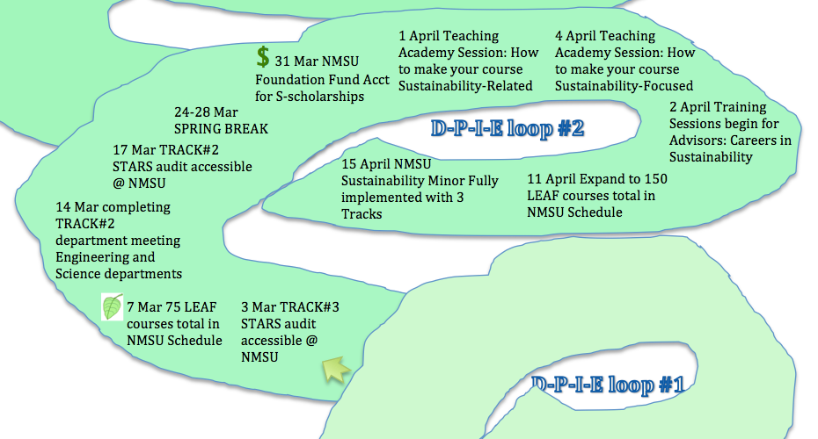
Boje’s DPIE 2

Slide 52
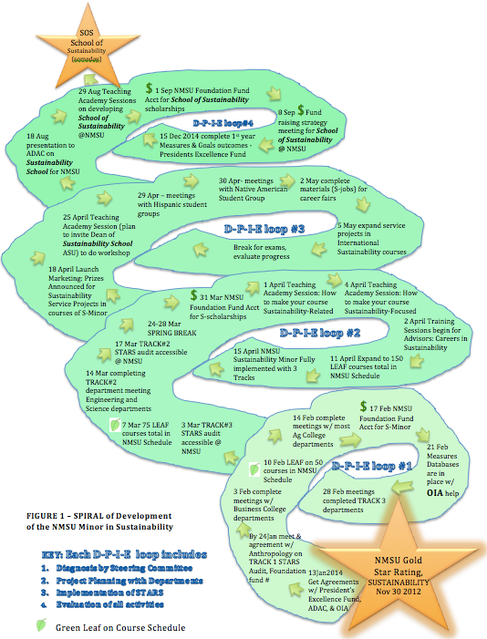

Slide 53
What happened to this Definition
The Oxford English Dictionary also defines the term "environmental sustainability" as "the degree to which a process or enterprise is able to be maintained or continued while avoiding the long-term depletion of natural resources".

Slide 54
SOS

Slide 55
LEGs of ASU SOS Graduate Studies
Master of Arts This traditional master’s programs is best suited to students interested in knowledge generation and designing new ways to address sustainability challengesMaster of Science This traditional master’s programs is best suited to students interested in knowledge generation and designing new ways to address sustainability challenges, and requires a thesis or academic paper as a culminating experience. The MS is designed for those inclined toward the natural sciences, economics, engineering, or related fields.
Master of Sustainability Solutions The MSUS is an applied master’s degree in sustainability, designed to prepare students to apply sustainability
Master of Sustainability Leadership The cohort-based MSL is a fully online degree program that teaches organizational leadership skills through the lens of sustainability
Executive Master of Sustainability Leadership The EMSL is a hybrid in-person and online sustainability degree program that teaches organizational leadership skills through the lens of sustainabilityDoctor of Philosophy The PhD in Sustainability allows students to focus on problems of interest to them, drawing upon relevant knowledge from a variety of disciplines. PhD students may be admitted with either a bachelor’s or a master’s degree.

Slide 56
Legs – ASU SOS Undergrad
Bachelor of Arts
The BA in Sustainability is an undergraduate degree best suited to students interested in social sciences, humanities, planning or related fields. Students learn concepts and methods relevant to the sustainability of environmental resources and social institutions, evaluating the sustainability of environmental institutions, legal frameworks, property rights and culture.
Bachelor of Science
The BS in Sustainability is an undergraduate degree best suited to students inclined toward natural sciences, economics, engineering or related fields. Students learn concepts and methods relevant to the sustainable use of environmental resources, evaluating the sustainability of technology, the built environment and environmental regulations and policy.

Slide 57
The Story told in Numbers

Slide 58
REVIEW: Is Sustainability Failing?
“The word "sustainability" should be banned from technical and political discourse. It has become so corrupted as to not only be meaningless, but to actually obscure the real issues that must be dealt with” (The Guardian)

Slide 59
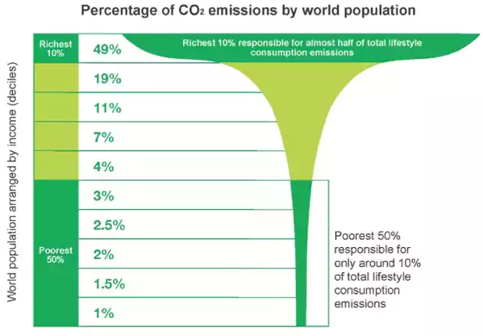
Notes:
https://www.theguardian.com/environment/2015/dec/02/worlds-richest-10-produce-half-of-global-carbon-emissions-says-oxfam

Slide 60
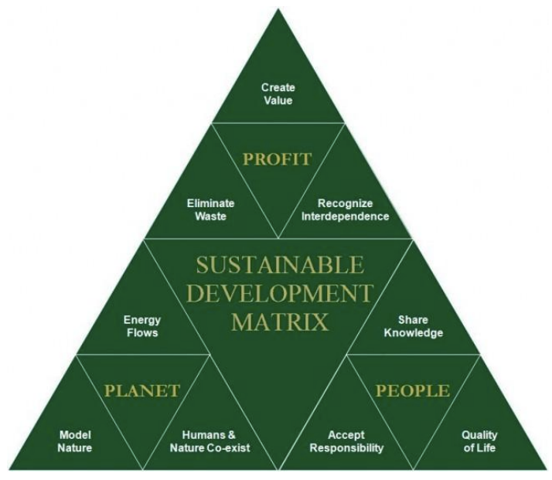
Triple Bottom Line fantasy - 3BL
Notes:
http://www.chinauscenter.org/attachments/0000/0001/CradleDesign.pdf

Slide 61
Arguments against School of Resilience
“The concept of resilience has been criticized as an abstract structural-functionalist notion that fails to account for community heterogeneity and power relationships (Berkes and Ross 2013; Cote and Nightingale 2011; Folke 2006; Leach 2008; Turner 2010)” source

Slide 62
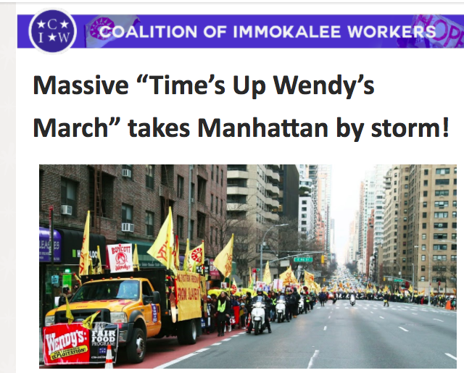
2,000 turnout in support of farmworkers’ Freedom Fast in NYC

