Slide 1
From Western Narrative to IWOK Māori living story: Forecaring for Human Extinction
David M. Boje
See http://davidboje.com/Canterbury for books & slides
Three Crosses

Slide 2
Hau
The Hau of a person, of land, of mountain, river, is its vital essence or power
I come from New Mexico called ‘The Land of Enchantment’
I am from Organ Mountain Range
I am from the Rio Grand River
I love Koru – Spiral of Silver Fren Leaves

Slide 3
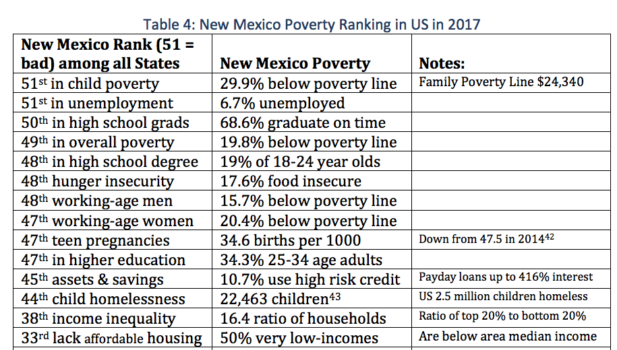
[In TRUMPLAND] there is a massive amount of economic anxiety. Unemployment is much too high, wages and income are too low, millions of Americans are struggling to find affordable health care and the gap between the very rich and everyone else is growing wider… Many of our people are physically exhausted as they work the longest hours of any industrialized country and have far less paid vacation time than other major countries
Notes:
https://www.huffingtonpost.com/rep-bernie-sanders/what-can-we-learn-from-de_b_3339736.html?utm_hp_ref=tw
Denmark is a small, homogenous nation of about 5.5 million people. The United States is a melting pot of more than 315 million people. No question about it, Denmark and the United States are very different countries. Nonetheless, are there lessons that we can learn from Denmark?
In Denmark, social policy in areas like health care, child care, education and protecting the unemployed are part of a “solidarity system” that makes sure that almost no one falls into economic despair. Danes pay very high taxes, but in return enjoy a quality of life that many Americans would find hard to believe.
Health care in Denmark is universal, free of charge and high quality. Everybody is covered as a right of citizenship. The Danish health care system is popular, with patient satisfaction much higher than in our country. In Denmark, every citizen can choose a doctor in their area. Prescription drugs are inexpensive and free for those under 18 years of age. Interestingly, despite their universal coverage, the Danish health care system is far more cost-effective than ours.
In Denmark, more than 75 percent of the people are members of trade unions. In America today, as a result of the political and economic power of corporate America and the billionaire class, we are seeing a sustained and brutal attack against the economic well-being of the American worker.

Slide 4
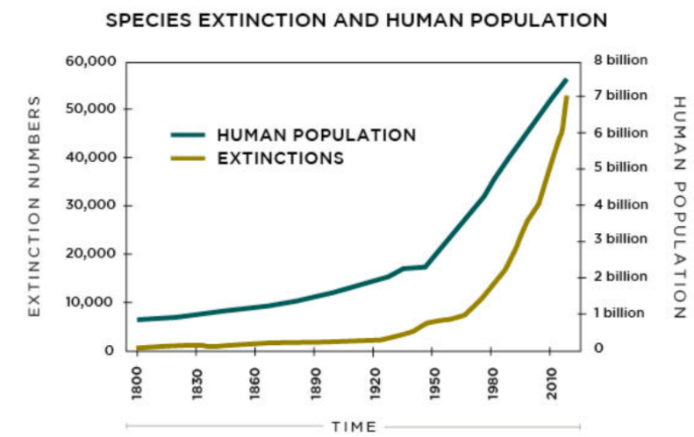
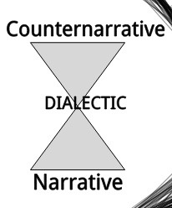
Western Narrative and Counternarrative is DIALECTIC
“We intend to offer a counter-narrative to those accounts of specific species extinction … that places humanity’s ways of organising at the core and recognises that only fundamental re-appraisal of (western) humanity’s current taken-for-granted narratives offers any hope for biodiversity and sustainability” (Gray & Milne, 2018)
“sustainability [will] hasten humanity’s extinction; whilst modernity, too, seems intent upon achieving this very aim through a destruction of ecology in the name of self-congratulatory accounts of human progress” (Gray & Milne bracket mine)
For every Narrative there is at least one counternarrative!
Notes:
Gray, R., & Milne, M. J. (2018). Perhaps the Dodo should have accounted for human beings? Accounts of humanity and (its) extinction. Accounting, Auditing & Accountability Journal, (just-accepted), 00-00.
Living Planet Index (LPI) argues that between 1970 and 2010 terrestrial species have declined by 39%; freshwater species by 76% and marine species by 39%. 82%
Scott, J. M, (2008) Threats to Biological Diversity: Global, Continental, Local. Shifting Baselines and
New Meridians: Water, Resources, Landscapes, and the Transformation of the American West (Summer
Conference, June 4-6). http://scholar.law.colorado.edu/water-resources-and-transformation-of-American-West/15

Slide 5
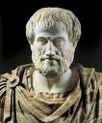
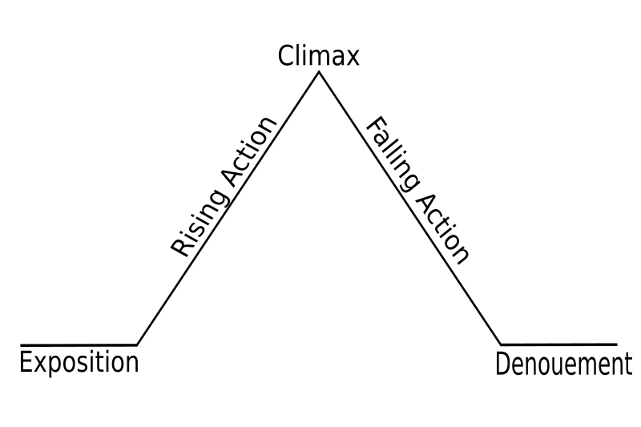
Western NARRATIVE IS too LINEAR
Narrative requires story to be “… a whole … a whole is that which has beginning, middle, and end” (Aristotle, 350 BCE: 1450b: 25, p. 233).
Notes:
See articles by Boje, Rosile and colleagues on Enron.

Slide 6
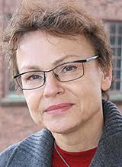
Western Narrative Plot too Petrified
Barbara Czarniawska (1997: 78)→ narrative “… consists of a plot comprising causally related episodes that culminate in a solution to a problem.”
“… every narrative becomes new with each retelling, and the ‘petrification’ of stories is not the result of the myopia of the researcher but of intense stabilizing work by the narrators” in organizations” (2004: 38)
Notes:
Czarniawska, Barbara (1997a.) A Narrative Approach to Organization Studies, London: Sage
Czarniawska, Barbara (1997b.) Narrating the Organization: Dramas of Institutional Identity, Chicago: University of Chicago Press
Czarniawska, B. (1999) Writing Organization, Oxford: Oxford University Press
Czarniawska, B. (2004) Narratives in Social Science Research, London: Sage

Slide 7
Weick-Sensemaking Narrative is too Retrospective & Linear
“typically searching for a causal chain”, “the plot follows - either the sequence beginning-middle-end or the sequence situation-transformation-situation. But sequence is the source of sense” (Weick, 1995: 128)
Notes:
Polkinghorne (1988: 15) follows the structural functionalist approach of treating “narrative as a cognitive scheme.”

Slide 8
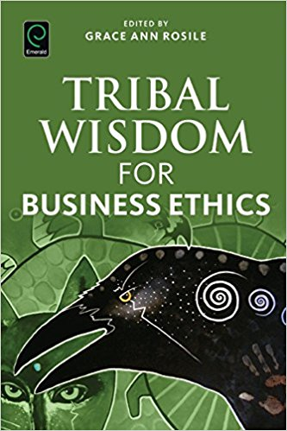
Western Narrative needs to learn IWOK – Indigenous Ways of Knowing → Living Story Webs of Relations to Community & Earth

Slide 9
Western Narrative can learn →“Tikanga”
Indigenous wisdom as everyday living story practice
IWOK = Indigenous Ways of Knowing
Notes:
8 is paths of life in infinity loop with one twist
Triple twist is cultrues joining to expiirence friendship and loyalty for life in balance with sky earth, sea, plants, soil animals.

Slide 10
Kaitiakitanga
What is Mātauranga Māori Heart of Care?
An obligation to implement care and protection of all forms of life, and to look after and respect the earth mother and sun father

Slide 11
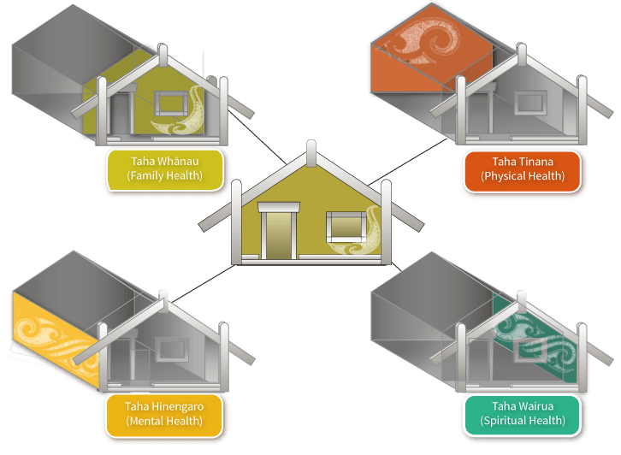
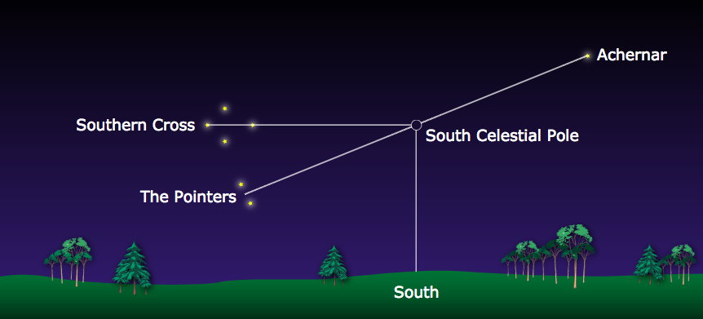
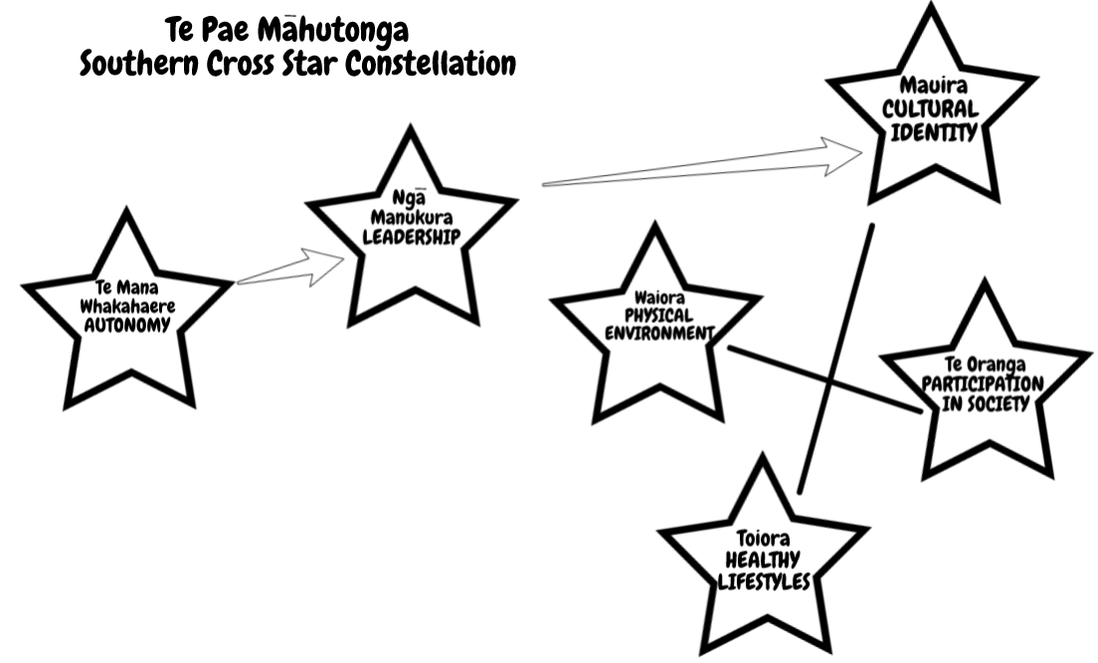
Mason Durie’s ANTENARRATIVE
By 2051 Māori population will almost double to close to one million, or 22% of the total New Zealand population, and 33% of all children in the country will be Māori.
Te Whare Tapa Whā
Ngā Tini Whetū: Navigating Māori Futures with the Huge Scale of Globalization, its technological changes, and climate change!
where health & socioeconomic well being are inseparable

Slide 12
Living Story IWOK
Māori storytelling to share and enrich understanding re-indiginization recovery from Colonialism, and Neo-Colonialism Globalization
Joe Harawira Māori storyteller about umbilical cord connection to Living Earth

Slide 13
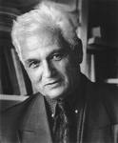
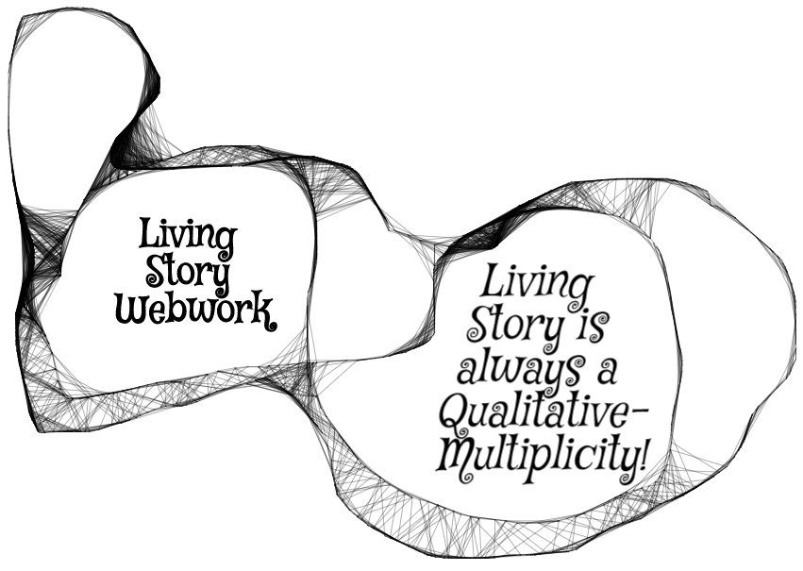
Living Story is Reflexivity Webwork
“Each story is at once larger and smaller than itself, includes itself without including (or comprehending) itself, identifies with itself even as it remains utterly different…” (1979: 82).; Derrida , treats story more in terms of their reflexivity web of story to other stories (99-100).
Notes:
Derrida (1979: 99-100), for example, treats story more in terms of their reflexivity web of story to other stories.

Slide 14
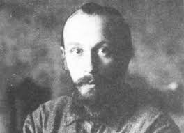
Mikhail Bakhtin
There is something called a 'dialogized story' (Bakhtin, 1981: 25)
How does one living story lead to another, to yet another, as webwork of relationality unfolds?
“Narrative genres are always enclosed in a solid and unshakable monological framework” - Bakhtin (1973: 13)

Slide 15
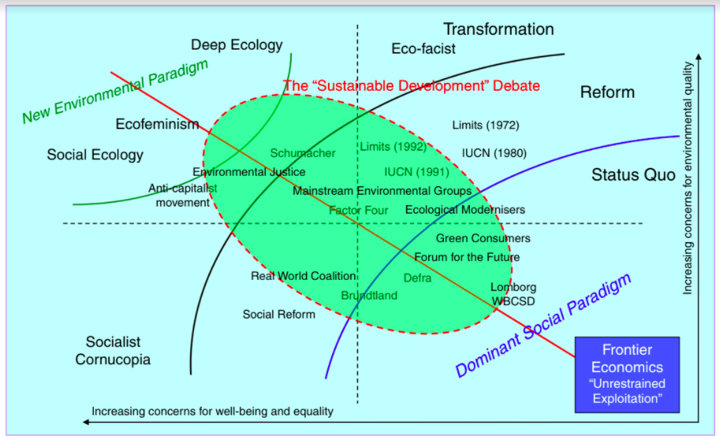
Byrch, C., Milne, M. J., Morgan, R., & Kearins, K. (2015). Seeds of hope? Exploring business actors’ diverse understandings of sustainable development. Accounting, Auditing & Accountability Journal, 28(5), 671-705.
IWOK
SMALL SCALE = BEAUTIFUL
TRIPLE BOTTOM LINE

Slide 16
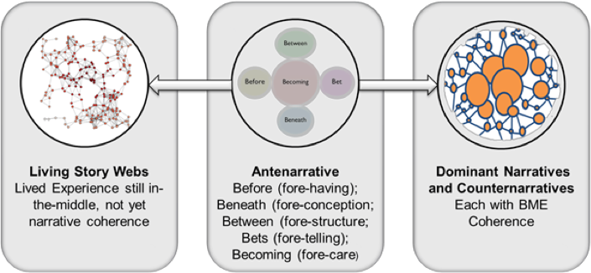
The Futurist perspective, too, seems consistent with these critiques, with an abandonment of economic growth, and a requirement for behavioral rather than technical change. There are elements in this perspective, however, that suggest change may be beyond human agency; an ecological crisis may force a radical re-learning that potentially excludes human existence…

Slide 18
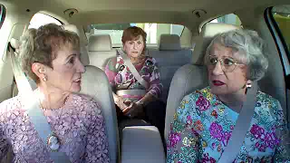
If you want to know about Corporate Narrative see VW Ads
VW Diesel car commercials

Slide 19
2017
Federal prosecutors announced criminal charges against six Volkswagen executives for their roles in the company's emissions-cheating scandal (Jan 11).
calls it a corporate culture fraud involving hundreds of VW executives, engineers, and managers.
TOTAL $25 Billion in Fines + civil suits & buyback 550,000 cars

Slide 20
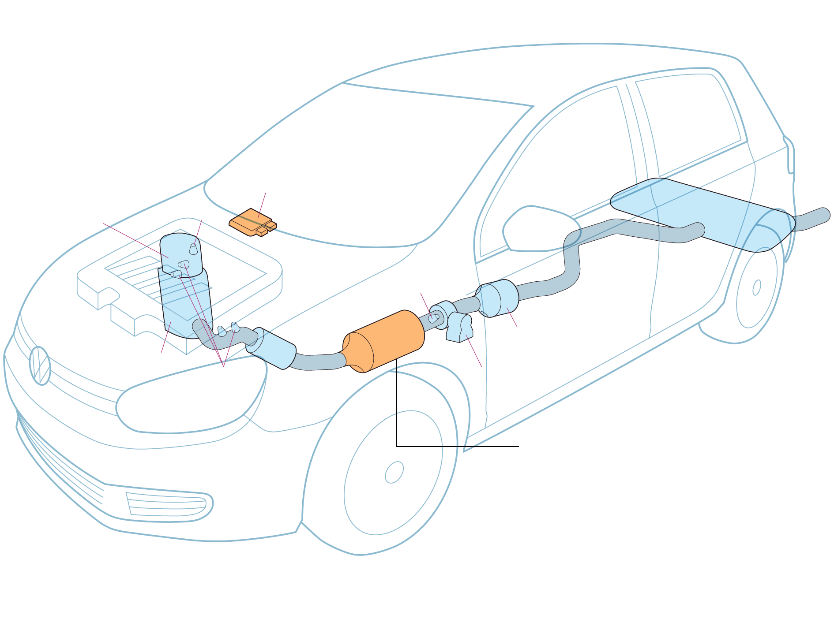
Main computer
Engine control module senses when car in LAB TEST because steering wheel does not move
Muffler
Diesel oxidation
catalytic converter
& Oxygen Sensor
H2S Catalytic Convert
Nitrogen oxide trap - Reduces toxic emissions. Engine ussse more fuel for trap to work. Computer save fuel by allowing more pollutants to pass through exhaust.
Temperature Sensors

Slide 21
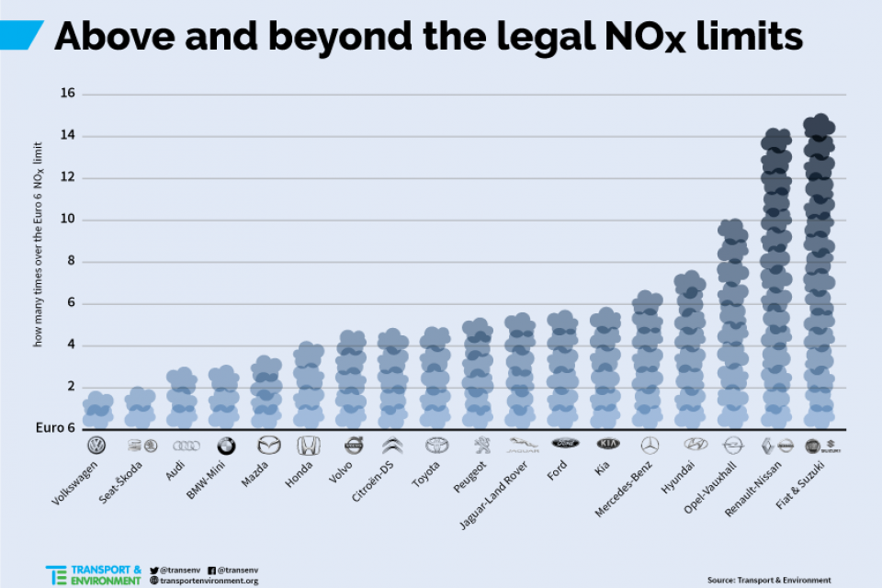
VW is conglomerate of 10 other brands including Skoda, Audi, Opel, Porsche, Bentley …
Now look at how many other diesel companies are above limits
Notes:
https://www.transportenvironment.org/sites/te/files/styles/main_image/public/pictures/AboveNOxLimits%20%281%29.png?itok=dqe0m_r0
Note: several of these are owned by VW
VW is conglomerate of 10 other brands including Skoda, Audi, Opel, Prosche, Benley

Slide 22
8,000 VW Diesel sold in NZ
There will be no compensation for Kiwi customers affected by last year's revelations the company cheated on diesel emissions tests, Volkswagen New Zealand's general manager says.
Why?

Slide 23
Is this ETHICS of EQUALITY PRINCIPLE?
Notes:
'Wealth: Having it all and wanting more'
Published 19 January 2015
Author: Deborah Hardoon, Senior Researcher, Oxfam GB
There were two main external data sources used:
1 - Credit Suisse Global Wealth Databook 2014
https://www.credit-suisse.com/uk/en/news-and-expertise/research/credit-suisse-research-institute/publications.html
Data was extrcated from the 2014 report and a STATA file which included revised calculations for global wealth and wealth shares dating back to 2000.
All data from Credit Suisse is highlighted in blue in this file

Slide 24
Purchasing-Power-Parity PPP
WB’s narrative→ life of the poor is improving with globalization; world has met and surpassed 1st Millennium Development Goal—to cut the 1990 poverty rate in half by 2015, moving 1.1 billion people out of extreme poverty, five years ahead of schedule, in 2010.
WB adjusts poverty line in each particular country.
2008, WB made it $1.25 a day based on 2005 purchasing-power parity (PPP) in developing countries. WB figure of $1.25 a day as poverty line in least developed nations (LDN’s) 1.3 billion of 7.4 billion people on the planet live in extreme poverty.
By 2015, WB made it $1.90 per day with 2100 PPP. With this way of calculating the WB can say 10% of world lives in extreme poverty.
WB makes it look like Adam Smith 1777 Wealth of Nations market works for global capitalism that is providing for affordable housing, food, and health for all but extreme poverty. But is this the case?
Notes:
World Bank accessed Feb 21 2018 at https://data.worldbank.org/indicator/SI.POV.DDAY
World Bank Oct 2 2016, accessed Feb 21 2018 at http://www.worldbank.org/en/topic/poverty/overview

Slide 25
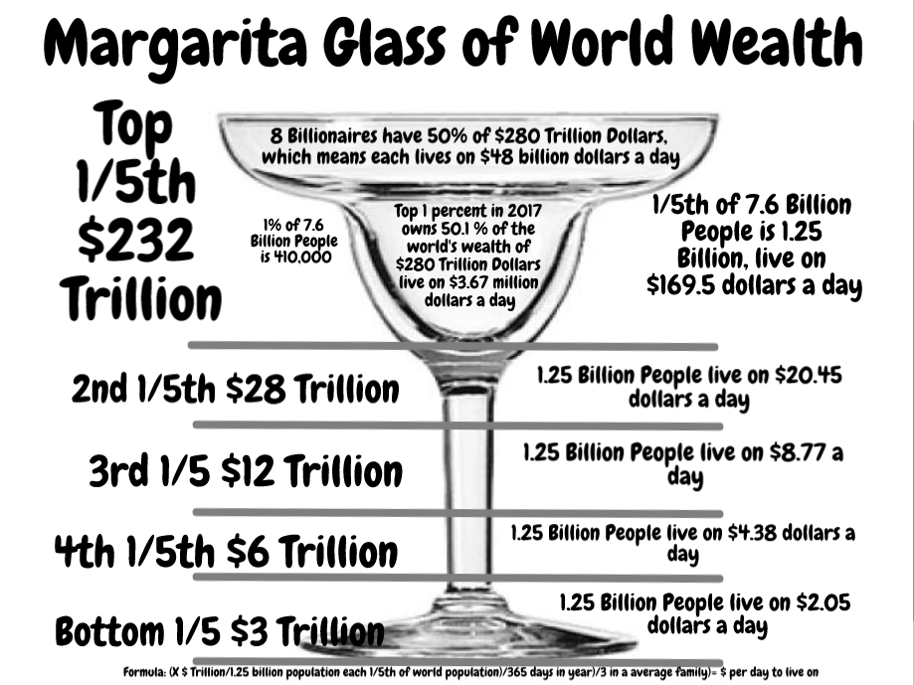
Is this Equal-Opportunity?

Slide 26
GDP is not measure of anything relevant to ecology
The GDP rankings of nations is “ecologically irrelevant, since they do not account for the possible absolute increases in material flows from the ecosphere to the economy” (Milne & Gray, 2013: 23).

Slide 27
GDP & Happy Planet Index (HPI) for countries Boje visiting on 2018 sabbatical

Slide 28
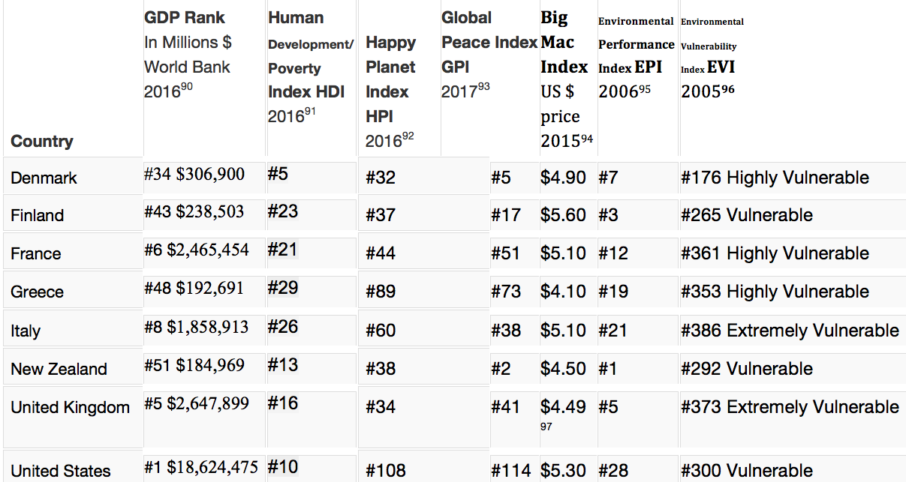
Various Globalization Indices

Slide 29
US companies dominate the 2015 Global 100 index of the world’s 100 most sustainable corporations

Slide 30
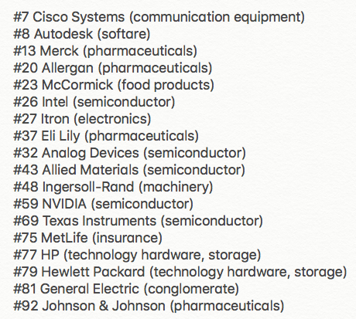
Global 100 2018 # US corporations in top 20 dropped to 4, with 18 in top 100

Slide 31
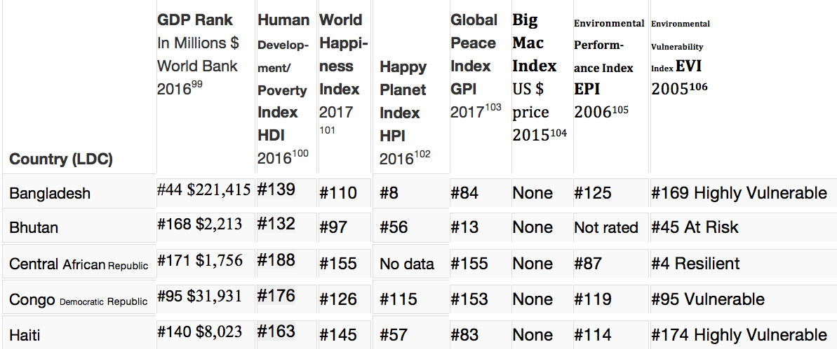
What about Less Developed Nations LDV’s

Slide 32
Below the Happy Planet Index-Iceberg

Slide 33
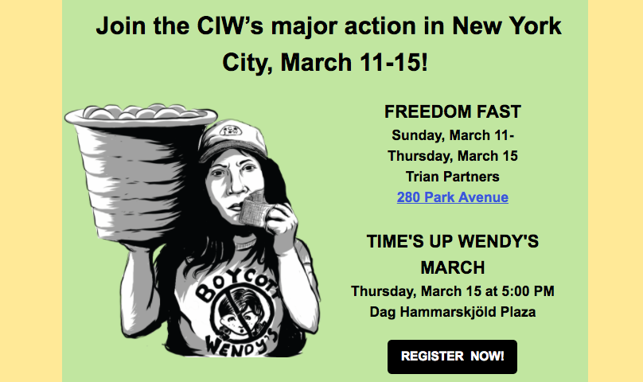
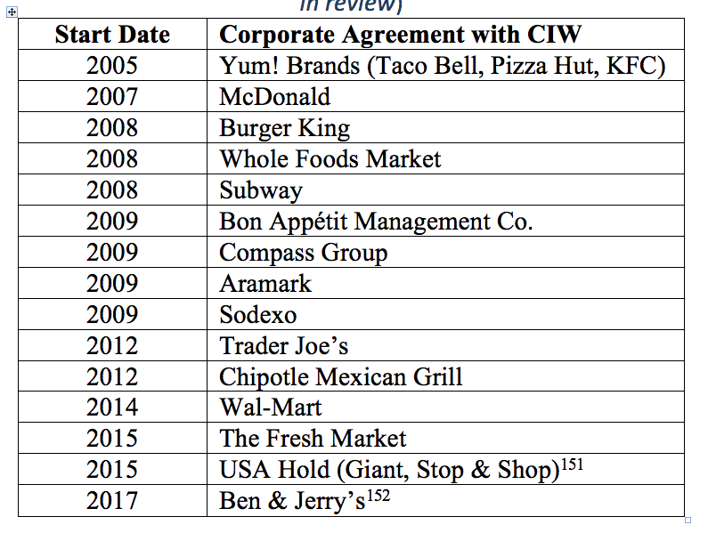
How to turn it around with worker-driven Corporate Social Responsibility?

Slide 34
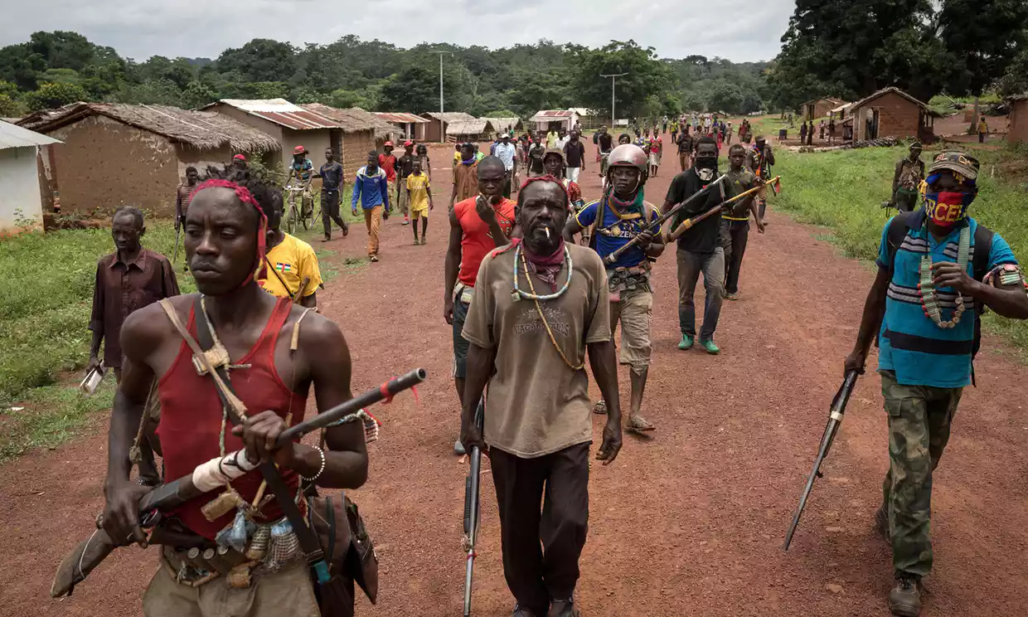
Notes:
Looting, escalating violence, and more death by rival rebel groups in CAR, as aid organizations withdrew at height of malaria season. One result is women are denied a safe place to give birth. Armed rebels entered a hospital where 7,000 sought refuge, and killed a baby held by its mother. 6 Red Cross volunteers were hilled in an attack on a health center. Health workers have to negotiate with armed people to gain access to villages. Stephen O’Brien a UN emergency relief coordinator, said this is “the early warnings of genocide”.
'People are dying': violence forces aid workers out of Central African Republic, by Rebecca Ratcliffe
Fri 1 Sep 2017 06.04 EDT
Last modified on Mon 11 Dec 2017, accessed Feb 16 2018 at https://www.theguardian.com/global-development/2017/sep/01/people-are-dying-violence-forces-aid-workers-out-of-central-african-republic

Slide 35
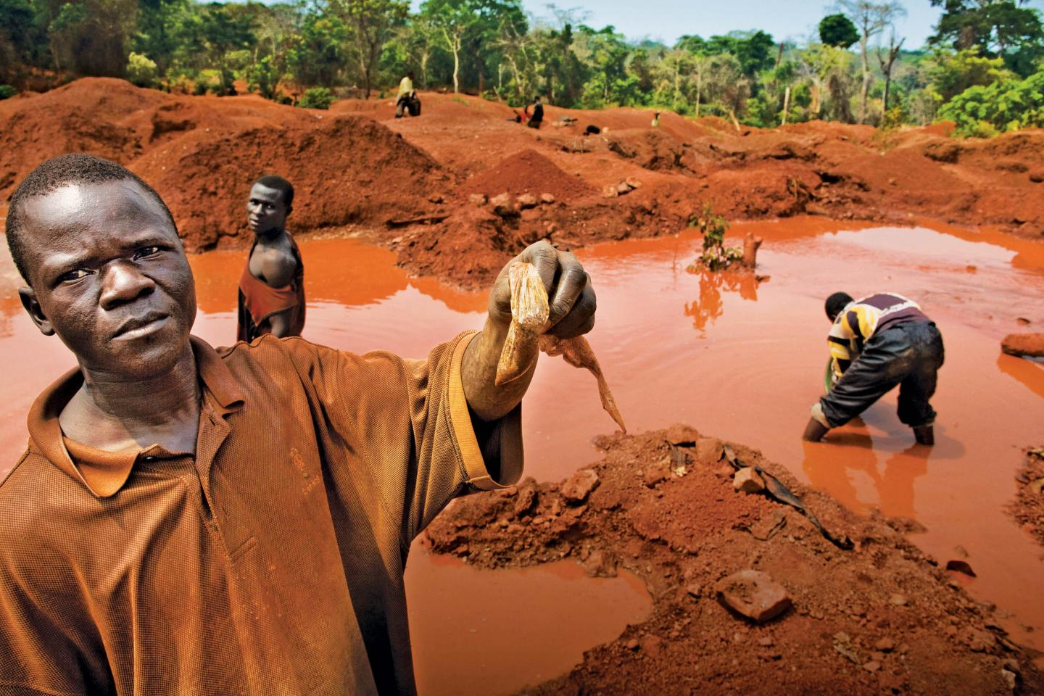
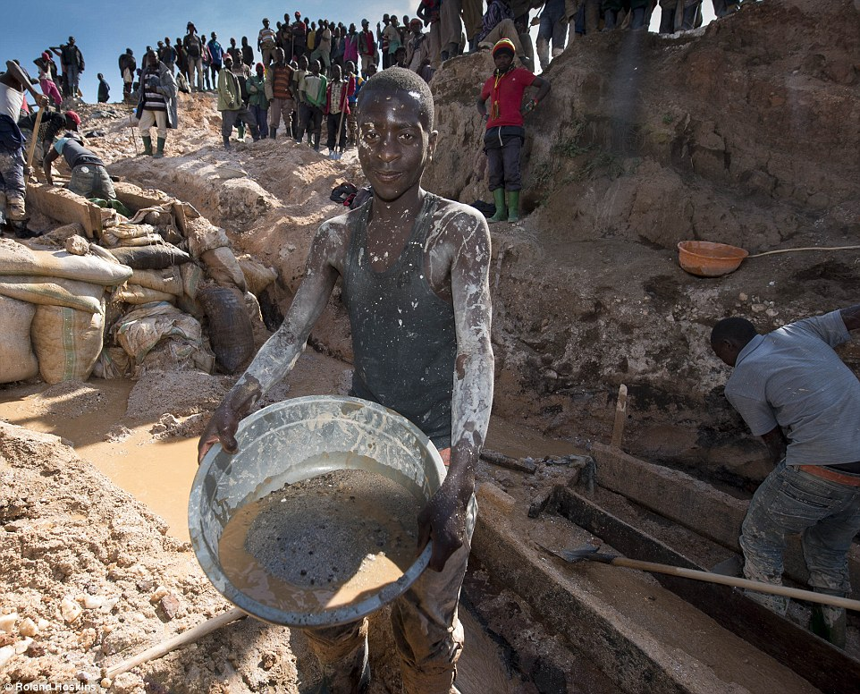
Democratic Republic on of Congo (DRC)
Notes:
2nd picture http://www.dailymail.co.uk/news/article-3280872/iPhone-mineral-miners-Africa-use-bare-hands-coltan.html

Slide 36
Cell-phone’s 3T’s + Gold
CONFLICT MINERALS
Tin is used as a solder on laptop and cellphone circuit boards
Tungsten makes your cellphone vibrate
Tantalum stores electricity on your cellphone
Gold is used to coat the cellphone wiring

Slide 37
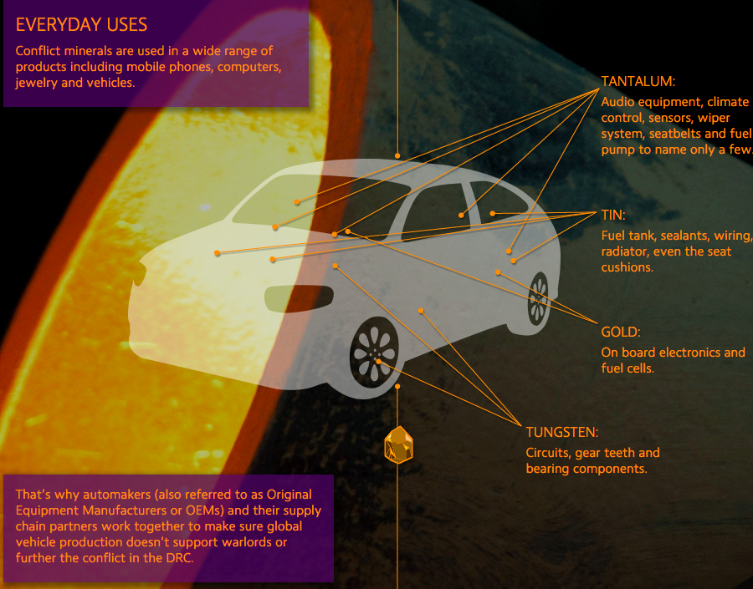
Untold story of 3T’s in Cars

Slide 38
Dieselgate Debriefing
Each exchange, triadic actors rewrote and revised the narrative-counternarrative
Each negation came a counter-negation
Untold stories (Hitchin, 2014) would surface, and get told
Storytelling system of negating each other’s negations began to break down
Those in-the-know were obstructing and obfuscating
VW executives, engineers, marketing and ad departments, and legal staff not-in-the-know.
Questions were being asked, and not answered very well. In a chain of command, its accepted practice, not to ask too many embarrassing questions.

Slide 39
Analyzing Corporate Narratives
VW’s TDI clean diesel became the ‘Green Car of the Year’ and had it all: not too expensive, great mileage, and unlike diesel engines of the past it was clean.
It is a Beginning-Middle-End (BME narrative) linear plot
It is retrospective narrative sensemaking (Weick, 1995).
It makes propositional claims

Slide 40
Narrative-Counternarrative Dialectic
Counternarrative (Negation). VW diesel been proactvcely, systematically reengineered to deceive emission testing.
Narrative (Negation of their negation). VW conforms to European emission laws that say it can shut off emission device if engine is threatened or if unsafe for occupants.
Counternarrative (Negation of their negation). Defeat devices are illegal in US and Europe.
Narrative (Negation of their negation). Most VW employees had no idea a defeat device was installed. We will take it out
Counternarrative (Negation of their negation). Hey, your software fix did not remove defeat device.

Slide 41
Conclusion
Post-Fordist discourse is being overlaid with sustainability development business economic discourse, and merged with globalization development progress narrative, and regurgitated in management and organization pedagogy. The counternarratives of deep ecology, environmental justice and IWOK get little play in the business colleges of USA.

Slide 42
In Sum
The lifestyle of US billionaires is unsustainable. The lifestyle of middle US citizens is unsustainable. Any one with any eco-science training can testify to the unsustainable impacts of business on water, air, soil, biodiversity, and climate change.

Slide 43
THE END - Questions
Kaua e takahia te mana o te tangata → People are often the experts in their own living stories (my translation)
“Nga Huia Te Awe Kotuku – Don’t trample on the integrity [mana] of the people” → Tuhiwai Smith 1999: 120, bracketed addition, mine

Slide 44
LIVING STORY EXERCISE
In Pairs, One person tells a Living Story WEB that is several of these: Dispersed, Polylogical, Web of Relationships, Multi-plotted, Non-linear, Now & Here, In the Middle; living stories are relationalities
LISTENER/ELICITOR- How does one living story lead to another, to yet another, as web of relationality unfolds

Slide 45
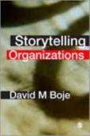
BAKHTIN

Slide 46
Table 1.1 Antenarrative Approaches
1 .Deconstruction | It is antenarrative in action, in ongoing acts of narrative self-deconstruction. The narrative is not fixed, but moves and flows with networks of embedded meaning. The analyst joins in the antenarrative by becoming part of the ongoing textual deconstruction of interpenetrating processes and weaves of reconstructing, unravelling and constructing stories.
2. Grand narrative | It is antenarrative in how one story can be told in ways that erase a prior way of telling the story. The ambition is to shatter grand narrative into many small stories and to problematize any linear mono-voiced grand narrative of the past by replacing it with an open polysemous (many-meanings) and multivocal (many-voiced) web of little stories. Not everyone wants grand narratives banished, which gives the tension between dominant or grand narrative, and the ante-narrating of little stories.
3 Microstoria | Antenarrative because they are quite against the narrating in deconstruction, postmodern, grounded theory, and macro¬history. They prefer to situate their 'little' story approach in Peircean 'abduction' (abduction stands between induction and deduction). They prefer local antenarrative knowledge, the 'little people's' histories and seem to ignore the macro narrative 'great man' accounts that are so fashionable in organization studies. Finally they resist interpreting 'little' people's stories of times long past into contemporary modern or postmodern narrative fashion.
4. Story network | Stories can become nodes or links in a narrative network analysis, mere architectural display. By contrast, in antenarrative analysis the analyst traces the storytelling behavior in the organizing situation. The organization is seen as a storytelling system in which stories are the medium of exchange. Antenarrative focuses on the ground that moves not on the map and analytic portrayal.
5. Intertextuality | It posits its own antenarrative network, a dialogic conversation among writers and readers of texts. Intertextuality gets at the process issues that narrative network analysis seems to miss. Intertext is a plurality, the polyphony of voices, a veritable textual system that is stereographic and almost living to use Barthes images.
6. Causality | The antenarrative alternative is to study situated acts of storytelling that retrospectively erect and re-erect causality attributions. The causal field is messy and often unfathomable, and acts of narration camouflage the antenarrative fabric. To study the non-linear antenarrative pathways of story reconstruction before retrospective sense making is an alternative to causal map methodology.
7. Plot | Plot analysis is based in Ricoeur's theory of emplotment, which allows for conditions of antenarrative, such as when there is not sufficient pre-understanding or coherence to grasp together a plot. Relevant to organization studies are questions of who gets to author the narrative in emplotments of complex organizations and what other emplotments are feasible?
8. Theme | An antenarrative approach to theme is opposed to taxonomic classification. Taxonomy cells are little narrative cells to trap stories. Antenarrative cannot be caged in taxonomy or the hierarchy of classification. Antenarrative highlights the storytelling moves and flows beyond such limits. Theme analysis would divest story of time, place, plurality and connectivity. Theme and taxonomy from an antenarrative view are a terrorist discourse, an analysis reduced to stereotypes, and a foreclosure on storytelling polysemy and a degradation of living exchange. It is the excess and in-between of theme analysis that concerns us here. Beyond the logic of theme the cells of taxonomy are the messy plenitude. Antenarrative theme analysis steps outside containment to engage fragmentation, becoming and undoing.
Sage publications 2001:10-11
Notes:
Each of the eight chapters in the Narrative Methods… book (2001) is applied to antenarrative.

Slide 48
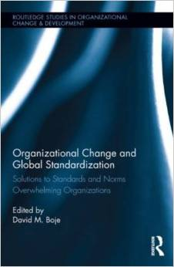
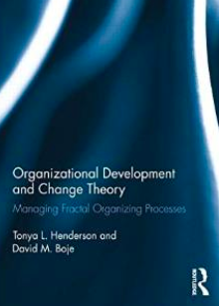

Slide 49
Deconstruction (Boje, 2008b)
Notes:
Figure 2, which you are welcome to reference and use, illustrates the inter-play of the 8 analytic processes (Derrida calls it style). The idea of the narrative deconstruction analysis is to use the first seven steps to flesh out all the missing stuff (missing duality poles, missing view to what is hierarchical hegemony, missing voices, missing sides to the story, missing counter-plots, and missing exceptions to their universalistic principles. The seventh analysis is critical since it now lets you step back and see the full dynamics in play, that ‘control narrative’ (Boje, 2007a; 2001) is leaving out. Step 8, I would argue is the summation of all the prior steps. It allows you to see not just a ‘New perspective” the way you interpret it, but to flesh out the dynamic relations in the fuller social field of antenarratives, and more dialogic stories (see Boje, 2006a for definitions of dialogic stories).

Slide 50
Beginning-Middle-End (BME) NARRATIVE Exercise
IN PAIRS
Instructions – Take a few minutes to draw a map, with peaks and valleys, your lifeline from birth till now. Peak events are high points, and valleys are the lows.
Next: In two minutes, tell your NARRATIVE as a Beginning, Middle, and End

Slide 51
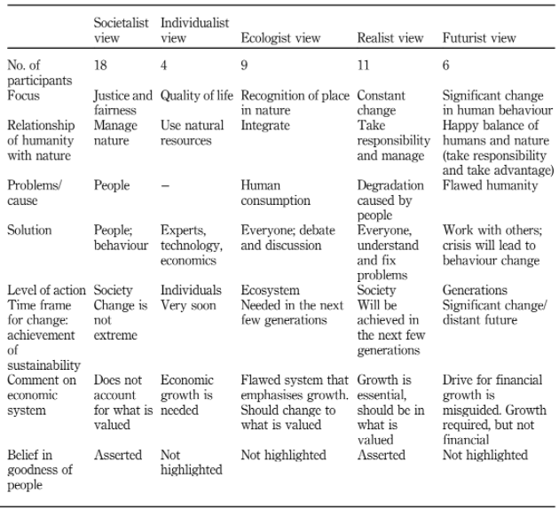

Slide 52
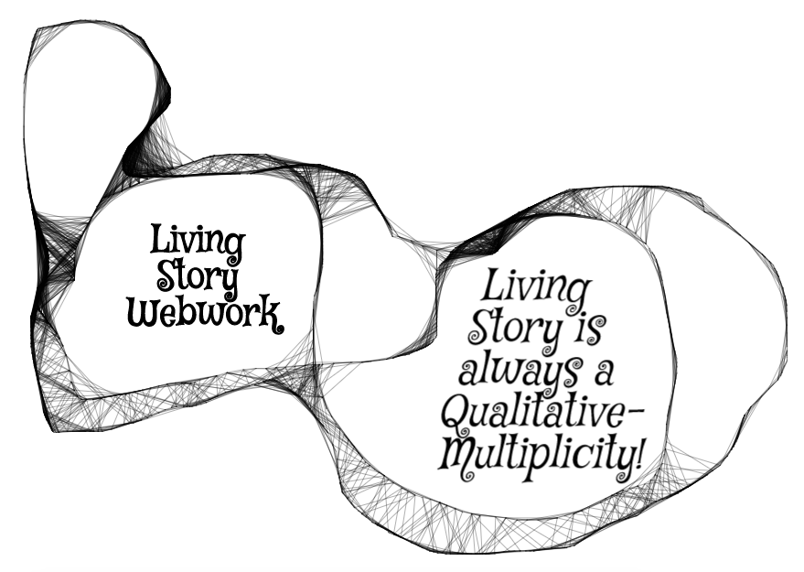
Qualitative-Multiplicity of our IWOK Living Stories
Living Story is unfolding present, in a web of answerable spheres of relationship: family, work, community, friendship, education, etc. without beginning or end, just in the middle (Boje, 2008)

Slide 53
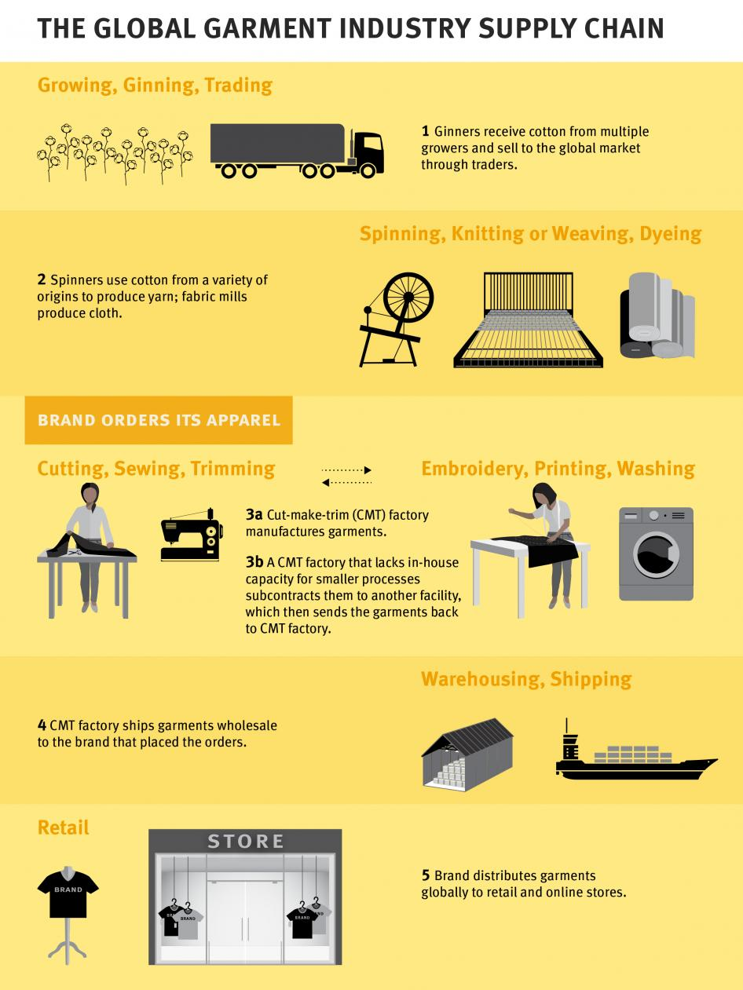

Slide 54
Bangladesh
Nike, Patagonia & H&M Group committed to adhere to transparency pledge. Others, such as Columbia Sportswear and the Walt Disney also publish names and addresses of supplier factories, acknowledge 2017 NGO report moving ‘in the right direction.’ But companies listed in the ‘No Commitment to Publish Supplier Factory Information’ category include Hugo Boss, Mango and Wal-Mart (NPR 2017)

Slide 55
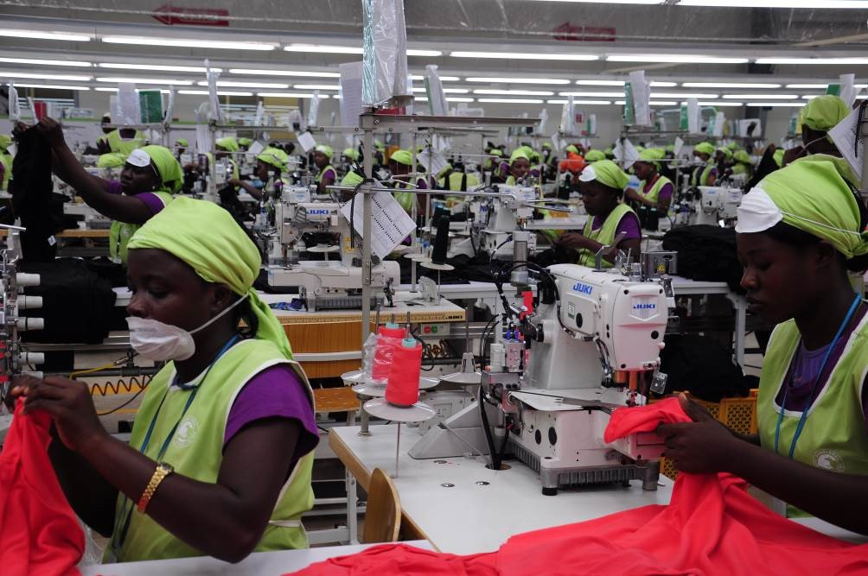
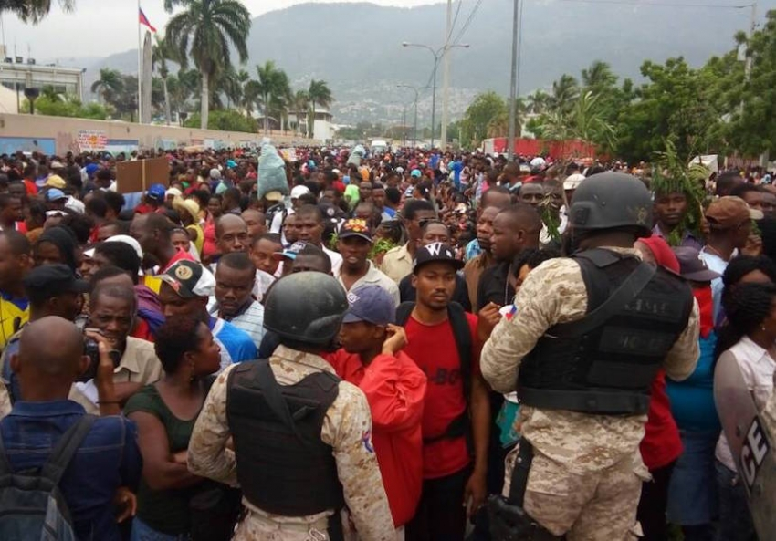
Globalization Sweatshops of Haiti
Notes:
May 19, 2017 thousands of sweatshop workers went on strike, shutting down dozens of textile factories, blocking the road to the International airport in Port-au-Prince, and marching toward the Presidential Place, until the riot police tear gassed the workers.

Slide 56
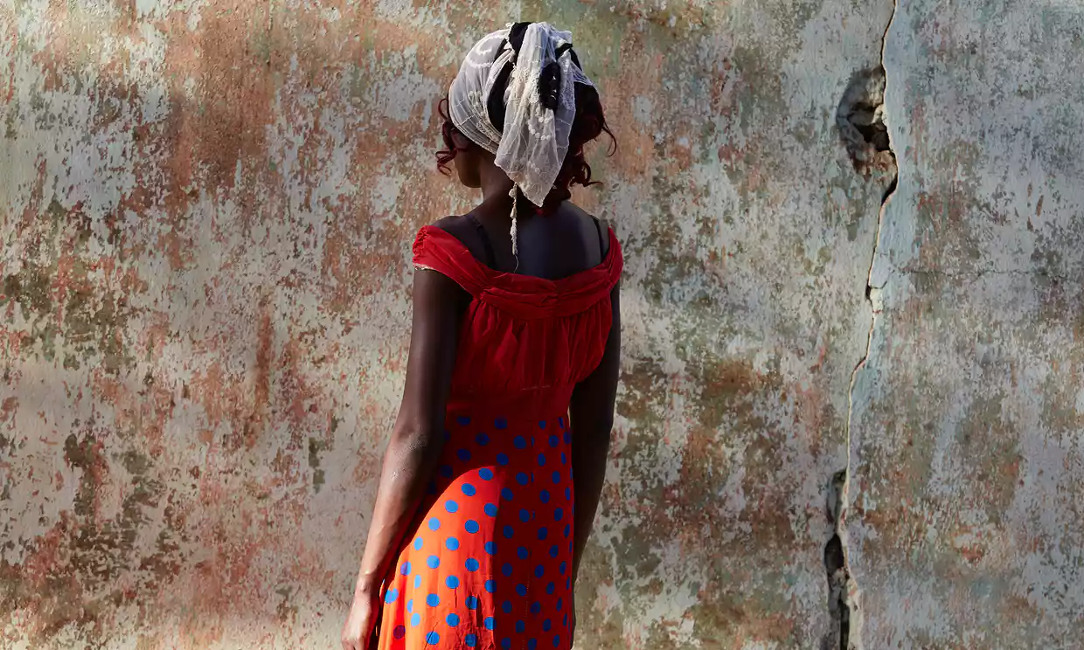
Living story of Central African Republic
Notes:
In the Central African Republic, this living story in a web of living stories. Pregnant at the time, Rosen Moseba fled her home, as Seleka (Muslim) rebels went door to door in 2013. She was caught by armed rebels: “Three of them raped me, one by one. After they raped me some of the Seleka said, ‘Let’s kill her’. Others said, ‘No, no we are not going to kill her, we have already done what we want to do’ … ‘I tried to resist but I couldn’t do anything because they had guns, and I had nothing’” Her children and her brother were killed in front of her. People such as Rosen are in crisis, with no housing, no livelihood to pay rent or pay for children to go to school. Her husband left her, went he found out she had been raped.
Five yeas since 2013 and the rapes of Rosen Moseba, half the population needs humanitarian assistance, and more than a million have been uprooted by the fighting. The capital is under government control but throughout CAR relations of Muslims and Christians is tense and the crisis worsened over past 12 months.
In terms of ecology, armed groups compete for natural resources, in a lawless context of ethnic and religious rivalries. Humanitarian space is shrinking, with fewer and fewer people having access, while conflicts worsen and children know the noise of guns. Rosen Moseba says “It’s very difficult” … “I am afraid I am going to be evicted from my house and my children don’t go to school… Before the crisis I used to sell things, not now I have lost everything and I don’t have enough money to start another activity … Because I am an orphan and I have no one to help me, it is very difficult. The future is very dark now”.
https://www.theguardian.com/global-development/2017/dec/18/the-future-is-very-dark-central-african-republics-relentless-cycle-of-suffering

Slide 57
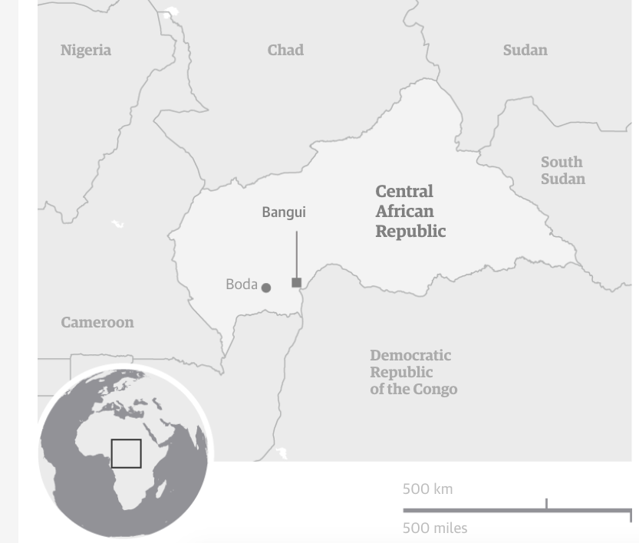

Slide 58
Reclaiming IWOK
Sanson, Dawne (Irene). (2012). Taking The Spirits Seriously: Neo-Shamanism and Contemporary Shamanic Healing in New Zealand. Doctoral dissertation at Massey University, Auckland
Māori storytelling of spirits of living in the lower spirit-world in their material form of this [middle] world.
Mātauranga Māori

