Slide 1
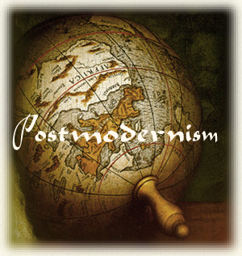
Critical Postmodern Storytelling Methods
David M. Boje
Pro Seminar

Slide 2
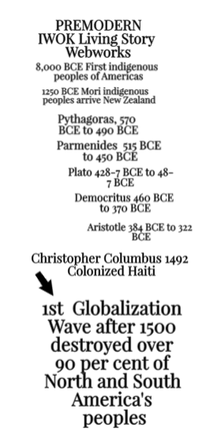
First Wave of Globalization

Slide 3
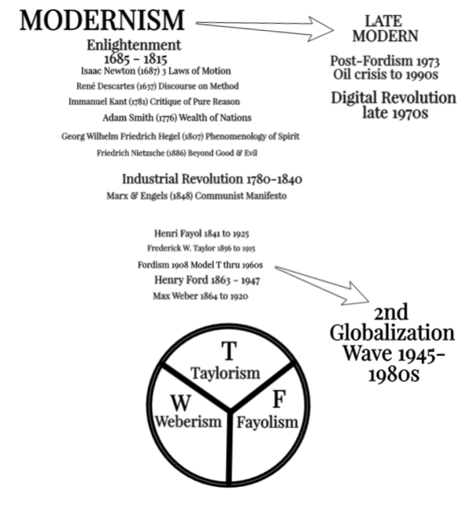
2nd Wave of Globalization

Slide 4
Rise of Critical Postmodern & COUNTER ACCOUNTING Critique of False Corporate Social Responsibility & Sustainability Reporting

Slide 5
In neocolonial 3rd wave of globalization
‘Māori time’ is referred pejoratively as “lack of concern for time, timetables and scheduling”, and as “laziness and unreliability” of the Māori people, who are never on time (Love &Tilley, 2013: 176).

Slide 6
Western and Māori time
Western narrative discourse is a foreconception of time as divisible, clock-time with successive final points of enlightenment modernity progress.
Māori temporality is multilayered, and cannot be periodized.
These are two very different ways of telling truths: progress (& evolution) narrative with pejorative implications and Māori people time where the past is Being-ever-present

Slide 7
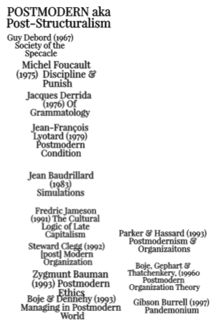
3rd Wave of Globalization

Slide 8
Tyron Love & Elsbeth Tilley
“I Mua I Muri (the past is in front of us, the future is behind). (Te Papa Tongarewa, 2012)” (as cited in Love & Tilley, 2013: 174).
Love, Tyron., & Tilley, Elsbeth. (2013). Temporal discourse and the news media representation of Indigenous-non-Indigenous relations: A case study from Aotearoa New Zealand. Media International Australia, 149(1), 174-188.

Slide 9
Globalization Progress Narrative
Globalization naturalizes a progress narrative in the ongoing politics of colonization by putting entire narration on a temporal scale of globalization development that is linear and reductionist of history

Slide 10
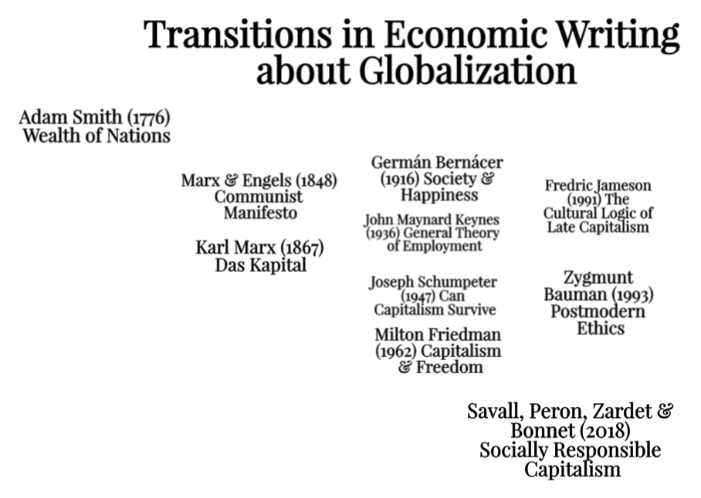

Slide 11
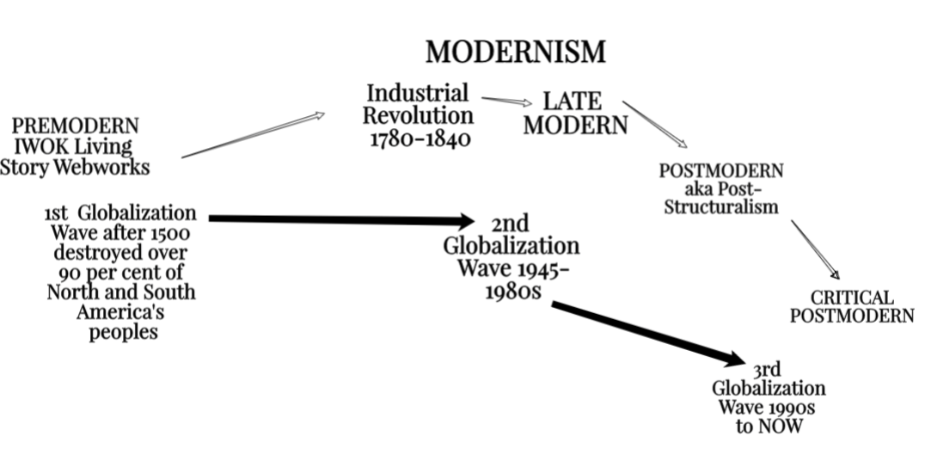
Relation of 3 Globalization Waves to Critical Postmodern Emergence

Slide 12
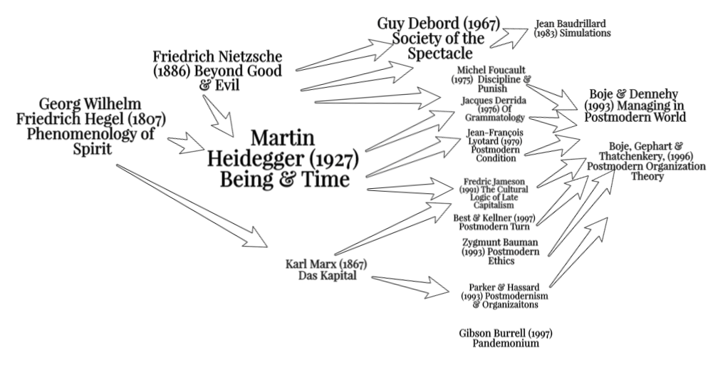
My Own Critical Postmodern Adventure

Slide 13
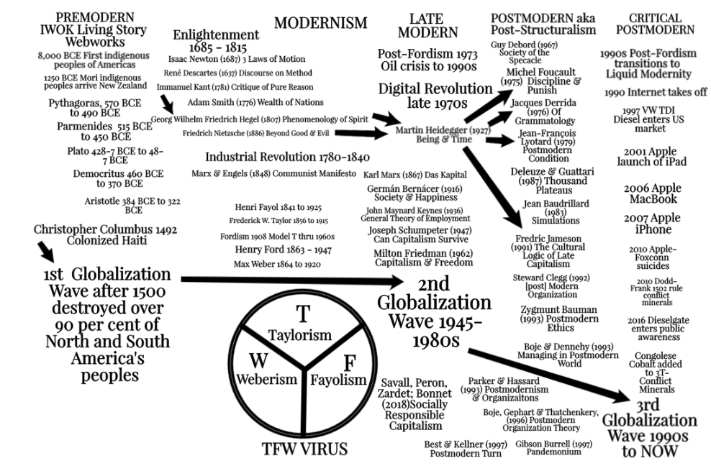

Slide 14
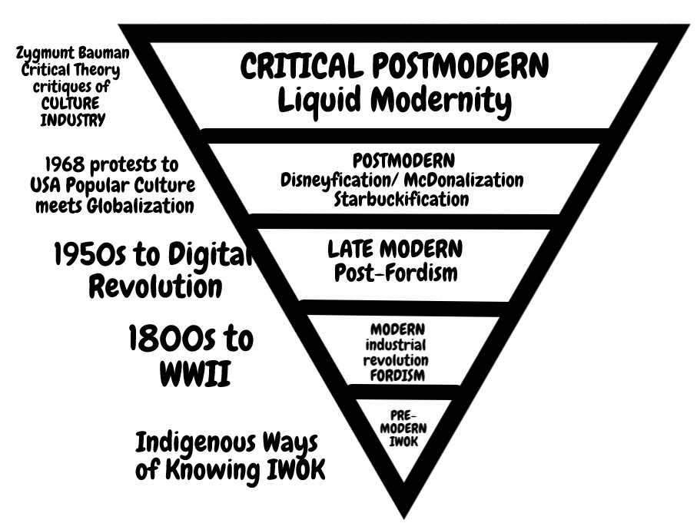

Slide 15
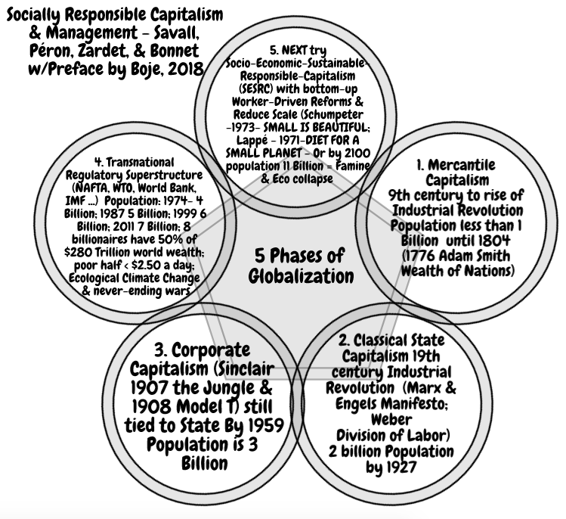

Slide 16
Deconstruction
We have never been Modern – Bruno Latour
Critical Postmod is NOT era-by-era
What is it?
Life in Trump World

Slide 17
If we live in a Living Story Multiplicity
Why do we reduce it to just one career narrative?
Narratives are retrospective sensemaking
Living Stories are happening Now
Living Stories do not have a definite Beginning or and Ending

Slide 18
Boje’s Storytelling Iceberg Model

Slide 19
STOP HERE
Thank you
More slides follow if you want more info

Slide 20
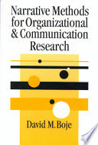
Example of qualitative Interpretative METHOD
THE STORYTELLING ORGANIZATION: A STUDY OF STORY PERFORMANCE IN AN OFFICE-SUPPLY FIRM by Boje, David .M., Administrative Science Quarterly, Mar91, Vol. 36, Issue 1 pp. 106-126.
With Excerpts from this research in the 2001 and 2008 books

Slide 21
“Organizations As Storytelling Systems In organizations, storytelling is the preferred sense-making currency of human relationships among internal and external stakeholders”
My most cited article, but this is all they mostly cite:

Slide 22
The rest of 1st paragraph
People engage in a dynamic process of incremental refinement of their stories of new events as well as on-going reinterpretations of culturally sacred story lines. When a decision is at hand, the old stories are recounted and compared to unfolding story lines to keep the organization from repeating historically bad choices and to invite the repetition of past successes. In a turbulent environment, the organization halls and offices pulsate with a story life of the here and now that is richer and more vibrant than the firm's environments

Slide 23
METHOD is called ‘in situ’
I am a participant observer I iteratively collected and analyzed (Spradley, 1980) the various social scenes that made up the discourse environment of an office-supply firm. These scenes included executive meetings held on and off-site: in conference rooms, restaurants, sales training sessions, as well as conversations in hallways and automobiles.
Tapes were transcribed and converted to line-numbered transcripts. Transcripts were analyzed to find the scantiest occurrences of story performance embedded in conversation. A story performance was operationally defined as an exchange between two or more persons during which a past or anticipated experience was being referenced, recounted, interpreted, or challenged.

Slide 24
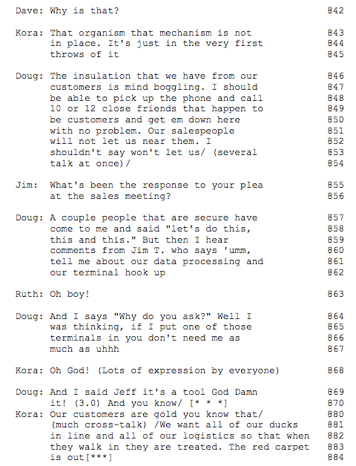
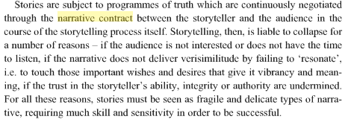
lines 846-54, story details are so terse that, at first glance, there may not appear to be a story at all. Indeed in Gabriel (2000) this story does not fulfill the narrative contract Czarniawska 92004) would say its not an emplotment, because it is not a Beginning, Middle, End telling and strong corporate cultures have petrified narrative plots
However, in lines 855-6, another executive hooks into the underlying experience to trigger more detail on the story behind the story. In 859-62, the story of a salesperson's reaction to executive attempts to implement computer information-system controls garners a severe group reaction.
In line 870, Doug uses a very common reflexive "you know" to reference experience that the other executives are expected to fill in between the lines. He references a story everyone knows all too well
In line 870, the use of an extended pause that invites hearers to fill in their knowledge of the story behind the performed story.

Slide 25
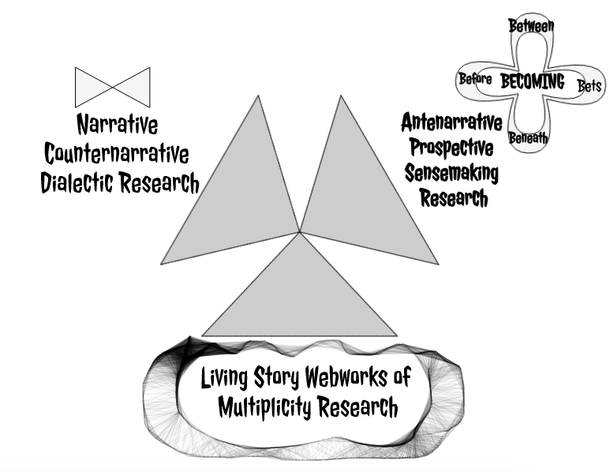
What is storytelling research?

Slide 27
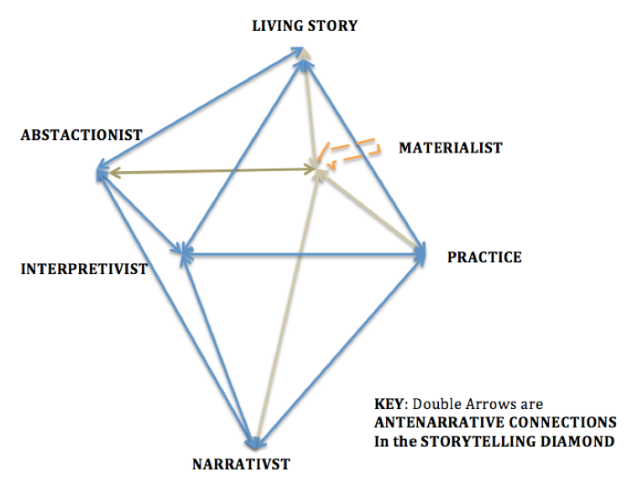
What is your Storytelling paradigm?
Rosile, G. A., Boje, D. M., Carlon, D. M., Downs, A., & Saylors, R. (2013). Storytelling diamond: An antenarrative integration of the six facets of storytelling in organization research design. Organizational Research Methods, 16(4), 557-580.

Slide 28
Heidegger – Being and Time
“if we are to understand the problem of Being, our first philosophical step consists in not … ‘telling a story’ – that is to say, in not defining entities as entities by tracing them back to their origin to some other entities, as if Being had the character of some entity” (p. 26).

Slide 29
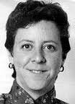
Narrative-Discourse turn went too far
“Language has been granted too much power. The linguistic turn, the semiotic turn, the interpretative turn, the cultural turn: it seems that at every turn lately every “thing”—even materiality—is turned into a matter of language or some other form of cultural representation” (Karen Barad, 2003: 801).
Notes:
“There is more to agency than the possibilities of linguistic resignification, and the circumvention of deterministic outcome does not require a clash of apparatuses/discursive demands (i.e., overdetermination)” Barad, 2003: 826 footnote).
Barad, K. (2003). Posthumanist Performativity: Toward an Understanding of How Matter Comes to Matter. Signs: Journal of Women in Culture and Society 2003, vol. 28, no. 3: pp. 801-831. Available on line at http://www.kiraoreilly.com/blog/wp-content/uploads/2009/06/signsbarad.pdf

Slide 30
YIANNIS GABRIEL IN UK
“I shall argue not all narratives are stories; in particular, factual or descriptive accounts of events that aspire at objectivity rather than emotional effect must not be treated as stories” (2000: 5).
“However, the mythologized past that is celebrated in organizational nostalgia is 'generally idealized' and bears little relation to 'documented history' (Gabriel, 2000: 170-177)”, as cited in Clark & Rowlinson 2002: 11.
“Stories are narratives with plots and characters, generating emotion in narrator and audience, through a poetic elaboration of symbolic material” (italics in original)
Notes:
“Boje's tersely told “you know the story” is a “narrative
deskilling,” not a “proper” story, with plot, preventing full collections being built in
management, as they are in his version of “organization folklore” (19-21)
Gabriel, Y. (2000) Storytelling in Organizations, Oxford: Oxford University Press
Gabriel, Y. (ed.) (2004) Myths, Stories, and Organizations: Premodern Narratives for Our Times, Oxford: Oxford University Press
Rowlinson et al “Business historians (e.g. Dellheim, 1986: 20; Kantrow et al., 1986) claim that many organizations would welcome an opportunity to confront their myths in the context of their history, to question whether their self-perception is accurate or distorted, creative or destructive, or whether their corporate "traditions" are selective misreadings of the past designed for legitimation. “

Slide 31
LIVING STORY IS MULTIPLICITY OF VOICES
Dialogical manner of story is “The plurality of independent and unmerged voices and consciousness and the genuine polyphony of full-valued voices” (Bakhtin, 1973: 4).
Story and narrative are different: “Dialogic manner of the story” (1981: 60); “Narrative genres are always enclosed in a solid an unshakable monological framework” (1973: 13); In dialogism there is a move beyond “systematic monological philosophical finalizedness”

Slide 32
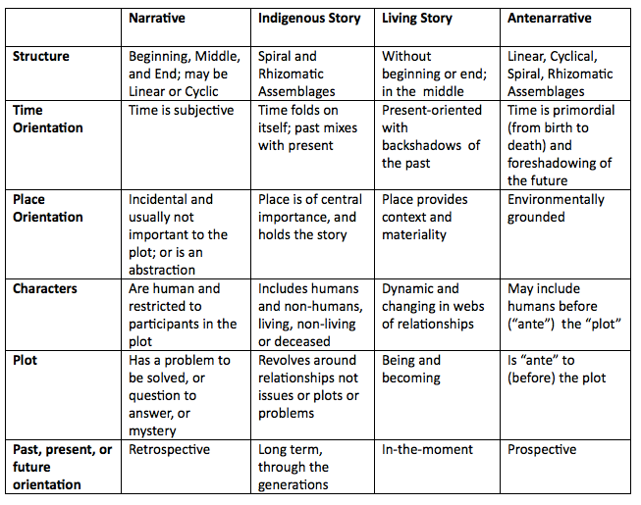

Slide 33
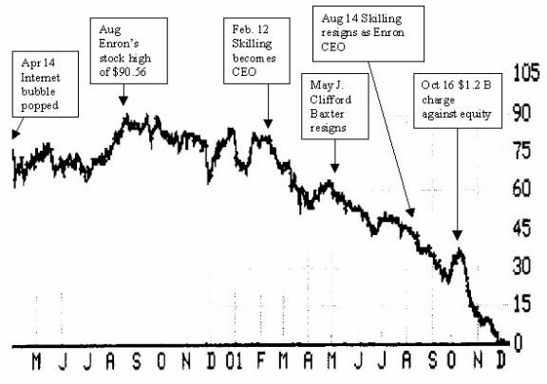
Enron as linear narrative - Oct 16 2001 meltdown
Notes:
Jan 25, 2002 ... Former Enron Corp. vice chairman J. Clifford Baxter was found dead in his car ... the victim of an apparent suicide, police said.

Slide 34
MULTIPLE ENRON COUNTERNARRATIVES (Boje & Rosile)
Plot 1. It was Andrew Fastow and his lieutenants. | Plot 6. It all relates to Afghanistan, and pipelines of ExxonMobil, Texaco, Unocal, BP Amoco, & Enron.
Plot 2. It was Fastow's bosses: Skilling and Lay. | Plot 7. Its a remake of the Seven Sisters from 1911
Plot 3. It was the Domino Effect, ripple effects of Enron caused other corporations & executives to be exposed | Plot 8. It was a failure of the system of Western Capitalism, its checks and balances.
Plot 4. It is the Whitehouse; this is Enrongate | Plot 9. It was the Business College, they taught the gentlemen crooks everything they needed to de-fraud.
Plot 5. It was all three Presidents (Bush Sr., Clinton, & Bush Jr.) | Plot 10. It was the greed and hubris of everyone.

Slide 35
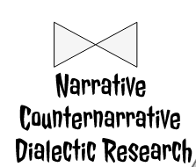
How do we do Dialectic Research
Type 1: Thesis-Antithesis-Synthesis is GROSS
Type 2: Negation of the Negation FEW UNDERSTAND IT

Slide 36
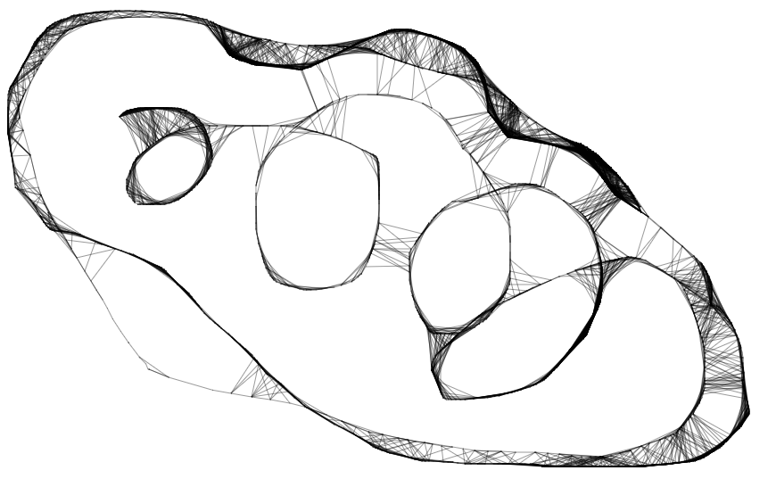
How do we do Living Story Research? TYPE 1: Actor-Network-Theory TYPE 2: Qualitative-Multiplicity
What happened to the Living Story Webwork?

Slide 37
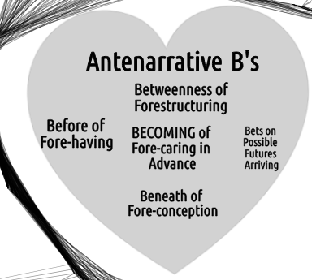
Heart-of-Care
Fore-caring in advance for Becoming

Slide 38
Heideggerian Storytelling with Dasein
Text-interpretation assertion (fore-conception) subject to fantasies
Eye-witness assertion - primary/authentic (fore-sight) subject to characterization
Hear-say assertion –psychically distorted (fore-hearing)
Mathematical-prediction (beforehand)
Forensic-materiality assertion – circumstantial existential constitution of Dasein, from the ground up (for-having)
for-having, fore-sight, and fore-conception (p. 192).
Each has different bindingness (p. 198)
POINT: The analysis of assertion has a special position in the fundamental ontology of storytelling!

Slide 39
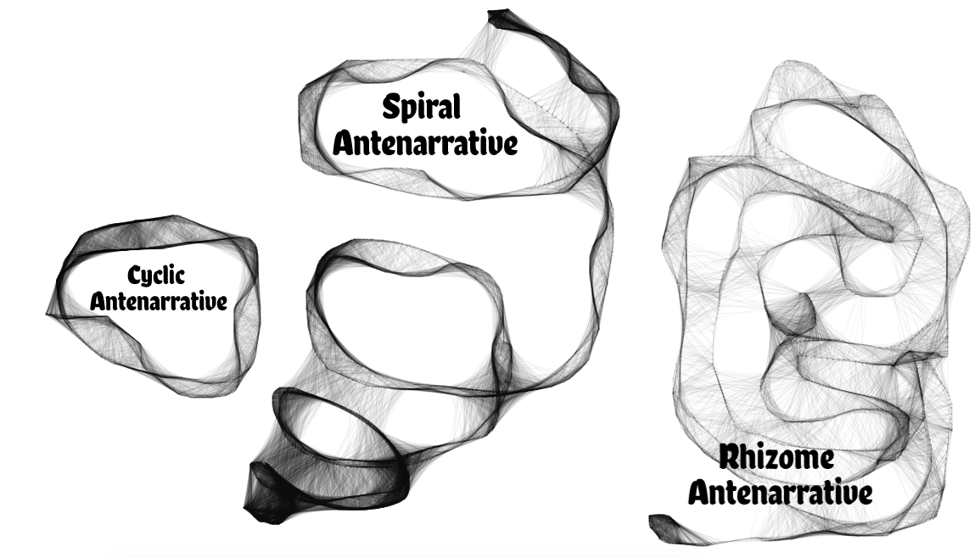
Do Antenarratives have Patterns?
Qualitative-Multiplicities

Slide 40
Do Antenarratives of Past business cycles predict the future?
“The story [more accurately, antenarrative] of business cycles can organize the past, but it contradicts itself when offered as a prediction of the future” (McCloskey, 1990: 95, insert by Boje)
WHY? The rigid stage by stage business cycle antenarratives would have NO SURPRISES if the past repeated itself in each future

Slide 41
SPIRAL-ANTENARRATIVE EXERCISE
5 minutes: Silently write of all the spirals your life, in work or university, draw them if you like– Is it narrowing or widening, upsurge or downward, are there fractal offshoots; do you bridge or jump between twirls; what becomes intelligible?
5 min: In Group of 4, pick out the examples of spirals that are common or different
Draw the spirals on a large sheet of news print, and tape them to the wall
5 min: Walk about and notice the different spirals

Slide 42
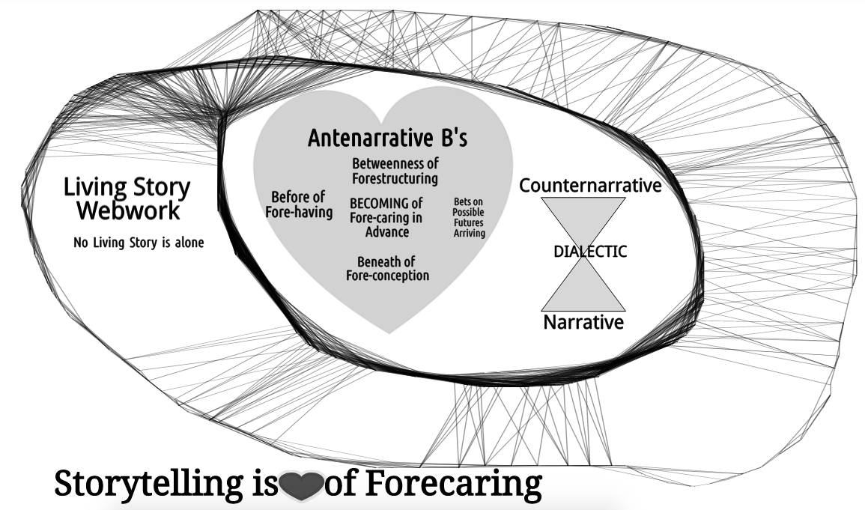
We Live in a webwork of Living Stories

