Slide 1
Managing Your Thesis Through to Submission
Presenter Names: Grace Ann Rosile & David Boje
Presentation Date Wednesday 6 March 2019
Canterbury Univesity
Erskine Ethics Fellows Seminar:
COMPLETING YOUR PhD with Professors Rosile and Boje
https://davidboje.com/Canterbury

Slide 2
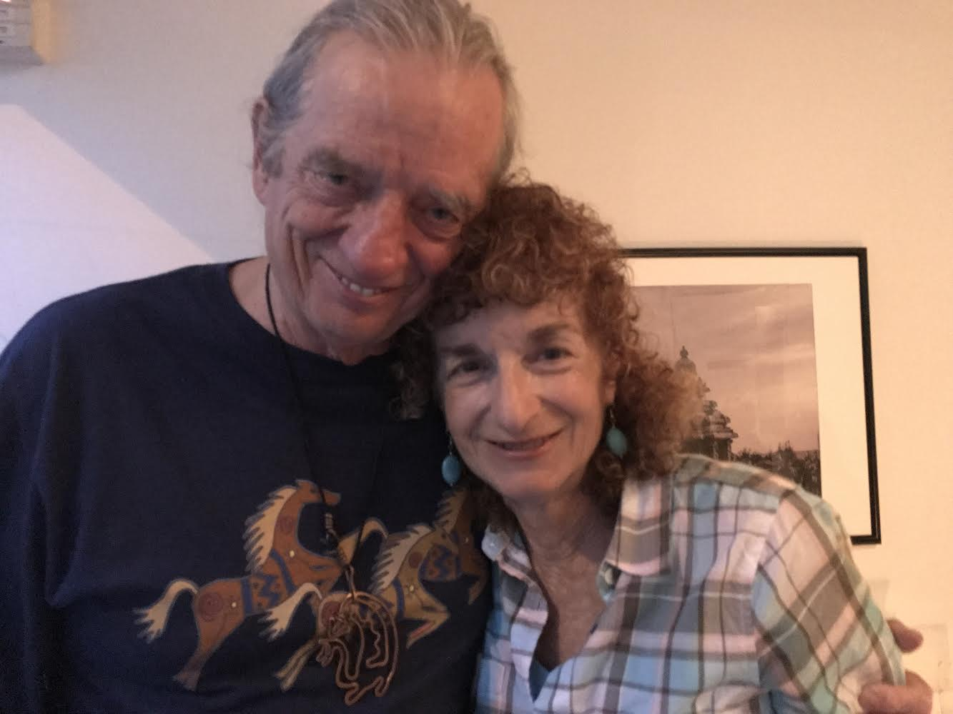
Managing Your Thesis Through to Submission OVERVIEW
What is your thesis about?
Tell your Living Story
Define the goal (is it similar to past or a new contribution?
Notes:
What is the project about?
Define the goal of this project
Is it similar to projects in the past or is it a new effort?

Slide 4
Scope: WWOK &/or IWOK
Define the scope (its space, time, and mattering or is it spacetimemattering?
 | Western Ways of Knowing WWOK | Indigenous Ways of Knowing IWOK
SPACE | Narrative of Capitalism of owning places & things in market & legal spaces | Living story of harmony of all creatures in place
TIME | Linear narrative chronology of history | Major cycles of life experience
MATTERING | Artificial systems mattering | Natured systems mattering in moral content
Spacetimemattering | Quantum Science without spirituality | Native Quantum Science with spirituality of all life
Notes:
Define the scope of this project
Is it an independent project or is it related to other projects?

Slide 5
Current Status Managing Your Thesis Through to Submission
What progress has been made?
Which chapters have been completed?
What research issues have been resolved?
What new contribution to you intend? *
Is the thesis currently ahead of schedule, on track, or delayed?
If delayed, what is the mitigation plan?
Notes:
* If any of these issues caused a schedule delay or need to be discussed further, include details in next slide.

Slide 6
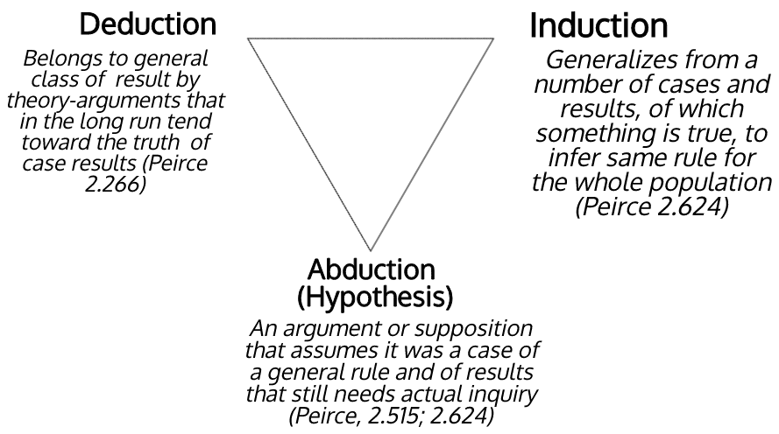

Slide 7
Issues and Resolutions
Description of the issue
How was it resolved?
What and how did it impact the project?
Time
Cost
Other
Notes:
Duplicate this slide as necessary if there is more than one issue.
This and related slides can be moved to the appendix or hidden if necessary.

Slide 8
Timeline
Milestone 1
Milestone 2
Milestone 3
Date 1
Date 2
Milestone 4
Date 4
Date 3
Notes:
The following slides show several examples of timelines using SmartArt graphics.
Include a timeline for the project, clearly marking milestones, important dates, and highlight where the project is now.

Slide 9
Timeline
Date 1
Date 2
Date 3
Date 4

Slide 10
Timeline
Date 1
Date 2
Date 3
Date 4

Slide 11
Looking Ahead
When is the next milestone?
What are the expected deliverables?
Known risks and issues
What is the investigation timeline for these issues?
What are the immediate next steps?

Slide 12
Storytelling Science and your Thesis
Project
Committee
Living Story
Research Question
WWOK &/or IWOK
Westorn &/or Indigenous Science
Notes:
What are the dependencies that affect the timeline, cost, and output of this project?

Slide 13
Appendix
Notes:
Prepare slides for the appendix in the event that more details or supplemental slides are needed. The appendix is also useful if the presentation is distributed later.

Slide 14
Appendix
Funding
First three chapters
Committee plan
Philosophy of Storytelling Science

