Slide 1
Interpreting Your Data With Self Correcting Storytelling
March 21 2019
University of Canterbury
David Boje, Grace Ann Rosile, &
Mark Van der klei
Download Storytelling Science book and slides for this presentation at https://davidboje.com/Canterbury

Slide 2
Mark Van der klei

Slide 10
Mark Van der klei

Slide 11
Mark Van der klei

Slide 16
Mark Van der klei

Slide 17
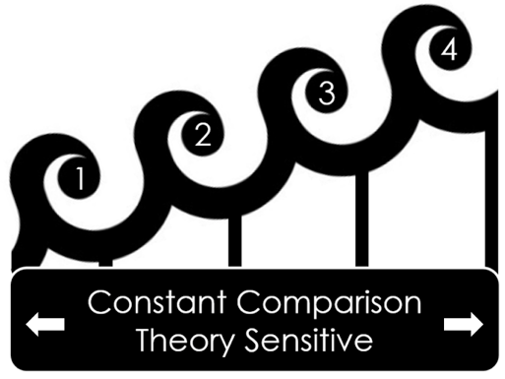
4th Wave GT
Finding ‘Ground’ &
‘Theory’ with
‘Self-Correcting’
Storytelling Science
Fallacy TBD
2018-
3rd Wave GT
Clarke, 2005
Charmaz 2008
Mills et al 2008
Constructivism
Fallacy
2005-2017
2nd Wave GT
Glaser & Corbin
1994
Positivism Fallacy
1994-2004
1st Wave GT
Glaser & Strauss
1967
Inductivism Fallacy
1967-1993

Slide 18
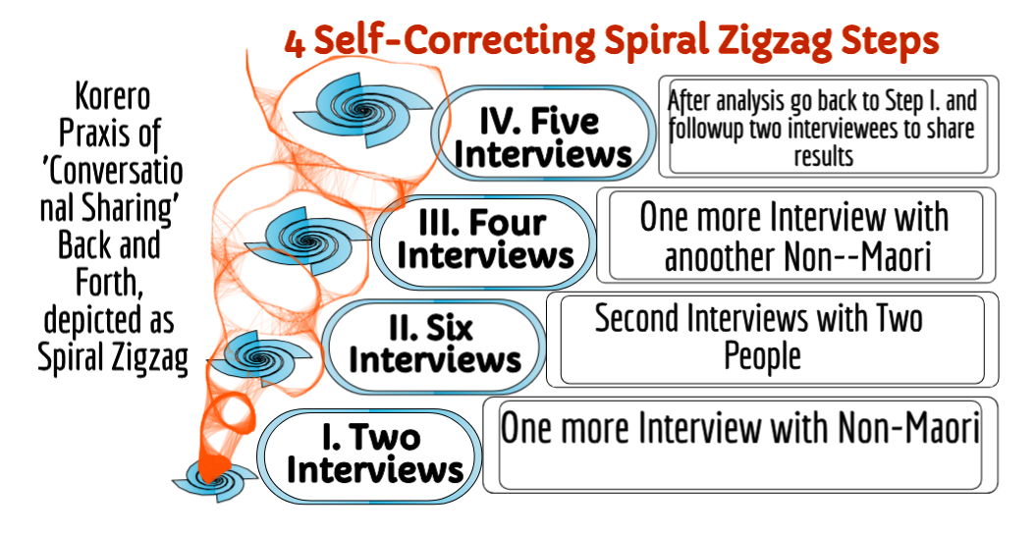

Slide 20
1.
Knowing Theories
2.
Being Inductive
3.
Testing by Refuting
4.
Doing Interventions

Slide 21
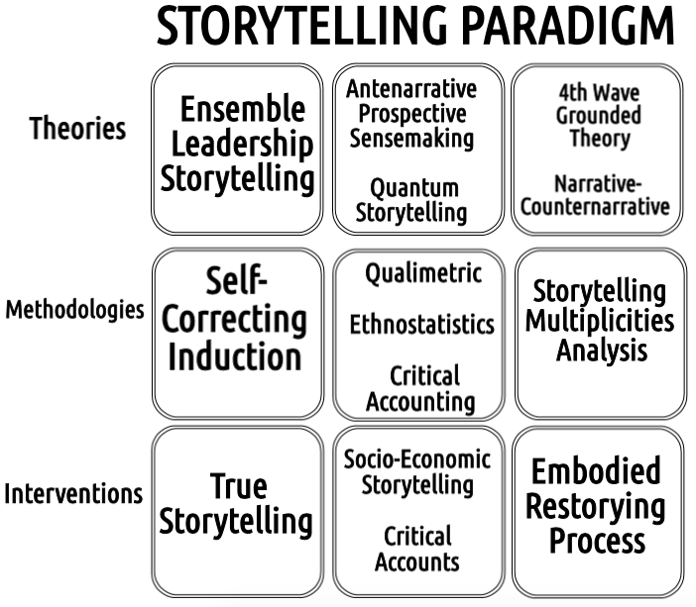

Slide 23
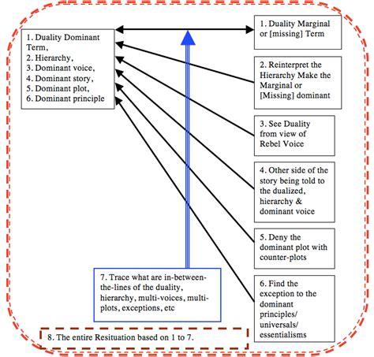
Boje, 2001 Narrative Deconstruction

Slide 24
How to Research the Fresh Water Replenishment STORYTELLING Claims of Coca Cola?
Use Coca Cola Annual Sustainability Report for ‘positive story’ claims
Then Study the Claims and ‘auxiliary assumptions’ in photos, graphs, numbers, and text
Check out Refutations in Farmers’ counterstories
Test Coke stories & counterstories with Facts of Nature, Fresh Water Scarcity and Water Stress on planet Earth

Slide 25
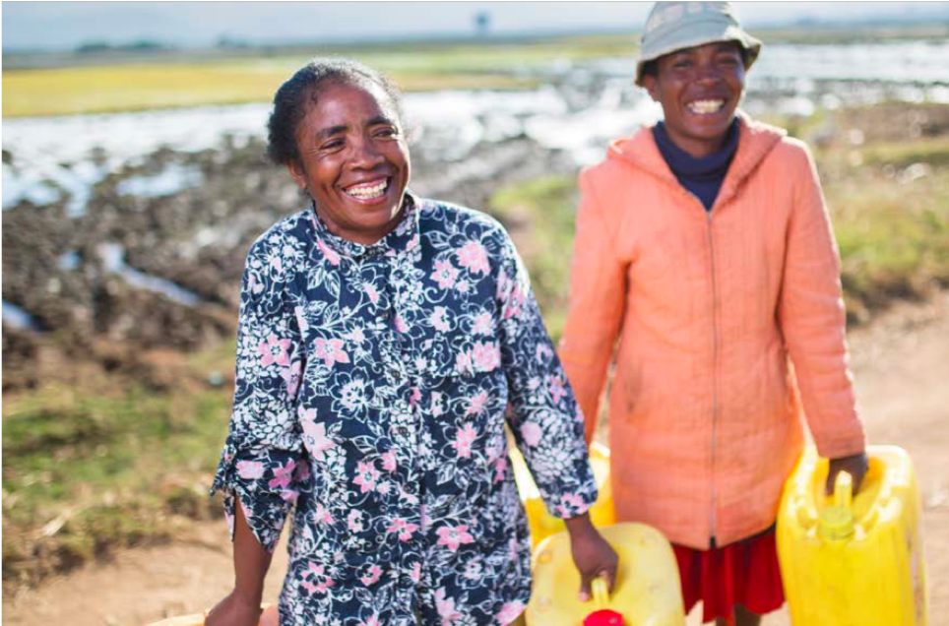
FOR EVERY DROP OF WATER WE USE, WE GIVE ONE BACK
… we take water leadership seriously because it’s the earth’s most valuable finite resource. With our size and local presence, we have the ability to help people and communities get access to the water they need (p. 11)

Slide 26
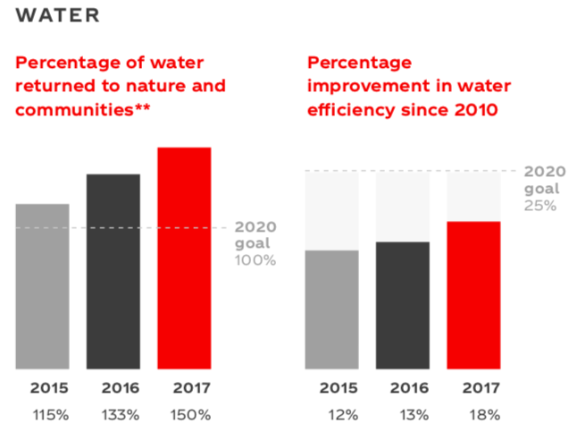
Coca Cola says “Water We aim to give back the amount of water used in our finished beverages to replenish communities and nature” SOURCE
Question: How would you research this?
**As estimated working with our many external partners and using generally accepted, independently peer-reviewed scientific and technical methods. Finished beverages based on global sales volume. (Coke Sustainability Report, p. 9)
Notes:
https://www.coca-colacompany.com/2017-sustainability-report

Slide 27
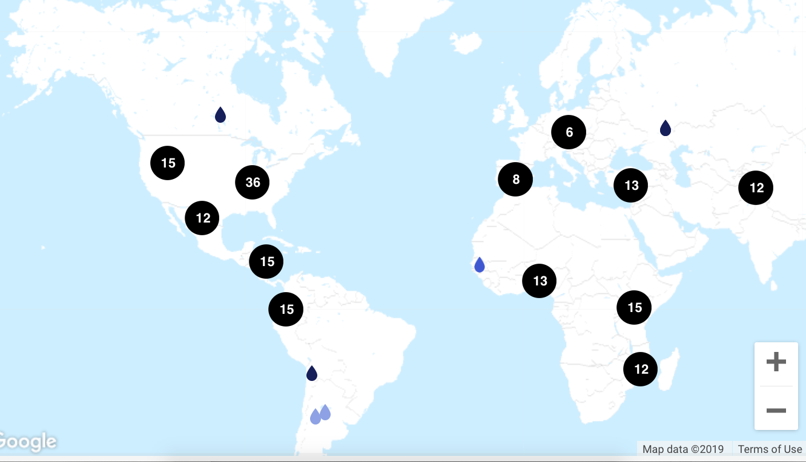
How does Coke Replenish 65.5 billion gallons of Fresh Water?
The numbers on the map represent site of 248 projects by Coke to Replenish water pumped out of Aquifers

Slide 28
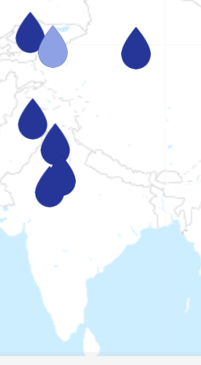
Coke Business ‘Water’-Storytelling
Conserving water usage through improved irrigation techniques
Laser-leveling activities y Read More
Drip irrigation experiment initiated by The Coca-Cola SOURCE
Project has expanded from 26 farmers in 2007, to 523 farmers. The goal, reach 1,000 farmers within the next three years

Slide 29
Coke Storytelling Statements
While water stress and challenges continue to increase in certain regions … https://www.coca-colacompany.com/stories/2017-water
2017, COKE continued to replenish 100% of the water used in our finished beverages back to communities and nature, … Projects implemented … are replenishing an estimated 248 billion liters per year through community and watershed projects globally

Slide 30
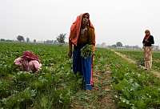
The Farmers Side of The Drip Story
Feb 12, 2016 - Coke Suspends Bottling at Plant at Center of Water Dispute ... Coca-Cola said it runs the Kaladera plant in Rajasthan "as a responsible steward of fresh water
Kudi, who is a member of the Kala Dera Sangharsh Samiti, a local group that has been demanding closure of the plant, said it was bad enough that various rules and norms were violated to allow the plant to be set up in a water-stressed area.
Worse, it was “positively obscene” that it was functioning as usual in the middle of a severe drought. SOURCE
COKE’S ‘Positive Story’ “In Kala Dera, we have created the potential to recharge 15 times more water into the ground than we use in our plant. Even with less than normal rainfall, these structures can recharge substantially more water than is drawn for our bottling operations.’’

Slide 31
Take aways
“Water shortages are commonplace in India”
“Whether they like it or not, Coca-Cola will have to accept that communities, farmers and livestock have precedence over water.” SOURCE

Slide 32
Coca-Cola Storytelling claims need fact checking for Stupidity
Coke claims: “FOR EVERY DROP OF WATER WE USE, WE GIVE ONE BACK”
If something is too good to be true, it usually is!

Slide 33
Water is an ensemble of three multiplicities:
Extensive Multiplicities of heterogeneous spaces of varieties of water mattering differently in ice, vapour and liquid states, in bodies of glacial water, lake, river, ocean, artesian springs, aquifer groundwater, and in all living bodies as élan vital (life force).
Intensive Multiplicities of heterogeneous times of water duration (dureé) mattering of water-now-past, water-now-present, and water-not-yet.
Virtual Multiplicities of real water in consumed in all phases of production, distribution, and consumption in ‘Water Capitalism.’

Slide 34
Stories-As-Texts Research
The story was not found to be a highly agreed-upon text, told from beginning to end
Rather, stories were dynamic, varied by context, and were sometimes terse, requiring the hearer to fill in silently major chunks of story line, context, and implication.
Stories were frequently challenged, reinterpreted, and revised by the hearers as they unfolded in conversation.
NEXT AN INTERACTIVE TEXT ANALYSIS

Slide 35
Stories-As-Performance (only)
In Yiannis Gabriel’s Story-as-Performance, ‘proper stories’ are emotive & fulfill implicit narrative contract.
My reply: First, because stories are contextually embedded, their meaning unfolds through the storytelling performance event across spaces/times (see Disney as Tamara-Land, AMJ 1995)
Second the 1991 research supports a theory of organization as a collective storytelling organization in which the performance of stories is a key part of members' sensemaking and a means to allow them to supplement individual memories with institutional memory, therefore ‘You now the story!’ though improper is part of sensemaking

Slide 36
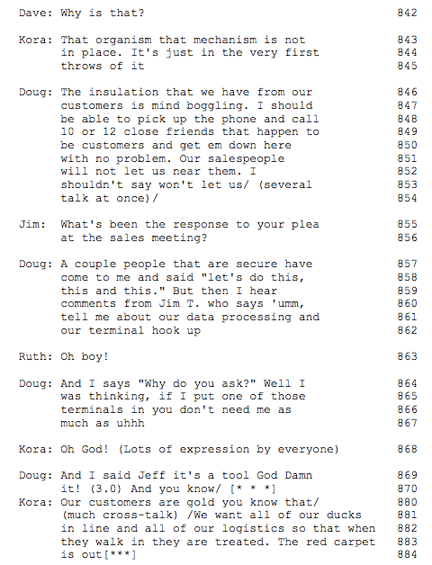
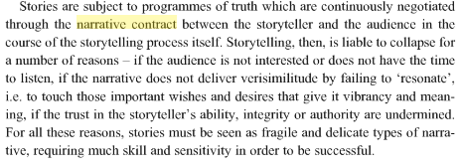
lines 846-54, story details are so terse that, at first glance, there may not appear to be a story at all. Indeed in Gabriel (2000) this story does not fulfill the narrative contract Czarniawska (2004) would say its not an emplotment, because it is not a Beginning, Middle, End telling and strong corporate cultures have petrified narrative plots
However, in lines 855-6, another executive hooks into the underlying experience to trigger more detail on the story behind the story. In 859-62, the story of a salesperson's reaction to executive attempts to implement computer information-system controls garners a severe group reaction.
In line 870, Doug uses a very common reflexive "you know" to reference experience that the other executives are expected to fill in between the lines. He references a story everyone knows all too well
In line 870, the use of an extended pause that invites hearers to fill in their knowledge of the story behind the performed story.

Slide 37
Boje 2001: 126

Slide 38
S1: Goldco Founding Story – part 1
Doug: I look at Goldco as a toy that 1154
somebody decided to put in the company 1155
because it was fun and it also brought 1156
in/ 1157
Sam: Well/ I'll tell you how that came 1158
about 1159
Doug: I thought you would (lots of laughter 1160
from the group) 1161
Sam: Sam Coche worked for Sea Breeze or 1162
something like that, oh you know the 1163
story? 1164
Doug: No go ahead tell it, really it's 1165
important. 1166

Slide 39
Continued
Sam: He got out there and he came over and 1167
they formed Goldco and Goldco does 1168
not mean Gold Company or anything 1169
else they took the first four 1170
initials from Billy Gold, which is 1171
G O L D and from Coche and that's how 1172
they got Goldco. 1173
Doug: And it was a good living for a couple 1174
of people. It was a nice toy for 1175
Billy, he made a few bucks on the 1176
thing. He had some fun for it but 1177
then the motivation at that time was a 1178
whole lot different than it is today. 1179
We don't have the luxury of screwing 1180
around with something like that /(lots 1181
of cross talk at this point)/ 1182
(Returns to turn-by-turn talk.)

Slide 40
RENO BRANCH STORY
Sam: I think five years ago there was no 727
Executive Committee. He just ran 728
the place the way he wanted as if you 729
wasn’t here. Raymond was [conglomerate’s] 730
man and he did what he pleased. 731
I guess you heard this all already 732
Dave: I heard about the high growth (nodding) 733
Sam: Yes we picked up San Diego 734
Dave: Reno? 735
Sam: Ed Fox picked up Reno and I guess 736
you heard the whole story before. 737
That’s why we picked up Reno because 738
Ed Fox had that with his father. You 739
know. 740

Slide 41
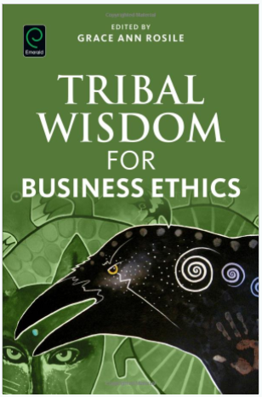
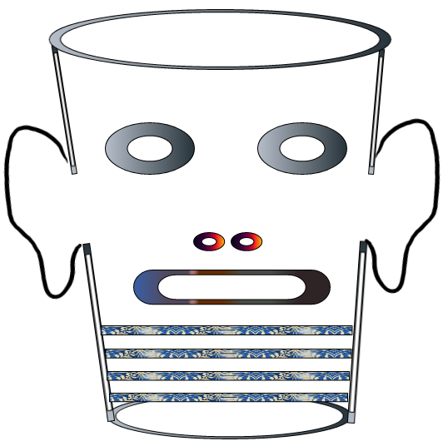
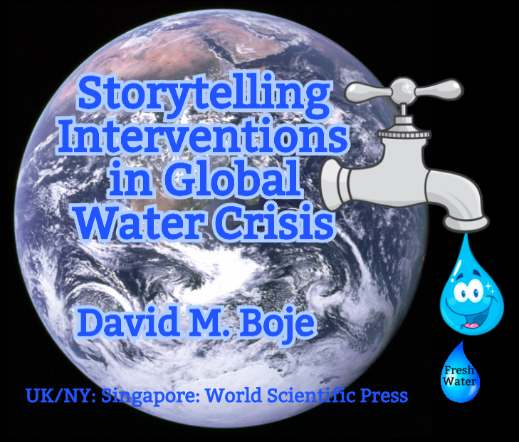
Storytelling Science and Your Dissertation
David M. Boje & Grace Ann Rosile
UK, US, Singapore: World Scientific
February 21, 2019; Revised March 19, 2019
Download Storytelling Science book and slides for this presentation at https://davidboje.com/Canterbury

