Slide 1
Conversational ‘storytelling’
March 26 2019
University of Canterbury
David Boje
Download Storytelling Science book and slides for this presentation at https://davidboje.com/Canterbury

Slide 2
Conversational Storytelling
Is BOTH/AND
Dialogical
Dialectical
HOW?
Co-Inquiry
Co-Sharing
Together Problem-Solving
Back and Forth Storytelling

Slide 3
Hawthorne Studies -July of 1929
After 1600 interviews, changed their method from semi-structured & structured interviews, called the ‘direct approach to questioning’
Changed to: ‘indirect approach’ people told their accounts and stories,
without interruption,
without trying to herd the [storyteller] back so some a priori topics and sub-topics (Roethlisberger, Dickson, & Wright: 1939: 203).

Slide 4
Freire (1970/2000) theory of anti-dialogical action
Conquest
Divide and rule
Manipulation, and
Cultural invasion

Slide 5
Theory of dialogical action characteristics:
Cooperation
Unity
Organization, and
Cultural synthesis

Slide 6
Conscientização and relation of anti-dialectical and anti-dialogical to their opposite

Slide 7
Round 1: Storytelling Conversation
Pick Partner you know least in room
Share experience of BEST CONVERSATION
For each story you hear, take a turn and share your story back
At least once share a counter-story to their story
Write verbatim notes as you listen to each other
After the conversation is done, write up your critical reflections of your own storytelling, and your partner’s storytelling

Slide 8
Round 2: Storytelling Conversation
Pick new Partner you know least in room
Share experience of WORST CONVERSATION
For each story you hear, take a turn and share your story back
At least once express a counter-story
Write verbatim notes as you listen to each other
After the conversation is done, write up your critical reflections of your own storytelling, and your partner’s storytelling

Slide 9
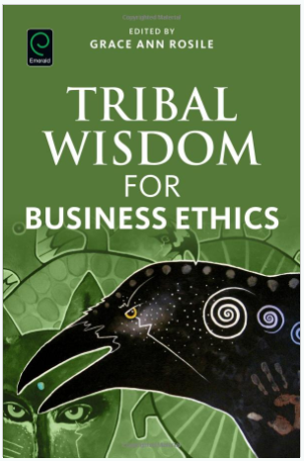
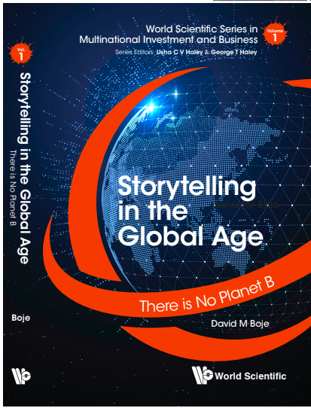
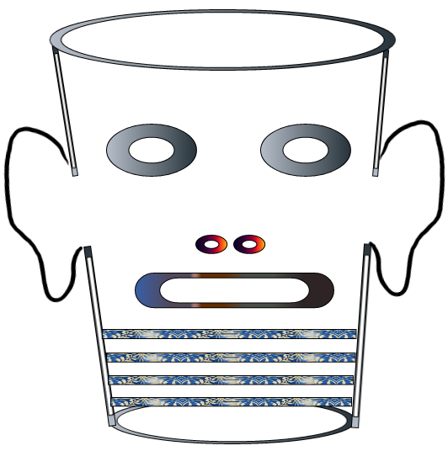
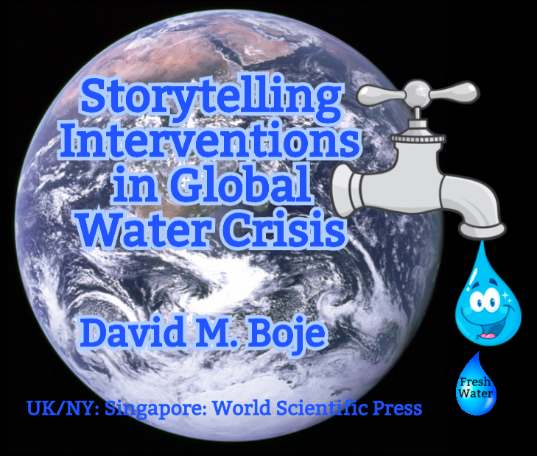
Storytelling Science and Your Dissertation
David M. Boje & Grace Ann Rosile
UK, US, Singapore: World Scientific
February 21, 2019; Revised March 19, 2019
Download Storytelling Science book and slides for this presentation at https://davidboje.com/Canterbury

