Slide 1
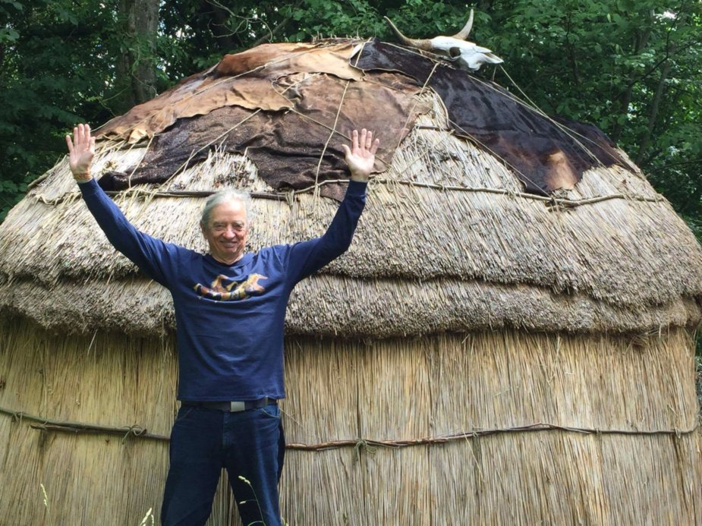
What is True Storytelling?
David M. Boje
Part 2: The Activist Antenarrative for to SAVE HUMANITY FORM ITS OWN EXTINCTION, May 8 2018 presentation to conference “A Discourse Activist Perspective on Organizational Storytelling” at Aalborg University

Slide 2
EXERCISE: Threats to Existence of Humanity
Individually, brainstorm list of TEN events that would cause 50 to 90% Human Extinction by end of century
What would cause Human Extinction, defined as undoing of the Human existence?
Get into groups of 5 and make one list of 10 on a poster
For each Human Extinction event, assign a probability from 0 to 100% that this will occur by end of century
How do we reduce the risk of Human Extinction for top 3 events? Add this to your poster

Slide 3
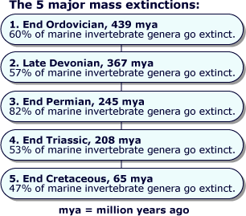

Slide 4
What is 6th Extinction
Sixth Mass Extinction is a massive die-off of plants and animals all across the planet.
Also known as Holocene extinction (mostly caused by HUMANS) or Anthropocene extinction (abrupt enough HUMAN CAUSED EXTINCTION, to be its own epoch)
ANTHROPOCENE is the ongoing extinction event of species during the present event, mainly result of human activity
If current rate of human disruption of BIOSPHERE continues then ½ of Earth higher life forms will be extinct by 2100.
6th Extinction is 10 to 100 times greater than any previous mass extinction
We have unleashed a mass extinction in which many life forms won’t exist by end of this century.

Slide 6
6th Extinction
2016 study published in the journal Science also suggests this sixth mass extinction is killing off large ocean dwellers (like sharks, whales, giant clams, sea turtles and tuna) in disproportionately greater numbers than smaller animals.
Deforestation to grow cows, logging for construction
Too many species die off sets a domino effect in motion
Invasive species threaten plants
Extinction rates for mammals, birds, amphibians & fish have all are 20 times expected rates since 1900 (rate for reptiles is 8 to 24 times above expected).
Biodiversity crisis we are in NOW, is real!
Human species is reliant on healthy ecosystems for food, water and air.
Its all about over-exploitation of Planetary Resources for Economic Gain, so 8 billionaires can own ½ of all wealth in PERVERTED GAME OF MONOPOLY

Slide 7
What is Globalization doing to End the World in your children’s children’s lifetime?
Results of focus groups so far, when asked: What was #1 Extinction threat that can bring about end of the world?
Donald J. Trump
Climate Change
Nuclear War
Pandemic
Introduction of Exotic Species
Deforestation/Habitat Loss
Pollution
Non-human causes →Asteroid, Alien Invasion, etc.
Extinction Event: causes drastic change in # of species in short period of geologic time

Slide 8
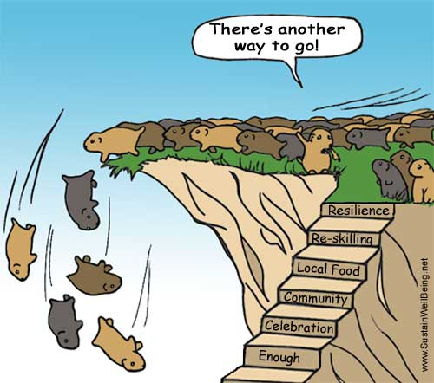
Myth: Globalization has no alternative

Slide 9
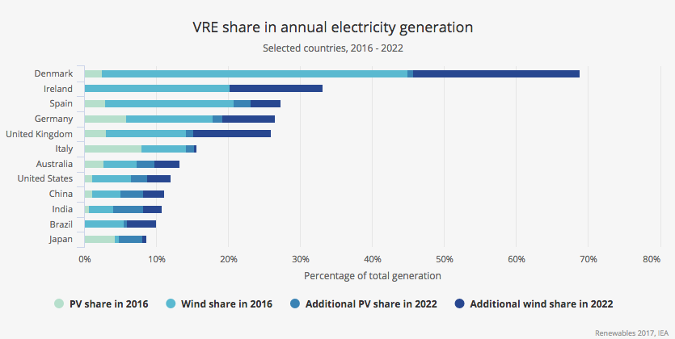
Denmark 44% of electric from PV, Wind, & Hydro, set for 77% by 2022
Notes:
https://grist.org/briefly/renewables-now-provide-a-quarter-of-the-worlds-power/

Slide 10
Hannah Arendt
To me, social constructivism becomes the tool of “totalitarian propaganda”, and a forgery of history used to oppress humankind (Arendt, 1958/1962: 332-3).
The official history of globalization is a joke, and we need traceability of the “known historical reality” and a deconstruction of the “outward facade erected explicitly to fool the people” (Arendt, 1958/1962: 333), or we will continue to elect Trumps, or politics will be “the playground of crackpots” who tell “gigantic lies and monstrous falsehoods” and fake news (333).

Slide 11
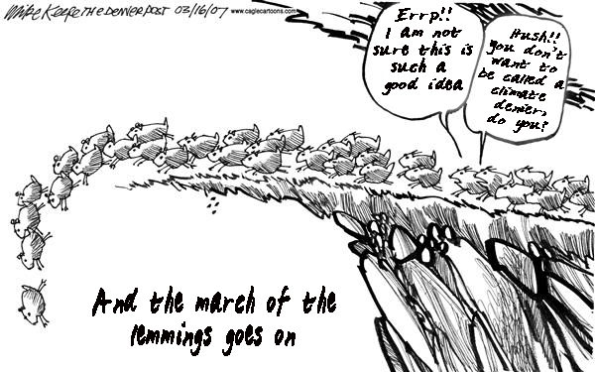
True Storytelling

Slide 12
Globalization Progress Narrative
Globalization’s progress narrative is at variance with generally accepted counternarrative of scientific evidence of climate change, pollution by plastic, and the concentration of total world financial wealth into fewer and fewer hands.
“The so-called leader principle; is in itself not totalitarian; it has borrowed certain features from authoritarianism and military dictatorship which have greatly contributed toward obscuring and belittling the essentially totalitarian phenomenon” (Arendt, 1958/1962: 364).
Rosile, Boje, and Claw (2016) have proposed ensemble leadership theory, where everyone is a leader, rather than relying upon great man leadership, or relational leadership reflexivity.

Slide 13
Poverty Purchasing Price Parity (P4) is not ‘True’ Storytelling
P4 $50 US basket of goods in supermarket, used to determine poverty rates across countries, now poverty line is set by World Bank committee at $1.90 a day
1776 Adam Smith argued poverty is inability to afford commodities necessary to support life and whatever the custom of a country’s lowest order people
1964 US Republicans endorsed LBJ’s concept of RELATIVE POVERTY
2008, the WB revised PPP (due to inflation) of $1.25 a day at 2005 purchasing-power parity(PPP).
2015, the WB updated the international poverty line to $1.90 a day based on PPP calculations of WHAT $1.90 would buy in US supermarket in 2011
CRITICISMS: P4 leaves thinks like healthcare, clean drinking water, nutrition, housing costs, fertile soil to grow crops, safety, and infrastructure out of the standardized food basket of goods

Slide 14
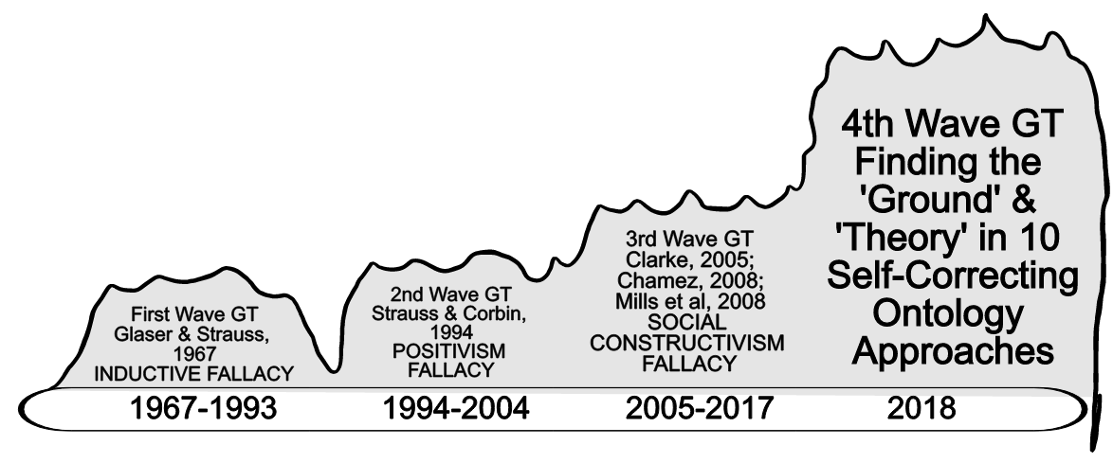
Pre-work: Which Storytelling Research Methods do you know and not know?
Please Review 20 Storytelling Paradigms; 18 are beyond 1st 3 waves of Grounded Theory (GT), and are basis of two new books on 4th Wave Self-Correcting Grounded Ontologies to download at http://davidboje.com/Strathclyde/

Slide 15
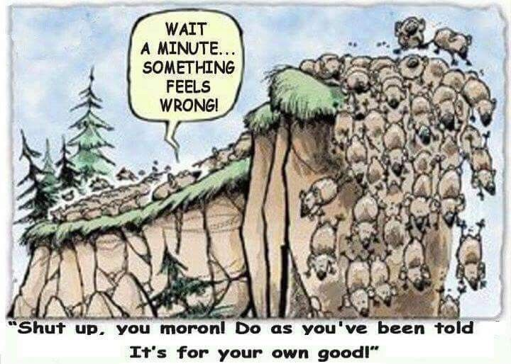
Globalization is a Nightmare

Slide 16
Globalization Nightmare
David Graeber believes, when governments insist on market solutions to every social problem: “a nightmare fusion of the worst elements of bureaucracy and the worst elements of capitalism” - UTOPIA OF RULES
But does it follow that Globalization by State & Corporate Power into vast network of bureaucracies always repressive-bureaucratic. Can it also be liberating to be against WALLS & NATIONALISM? Can there be a GLOBAL JUSTICE MOVEMENT?

Slide 17
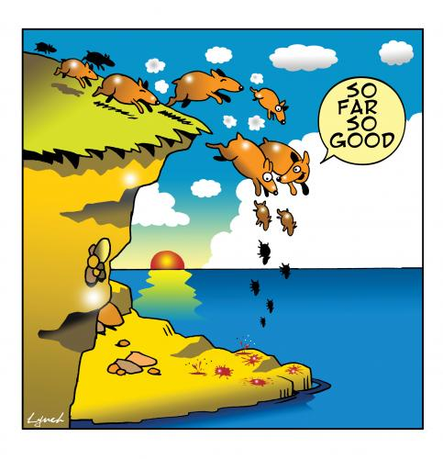
As we approach 6th Extinction

Slide 18
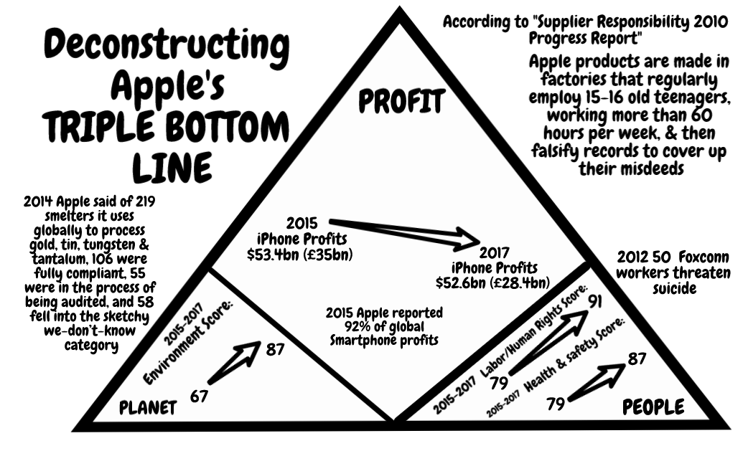
Apple Example

Slide 19
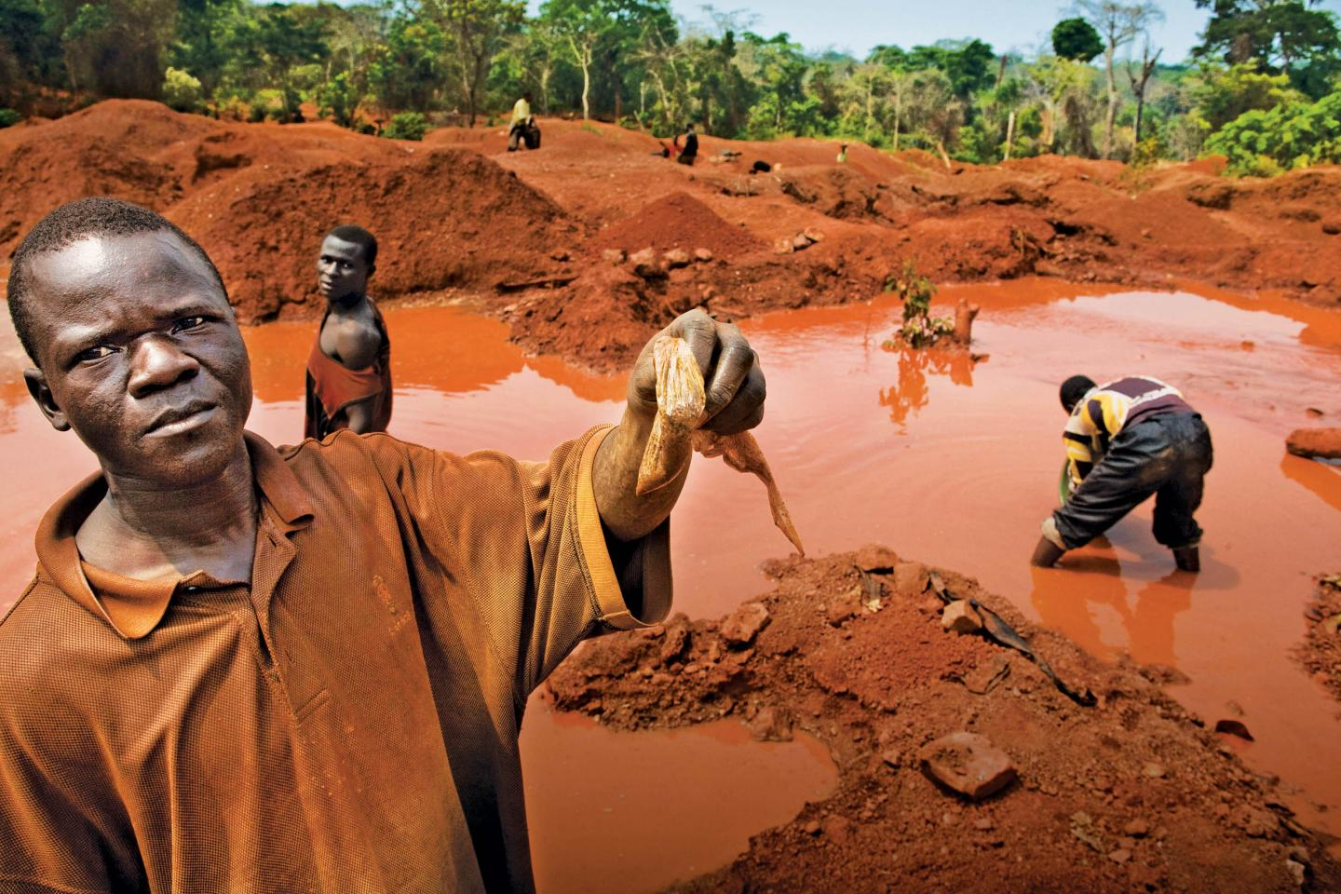
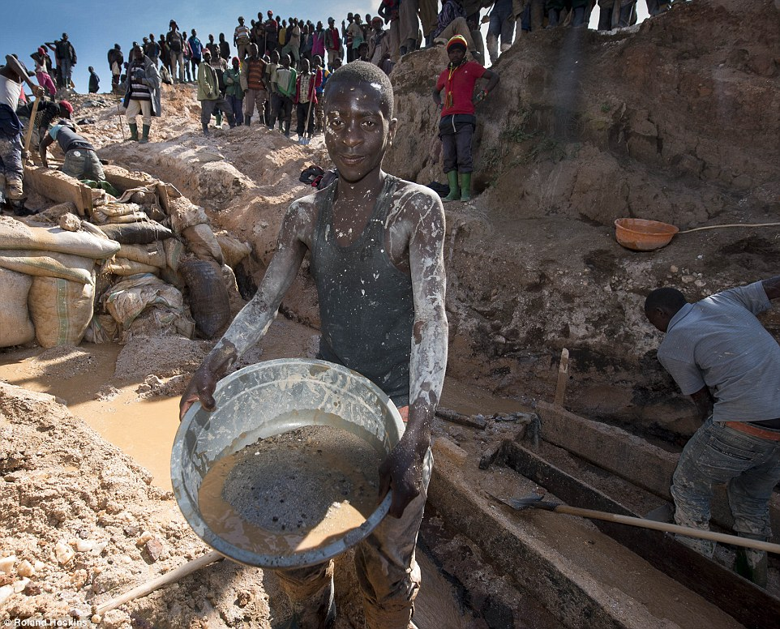
Apple & Democratic Republic on of Congo (DRC)
Notes:
2nd picture http://www.dailymail.co.uk/news/article-3280872/iPhone-mineral-miners-Africa-use-bare-hands-coltan.html

Slide 20
Foucault & Barad
Deployment of ‘true’ storytelling would be deployments of technologies power are directly connected to the body in what is most material and vital (Foucault, 1980a: 151).
As Barad (2003: 810) observes, our bodies are always already historical forces that are already biological that matters, in agential realism in the fullness of materiality.

Slide 21
Cell-phone’s 3T’s + Gold
CONFLICT MINERALS
Tin is used as a solder on laptop and cellphone circuit boards
Tungsten makes your cellphone vibrate
Tantalum stores electricity on your cellphone
Gold is used to coat the cellphone wiring

Slide 22
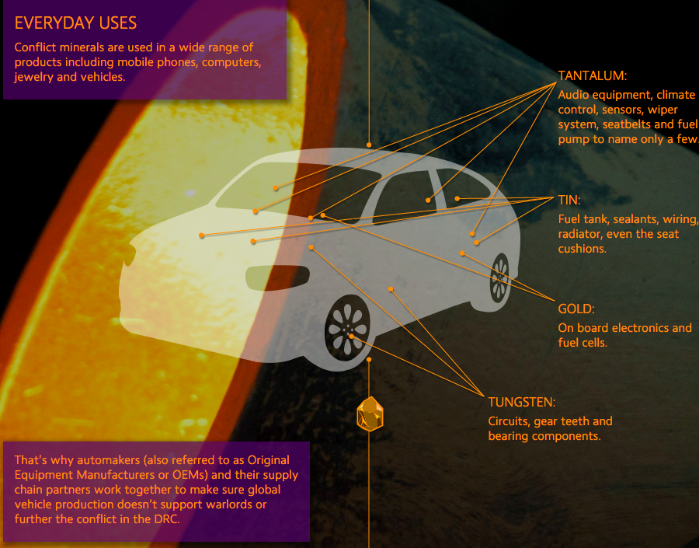
Untold story of 3T’s in Cars

Slide 23
Globalization
Rich western countries are depleting planet’s resources & destroying Earth-ecosystems at accelerating rate.
We build highways across Serengeti plain (Tanzania) to get more rare earth minerals for our iPhones, MacBook & GPS. We grab all the fish from the sea, wreck the coral reefs and put carbon dioxide into the atmosphere.
We have triggered a major extinction event in which humanity is annihilating its own life

Slide 24
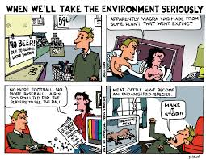
Pause for Q&A
Notes:
See Vinnarei & Laine (2017) The moral mechanism of counter accounts: The case of industrial animal production. Accounting Organizations and Society. Vol. 57: 1-17.

Slide 25
Slavery Auction in Libya 2017
https://www.youtube.com/watch?v=2S2qtGisT34

Slide 26
Fair Food Program — the unfolding story of increasing compliance through the constant back and forth of audits, investigations, and corrections — over the course of all six seasons of the Program’s operation

Slide 27
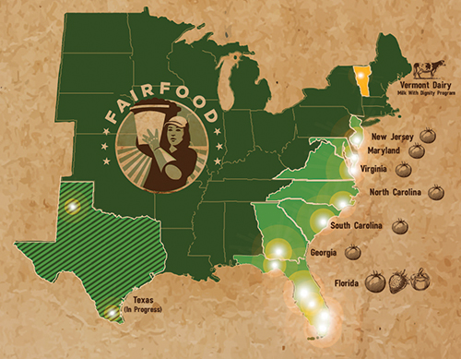
Worker-Driven “Corporate Social Responsibility’ ETHICS Example

Slide 28
Sociomateriality of Modern-Day Slavery In USA
"The bosses carried weapons. They scared me. I never knew where I was. We were transported every fifteen days to different cities. I knew if I tried to escape I would not get far because everything was unfamiliar. The bosses said that if we escaped they would get their money from our families."
--Congressional testimony of Maria, trafficking survivor from Mexico
https://www.commondreams.org/views/2010/06/19/driven-globalization-todays-slave-trade-thrives-home-and-abroad

Slide 29
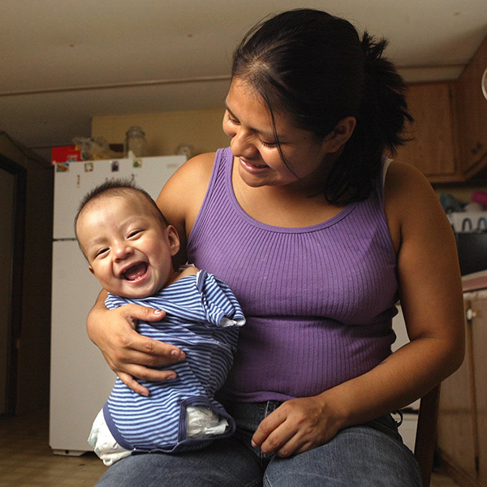
What are the Chemical Working Conditions”
Carlos Candelario, known as Carlitos, was born Dec. 17 without arms or legs.
At the entrance to the field where the mother worked, there is a list of some 30 chemicals used on the crops during the year
This is sociomateriality of storytelling.
Its an embodiment and dismemberment of the next generation
http://www.mypalmbeachpost.com/news/carlitos/

Slide 30
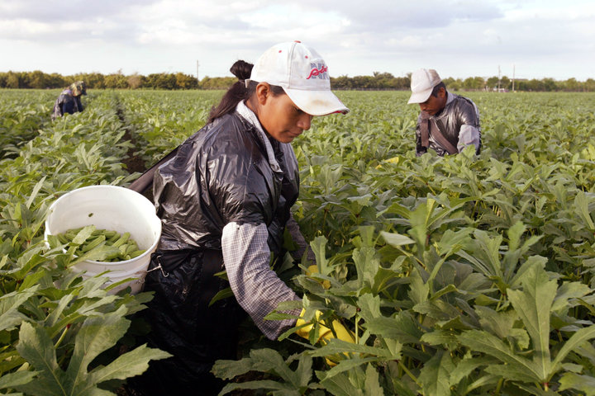
Five Female Migrant Workers Awarded $17 Million In Rape, Harassment Case
The women claim their bosses assaulted them on the job.
By Laura Bassett

Slide 31
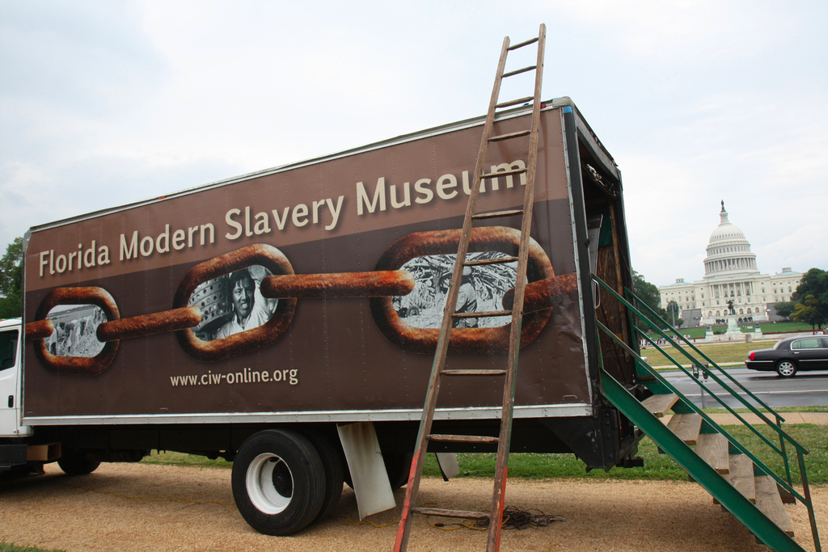
How can you help end global slavery supply chain?
Worker education,
Worker-driven alliances, &
System of alliance of consumers, brands, growers, and workers
This creates revolutionary changes

Slide 32
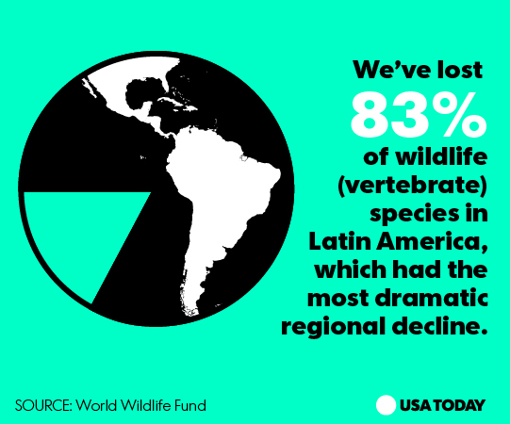
Pause for Q&A

Slide 33
True Storytelling & Kirkeby
1. To be there for the other
To not lead with your judgments
Be part of the groups, face-to-face, and in the flesh
Being aware of different levels of storytelling in the event (or situation)
Be responsible for the event, somehow, as something we do together, in together-telling
Finish the event. Is it true, do you believe it, is it sustainable, and do you have the energy to finish?

Slide 34
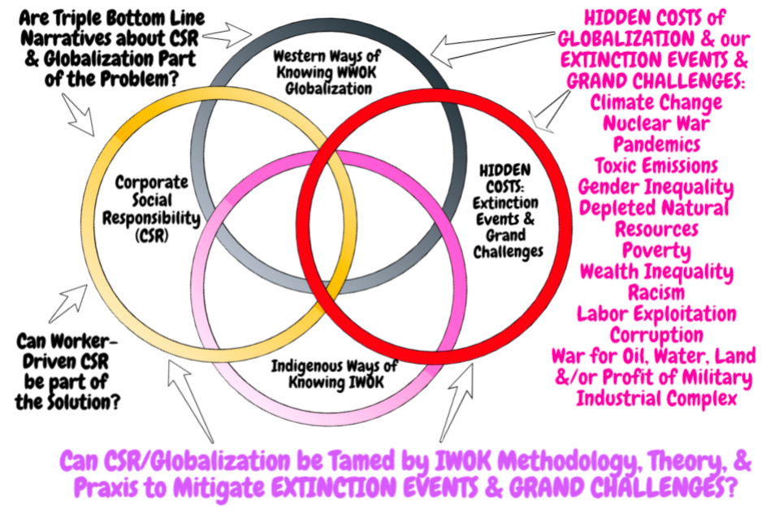

Slide 35
Ranking 18 Economy Models, 3 Offer True Storytelling Solutions to Globalization
Mother Earth Economy
Feminist Economy
Diverse Economy
Moral Economy
Reverse Economy
Informal Economy
Pro-Commons Economy
Circular Economy
Sharing Economy
11. Profitable Economy
12. Collaborative Economy
13. Network Economy
14. Real Business Cycle Economy
15. Triple Bottom Line Economy
16. Invisible Hand Economy
17. Variegated Economy
18. Neoliberal Economy

Slide 36
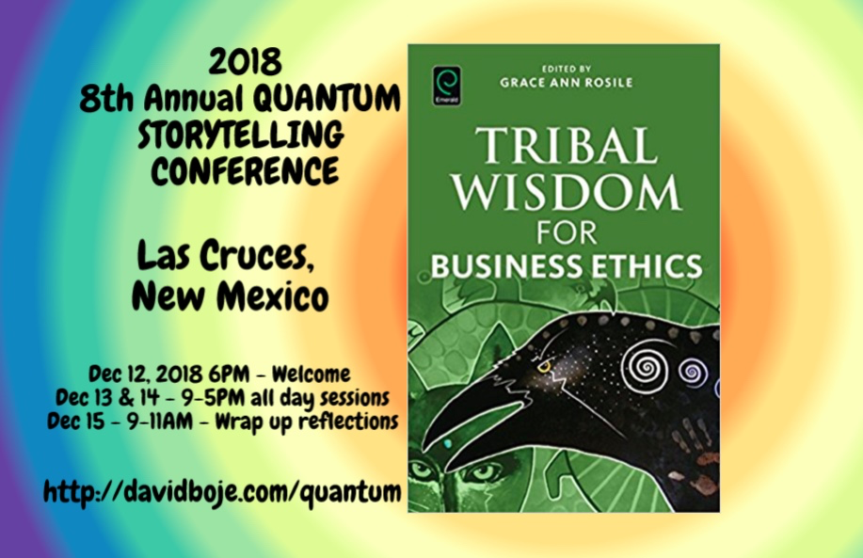
STOP HERE
Question & Answers about TRUE STORYTELLING
Thank you
Milan Storytelling Seminar
Slides & books at http://davidboje.com/Aalborg

