Slide 1
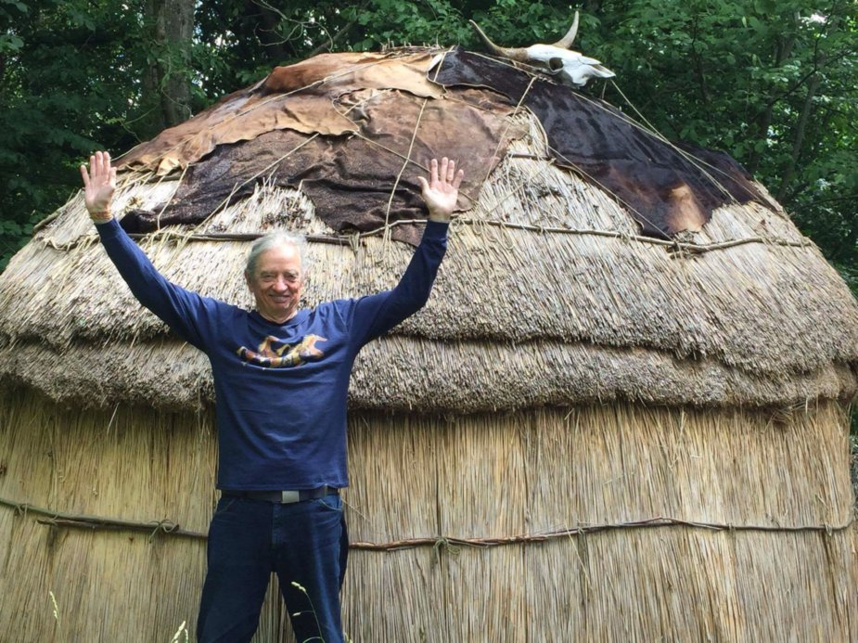
What is True Storytelling?
David M. Boje
Part 1: The Activist Antenarrative for Organizational Storytelling, May 8 2018 presentation to conference “A Discourse Activist Perspective on Organizational Storytelling” at Aalborg University

Slide 2
Problem Based Learning

Slide 3
How can Aalborg PBL save Humanity from Itself?
PBL is an Antenarrative of Forecaring in advance for the Future
PBL can teach students how to foretell and forestructure the future of Humanity in a way that is in balance with planetary limits
PBL can solve the problem of Business School teaching students to believe in the Invisible Hand Narrative of Selfish enterprise in ways that ignores Adam Smith’s moral sentiments.

Slide 4
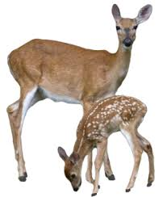
True Storytelling Example
“Grandpa John told me endless stories about young men who had opportunities to live up to their names. One day, he said, ‘there was a young man named Looks Twice---really, he was more like a boy---who left his village alone to hunt, hoping to bring back some meat. He wanted to prove that he was a man. It was in the springtime. He went without a bow or a lance, and he killed a deer with his knife.’… ‘How did he kill the deer, Grandpa?’ I interrupted. ‘You’d better figure that out,’ he said. ‘That’s what will make you a man.’” (Russell Means, in Fixico, p. 88, as cited in Rosile, 2016: 239).

Slide 5
What was he supposed to be looking at?
CONTEXT: What does ‘runs like a deer’ mean?
1. How could LOOKS TWICE get close enough to kill a deer, if he is alone?
2. What kind of deer would be that slow?
3. In Spring, the rains flood the streams?
4. If one hunts with others, then there are more pairs of eyes to see
5. When something seems too good to be true…
6. If true, then is this INDIVIDUALISM the ways of TRIBAL COMMUNITY?
7. What are the sustainability long-term effects of this kind of hunting?
8. Many reasons why hunting alone is TABOO, a rule this young hunter broke
9. When growing up others hear this story and by the time they are young adult, they know the CONTEXT of the living story lessons

Slide 6
Ranking 18 Economy Models, 3 Offer True Storytelling Solutions to Globalization
Mother Earth Economy
Feminist Economy
Diverse Economy
Moral Economy
Reverse Economy
Informal Economy
Pro-Commons Economy
Circular Economy
Sharing Economy
11. Profitable Economy
12. Collaborative Economy
13. Network Economy
14. Real Business Cycle Economy
15. Triple Bottom Line Economy
16. Invisible Hand Economy
17. Variegated Economy
18. Neoliberal Economy

Slide 7
GDP is not ‘true’ storytelling
GDP is NOT measure of anything relevant to ecology
GDP rankings of nations is “ecologically irrelevant, since they do not account for the possible absolute increases in material flows from the ecosphere to the economy” (Milne & Gray, 2013: 23).

Slide 8
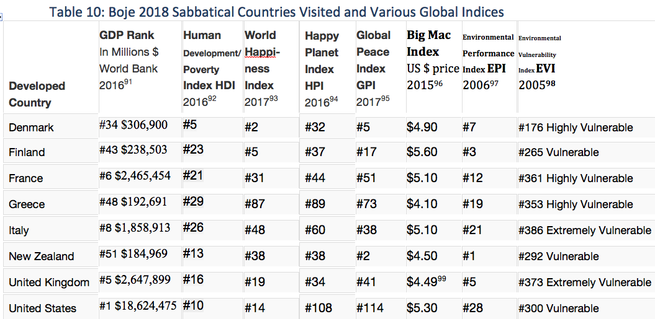
Various Globalization Indices on Boje’s Sabbatical

Slide 9
Smith’s Invisible Hand Narrative is a Problem for PBL
Smith observed that nature is design to look after itself first, and others second, which is how humankind ought to approach happiness. However, this is not a self-interest that equates with selfishness. “To be selfish is to be a slave to one’s own passions, constantly seeking to appease short term desires at the expense of our long term health or well-being and heedless of the views of others” (Hodder, 2016: 47).

Slide 10
Globalization = Invisible Hand Fantasy
Globalization is the ultimate ‘invisible hand fantasy’ NARRATIVE: by slashing budgets, deregulating markets, there will be an system equilibrium of greed=good that supports efficient national economies that are for good of all nations (& corporations). The reality is globalization greedy, growth mania, and gluttony is a recipe for bust and boom crisis- cycles of socioeconomic instability profiteering, not general equilibrium.

Slide 11
Working with Marita & Kenneth
Social constructivism is making an important turn to understand how the social and the material are both agential.
Business schools teach the Invisible Hand Fantasy Narrative without attending to the fantasies of organizational communication, the need for counter account in accounting, the need to treat people as humans and not resources in Human Resource Management.

Slide 12
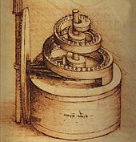
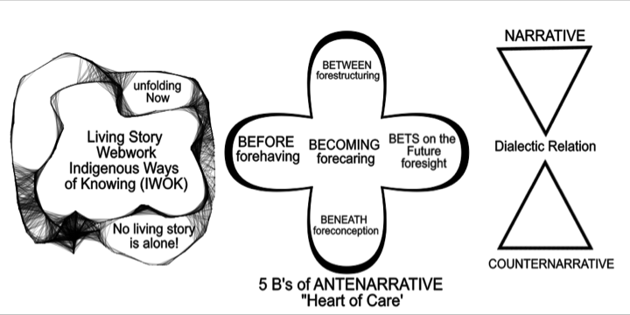
What is Antenarrative?

Slide 13
Antenarrative & True Storytelling
“Antenarratively, True Storytelling is “pre-ontological” in all kinds of fore processes, ante to ontological: fore-having (before), fore-conception (beneath), fore-structuring (between), fore-sight (bets on the future), and fore-caring for our own liberatory praxis (Boje, 2014; see work with Marita Svane, and articles with Haley and with Saylors).

Slide 14
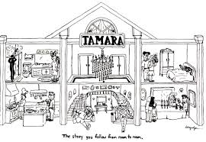
TAMARA-LAND

Slide 15
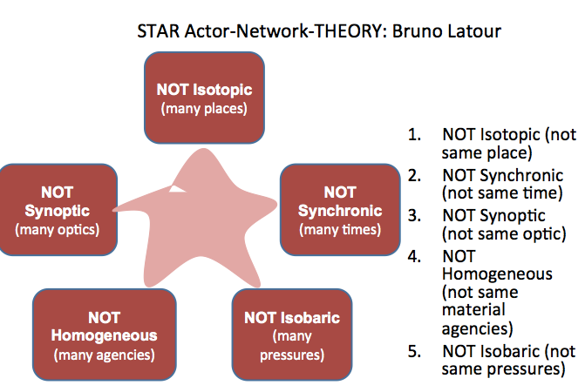
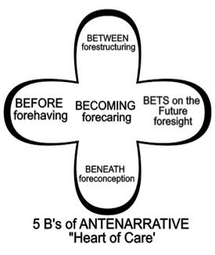
Antenarrative Process and Latour
What is Actor Network Theory (ANT)?
What is Agential Realism in Karen Barad’s work
What is Sociomaterialism?

Slide 16
Antenarrative is NOT Representationalism
Representationalism has been challenged by Michel Foucault and Judith Butler. Foucault focuses on juridical systems of power that produce subjects according to requirements of power structures using language and power. Butler (1990: 2) looks at how women as subject is a discursive formation and effect of a given representationalist politics. If we follow Butler, then performative is not a thing, or free-floating representational story/narrative, but rather the doing of ‘true’ storytelling.

Slide 17
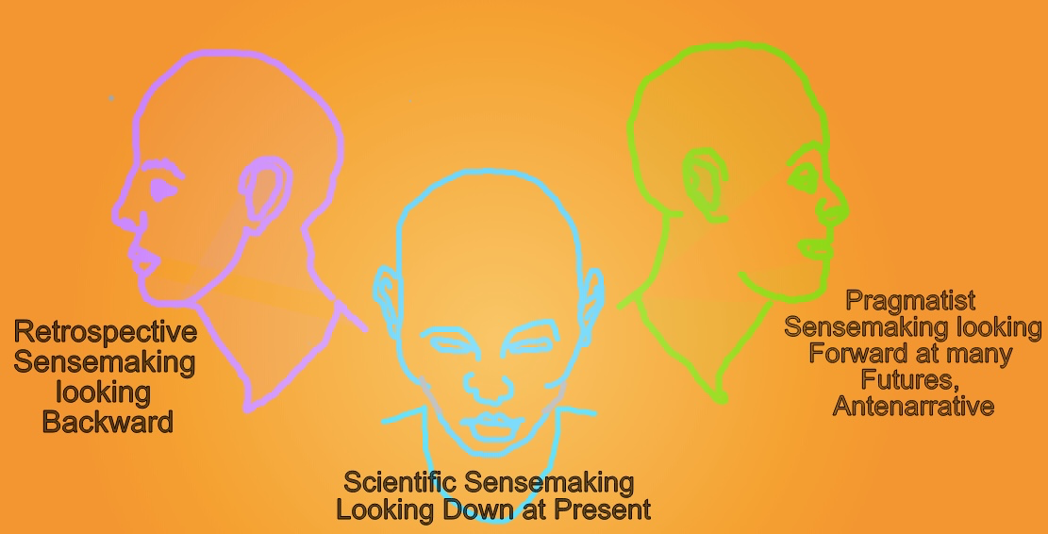
Retrospective & Antenarrative Look Differently

Slide 18
Kierkegaard & True Storytelling
“More specifically, the ethic realm starts with a conscious effort to choose one's life, with a choice to choose. Either way, however, an individual can go too far in these realms and lose sight of his or her true self” – Either/Or

Slide 19
Dialectics
It is important to move beyond silly dialectic of thesis-antithesis-synthesis between Narrative-Counternarrative
To the dialectic Hegel imagined, but Marx could not appreciate
It is called the Negation of the Negation Dialectic
Marita and I are developing this 2nd Dialectic as a way to understand the relation between LIVING STORIES and ANTENARRATIVE PROCESSES.

Slide 20
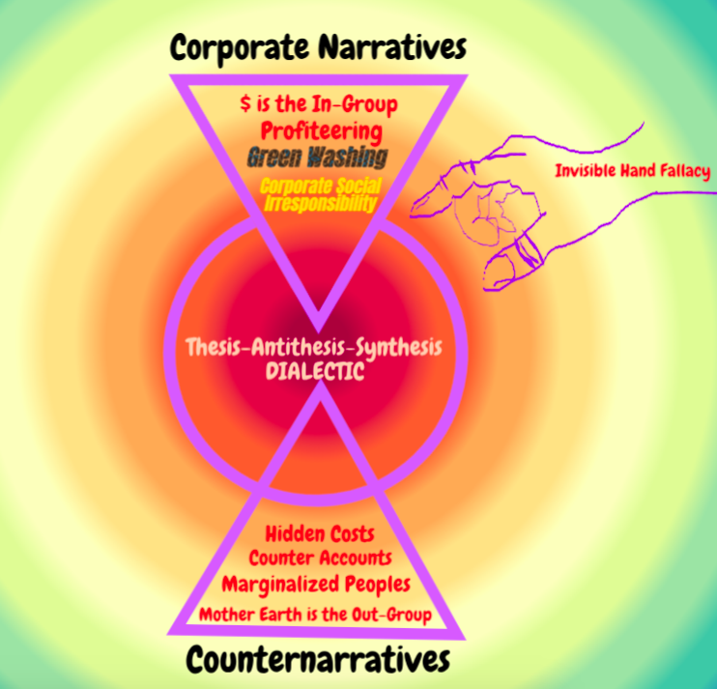

Slide 21
What is 2nd Dialectic
It is an endless echoing negation of the negation that is itself negative. ‘Not not Being’ is the equivalent of saying “it is in itself negative” (Henrich, 2003: 218). Henrich (2003: 316) explains the negation of negation dialectic as Hegel’s conception of the notion of ‘life’. By contract, for Heidegger, negation of negation dialectic is a notion of fore-caring in advance of good conscience, where a evil fore-caring is always a potentiality.

Slide 23
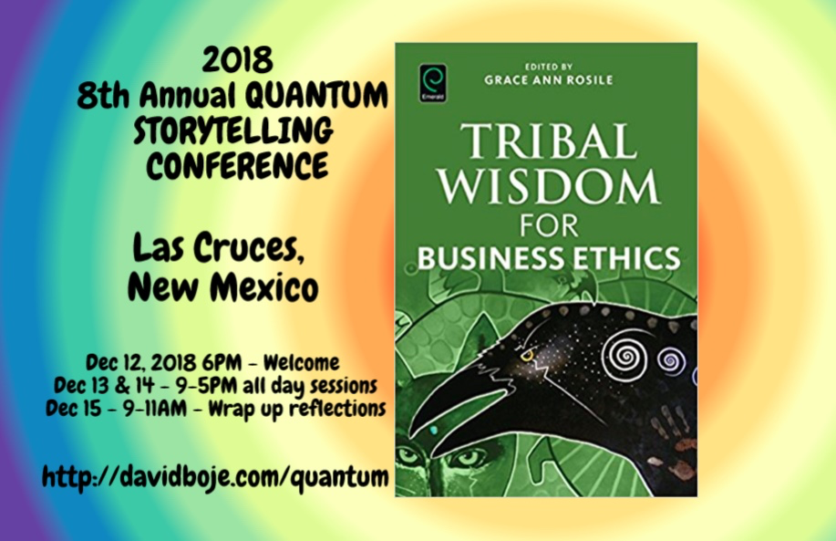
STOP HERE
Question & Answers about TRUE STORYTELLING
Thank you
Milan Storytelling Seminar
Slides & books at http://davidboje.com/Aalborg

