Slide 1
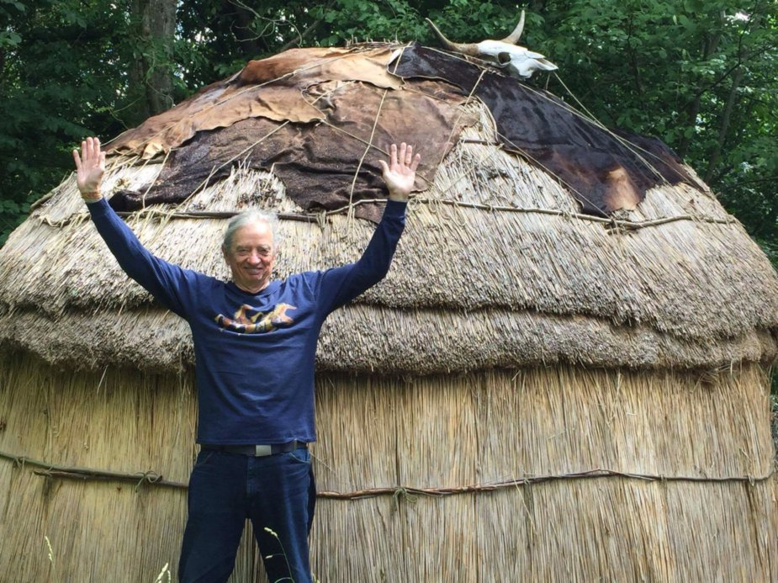
What is True Storytelling?
David M. Boje
Part 3: The Activist Antenarrative for TRUE STORYTELLING CONSULTATION, May 8 2018 presentation to conference “A Discourse Activist Perspective on Organizational Storytelling” at Aalborg University

Slide 2
People say
There is no ‘true’ storytelling because there is no singular truth, never will be. 1
There is no ‘true’ storytelling because our lives of comprised of many overlapping stories. 2
Yet, we live in the eye of the HURRICANE of change, the turbulent movements, the emergence, the path of our LIVING ‘TRUE’ STORYTELLING that has an aliveness

Slide 3
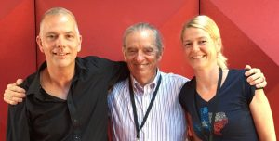
Old Friends
‘True’ Storytelling, not only of history, but the future, in antenarrative practices (Jens Larsen, Lena Bruun, and David Boje, Old Friends Industries http://oldfriendsindustries.com/?page_id=960).

Slide 4
Ranking 18 Economy Models, 3 Offer True Storytelling Solutions to Globalization
Mother Earth Economy
Feminist Economy
Diverse Economy
Moral Economy
Reverse Economy
Informal Economy
Pro-Commons Economy
Circular Economy
Sharing Economy
11. Profitable Economy
12. Collaborative Economy
13. Network Economy
14. Real Business Cycle Economy
15. Triple Bottom Line Economy
16. Invisible Hand Economy
17. Variegated Economy
18. Neoliberal Economy

Slide 5
The Seven True Storytelling Principles:
One. You yourself must be true and prepare the energy and effort for a sustainable future.
Two. True storytelling makes spaces respecting the stories already there.
Three. You must create stories with a clear plot creating direction and help people prioritize.
Four. You must have timing.
Five. You must be able to help stories on their way and be open to experiment.
Six. You must consider staging including scenography and artifacts.
Seven. You must reflect on the stories and how they create value.

Slide 6
1st True Storytelling Principle: You yourself must be true and prepare the energy and effort for a sustainable future.
3 Questions:
Do you believe in it?
Do you have the knowledge to solve it?
Can you be in it (get energy and not burn out) in long future?
YouTube: Council of Elrond
Notes:
Example: Living Stories with a Place, A Time, and a Truth of lived experience
Happening Here and Now
In the middle, unfolding, emerging, happening
Goes from strategic level of power, to what is best for the world in Council of Elrond
Tell LESS is MORE
BE AUTHENTIC - Create an emotional component that resonates with the audience YouTube Peter Guber of Mandalay Group, so they retell it forward owning; See article 4 truths of the storyteller HBR

Slide 7
What is True Storytelling?
“Actuality is the unity, become immediate, of essence with existence, or of inward with outward … Existence is immediate unity of being and reflection: hence appearce: it comes from the GROUND, and falls to the GROUND” (Hegel #142, Encyclopedia of the Philosophical Sciences, Part One).

Slide 8
PRACTICE Exercise Principle 1: You yourself must be true and prepare the energy and effort to be sustainable future
INSTRUCTIONS:
Write a living story of you being true and preparing something you believe in
How were you able to stay energized (or not)?
How was this sustainable future?
PRAXIS means THEORY+METHOD in ACTION, a transformational change/liberation from oppression, injustice, in order for family and/or community to bring about new way of Being-in-the-world together so LOOKS TWICE has lessons for the Elders and Parents to teach the young, growing up, so they don’t hunt alone, and destroy the herd the sustains the tribe.
Notes:
1.INDIRECT Give a ‘story-stem’ and ask partner to complete the story, what do you imagine happened next?
2. INCLUSIVE – Include non-human characters in your story They send meta message about Natural world
3. INCOMPLE – Tell it terse so the partner fills in the blanks with taken-for-granted assumptions
4. IN CONTEXT – Partner needs to explore the context of the story to discover learning principles/lessons
5. INQUIRING – Story-teller, ask partner ‘what is the moral of this story’ rather than just telling it.

Slide 9
Debrief True Storytelling Principle 1: You yourself must be true and prepare the energy and effort to be sustainable future
LIST DISADVANTAGES
1.
2.
3.
4.
LIST ADVANTAGES
1.
2.
3.
4.

Slide 10
Principle 2: True storytelling makes spaces respecting the stories already there
How can you take a BUS TOUR to visit spaces to listen to others’ storytelling before imposing your own strategy (power-over)?
Before a new initiative, how can you make spaces for stories already there? (power-with)
How can you make space for how Mother Earth is telling her story? (how is Mother Earth telling; are we listening?)
Walter Benjamin (1928) walks through the spaces of a city in order to develop intuitive understanding of signs of what is Becoming (this is antenarrative method to assess future arriving).
Notes:
Diane Dredge suggested Bus Tour with all the stakeholders on board on Tues May 8 2018 at Aalborg, at conference held there on storytelling
How to tell a motivating & inspiring story? MOST ENGAGING STORY WAITING TO BE TOLD IS YOURS! I was so shocked, surprised, stupid, suspicious (HOW DID YOU FEEL?)
What is ENGAGING & EMOTIVE-language? – when audience is ENERGIZED (look to body language) – START WITH CONTEXT (PAINT THE VIVID SCENE) e.g. in my driving through woods, icy roads, snowing, on mountain road ADD DIALOGUE
A PROBLEM, an OBSTACLE to OVERCOME: E.g. When I was first person in family ever to go to college? SET UP FOR THE TIMING POINT (THE ARC is SET) THEN SURPRISING TURNING POINT seeYouTube: Jim Carey
A proud moment when MORAL OF STORY →YOU inspired others? THE RESOLUTION E.g. When Bo Kimble died, the team used my motto to move forward

Slide 11
True Storytelling Leader
True storytelling leadership means change form the ‘strong leader’ assumption that other people don’t know anything and like lemmings have to be led.
How could you, as leaders, support other’s way of life? - Maiken

Slide 12
EXERCISE Principle 2
Practice in pairs using Principle 2: True storytelling makes spaces respecting the stories already there
How to develop together-telling to develop your own true storytelling initiative?
Talk to all kinds of people from many walks of life?
How can you be caring in advance to develop together-telling of your initiative?
Where are the material-discursive spaces of True Storytelling? CAN YOU TAKE A TOUR OF THEM?

Slide 13
Debrief Principle 2 True storytelling makes spaces respecting the stories already there
LIST DISADVANTAGES
1.
2.
3.
4.
LIST ADVANTAGES
1.
2.
3.
4.

Slide 14
Principle 3: You must create stories with a clear plot creating direction and help people prioritize
What is the STADUM (plot, theme, etc.) of the ‘true storytelling’?
What is the PUNCTUM that moves the ‘true’ storytelling into it twist, surprise direction?
What was so well hidden that the actor herself was unaware or unconscious of it?
A PLOT has a WHY in it. “The king died, and then the queen died” is STORY without PLOT; The king died, and then the queen died of grief → is a PLOT that tells WHY? (E M Forster, Aspects of the Novel).
Notes:
In change people grasp for a narrative plot with clear why. A Punctum helps this.
Lars Bo H. presentation in Aalborg May 19 2018 spoke of the WHY in plot.

Slide 15
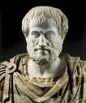
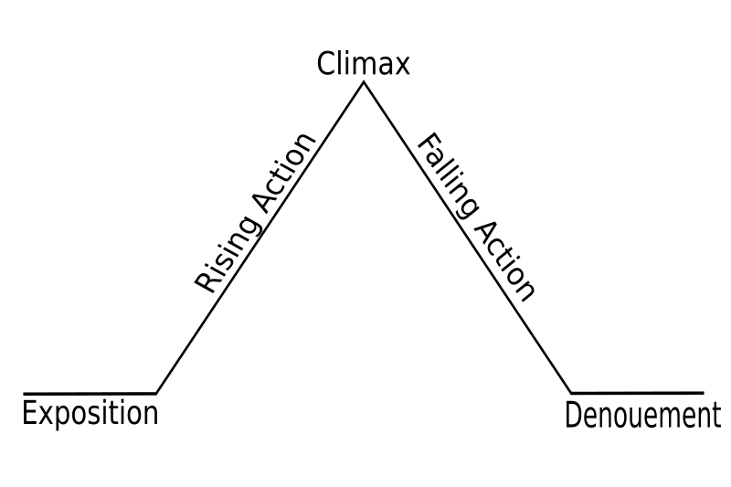
Principle 3 of True Storytelling: You must create stories with a clear plot creating direction and help people prioritize.
Narrative requires story to be “… a whole … a whole is that which has beginning, middle, and end” + WHY? (Aristotle, 350 BCE: 1450b: 25, p. 233).
Notes:
To create a wide narrative with clear plot, but one where they can see themselves, and what is important less important. But not petrified, needs to be flexible

Slide 16
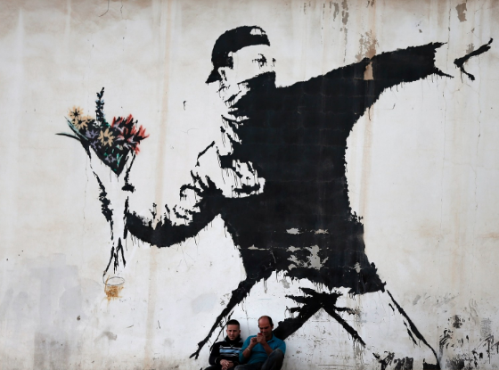
Punctum YouTube
Banksy’ street-art YouTube

Slide 17
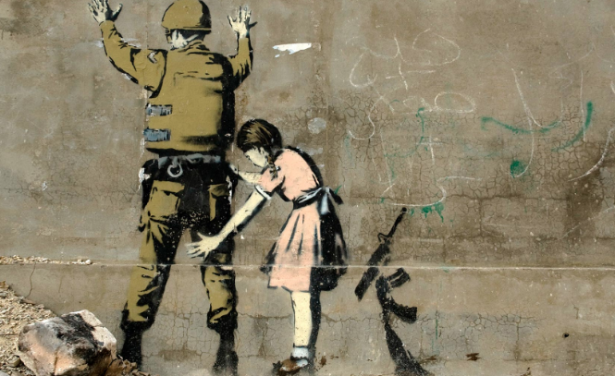
Punctum is a [re]‘grounding’
‘Existence is immediate unity of being and reflection: hence appearance: it comes from the ground, and falls to the ground.
In actuality this unity is explicitly put, and the two sides of the relation identified. Hence the actual is exempted from transition, and its externality is its energising. In that energising it is reflected into itself: its existence is only the manifestation of itself, not of another” (Hegel, Encyclopedia of the Philosophy of Science, #142)
Banksy’ street-art

Slide 18
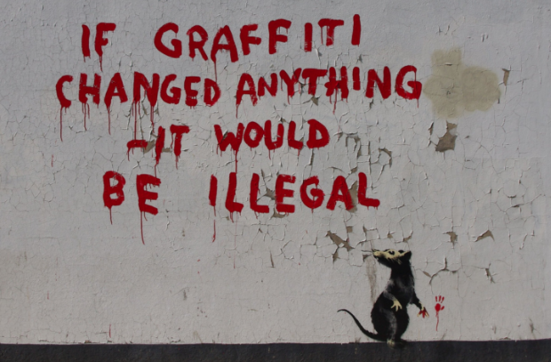
Punctum
Banksy’ street-art

Slide 19
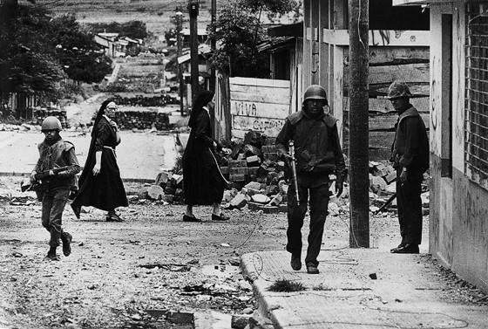
Roland Barthes
What is the PUNCTUM in the overall STADUM (plot, theme, etc.) of the ‘True Storytelling’?
The PUNCTUM moves the story into it twist, surprise direction of WHY?.

Slide 20
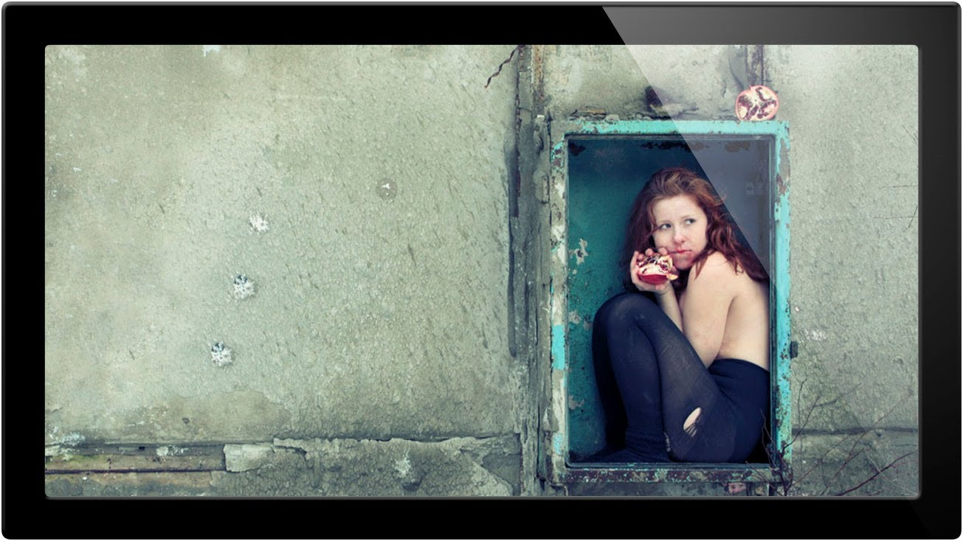
SHOCK or PUNCTUM
“Shock” (quite different from the punctum) consists less in traumatizing than in revealing what (WHY) was so well hidden that the actor [herself] was unaware or unconscious of it (Barthes, p. 32) YouTube

Slide 21
Sears Corporation lost its plot & punctum
Sears was once the most trusted retailer in the world
Everyone had a Sear catalogue
Everyone bought life-time guaranteed Craftsman tools
Everyone could go the the service center to get schematic on how to repair a washing machine, TV, etc.
THEN SEARS LOST ITS PLOT, ITS PUNCTUM
WAL-MART has PLOT with why of low cost goods, but PUNCTUM is missing & its UNTRUE & UGLY engagement, of ETHICS is missing in action
Notes:
Wal-Mart is not a creative space of Thinking-Action-Judgment (phronesis). Where is the Ethical Judgment
See vita activa of Arendt 1998 – freedom resides in the field of politics and actions as Kenneth Jorgensen interprets.

Slide 23
Principle 3 of True Storytelling: You must create stories with a clear plot creating direction and help people prioritize
EXERCISE: Develop 3 strategic plots, each with a WHY & PUNCTUM
Instructions: Individually develop the plot the organization has AS IS now in play (go back in time, to tell how it developed 5, 10, or 20 years and tell it). Second, develop a plot that takes it in a SMALL TURN new direction (tell how it can be future). And a third option that would imagine a quite different future possibility of PATTERN BREAKING.
Get into small groups and discuss all the versions. Agree on the plot now in play, pick a slightly new plot direction, and one that imagines different possibility. What is the PUNCTUM in your version?
Finally, which one does the group seem to agree upon, is the TRUER VERSION of the plot with PUNCTUM. How to put into action?
Notes:
FOCUS: Aristotle, Weick, Czarniawska, Gabriel & Bakhtin say narratives have plots:
1. Count off by 4’s
2. Individually, write brief notes on a plot of your life that is your narrative number: 1. Tragedy, 2. Comedy, 3. Romance-Adventure, & 4. Irony.
3. Pick a new plot (another of the 4 types), and re-narrate same events & characters into a new narrative-plot. Write down a few notes, and put your notes away. USE CONVERSATIONAL INTERVIEWING & ACTIVE LISTENING, NOTE QUESTIONING; In CONVERSATIONAL INTERVIEWING there is mutual sharing back and forth rather than one way interrogation.
4. Find a partner and do CONVERSATIONAL INTERVIEWING with each other.

Slide 24
Debrief ‘True’ Storytelling Principle 3 You must create stories with a clear plot creating direction and help people prioritize
LIST DISADVANTAGES
1.
2.
3.
4.
LIST ADVANTAGES
1.
2.
3.
4.

Slide 25
True Storytelling Principle 4 You must have timing.
KAIROS: place & time when conditions are right for the accomplishment of a crucial ’intelligent’ action
NOT the Beginning Middle End CHRONOS type of Narrative Plot we just did
Rather it is the fleeting RIGHTNESS of PLACE and TIME, and Material-Circumstance for an Opportune Moment
E.g. David’s Story of Meeting Grace Ann & an opportune moment of action

Slide 26
Exercise Principle 4: You must have timing
Write a story of of how TIMING, of an Opportune Moment of Action, you can do to create new future?
Pair off and share with another person
How are the stories similar or different?

Slide 27
Debrief ‘True’ Storytelling Principle 4 You must have timing
LIST DISADVANTAGES
1.
2.
3.
4.
LIST ADVANTAGES
1.
2.
3.
4.

Slide 28
Practice Principle 5: You must be able to help stories on their way and be open to experiment
In socioeconomic approach, we do DPIESs to help stories along. We collect the stories in diagnostic, and experiment in releasing human potential, finding new ways
Diagnostic
Project Design
Implementation
Evaluation of Results

Slide 29
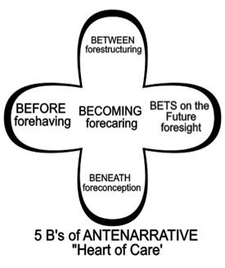
Practice Principle 5: You must be able to help stories on their way and be open to experiment
Use Antenarrative Process Analytic Methodology
INSTRUCTIONS: In small groups work through the 5 B’s, put them on a flip chart page
How is your company preparing in advance BEFORE the future takes place?
What is in advance BENEATH in fore-conceptions?
Identify any BETWEEN the parties, in their fore-structuring?
What are the BETS on the future made with foresight?
What is the entire BECOMING, forecaring?
Notes:
Practice capturing attention, and getting it back when it moves away
Find pulse of audience, then hold it
Prepare the future in advance
Bring new future into being that changes everything before

Slide 30
Debrief ‘True’ Storytelling Principle 5 You must be able to help stories on their way and be open to experiment
LIST DISADVANTAGES
1.
2.
3.
4.
LIST ADVANTAGES
1.
2.
3.
4.

Slide 31
Principle 6: You must consider staging including scenography and artifacts.
True storytelling is responsiveness of performative-action to entanglement of human agents with nonhuman actants in reconfigurations.

Slide 32
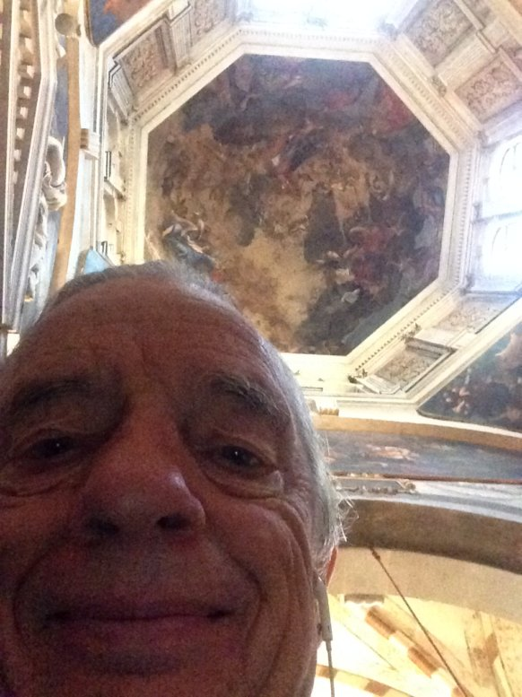
Our place in the world
“Wherever we are, each of us, with our awareness centered inner bodies, is the center of our world. Where we are at any given time is the place, our place in the world. The world of our present consciousness is here and now. Each of us is centered upon ourselves, and from this state of centered presence comes the idea that the surface of the earth is centered at a particular place” (Pennick, 2015: 37).

Slide 33
Practice Principle 6 You must consider staging including scenography and artifacts
Pick from a tray of material objects, several that call out to you, but you are not sure why.
Stage the scenography by placing the objects into relation to one another
This is know as onto-story (vibrant matter as Jane Bennett calls it)

Slide 34
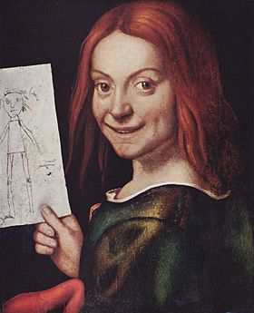
Giovan Francesco Caroto, 1523
Museo di Castelvecchio, Verona

Slide 35
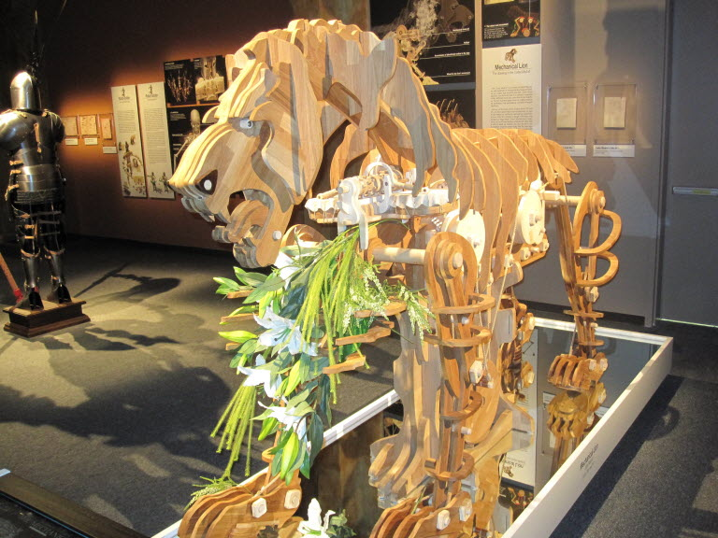
TRUE STORYTELLING Principle 6: You must consider staging including scenography and artifacts.

Slide 36
Debrief ‘True’ Storytelling Principle 6 You must consider staging including scenography and artifacts
LIST DISADVANTAGES
1.
2.
3.
4.
LIST ADVANTAGES
1.
2.
3.
4.

Slide 37
TRUE STORYTELLING Principle 7 You must reflect on the stories and how they create value.
Why a Greenwash story does not create long-term value?
How a FAKE Corporate Social responsibility story loses value?
Can you pull yourself up and look at the WHOLE SITUATION?

Slide 38
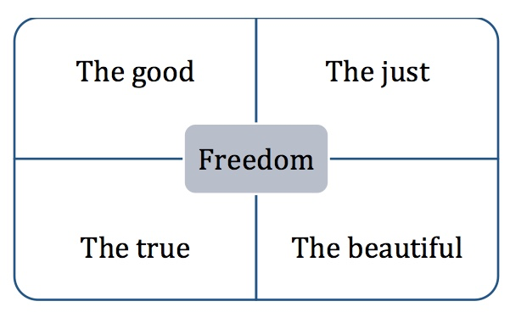
Plato and Kirkeby – GREEK SQUARE

Slide 39
Walter Benjamin – One-Way Street
“If society has so denatured itself through necessity and greed that it can now receive the gift of nature only rapaciously—that it snatches the fruit unripe from the trees in order to sell it most profitably, and is compelled to empty each dish in its determination to have enough—the earth will be impoverished and the land will yield bad harvests” (Benjamin, 2015: 40).

Slide 40
PRACTICE True Storytelling Principle 7 You must reflect on the stories and how they create value.
What are examples of Just, Beautiful, Good, & TRUE Storytelling in your organization?

Slide 41
Debrief ‘True’ Storytelling Principle 7 You must reflect on the stories and how they create value
LIST DISADVANTAGES
1.
2.
3.
4.
LIST ADVANTAGES
1.
2.
3.
4.

Slide 42
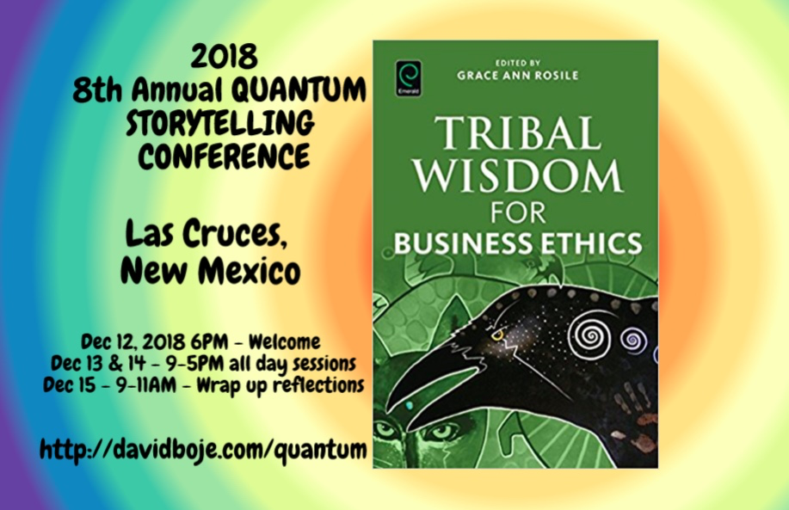
STOP HERE
Question & Answers about TRUE STORYTELLING
Thank you
Milan Storytelling Seminar
Slides & books at http://davidboje.com/Aalborg

