Slide 1
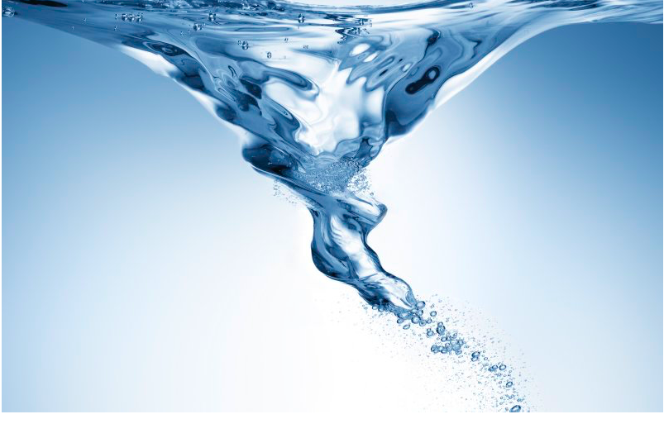
Storytelling and Temporal Interplay Seminar
Centre for Organizational Time (COT)
CBS August 26 2019
David M. Boje
Business & Management Department
Aalborg University
Slides at:
https://davidboje.com/Aalborg
davidboje@gmail.com
Notes:
https://www.cbs.dk/en/research/departments-and-centres/department-of-organization/centres-and-groups/centre-organizational-time-cot
Changing in Time project of COT:
One which studies how temporal structures influence the interplay between strategy and identity across time. This work has recently been published in Strategic Organization. Another strand focuses on the material dimensions of temporality of food organizations based on in-depth studies of several innovations in the two case organizations. Last, but not least the extensive empirical studies of Carlsberg and Arla are serving to inspire the broader theoretical development of a situated view on temporality in organizations.

Slide 2
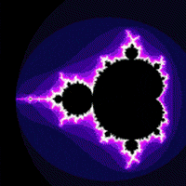
Q1: what is the difference of storytelling and antenarratives?
Antenarrative is prospective sensemaking
Most narrative-counternarrative is retrospective sensemaking
Most narrative is beginning, middle & end – linear time that is ‘abstracting’ a universality
Living story webs are grounding ontologically
I take an ontological approach to temporal entanglement e.g. onto-story (Jane Bennett’s vibrant matter)

Slide 3
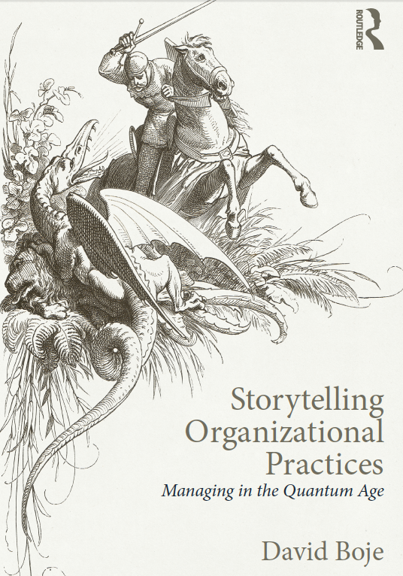
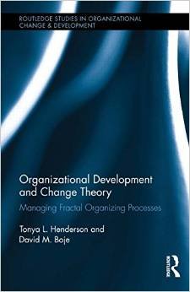
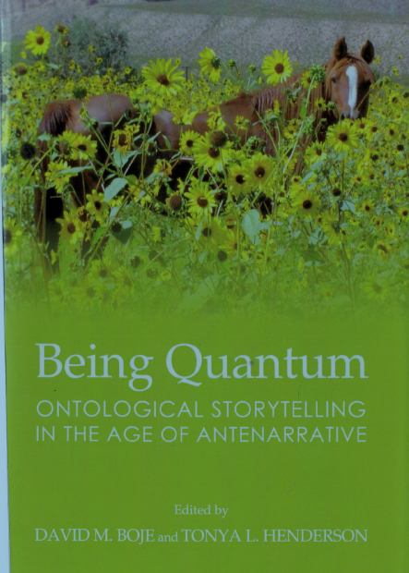
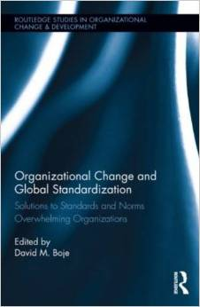
Temporal Interplay is Multifractal
https://davidboje.com/fractal
Notes:
Fractal narrative’ is defined as “a narrative that finds its best accomplished form in the Web” in hyperlink networks (Durate, 2014: 284). A fractal-narrative is linear or cyclical in form, with a central monologic or monomythic structure, a heroic character, in a complex plot within plots, patterns within patterns — that repeats and repeats, from one telling to the next (Boje, 2015, in press).
“A fractal story is defined here as a web of fluid, living story interrelationships between urban chaos and fractal cyber order that is centrifugal, veering away from order toward anarchies, discontinuity and erratic, violent urbanity” (p. 7Boje editor, Organizational Change and Global Standardization: Solutions to Standards and ...
Definition of Fractal-Antenarrative: The fractal antenarrative is different than these other fractals,. The Fractal-Antenarrative is the before-bets-beneath-between-becoming patterning, what Jeff Noon (1996) the “randomologist” calls the Vurt, sometimes in pattern of ‘downward fractal-spiral’ (XXiX), e.g. the downward fractal-spiral of the eco-system with loss of more and more species, extinct by unintelligent action as John Dewey calls it (Boje, 2015: xxxii).

Slide 4
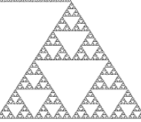
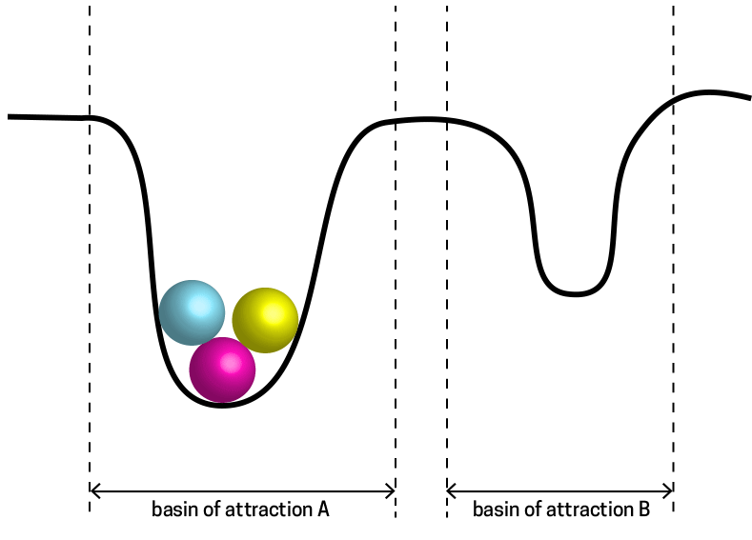
Notes:
Sierpinski triangle fractal, Mandelbrot fractal (see Deleuze & Guattari) and shift of attractors

Slide 5
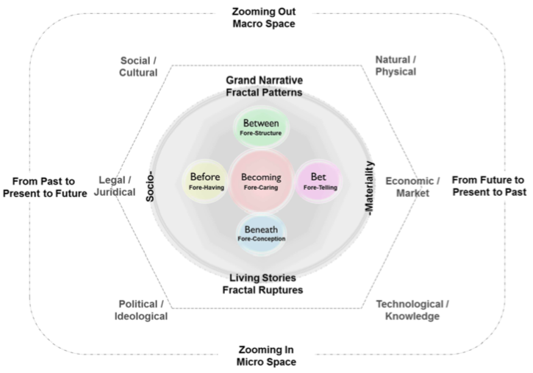
Boje & Svane, 2015
Notes:
https://davidboje.com/vita/paper_pdfs/CHAPTER_Fractal%20change%20management%20and%20counternarrative%20in%20crosscultural.pdf

Slide 6
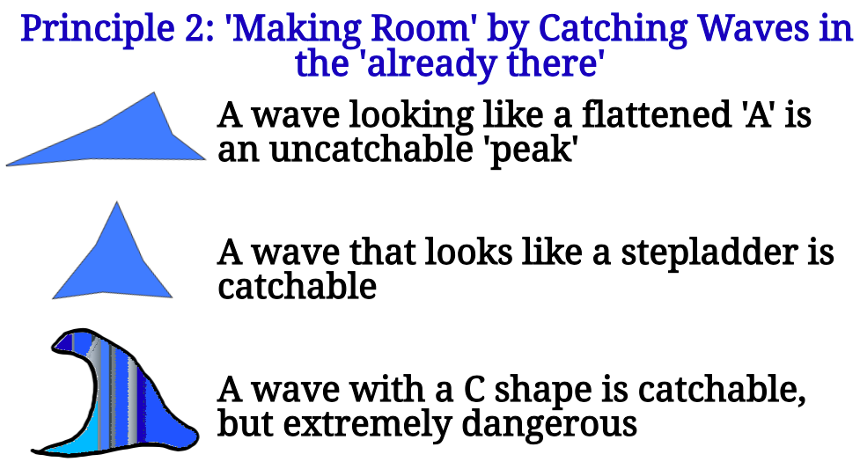
From new book ‘True Storytelling’ with Jens Larsen & Lena Bruun
Notes:
www.truestorytelling.org
Trump and Emmanuel Macron surfs internationally on a false image of climate champion,
There is a gap between the surf conditions and Trump’s enactments of climate denial
Citizens in France are taking down his official portrait from town halls and carrying it upside down in G7 protests https://www.theguardian.com/world/2019/aug/25/french-climate-activists-protest-while-macron-attends-g7-summit
They’ re on a C shape wave that is extremely dangerous even fro the most experience surfers
To study storytelling waveform dynamics requires a different org studies methodology, which is why we are developing self-correcting storytelling science to get at the complexity of multiplicities of storytelling temporal interplay, its spacetimemattering

Slide 7
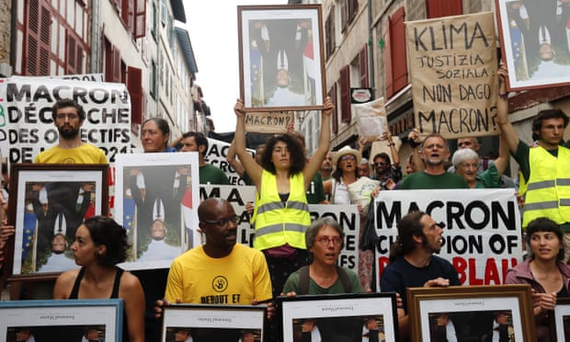
Emmanuel Macron surfs internationally on a false image of climate champion
Notes:
The temporal interplay of narrative identity of Macron is out of whack with the reality of climate emergency On the plus side Macron is saying France needs to be more like Denmark Aug 28 2018 https://www.apnews.com/6e7260b631784585834d945190c0f437/France%27s-Macron:-Denmark-can-do-more-in-European-Union Macron says danish can change because they are Luthern, and the French, well they just hate reform https://www.newsweek.com/macron-criticizes-french-heritage-says-danish-can-change-because-theyre-1097637
Trump officials voice anger at G7 focus on 'niche' issues such as climate change and gender equality and development in Africa. In other words he is zooming out on global trade and economics, while others are zooming in https://www.theguardian.com/world/2019/aug/25/trump-officials-voice-anger-at-g7-focus-on-niche-issues-such-as-climate-change
Trump’s macro zoom-out includes his move to buy Greenland from Denmark https://www.theguardian.com/world/2019/aug/24/trump-greenland-gambit-sad-sign-arctic-up-for-grabs

Slide 8
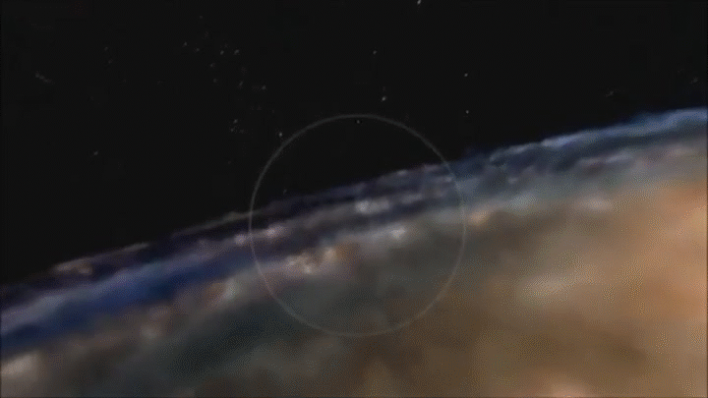

Slide 9
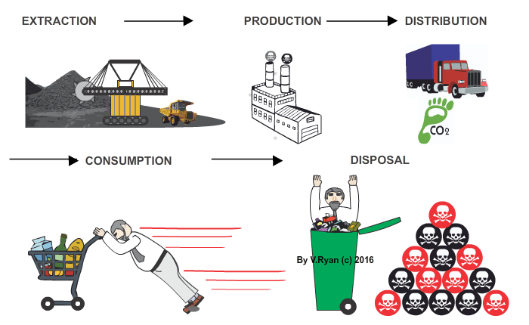
Temporal Interplay Problematic
“The problem is a particular way of arranging humanity’s relationship to the rest of the natural world, in a system focused on ceaseless resource extraction and hydrocarbon consumption in order to funnel wealth and power into the hands of a select few. It’s more commonly known as capitalism.”
Notes:
https://www.newstatesman.com/world/2019/03/who-gets-survive-climate-change
As the waters rise the rich are preparing their arcs https://www.newstatesman.com/world/2019/03/who-gets-survive-climate-change

Slide 10
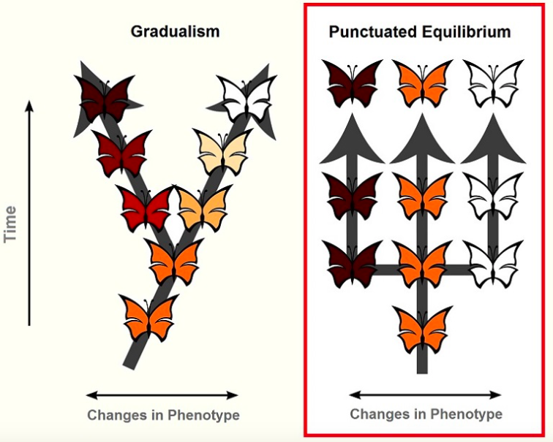
Centre for Organizational Time (COT)
Schultz, Majken, & Hernes, Tor (2019). Temporal interplay between strategy and identity: Punctuated, subsumed, and sustained modes. Strategic Organization
Ordering of past and future time horizons and the temporal depth between those horizons
Different combinations of temporal structures lead to different modes of interplay:
    “punctuated,”
    “subsumed,” and
    “sustained.
Notes:
Toward a theory of using history authentically: Historicizing in the Carlsberg Group
MJ Hatch, M Schultz, Administrative Science Quarterly 62 (4), 657-697
Temporal interplay is their term to “describe how the different temporalities of strategy and identity influence their interaction” Temporal interplay unfolds in a multiplicity of ‘modes of interplay’
A sustained interplay is a continual reciprocal relationship among multiple time horizons and has greater temporal depth extending into both past and future
Longer time horizons have reciprocal interplay between strategy and identity
Abstracting misses connecting identity to the actionability of strategy in ways more consequential to actors.
A subsumed interplay is more dominated by strategy
A sustained interplay is a continual reciprocal relationship among multiple time horizons and has greater temporal depth extending into both past and future

Slide 11
Subsuming and Negation
Do we subsume space within time? (Japanese Aesthetic) - negates time within the depths of time itself
Do we subsume time within space? (Greek Aesthetic) –negated time within a spatial direction
Deleuze negation of the plot with non-narrativizable elements
Comparative Political Culture in the Age of Globalization: An Introductory ...
edited by Hwa Yol Jung, p. 225
Notes:
Deleuzian fractal narratives are spatialized – see German Duarte on fractal narrative
“Deleuzian narrative spatial organization does not represent an arborescent structure, which usually presents a hierarchical system in which the object only receives information from a superior object in a direct line. [39] Like a rhizome, Deleuze analyses the narrative structure of cinematic medium as a 'center-less' system where the communication is not hierarchical and where many different signs in their heterogeneity are able to communicate.” Duarte, G. A. (2012). Gilles Deleuze’s Ideas on Non-Euclidean Narrative: A Step towards Fractal Narrative. Rhizomes: Cultural Studies in Emerging Knowledge, 23.
https://s3.amazonaws.com/academia.edu.documents/39764077/Rhizomes__Issue_23_German_Duarte.pdf?response-content-disposition=inline%3B%20filename%3DGilles_Deleuzes_ideas_on_non-Euclidean_n.pdf&X-Amz-Algorithm=AWS4-HMAC-SHA256&X-Amz-Credential=AKIAIWOWYYGZ2Y53UL3A%2F20190825%2Fus-east-1%2Fs3%2Faws4_request&X-Amz-Date=20190825T052944Z&X-Amz-Expires=3600&X-Amz-SignedHeaders=host&X-Amz-Signature=acf341f8978a945ef6c7a28a7351a9e5897166e3c8dffde05c652e2f20cbe31a

Slide 12
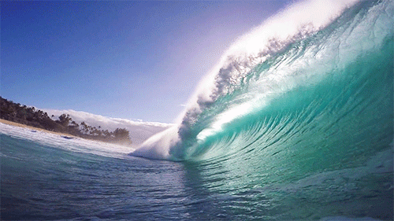
What is Sustained Time?
E.g. Relationship between changes in the concentration of surface nutrients and phytoplankton and that of the downward flux of particles in the deep ocean
E.g. With changes in global average temperature greater than 2 degree C, coastal waveforms are more forceful and destructive
Notes:
https://www.sustainability-times.com/environmental-protection/climate-change-is-making-ocean-waves-stronger/
PROBLEM: temperature increases are increasing flood levels through wave setup, run-up and overtopping.
Climate change will alter waves along half the world's coast August 22, 2019 National Oceanography Centre, UK https://www.sciencedaily.com/releases/2019/08/190822103838.htm

Slide 13
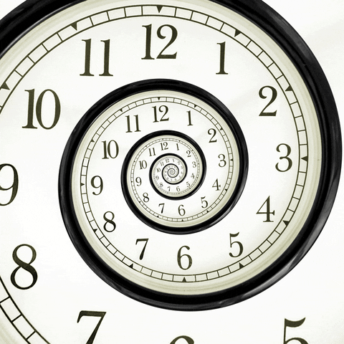
Time Entanglements
Clock time in Cartesian Subject-Object Dualism
Spacetimemattering entanglement (Barad)
Ontology time, Being-in-the-World (Heidegger)
Primordial existence – our birth to death time
Ontic time of an entity – existentiell understanding of things in the world
  Ready-to-hand
  Present-at-hand
Existential – our being-ness in once-occurrent eventness, & moral answerability to intervene (Bakhtin)
Notes:
See https://medium.com/thortspace/heideggers-being-and-time-reader-s-guides-f6f35990b6fa for overview of Heidegger Time vs Cartesian time

Slide 14
Chronos and Existential times
‘Chronos’ (chronological) time is limited by minutes, hours, days, months, years, and end of physical existence
Existential Time’ is multiplied by our creative life force energy, interactions, connections, experiences, attitudes, the legacy we are ‘living,’ and becomes an imprint of our existence and unique essence long after our physicality ends.
Notes:
https://docs.wixstatic.com/ugd/074d7e_5ed0cebc443648d9a7958e56c04477d0.pdf Marie S. Dezelic, PhD & William S. Breitbart, MD

Slide 15
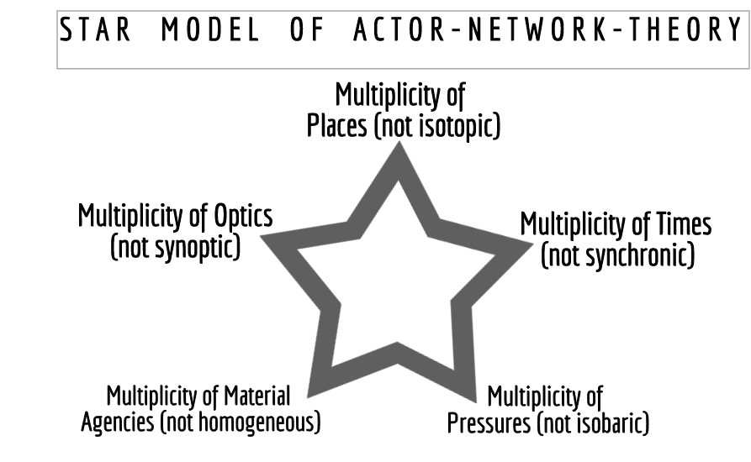
Boje 2019 Organizational Research: Storytelling in Action (Routledge)

Slide 16
Storytelling & Temporal Interplay
Lawson, J. (2011). Chronotope, story, and historical geography: Mikhail Bakhtin and the space‐time of narratives. Antipode, 43(2), 384-412.
Dawson, P., & Sykes, C. (2019). Concepts of time and temporality in the storytelling and sensemaking literatures: A review and critique. International Journal of Management Reviews, 21(1), 97-114. https://onlinelibrary.wiley.com/doi/pdf/10.1111/ijmr.12178

Slide 17
Boje, D.M., Haley, U. and Saylors, R. (2016a). Antenarratives of organizational change: the microstoria of Burger King’s storytelling in space, time and strategic context. Human Relations, 69, pp. 391–418.

Slide 18
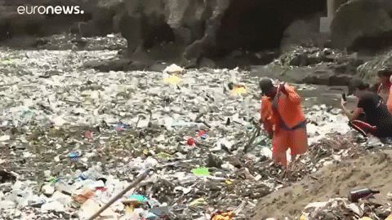
Little Consideration of Temporal Interplay
Aristotelian narratives with a linear time structure, stories with a beginning, middle and end (Dawson & Sykes, 2019)
Retrospective sensemaking narratives (Weick) of the past

Slide 19
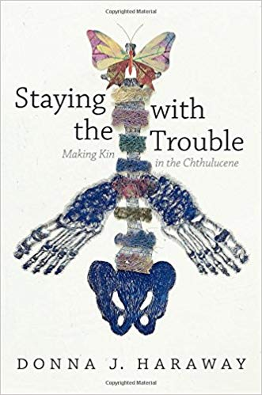

Slide 20
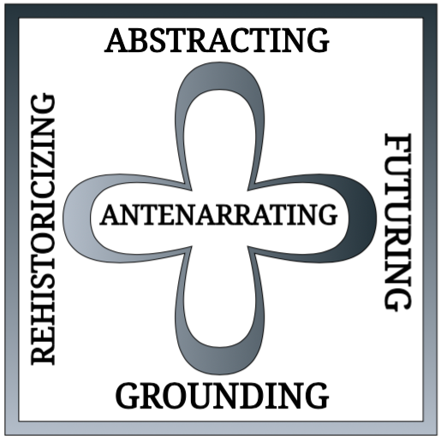

Slide 21
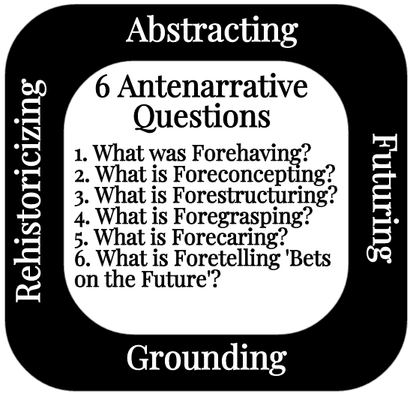

Slide 22
Q2 - what is time and/ temporality in a narrative/storytelling approach to org studies?
“The attribution of anthropogenically forced trends in the climate system requires an understanding of when and how such signals emerge from natural variability”
Sarah Schlunegger, Keith B. Rodgers, Jorge L. Sarmiento, Thomas L. Frölicher, John P. Dunne, Masao Ishii & Richard Slater. (2019). Emergence of anthropogenic signals in the ocean carbon cycle. Nature Climate Change https://www.nature.com/articles/s41558-019-0553-2
Notes:
McKinley, G. A., Pilcher, D. J., Fay, A. R., Lindsay, K., Long, M. C., & Lovenduski, N. S. (2016). Timescales for detection of trends in the ocean carbon sink. Nature, 530(7591), 469.

Slide 23
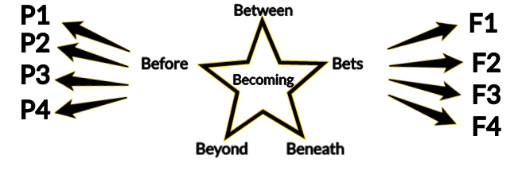
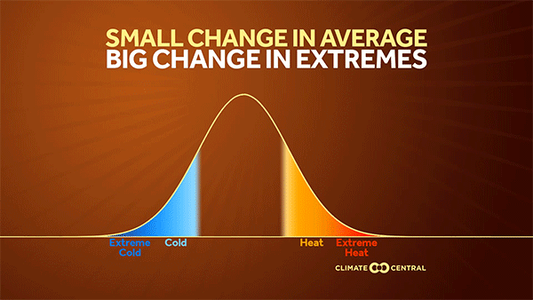

Slide 24
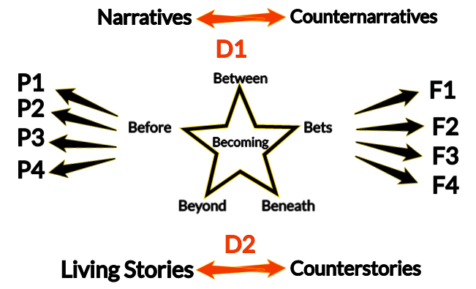

Slide 25
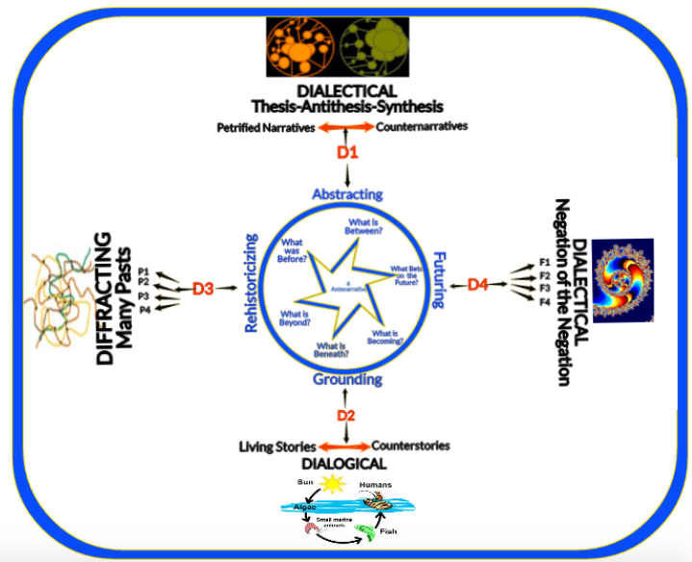

Slide 26
Q3 - - what role does storytelling fractality play in creating organizational (sustainable) past/present/futures?

Slide 27
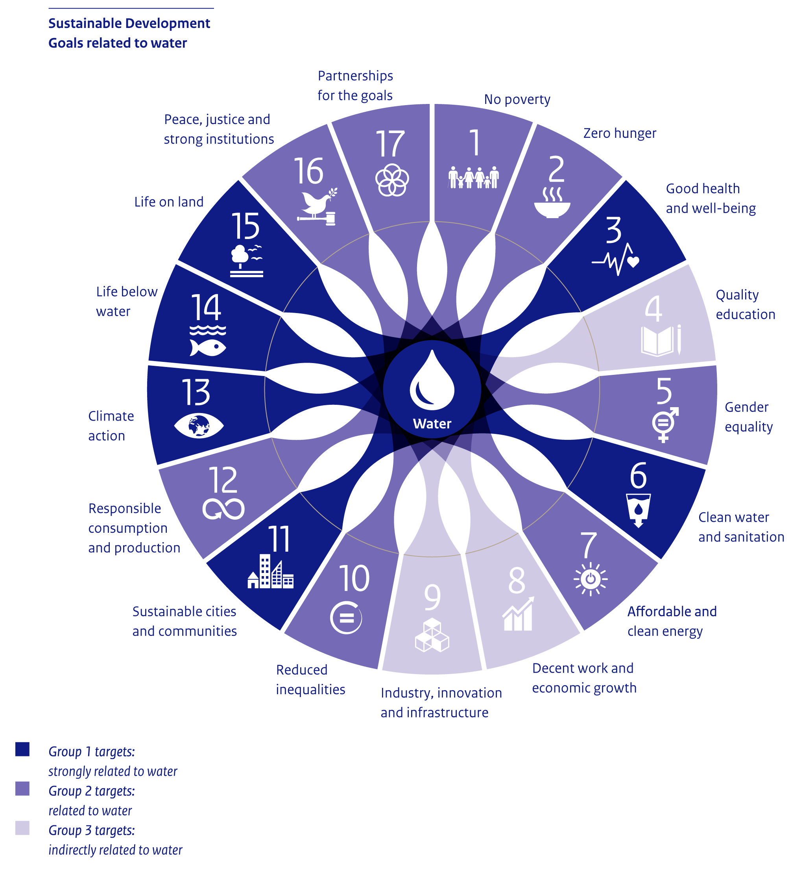
Notes:
https://www.pbl.nl/sites/default/files/cms/038s_iwc18.png

Slide 28
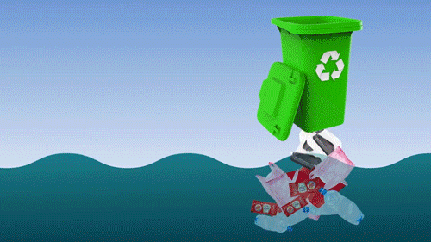

Slide 29
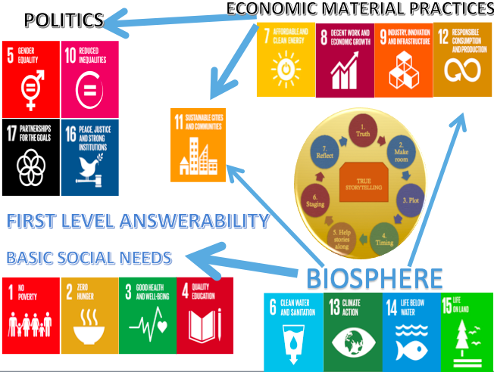

Slide 30
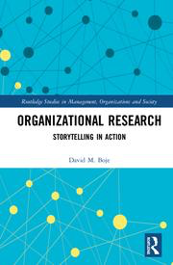
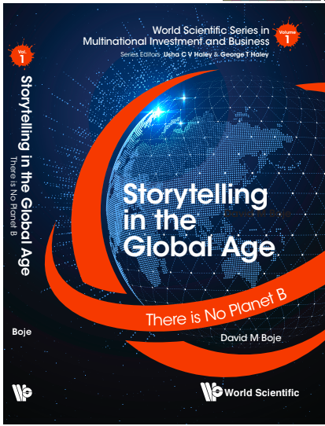
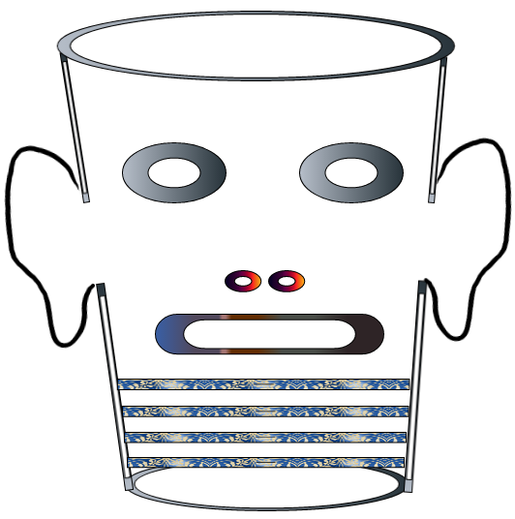
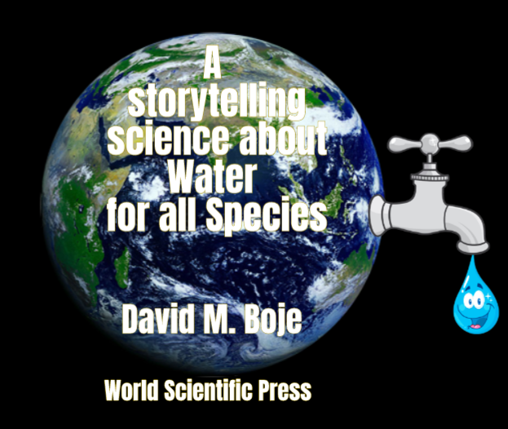
Storytelling Science and Your Dissertation
David M. Boje & Grace Ann Rosile
UK, US, Singapore: World Scientific
February 21, 2019; Revised March 19, 2019
Thank You: Any Questions?
Download Storytelling Science book and slides for this presentation at https://davidboje.com/Aalborg
Notes:
If you have and comments or questions contact me at davidboje@gmail.com
Thank you

Slide 31
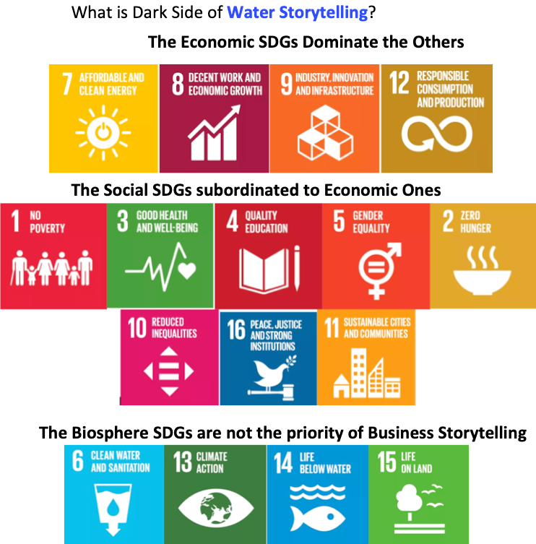

Slide 32
Boje, D.M. (2001). Narrative Methods for Organizational and Communication Research. London: Sage.
Boje, D.M. (2006). Breaking out of narrative’s prison: im- proper story in storytelling organization. Storytelling, Self, Society: An Interdisciplinary Journal of Storytelling Stud- ies, 2, pp. 28–49.
Boje, D.M. (2008). Storytelling Organizations. London: Sage.
Boje, D.M. (ed.) (2011). Storytelling and the Future of Organizations. An Antenarrative Handbook. London: Routledge.
Boje, D.M. (2012). Reflections: what does quantum physics of storytelling mean for change management? Journal of Change Management, 12, pp. 253–271.
Boje, D.M. (2014). Storytelling Organizational Practices. Managing in the Quantum Age. New York, NY: Routledge. Boje, D.M. and Smith, R. (2010). Re-storying and visualizing the changing entrepreneurial identities of Bill Gates and Richard Branson. Culture and Organization, 16, pp. 307–331.
Boje, D.M., Haley, U. and Saylors, R. (2016a). Antenarratives of organizational change: the microstoria of Burger King’s storytelling in space, time and strategic context. Human Relations, 69, pp. 391–418.
Boje, D.M., Svane, M. and Gergerich, E.I. (2016b). Counnternarrative and antenarrative inquiry in two cross-cultural contexts. European Journal of Cross-Cultural Manage- ment, 4, pp. 55–84.

