Slide 1
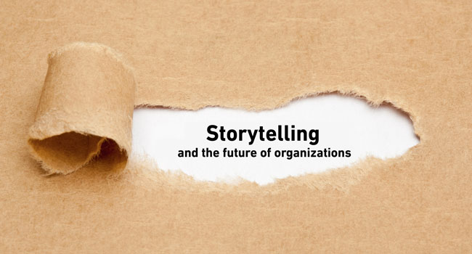
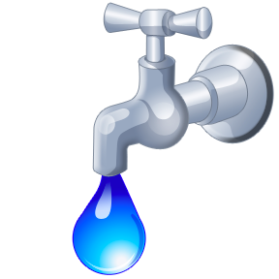
Water’s Business Models & Business Storytelling
David M. Boje
Professor, Aalborg University & Storytelling Researcher
https://davidboje.com/Aalborg
Adorno told us in Minima Moralia ‘Es gibt kein richtiges Leben im falschen’
(‘Wrong life cannot be lived rightly’)
Notes:
Business model storytelling See Christian Nielsen, Morten Lund, Marco Montemari, Francesco Paolone, Maurizio Massaro & John Dumay (2019). Routledge.
Digital transformation transfomrs a given business model, into an ensemble of dispositifs that affect selection of intellectual capital and (re)con-figure the value creation processes to the customer and what he/she requires
Not all businesses have data that works in a big-data context. They need different business models
See - “Sokkelund Café &amp; Brasserie” a 7 year intervention with conversational interviews and data, in digital enablers from analgue to data-driven small-data restaurant.
2009
40 seats and 850.000 euro
2017
74 seats and 4,7 million euro
We want business storytelling and its business model-dispositif to work for us, instead of confining the human potential
Move from too many documents, notes and paper, inefficent processes, slow comm, irrelevant into, and nothing was real time
The HR, productions, sales, and staff cost in one app.
Small-data – began with sales per seat per day (or per customer), customer retention, and find causation in data that is logical enough for humans to understand
Themes of natality and plurality becomes more visible.

Slide 2
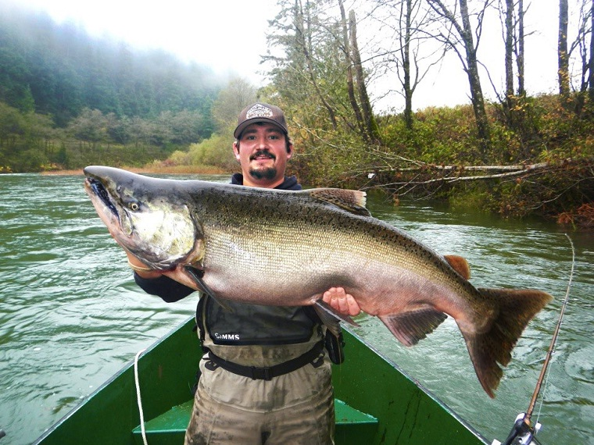
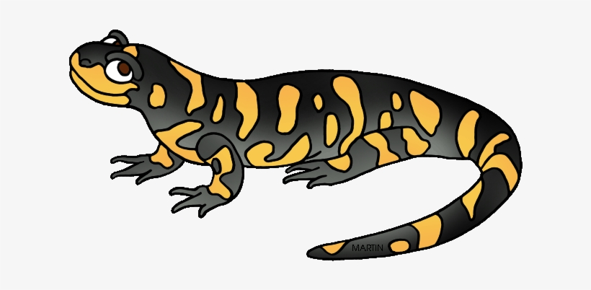
Scabby Round Robe & Salamander
Quantum Storytelling by Don Pepion
Notes:
Once Upon a time Boje’s story of King Salmon at Spokane River, on Boje’s grandfather’s farm
This one weighs 36 kilos or about 80 pounds
This is when Boje, got the call to care and Stewardship for the WHOLE of CREATION
QUOTING DON PEPION STORY TO ME
Pepion: “What do you need to know?
Boje: “Everything!”
Pepion: “ ““In our tribe, there’s a story of a person named… ‘Scabby Round Robe.’ He’s probably a person with a worn buffalo robe. He’d stayed with the beavers and learned many things. That is another whole long story. But this story I want to tell now, it was decided that there needed to be a treaty between humans and all the animals. And this goes back to native philosophy, native belief that ‘we’re related to everything, both animate and inanimate, and to the cosmology.’ So actually we’re related to the water, and to things that are in the water” fish, plants, and all things, the rocks… But the animals, our relatives, we felt there needs to be an agreement between all the animals and us as humans, because we all have to live together in this place, and there needs to be some understandings and some peace…. So in this meeting with the animals, Scabby Round Rope, kind of, you might say, facilitated that. And after discussions, the animals agreed, ‘well we need to make this agreement, this understanding between us, to be able to keep things in harmony and balance, and to insure continuation, as you work with sustainability, if you will. So they agreed to it.
And there was a lizard there, a salamander. Here’s what it was though. What the animals agreed is they would share their power with humans. “
,,, And share some of their power. And so because we all have power, and as you know in Quantum Physics, power is related to energy. That’s because everything has energy. And that’s how everything is related. And everyone was agreeing to share their power with humans.
And so the Salamander said, ‘OK Yeah, I’ll share some of my power.’
And the other animals started laughing at him. ‘Oh, you’re just a little tiny thing.’ ‘You don’t have any power.’ And that, and so the little salamander says ‘OK, we’ll see then.’
And so what happened is he made it rain.
And it rained.
And it rained.
And it rained.
And it rained!
And the Earth started to flood. Pretty soon the animals got scared and realized what was going on. So they went to the salamander and said: “OK, OK, you got power. You got power!”
[Boje and Pepion both belly laughing]
Pepion: Between them, they said: ‘please stop it. Please stop it!’ And so that’s when they realized that even something that minute and something that small has power. So to this day the salamander, as well as the frog, Namamska, and pointing to a drawing of salamander, ‘this Namski.’ What the medicine bundle is called is Namnamski.
So water is powerful.
----- Meeting Notes (5/8/19 05:27) -----
This slamon weighs over 80 pounds
----- Meeting Notes (5/8/19 05:40) -----
Don does not eat fish to this day

Slide 3
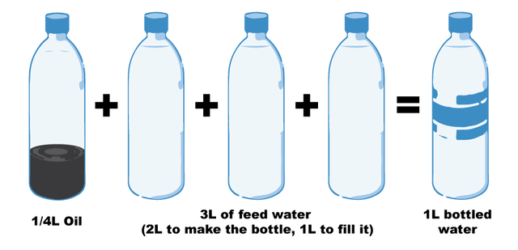
QUESTION: How to pursue a good life for oneself, as oneself, in the context of a broader world that is structured by inequality, exploitation and forms of effacement – Hannah Arendt
Notes:
Fill a plastic water bottle 25% with OIL to illustrate how much oil it take. https://www.portlandoregon.gov/sustainabilityatwork/article/535746
USA consumes 50 billion plastic water bottles a year, 23% head to recycling, but 38 billion don’t go to recycling, and then only about 9% actually gets recycled, because China is no long taking them, and because it costs $$$ to sort the bottles, shred them, wash them, heat them to sanitize, then melt into pellets and sell to beverage companies
Billions of gallons of water are used to make the Billions of gallons of water in water bottles ( feed waters 3 to 1 final bottle of water)
50 billion USA plastic water bottles is 17 million gallons of oil. It takes 6,000 megajoules of electricity for each barrel of oil, and with all the oil for 40 billion bottles that is 106 billion megajoules of electricity, which is how the 25% oil calculation is based on.
OUR PROBLEM TO BE SOLVED GETS WORSE: 50 billion USA plastic water bottles, is small part of the 250 billion BEVERAGE bottles with juices, sodas, etc. in them
WORLDWIDE: USA is 50 billion plastic water bottles, but world total is 500 Billion, and that means five times that in Total World Beverage plastic bottles
PROBLEM GETS WORSE AGAIN: Most are made of PET –Polyethylene Terephthalate and that has BPA in it.
https://www.madesafe.org/avoid-toxic-chemicals-plastics/
BPA stands for Bisphenol-A and it is a carcinogen, cause low sperm count in boys, and early puberty in girls. PBA is endocrine disruptor.
BPA has been a resin to make plastics clear and strong since the 1960s. https://www.mayoclinic.org/healthy-lifestyle/nutrition-and-healthy-eating/expert-answers/bpa/faq-20058331
It is not just making plastic bottles, but coats the insides of beverage cans, and used to make epoxy.
The FDA does not regulate it, saying low levels of BPA are SAFE to use in foods, and of no harm to human body. But Mayo Clinic says cut back on plastic bottles, and on metal cans (coated in BPA), for your good health life.
PROBLEM GETS WORSE: BPA has phthalates, and FDA refuses to regulate them either. Phthalates are industrial chemicals are binding agents, and to soften plastic, make it clearer and more durable.Also used in cosmetic consumer products. https://www.fda.gov/cosmetics/productsingredients/ingredients/ucm128250.htm Phthalates however do cause reproductive, liver, kidney, and lung problems in human beings. See Canada https://noharm-uscanada.org/issues/us-canada/phthalates-and-dehp Guardian https://www.theguardian.com/lifeandstyle/2015/feb/10/phthalates-plastics-chemicals-research-analysis
CDC recommends further study, FDA says its safe to consume, but others say health hazard https://www.theguardian.com/lifeandstyle/2015/feb/10/phthalates-plastics-chemicals-research-analysis. 2008 Henry Waxman bill did ban phthalates in some baby products
BUT the science says phthalates linked to asthmas, attention-deficit disorder, breast cancer, Type II diabetes, autism, and male fertility disorders. Watch the milk because a lot of plastic tubes are used in milking machines, and the phthalates make their way into even glass bottles of milk.
rPET is recycled PET https://earthhero.com/whats-the-deal-with-rpet/ Good news it uses 75% less energy to make rPET, less resource extraction, less CO2,
BUT ITS NOT A PERFECT SOLUTION TO NANOPLASTIC POLLUTION
The rPET, has microfibers, and with each washing, or swallow, it goes into the water, and these break down into microplastics, then into nanoplastic particles, which circulate in the water cycle with the PET nanoplastic particles, and it take 500 years to degrade, and that means all the plastic every made (except some incinerated) is still here, and worse problem, that are a lot of other plastics, and they break down to nanoparticles and head into food chain, so the water cycle gets more and more contaminated.
BOTTOM LINE
Our desire for plastic has change our Self. Other contaminants stick to the plastic and circulate in the water cycle, and the food chain, and that means plastic water and beverage bottles is a huge contributors to the human activities changing the global water cycle, and changing the Self of Water=Desire, Water=Life, Water=Memory, Water=Spirit, and Water=Matter but also means we are in Water-Denial, so Water=$$$
Plastic is a waste byproduct of petrochemical manufacturing. The oil industry had to get rid of the waste, so making it into plastic was how to do that, now we are past peak oil, and past three water peaks, and Water=Desire (our Ego manipulated by marketing hype) is causing an evolutionary change in the Self, so instead of an authentic Self, we have the Self as Desired by DuPont (inventor of plastic), and by Nestle, Coke, and PepsiCo (and their imitators). This is why Boje says in his books we are in a culture of denial, as marketing sells us a new self, and corporate lobbies corrupt agencies like FDA, or defang the EPA, and fund the campaigns of political leaders with PAC meney, as the corporation became a legal person, then its PAC money declared free speech act in political elections, while a human citizen ahs a limit in USA of $2,500.
All this boils down to Water=Desire is a corruption of Water=Spirit (Radah, mistranslated from the Hebrew in King James bible 1611, and used to by Francis Bacon soon after to make scientific method about subduing and domination of nature as an improper translation of ‘dominion’ and this became a political ideology in the 1970s e.g. James Watt, Secretary of the Interior to Reagan, said “After the last tree is felled, Christ will come back”
In sum bad bible translations of Radah are now being corrected so that it means ‘caring for creation’ and ‘stewardship, but the damage will take generations to undo, and by then the science says the water cycle will be destroyed. I.E. By 2030 global water demand will be 40% greater than it is today (McKinsey Report). By 2030 40% of world’s population will lack access to safe, sanitary water, in 2030 there will need 60% more fresh water to support demand than we have today in the water cycle. The developing nations are increasing water withdrawals by 50% and 18% in developing nations. In short, the fresh water system, if it were a bank, has more withdrawals than deposits, and is bankrupt!
https://www.waterlogic.com/en-us/resources-blog/world-oceans-day-plastic-pandemic/ for ocean impact
----- Meeting Notes (5/8/19 05:40) -----
PET is Polyethylene Terephthalate
BPA is Bisphenol-A is a carcinogen

Slide 4
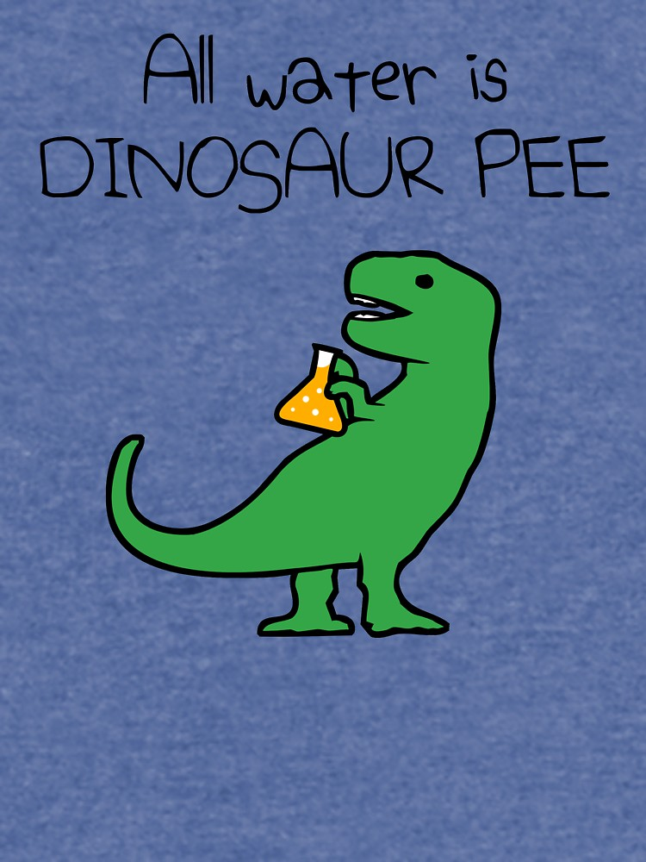
Notes:
Question: Why is all Water Dinosaur Pee?
Answer: In the beginning, at BIG BANG or CREATION, all the water at that event, is the same water we have today
It circulates in atmosphere, rains down on us, then becomes rivers and lakes and aquifers

Slide 5
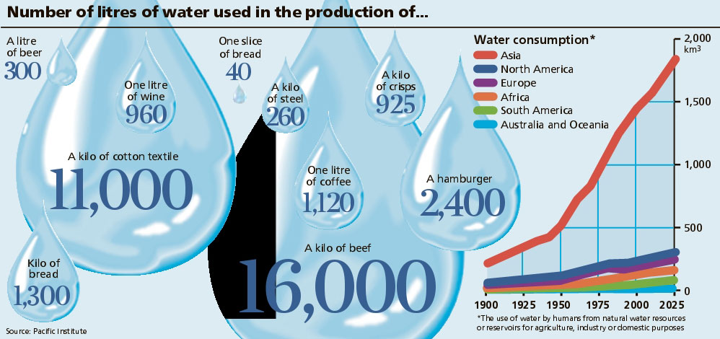
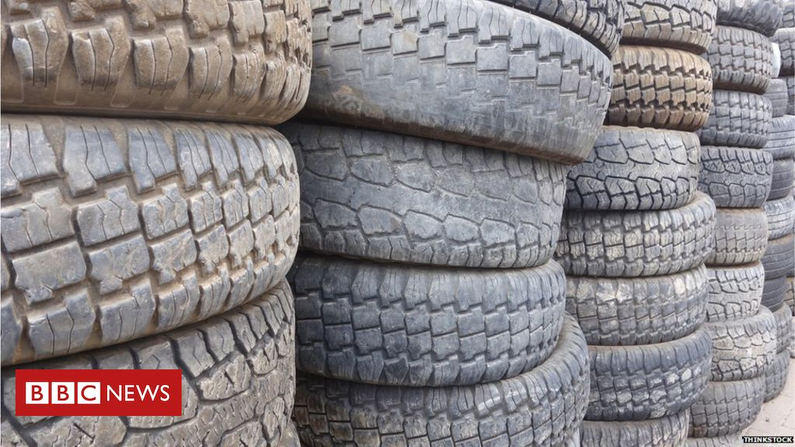
What is VIRTUAL WATER?
Microplastics from tires bigger source marine pollution than breakdown of larger plastic waste in some areas
Notes:
http://www.linv.org/virtual-water/
https://www.bbc.com/news/science-environment-39042655 tires

Slide 6
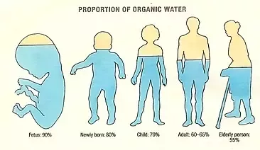
Notes:
Water=Life. Water is an ecological necessity
The human body is 60 to 75% water depending on age and gender. Each human body has 37.2 trillion living cells, al lof them have water or they die.
We all drink Dinosaur Pee.
----- Meeting Notes (5/8/19 05:54) -----
We are actually a walking climate system, with our living cells exchanging with colonies of cells, trillions and trillions of them in our environment
We are not ONE BODY, but many trillions of living cells

Slide 7
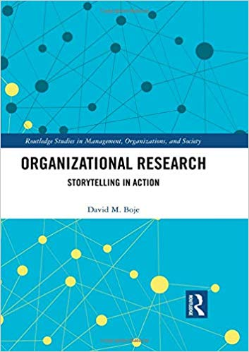
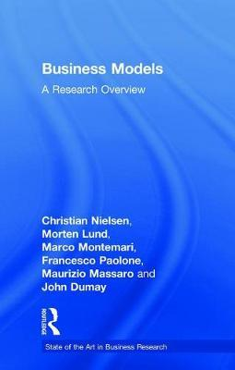
2019
Morten Lund’s dissertation – narratives exemplifying existing business models
Notes:
Lund’s dissertation – narratives exemplifying existing business models

Slide 8
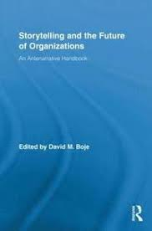
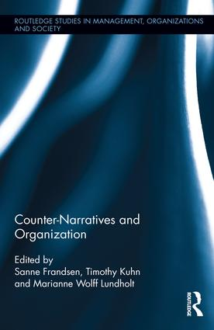
2001
2011
2016
Notes:
WHAT IS STORYTELLING
Storytelling is coming to an end (Walter Benjamin)
Storytelling became petrified narrative (Barbara Czarniawska)
Storytelling reduced to retrospective narrative sensemaking (Karl Weick)
Narrative and story are not the same (Yiannis Gabriel)
For every narrative there is a counternarrative (Lundholt & Boje, 2018; Bager, Lundholt, 2019)
Storytelling is also together-telling of living stories (Grace Ann Rosile, 2016)
Before narratives and stories are our antenarrative bets on the future (Boje, 2001)
----- Meeting Notes (5/8/19 05:54) -----
Michael Bamberger distinguishes between
TEMPORARY NARRATIVE

Slide 9
ANTENARRATIVE BET ON THE FUTURE:
97.5% of Terrestrial Water is saltwater
Remaining 2.5% is mostly inaccessible & unevenly distributed
Remaining for all life is 0.014% of all water
By 2030 Fresh Water Demand will Exceed Fresh Water Supply by 40%
Notes:
McKinsey Report prediction by 2040 Terrestrial World is in Water Bankruptcy

Slide 10
Notes:
6,000 children every single day die of water-borne diseases that are preventable
Some 21 cities around the world are DAY ZERO

Slide 12
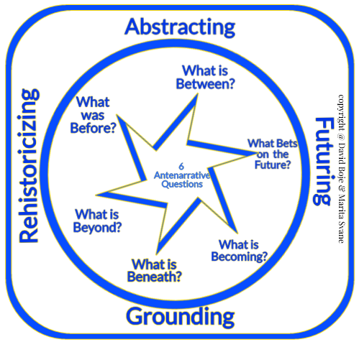

Slide 13
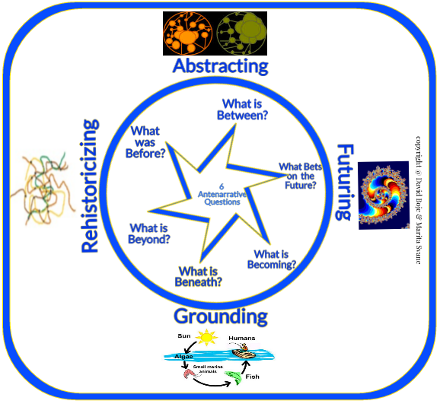

Slide 14
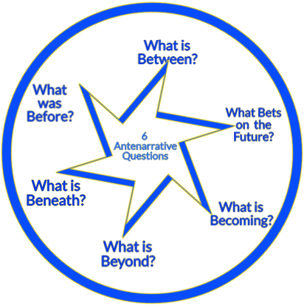
6 B’s of Antenarrative
WATER’s BUSINESS MODEL
example
Before – Water was commodified and privatized the Business Model was WATER=PUBLIC GOOD
Beyond – In EMBODIMENT pre-conscious intuited WATER=LIFE ITSELF in Business Model (taken for granted)
Becoming – Scarcity Business Model (Demand > Supply)
Beneath – Search for conceptions, language, symbols, gestures WATER=PRE-CONCEPTION (1st Mimesis, Ricoeur)
Between – In-between is getting and supplying WATER=INFRASTRCTURE SPACETIMEMATTERING of upstream vs. downstream Business Model (Barad, Strand)
Bets – Multiple ‘Bets On the Future’ WATER=ENSEMBLE OF BUSINESS MODELS along differentiations- value chain players
Notes:
Before – Water was commodified and privatized in the Business Model, it was WATER=PUBLIC GOOD
Beyond – In EMBODIMENT pre-conscious intuited WATER=LIFE ITSELF
Beneath – Search for conceptions, language, symbols, gestures WATER=PRE-CONCEPTION (1st Mimesis, Ricoeur)
Between – In-between is getting and supplying WATER=INFRASTRCTURE SPACETIMEMATTERING (Barad, Strand)
Bets – Multiple ‘Bets On the Future’ WATER=ENSEMBLE OF BUSINESS MODELS

Slide 15
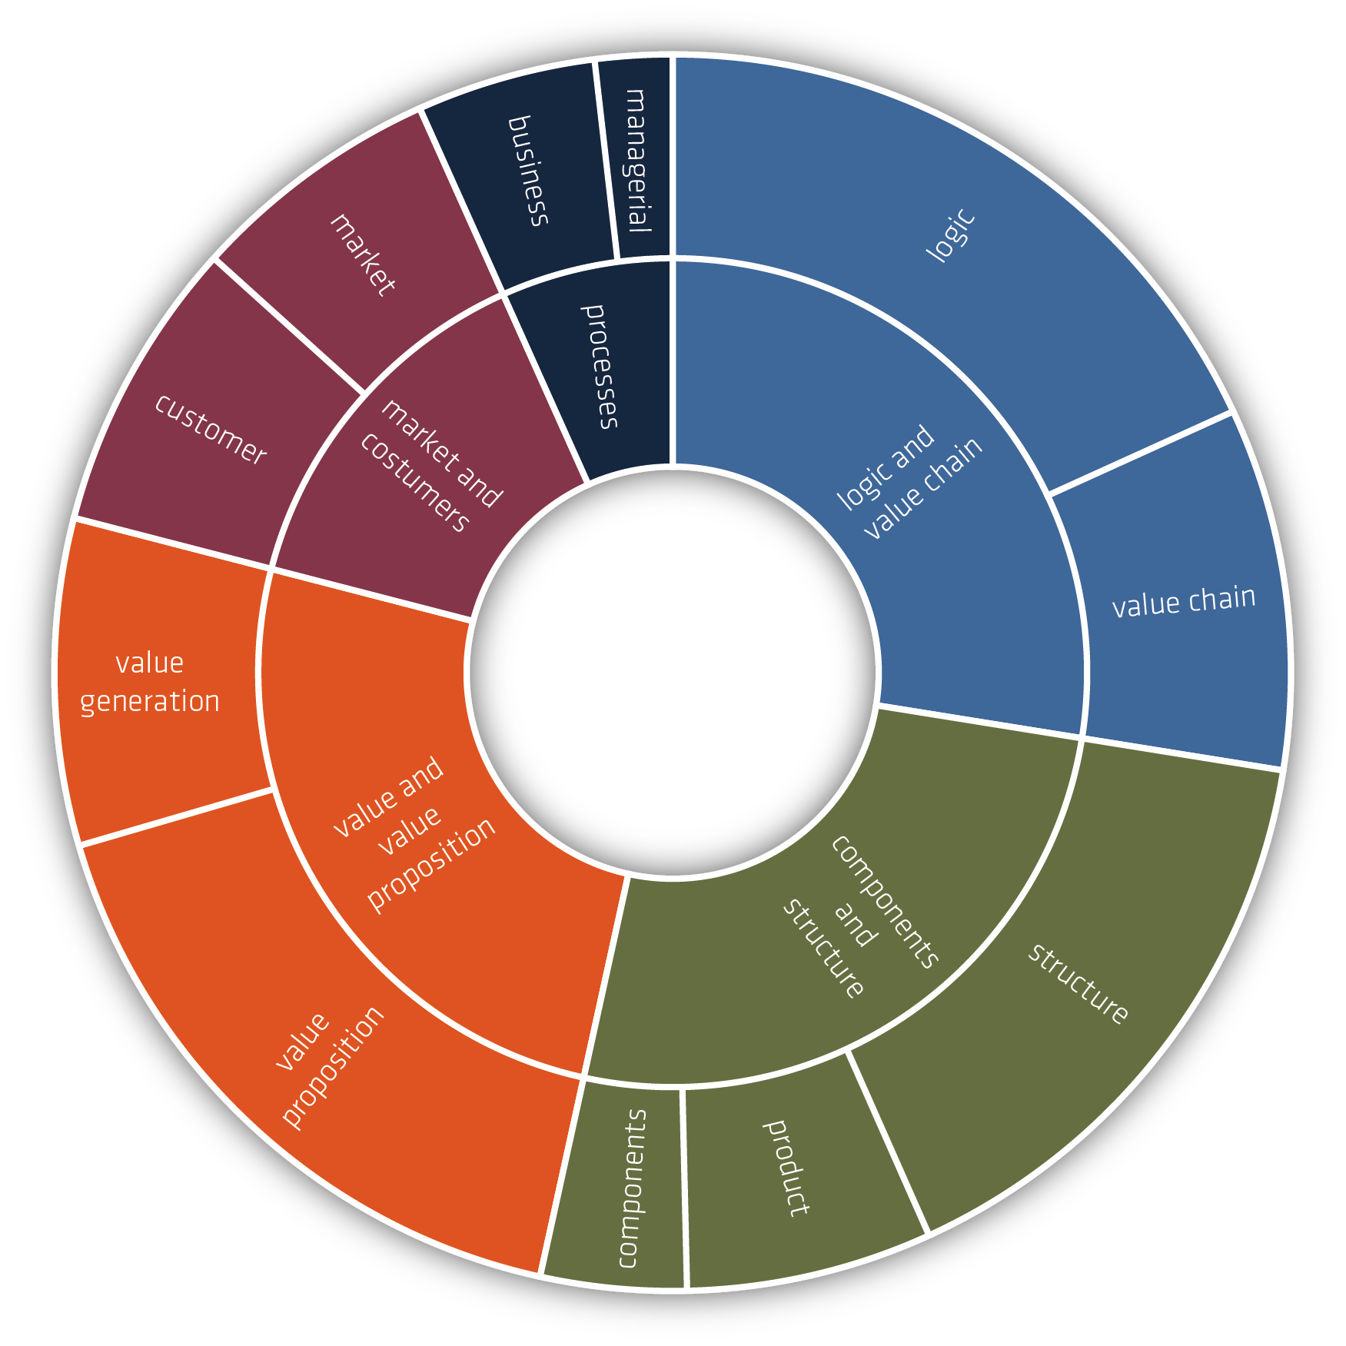
Christian Nielsen, Morten Lund, Marco Montemari, Francesco Paolone, Maurizio Massaro and John Dumay (2019) Business Models

Slide 16
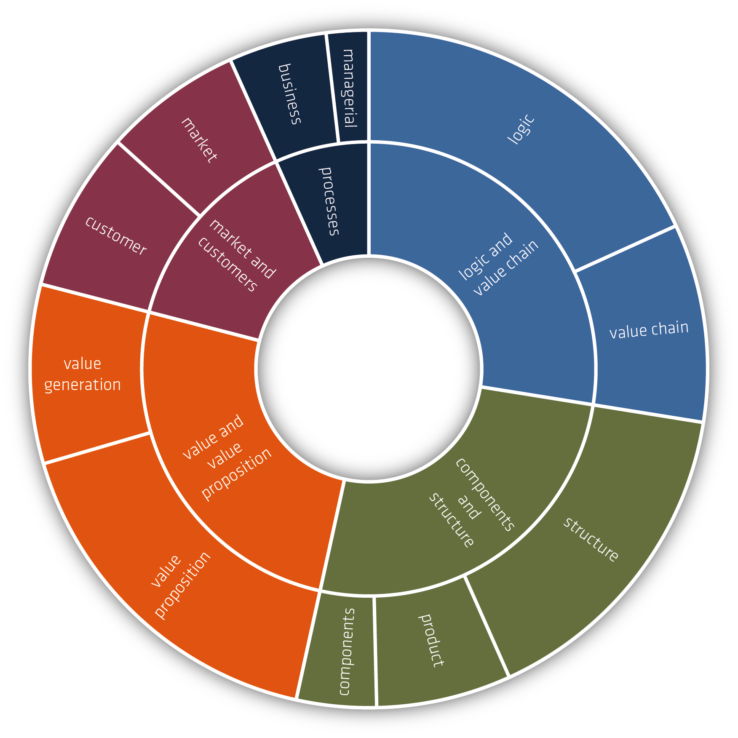
Christian Nielsen, Morten Lund, Marco Montemari, Francesco Paolone, Maurizio Massaro and John Dumay (2019) Business Models

Slide 17
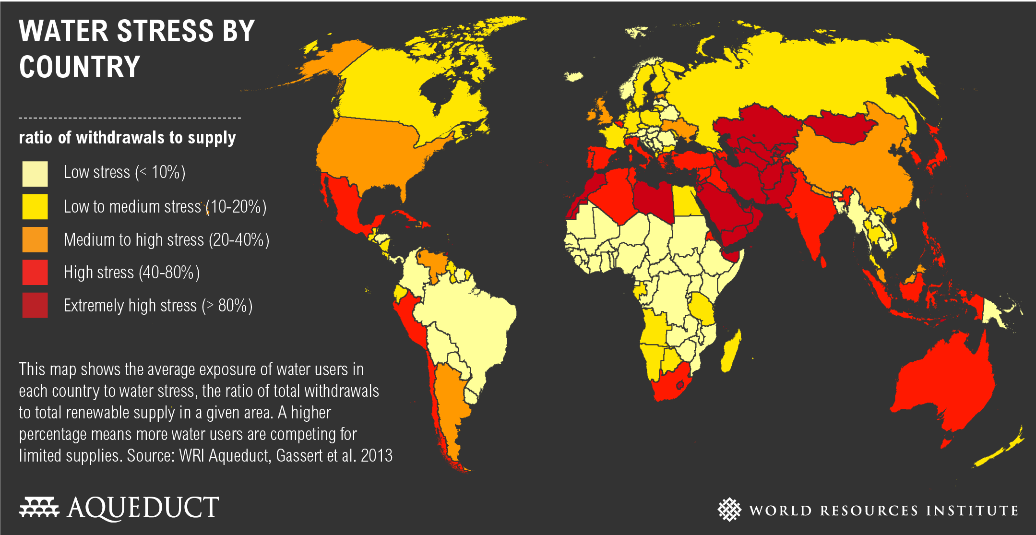
TRUE STORYTELLING: 2.8 Billion people are in Water Stress Defined as below 1000 cubic meters per person per year
Notes:
https://www.wri.org/resources/charts-graphs/water-stress-country

Slide 18
Antenarrative & Business Models
In ‘dangerous’ Business Models, ‘True Storytelling’ is no longer at stake
Can we investigate a ‘True Storytelling’ of the ‘Virtual Water’ Footprint of Business Models?
WHY? To develop SUSTAINABLE ‘Virtual Water’ business modeling

Slide 19
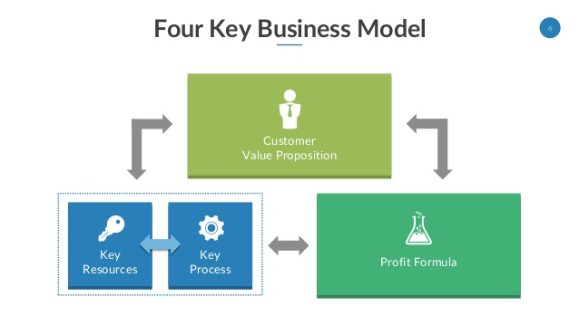
“ ”
Customers
Living Stories
VIRTUAL
Water
Petrified
Narrative
ANTENARRATIVE Processes
Notes:
See p. 28 of Mark W. Johnson – Reinvent your Business Model: How to Seize the White Space for Business Growth?

Slide 20
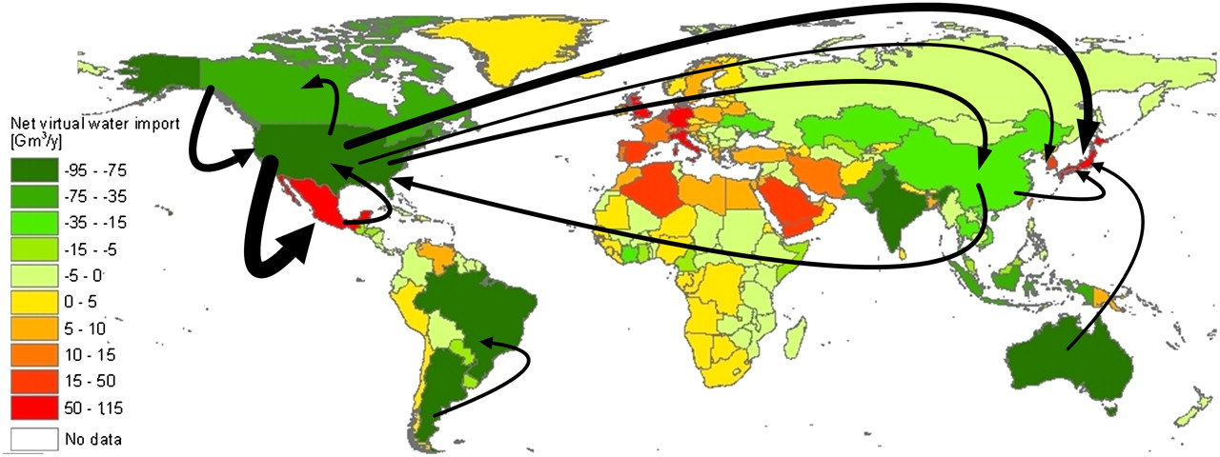
Virtual water balance per country and direction of gross virtual water flows related to trade in agricultural and industrial products over the period 1996–2005.
Arjen Y. Hoekstra, and Mesfin M. Mekonnen PNAS 2012;109:9:3232-3237
©2012 by National Academy of Sciences
Notes:
Virtual water balance per country and direction of gross virtual water flows related to trade in agricultural and industrial products over the period 1996–2005. Only the biggest gross flows (> 15 Gm3/y) are shown. https://waterfootprint.org/en/water-footprint/national-water-footprint/virtual-water-trade/

Slide 21
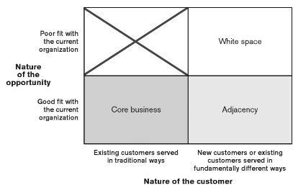
Blue Space
Antenarrative
New ‘Bets on the Future’
Petrified Narrative
Notes:
With petrified narrative, there is no agility to move into WHITE SPACE opportunity. The traditional core of existing business model to move to adjacencies require changes in operations, a different formula to make money, new set of resources, new processes.
WHITE SPACE is potential activities not defined or addressed by the company’s current business model., and are beyond Adjacencies.
WHITE SPACE will require subjective valuation of company core, its activities that are far outside usual way of working

Slide 22
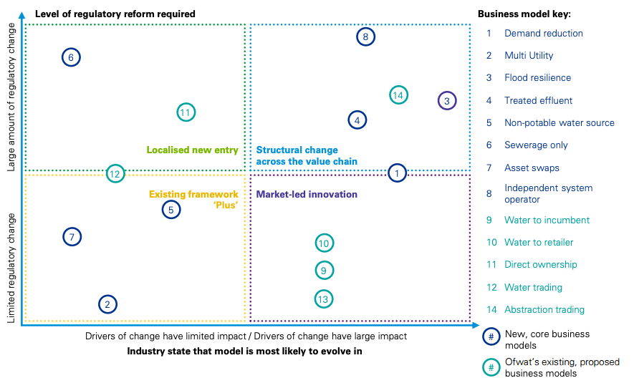
KPMG Water Business Models
13 = Water Trading
Notes:
KPMG Water Business Model Analysis https://stakeholder.affinitywater.co.uk/docs/KPMG%20-Water-sector-business-models.pdf
Affinity Water a UK Company
Promoting groundwater abstraction trading where it moves pressure away from sensitive areas, for example, wetlands and river valleys or coastal areas with saline intrusion risk.
https://gov.wales/sites/default/files/consultations/2018-01/160115-consultation-response-en.pdf
WHAT IS ABSTRACTION TRADING
Summary of proposals:
• Abstractors will receive an annual and daily permitted volume with
similar reliability to now.
• In enhanced catchments, these permitted volumes will be accounted for as proportions or ’shares’ of the water available in different parts of the catchment and any hands off flows will be gradually switched on and off.
Following reform, some groundwater abstractors in enhanced catchments17 will enjoy easier access to water trading due to the establishment of preapproved trading rules.

Slide 23
How to Develop a New BLUE Business Model-Dispositif about Water in Denmark?
Deconstruct UNSUSTAINABLEof PETRIFIED NARRATIVE: BUSINESS MODEL
Critical Accounting of VIRTUAL WATER
Do STORYTELLING SELF-CORRECTING METHOD to reset CORE Values
EXPERIMENTS with BLUE SPACE BUSINESS MODEL
See” REINVENT YOUR BUSINESS MODEL: How to Seize the White Space for Transformative Growth Mark W. Johnson (Boston, MA: Harvard Business Review Press).
Notes:
How to create a ‘[BLUE] Space’ for Business Model-Dispositif Innovation in Caring for Water?
To venture into the White Space, from business’ current operational space, and into ➔ ‘[BLUE] Space’?
Storytelling Relevance? The operational space becomes a ‘petrified narrative’ of strong [core] business culture values (Czarniawska, 2004).
Problem: When new ‘bet on the future’ opportunity appears, the petrified narrative core blocks path to a ‘[BLUE] Space’

Slide 24
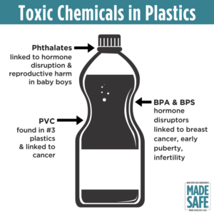
How does Business Model Respond?
https://nutritionfacts.org/video/are-the-bpa-free-alternatives-safe/
Notes:
QUESTION: How to pursue a good life for oneself, as oneself, in the context of a broader world that is structured by inequality, exploitation and forms of effacement – Hannah Arendt
BPA (bisphenol A) is a chemical that is added to many commercial products, including food containers and hygiene products. ... These days, BPA-containing plastics are commonly used in food containers, baby bottles, and other items
PROBLEM GETS WORSE AGAIN: Most are made of PET –Polyethylene Terephthalate and that has BPA in it.
https://www.madesafe.org/avoid-toxic-chemicals-plastics/
BPA stands for Bisphenol-A and it is a carcinogen, cause low sperm count in boys, and early puberty in girls. PBA is endocrine disruptor.
BPA has been a resin to make plastics clear and strong since the 1960s. https://www.mayoclinic.org/healthy-lifestyle/nutrition-and-healthy-eating/expert-answers/bpa/faq-20058331
It is not just making plastic bottles, but coats the insides of beverage cans, and used to make epoxy.
The FDA does not regulate it, saying low levels of BPA are SAFE to use in foods, and of no harm to human body. But Mayo Clinic says cut back on plastic bottles, and on metal cans (coated in BPA), for your good health life.
PROBLEM GETS WORSE: BPA has phthalates, and FDA refuses to regulate them either. Phthalates are industrial chemicals are binding agents, and to soften plastic, make it clearer and more durable.Also used in cosmetic consumer products. https://www.fda.gov/cosmetics/productsingredients/ingredients/ucm128250.htm Phthalates however do cause reproductive, liver, kidney, and lung problems in human beings. See Canada https://noharm-uscanada.org/issues/us-canada/phthalates-and-dehp Guardian https://www.theguardian.com/lifeandstyle/2015/feb/10/phthalates-plastics-chemicals-research-analysis
CDC recommends further study, FDA says its safe to consume, but others say health hazard https://www.theguardian.com/lifeandstyle/2015/feb/10/phthalates-plastics-chemicals-research-analysis. 2008 Henry Waxman bill did ban phthalates in some baby products
BUT the science says phthalates linked to asthmas, attention-deficit disorder, breast cancer, Type II diabetes, autism, and male fertility disorders. Watch the milk because a lot of plastic tubes are used in milking machines, and the phthalates make their way into even glass bottles of milk.
rPET is recycled PET https://earthhero.com/whats-the-deal-with-rpet/ Good news it uses 75% less energy to make rPET, less resource extraction, less CO2,
BUT ITS NOT A PERFECT SOLUTION TO NANOPLASTIC POLLUTION
The rPET, has microfibers, and with each washing, or swallow, it goes into the water, and these break down into microplastics, then into nanoplastic particles, which circulate in the water cycle with the PET nanoplastic particles, and it take 500 years to degrade, and that means all the plastic every made (except some incinerated) is still here, and worse problem, that are a lot of other plastics, and they break down to nanoparticles and head into food chain, so the water cycle gets more and more contaminated.
BOTTOM LINE
Our desire for plastic has change our Self. Other contaminants stick to the plastic and circulate in the water cycle, and the food chain, and that means plastic water and beverage bottles is a huge contributors to the human activities changing the global water cycle, and changing the Self of Water=Desire, Water=Life, Water=Memory, Water=Spirit, and Water=Matter but also means we are in Water-Denial, so Water=$$$
Plastic is a waste byproduct of petrochemical manufacturing. The oil industry had to get rid of the waste, so making it into plastic was how to do that, now we are past peak oil, and past three water peaks, and Water=Desire (our Ego manipulated by marketing hype) is causing an evolutionary change in the Self, so instead of an authentic Self, we have the Self as Desired by DuPont (inventor of plastic), and by Nestle, Coke, and PepsiCo (and their imitators). This is why Boje says in his books we are in a culture of denial, as marketing sells us a new self, and corporate lobbies corrupt agencies like FDA, or defang the EPA, and fund the campaigns of political leaders with PAC meney, as the corporation became a legal person, then its PAC money declared free speech act in political elections, while a human citizen ahs a limit in USA of $2,500.
All this boils down to Water=Desire is a corruption of Water=Spirit (Radah, mistranslated from the Hebrew in King James bible 1611, and used to by Francis Bacon soon after to make scientific method about subduing and domination of nature as an improper translation of ‘dominion’ and this became a political ideology in the 1970s e.g. James Watt, Secretary of the Interior to Reagan, said “After the last tree is felled, Christ will come back”
In sum bad bible translations of Radah are now being corrected so that it means ‘caring for creation’ and ‘stewardship, but the damage will take generations to undo, and by then the science says the water cycle will be destroyed. I.E. By 2030 global water demand will be 40% greater than it is today (McKinsey Report). By 2030 40% of world’s population will lack access to safe, sanitary water, in 2030 there will need 60% more fresh water to support demand than we have today in the water cycle. The developing nations are increasing water withdrawals by 50% and 18% in developing nations. In short, the fresh water system, if it were a bank, has more withdrawals than deposits, and is bankrupt!
https://www.waterlogic.com/en-us/resources-blog/world-oceans-day-plastic-pandemic/ for ocean impact

Slide 25
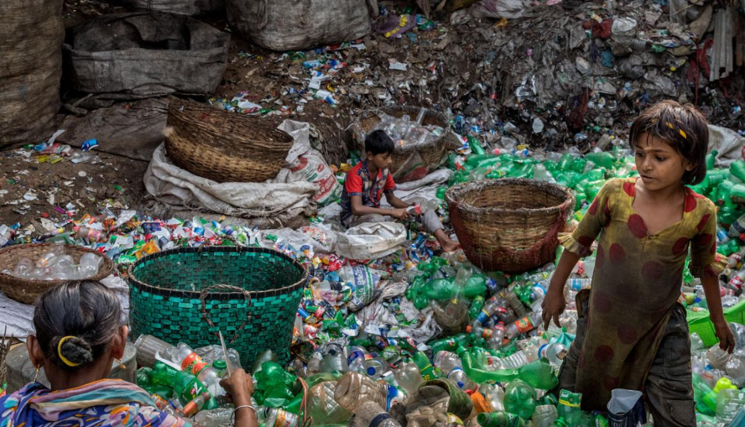
QUESTION: How to pursue a good life for oneself, as oneself, in the context of a broader world that is structured by inequality, exploitation and forms of effacement – Hannah Arendt
Notes:
Denmark is better at Plastic recycling than US, but we don’t see the devastating health crisis on other continents, and child laborers doing recycling of plastic in villages
USA consumes 50 billion plastic water bottles a year, 23% head to recycling, but 38 billion don’t go to recycling, and then only about 9% actually gets recycled, because China is no long taking them, and because it costs $$$ to sort the bottles, shred them, wash them, heat them to sanitize, then melt into pellets and sell to beverage companies
Billions of gallons of water are used to make the Billions of gallons of water in water bottles ( feed waters 3 to 1 final bottle of water)
50 billion USA plastic water bottles is 17 million gallons of oil. It takes 6,000 megajoules of electricity for each barrel of oil, and with all the oil for 40 billion bottles that is 106 billion megajoules of electricity, which is how the 25% oil calculation is based on.
OUR PROBLEM TO BE SOLVED GETS WORSE: 50 billion USA plastic water bottles, is small part of the 250 billion BEVERAGE bottles with juices, sodas, etc. in them
WORLDWIDE: USA is 50 billion plastic water bottles, but world total is 500 Billion, and that means five times that in Total World Beverage plastic bottles
PROBLEM GETS WORSE AGAIN: Most are made of PET –Polyethylene Terephthalate and that has BPA in it.
https://www.madesafe.org/avoid-toxic-chemicals-plastics/
BPA stands for Bisphenol-A and it is a carcinogen, cause low sperm count in boys, and early puberty in girls. PBA is endocrine disruptor.
BPA has been a resin to make plastics clear and strong since the 1960s. https://www.mayoclinic.org/healthy-lifestyle/nutrition-and-healthy-eating/expert-answers/bpa/faq-20058331
It is not just making plastic bottles, but coats the insides of beverage cans, and used to make epoxy.
The FDA does not regulate it, saying low levels of BPA are SAFE to use in foods, and of no harm to human body. But Mayo Clinic says cut back on plastic bottles, and on metal cans (coated in BPA), for your good health life.
PROBLEM GETS WORSE: BPA has phthalates, and FDA refuses to regulate them either. Phthalates are industrial chemicals are binding agents, and to soften plastic, make it clearer and more durable.Also used in cosmetic consumer products. https://www.fda.gov/cosmetics/productsingredients/ingredients/ucm128250.htm Phthalates however do cause reproductive, liver, kidney, and lung problems in human beings. See Canada https://noharm-uscanada.org/issues/us-canada/phthalates-and-dehp Guardian https://www.theguardian.com/lifeandstyle/2015/feb/10/phthalates-plastics-chemicals-research-analysis
CDC recommends further study, FDA says its safe to consume, but others say health hazard https://www.theguardian.com/lifeandstyle/2015/feb/10/phthalates-plastics-chemicals-research-analysis. 2008 Henry Waxman bill did ban phthalates in some baby products
BUT the science says phthalates linked to asthmas, attention-deficit disorder, breast cancer, Type II diabetes, autism, and male fertility disorders. Watch the milk because a lot of plastic tubes are used in milking machines, and the phthalates make their way into even glass bottles of milk.
rPET is recycled PET https://earthhero.com/whats-the-deal-with-rpet/ Good news it uses 75% less energy to make rPET, less resource extraction, less CO2,
BUT ITS NOT A PERFECT SOLUTION TO NANOPLASTIC POLLUTION
The rPET, has microfibers, and with each washing, or swallow, it goes into the water, and these break down into microplastics, then into nanoplastic particles, which circulate in the water cycle with the PET nanoplastic particles, and it take 500 years to degrade, and that means all the plastic every made (except some incinerated) is still here, and worse problem, that are a lot of other plastics, and they break down to nanoparticles and head into food chain, so the water cycle gets more and more contaminated.
BOTTOM LINE
Our desire for plastic has change our Self. Other contaminants stick to the plastic and circulate in the water cycle, and the food chain, and that means plastic water and beverage bottles is a huge contributors to the human activities changing the global water cycle, and changing the Self of Water=Desire, Water=Life, Water=Memory, Water=Spirit, and Water=Matter but also means we are in Water-Denial, so Water=$$$
Plastic is a waste byproduct of petrochemical manufacturing. The oil industry had to get rid of the waste, so making it into plastic was how to do that, now we are past peak oil, and past three water peaks, and Water=Desire (our Ego manipulated by marketing hype) is causing an evolutionary change in the Self, so instead of an authentic Self, we have the Self as Desired by DuPont (inventor of plastic), and by Nestle, Coke, and PepsiCo (and their imitators). This is why Boje says in his books we are in a culture of denial, as marketing sells us a new self, and corporate lobbies corrupt agencies like FDA, or defang the EPA, and fund the campaigns of political leaders with PAC meney, as the corporation became a legal person, then its PAC money declared free speech act in political elections, while a human citizen ahs a limit in USA of $2,500.
All this boils down to Water=Desire is a corruption of Water=Spirit (Radah, mistranslated from the Hebrew in King James bible 1611, and used to by Francis Bacon soon after to make scientific method about subduing and domination of nature as an improper translation of ‘dominion’ and this became a political ideology in the 1970s e.g. James Watt, Secretary of the Interior to Reagan, said “After the last tree is felled, Christ will come back”
In sum bad bible translations of Radah are now being corrected so that it means ‘caring for creation’ and ‘stewardship, but the damage will take generations to undo, and by then the science says the water cycle will be destroyed. I.E. By 2030 global water demand will be 40% greater than it is today (McKinsey Report). By 2030 40% of world’s population will lack access to safe, sanitary water, in 2030 there will need 60% more fresh water to support demand than we have today in the water cycle. The developing nations are increasing water withdrawals by 50% and 18% in developing nations. In short, the fresh water system, if it were a bank, has more withdrawals than deposits, and is bankrupt!
https://www.waterlogic.com/en-us/resources-blog/world-oceans-day-plastic-pandemic/ for ocean impact

Slide 26
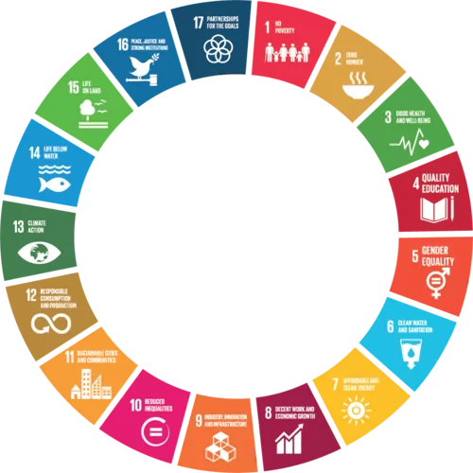
Water Scarcity Affects all 17 United Nations Sustainable Development Goals
https://truestorytelling.org

Slide 27
Water Business Models & Immigrant’s Subjectification and Desubjectification
"With migration to Denmark it's our own voters, and our own families, who have paid the highest price" — Mattias Tesfaye, Social Democrat spokesman
Often migration is both the result of and a way to adapt to climate-induced water scarcity & stresses
Notes:
https://www.politico.eu/article/danish-copenhagen-left-veers-right-on-immigration-policy-integration/
Subjectification is defined as subject positions that immigrant, organizational, & societal actors move towards strange GOVERNMENTALITIES
Desubjectification is defined as the subject positions immigrant, organizational & societal actors break free from PREJUDICE
UN SDGs provide several entry points to address the links between migration and water in line with the 2030 Agenda’s overall ambition of leaving no one behind. First, a number of the SDGs provide guidance to address environmental migration related to water scarcity by building resilience in the face of environmental changes and ensuring human right to water, including:
- Ending poverty by building resilience of vulnerable populations to extreme events under Goal 1.
- Achieving food security and promoting sustainable agriculture and strengthening capacity for adaptation to environmental changes under Goal 2.
- Reducing the number of people suffering from water scarcity under Goal 6.
- Promoting the implementation of planned and well-managed migration policies under Goal 10.
- Reducing the number of deaths and people affected by disasters through effective disaster risk reduction (DRR) practices and strengthening development planning for resilient cities and settlements under Goal 11.
- Building adaptive capacity in the face of climate change and integrating climate change measures in policies under Goal 13.
https://medium.com/@UNmigration/water-and-migration-implications-for-policy-makers-f40f9d3e5dd7
People with foreign heritage make up 13.3 percent of the country's residents. In total, there are 5,781,190 people living in Denmark, according to the latest figures from Statistics Denmark (DST) from the first quarter of 2018. Of those, 770,397 are of foreign heritage.Apr 11, 2018 https://www.thelocal.dk/20180411/heres-where-denmarks-foreign-residents-live-and-where-they-come-from
https://www.thelocal.dk/20180411/heres-where-denmarks-foreign-residents-live-and-where-they-come-from
Here, the five biggest contributing countries are Turkey (30,428), Lebanon (13,948), Pakistan (11,024) Iraq (10,867) and Somalia (9,397). Poland is sixth with 6,299 descendants.
Other nationalities include Bosnia-Herzegovina (6,084), the former Yugoslavia (5,941), the UK (1,569), USA (742), Australia (133), Sweden (2,147) and Norway (1,606).
Water stress and migration patterns https://unesdoc.unesco.org/ark:/48223/pf0000258968

Slide 28
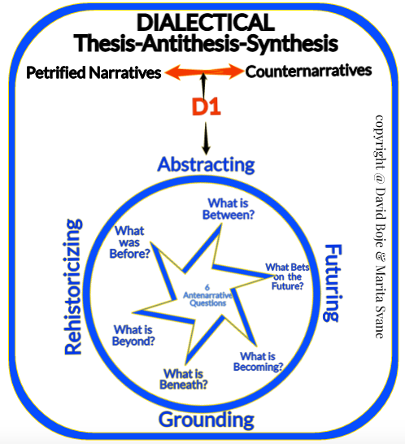

Slide 29
D1
Hannah Arendt’s
DIALECTICAL SPIRAL

Slide 30
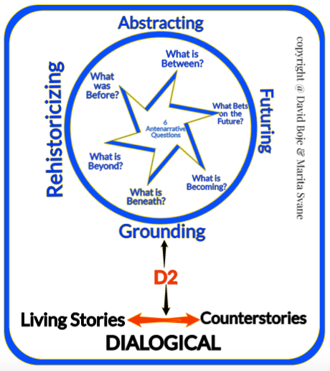
D2 = 4 Dialogisms 1. Polyphonic Dialogism 2. Stylistic Dialogism 3. Chrontopic Dialogism 4. Architectonic Dialogisms

Slide 31
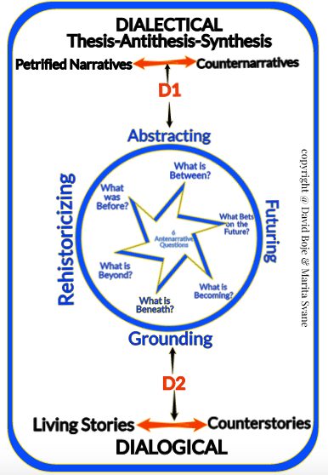

Slide 32
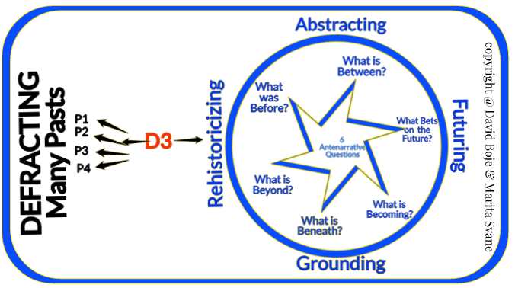
D3=Defracting Past never ends
P1= The Past that never was (Deleuze)
P2= The Restoried past (Boje & Rosile)
P3= The Renarrated past (Weick)
P4= More and More Rehistoricized Pasts
More on Defracting see work by Donna Haraway & Karen Barad
Notes:
Defration (Donna Haraway, and then Karen Barad)

Slide 33
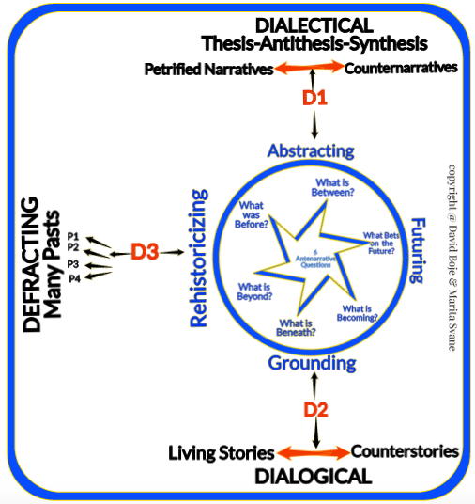

Slide 34
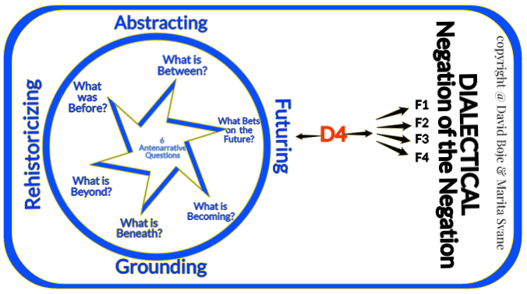
D4=Dialectical Negations

Slide 35
D4 – Negation of the Negation
In this time of FAKE STORYTELLING, negation of negation gets us closer to TRUE STORYTELLING (Boje, Larsen, & Bruun, 2017)
Notes:
Colton was an English cleric 1780-1832 who wrote short stories
The Negation of the Negation is not difficult. http://www.andersfloderus.com/marx-laws.html
Water has become its own negation. The negation of Water1, we can call Water3
We can find some similarity between Water1 and Water3.
And I can find a similarity between Water2 and Water3. So water3 is the synthesis of Water1 and Water2.
If we extract three liters of bottled water we get its negation, 1 liter of bottled water. It produces plastic nanoparticles, and
These are negating the Water Cycle (Water2), now a multiplicity, on a higher sclability and planetary dissemination to all beaches of the world.
When Coca-Cola produces a bottle of soda water (Water2), the Business Model ensemble of dispositifs enables the third negation (Water3), making possible a fourth, fifth, and n-negation. That makes the sequence of negations possible in the value chain

Slide 36
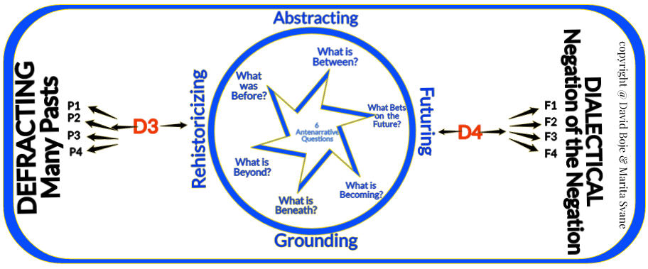
Notes:
The past that never was
The future that will never be
We make different bets on the future
We choose which future to bet on, and to actualize
Then we rehistoricize our many pasts
It’s the difference between Kairos and Chronos

Slide 37
D4 is Dialectics of Negation
If we extract three liters of Feed-water we get its negation, 1 liter of bottled water (Water1).
It produces plastic nanoparticles, and
These are negating the Water Cycle (Water2), now a multiplicity, on a higher scalbility and planetary dissemination to all beaches of the world (Water3) … UNHEALTHY (Water3)

Slide 38
Coke Life BUSINESS MODEL NEGATIONS
Delivers a modest reduction in sugar compared with regular Coke and has a tenth of the sodium
2016, reformulated and now contains even less sugar than regular Coke (45% less).
April 5, 2017announced due to decrease in sales, and increase in Coca-Cola Zero Sugar sales, that Life would no longer be sold and was discontinued in June 2017
Notes:
Coca-Cola No Sugar has no sugar in it. It is sweetened with the same sugar alternatives as Coke Zero and Diet Coke. Coca-Cola No Sugar is sweetened with aspartame and acesulphame potassium (sometimes called Acesulphame-K or Ace-K) which is also what Coke Zero and Diet Coke is sweetened with.
https://www.newshub.co.nz/home/health/2017/06/coca-cola-just-following-the-money-health-expert.html
“The sweeteners in Coke No Sugar, just like Coke Zero and Diet Coke, are aspartame - listed on the can as sweetener 951 - and acesulfame potassium, otherwise known as sweetener 950 or 'Ace K'. Aspartame is perhaps the most common artificial sweetener in the world, sold under the brand names Equal and NutraSweet.
Both products are considered safe by food authorities here, in the US and in Europe. Because it's around 200 times sweeter than sugar, only a very small amount of aspartame needed to make a drink taste nice - about 185mg (in contrast, a can of Coke Classic has 27g of sugar). It would take 18 cans for the average person to exceed the US Food and Drug Administration's daily recommended maximum.
If you drink fewer than 18 cans a day, according the Mayo Clinic the only proven risks aspartame poses are to people:
with the genetic disorder phenylketonuria or muscle disorder dyskinesia
taking certain medications
who have a sleep or anxiety disorder, which aspartame can worsen.
Recent studies looking at suspected links between aspartame and cancer have largely come up empty. “
How fake sugar drives you to the real thing
"Inside the brain's reward centres, sweet sensation is integrated with energy content," Associate Professor Greg Neely from the University of Sydney said last year.
"When sweetness versus energy is out of balance for a period of time, the brain recalibrates and increases total calories consumed."
All Coke variants are acidic says Ms Bezzant, so are bad for your teeth regardless of their sugar content.
"Try and get yourself towards where you're having more water than anything else."
Coca-Cola's position is that its sweeteners are "perfectly safe".
“Ms Bezzant says Coke's move has little do with health, and more about capturing the emerging sugar-free market.
"They're going where the demand is," she told The AM Show. "Everyone's wanting to have less sugar in their diet. This is Coke being a savvy business."
Ms Pillay says Coca-Cola's sugar-free range currently makes up about a third of the company's sales, but that's rising fast - about at least 12 percent in the last year.
"We're in the business of treats - that's part of our portfolio. But now you're going to have an option."
Coke No Sugar goes on sale on June 12. In the meantime, both Diet Coke and Coke Zero will still be available. It's not clear if they'll eventually be discontinued. "We've been so focused on getting this to market, because it's been five years in the making, we haven't even had conversations about that yet," says Ms Pillay.
In countries where a similar 'Coke Zero Sugar' offering has been unveiled in the past year, the 10-year-old Coke Zero range has been discontinued.
“

Slide 39
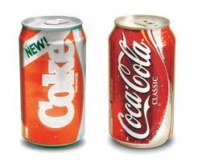
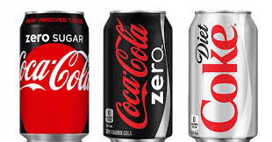
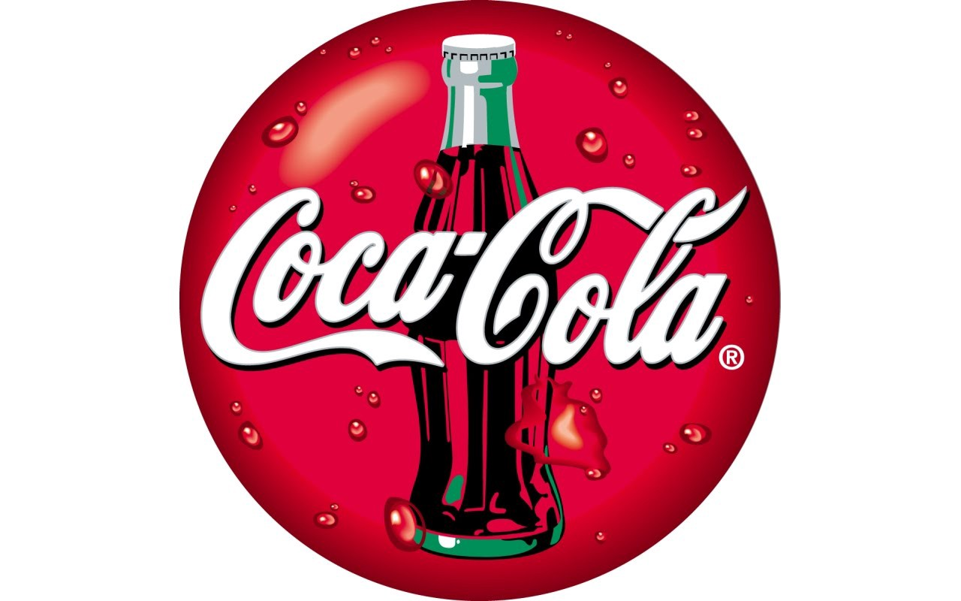
COKE CLASSIC
negated ‘NEW’ COKE
MORE Negations of Negations
Notes:
What have Business Models to do with Negating Negations?
When Coca-Cola extracts 3 virtual waters (Water1) negating to produce a bottle of soda water (Water2), Coke’s Business Model ensemble of dispositifs enables more negations Classic Coke (Water3), making possible a fourth as Coke Zero (Water4), fifth, Diet Coke (Water5), Dasani (Water6), etc. n-negations. That makes the sequence of negations possible in Coca-Cola’s Business Model value chain
Coca-Cola No Sugar has no sugar in it. It is sweetened with the same sugar alternatives as Coke Zero and Diet Coke. Coca-Cola No Sugar is sweetened with aspartame and acesulphame potassium (sometimes called Acesulphame-K or Ace-K) which is also what Coke Zero and Diet Coke is sweetened with.
https://www.newshub.co.nz/home/health/2017/06/coca-cola-just-following-the-money-health-expert.html
“The sweeteners in Coke No Sugar, just like Coke Zero and Diet Coke, are aspartame - listed on the can as sweetener 951 - and acesulfame potassium, otherwise known as sweetener 950 or 'Ace K'. Aspartame is perhaps the most common artificial sweetener in the world, sold under the brand names Equal and NutraSweet.
Both products are considered safe by food authorities here, in the US and in Europe. Because it's around 200 times sweeter than sugar, only a very small amount of aspartame needed to make a drink taste nice - about 185mg (in contrast, a can of Coke Classic has 27g of sugar). It would take 18 cans for the average person to exceed the US Food and Drug Administration's daily recommended maximum.
If you drink fewer than 18 cans a day, according the Mayo Clinic the only proven risks aspartame poses are to people:
with the genetic disorder phenylketonuria or muscle disorder dyskinesia
taking certain medications
who have a sleep or anxiety disorder, which aspartame can worsen.
Recent studies looking at suspected links between aspartame and cancer have largely come up empty. “
How fake sugar drives you to the real thing
"Inside the brain's reward centres, sweet sensation is integrated with energy content," Associate Professor Greg Neely from the University of Sydney said last year.
"When sweetness versus energy is out of balance for a period of time, the brain recalibrates and increases total calories consumed."
All Coke variants are acidic says Ms Bezzant, so are bad for your teeth regardless of their sugar content.
"Try and get yourself towards where you're having more water than anything else."
Coca-Cola's position is that its sweeteners are "perfectly safe".
“Ms Bezzant says Coke's move has little do with health, and more about capturing the emerging sugar-free market.
"They're going where the demand is," she told The AM Show. "Everyone's wanting to have less sugar in their diet. This is Coke being a savvy business."
Ms Pillay says Coca-Cola's sugar-free range currently makes up about a third of the company's sales, but that's rising fast - about at least 12 percent in the last year.
"We're in the business of treats - that's part of our portfolio. But now you're going to have an option."
Coke No Sugar goes on sale on June 12. In the meantime, both Diet Coke and Coke Zero will still be available. It's not clear if they'll eventually be discontinued. "We've been so focused on getting this to market, because it's been five years in the making, we haven't even had conversations about that yet," says Ms Pillay.
In countries where a similar 'Coke Zero Sugar' offering has been unveiled in the past year, the 10-year-old Coke Zero range has been discontinued.
“

Slide 40
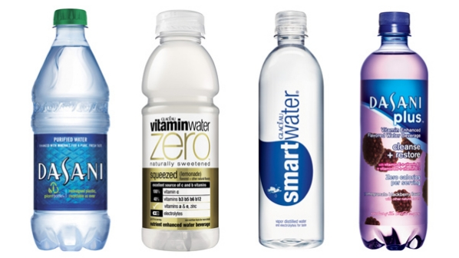
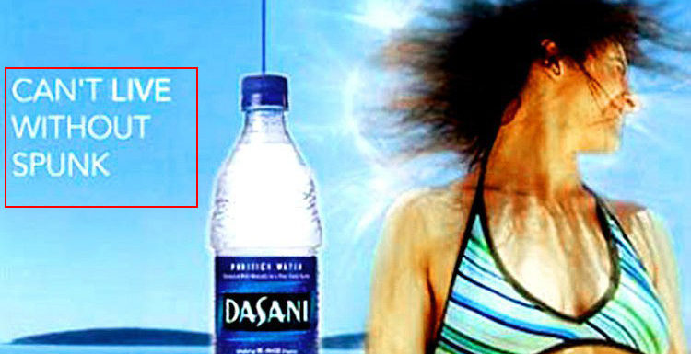

Slide 41
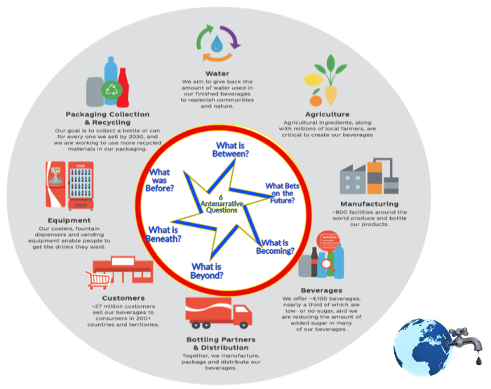
Coke’s Business Models
CLICK TO EXPLORE INTERACTIVE VALUE CHAIN

Slide 42
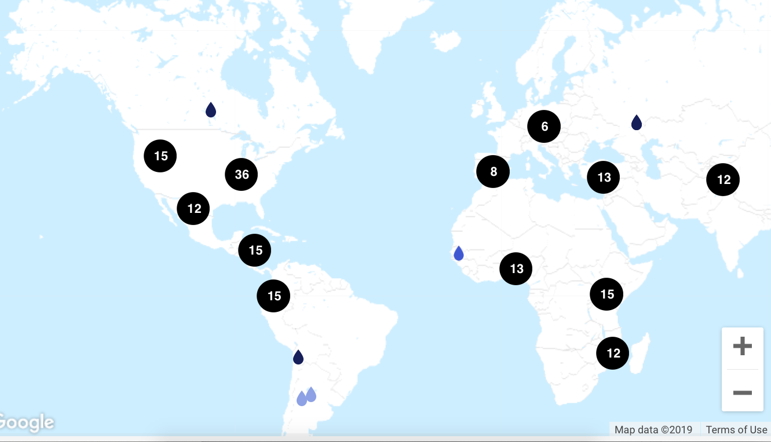
How does Coke Replenish 65.5 billion gallons of Fresh Water?
COCA-COLA’s STORY MAP
# = projects in that location to replenish water used

Slide 43
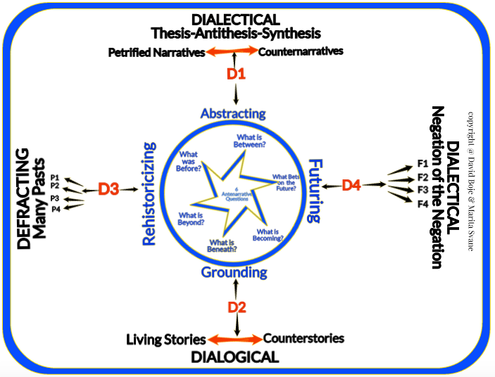

Slide 44
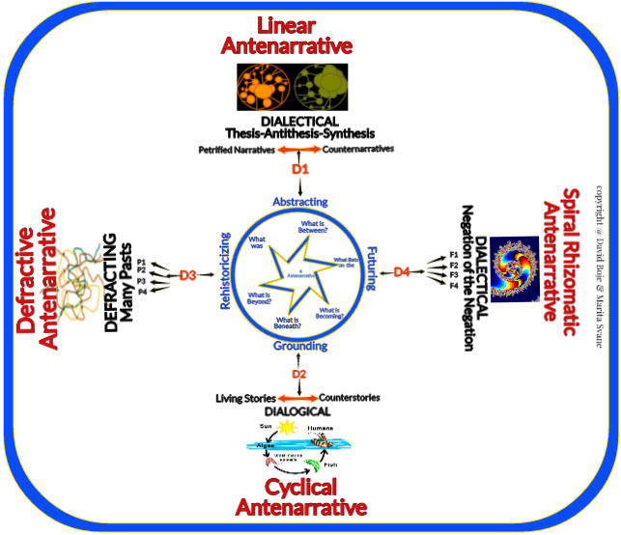
Notes:
Charles Eisenstein? Former traditional Economist - now writing boks on Sacred Economist, and Interbeingness as opposed to separateness in regard to the need for a new story of the people, for human connection with earth and its inhabitants to come to terms with the root problems of sustainability and climate change... I met him in 2015 in Italy - he is a wonderful person, very kind.
https://charleseisenstein.org/essays/scale-in-the-story-of-interbeing/
‘The more beautiful world our heart knows is true’..ac

Slide 45
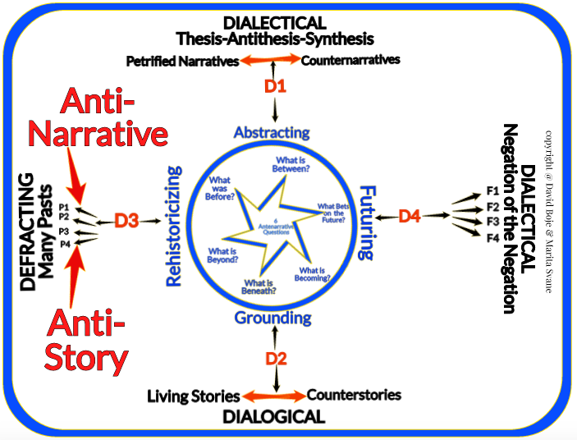
Anti-Narrative is not Antenarrative Anti-Story is not Living Story

Slide 46
“Antenarrative is not the same as ‘anti’-narrative. In anti-narrative, the person cannot narrate plot or closure, but is in the present moment.” “Anti-narrative and antenarrative do share this in common: both are beyond the closure required of narrative theory” (Boje, 2001: 3).
Indeed Antenarrative is precisely what Judith Butler (2005) is doing in ‘Giving a [Moral] Account beyond limits of Narrative’ and Bakhtin (1993: 3) is doing in ‘Moral Answerability’ beyond bystander answerability
Notes:
It is precisely this Bojean definition of 'anti-narrative' that Riach, Rumens, and Tyler (2014), and again, Riach, Rumens, and Tyler (2016: 2078) recast as their own original Butlerian sort of definition: “Anti-narrative research seeks to unravel seemingly coherent narratives, including chronological ones, in order to reveal the labor that goes into producing and maintaining them.” A key difference between us, is I read Judith Butler (2005) as being all about 'antenarrative' while Riach, Rumens, and Tyler (2014, 2016) declare Bojean antenarrative as nice but hardly relevant to Butler's questions of giving an account of oneself. This is puzzling, since Butler, herself, never actually uses the terms anti-narrative or antenarrative.
Butler J (2005) Giving an Account of Oneself. New York: Fordham University Press.
Riach, K., Rumens, N., & Tyler, M. (2014). Un/doing chrononormativity: Negotiating ageing, gender and sexuality in organizational life. Organization Studies, 35(11), 1677-1698. Accessed Mar 29 2019 at https://journals.sagepub.com/doi/pdf/10.1177/0018726716632050
Riach, K., Rumens, N., & Tyler, M. (2016). Towards a Butlerian methodology: Undoing organizational performativity through anti-narrative research. Human Relations, 69(11), 2069-2089. Accesed ar 28 2019 at https://journals.sagepub.com/doi/pdf/10.1177/0018726716632050

Slide 47
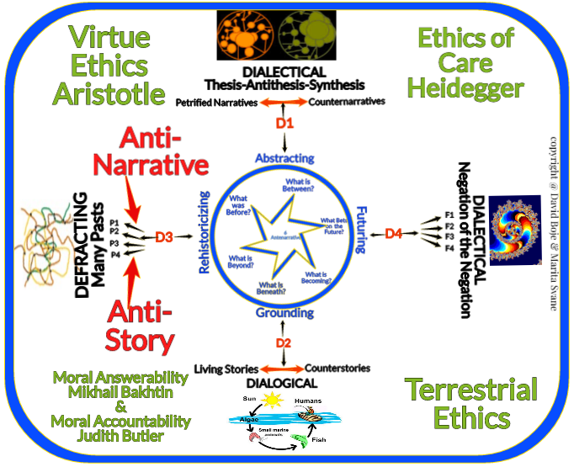
Notes:
ECOLOGICAL BUSINESS MODELS
Bocken, N., Boons, F., & Baldassarre, B. (2019). Sustainable business model experimentation by understanding ecologies of business models. Journal of Cleaner Production, 208, 1498-1512.
Boons, F., & Laasch, O. (2019). Business models for sustainable development: a process perspective. Journal of Business Models, 7(1), 9-12.
Joyce, A., & Paquin, R. L. (2016). The triple layered business model canvas: A tool to design more sustainable business models. Journal of Cleaner Production, 135, 1474-1486.
Lüdeke-Freund, F., Bohnsack, R., Breuer, H., & Massa, L. (2019). Research on Sustainable Business Model Patterns: Status quo, Methodological Issues, and a Research Agenda. In Sustainable Business Models (pp. 25-60). Palgrave Macmillan, Cham.
Schaltegger, S., Hansen, E. G., & Lüdeke-Freund, F. (2016). Business models for sustainability: Origins, present research, and future avenues.

Slide 49
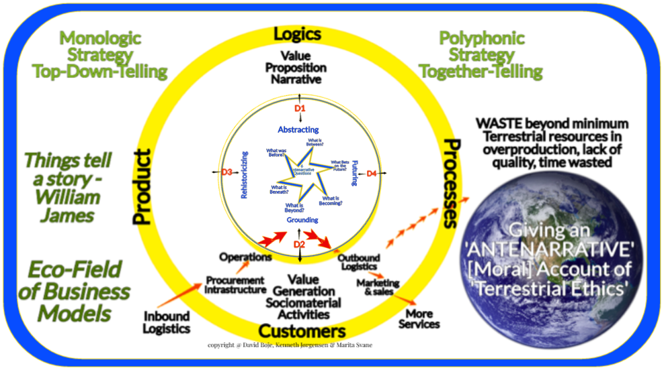
Notes:
Based on connections to p. 29 of Christian Nielsen, Morten Lund, Marco Montemari, Francesco Paolone, Maurizio Massaro and John Duman (2019) Business Models: A Research Overview
Antenarrative Business Model

Slide 50
Conclusion: Water Business Models and Business Storytelling are Entangled
Notes:
p. 28 https://stakeholder.affinitywater.co.uk/docs/KPMG%20-Water-sector-business-models.pdf
Affinity Water was established through the purchase of Veolia Water's UK water supply operations by Rift Acquisitions, an entity established by Morgan Stanley and M&G Investments, for £1.2 billion on 28 June 2012. Wikipedia
Self-Correcting Storytelling Methodology is about testing and experimenting to get new ‘bets on the future’
Bocken, N., Boons, F., & Baldassarre, B. (2019). Sustainable business model experimentation by understanding ecologies of business models. Journal of Cleaner Production, 208, 1498-1512.
Boons, F., & Laasch, O. (2019). Business models for sustainable development: a process perspective. Journal of Business Models, 7(1), 9-12.
Joyce, A., & Paquin, R. L. (2016). The triple layered business model canvas: A tool to design more sustainable business models. Journal of Cleaner Production, 135, 1474-1486.
Lüdeke-Freund, F., Bohnsack, R., Breuer, H., & Massa, L. (2019). Research on Sustainable Business Model Patterns: Status quo, Methodological Issues, and a Research Agenda. In Sustainable Business Models (pp. 25-60). Palgrave Macmillan, Cham.
Schaltegger, S., Hansen, E. G., & Lüdeke-Freund, F. (2016). Business models for sustainability: Origins, present research, and future avenues.

Slide 51
Develop TERRESTRIAL ETHICS WATER BUSINESS PLAN or our grandchildren will be the BET ON THE FUTURE THAT WILL NEVER BE
Notes:
Self-Correcting Storytelling Methodology is about testing and experimenting to get new ‘bets on the future’
Bocken, N., Boons, F., & Baldassarre, B. (2019). Sustainable business model experimentation by understanding ecologies of business models. Journal of Cleaner Production, 208, 1498-1512.
Boons, F., & Laasch, O. (2019). Business models for sustainable development: a process perspective. Journal of Business Models, 7(1), 9-12.
Joyce, A., & Paquin, R. L. (2016). The triple layered business model canvas: A tool to design more sustainable business models. Journal of Cleaner Production, 135, 1474-1486.
Lüdeke-Freund, F., Bohnsack, R., Breuer, H., & Massa, L. (2019). Research on Sustainable Business Model Patterns: Status quo, Methodological Issues, and a Research Agenda. In Sustainable Business Models (pp. 25-60). Palgrave Macmillan, Cham.
Schaltegger, S., Hansen, E. G., & Lüdeke-Freund, F. (2016). Business models for sustainability: Origins, present research, and future avenues.

Slide 52
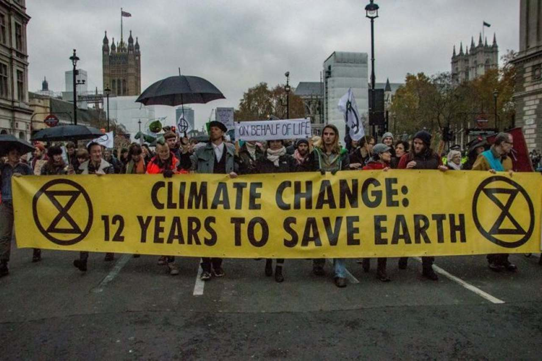
https://rebellion.earth/the-truth/the-emergency/
Tell the Truth at Oxford Circus
Act Now at Waterloo Bridge
Beyond Politics in Parliament Square
This is an Emergency at Marble Arch
The Heart at Piccadilly Circus

Slide 53
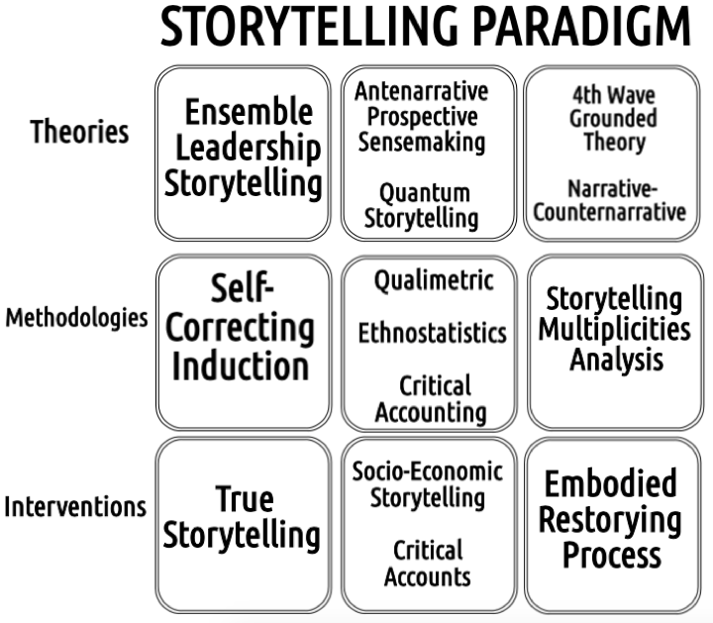
https://davidboje.com/quantum
9th Annual QUANTUM STORYTELLING CONFERENCE, in Las Cruces, New Mexico December 16, 17 & 18, 2019

Slide 54
World Scientific Encyclopedia of Business Storytelling Set 1: “Corporate and Business Strategies of Business Storytelling”
Business Storytelling Socioeconomics - Amandine Savall Lyon ISEOR Institute SAVALL Amandine amandine.savall@iseor.com
Business Storytelling of Entrepreneurship - Associate Professor Duncan Pelly duncan.pelly@gmail.com Abilene University, Texas
Business Storytelling in Ensemble Leadership - Grace Ann Rosile Professor Emeritus, New Mexico State University, garosile@nmsu.edu
Business Storytelling and Strategy - Yue Cai - Yue Cai "Yue C. Hillon" <ycaihillon@gmail.com> Associate Professor, Western North Carolina "Yue C. Hillon" ycaihillon@gmail.com
Business Storytelling and Change Management - Mark Hillon, mehillon@gmail.com independent consultant and Ph.D. in socioeconomic change management
Business Storytelling and Communication - Independent research scientists and Ph.D. Jillian Saylors, jrwsaylors@gmail.com

Slide 55
Business Storytelling Encyclopedia Set 2: "Methodologies and Big Data Analysis of Business Storytelling”
Business True Storytelling - Jens Larsen - Independent Consultant and Ph.D. info@oldfriendsindustries.com Copenhagen, Denmark
Business Storytelling and Big Data Methods - Associate Professor Rohny Saylors rsaylors@gmail.com Washington State University
Business Storytelling and 4th Wave Grounded Theory Methodology - Marita Svane msvane@business.aau.dk Associate Professor, Business College, Aalborg University
Business Storytelling, Science, and Statistics - Professor David Trafimow dtrafimo@nmsu.edu and editor Journal of Applied and Experimental Social Psychology, New Mexico State University
History and Business Storytelling - Prof. Albert Mills,
St Mary's University, albert.mills@smu.ca

Slide 56
Business Storytelling Encyclopedia Set 3: “Ethical Practices of Business Storytelling” (set sub-title)
Business Storytelling and Sustainability - Professor Kenneth Mølbjerg Jørgensen kmj@business.aau.dk -Business College, Aalborg University, Denmark
Business Storytelling and Postcolonialism – TBA contact davidboje@gmail.com
Business Storytelling and Gender-Telling - Alessio Sartore alessio.sartore@gmail.com Professor of Content Management &
Corporate Storytelling at IULM University, Milan, Italy
Race, Ethnicity and Business Storytelling - Jean Helms Mills - jean.mills@smu.ca Professor Saint Mary's University, Nova Scotia
Business Storytelling and Indigenous Wisdom - Professor Tyron Love tyron.love@canterbury.ac.nz Business College, University of Canterbury, New Zealand

Slide 57
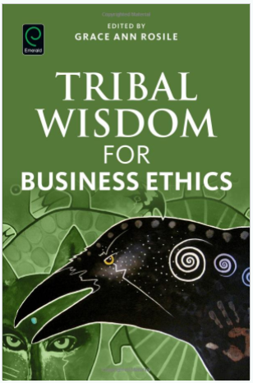
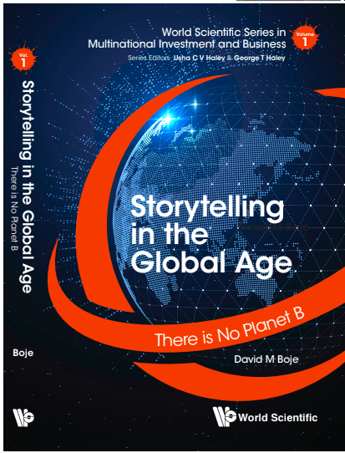
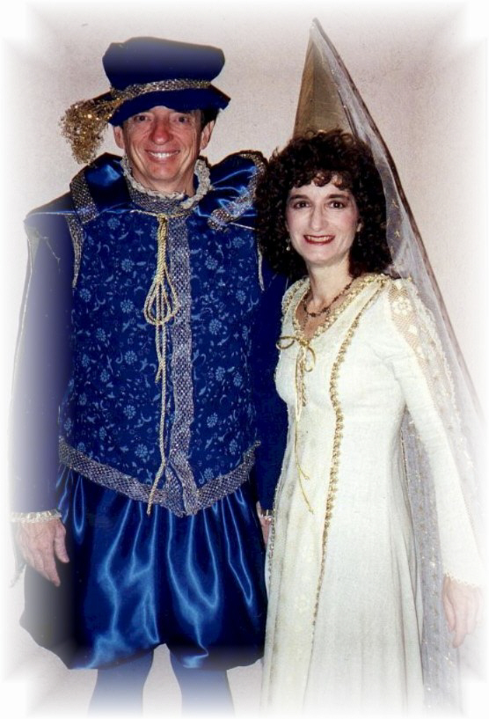
Storytelling Science and Your Dissertation
David M. Boje & Grace Ann Rosile
UK, US, Singapore: World Scientific
February 21, 2019; Revised March 19, 2019
Thank You Questions?
Download Storytelling Science book and slides for this presentation at https://davidboje.com/Aalborg
Notes:
If you have and comments or questions contact me at davidboje@gmail.com
Thank you

