Slide 1
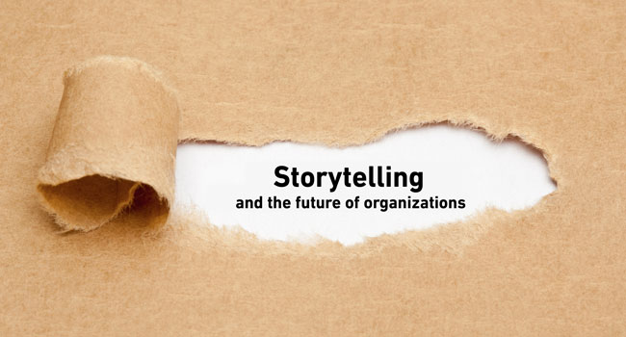
David M. Boje
Professor, Aalborg University & Storytelling Researcher
Adorno told us in Minima Moralia ‘Es gibt kein richtiges Leben im falschen’
(‘Wrong life cannot be lived rightly’)
Notes:
Business model storytelling See Christian Nielsen, Morten Lund, Marco Montemari, Francesco Paolone, Maurizio Massaro & John Dumay (2019). Routledge.
Digital transformation transfomrs a given business model, into an ensemble of dispositifs that affect selection of intellectual capital and (re)con-figure the value creation processes to the customer and what he/she requires
Not all businesses have data that works in a big-data context. They need different business models
See - “Sokkelund Café &amp; Brasserie” a 7 year intervention with conversational interviews and data, in digital enablers from analgue to data-driven small-data restaurant.
2009
40 seats and 850.000 euro
2017
74 seats and 4,7 million euro
We want business storytelling and its business model-dispositif to work for us, instead of confining the human potential
Move from too many documents, notes and paper, inefficent processes, slow comm, irrelevant into, and nothing was real time
The HR, productions, sales, and staff cost in one app.
Small-data – began with sales per seat per day (or per customer), customer retention, and find causation in data that is logical enough for humans to understand
Themes of natality and plurality becomes more visible.

Slide 2
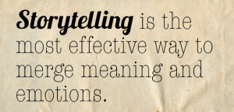
What is Storytelling?
Storytelling is coming to an end (Walter Benjamin)
Storytelling became petrified narrative (Barbara Czarniawska)
Storytelling reduced to retrospective narrative sensemaking (Karl Weick)
Narrative and story are not the same (Yiannis Gabriel)
For every narrative there is a counternarrative ()
Storytelling is also together-telling of living stories (Grace Ann Rosile)
Before narratives and stories are our antenarrative bets on the future (Boje)
Notes:
image from https://adoration.com/2017/the-death-of-a-storyteller/storytelling/

Slide 4
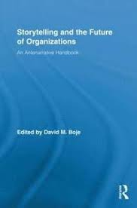
2001
2011
2016

Slide 5
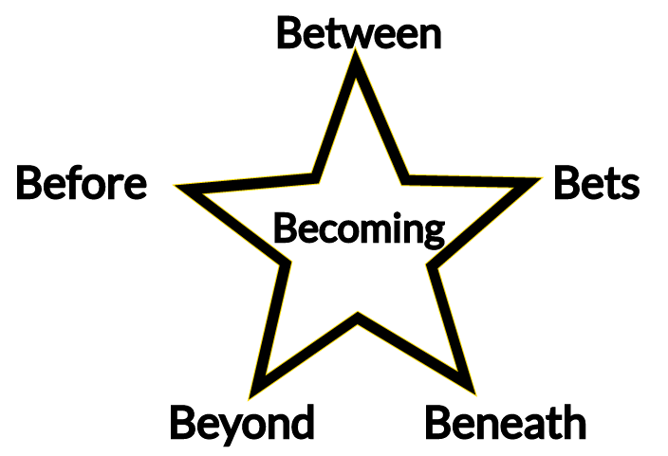
6 B’s of Antenarrative Theory

Slide 6
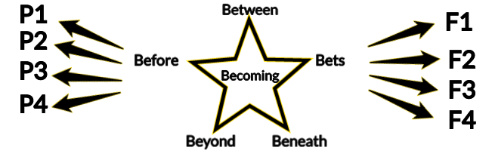
Many Pasts and Many Futures
Notes:
The past that never was
The future that will never be
We make different bets on the future
We choose which future to bet on, and to actualize
Then we rehistoricize our many pasts
It’s the difference between Kairos and Chronos

Slide 7
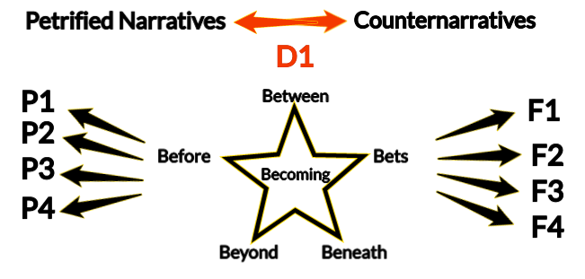
D1 = Dialectical Opposition

Slide 8
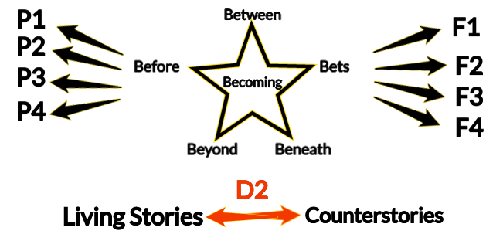
D2 = Dialogical (negations)

Slide 9
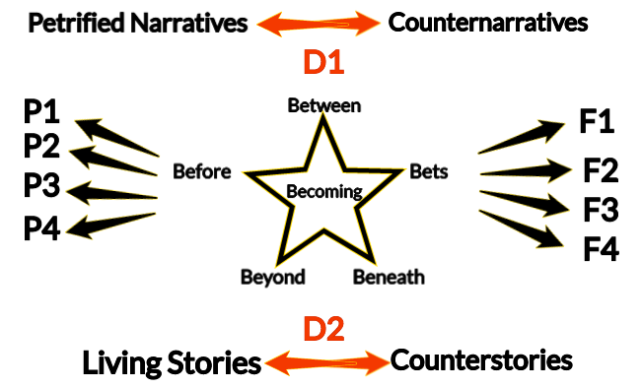
Storytelling Paradigm Theory

Slide 10
Storytelling Paradigm

Slide 11
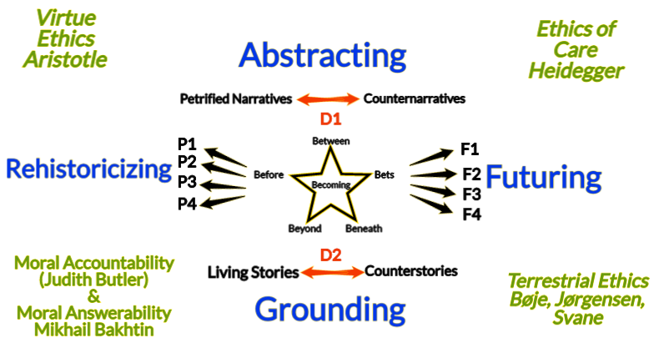

Slide 12
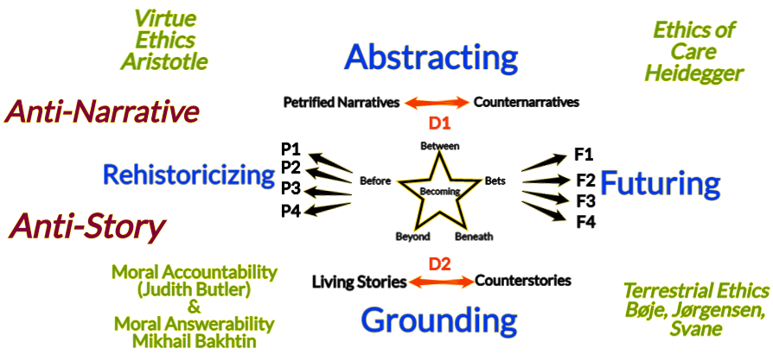
Anti-Narrative is not Antenarrative Anti-Story is not Living Story

Slide 13
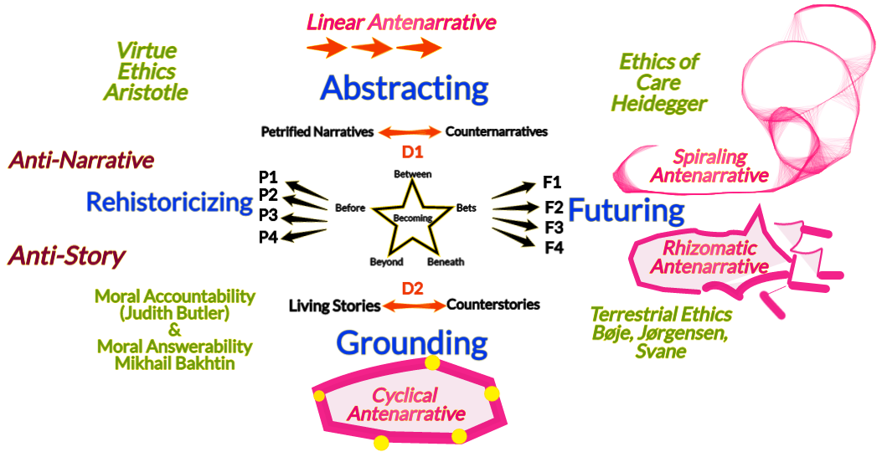
Four types of Antenarrative

Slide 14
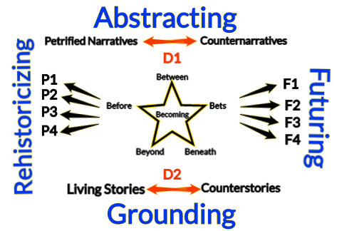
Basic Model

Slide 15
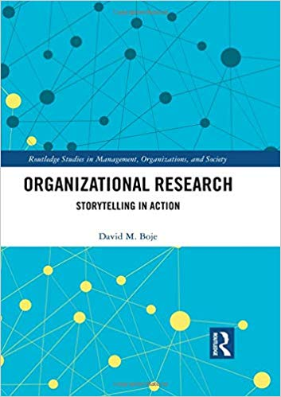
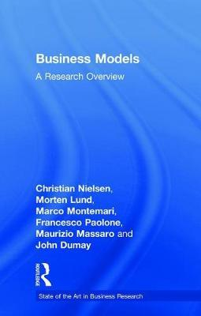
2019
Morten Lund’s dissertation – narratives exemplifying existing business models
Notes:
Lund’s dissertation – narratives exemplifying existing business models

Slide 16
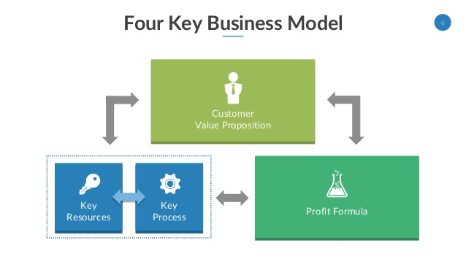
Customers
Living Stories
VIRTUAL
Water
Petrified
Narrative
ANTENARRATIVE Processes
Notes:
See p. 28 of Mark W. Johnson – Reinvent your Business Model: How to Seize the White Space for Business Growth?

Slide 17
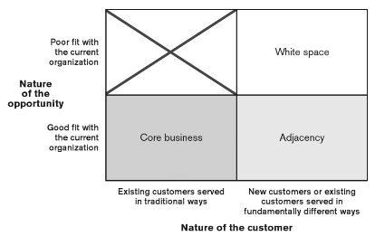
Antenarrative
New ‘Bets on the Future’
Petrified Narrative
Notes:
With petrified narrative, there is no agility to move into WHITE SPACE opportunity. The traditional core of existing business model to move to adjacencies require changes in operations, a different formula to make money, new set of resources, new processes.
WHITE SPACE is potential activities not defined or addressed by the company’s current business model., and are beyond Adjacencies.
WHITE SPACE will require subjective valuation of company core, its activities that are far outside usual way of working

Slide 18
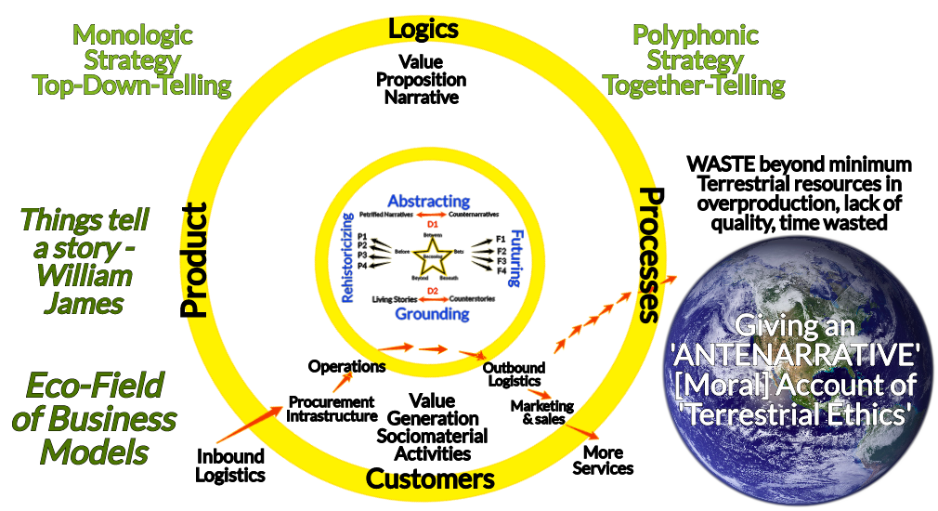
Antenarrative Business Model
Based on connections to p. 29 of Christian Nielsen, Morten Lund, Marco Montemari, Francesco Paolone, Maurizio Massaro and John Duman (2019) Business Models: A Research Overview

Slide 19
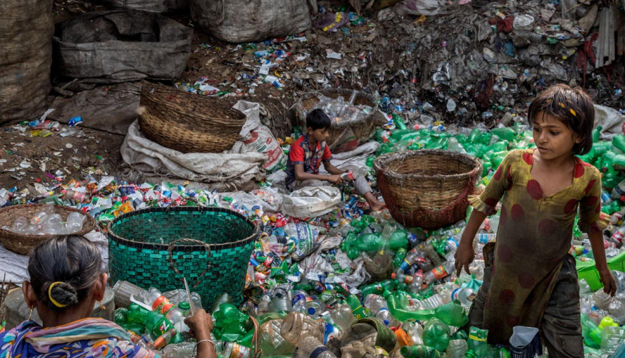
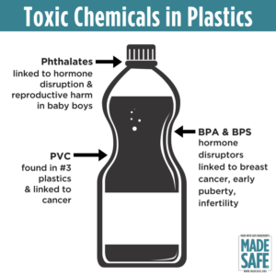
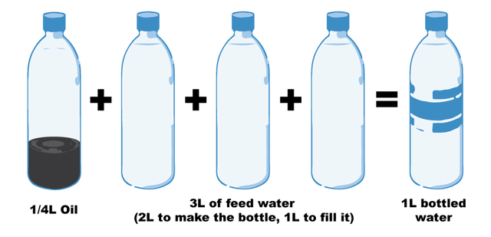
QUESTION: How to pursue a good life for oneself, as oneself, in the context of a broader world that is structured by inequality, exploitation and forms of effacement – Hannah Arendt
Notes:
Fill a plastic water bottle 25% with OIL to illustrate how much oil it take. https://www.portlandoregon.gov/sustainabilityatwork/article/535746
USA consumes 50 billion plastic water bottles a year, 23% head to recycling, but 38 billion don’t go to recycling, and then only about 9% actually gets recycled, because China is no long taking them, and because it costs $$$ to sort the bottles, shred them, wash them, heat them to sanitize, then melt into pellets and sell to beverage companies
Billions of gallons of water are used to make the Billions of gallons of water in water bottles ( feed waters 3 to 1 final bottle of water)
50 billion USA plastic water bottles is 17 million gallons of oil. It takes 6,000 megajoules of electricity for each barrel of oil, and with all the oil for 40 billion bottles that is 106 billion megajoules of electricity, which is how the 25% oil calculation is based on.
OUR PROBLEM TO BE SOLVED GETS WORSE: 50 billion USA plastic water bottles, is small part of the 250 billion BEVERAGE bottles with juices, sodas, etc. in them
WORLDWIDE: USA is 50 billion plastic water bottles, but world total is 500 Billion, and that means five times that in Total World Beverage plastic bottles
PROBLEM GETS WORSE AGAIN: Most are made of PET –Polyethylene Terephthalate and that has BPA in it.
https://www.madesafe.org/avoid-toxic-chemicals-plastics/
BPA stands for Bisphenol-A and it is a carcinogen, cause low sperm count in boys, and early puberty in girls. PBA is endocrine disruptor.
BPA has been a resin to make plastics clear and strong since the 1960s. https://www.mayoclinic.org/healthy-lifestyle/nutrition-and-healthy-eating/expert-answers/bpa/faq-20058331
It is not just making plastic bottles, but coats the insides of beverage cans, and used to make epoxy.
The FDA does not regulate it, saying low levels of BPA are SAFE to use in foods, and of no harm to human body. But Mayo Clinic says cut back on plastic bottles, and on metal cans (coated in BPA), for your good health life.
PROBLEM GETS WORSE: BPA has phthalates, and FDA refuses to regulate them either. Phthalates are industrial chemicals are binding agents, and to soften plastic, make it clearer and more durable.Also used in cosmetic consumer products. https://www.fda.gov/cosmetics/productsingredients/ingredients/ucm128250.htm Phthalates however do cause reproductive, liver, kidney, and lung problems in human beings. See Canada https://noharm-uscanada.org/issues/us-canada/phthalates-and-dehp Guardian https://www.theguardian.com/lifeandstyle/2015/feb/10/phthalates-plastics-chemicals-research-analysis
CDC recommends further study, FDA says its safe to consume, but others say health hazard https://www.theguardian.com/lifeandstyle/2015/feb/10/phthalates-plastics-chemicals-research-analysis. 2008 Henry Waxman bill did ban phthalates in some baby products
BUT the science says phthalates linked to asthmas, attention-deficit disorder, breast cancer, Type II diabetes, autism, and male fertility disorders. Watch the milk because a lot of plastic tubes are used in milking machines, and the phthalates make their way into even glass bottles of milk.
rPET is recycled PET https://earthhero.com/whats-the-deal-with-rpet/ Good news it uses 75% less energy to make rPET, less resource extraction, less CO2,
BUT ITS NOT A PERFECT SOLUTION TO NANOPLASTIC POLLUTION
The rPET, has microfibers, and with each washing, or swallow, it goes into the water, and these break down into microplastics, then into nanoplastic particles, which circulate in the water cycle with the PET nanoplastic particles, and it take 500 years to degrade, and that means all the plastic every made (except some incinerated) is still here, and worse problem, that are a lot of other plastics, and they break down to nanoparticles and head into food chain, so the water cycle gets more and more contaminated.
BOTTOM LINE
Our desire for plastic has change our Self. Other contaminants stick to the plastic and circulate in the water cycle, and the food chain, and that means plastic water and beverage bottles is a huge contributors to the human activities changing the global water cycle, and changing the Self of Water=Desire, Water=Life, Water=Memory, Water=Spirit, and Water=Matter but also means we are in Water-Denial, so Water=$$$
Plastic is a waste byproduct of petrochemical manufacturing. The oil industry had to get rid of the waste, so making it into plastic was how to do that, now we are past peak oil, and past three water peaks, and Water=Desire (our Ego manipulated by marketing hype) is causing an evolutionary change in the Self, so instead of an authentic Self, we have the Self as Desired by DuPont (inventor of plastic), and by Nestle, Coke, and PepsiCo (and their imitators). This is why Boje says in his books we are in a culture of denial, as marketing sells us a new self, and corporate lobbies corrupt agencies like FDA, or defang the EPA, and fund the campaigns of political leaders with PAC meney, as the corporation became a legal person, then its PAC money declared free speech act in political elections, while a human citizen ahs a limit in USA of $2,500.
All this boils down to Water=Desire is a corruption of Water=Spirit (Radah, mistranslated from the Hebrew in King James bible 1611, and used to by Francis Bacon soon after to make scientific method about subduing and domination of nature as an improper translation of ‘dominion’ and this became a political ideology in the 1970s e.g. James Watt, Secretary of the Interior to Reagan, said “After the last tree is felled, Christ will come back”
In sum bad bible translations of Radah are now being corrected so that it means ‘caring for creation’ and ‘stewardship, but the damage will take generations to undo, and by then the science says the water cycle will be destroyed. I.E. By 2030 global water demand will be 40% greater than it is today (McKinsey Report). By 2030 40% of world’s population will lack access to safe, sanitary water, in 2030 there will need 60% more fresh water to support demand than we have today in the water cycle. The developing nations are increasing water withdrawals by 50% and 18% in developing nations. In short, the fresh water system, if it were a bank, has more withdrawals than deposits, and is bankrupt!
https://www.waterlogic.com/en-us/resources-blog/world-oceans-day-plastic-pandemic/ for ocean impact

Slide 20
What is a Business Model
Value Proposition about product/service doing job for customers at affordable price = Hidden Cost of Fresh Water
Resources = Water for ➔ people, technology, facilities, equipment, funding, branding, and other raw materials
Processes= Water for ➔ means people use to develop and produce products that are repeatable, scalable, and sustainable
Profit formula = Water for ➔ creating value for shareholders
QUESTION: Can DeGrowth work as a Business Model?

Slide 21
The problem: In 10 years it will be too late to solve it
By 2030 global water demand will be 40% greater than it is today (McKinsey Report).
By 2030 40% of world’s population will lack access to safe, sanitary water
In 2030 there will need 60% more fresh water to support demand than we have today in the water cycle.
Developing nations are increasing water withdrawals by 50% and 18% in developing nations.
In short, the fresh water system, if it were a bank, has more withdrawals than deposits, and is bankrupt!

Slide 22
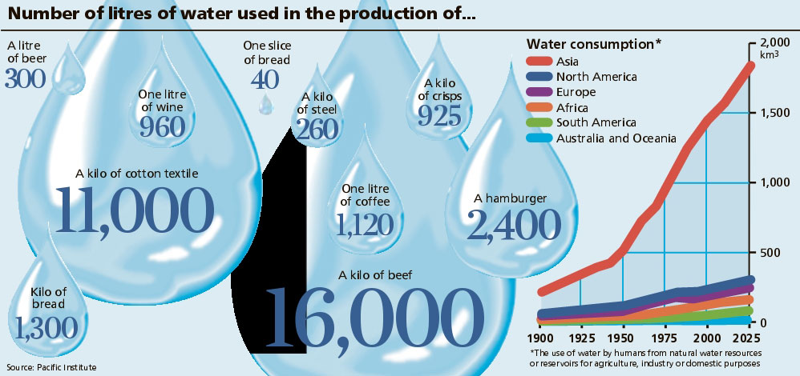
What is VIRTUAL WATER?
Notes:
http://www.linv.org/virtual-water/

Slide 23
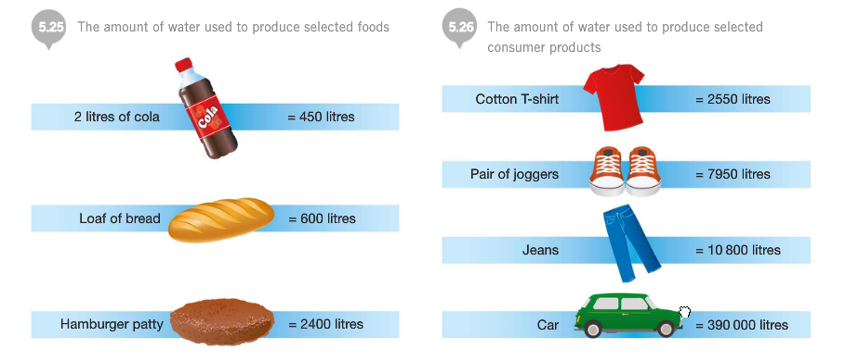
Virtual Water’s Hidden Cost Diagnostics
Notes:
http://sncyear7geography.weebly.com/virtual-water.html
“When a country imports (bring in from another country) 1 tonne of wheat, that country saves about 1,300 cubic metres of its own water (as it would have used 1,300 cubic metres of its own water if it produced the wheat themselves instead of importing it). If the water is scare in a country, the water it saved can be used for other purposes. If however, the water is scarce in the country that produced the wheat, then they have exported 1,300 cubic metres of water that is no longer available for other purposes.”
“

Slide 24
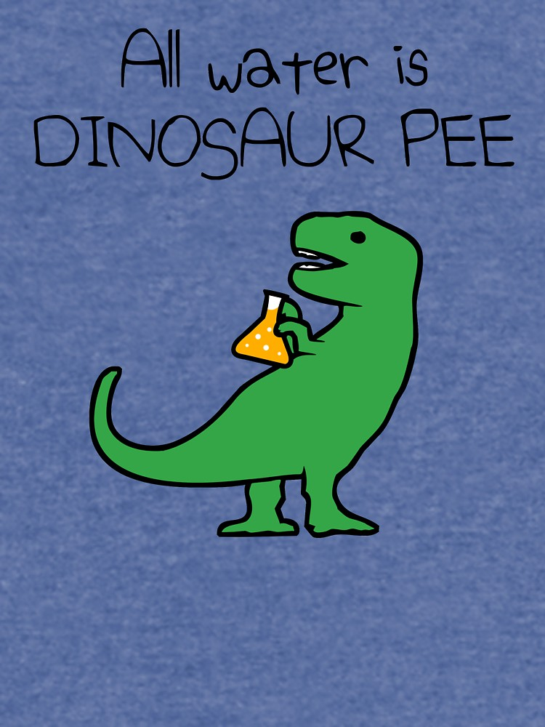
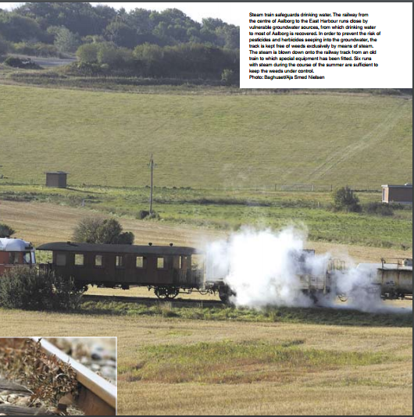
Steam train safeguards drinking water. Railway from centre of Aalborg to East Harbour runs close by vulnerable groundwater sources, from which drinking water to most of Aalborg is recovered. In order to prevent the risk ofpesticides and herbicides seeping into the groundwater, track is kept free of weeds exclusively by means of steam.
Notes:
https://www.aalborgforsyning.dk/media/1810/rapport-uk.pdf
Question: Why is all Water Dinosaur Pee?
WATER sourced in a State, is NOT subject to FDA jurisdiction. And see Documentary Tapped – only one person works in FD WITH JOB OF OVERSEEING BOTTLED WATER INDUSTRY.
https://www.isitbadforyou.com/questions/is-ozarka-water-bad-for-you
Nestle says ‘Water is NOT a Human Right!’ https://www.nestle-watersna.com/en/bottled-water-brands/ozarka/ozarka-water-quality-report
Bottled Water Leaches dangerous chemicals into what you drink.
Most plastic bottles end up in the land fill
USA consumes 50 billion plastic single use bottles a year, and 77% are not recycled, much of the ones that are, are down-cycled to making polyester shirts, or rugs.
Since plastic invented, and took off in 1950s, then in bottled water in 1970s, we have 9.2 billion tons of it, and more each year than the prior year, and ALL OF IT STILL HERE. Of the 9.2 billion tons, 6.2 billion tons of plastic never reaches the recycling bin, and that which does, most of that is not actually being recycled.
Oil companies had waste gas, ethylene to get rid of, so plastic

Slide 25
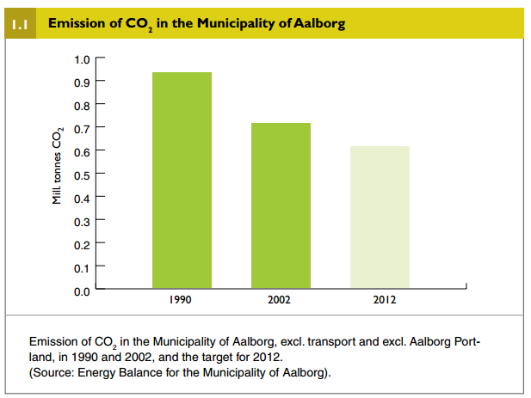
“In terms of water resources, the local authority in Aalborg is an international leader with regard to the active protection of groundwater”
https://www.aalborgforsyning.dk/media/1810/rapport-uk.pdf
Notes:
https://www.aalborgforsyning.dk/media/1810/rapport-uk.pdf

Slide 26
Aalborg is a Drinking Water Protector
“Aalborg is one of only a handful of municipalities in Denmark – in the process of safeguarding the future supply of drinking water by protecting the groundwater in particular catchment areas … The first tests carried out here - of nitrate content in the water at a depth of one metre – have demonstrated that protection is effective.”
DeGrowth QUESTION: Can Aalborg Protect its water by DeGrowth?

Slide 27
Water= $
3
Water= Thirst
2
Water= Denial
4
Water=Desire
1
“A discharge of untreated effluent can have disastrous consequences for the {Denmark} ecosystem in an individual watercourse, whereas the continued increase in the emission of greenhouse gases can have serious consequences for the climate on a global scale” https://www.aalborgforsyning.dk
Water= Life
5
Water= Matter
9
Water= Ethics
8
Water= Memory
6
Water= Spirit
7
Notes:
https://www.aalborgforsyning.dk/media/1810/rapport-uk.pdf

Slide 28
Question: What Does ‘Care of Creation’ mean for Moral Answerability for Water & Soda?
Water= $
3
Water= Thirst
2
Water= Denial
4
Water=Desire
1
Water= Matter
9
Water= Life
5
Water= Ethics
8
Water= Memory
6
Water= Spirit
7
Notes:
According to United Methodists, “Care for Creation” means “caring for and healing the earth are integral to what it means to be a United Methodist”. See “Social Principles: The Natural World”
It says that water, and resources for plants, for animal life, etc. are useful to human bings, but “God has granted us stewardship of creation. We should meet these stewardship duties through acts of loving care and respect” https://www.unitedmethodistwomen.org/bible-studies/choose-life
“Be an Earthkeeper” https://www.umccreationcare.org/

Slide 29
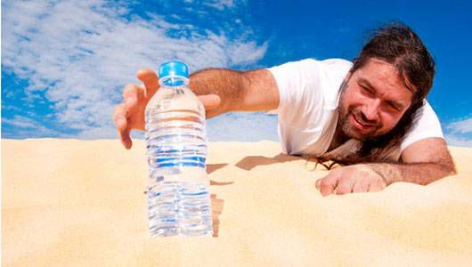
Water= $
3
Water= Thirst
2
Water= Denial
4
Water=Desire
1
Tap water in Denmark is one of the safest in the world. You can feel free and drink it without any concerns about your health https://www.visitaalborg.com/ln-int/aalborg/good-know#Other
Water= Matter
9
Water= Life
5
Water= Ethics
8
Water= Memory
6
Water= Spirit
7
Notes:
https://denmark.dk/innovation-and-design/sustainability

Slide 30
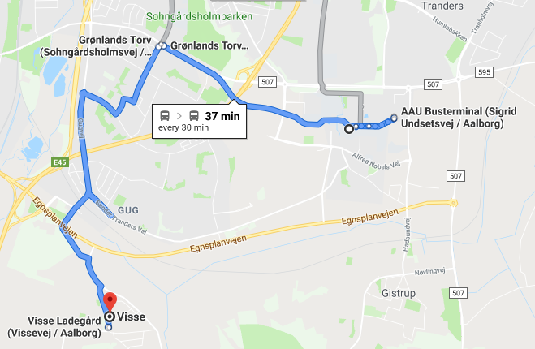
Aalborg is expected to continue to have a supply of clean drinking water in the form of untreated groundwater.
“How to live one’s own life well, such that we might say that we are living a good life within a world in which the good life is structurally or systematically foreclosed for so many?” Hannah Arendt
Notes:
New Catchment area directions from AAU

Slide 31
What is Dispositif?
Foucault’s work on interaction (& Baradian intra-activity) of discourse with administrative mechanisms and with knowledge structures that maintain exercise of power within an organization or social body.

Slide 32
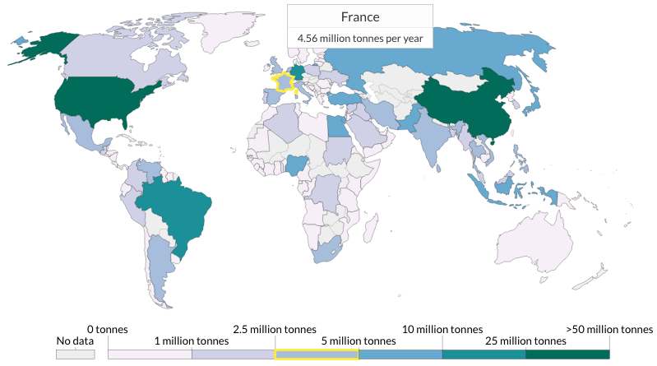
Plastic Waste By Country
United States
38 million tonnes per year
China
59 millon tonnes per year
For human health, it is the smallest particles — micro- and nano-particles which are of greatest concern. Particles must be small enough to be ingested.
Notes:
https://ourworldindata.org/plastic-pollution

Slide 33
PET (Polyethylene Terephthalate)
The new rPET (recycled PET) not as good for you as the advertising suggests
rPET microfibers come loose in each washing, and in swooshing the beverage, some get into the water or soda-water, and are being swallowed
rPET gets into the water cycle, breaks down into microplastics, which breakdown into nanoplastic particles, and just like PET, the rPET takes about 500 years to degrade.
Notes:
Hu et al. (2019: 1221) tested rPET and found "high temperature and oxygen in the recycling process may accelerate the degradation of PET and residual dyes, resulting in the volatile organic compounds (VOCs) emissions, which will do serious harm to the environment and human health."

Slide 34
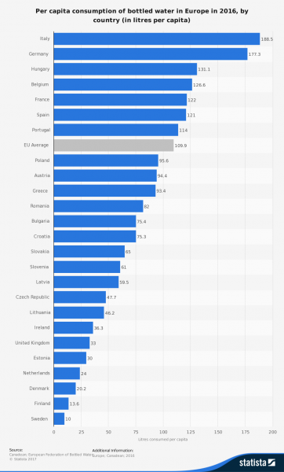
52 Billion litters of bottled water consumed in Europe per year
Plastic bottles are made of polyethylene terephthalate (PET or PETE), a 100% recycling material
59% are recycled in EU, about 35% in US
US uses 50 billion plastic water bottles a year
Notes:
https://www.surfrider.eu/en/le-blog/plastic-bottles-key-figures-environmental-disaster/

Slide 35
What is relation of Business Model to Dispositif?
A Business Model is defined as an Ensembel of Dispositifs
CHALLENGE: We want business storytelling and its business model-dispositif to work for us, instead of confining the human potential in panopticon
Digital transformation transforms a given business model, into an ensemble of dispositifs that affect selection of intellectual capital and (re)con-figure the value creation processes to the customer and what he/she requires
VALUE CREATION – New ways of dong business and new business models change the necessary dispositif ensemble components of intellectual capital in the value create process (Dane-Nielsen & Nielsen, 2018).
See BUSINESS MODELS: A Research Overview by Christian Nielsen, Morten Lund, Marco Montemari, Francesco Paolone, Maurizio Massaro & John Dumay (2019). Routledge.

Slide 36
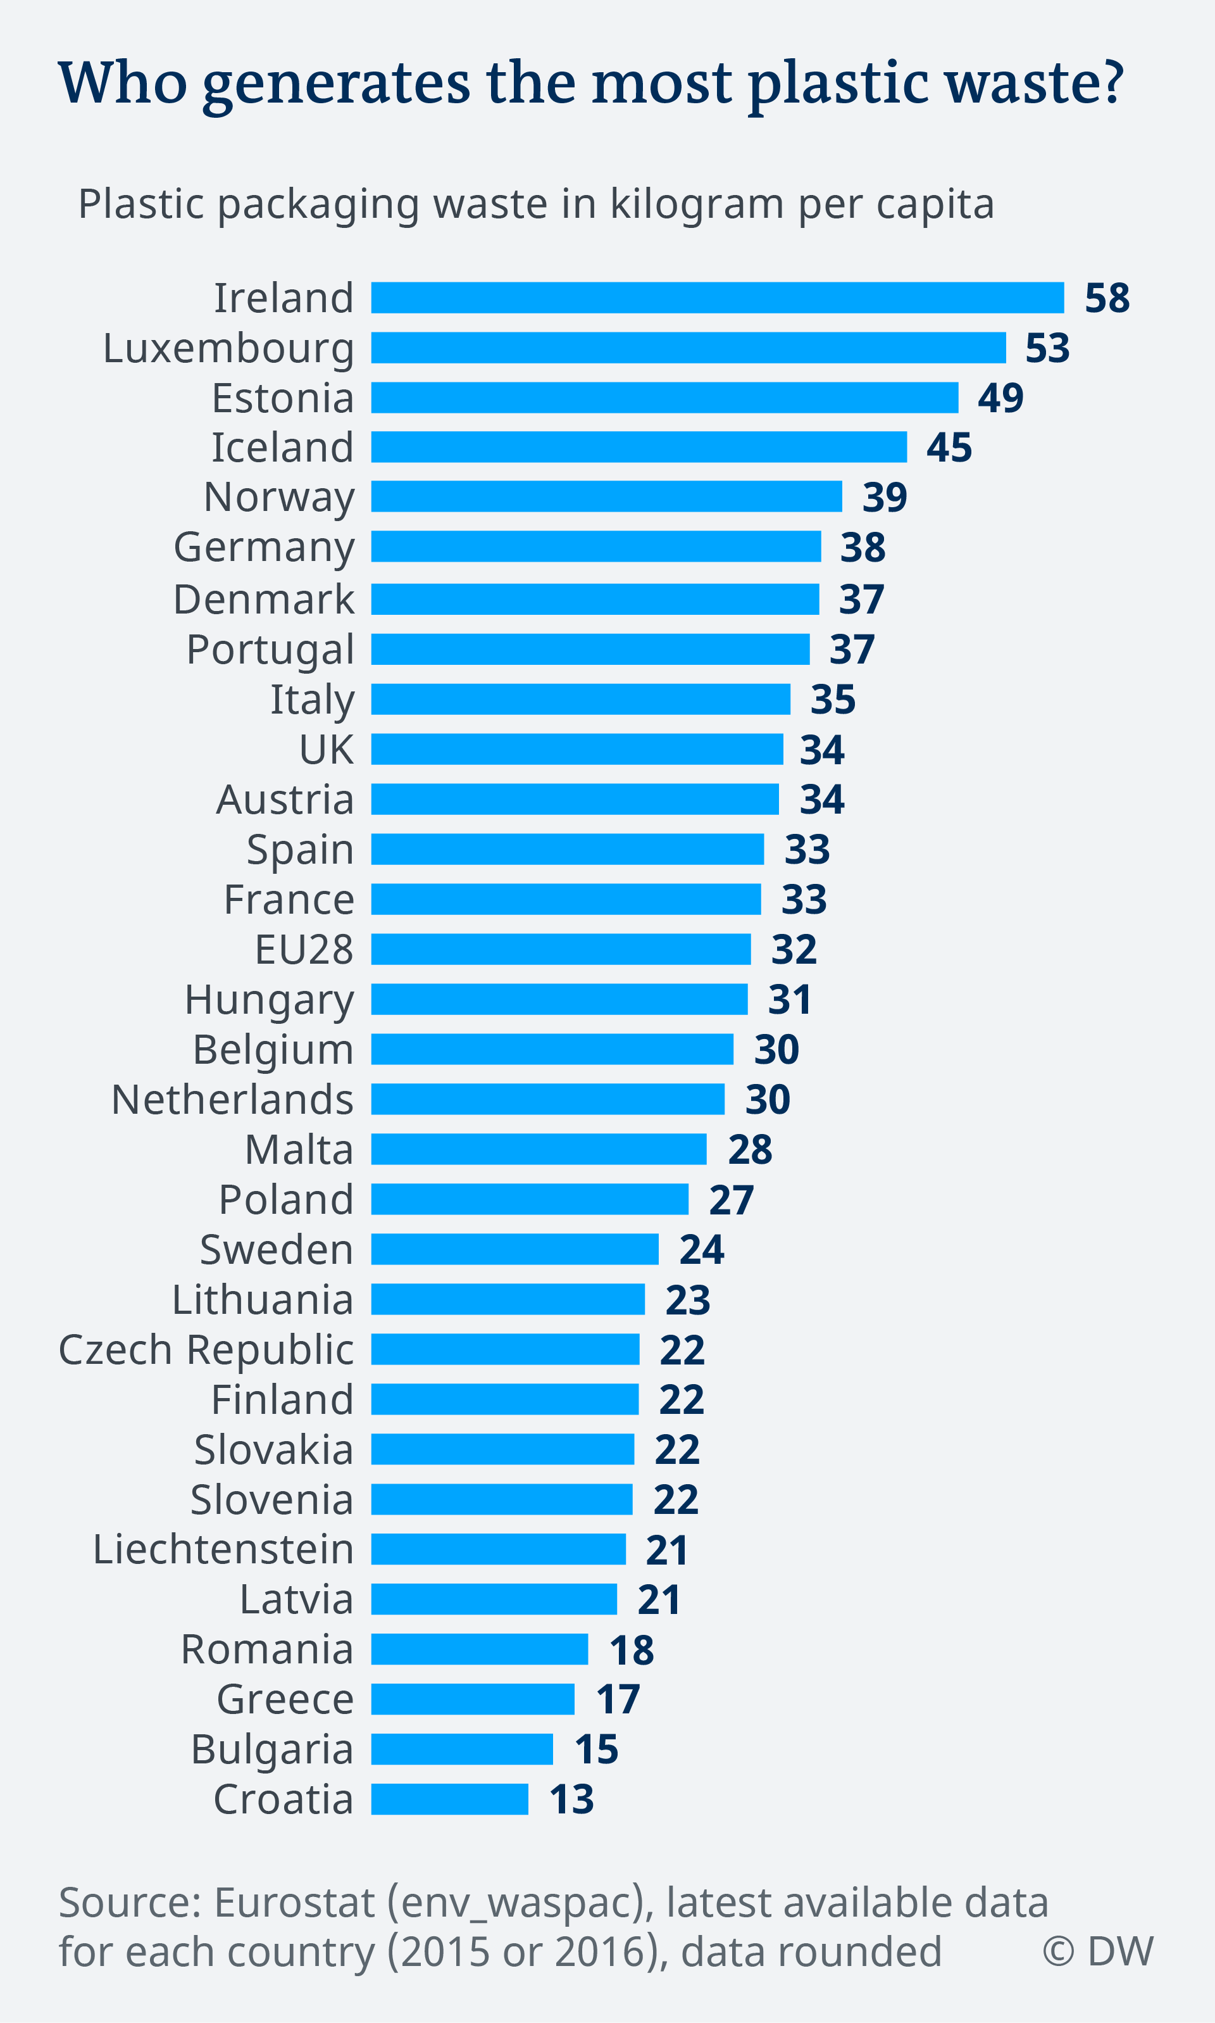
Notes:
https://www.dw.com/en/plastic-waste-and-the-recycling-myth/a-45746469

Slide 37
Climate Denial of clean air and drinkable water is rampant in USA & in Denmark there is Consciousness
Limfjord
Notes:
https://en.wikipedia.org/wiki/Limfjord
“Limfjord (common Danish: Limfjorden [ˈliːmˌfjoːˀɐn], in north Jutlandish dialect: Æ Limfjord) is a shallow part of the sea, located in Denmark where it is regarded as a fjord ever since the Vikings.
A 1946 act provided for re-closing the Channel with dams and sluices at Thyborøn, but this was never carried out. This idea re-emerged in 2005 and is now officially being investigated. It is thought that the isthmuses would be easier to preserve, and that the water level of the Limfjord would be more controllable. In periods of persisting western winds, flooding occurs at low-lying land and harbor areas in the towns of the western Limfjord, since the water can't escape through the narrow, eastern part of the Limfjord.[1]
The western breakthrough of 1825 changed the waters of the Limfjord from brackish to salty with a considerable current from west to east. Hypoxia sometimes occurs due to warm, windless periods in summer or ice in winter.
The fjord has today oceanic salinity, approximately 30 PSU (or per mille by weight) at all depths. Many animals and maritime plants that can be found in Skagerrak, Kattegat and the North Sea might hence be found in the fjord.
Due to its shallow waters, the temperature rises rather quickly during warm and sunny days from mid April to early September. While in winter, ice can form faster during the cold periods, especially in bays with little current. Far from all winters experience problematic ice conditions.
The Limfjord is notable for its tasty mussels (Mytilus edulis) [1]. Gourmets appreciate its oysters which are considered to be of extraordinary size and quality. Without the western breakthrough in 1825, these mussels wouldn't grow so well as they do in the oceanic salinity waters.

Slide 38
How to Develop a New Business Model-Dispositif about Water in Denmark?
How to create a ‘White Space’ for Business Model-Dispositif Innovation in Caring for Water?
To venture into the White Space, from business’ current operational space?
Storytelling Relevance? The operational space becomes a ‘petrified narrative’ of strong [core] business culture values (Czarniawska, 2004).
Problem: When new ‘bet on the future’ opportunity appears, the petrified narrative core blocks path to WHITE SPACE.
See” REINVENT YOUR BUSINESS MODEL: How to Seize the White Space for Transformative Growth Mark W. Johnson (Boston, MA: Harvard Business Review Press).

Slide 40
Bisphenol-A (BPA) Its substitutes not that safe
"BPA but not BPS concentrations were positively correlated with both estrogenic and antiandrogenic activities. BPA still dominates the thermal paper market in Brazil and Spain, and BPS appears to be one of the main alternatives in France. There is an urgent need to evaluate the safety of alternatives proposed to replace BPA as developer in thermal printing. The large proportion of samples with hormonal activity calls for the adoption of preventive measures"
BPA, bisphenol S (BPS) and bisphenol F (BPF)

Slide 41
Most plastic water bottles never recycled
Plastic took off in 1950s, then in bottled water in 1970s
We have 9.2 billion tons of it, and more each year than the prior year
ALL OF IT STILL HERE
And 6.2 billion tons of plastic never reaches the recycling bin, and that which does, most of that is not actually being recycled.
WHAT IS OUR MORAL ANSWERABILITY: “What form does this question take for us now?
Or, how does the historical time in which we live condition and permeate the form of the question itself?

Slide 42
Plastic is dangerous to Health
BPA stands for Bisphenol-A and it is a carcinogen, causes low sperm count in boys, and early puberty in girls.
PBA is endocrine disruptor.
BPA has phthalates, industrial chemicals: binding agents and to soften plastic, make it clearer and more durable.
Phthalates are linked to asthmas, attention-deficit disorder, breast cancer, Type II diabetes, autism, and male fertility disorders
WHAT IS OUR MORAL ANSWERABILITY: “What form does this question take for us now?
Or, how does the historical time in which we live condition and permeate the form of the question itself?

Slide 43
Plastic water bottles are dangerous to your health
Plastic has entered the water cycle
BPA and substitutes BPS and BPF are equally toxic
Fresh safe drinking water and sanitation getting so scarce
6,000 children die every day of water-borne diseases that are entirely preventable with modern science

Slide 44
Polychlorinated biphenyls (PCBs) are manmade chemicals that adhere to plastic
PCB, for example). If there was significant accumulation of environmental contaminants, there is the possibility that these concentrations could 'biomagnify' up the food chain to higher levels, to humans

Slide 55
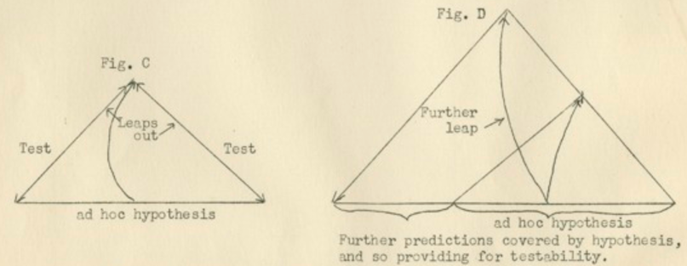
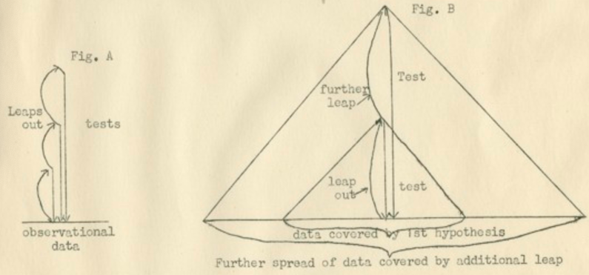

Slide 61
Self-Correcting Induction Methods
For Karl Popper it is Zigzag between intuitive hypotheses and testing theories by disconfirmation, not by confirmation
For C. S. Pierce it is self-correcting induction by four tests to get closer to Truth
For Henri Savall it is self-correcting by ’Agile’ intervention using Peirce’s Abduction-Induction-Deduction in Scientific Method of unleashing human potential

Slide 62
Charles Sanders Peirce 4 Tests of Self- Correcting Induction
Test One: Try to dismiss the precepts. Given fallibility, “the first test consists in trying to dismiss the precepts” as as some kind of fancy or daydream. If the flow of precepts persists, proceed to Test Two.
Test Two: Ask other people if they see and hear the same thing. If you have reason to suspect hallucination persists, the second test consists in “asking some other person whether he [or she] sees or hears the same thing” If several people concur then treat the induction as conclusive, or proceed to Test Three.
Test Three: Use your knowledge of laws of nature. Some hallucinations and illusions can affect many people. The third test is surer than the first two. “I may make use of my knowledge of the laws of nature” (as fallible as that may be). Apply your knowledge of the Nature, making our observations.
Test Four: Do experiments to see if the precept is illusory. There is a fourth test, and it is the surest of them all. “ apply the test of experiment” .
Charles Sanders Peirce (Vol. 2.142)

Slide 63
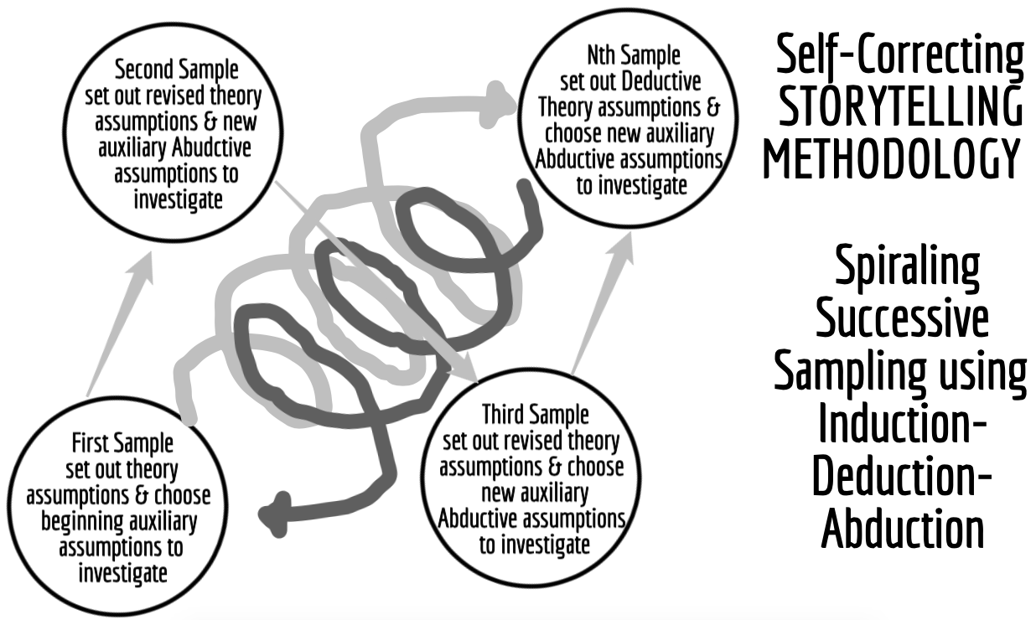
What is Self-Correcting Method?

Slide 65
What is TRUE STORYTELLING now?
How to plan FUTURE?
When & Where to do PROJECT?
Reflect on OUTCOMES?

Slide 66
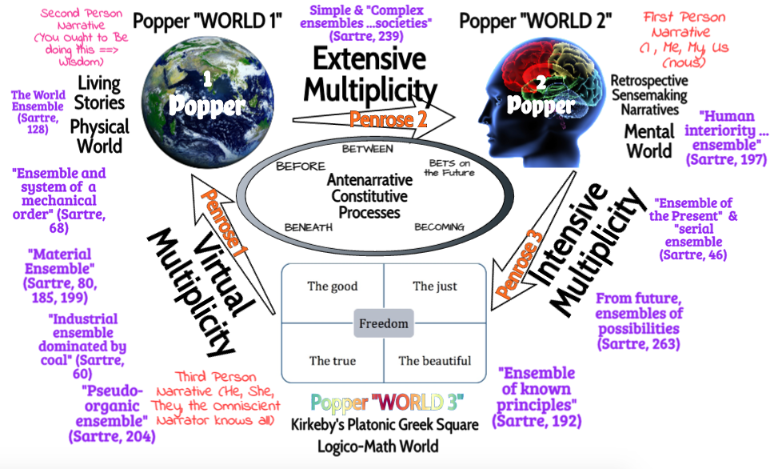

Slide 68
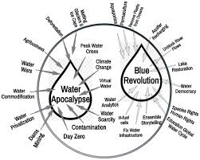
Can Denmark solve the Water Cycle Problems

Slide 69
Freire (1970/2000) theory of anti-dialogical action
Conquest
Divide and rule
Manipulation, and
Cultural invasion
Notes:
VALUE CREATION – New ways of dong business and new business models change the necessary components of intellectual capital in the value create process (Dane-Nielsen & Nielsen, 2018).
Successful businesses today are able to do storytelling, antenarratives-business-model scalability (Nielsen & Lund, 2018)
Digital transformation and intellectual capital are dispositif to visualize and clarify firm’s value creation processes and which intellectual capital is most relevant.
Business model is a value proposition towards the customer, so if firm delivers to the customer then
It is the notion of digital disruption (Christensen, 2013). Of the dispositif
Dispositif is the interaction of discourse with administrative mechanisms and knowledge structures that maintain exercise of power within an organization or social body.
Business model is heterogeneous ensemble of architectural forms, institutions, discourses, regulatory decisions, laws, scientific statements philosophical and oral propositions – as much told as the untold stories, the said and the unsaid. Discursive with the non-discursive, and part of the power relations game materializing in institutions that try to control your mind, body and spirit --- how you think about particular issues, and based on shared knowledge pool
Part of discursive norms and traditions to control – by subjectivication (technologies of the self) of how you appear and subjectivation (working on self to become more obedient) of how you are supposed to appear.
subjectification—to the changes in the
prevailing power relations.
Thus, his histories have explored the multiple
dimensions of sovereign power, of pastoral power, of disciplinary power,
and of bio-power, and their complex web of control over a population. In
speaking of assujettissement, two related problems immediately arise: the
wide range of meanings contained in the term assujettissement as Foucault
wields it and as we take it as a formal indication, and the translation of it
into English by Foucault’s several translators and by those who write on
Foucault. With respect to its range of meanings, assujettissement clearly
entails subjugation and “subjection”
he accentuates a
vision of government through freedom. In this regard, Judith Butler has
grasped some of the elements of assujettissement that have escaped many
others: “Power not only acts on a subject but, in a transitive sense, enacts
the subject into being. A
Busness model makes people more obedient, more ocmplicit in disciplining the solf into a docile role – subjectivation – active work on the self, so the self cannot find their own Living Story Freedom, and is overrun by the apps of dispositif
You renounce your Self, as you enact the subjection and subjectvation ----
Business model configurations are divided into ontology of 5 areas
Digitalizaiton

Slide 70
Theory of dialogical action Business Model-Dispositif Ensemble characteristics:
Cooperation
Unity
Organization, and
Cultural synthesis

Slide 71
Conscientização and relation of anti-dialectical and anti-dialogical to their opposite

Slide 72
Round 1: Storytelling about BEST Conversation Ever Had
Pick Partner you know least in room
Share experience of BEST CONVERSATION
For each story you hear, take a turn and share your story back
At least once share a counter-story to their story
Write verbatim notes as you listen to each other
After the conversation is done, write up your critical reflections of your own storytelling, and your partner’s storytelling

Slide 73
Round 2: Storytelling about WORST Conversation
Pick new Partner you know least in room
Share experience of WORST CONVERSATION
For each story you hear, take a turn and share your story back
At least once express a counter-story
Write verbatim notes as you listen to each other
After the conversation is done, write up your critical reflections of your own storytelling, and your partner’s storytelling

Slide 74
Norway’s solution of deposits
Norway recycles 97% of its plastic bottles Now
Denmark will do 50% by 2025
EU rate if 57%
In United States, recycling rates for plastic bottles have plunged from 37.3 percent in 1995 to 28 percent today.
Notes:
https://www.huffpost.com/entry/norway-plastic-pollution_n_5b7c07e0e4b05906b41779ee
https://foodnationdenmark.dk/news/half-of-danish-plastic-bottles-will-be-recycled-by-2025/

Slide 75
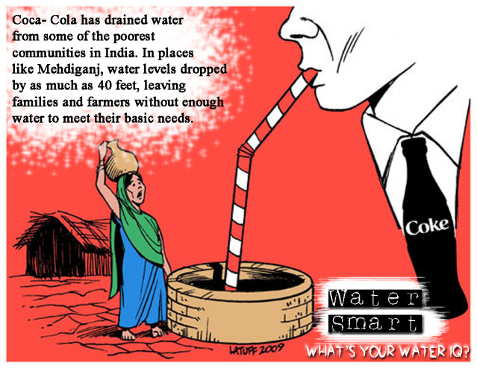
Water= $
3
Water= Thirst
2
Water= Denial
4
Water=Desire
1
Water= Matter
9
Water=Ethics Aalborg’s ‘Creation Care’ and Justice.
QUESTION: How to be an earth Keeper? A Water Protector?
Water= Life
5
Water= Ethics
8
Water= Memory
6
Water= Spirit
7

Slide 76
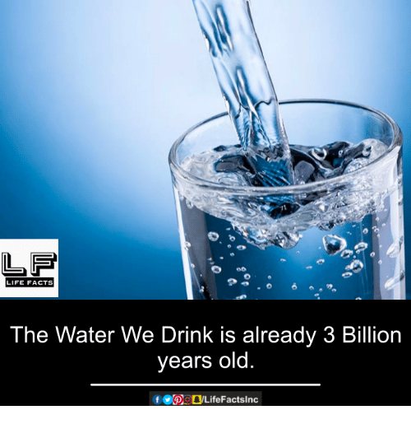
Water= $
3
Water= Thirst
2
Water= Denial
4
Water=Desire
1
Water= Matter
9
Water= Life
5
Water= Ethics
8
Water= Memory
6
Water= Spirit
7
Notes:
Water=Desire is a marketing and advertising game to build desire for water.
Dita Von Teese douses herself in Perrier in this popular ad designed to equate WATER with DESIRE https://www.youtube.com/watch?v=aRTYDUS8fp0
Twilight Actress, Ashley Greene, endorses SoBe Lifewater in an ad that features her wearing nothing but body paint.
Mark Wahlberg endorses this high performance sports water in a commercial that features him in the middle of an intense workout. Recently, Wahlberg teamed up with IZOD and AquaHydrate in a strategic marketing partnership to promote the brands through the IZOD IndyCar Series.
When Coca-Cola tried to Sell Dasani Bottled Water with SPUNK ads (it flopped) https://www.youtube.com/watch?v=TK4IhaLwXVc
Jennifer Aniston Video selling SMART WATER (Glaceau Coca-Cola) with humor and with Sexual posing and with dancing babies to appeal to another demographic http://www.filtersfast.com/blog/index.php/2010/06/celebrities-for-bottled-water/
Nestle’s PURE LIFE bottled water ad sells theDESIRED FUTURE = BOTTLED WATER https://www.youtube.com/watch?v=Aa6a6qOu-aM
QUESTION: Why do we Drink Cleopatra’s Bathwater?
ANSWER: Water is a closed loop planetary system.
We have the same water that we had at GENESIS or for Atheists BIG BANG, 3-4.5 billion years ago
Water recirculates in the closed loop water cycle between surface water, ground water, evaporation to atmosphere, precipitation, etc.
Our bodies are 55% to 75% water
Our bodies are 37.2 trillion living cells, that are mostly composed of water

Slide 77
Water= $
3
Water= Thirst
2
Water= Denial
4
Water=Desire
1
By 2025 UN predicts 66% of world’s people will live in countries with high water stress = 5.3 billion
Water= Matter
9
Water= Life
5
Water= Ethics
8
Water= Memory
6
Water= Spirit
7
Notes:
https://saveabilenewater.com/our-lakes/
https://saveabilenewater.com//wp-content/uploads/2015/03/Water_Stage_Chart.pdf

Slide 78
Water= $
3
Water= Thirst
2
Water= Denial
4
Water=Desire
1
Water= Matter
9
Every Day 6,000 children die of water-borne diseases that are preventable
Water= Life
5
Water= Ethics
8
Water= Memory
6
Water= Spirit
7
Notes:
Water=Desire is a marketing and advertising game to build desire for water.
Americans consume 50 billion single use plastic water bottles a year
It takes 3x the water to make the bottled water as it does tap water, which is not counting the VIRTUAL WATER going into the production and distribution process. https://pacinst.org/publication/bottled-water-and-energy-a-fact-sheet/
2009 study shows it takes 2000 times more energy to make and distributed bottled water than your tap water https://pacinst.org/news/352/
Bottling water produced more than 2.5 million tons of carbon dioxide
LIFE WTR
The launch of LIFEWTR is especially intriguing because PepsiCo has a big, bottled water brand already. It owns Aquafina, which is one of the company's 22 “billion-dollar brands” and already dominates the $185 billion global bottled water market http://fortune.com/2016/12/09/pepsico-new-premium-water/abcklash- some calling it Satanic Anti-Life WTR https://me.me/i/pepsis-newsatanicline-pepsi-life-beb-life-wtr-wtr-666-united-8373877 http://www.evilyoshida.com/thread-13354.html
There is a b

Slide 79
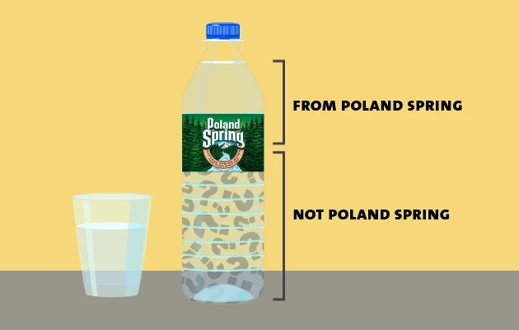
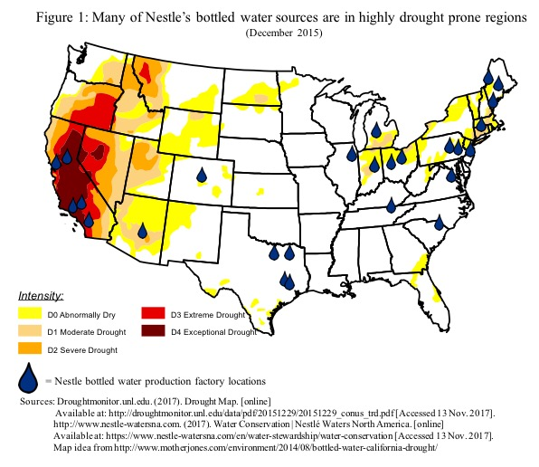
Water= $
3
Water= Thirst
2
Water= Denial
4
Water=Desire
1
Nestlé mines water in areas with weak water laws:
Maine and Texas operate under a remarkably lax rule from the 1800s called “absolute capture,” which lets landowners take all the groundwater they want.
Water= Matter
9
US is largest consumer of bottled water in the entire world
50 Billion water bottles/year US
Water= Life
5
Water= Ethics
8
Water= Memory
6
Water= Spirit
7
Notes:
FACT: US is largest consumer of bottled water in the entire world: 50 billion single-use plastic water bottles,
GETS WORSE: 250 Billion beverage bottles made of plastic sold in USA, 69% go to landfill
USA=> 8.6 billion gallons a year in 2017; Average US consumer 21 gallons a year
Bottled water costs consumers 3 to 7 times more water in production than tap water & costs 1,000 times more
50 billion bottles of water in plastic sold in US each year.
They say 23% recycled, most of other 38 billion single use bottles make their way to the ocean
In 1999 Charles Moore found 6 times more plastic than plankton, by 2008 it was 46 times more, a huge increase
rPET is the new storytelling of how to make plastic beverage drinks healthy for people & planet
But the the plastic fiber in rPET breaks down, putting microplastics, and then nanoplastic particles into the water
PepsiCo says its consumers are INDIFFERENT to plastic effect on health and ecology, so it refuses to put post-consumer content on its labels
This goes back to Water=Desire is being manipulated by advertising
Poland Springs water does not come from Poland Springs, Maine, not much of it, less than 30%, and its mostly well water that is being mislabeled as spring water.
Looking at the places Nestle (owner of Poland Springs, Arrowhead Mountain, etc) sinks their wells, much of it is in draught areas
In Texas, so far, its in areas not hit by drought.

Slide 80
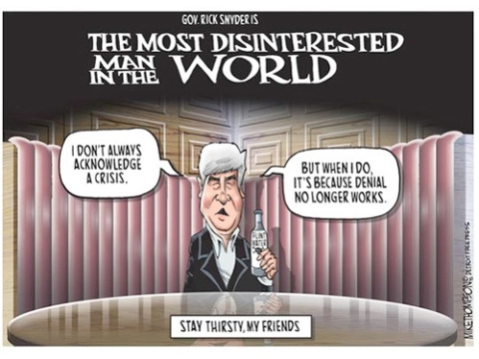
Water= $
3
Water= Thirst
2
Water= Denial
4
Water=Desire
1
Faced with Doomsday Water Scenarios, human inclination is denial
By selectively filtering-in what AFFIRMS & CONFIRMS self-interest
Be selectivity filtering-out what Disaffirms & Refutes self-interest
Therefore ‘storytelling science’ needed to do refutations of denial
Water= Matter
9
Water= Life
5
Water= Ethics
8
Water= Memory
6
Water= Spirit
7
Notes:
Former Gov. Rick Snyder is again a defendant in Flint water class action lawsuit
By STEVE CARMODY • APR 1, 2019
One story (unconfirmed) is Flint Michigan was a greedy plot to make $ from having to sell more bottled water. Beneath the surface, bottled water companies do engage in ads disparaging the quality and safety of tap water.
The Flint water crisis began in 2014, after the drinking water source for the city of Flint, Michigan .... October 15 – Michigan Governor Rick Snyder signs a bill for $9.35 million to re-connect to Detroit water and provide relief. The switch is made https://www.michiganradio.org/post/former-gov-rick-snyder-again-defendant-flint-water-class-action-lawsuit

Slide 81
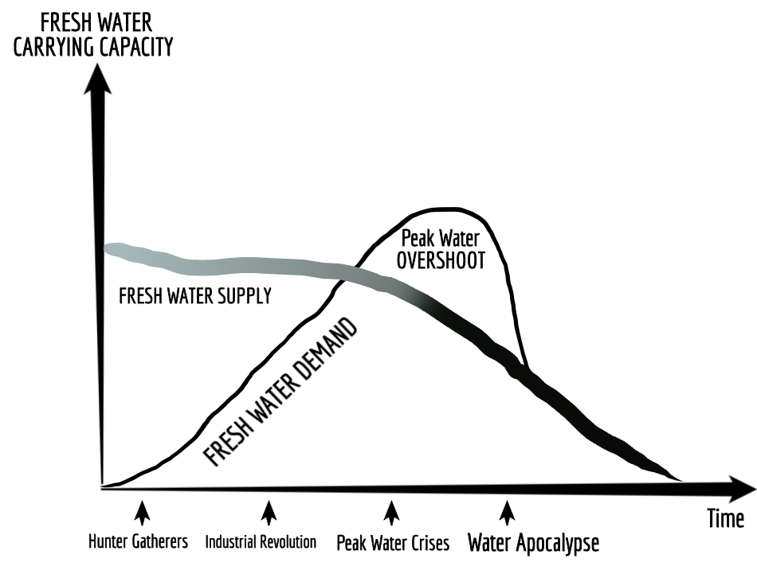
Water= Denial
4

Slide 82
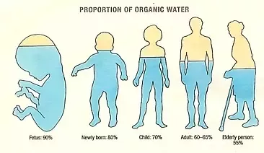
Water= $
3
Water= Thirst
2
Water= Denial
4
Water=Desire
1
Water= Matter
9
Water= Life
5
Water= Ethics
8
Water= Memory
6
Water= Spirit
7
Notes:
Water=Life. Water is an ecological necessity
The human body is 60 to 75% water depending on age and gender. Each human body has 37.2 trilliion living cells, allof them have water or they die.

Slide 83
Water= $
3
Water= Thirst
2
Water= Denial
4
Water=Desire
1
YES, USA 4.25 billion prescriptions/year
Studies find more Meds in Rivers, Lakes, Reservoirs, and, in drinking water
QUESTION: Does the water we drink contain Prescription Meds, Animal Growth hormones, nicotine, caffeine, fertilizers, pesticides?
Water= Matter
9
Water= Life
5
Water= Ethics
8
Water= Memory
6
Water= Spirit
7
Notes:
Unsafe water kills 200 children every hour of diarrheal, malaria, parasites
3.4 million people, mostly children die each year of water-borne diseases.
11 million children die each year of mostly quite preventable diseases before reaching their 5th birthday! And ½ of world’s population suffering from 1 or more water-related diseases.4 billion annual cases of diarrheal water-borne disease cause 2.2 million deaths a year, mostly of children under five https://www.unicef.org/media/media_21423.html
QUESTION: Does the water we drink contain Prescription Meds, Animal Growth hormones, nicotine, caffeine, fertilizers, pesticides?
YES, Mayo Clinic study says Pain Killers top list of Meds taken in USA, and USA consumes more than other nations
Leading cause of death now among people under 50 is opioid Med overdose, 59,000 deaths a year (19% up from year before) https://www.cbsnews.com/news/overdoses-are-leading-cause-of-death-americans-under-50/
Study in 2008 found Mood altering Meds in tap water in 24 municipalities, and 34 other that don’t test at all Americanlives.org
THEREFORE: Need more research into water treatment methods that can remove Meds from not just drinking water but entire Closed Loop Water Cycle
Another study found 47 different Meds in samples of drinking water before water treatment plants, and 37 still there after treatment tonicvice.com
QUESTION: WHY are people in US, UK, Western Europe using so many Meds? Why the upward trend?
ANSWER: People seeking quick fix to health instead of exercise, changing drink and food habits, or changing their life/work styles
Age 50 to 65, average # of Meds is 19.2. Number of Meds drops after age 65
Drug companies charge Americans 2 and 3 times price of same drugs sold in UK or Switzerland healthsystemtracker.org
HOW TO FILTER MEDS FROM WATER? Reverse Osmosis is best, but tastes Yuk; Activated Charcoal filters some
Most bottled water contains Meds, Caffeine, and Nicotine
Study in Spain found 58 active Meds in 10 bottled water brands
Study in UK found Meds in ground water, drinking water, and says bottled water often uses no filtration or filtration designed for Macro-Pollutants, NOT the Micro-Pollutants
See book by Cases Adams, Pure Water
Study by Scientific America.com finds Meds in 80% of samples of USA groundwater, rivers, lakes, estuaries, and affects the drinking water of 40 million Americans.
THEREFORE: We can conclude from the Statistical Storytelling that 11 million children die each year of preventable diseases, most of them involving water quality and sanitation practices
We can also conclude that Closed Loop Water Cycle of the World is being Over-Medicated, and the kinds of Filtration Systems being used and regulated are not getting at the root causes of the problem of decreasing worldwide fresh water quality control, and we are slipping into a downward spiral, hovering over the abyss, which makes Water=Denial and escapism popular option, rather than actually getting at Water= 5, 6, 7, 8, 9, we expect Water-3 to solve Water=2, but fail to understand Water+1, 4,7 8, & 9.
56 meds found in drinking water
CA has meds such as sex hormones
3 kinds of meds in AZ
There are no federal regulations for meds in the drinking water of America. So anyone can dump any med in the water, and there are no testing going on. NY state refused to test their water for meds. Then USDA stepped in and found lots of different meds. But NYC drinking water continues to meet all federal EPA regulations (because there aren’t any).
90% of bottled water, come from tap supplies, and it still has the pharmaceutical in it. No telling the long term side effects of ingesting meds in bottled water.
US citizens take 4.25 billion pills a year, https://www.youtube.com/watch?v=qGWWarqyp8I Drugs in Drinking Water Mind Control and Others Must Watch
7 EXAMPLES:
J&J 2006 $11 billion profit
Pfizer $19.3 billion profit(viagra)
GSK $10.1 billion profit
Merck $4.4 billion profit
Abbott 1.7 billion profit
P&G 1$0.3 billion profit
Genetech $2.1 billion profit

Slide 84
Water= $
3
Water= Thirst
2
Water= Denial
4
Water=Desire
1
“And God blessed them, and God said unto them, Be fruitful, and multiply, and replenish the earth, and subdue it: and have dominion [Radah] over the fish of the sea, and over the fowl of the air, and over every living thing that moveth upon the earth” King James G 1.28
Water= Matter
9
Water= Life
5
Water= Ethics
8
Water= Memory
6
Water= Spirit
7
Notes:
Point: 1611 King James reflect the Renaissance period of English monarchy where kings wanted a ‘Radah’’=$, interpretation
Wartman (2003: 16 )Steffen argues “that by translating the Hebrew word radah into the English word dominion, the authors of the King James Bible played on meaning appropriate to that English word in its particular historical and cultural context” (66, footnote 3). https://scholarcommons.usf.edu/cgi/viewcontent.cgi?referer=https://scholar.google.com/&httpsredir=1&article=2508&context=etd
1620 Francis Bacon invents ‘Scientific Method’ and say ‘Nature is enemy to be crushed and conquered’, as Radah.
King James Bible: “And God blessed them, and God said unto them, Be fruitful, and multiply, and replenish the earth, and subdue it: and have dominion over the fish of the sea, and over the fowl of the air, and over every living thing that moveth upon the earth” https://www.kingjamesbibleonline.org/Genesis-Chapter-1/#28

Slide 86
Water= $
3
Water= Thirst
2
Water= Denial
4
Water=Desire
1
Psalm 72:8, 12-14 “May he rule (Radah) from sea to sea and from the River to the ends of the earth…”
Water= Matter
9
Water= Life
5
Water= Ethics
8
Water= Memory
6
Water= Spirit
7
Notes:
Psalm 72:8, 12-14 “May he rule (Radah) from sea to sea and from the River to the ends of the earth. For he will deliver the needy who cry out, the afflicted who have no one to help. He will take pity on the weak and the needy and save the needy from death. He will rescue them from oppression and violence, for precious is their blood in his sight.”
1620 Francis Bacon invents ‘Scientific Method’ and say ‘Nature as enemy to be crushed and conquered’, as Radah.
Exact phrase “For man by the fall fell at the same time from his state of innocency and from his dominion over creation” OR TRUE DIRECTIONS CONCERNING THE INTERPRETATION OF NATURE
L2 https://www.constitution.org/bacon/nov_org.htm
1969 when Cuyahoga River caught fire in Ohio
In 2019 United Methodist Creation Care Conference will be held in Nashville, TN, July 11-13 https://www.umccreationcare.org/
There is a Global Ministries Earthkeepers Program with trianing application announced for 2019.
For Psalm 72:8, 12-14 study of Radah see https://veritas.community/veritas-community/2015/04/20/the-generous-life-week-2-stewardship-of-the-environment
See Gen @:% study of Radah at http://www.abxn.org/radah.html
A Majority of Christians believe God has called them to care for the world -- https://www.deseretnews.com/article/865621588/A-majority-of-Christians-believe-God-has-called-them-to-save-the-world.html This is also source of Francis Bacon quote

Slide 87
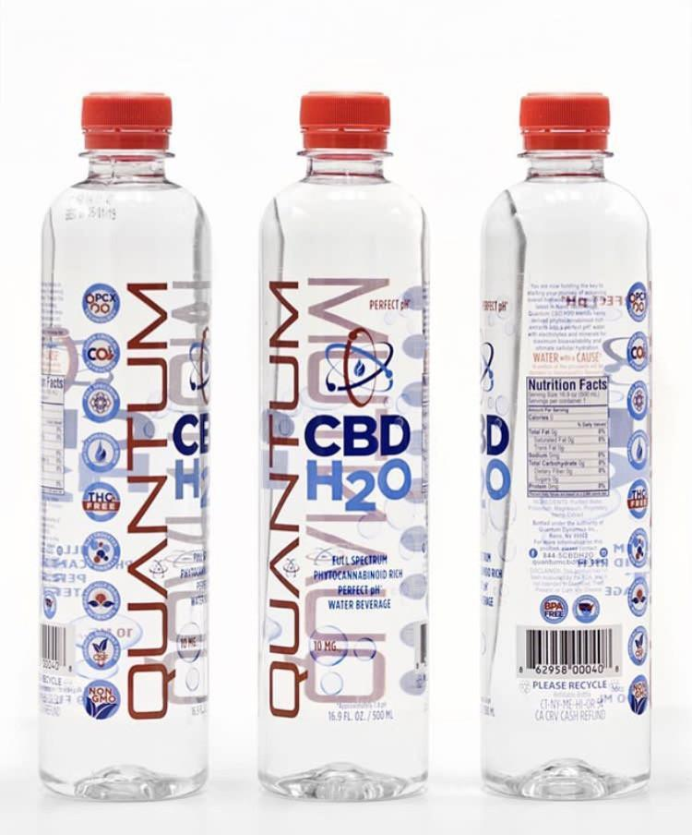
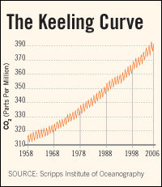
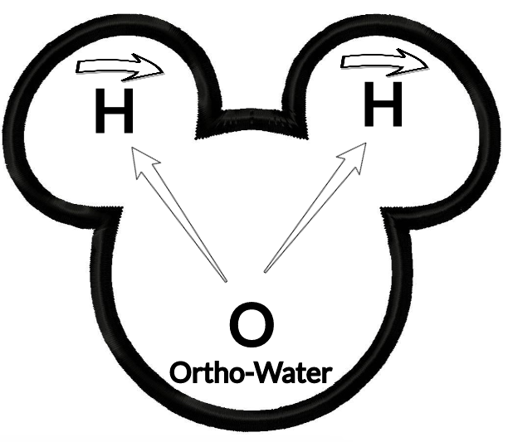
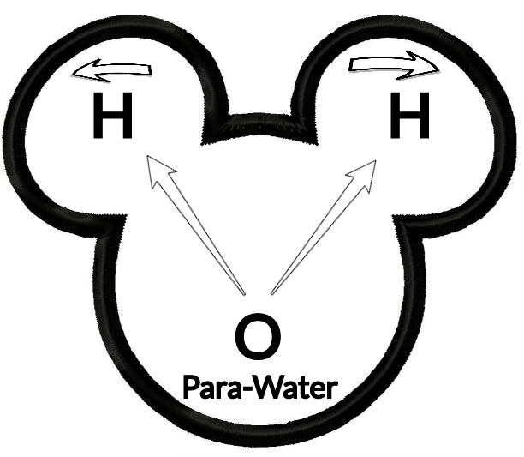
Water= $
3
Water= Thirst
2
Water= Denial
4
Empirical evidence:
Collapsing aquifers,
60% die-off of marine life in last few decades,
Deforestation,
Desertification,
Bioaccumulation of carcinogenic toxins, and
Keeling’s Curve of CO2 Climate Change summarily ignored by those in Water=Denial
Water=Desire
1
Water= Matter
9
Water= Life
5
Water= Ethics
8
Water= Memory
6
Water= Spirit
7
Notes:
The quantum tunneling of water occurs when water molecules in nanochannels exhibit quantum tunneling behavior that smears out the positions of the hydrogen atoms into a pair of corrugated rings. In that state, the water molecules become delocalized around a ring and assume an unusual double top-like shape.
The bottled water part is a joke sort of being played by https://www.quantumpcr.com/ https://www.terrawellnessok.com/12_pk_quantum_cbd_h20
It is water, it is for sale, but not really quantum in the scientific sense of the term
“QUANTUM PCR H2O uses a broad spectrum, hemp derived formula to provide CBD along with additional active cannabinoids and terpenoids providing maximum efficacy with a unique and familiar flavor profile”
See Roberto Car from Princeton University, “Quantum Physics in a Glass of Water” https://www.youtube.com/watch?v=SXqDhu4AEF8
https://www.livescience.com/62708-water-two-kinds.html
Second company -- http://www.quantumagua.com/quantum_en.html Quantum Water --- Quantum is derived from the springs deep within the mountains of the Juan Castro Blanco Water National Park of Costa Rica. The sedimentary rocks act as a natural filtration system, controlling the levels of acidity and minerals creating an ideal PH7.+. Quantum is not chemically processed in any way. We at Quantum know that what you drink is just as important as what you eat. This clean, crisp water will keep you hydrated and refreshed. Premium water created by nature and brought to you by Quantum.”
See Youtube “Water and Quantum Physics; The Perfect Couple” https://www.youtube.com/watch?v=sVIX3fnTCg0 by Marta from

Slide 88
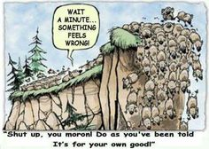
FINAL QUESTION about Water=DENIAL & Water=Spirit: JUST HOW BAD DOES WATER SHORTAGE HAVE TO BE BEFORE WE BELIEVE AND CHANGE OUR BEHAVIORS FROM DOMINATION Radah TO STEWARDSHIP Radah?
Water= Denial
4
Water= Spirit
7
Notes:
For some United Methodists, Creation Care is a biblical mandate https://www.umnews.org/en/news/assuming-role-of-creation-care-as-gods-mandate
God’s first word to Adam was ‘to till and keep the earth’
The spring conference in Atlanta, of Methodist Church had the them “Let Justice Roll Down Like Waters.
See Caretakers for God’s Creation United Methodist’s website https://www.umccreationcare.org/#!about_us/csgz
“Whether it’s clean water, chemical free food [& water], or healthy air [& water], millions of disadvantaged populations [& Abilene population] are affected by these environmental effects” says Beth Bond, member of Decatur First Methodists. She continues “as God’s people, part of us taking care of these sensitive populations, is taking care of the planet. Creation care is a key component of social justice” https://www.umnews.org/en/news/assuming-role-of-creation-care-as-gods-mandate
http://www.abxn.org/nv/shepherds.html Radah as Self-Giving love instead of Water=DESIRE, the Ego trip
Thanks to Marty Wortman, Dean at Dona Anna Community College for referring me to his dissertation, which is about the misinterpretation of Radah for over 400 years. See Wortman, Marty J. (2003). Dwellness: A radical notion of wilderness.Accessed Apr 14 2019 at https://scholarcommons.usf.edu/cgi/viewcontent.cgi?referer=https://scholar.google.com/&httpsredir=1&article=2508&context=etd
Wartman (2003: 10): “Referring to the original Hebrew, Steffen states that radah (dominion) means to govern, rule and to have dominion:
‘The verb was employed to refer in a general way to the rule of kings over territory, masters over servants, and the rule of God either over land or in the midst of God’s enemies. Outside of Genesis, the verb is used only five other times, and in each context, something other than oppressive power relations is connoted. (64-65).”

Slide 89
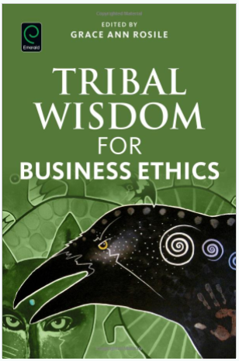
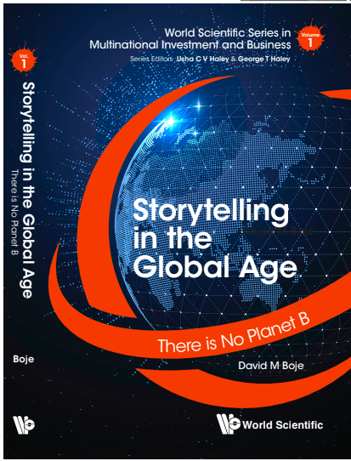
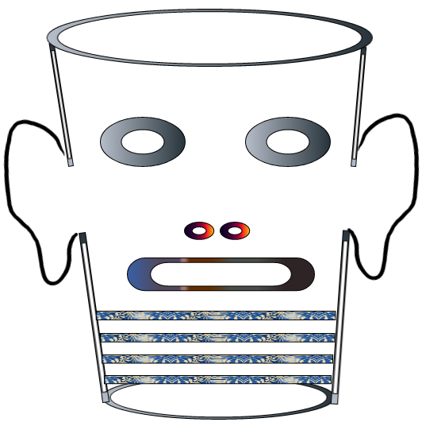
Storytelling Science and Your Dissertation
David M. Boje & Grace Ann Rosile
UK, US, Singapore: World Scientific
February 21, 2019; Revised March 19, 2019
Thank You: Any Questions?
Download Storytelling Science book and slides for this presentation at https://davidboje.com/Aalborg
Notes:
If you have and comments or questions contact me at davidboje@gmail.com
Thank you

