Slide 1
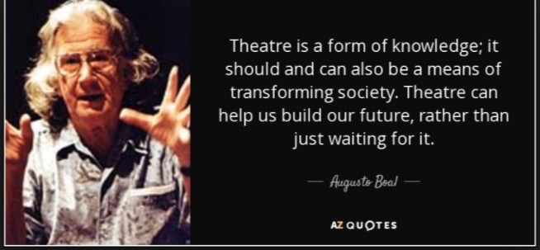
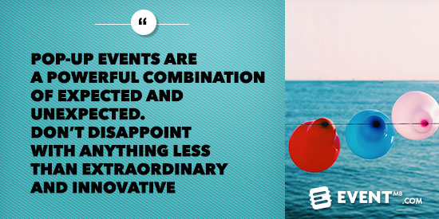
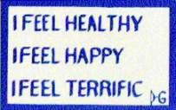
Leadership In Society
David M. Boje
August 2018
25% ATTENDANCE, and actually participating in day-by-day class events, includes completing make-up written work for ANY missed class & missed HOMEWORK are important to LEARNING THE NEW ROUTINES OF BEING AN ENSEMBLE LEADER & doing your POP-UP EVENT.
Notes:
Please Put NAME ALL CAPS (as you want to be called) on NAME PLATE
Use Magic Marker – Use big letters – thank you
Add TEAM NUMBER (when we get to that part of event today)

Slide 2
Timeline of How Boje Organized Class
Milestone 1
Milestone 2
Milestone 3
Pick UN Goal
Pick books you will use to write weekly Homework Answers
Milestone 4
Final Exam: Turn in Final Team Project of your POP-UP
Write your Lesson Plan for a class your ENSEMBLE Project Team will conduct
Answer 2 Value-Added questions orally at ORAL Exam
Join Project Team
Notes:
The following slides show several examples of timelines using SmartArt graphics.
Include a timeline for the project, clearly marking milestones, important dates, and highlight where the project is now.

Slide 3
Milestone 1: Now please Pick project & Join Team; 1st team up in 2 weeks; Numbers below are not order of team class event
Each person will pick one of the UN sustainability Goals
Then find people in room who picked same goal
Finally, equalize team sizes so there are at least 4 per team and no more than 5 per team

Slide 4
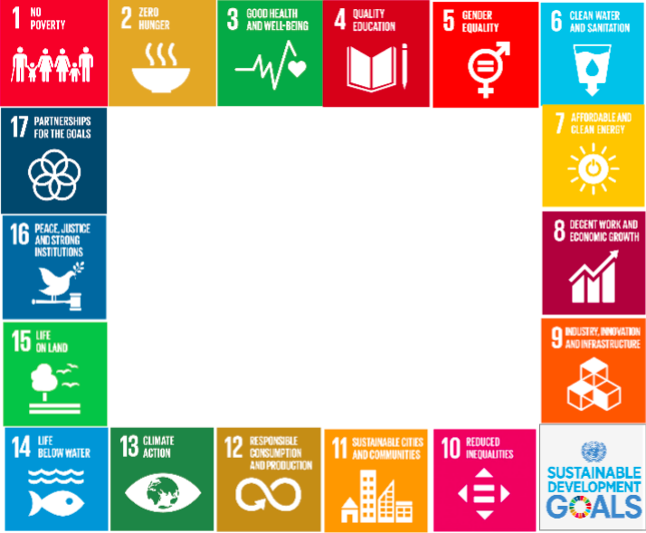
INDIVIDUALS pick one goal and write it down
Find OTHERS with same goal
Can only have 5 max on TEAM
Must have at least 4 on TEAM
Notes:
Duplicate this slide as necessary if there is more than one issue.
This and related slides can be moved to the appendix or hidden if necessary.

Slide 5
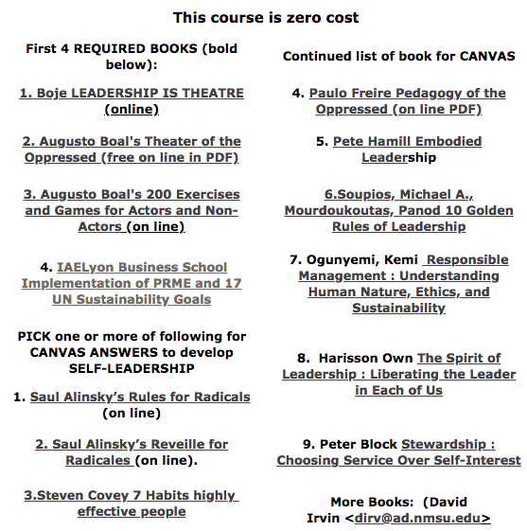
Milestone 2: Pick Texts
3 REQUIRED BOOKS (bold below):
Notes:
* If any of these issues caused a schedule delay or need to be discussed further, include details in next slide.

Slide 6
Do Team From Hell CONTRACT
Step 1: Before meeting, before talking, each person write down a list: What are 7 things that drive you crazy about team work?
Step 2: Share the lists, and rank as a new team, what are the top 5. Share horror stories about each person's experience with Teams From Hell.
Step 3: Come up with a way to address each of the top 5. This can be norms that the group will enforce, giving permission to call each other out if there are norm violations, punishments that will happen (these can involve ways to make it up to the offended team members by the offending member), etc.
Step 4: Make a team contract using Step 3 and submit copy to instructor signed by everyone. Keep copy for yourselves.

Slide 7
Milestone 3 Write your Lesson Plan for a Class
STEP 1. DO BOAL 'LEADERSHIP IS THEATER' Training exercise (20 minutes) & write your 2 Canvas Questions for class on board (run them by Boje several days before). One question based on assigned course text, other question based on student's development of LEADER-SELF (answer must cite texts each students using)
QUESTION 1: What is UN Goal you Picked, and why and cite two references (try google)
QUESTION 2: What is your Living Story as someone BECOMING LEADER.
STEP 2. 'Leadership team' presents Slides on IN THE BOX OUT OF THE BOX for 15-20
Minutes; Include YouTube (5-10 minutes) related to UN Goals
STEP 3. Presenting teams coordinate a HIGHLY INTERACTIVIE class SKIT activity (30 minutes)
STEP 4. After your event, do a 2 minutes Q & A with class to see what worked well today, and what could be better (2 minutes)
STEP 5. Not done yet. Presenting Team is responsible for making copies of the EVALUATION FORM for audience members scoring sheet - we have no funds to do copies for you (3 minutes)
STEP 6. Good News! In exchange for presenting SKIT team not doing CANVAS homework, the team will access Canvas, and do numeric score, and make constructive comments to audience member's homework submissions.
Notes:
"Only power that springs from the weakness of the oppressed will be sufficiently strong to free both. Any attempt to "soften" the power of the oppressor in deference to the weakness of the oppressed almost always manifests itself in the form of false generosity" (Freire, p. 44).

Slide 8
OVERVIEW: Lesson Plan Demo By Boje
STEP 1 (20 Min)Healthy Happy Terrific Opener and then one Augusto Boal Training exercise Warmup 200 exercises are in the book and WRITE HOMEWORK QUESTION ON THE BOARD: What is UN Goal you Picked, and why and How will You Change Your Own Phrog Farm-DAILY LEADER ROUTINES to make it happen? Homework is due next class period, bring 2 pages single spaced, citing 3 references
STEP 2 (30 Min) Each individual pick JUST 1 of 17 UN Sustainability Goals, join team with same goal (swap members till no more than 5 per team), and at home Pick CANVAS books,
Slides on what course is about w/ 15 Min YouTube: Boje video what is storytelling?
STEP 3 (30 Min) After doing TEAM FROM HELL, create INTERACTIVE SKIT for today: Get in Project teams, and a Skit where one of your Team mates violates their TEAM FROM HELL AGREEMENT
BREAK
After Break
Boje presents on Getting OUT-OF-BOX of leadership into future of leadership
Case of PRME REPORTS that are GREENWASH WHITEWASH e.g. ASU PRME compare to IAELYON
STEP 4 (2 minutes) Q & A with class to see what worked well today, and what could be better
DO NOT HAND OUT EVALUTATION SHEETS UNTIL STEP 4 IS COMPLETED – Thank you.
STEP 5. (2 Min ) Evaluation Sheet. Presenting Team is responsible for making copies, - we have no funds to do copies for you, after this (see Big Mistake above)
STEP 6. OUTSIDE CLASS – Ensemble Team will access Canvas, and do numeric score, and make constructive comments to audience member's homework submissions.

Slide 9
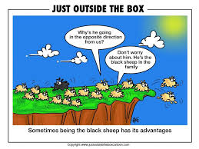
To be LEADER, change your LEMMING HABITS to new LEADER ROUTINES

Slide 10
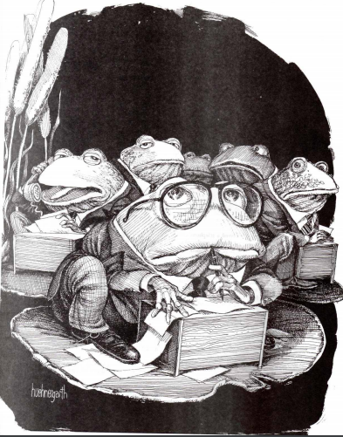
Phrog Farm – say ‘Ribbit’
In the big University or Corporate phrog
pond with your boss's boss sitting on a Lilly Pad saying to himself: “I think I'll
turn ol’ David into a phrog.” Harvey, Jerry (1977) Organizations as Phrog Farms

Slide 11
STEP 1 (20 Min)
1. Write on board the homework: What is UN Goal you Picked, and why and How will You Change Your Own Phrog Farm (or Lemming) habits into NEW DAILY LEADER ROUTINES to make it happen? Lead your self before leading others.
2. A new and different 2 minute Healthy Happy Terrific event each day (What are your Lemming daily Habits that are not Healthy, Happy, & Terrific Routines.
3. ONE Augusto Boal Training exercise Warmup (Silent Image Theater: Completing Story, Scene by Scene; then Debrief. PROBLEML Be in Lemming Routine POSE, Partner do their own Lemming Pose, then Go total Lemming, then gradually find Healthier, Happier, more Terrific LEADERSHIP ENSEMBLE ROUTINES frame-by-frame
.
4. DEBRIEF: Write silently, without talking, in your own notebook. Answer this question: What are your daily LEMMING habits? How can you change daily LEMMING habits into your daily leadership habits?
After you and partner wrote this out (silently), then exchange, and read your partner's UNTOLD STORY, while they read yours. Still no talking. Answer this question: How was their UNTOLD STORY different from yours, and/or similar to yours?

Slide 12
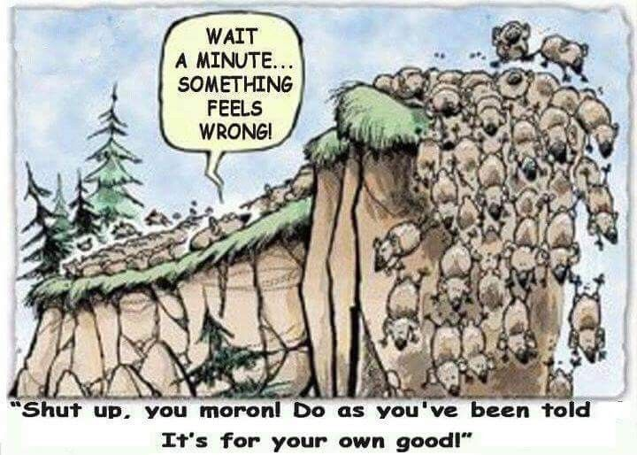
Leadership of the Lemmings in 6th Extinction

Slide 13
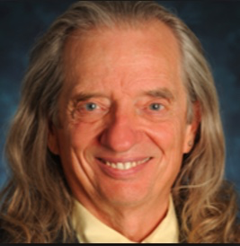
Lesson Plan Step 2: 30 MINUTES - Slides on What Course is About
This course is zero cost
What is the course about? Leadership is Theater is a means of transforming Society by fore-caring!
Each individual pick JUST 1 of 17 UN Sustainability Goals, join ENSEMBLE LEADER team with same goal (swap members till no more than 5 per team), and at home Pick CANVAS books,
Slides on what course is about w/ 15 Min YouTube: Boje video what is storytelling?
Half slides about XYZ in=the-box-Leadership
Define the goal of this course? To train you to be an OUT-OF-THE-BOX Leader in Society that is in its biggest transformation since it began! HOW: Develop New Daily Routines of Leadership instead of being a Lemming or Phrog in the swamp!
Define the scope of the course? You develop your own Leader-SELF, and you work in Project Team where you get your turn to Lead forecaring for your NEW ROUTINES, OUT-OF-THE-BOX by doing Pop-Up Event!
Notes:
What is the project about?
Define the goal of this project
Is it similar to projects in the past or is it a new effort?
Define the scope of this project
Is it an independent project or is it related to other projects?
* Note that this slide is not necessary for weekly status meetings

Slide 14
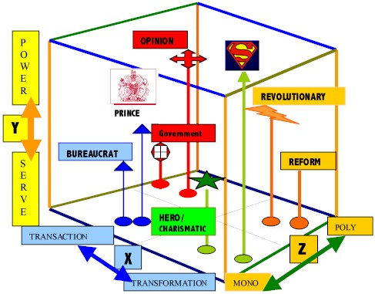
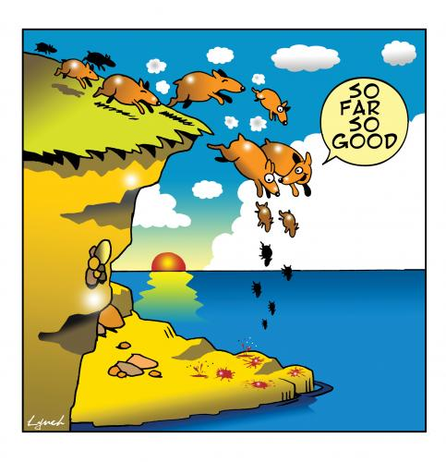
IN-THE-BOX XYZ Leadership
Notes:
Where is Trump in XYZ Box?

Slide 15
What is TRUE STORYTELLING now?
How to plan FUTURE?
When & Where to do PROJECT?
Reflect on OUTCOMES?

Slide 16
EXAMPLE: PLASTIC IS SDG # 3. Good Health & Well Being, # 6. Clean Water and Sanitation, # 12. Responsible Consumption & Production, & # 14. Life Below the Water
One million plastic bottles are purchased every minute with less than 50% recycled
only 7% turned into new bottles
About 13 million tons of plastic leaking into our oceans each year
to be ingested by sea life.
In turn, people who eat seafood ingest about 11,000 pieces of tiny plastic every year.

Slide 17
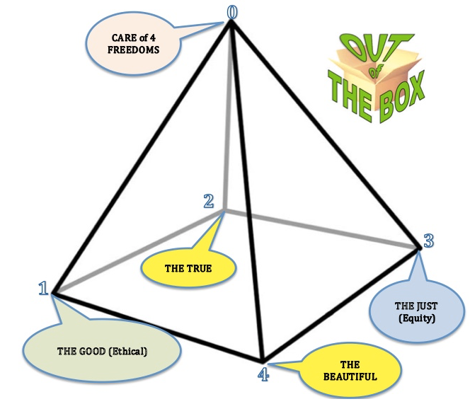
What is OUT-OF-THE-BOX Leadership?
The 4 virtues implemented in 17 UN Sustainability Goals to Prevent 6th Extinction to CHANGE ROUTINES
Notes:
The 4 virtues implemented in 17 UN Sustainability Goals

Slide 18
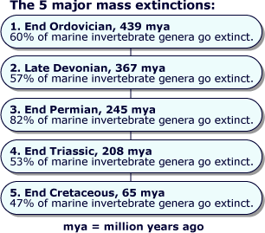

Slide 19
What is the 6th Extinction
Sixth Mass Extinction → massive die-off of plants and animals all across the planet.
6th Extinction will be 10 to 100 times greater than any previous mass extinction

Slide 20
Get into groups of 5 persons and brainstorm a list of 10 extinction events that could bring about EXTINCTION of most of Humanity in the world by 2100.
Make a list on one piece of paper, sign all your group’s names
Next to each item on your list of 10, write the probability from 1 to 100% that this is likely to happen by the year 2100
Develop an idea for a POP-UP event to take to the campus
Pop-up events are temporary, unexpected theater events in unique spaces. They pop up and, after a few hours, they pop down. By definition, these are ENSEMBLE LEADERSHIP-is-THEATER and OUT-OF-THE-BOX

Slide 21
9 Earth Systems have limits currently being exceeded in the 6th Extinction:
Climate Change
Biodiversity Loss
Biogeochemical – Phosphorous Change
Ocean Acidification
Land Use Crisis
Fresh Water Crisis
Ozone Depletion
Atmospheric Aerosols
Chemical Pollution by Plastics & Heavy Metals

Slide 22
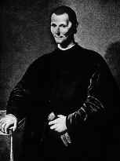
IN THE BOX➔ Example, TRAITS THEORY
Machiavelli Great Man Theory
Stogdill 1948 early traits
Stogdill 1974 revised traits
McGregor 1960 Theory X Y
McClelland 1965 Stories
Katz 1955 Skill Taxonomy
Yukl 1989
Flanagan 1951 Critical Incidents
Boyatzis 1982(Traits & Competencies)

Slide 23
In presentation slides, tell us something we do not know: e.g. There are positive and negative Princes
Superficial readings of Machiavelli (The Prince and Discourses books) focus on the cruel and tyrannical Princes, ignoring Machiavelli's Prince of Peace (Jesus) and other positive princes.
Can leader use power in a tough-minded fashion to benefit community?
Machiavelli imagined the Prince who would make the tough choices in hard times, and be merciful in bountiful ones
POINT: Machiavelli groomed PRINCES to work for COMMON GOOD. This could relate to UN Sustainability Goals if we think OUT OF THE BOX.

Slide 24
McDonald’s Sustainability Report is McFantasy
McDonald’s reports on water use at its fast food outlets, but not of the 600 gallons of water to make each quarter-pounder
Not reported →large-scale pork produced water pollution (pfisteria-laden waters) in the southeast US causing lesions in fish & fish die-off
Reports on energy use, NOT on 10 calories of energy for every calorie of good produced in unsustainable fast food system
Para. Hawken 2002 as cited in Milne, Markus J. (2013). Phantasmagoria, sustain-a-babbling in social and environmental reporting. Pp. 135-153 in Lisa Jack, Jane Davison, Russell Craig (Eds.) The Routledge companion to accounting communication. NY: Routledge.
Notes:
The report carefully avoids the corporation’s real environmental impacts. It talked
about water use at the outlets, but failed to note that every quarter-pounder requires
600 gallons of water. It talked about recycled paper, but not the pfisteria-laden waters
caused by large-scale pork producers in the southeast. It talked about energy use in the
restaurants, but not in the unsustainable food system McDonald’s relies upon that uses
10 calories of energy for every calorie of good produced. “Sustaining” McDonald’s requires
a simple unsustainable formula: cheap food plus cheap non-unionized labor plus deceptive
advertising = report would tell stakeholders how much it truly costs
society to support a corporation like McDonald’s high profits. An honest. It would detail the externalities borne by
other people, places, and generations.
Hawken (2002)

Slide 25
From Milne, 2013
“‘Sustaining’ McDonald’s requires a simple unsustainable formula”:
cheap food + cheap non-unionized labor + deceptive advertising = high profits
(Hawken, 2002, as cited in Milne, 2013: 143, boldness, mine).

Slide 26
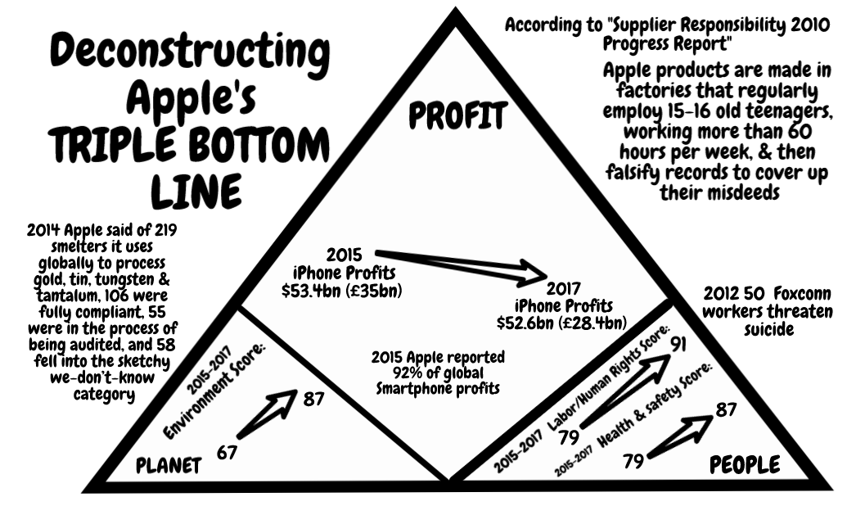
What kind of leadership is this

Slide 27
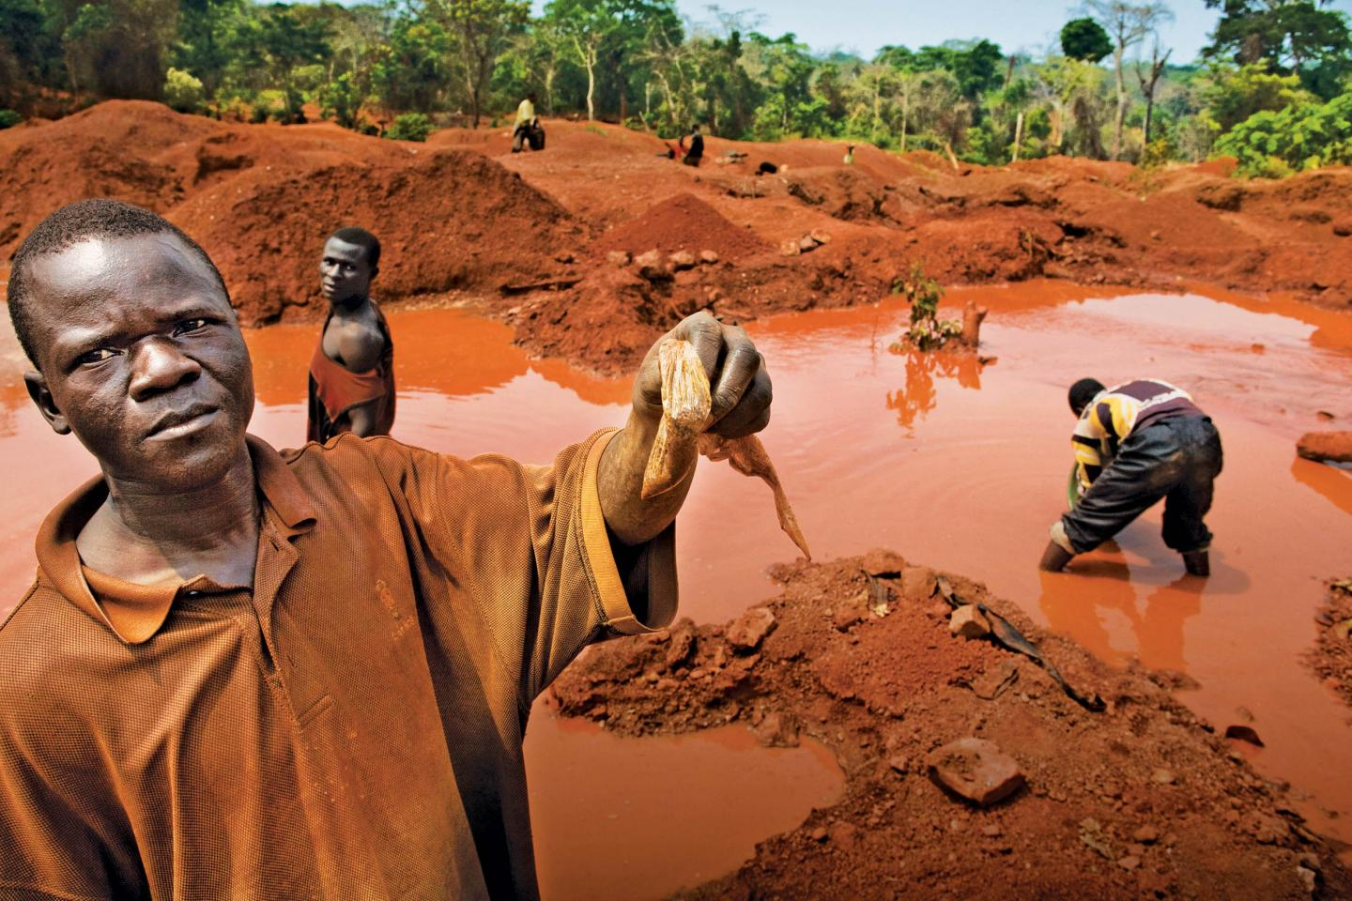
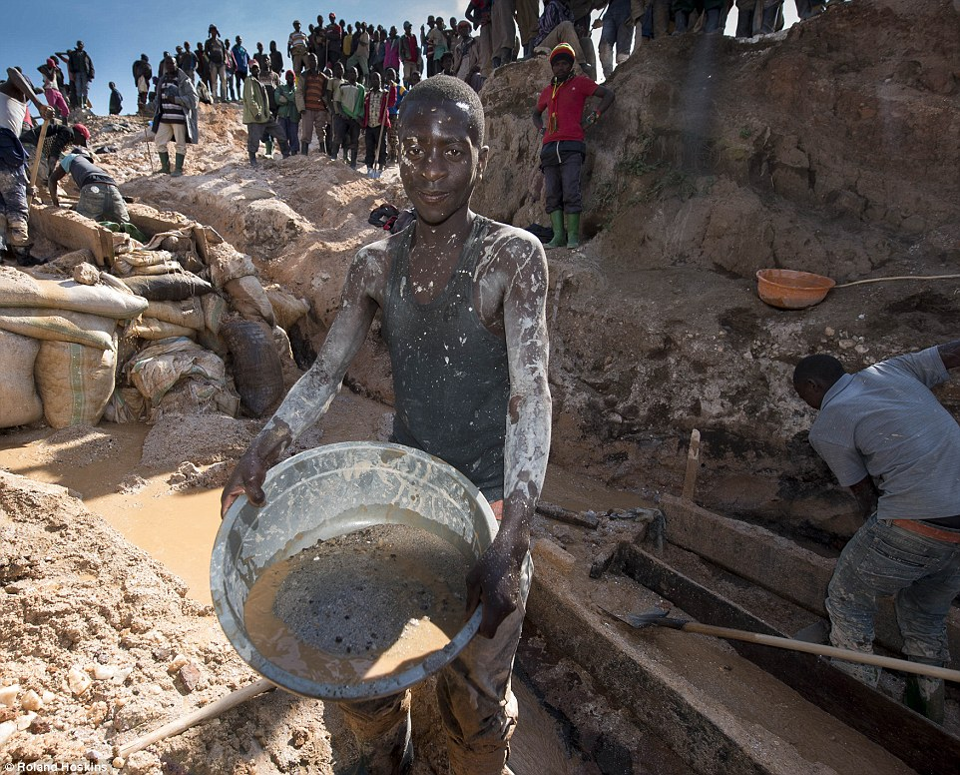
What are Consequences of Apple Phrog Farm Leadership?
Notes:
2nd picture http://www.dailymail.co.uk/news/article-3280872/iPhone-mineral-miners-Africa-use-bare-hands-coltan.html

Slide 28
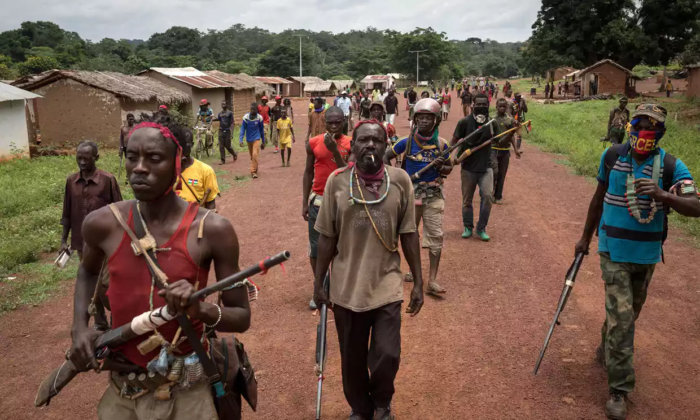
Hidden Costs of Globalization
Notes:
Looting, escalating violence, and more death by rival rebel groups in CAR, as aid organizations withdrew at height of malaria season. One result is women are denied a safe place to give birth. Armed rebels entered a hospital where 7,000 sought refuge, and killed a baby held by its mother. 6 Red Cross volunteers were hilled in an attack on a health center. Health workers have to negotiate with armed people to gain access to villages. Stephen O’Brien a UN emergency relief coordinator, said this is “the early warnings of genocide”.
'People are dying': violence forces aid workers out of Central African Republic, by Rebecca Ratcliffe
Fri 1 Sep 2017 06.04 EDT
Last modified on Mon 11 Dec 2017, accessed Feb 16 2018 at https://www.theguardian.com/global-development/2017/sep/01/people-are-dying-violence-forces-aid-workers-out-of-central-african-republic

Slide 29
Cell-phone’s 3T’s + Gold
CONFLICT MINERALS
Tin is used as a solder on laptop and cellphone circuit boards
Tungsten makes your cellphone vibrate
Tantalum stores electricity on your cellphone
Gold is used to coat the cellphone wiring

Slide 30
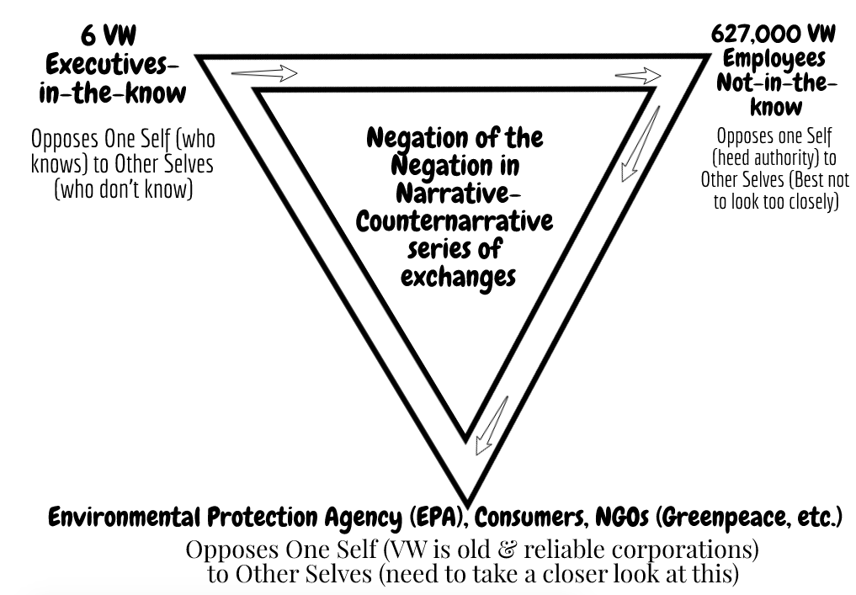

Slide 31
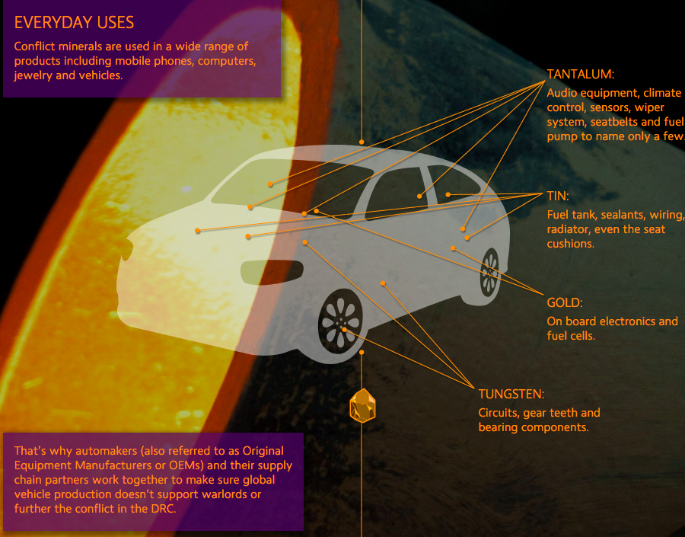
THE GROUND of 3T’s in our Cars

Slide 32
8 Steps in Team Project
Leadership-is-Theater Project
1. Pick a Project
2. Do Team from Hell Contract
3. Schedule Meeting Time
4. Develop Lesson Plan
5. Do In-class Event
7. Do Out-of-Class Real Life Event
8.. Write up Team Project
6. Meet o give Canvas Feedback
Notes:
What are the dependencies that affect the timeline, cost, and output of this project?

Slide 33
Grades
25% ATTENDANCE, and actually participating in day-by-day class events, includes completing make-up written work for ANY missed class & missed CANVAS, & completing course evaluation (deduct this entire 25% if evaluation NOT completed).
25% TEAM SKIT - including lesson plan facilitation, its evaluation, and giving class feedback on their Canvas answers for your event.
25% HOMEWORK - 10 assignments, includes reflections on required texts, attach any missed day writing you did as makeup, and turn this Canvas Packet in on Finals Day.
25% FINAL First, Turn in written report and then Show Real World with film or other evidence of your taking ENSEMBLE TEAM’s POP-UP PROJECT done in Real World. Second, oral Team exam answer to What is Value-added in team project (& what each team member led)? Third, each individual oral-answer, what you learned about leadership-IS-ENSEMBLE-theater from books articles in the course (be prepared).
(deduct 25% of total individual grade points, if you don't show up at midterm or at final)

Slide 34
10 Minute Break

Slide 35
Example of High Quality Event
Compare PRME REPORTS that are GREENWASH WHITEWASH or substantive
e.g. ASU PRME has no measures of performance nor does it get at 9 planetary limits
compare to IAELYON PRME which integrates the 17 goals within its program

Slide 36
ASU Thunderbird PRME
Thunderbird Professional Oath of Honor
As a Thunderbird and a global citizen, I promise: I will strive to act with honesty and integrity, I will respect the rights and dignity of all people, I will strive to create sustainable prosperity worldwide, I will oppose all forms of corruption and exploitation, and I will take responsibility for my actions. As I hold true to these principles, it is my hope that I may enjoy an honorable reputation and peace of conscience. This pledge I make freely and upon my honor.

Slide 37
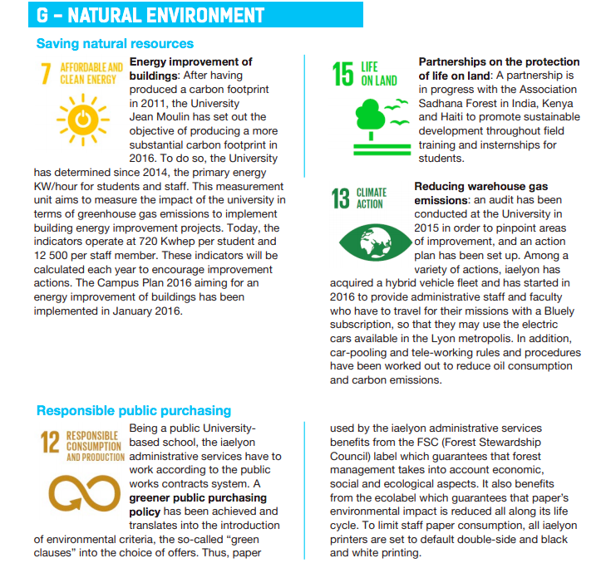
IAELyon PRME Implementations

Slide 38
As IN THE BOX LEADERS Approach 6th Extinction

Slide 39
STEP 4 (2 minutes) Q & A with class to see what worked well today, and what could be better
Write + on one side of board, and – on the other side
List the comments from the following question:
Q & A with class to see what worked well today, and what could be better

Slide 40
STEP 5. (2 Min ) Evaluation Sheet.
Presenting Team is responsible for making copies, - we have no funds to do copies for you.

Slide 41
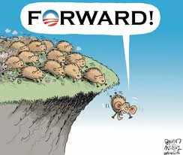
RESOURCES
Course syllabus on line http://davidboje.com/388
Boje Cell (between hours of 9am to 6pm), or text 575-936-9578
Boje email: davidboje@gmail.com
Boje office hours are in Frenger Food Court, on Mondays, noon to 2PM, please see him at least once during the term as team.

Slide 42
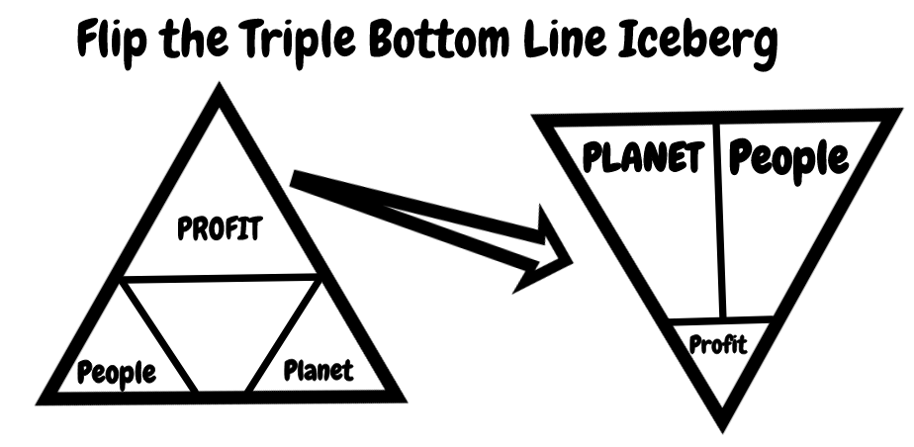

Slide 43
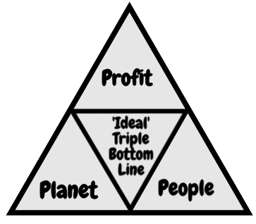
Critique of Triple Bottom Line
3BL assumes 3 bottom lines are EQUAL
Measures exist for PROFIT; disagreement on or missing ‘real’ measures of PLANET and PEOPLE
3BL = Greenwashing narrative used to make it seem like Corporate Sustainability exists
3BL = narrative exceptionalism→ humanity creates itself as outside the natural limits of ecosystems AND technology can solve any problem
3BL = humancentric narrative opposed by the counternarrative of posthumanism (all species matter)

Slide 44
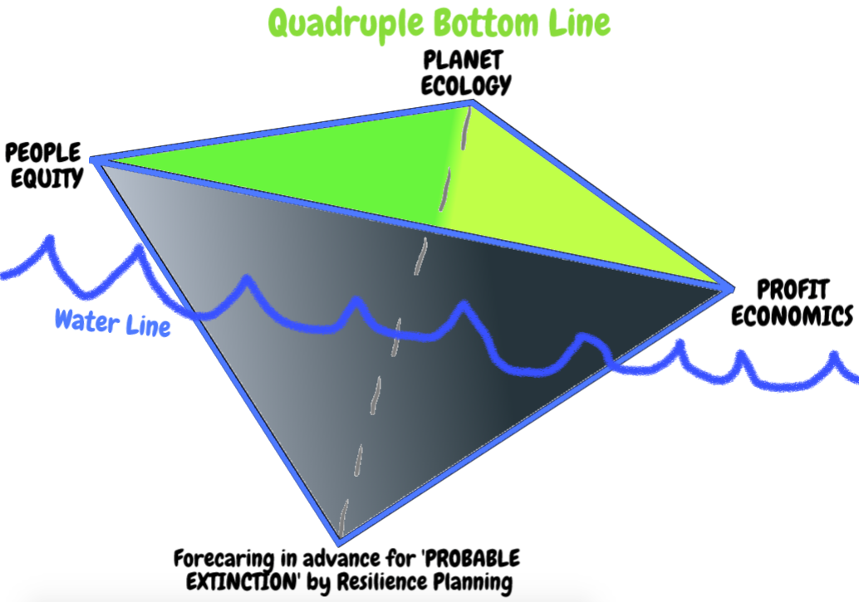
4BL of SOCIALLY RESPONSIBLE CAPITALISM

Slide 45
Fair Food Program — the unfolding story of increasing compliance through the constant back and forth of audits, investigations, and corrections — over the course of all six seasons of the Program’s operation

Slide 46
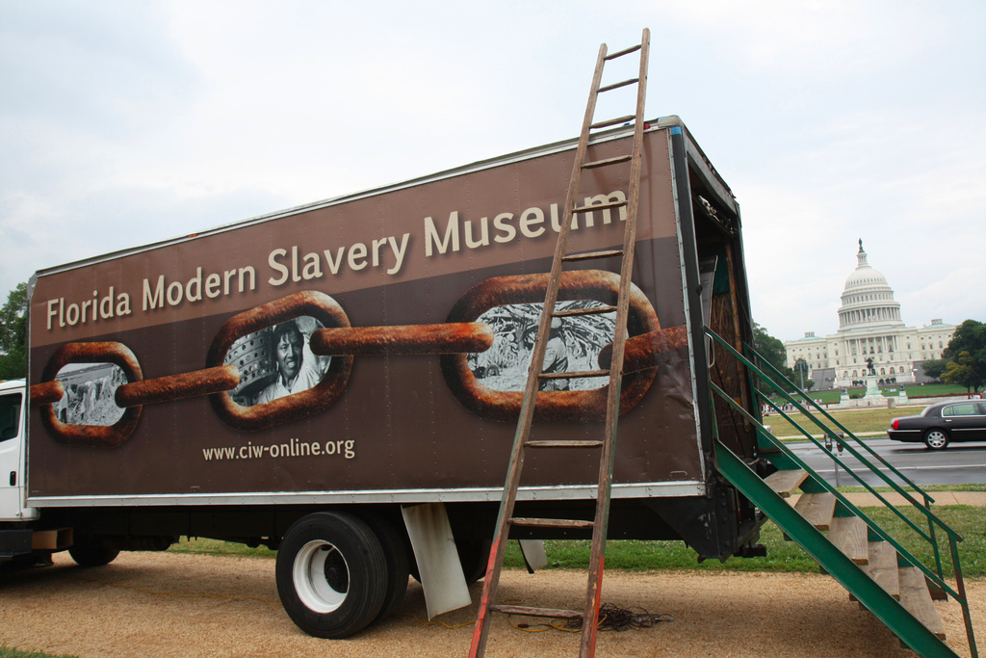
How can you help end global slavery supply chain?
Worker education,
Worker-driven alliances, &
System of alliance of consumers, brands, growers, and workers
This creates revolutionary changes

Slide 47
